Slide 1
Inverse Problems: THz- and phase space tomography and machine learning
Andrea Santamaria Garcia, Erik Bründermann, Stefan Funkner,
22 Nov 2021, 13:30-17:35
Mathematik in der Teilchen- und Astroteilchenphysik:
Diskussion zukünftiger Zusammenarbeit und Identifikation gemeinsamer Projekte

Slide 2
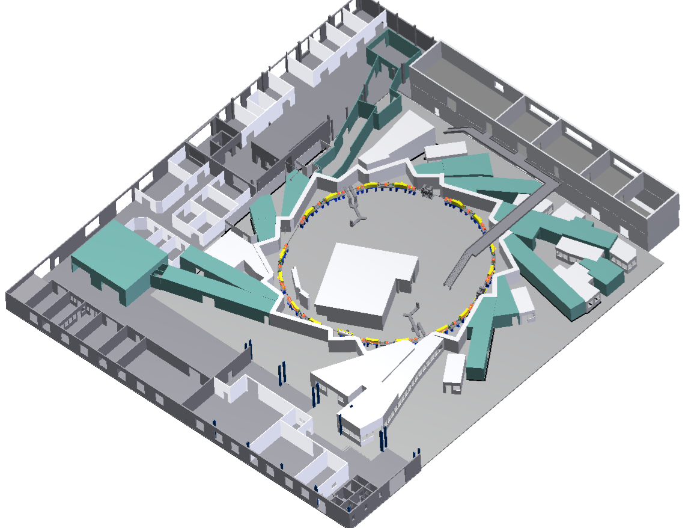
Particle accelerators – one of the most complex machines in the world!
A feat of enginering
The Karlsruhe Research Accelerator (KARA)
Magnet systems
Radiofrequency cavities
Diagnostics
Vacuum
Cryogenics
Detectors
for applied research
(and industry, medicine)
currently more than 30,000 accelerators in operation around the world
R&D
Users (experiments)

Slide 3
Particle accelerators – one of the most complex machines in the world!
Goal for any accelerator:
maximum availability
The Karlsruhe Research Accelerator (KARA)
= useful beamtime
Minimum mean time between failures
Prevention / early detection / fast interventions
Minimum time to set-up & optimize operation modes

Slide 4
Fault detection to increase availability
The fault detection problem
Alarm
Isolation
Estimation
Labeling an event as faulty or normal (binary classification)
What type of fault has happened (explainability)
What is the magnitude of the failure (non-functional or functional in a degraded state?)
Model-based fault diagnosis:
Model
-
Observed signal
=
residual signal
discrete Kalman filter eq.
used to identify faults
The majority of the time we don’t have a model
Models are always approximations

Slide 5
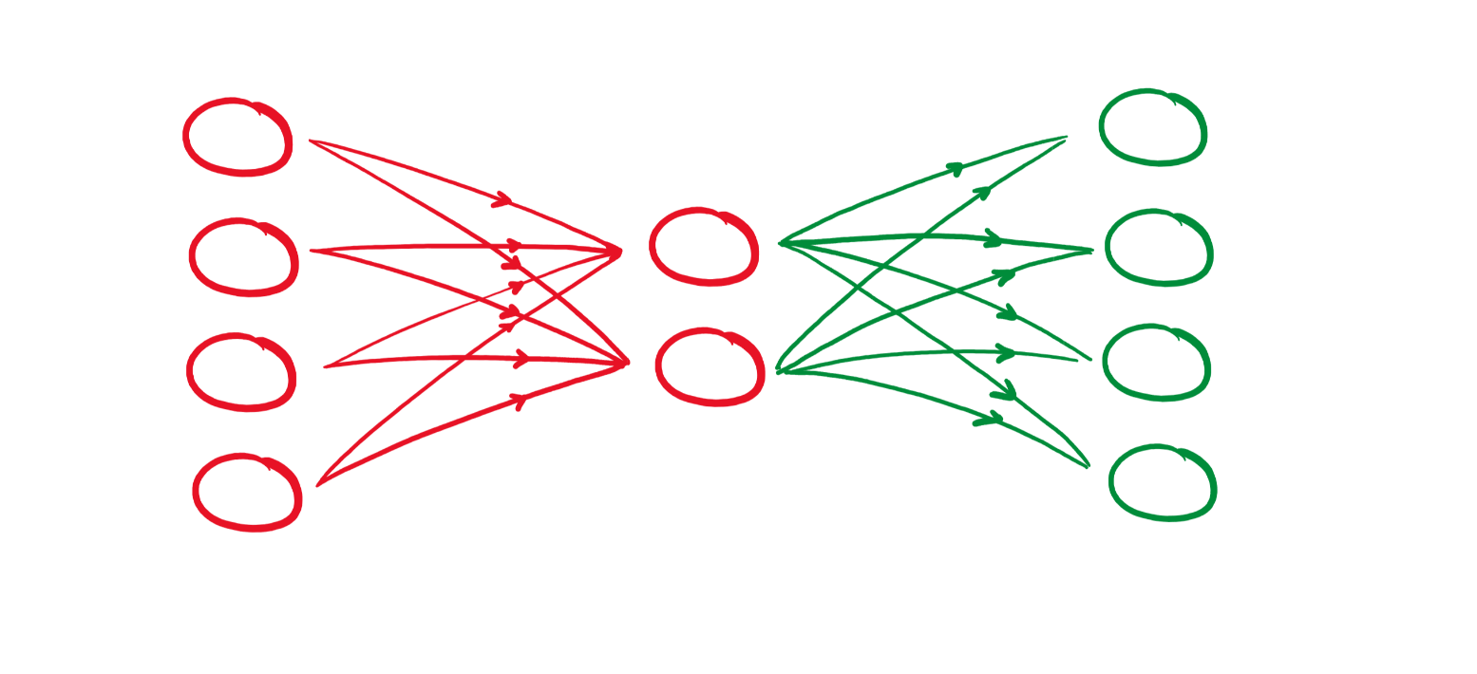
Data-driven methods for fault detection
Challenges
Autoencoder neural network
Data asymmetry
Heterogeneity of the failure types
Data sampling rate
Latent space
Sparse representation focusing on key properties
Date | Description
12.04.2021 | BPM restart loop
22.10.2020 | Sudden variation of BPM charge button
16.10.2019 | Sudden variation of BPM charge button
06.09.2019 | Faulty fan in BPM cooling system
04.09.2019 | BPM RAM usage warning
28.10.2016 | No data readout
Input data
Normal operation data
(no failures)
Output
Loss threshold
Anomaly would be above threshold
BPM = Beam Position Monitor

Slide 6
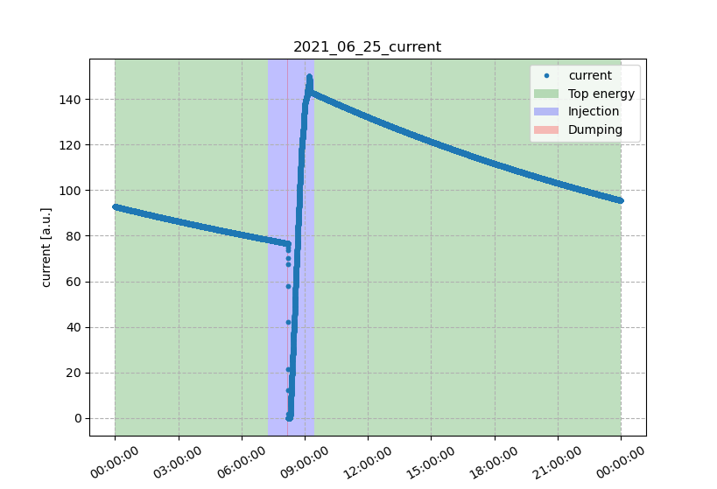
Data-driven methods for fault detection
Feature selection & crafting
Autoencoder neural network
Which accelerator signals are correlated and are relevant to the device failure?
Latent space
Sparse representation focusing on key properties
Data cleaning
Based on domain knowledge
Time series analysis
Which time interval is representative?
How to normalize different signals?
Autocorrelation, seasonality, stationarity
Segmentation, smoothing, signal estimation
Input data
Normal operation data
(no failures)
Output
Loss threshold
Anomaly would be above threshold

Slide 7
Data-driven methods for fault detection
Feature selection & crafting
Which accelerator signals are correlated and are relevant to the device failure?
Data cleaning
Important for any machine learning method
Based on domain knowledge
Time series analysis
Which time interval is representative?
How to normalize different signals?
Autocorrelation, seasonality, stationarity
Segmentation, smoothing, signal estimation
Notes:
Causal analysis

Slide 8
The final challenge
“The curse of dimensionality” or Hughes phenomenon
Fixed number of data samples
Sparse data
ML method
Classifier
Regressor
Clustering becomes impossible because the distance of observations appears equal
Number of features
Predictive power
Accelerators have hundreds of thousands of not-so-statistically-significant signals
Feature selection / dimensionality reduction is key

