Slide 1




PANDA DAQ FEE Workshop, 6-7 October, 2021
MDC architecture (Brainstorming)
Michele Caselle

Slide 2
Micro Vertex Detector of PANDA
The innermost detector for precise tracking and detection of primary and secondary vertices
target
Hybrid silicon pixel
  10 million pixel
  2 barrel layers + 6 disks
Silicon micro-strip
  200,000 strip channels
  296 sensors
  2 barrel layers + 2 disks
  312 strip modules (Barrel)
  48 strip modules (Disk)
p
40 cm
Notes:
The Micro-Vertex Detector (MVD) as the innermost part of the tracking system will enable precise tracking and detection of primary and secondary vertices. It is equipped with both silicon pixel and strip sensors.

Slide 3
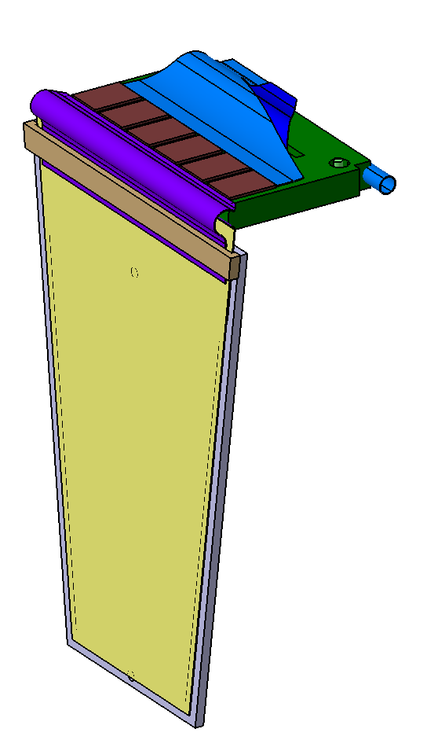
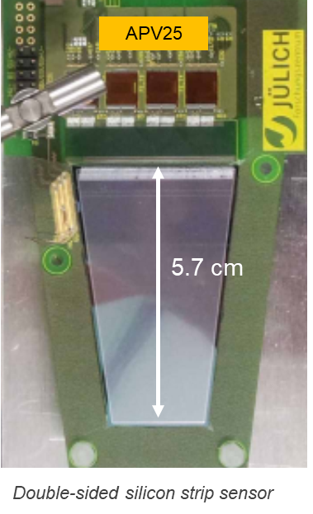

Silicon Strip Detector
Complex detector modules for both barrel and disk
Barrel
  # 64 square sensor modules readout by 8 ToASt each
  # 184 rectangular sensor modules readout by 11 ToASt each
Disk
  # 48 trapezoidal sensor modules readout by 12 ToASt each
ToASt front-end chip
Silicon sensor
Module Data Concentrator
ASIC
Carbon fiber support
# 296 MDCs are foreseen to transmit the data to the GBTX (or LpGBT) by e-link (320 Mb/s) interface
# 30 GBTs are foreseen to readout the entire strip detector by optical links (to off-detector electronics)

Slide 4
Silicon Strip Detector
Status of ToASt front-end ASIC
Design completed in UMC 110 nm by INFN-Turin
Triple modular redundancy (TMR) logic protection
Submitted on April, 28th , 2021
HDL model still in preparation (Gianni)
50
ToAST manual + material on our indico:
https://indico.scc.kit.edu/category/124/

Slide 5
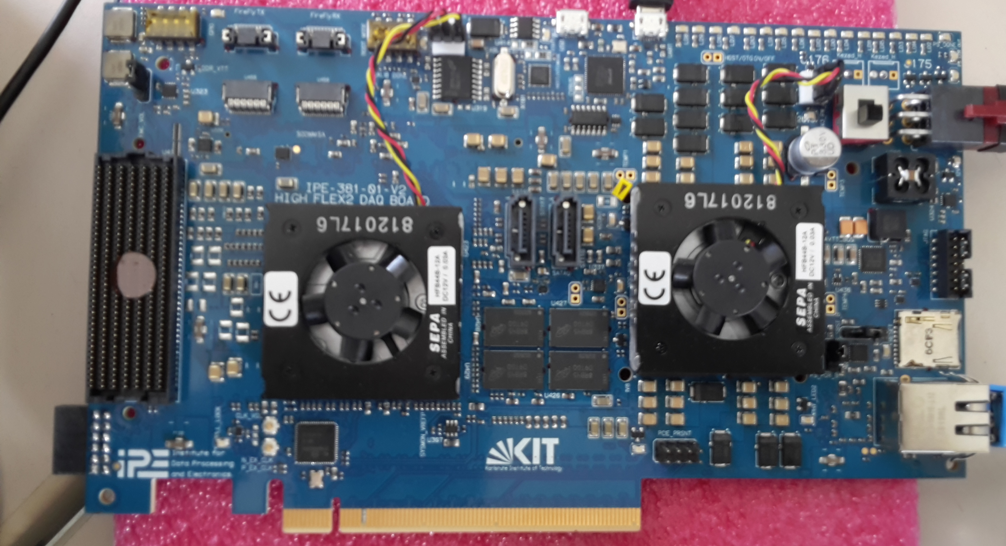
Module Data Concentrator (MDC) - ASIC
Architecture
Module Data Concentrator (MDC) ASIC
ToASt
…
GBT
ToASt
MMB
(MVD Multiplexer Board)
…
…
Optical link
ToASt
Detector timing & controls
sensor
  Developed in UMC 110 nm CMOS technology
  Digital logic based on Triplicated Modular Redundancy (TRM) for Single Event Upset mitigation (registers, memories and FSMs)
  First implementation on FPGA to prove the digital behaviour
  Electrical test by HghFlex 2 (HW platform)
Notes:
(consolidated experience at KIT, collaborations synergies with PSI and INFN-TO)

Slide 6
Module Data Concentrator (MDC) - ASIC
Architecture
ToASt
ToASt
…
ToASt
Detector timing & controls
sensor
  Only HDL codes (no IPcores)
  Reduce the logic as the minimum possible ( no large memories user-space, limited number of states for FSM
  Triplicated Modular Redundancy (TRM) for Single Event Upset mitigation (registers, memories and FSMs)
  Power consumption as low as possible

Slide 7
Module Data Concentrator (MDC) - ASIC
Current status and what’s next
Module Data Concentrator (MDC) ASIC
ToASt
ToASt
…
MMB
(MVD Multiplexer Board)
…
…
GBT
…
Optical link
ToASt
Detector timing & controls
Moving “Feature Extraction” data processing on more flexible programmable logic (FPGA)
More flexibility, leveraging the ASIC design and more intelligent (ML) data processing on FPGA
Notes:
(consolidated experience at KIT, collaborations synergies with PSI and INFN-TO)

Slide 8
Module Data Concentrator (MDC) - ASIC
ToASt
ToASt
Data-down
…
Data-up (160 Mb/s)
Clock from GBT
ToASt
Detector timing & controls
  HIGH PRTIORITY
  Front-end interface (SerDes, bitslip, 8b/10b decoding)
  Intelligent multiplexer, only the active and working channels must be readout
  We need the FPGA implementation of the E-port, for now (by CERN ?)
Notes:
(consolidated experience at KIT, collaborations synergies with PSI and INFN-TO)

Slide 9
Module Data Concentrator (MDC) - ASIC
10 bit
8 bit
Only data with hit
SerDer
10b/8b
Zero-suppresion
Small FIFO
MUX
ToASt
Tx_1
Bitslip
CRC correction
Tx_2
160 Mb/s
SerDer
10b/8b
Zero-suppresion
Small FIFO
Two output serial links
SerDer
10b/8b
Zero-suppresion
Small FIFO
ToASt
Tx_1
Tx_2
Bitslip
160 Mb/s
SerDer
10b/8b
Zero-suppresion
Small FIFO
Two output serial links
empty
logic
Priority encoder

Slide 10
Module Data Concentrator (MDC) - ASIC
32 bit
SerDer
Small FIFO
MUX
On case of:
NO 8b/10b
No zero-suppression
ToASt
ECC error correction
code
Tx_1
Tx_2
Bitslip
160 Mb/s
SerDer
Small FIFO
Two output serial links
32 bit
SerDer
ECC error correction
code
Small FIFO
ToASt
Tx_1
Tx_2
Bitslip
160 Mb/s
SerDer
Two output serial links
Small FIFO
Sync code: 00 00 1100 1100 1100 1100 1100 1100 1111
empty
logic
Priority encoder

Slide 11
Backup slides

Slide 12
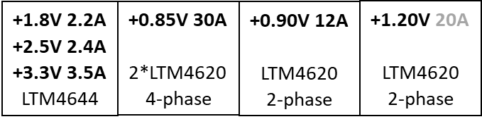
Proposed DC-PANDA based on ZYNQ
Very-flexible, heterogenous and high-performance back-end
16 x LVDS
SODANET
FireFly Tx/Rx
PLL
LMK04610
FireFly Tx/Rx
SATA (opt.)
Up to #34 GBTs
(from/to detector)
FireFly Tx/Rx
US+
Zynq
…
…
DDR4
Udimm
X 4 PCIe
AMC backplane
Protocol on the AMC-backplane
FireFly Tx/Rx
RoCE
X 2 GbE
FireFly Tx/Rx
ETH (up to 100 Gb/s)
To server Node
IPMI*
  Up to 60 optical links from/to GBTs still possible
  Up to 100 Gb/s ETH (upstream) + an additional 100Gb/s as spare
  Fully compilated AMC-backplane connections including 2 x GbE , 4 x lanes PCIe, 2x SATA and IPMI on ARM processors ➔ dramatic reduction of the necessary firmware (FPGA) for the implementation of the AMC protocols
*Intelligent Plattform Management Interface
** Module Management Controller
Notes:
Module management controller (MMC)

Slide 13
Proposed MMB for MVD
Optical links - details
Optical fibers front-panel detail
16 x LVDS
SODANET
FireFly Tx/Rx
PLL
LMK04610
SODANET
SATA (opt.)
FireFly Tx/Rx
FireFly Tx/Rx
Up to #34 GBTs
(from/to detector)
FireFly Tx/Rx
US+
Zynq
spare
FireFly Tx/Rx
…
…
X 4 PCIe
PLL
LMK04610
DDR4
Udimm
AMC backplane
FireFly Tx/Rx
FireFly Tx/Rx
Protocol on the AMC-backplane
GBTs
(up to 24 links)
X 2 GbE
FireFly Tx/Rx
RoCE
…
…
US+
Zynq
FireFly Tx/Rx
ETH (up to 100 Gb/s)
To server Node
IPMI*
MMC**
ATMega328P
FireFly Tx/Rx
X10 links as spares
FireFly Tx/Rx
RoCE
Spares fibers
Not used optical fibers in power-saving modes
Dynamic reconfiguration of the transceivers by ARM processor and not by FPGA
ETH (up to 100 Gb/s)
To server Node
FireFly Tx/Rx
ETH spare
FireFly Tx/Rx
4 x 25 Gb/s FireFly

Slide 14
MMB at the experimental area
Advantages of the ZYNQ – ARM processor for the MVD
Data flow from the detector to compute node fully independent from the ARM processes
ARM could process the incoming detector data without disturb the main data flow
Processors systems
On-line Data Quality Monitoring and Anomaly Detection
ARM cores
GbE
Quality of the data =
Quality of the physics results
TCP/IP
AXI interconnect
Data check
FireFly Tx/Rx
Data Receivers
FPGA
Processing
Data Transmitters (ETH)
From
detectors
To Compute Node
FireFly Tx/Rx
FireFly Tx/Rx
…
FireFly Tx/Rx
FPGA

Slide 15
Silicon Strip Detector
Readout architecture
…
Counting room
(Real-time)
On-line
(off the shelf devices)
Double-sided strip modules
Outside active volume
ToASt
Downlink (controls & timing)
Compute node cluster
MDC
(Module data Concentrator)
Ethernet switch / InfiniBand
ToASt
…
ToASt
e-links
GBT
MMB
(MVD Multiplexer Board)
Server node
ToASt
MDC
(Module data Concentrator)
e-links
GBT
ToASt
…
Server node
…
Sensor
ToASt
optical link
ToASt
Permanent storage
MDC
(Module data Concentrator)
e-links
GBT
Server node
ToASt
MMB
(MVD Multiplexer Board)
…
ToASt
GBT
ToASt
e-links
…
Server node
MDC
(Module data Concentrator)
ToASt
…
…
SODANET
ToASt
FEE- ASICs
Local controller ASICs
Server nodes equipped with commercial and powerful hardware (CPU/GPU/FPGA)

