Slide 1


Detecting relic neutrinos with tritium on graphene: the PTOLEMY project
Nicolo de Groot (Radboud University and Nikhef)
for the PTOLEMY collaboration

Slide 2
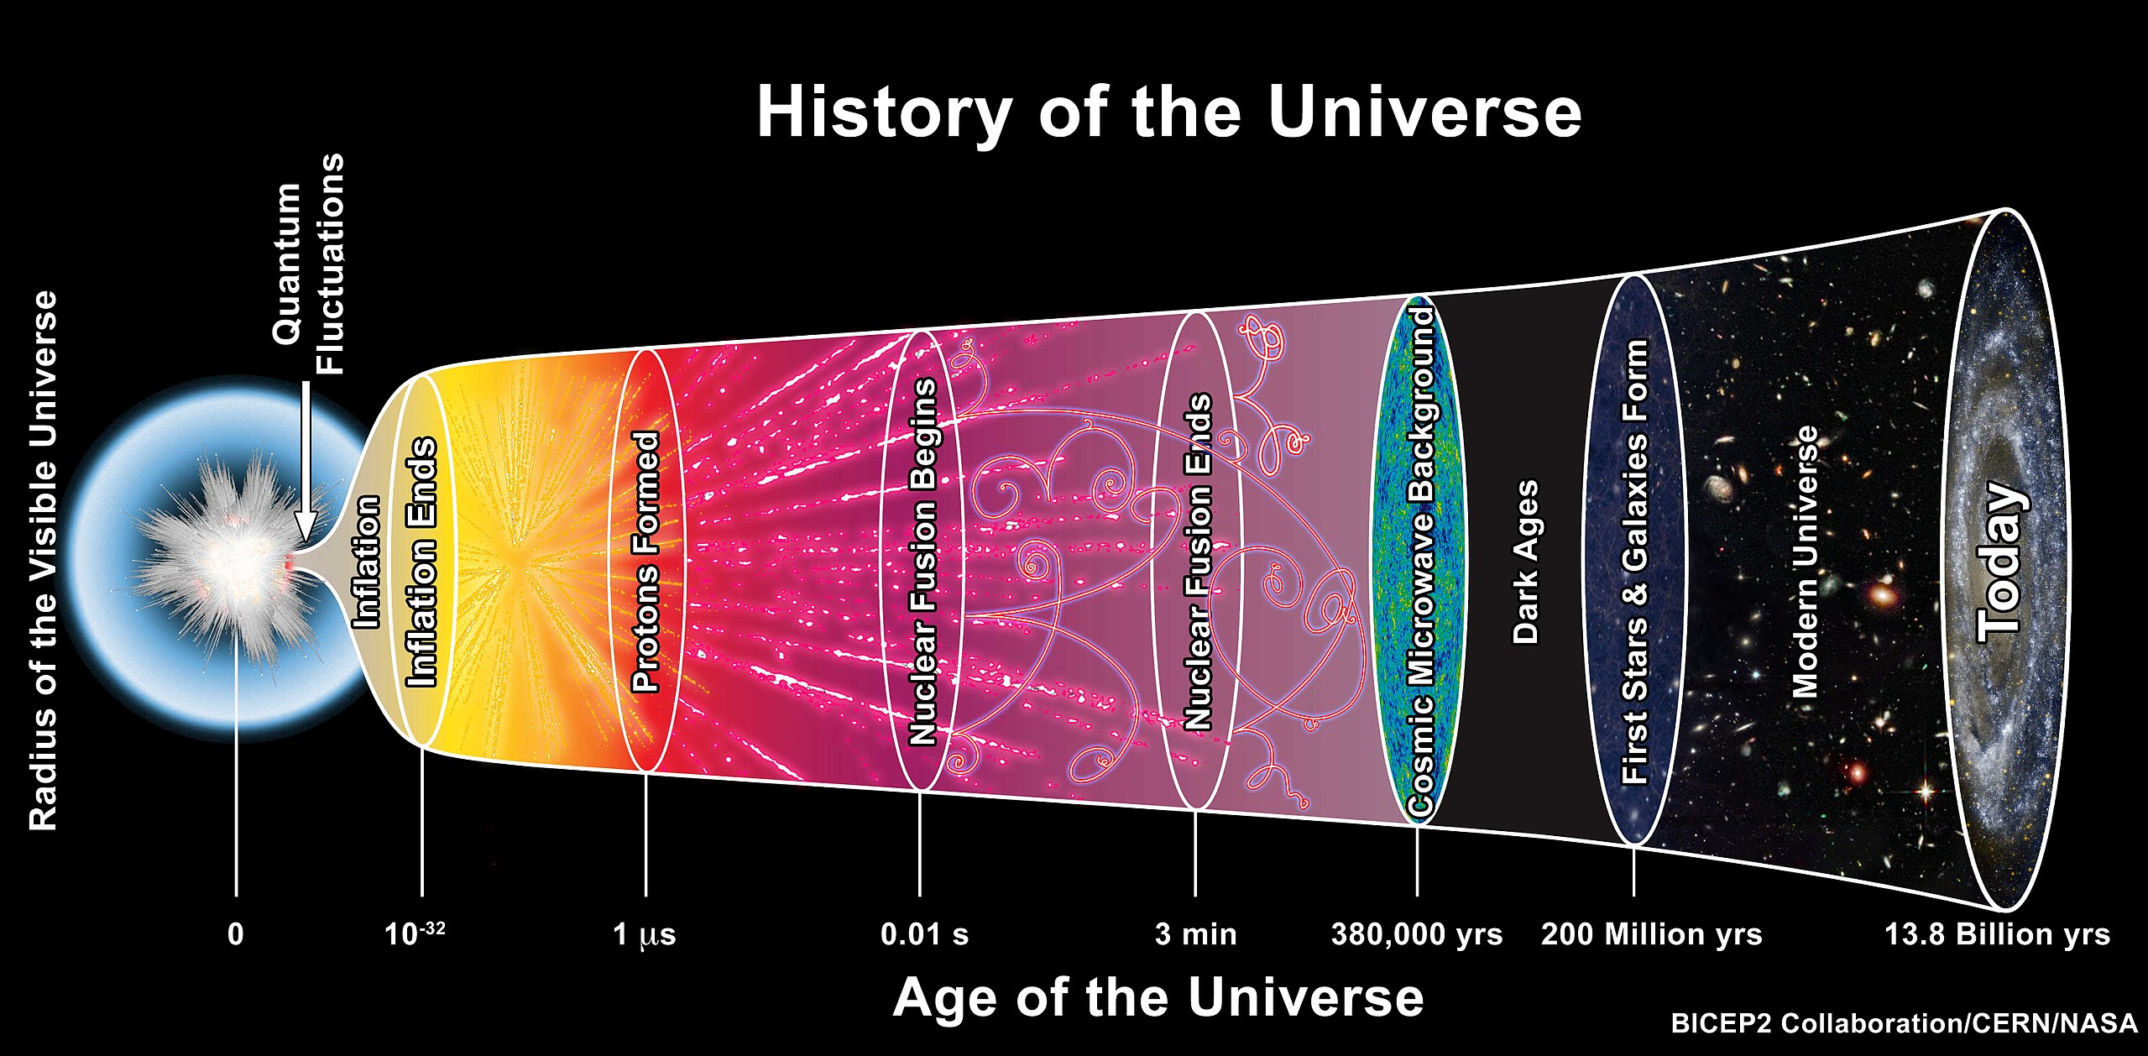
~1 s: neutrinos decouple
Ptolemy

Slide 3
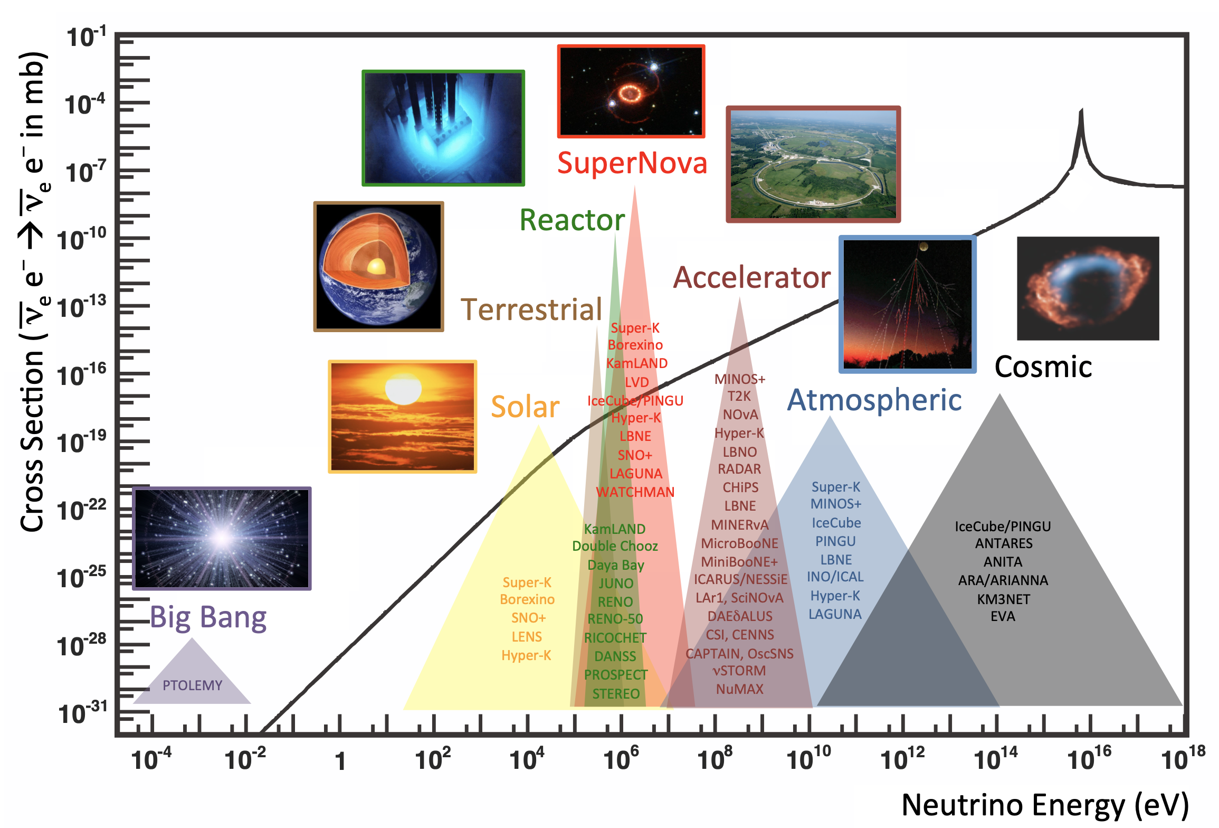
Neutrinos sources across the Cosmos

Slide 4
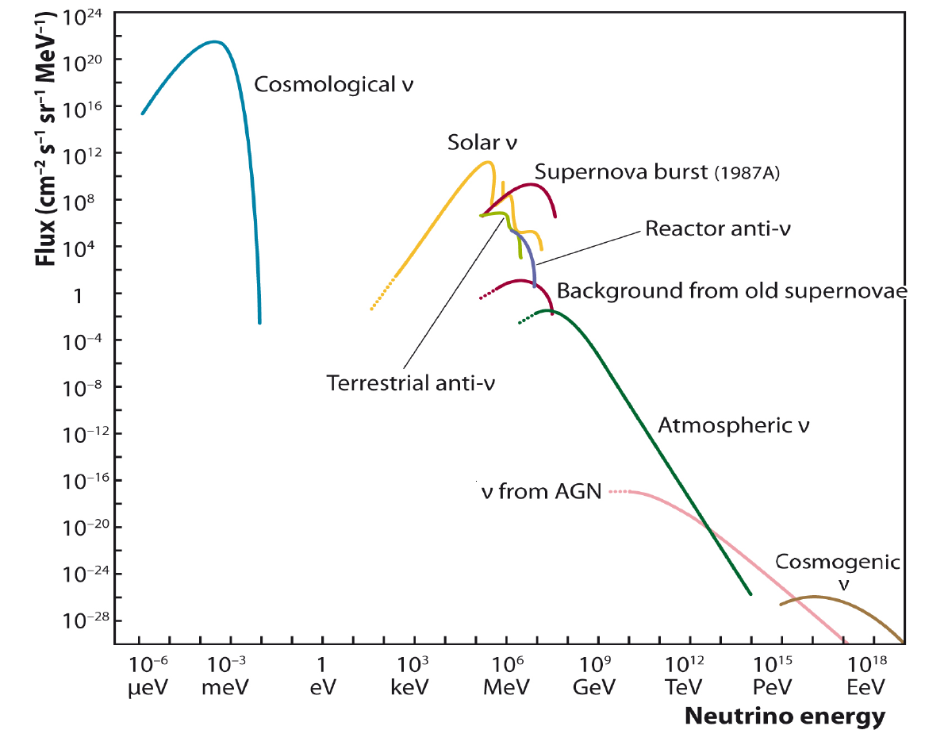
Relic Neutrino Background
Number density:
n_{ν} = 112/cm³
Temperature:
T_{ν} ~ 1.95K
( p ~ 0.17 meV)
Notes:
How can we directly detect the relic neutrinos today.
Edward Witten – joke H->D->T
It’s not as crazy as it seems – the neutrinos have very little kinetic energy, so you need to capture them on nuclei that are have no energy barrier transform into a lighter element – which means they are unstable to beta-decay.

Slide 5
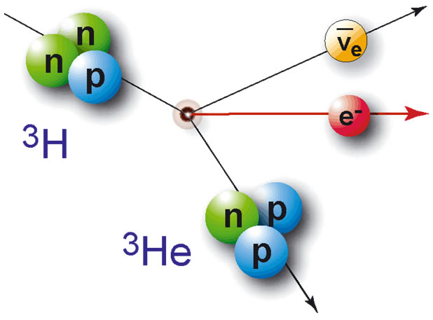
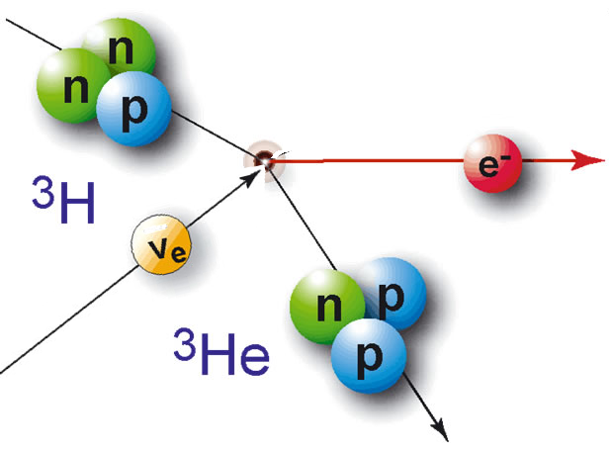
Relic Neutrino Capture
S. Weinberg [Phys. Rev. 128:3, 1457 (1962)]
A.G.Cocco, G.Mangano and M.Messina. [JCAP 06(2007)015 DOI: 10.1088/1475-7516/2007/06/015]
E_{K} = 18.6 keV
Tritium β-decay
(12.3 yr half-life)
Gap (2m) constrained to
m ≲ 200meV
from precision cosmology
Neutrino flavor expected with m ≳50meV
from oscillations
Ptolemy aim: <50meV
100g of T
M.G. Betti et al
JCAP 07(2019)047
Notes:
How can we directly detect the relic neutrinos today.
Edward Witten – joke H->D->T
It’s not as crazy as it seems – the neutrinos have very little kinetic energy, so you need to capture them on nuclei that are have no energy barrier transform into a lighter element – which means they are unstable to beta-decay.

Slide 6
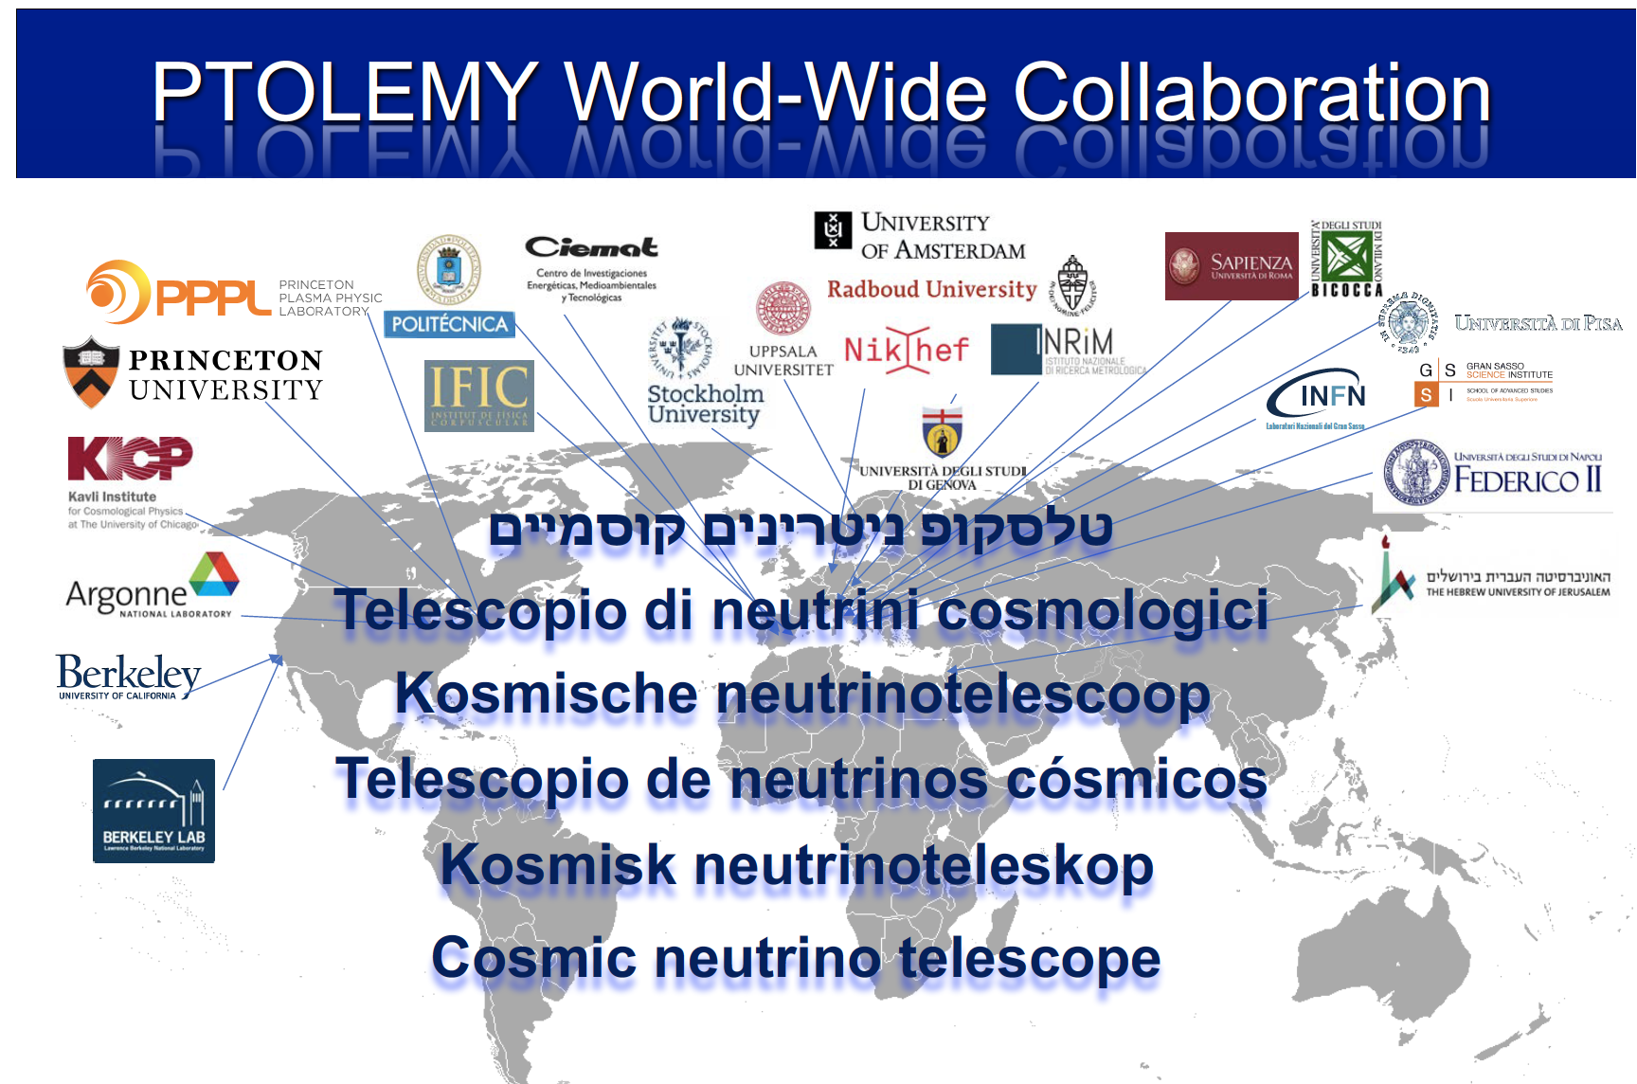
More than 40 physicists and 22 I institutions

Slide 7
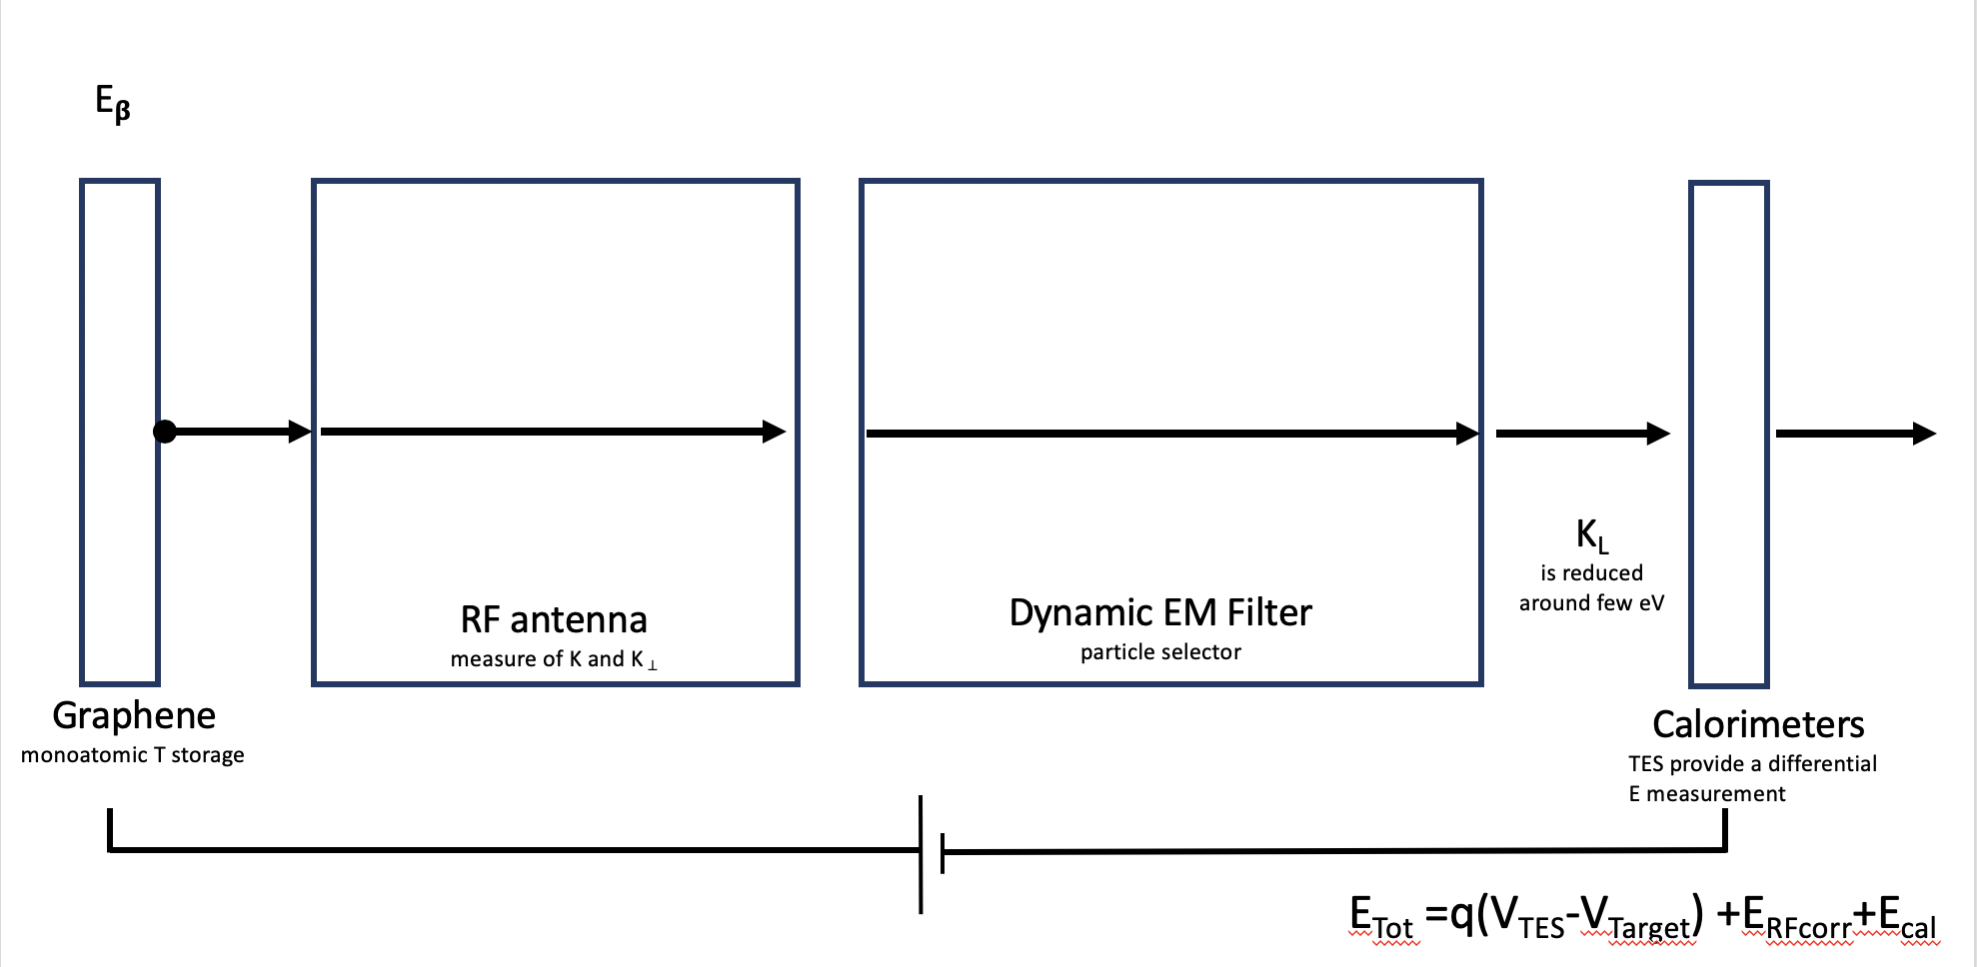
PTOLEMY Basic concept
10⁻⁴
10⁻²
HV
18.6kV
$$E_{Total}=q\left(V_{TES}−V_{Target}\right)+E_{RFcorr}+E_{cal}$$

Slide 8
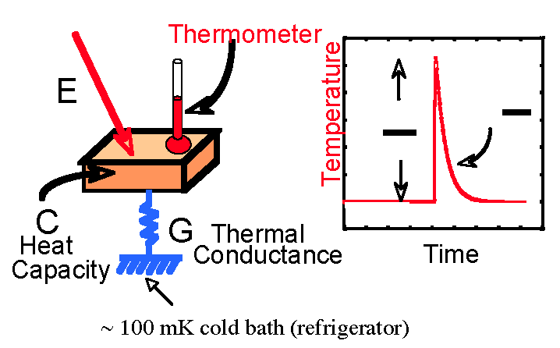
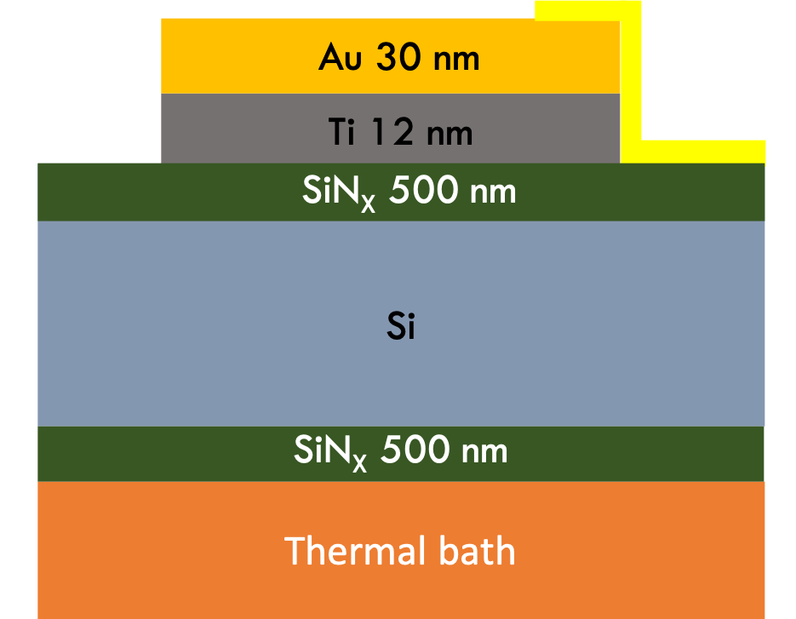
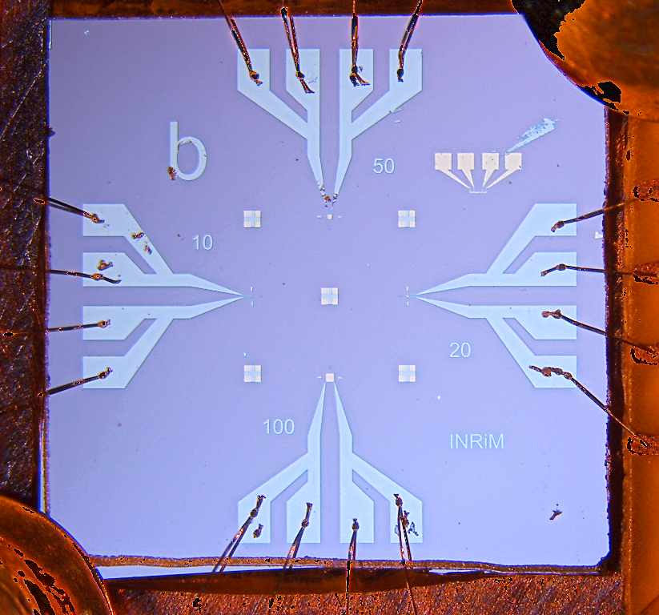
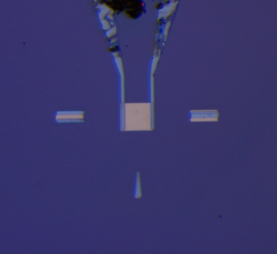
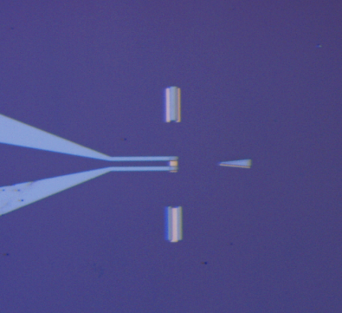
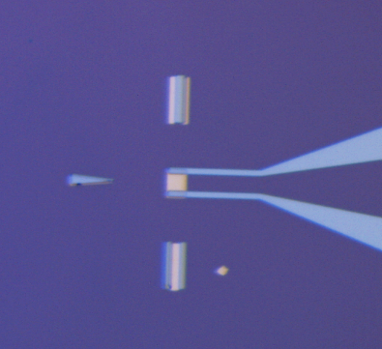
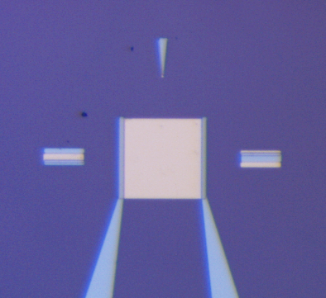
Calorimeter: TES μCal
e⁻
Thin sensors:
~1 eV electron can be stopped with very small C
C
E
τ =
G
C
50x50 µm
10x10 µm
20x20 µm
100x100 µm
C. Pepe, E. Monticone, M. Rajteri
Mauro Rajteri, Eugenio Monticone and others, https://doi.org/10.1007/s10909-019-02271-x
“TES Microcalorimeter for PTOLEMY”, J. Low Temp. Phys. 199 (2020) 138-142.

Slide 9

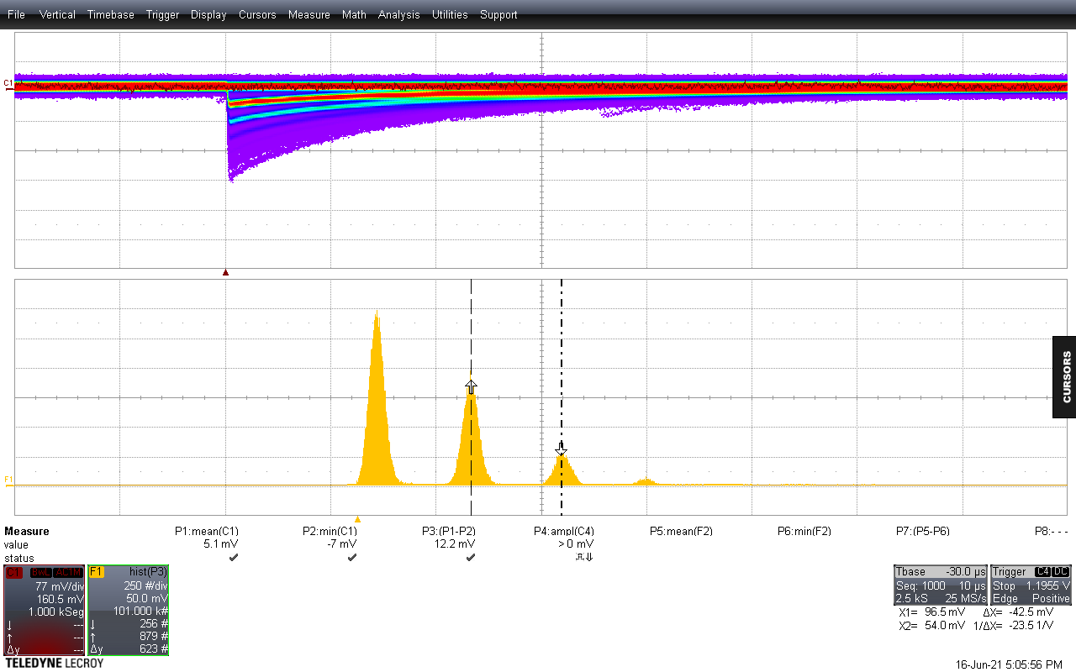
1% energy resolution at optical photon energies, i.e.
measures the wavelength of a 500nm photon to a few nm
amplitude
baseline
min
World-record TES calorimeter
w/50 meV resolution for CNB neutrinos
time (100ns/div)
counts
0 photons
λ= 1540 nm
1 photon
Infrared
Photons
(0.8 eV)
2 photons
3 photons
C. Pepe, E. Monticone, M. Rajteri

Slide 10
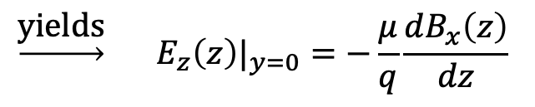
Ptolemy filter concept
y
x
x
z
Enforce zero drift in y (rotate E)
$$\underset{→}{\text{yields}} {E_{z}\left(z\right)|}_{y=0}=−\frac{μ}{q}\frac{dB_{x}\left(z\right)}{dz}$$
A.P Colijn, (PATRAS2019)

Slide 11
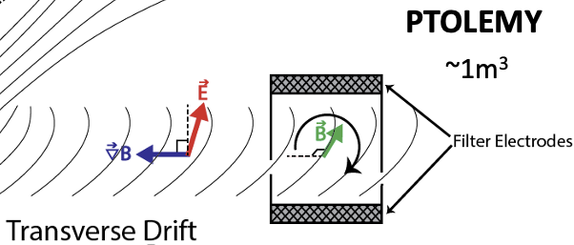

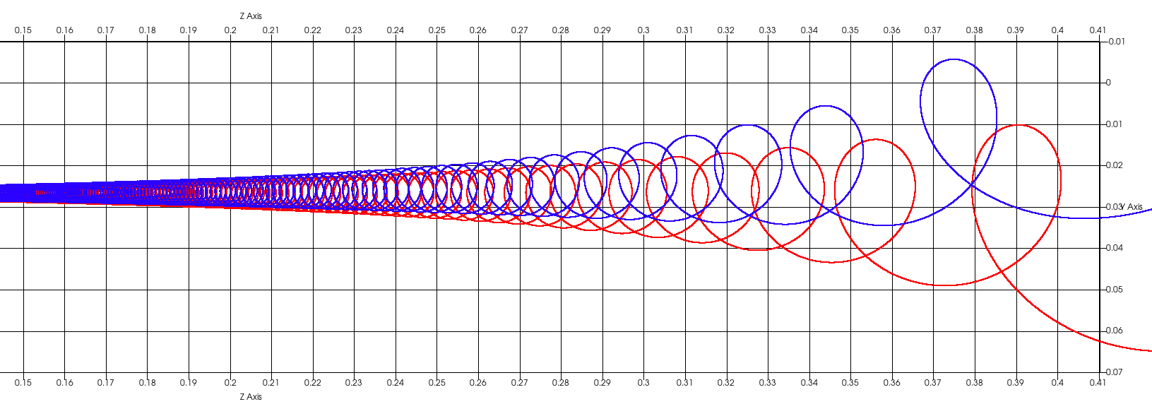
Ptolemy filter
Simulations with KASSIOPEIA
code (KATRIN) and Lorentz4
(N. Rossi, M. Messina, LNGS)
https://github.com/gkrossi/lorentz4

Slide 12
Filter Performance
Improves as B² for a fixed filter dimension
18.6 keV @ 1T → ~10eV (in 0.4m)
18.6 keV @ 3T → ~1eV (in 0.6m)
PTOLEMY Collaboration,
“Implementation and Optimization of the PTOLEMY Electromagnetic Filter”
https://arxiv.org/abs/2108.10388
https://iopscience.iop.org/article/10.1088/1748-0221/17/05/P05021

Slide 13
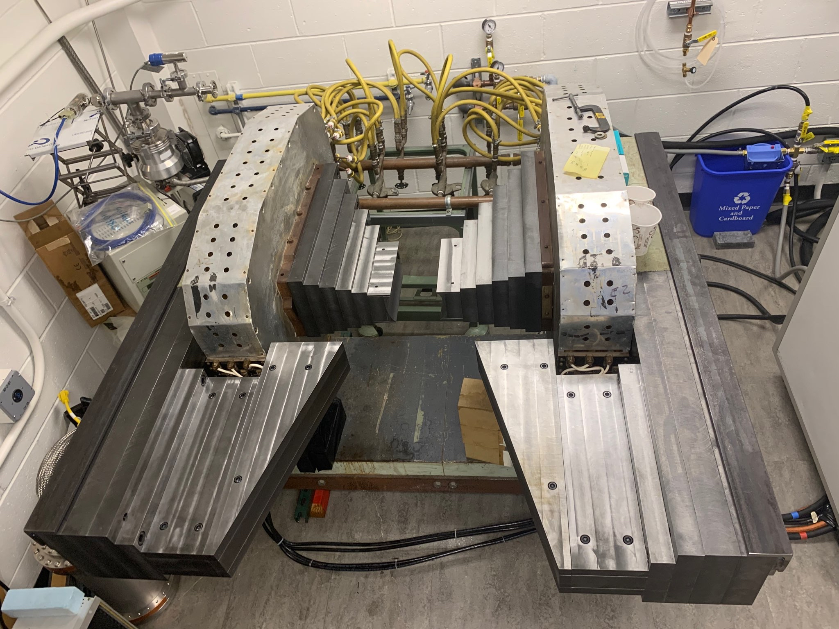
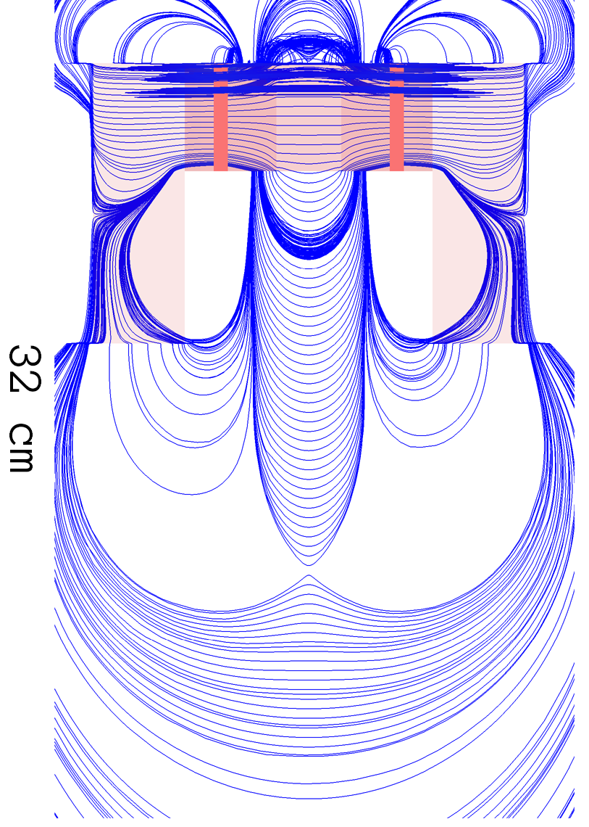
First Version of the PTOLEMY filter
Wonyong Chung
PTOLEMY
filter@Princeton
RF pickup region
Filter region
Andi
Tan
Zero field (location for TES microcalorimeter)

Slide 14
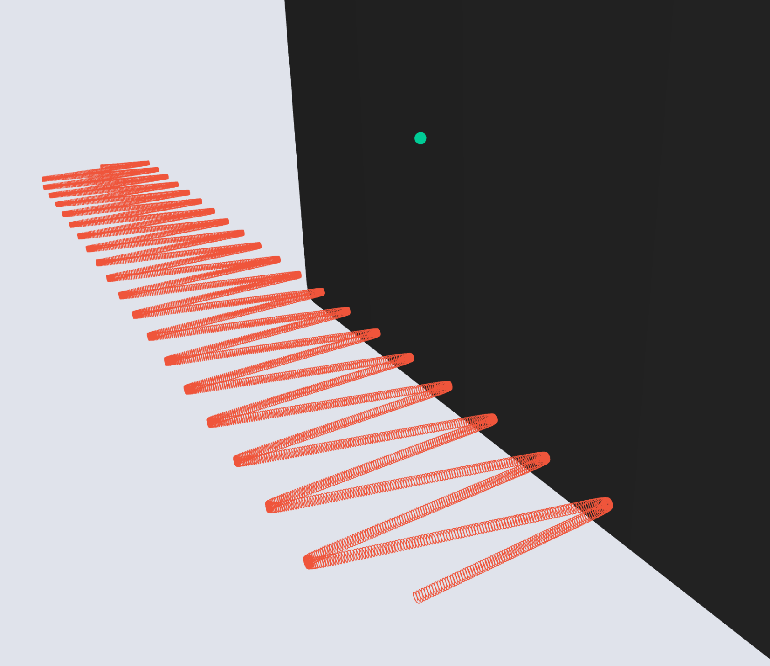
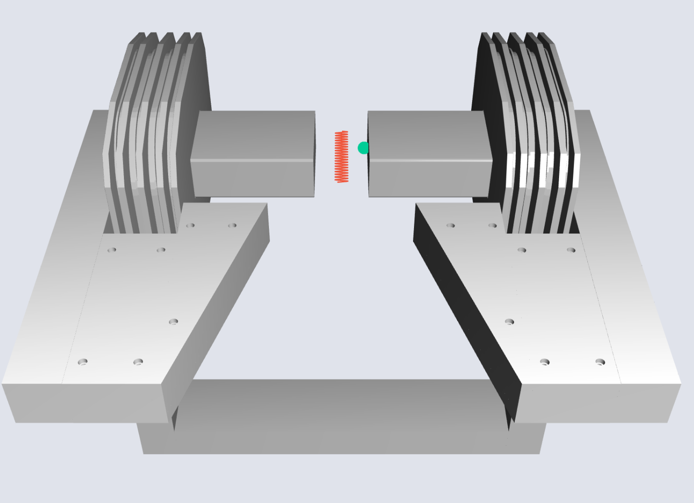
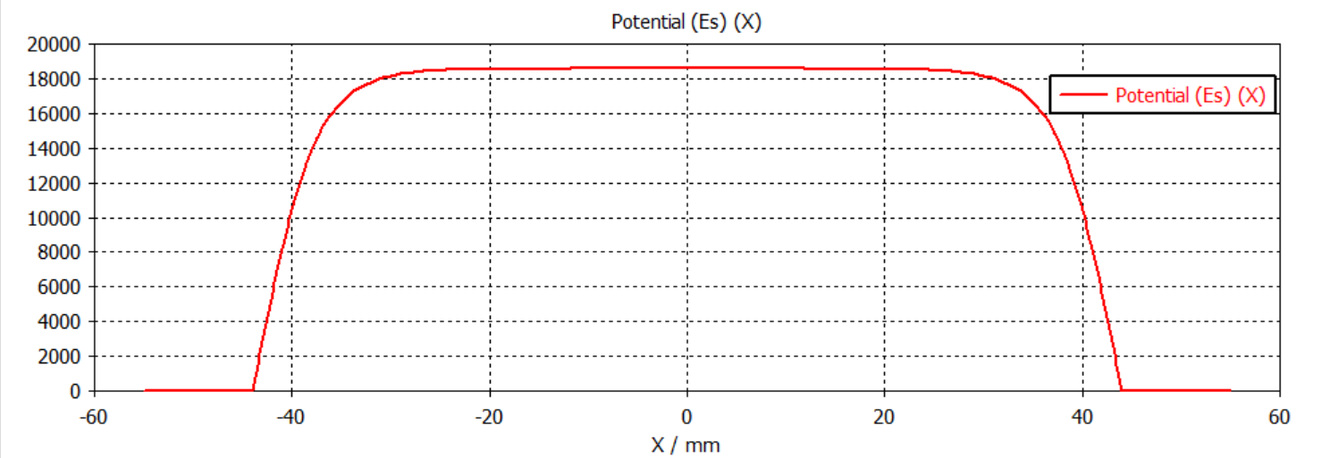

RF pick-up
Andi Tan (Princeton)
inspired

Slide 15
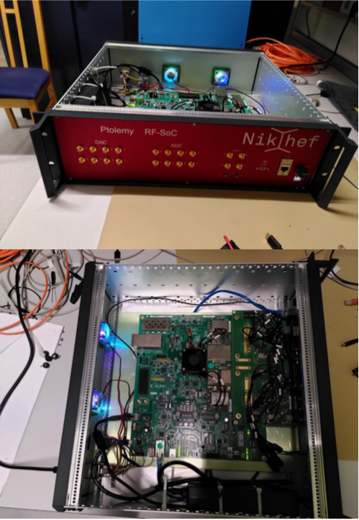
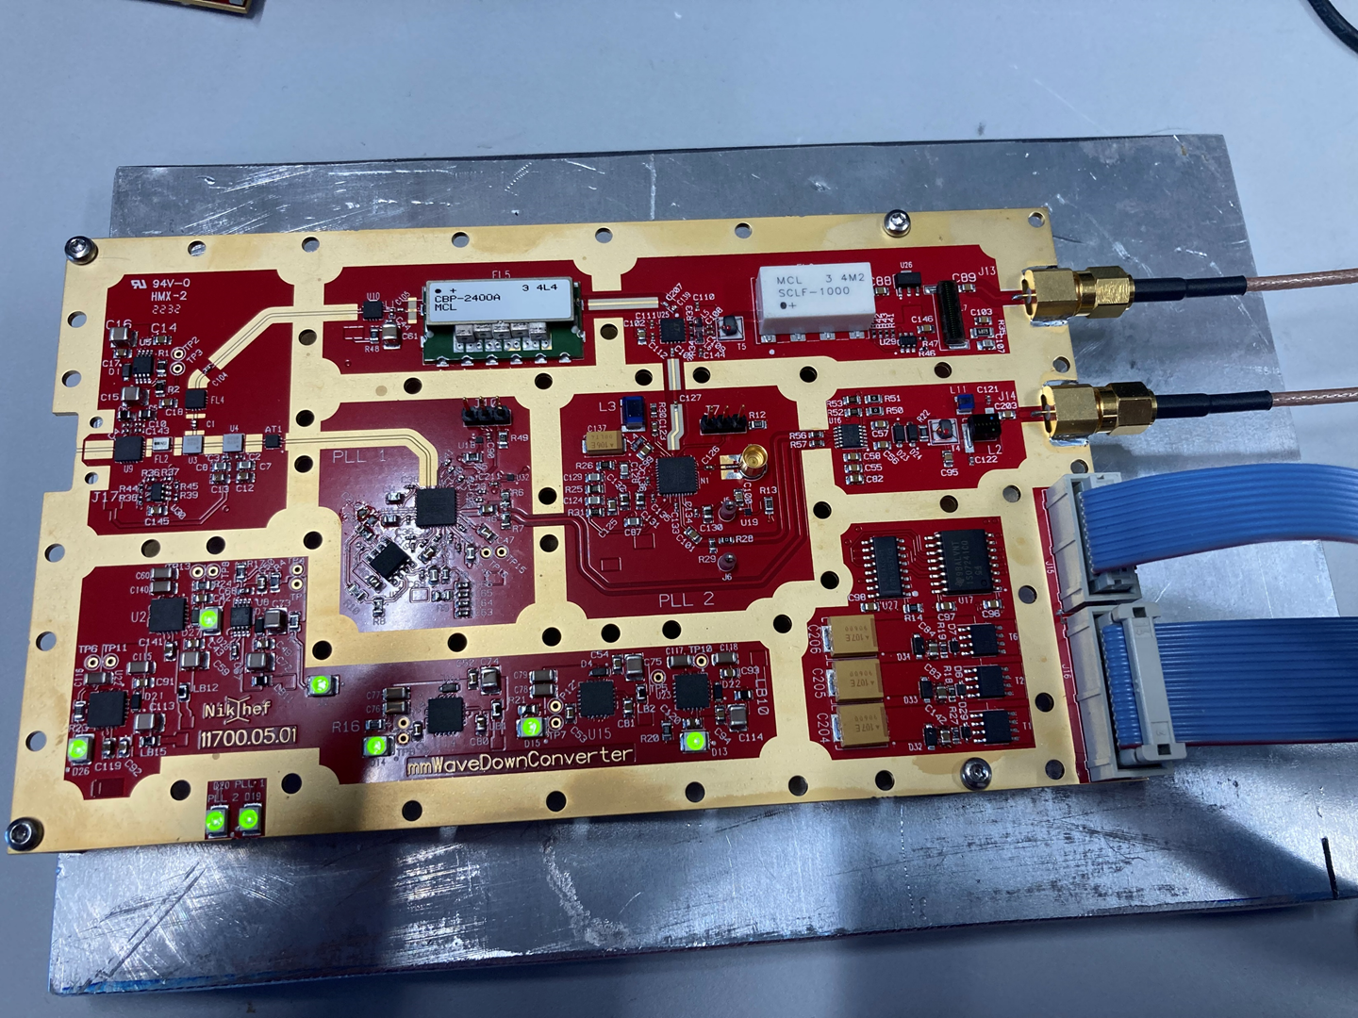
RF electronics
FPGA for online signal processing (online FFT)
Downconverter
Input: RF signal (26 GHz)+high precision oscillator
Output: down-sampled signal at around 1 GHz
Nikhef

Slide 16
Target: Tritium on graphene
atomic H as a tool to ‘pinch’ the sp2 bonds towards an sp3 configuration while maintaining the planar nature of graphene
sp3 H-C bond
H₂ flow into a capillary with hot-spot (~2000 C) in UHV → more than 95% molecules cracked in atomic H concentrated onto the sample
Notes:
16

Slide 17
Hydrogen and Deuterium on (nanoporous) graphene
Betti et alii, Nano Lett. 22, 2971 (2022)

Slide 18
Heisenberg effect

Slide 19
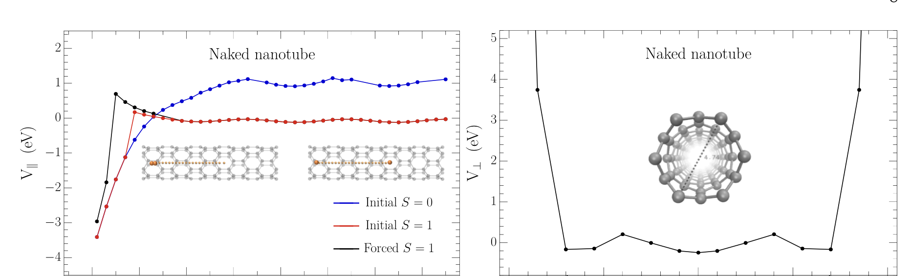
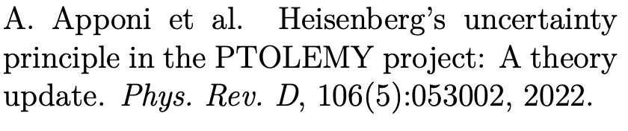
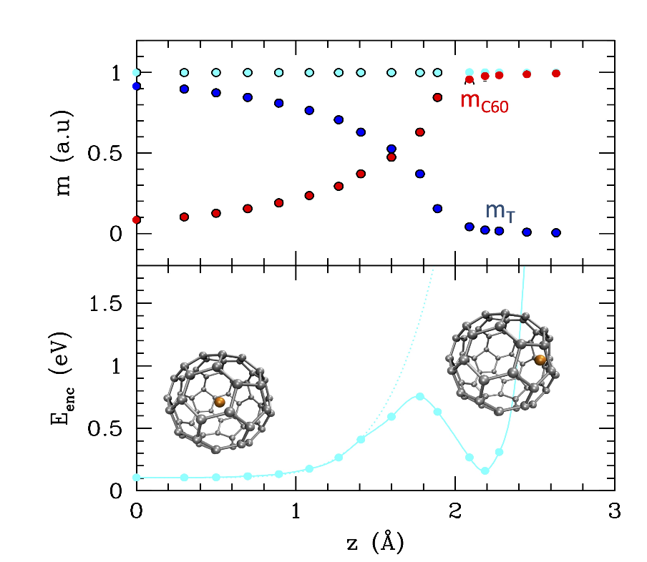
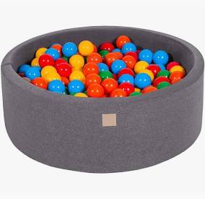
Alternative substrates
Concave substrate: flatter potential
Carbon nanotubes
  X and Y different
  Recombination in the tubes
Fullerenes
V. Tozzini (I. Nanoscienze)

Slide 20
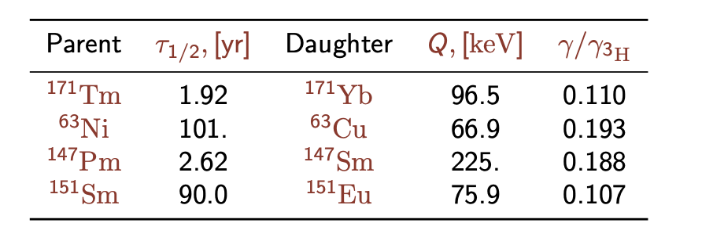
Beyond Tritium?
0. Mikulenko, Y. Cheipesh, V. Cheianov, A. Boyarsky, arXiv:2111.09292 (2021)
30x smaller cross-section
500x smaller cross-section
800x smaller cross-section
²⁴¹Pu 14.3 ²⁴¹Am 20.8 0.04
N. De Groot, J. Phy.s G50 055106 (2023)
DOI 10.1088/1361-6471/acc5fc
The bad news: 2 x 10⁻⁵ α-decay to ²³⁷U which decays in 6 days to ²³⁷Np, Q = 459 keV
Use recoil ?
Veto gammas from ²³⁷U-decay
Maybe gaseous target (PuF₆) with regeneration to filter Am and U for mass measurement
Sterile neutrinos: Magneto-ν @LLNL (https://indico.cern.ch/event/1188759/contributions/5244403/)
Not for solid target an CNB
Tritium still the only serious option for relic neutrino detection!

Slide 21
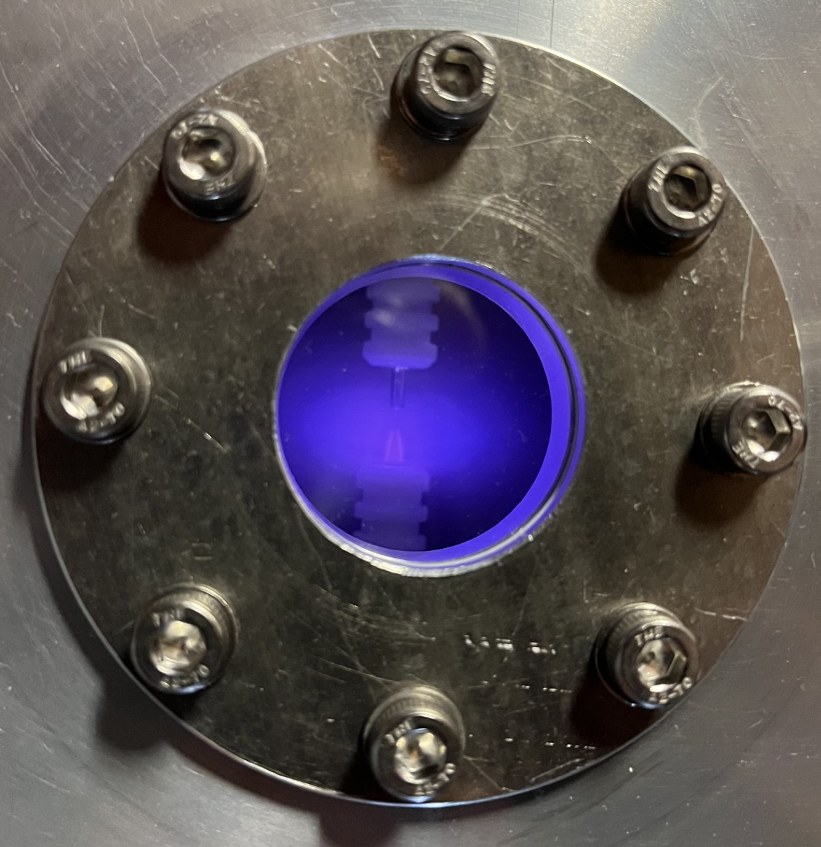
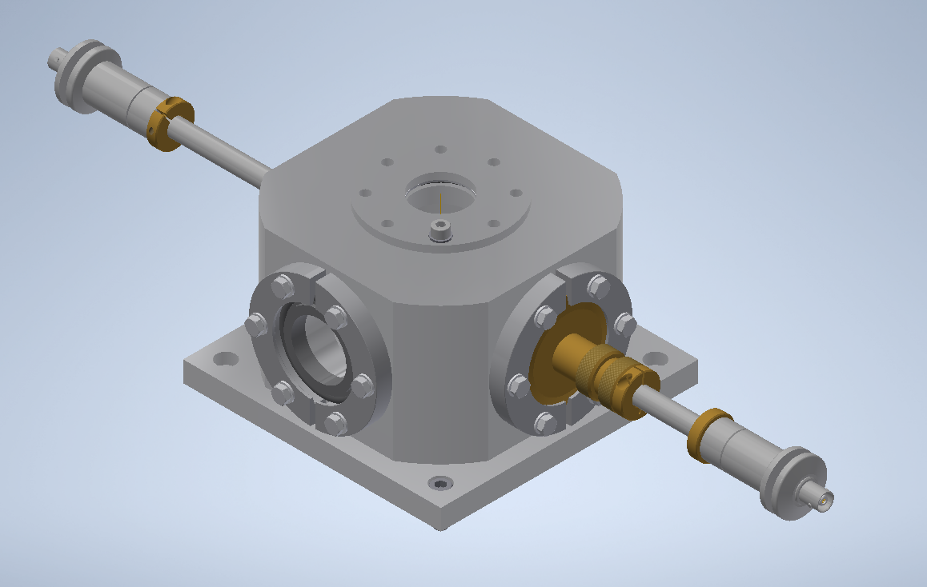
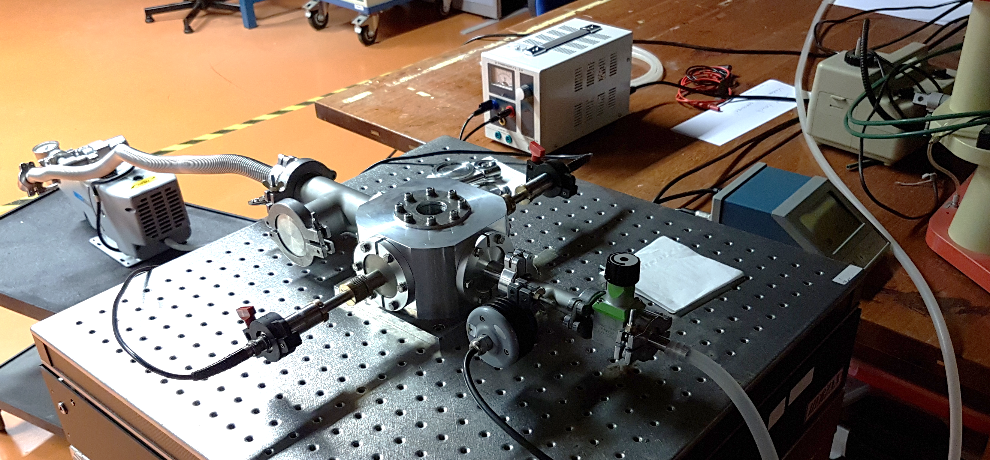
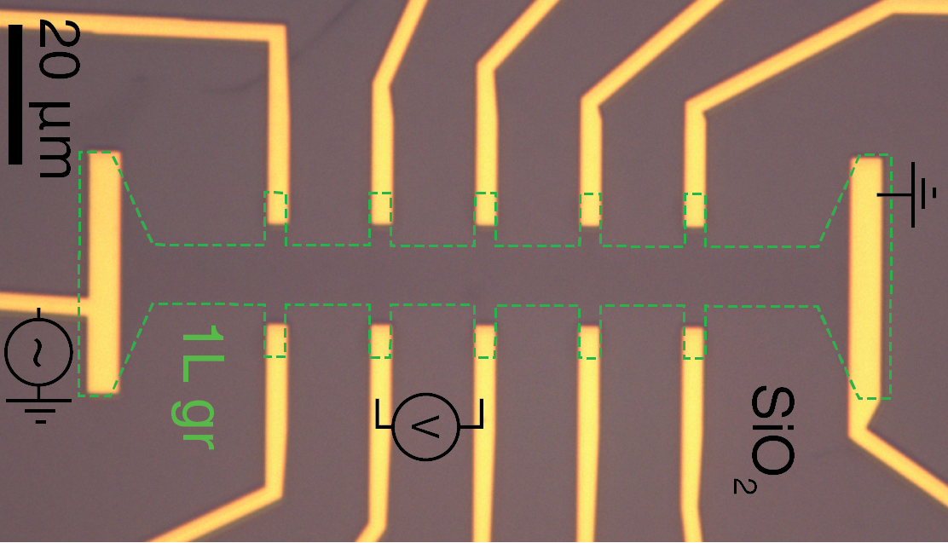
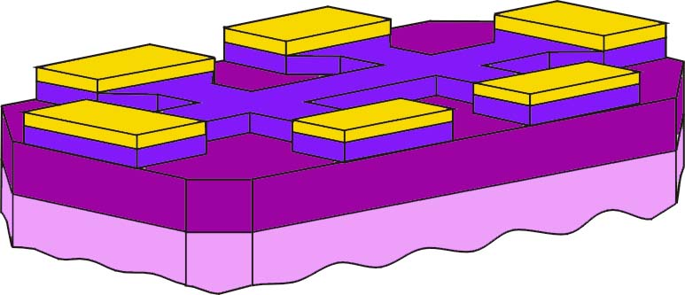
Hydrogenation of Graphene
Transfer Curve:
Gate voltage
Electron mobility
Temperature effect
Charging efects
Impurities
Au contacts
graphene
SiO₂
gate insulator
O. Zheliuk (Radboud)
Si backgate

Slide 22
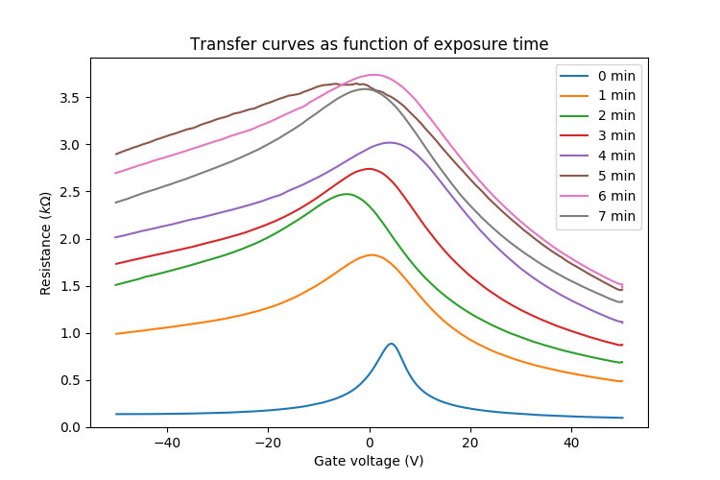
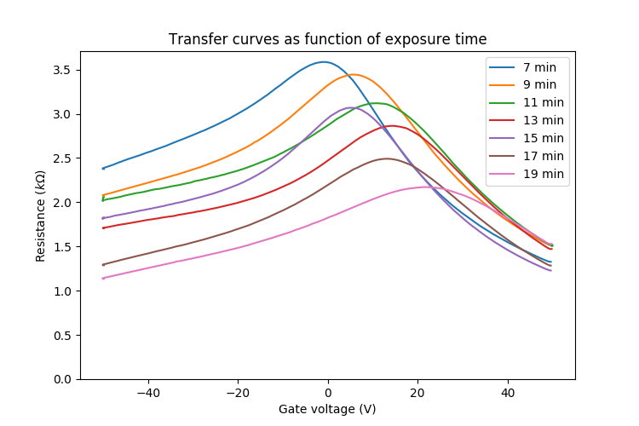
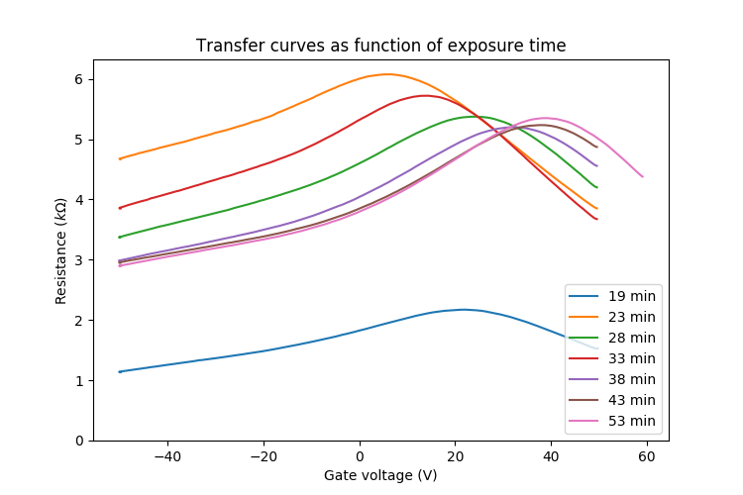
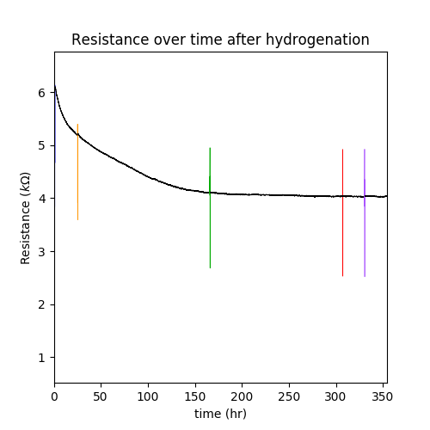

Hydrogenation of Graphene
Work in process
Many transient effects
Annealing reduces resistance
180º removes contamination
400º removes hydrogen
Next: quantum hall, tritium, spectroscopy

Slide 23
Conclusions
Ptolemy aims to measure the CNB
An energy resolution of 50meV or better is required
Many experimental challenges (target, RF, filter, calorimeter)
Vibrant research programme
Good progress towards demonstrator
Many challenges still remain (target)
Tritium still the best option, vital role for KIT
Many activities not covered

