Slide 1
Application of CORSIKA 8 in TRIDENT neutrino telescopes
Fan Hu, Cen Mo, Fuyudi Zhang
Time: 2023.06.13

Slide 2
Contents
Introduction to TRIDENT
Build event generator for neutrino telescopes
Simulate atmospheric muons
Detector simulation using C8 (feature plan)

Slide 3
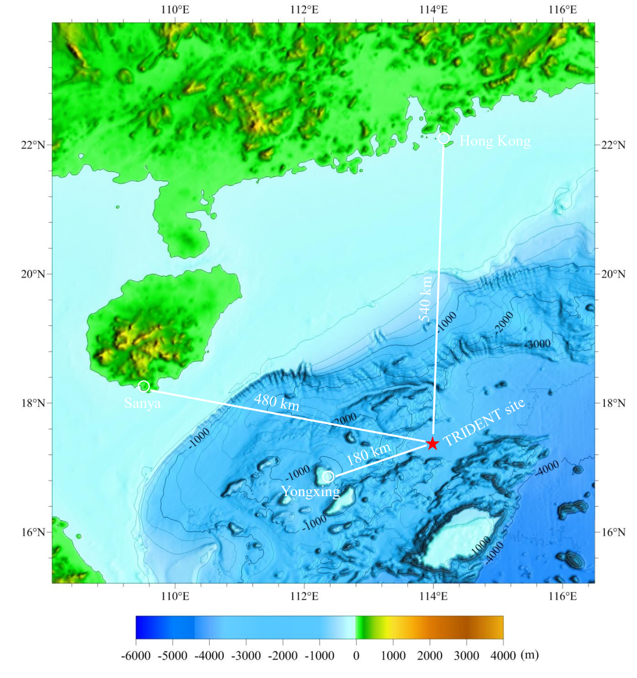
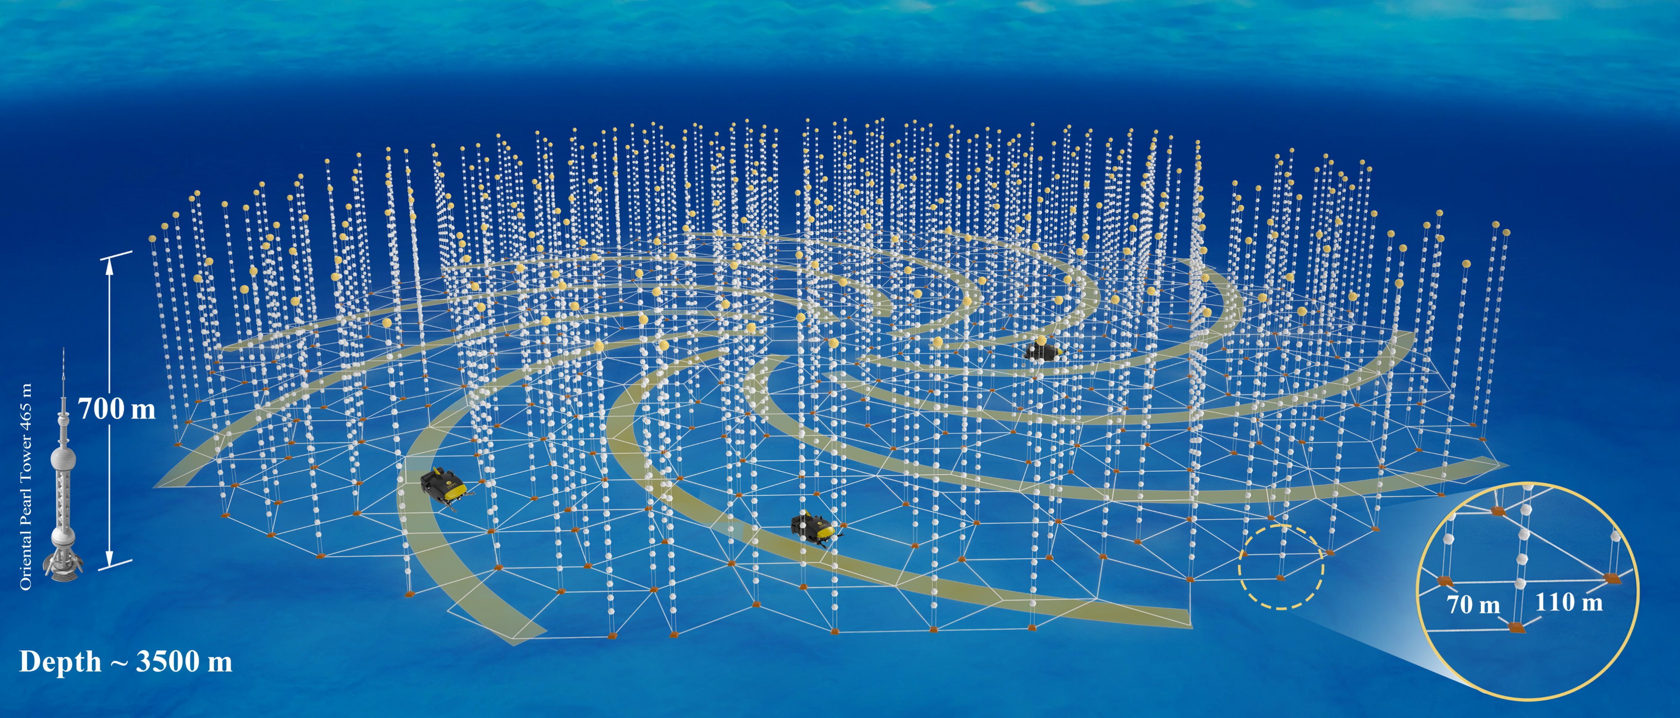
TRIDENT – A neutrino telescope in South China Sea
Proposal for a neutrino telescope in South China Sea, arXiv:2207.04519

Slide 4
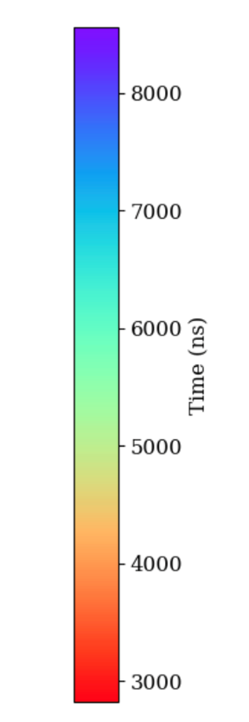
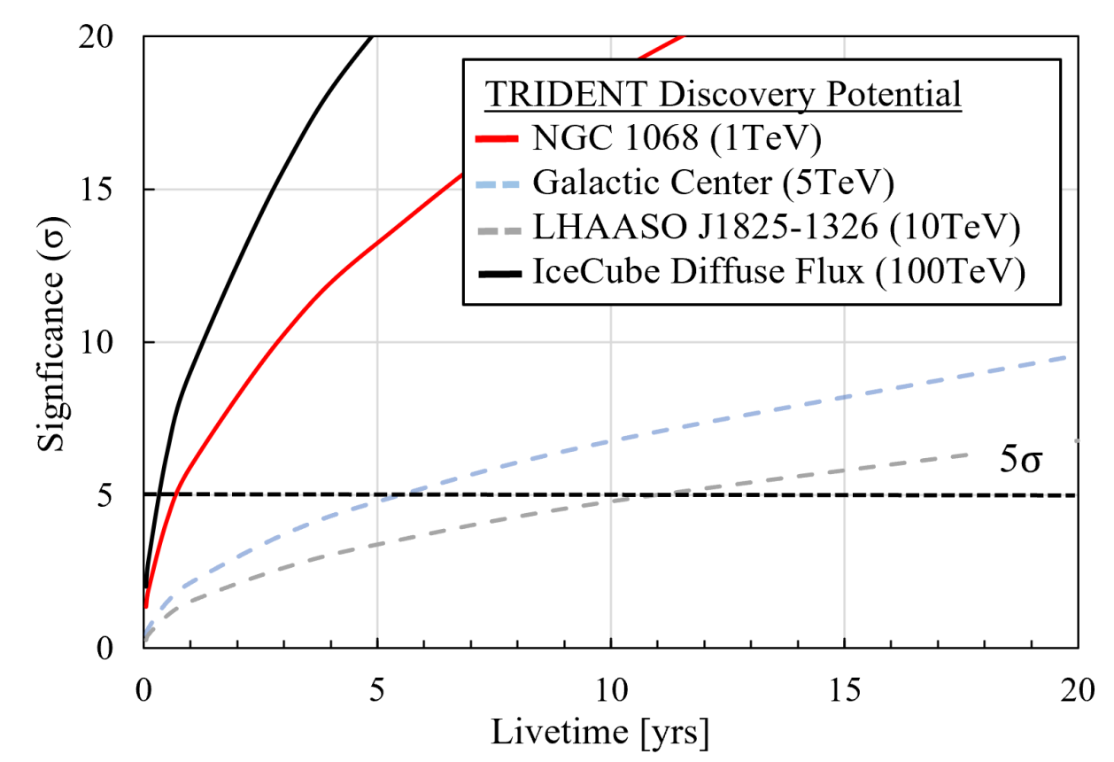
TRIDENT sensitivity
A 1PeV muon track event
Sensitivity curve

Slide 5
Part 2
Event generator for neutrino telescopes

Slide 6
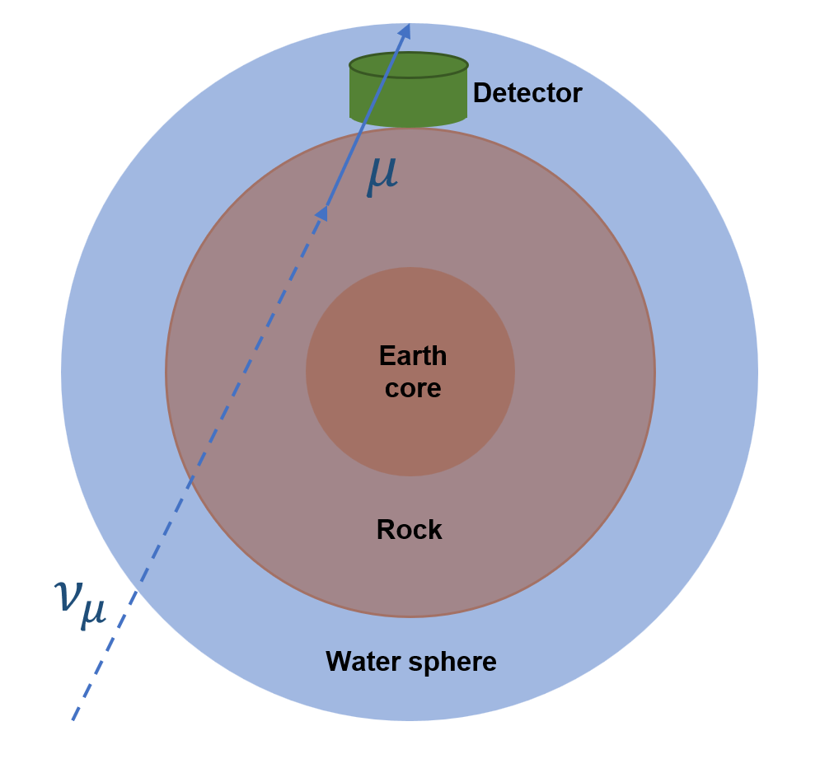
Neutrino event generator
Sample neutrinos
Perform physics simulation for primary particles:
neutrino-nucleon DIS
muon propagation
tau propagation
tau decay
record secondary particles for detector simulation

Slide 7
Neutrino event generator - Implementation
(b)
(a) direction and position sampling
Some magic of important sampling
$$Sampling length$$
$$D_{μ}+D_{0}$$
$$V_{det}$$
$${\vec{x}}_{i}$$
$${\hat{n}}_{ν}$$
$$D_{0}$$
(b) DIS simulation, muon propagation and output
(b)
$$DIS vertex$$
$${\vec{x}}_{f}$$
Related to C8
out-going $μ$
$$V_{det}$$
$${\vec{x}}_{i}$$
$${\hat{n}}_{ν}$$

Slide 8
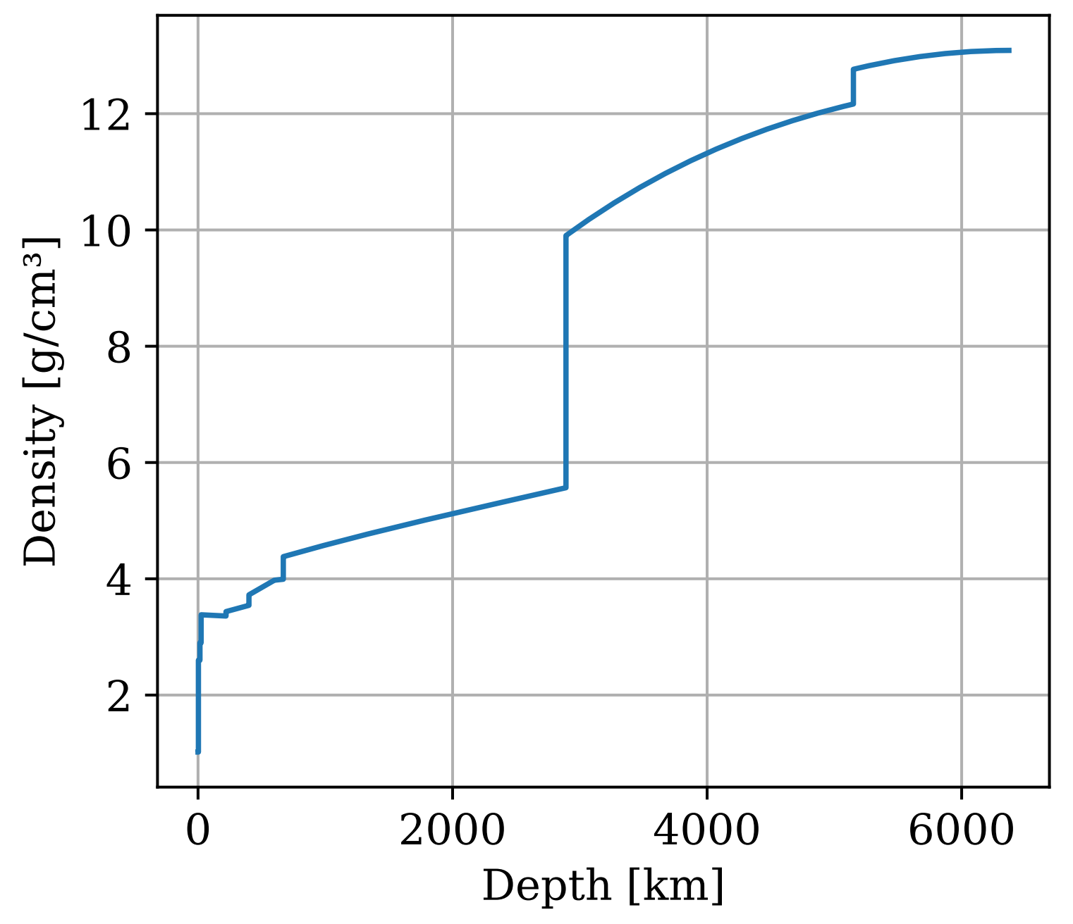
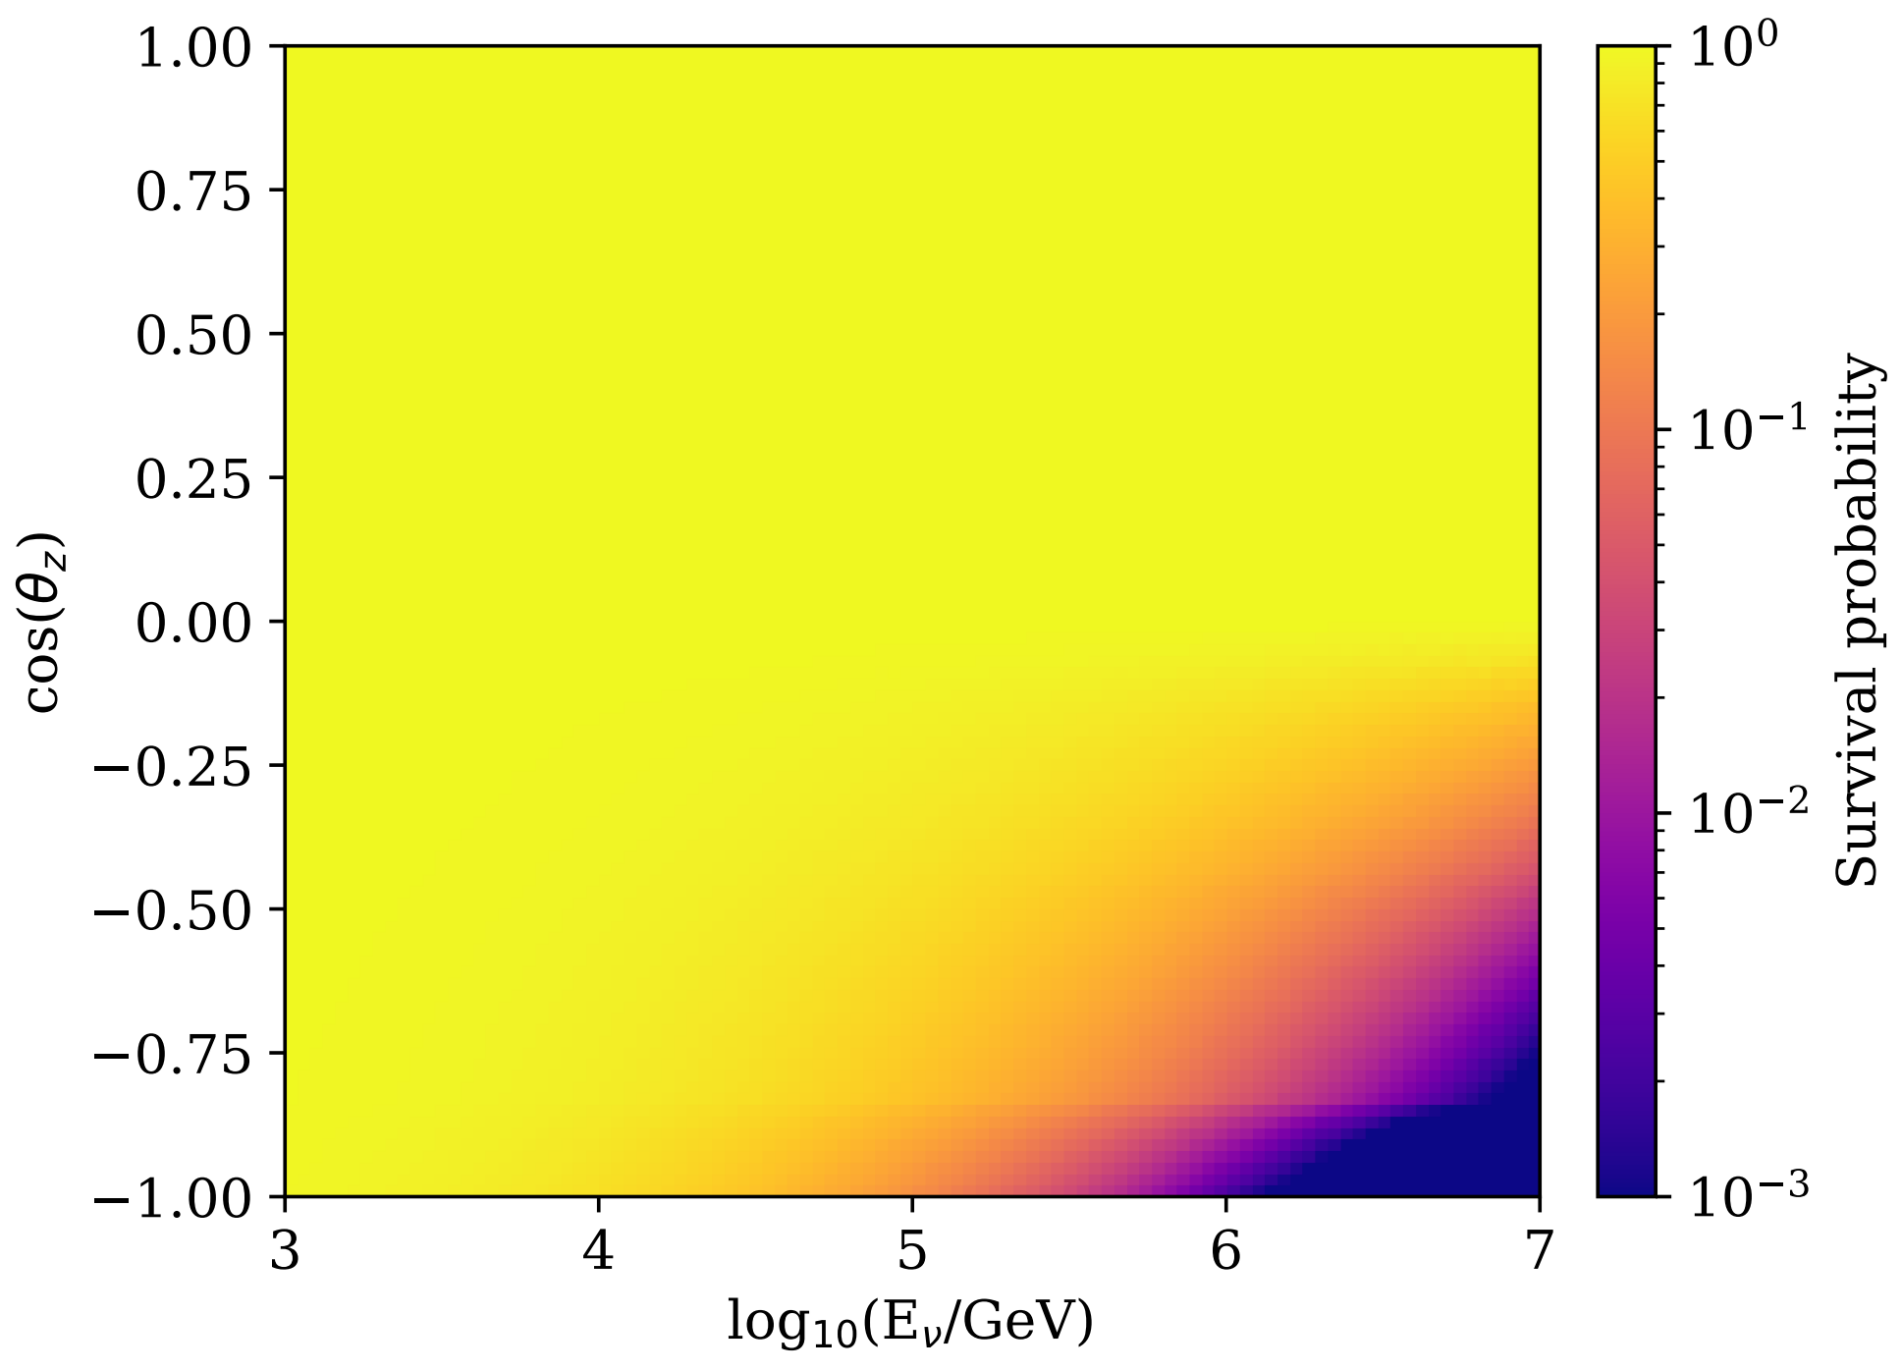
Build Earth model inside CORSIKA8
Build the PREM model using the way similar to layered atmosphere
Get grammage along a trajectory using C8

Slide 9
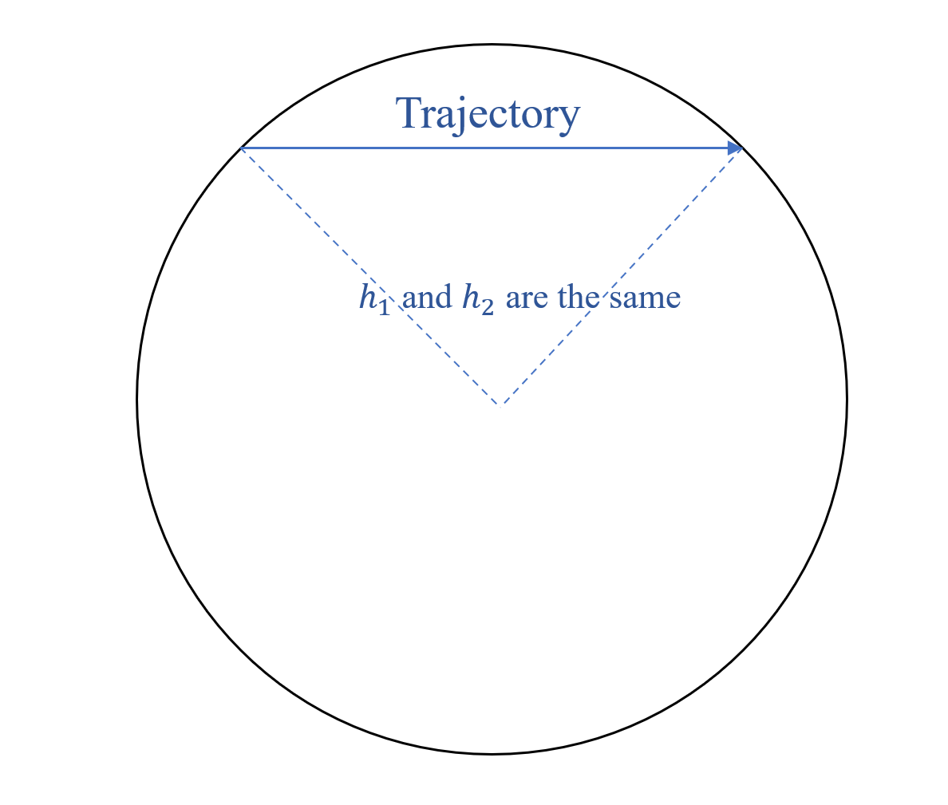
Fix medium
BaseTabular does not support for tracks that
“changes direction compare to height frame”
inline GrammageType BaseTabular::getIntegratedGrammage(
BaseTrajectory const& traj) const {
LengthType height1 = (traj.getPosition(0)
- point_).getNorm();
LengthType height2 = (traj.getPosition(1)
- point_).getNorm();
for (int bin1 = height1/binsize_;
bin1 < height2/binsize_; bin1++) {
// sum up grammage
}
}

Slide 10
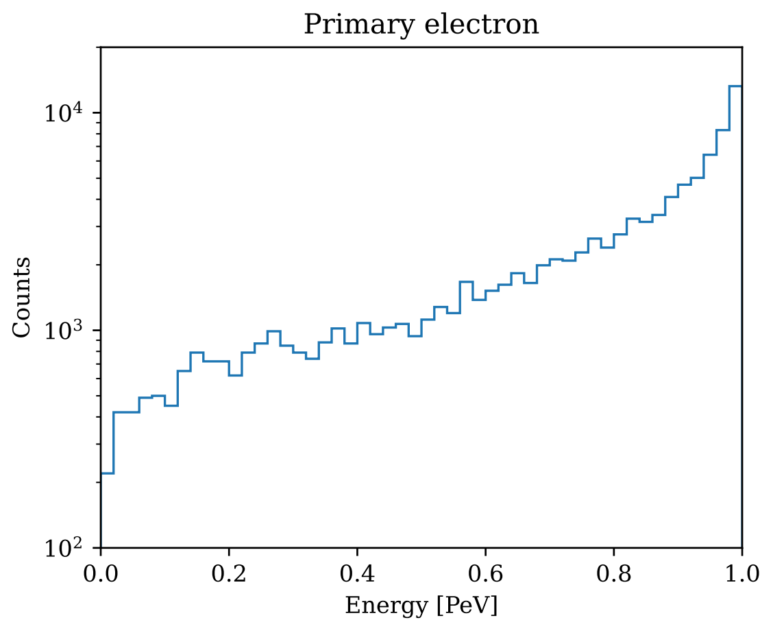
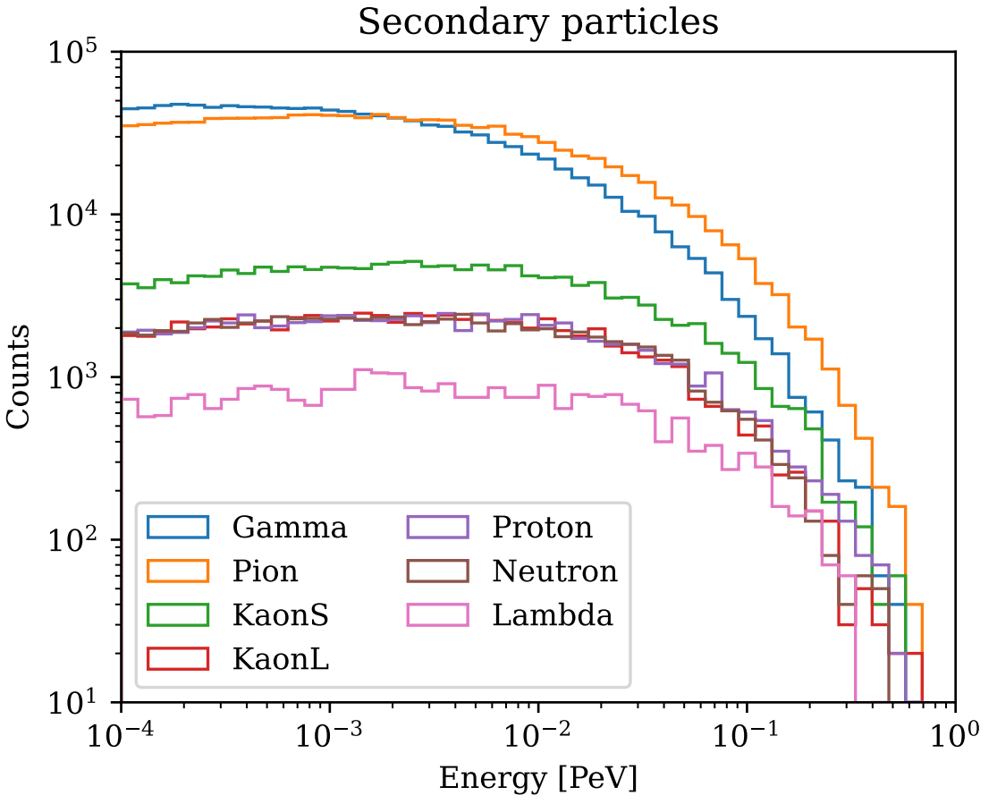
Force neutrino DIS interaction
// set up Pythia8
pythia8::Pythia::readString( "WeakBosonExchange:ff2ff(t:W) = on");
// sample neutrino ...
// force interaction
neutrino = stack.addParticle(Code::NuMu,
kinEnergy, direction, position, 0_ns);
pythia8::Interaction::doInteraction( neutrino, Code::Proton);
// muon propagation, output
EAS.run();

Slide 11
Observation Volume
Similar to ObservationPlane, records particles arriving at the surface of volume.
template <typename TTracking, typename TVolume,
typename TOutputWriter = ObservationVolumeWriterParquet>
class ObservationVolume;
For volume that can be called in:
TTracking::intersect(particle, volume_);

Slide 12
The neutrino_telescope branch
An experimental branch to add features required by running neutrino telescope.
Features added:
Fix BaseTabular !527
Add ObservationVolume !408
Add Cylinder and its tracking method
Add Preliminary Reference Earth Model (PREM)
Add neutrino interaction module (force interaction)

Slide 13
Part 3
Simulate atmospheric muons

Slide 14
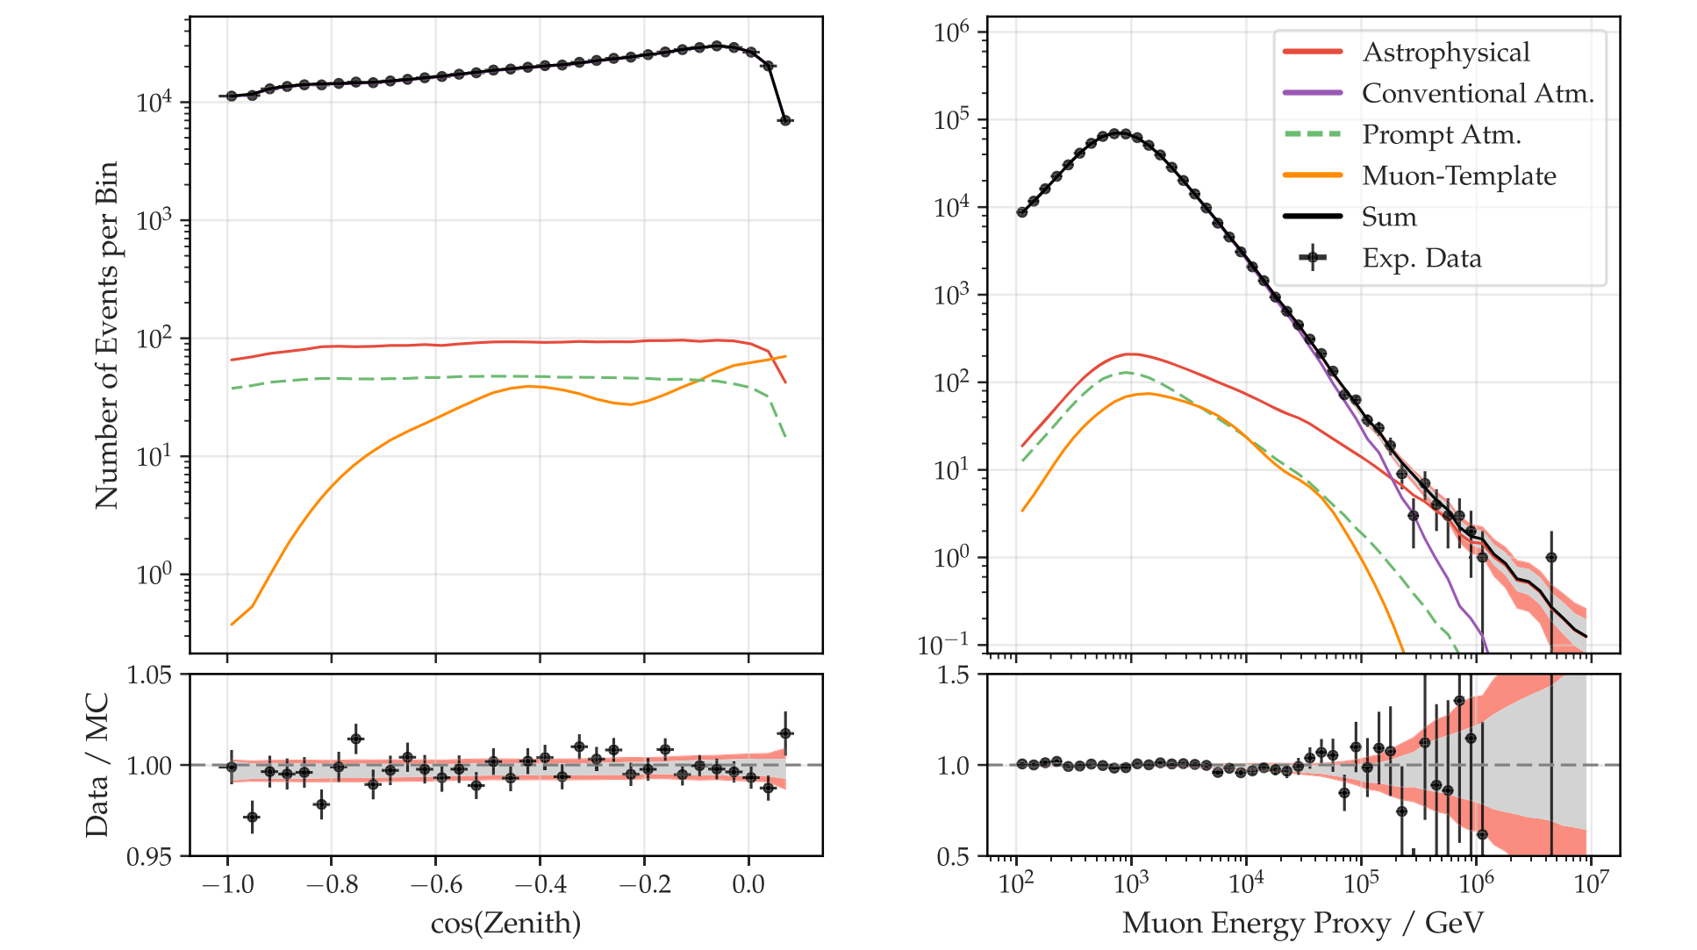
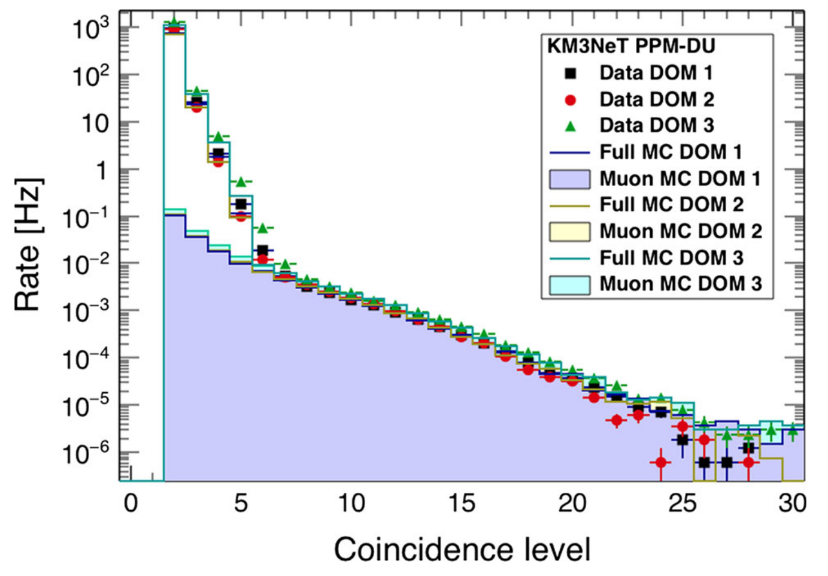
Atmospheric muons
Major background in neutrino telescope
Calibrate the detector
Figure from IceCube, APJ 2022
Figure from KM3NeT, Eur. Phys. J. C 2016

Slide 15
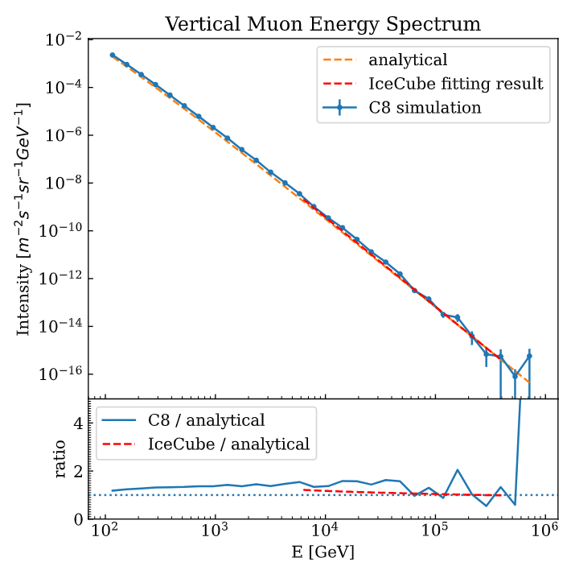
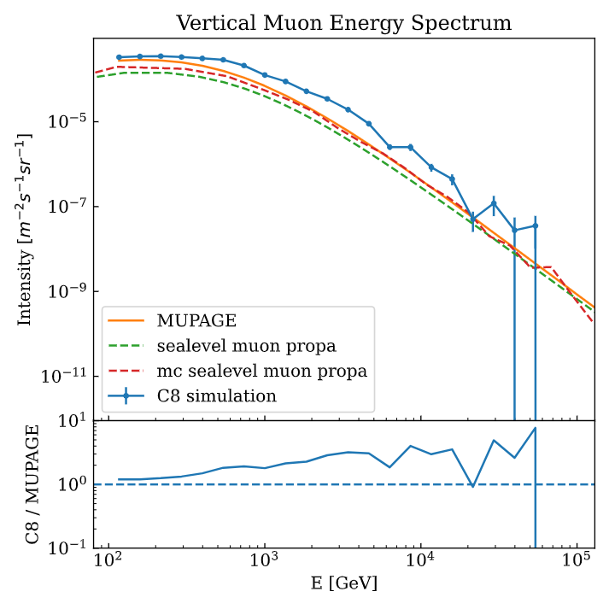
Spectrum: proton reweighted to poly-gonato
Physics: sibyll + UrQMD + PROPOSAL
Cut: 100 GeV
Atmospheric muons
Flux at sea level
Flux at deep sea (2400 m)
Compared to PDG
Compared to MUPAGE

Slide 16
Part 4
Detector simulation

Slide 17
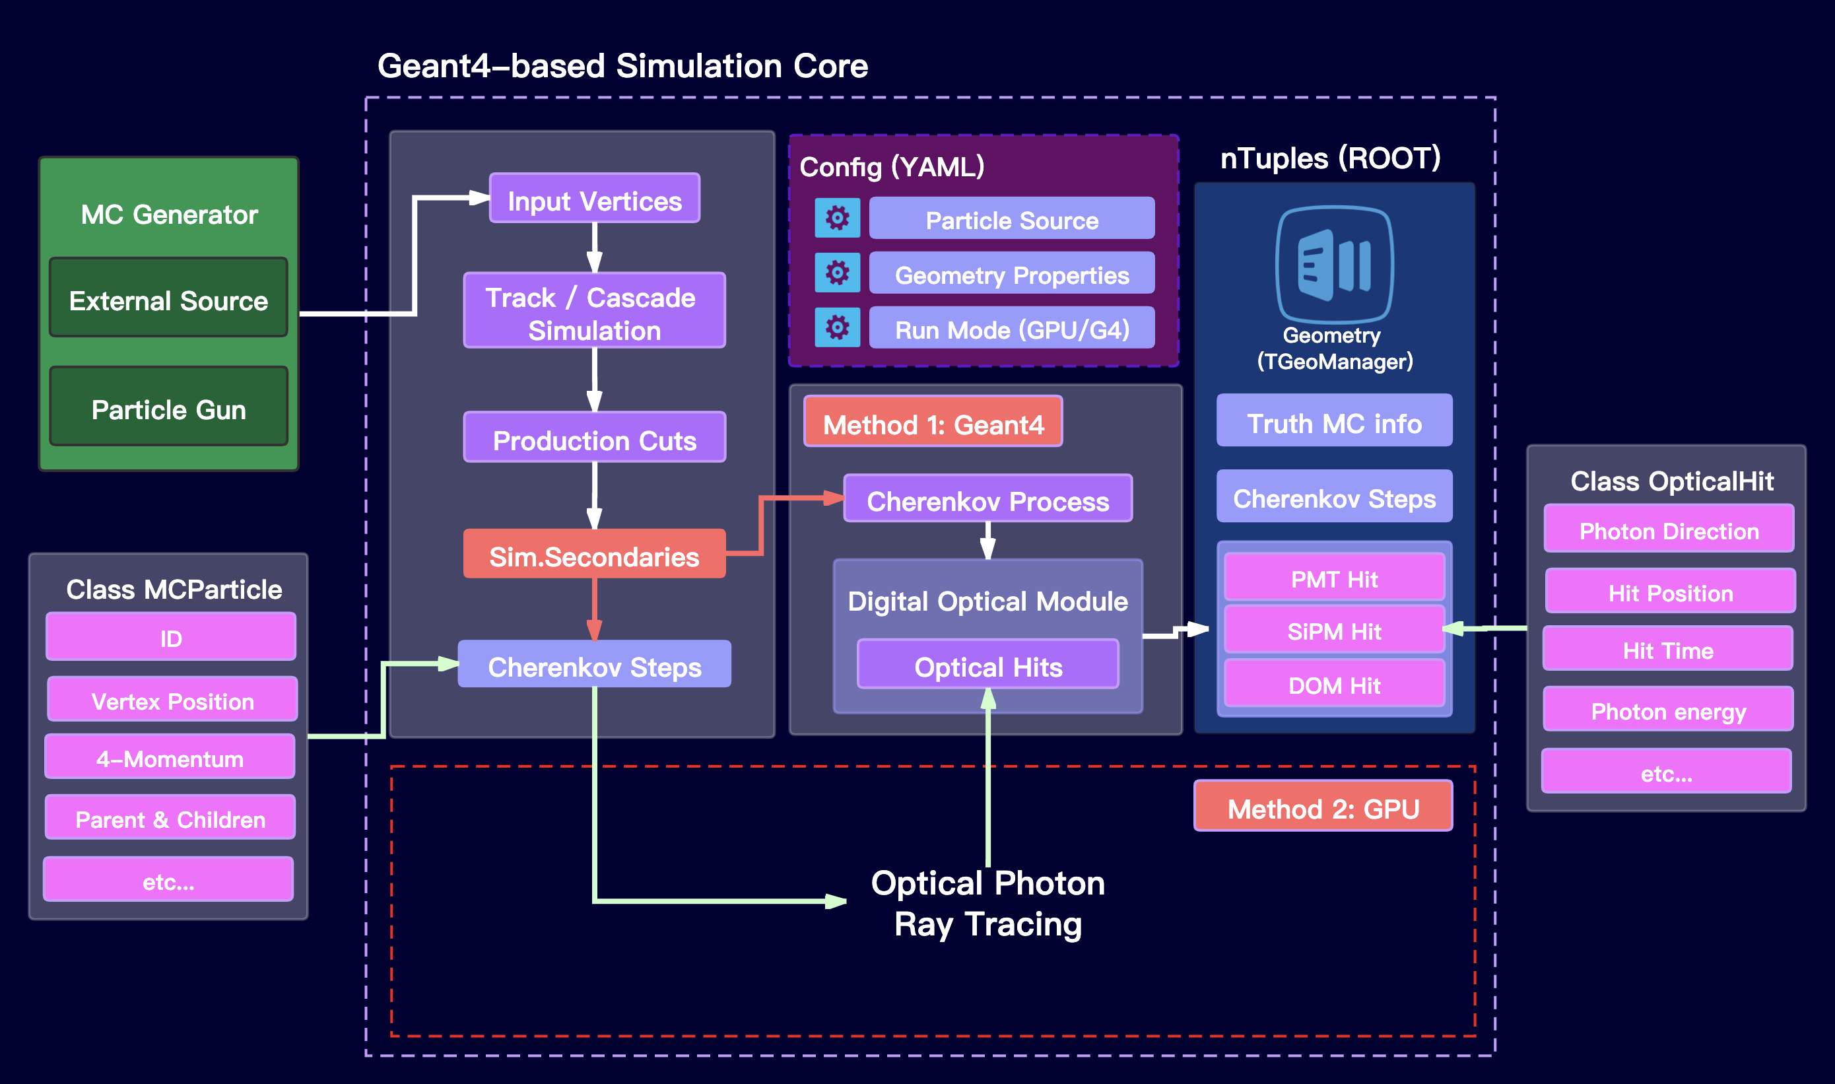
Current simulation workflow
Event generator
based on C8

Slide 18
Replace Geant4 with CORSIKA8 for detector simulation
Pros:
Geometry is simple:
Showers and muons developed in water.
Detailed geometries are handled in OptiX.
High energy hadronic shower:
Geant4 only supports 100 TeV hadronic interaction
Cons:
Refractive index ~ 1.35 -> energy threshold for electron ~ 0.25 MeV
Maybe relay on FLUKA
Runtime performance?

Slide 19
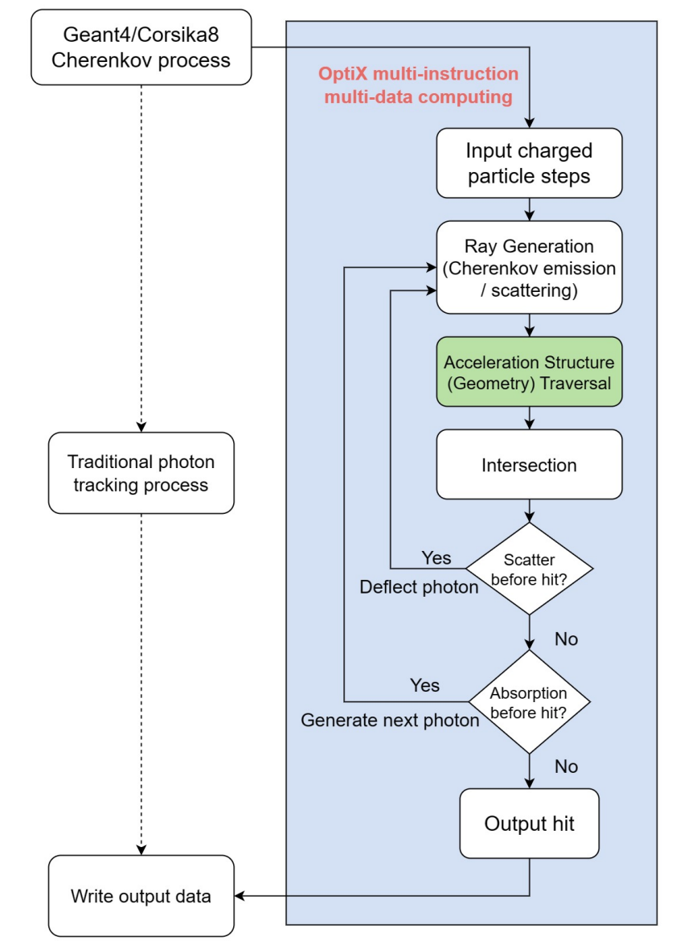
Sidenote on raytracing in TRIDENT
We use OptiX to perform ray-tracing:
Could be slower than handcraft CUDA, but support more complex geometry
To feed GPU with more tracks, we use EM shower parameterization.
1000x speed improvement on CPU side
Refer to Opticks by Simon

Slide 20
Summary
We can build a event injector for neutrino telescope using C8
Merge of features tested on neutrino_telescope branch is on-going
C8 can be used to simulate atmospheric muons and neutrinos
We might build the detector simulation framework based on C8 in the feature.
Thanks for listening!

