Slide 1
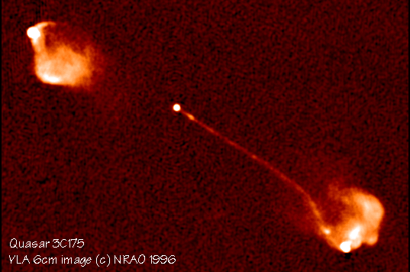



Models of Blazar Variability:
Variability Signatures of Shock Acceleration
0
Markus Böttcher
North-West University
Potchefstroom
South Africa
Supported by the South African Research Chairs Initiative (SARChI) of the Department of Science and Technology and the National Research Foundation of South Africa.

Slide 2
Overview
Focusing on microphysical description, specific variability scenarios
For statistical properties (flux distributions, …), see talks by Arti Goyal (Tu.), Frank Rieger (We.), Hannes Thiersen (Th.)
Necessarily incomplete. Apologies for not mentioning your favourite model / paper.
Will not discuss “variability models” merely describing variability by a sequence of steady-state models.

Slide 3
Classes of Variability Models
Geometric Models (bent / helical jets / kink instability)
  Villata & Raiteri (1999); Ostorero et al. (2004); Marscher et al. (2008); Larionov et al. (2016); Zhang et al. (2016); Raiteri et al. (2017); …
External Influences (jet – cloud/star interactions, synchrotron mirrors)
  Böttcher (2005); Barkov et al. (2010, 2012); Khangulyan et al. (2013); Tavani et al. (2015); Zacharias et al. (2017, 2018); …
Turbulence / Magnetic Reconnection / Mini-Jets
  Giannios et al. (2009, 2010, 2013); Nalewajko et al. (2011); Marscher et al. (2014); Sironi et al. (2015); …
Internal Shocks / Shock-in-Jet
  Marscher & Gear (1985); Sokolov et al. (2004); Sokolov & Marscher (2005); Graff et al. (2008); Böttcher & Dermer (2010); Joshi & Böttcher (2011); Chen et al. (2011, 2012); Joshi et al. (2014); Zhang et al. (2014, 2015, 2016); …

Slide 4
Classes of Variability Models
Geometric Models (bent / helical jets / kink instability)
  Villata & Raiteri (1999); Ostorero et al. (2004); Marscher et al. (2008); Larionov et al. (2016); Zhang et al. (2016); Raiteri et al. (2017); …
  Variability through
  changing Doppler
  factor
  Predicts correlated,
  nearly achromatic
  variability
  Possibly explaining
  polarization-angle
  swings
(Larionov et al. 2016)

Slide 5
Classes of Variability Models
External Influences (jet – cloud/star interactions, synchrotron mirrors)
  Böttcher (2005); Barkov et al. (2010, 2012); Khangulyan et al. (2013); Tavani et al. (2015); MacDonald et al. (207); Zacharias et al. (2017, 2018); …
  Possibly explaining orphan flares (synchrotron mirrors)
  Jet-obstacle interactions -> quasi-symmetric time profiles
(Oberholzer & Böttcher, in prep.)
(Tavani et al. 2015)

Slide 6
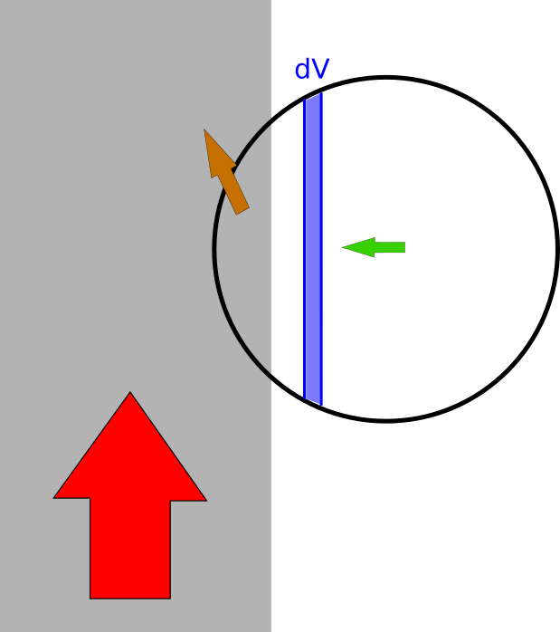
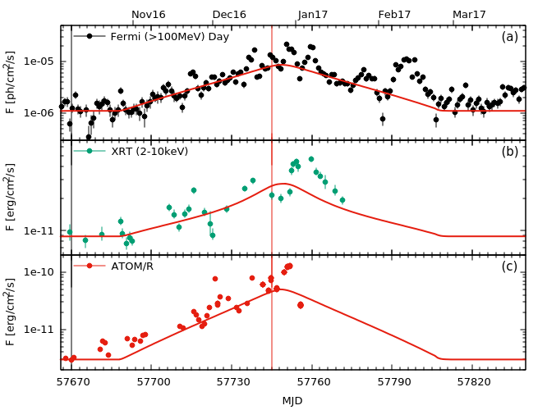
Classes of Variability Models
External Influences (jet – cloud/star interactions, synchrotron mirrors)
  Böttcher (2005); Barkov et al. (2010, 2012); Khangulyan et al. (2013); Tavani et al. (2015); Zacharias et al. (2017, 2018); …
  Possibly explaining orphan flares (synchrotron mirrors)
  Jet-obstacle interactions -> quasi-symmetric time profiles
(Zacharias et al. 2017)

Slide 7
Classes of Variability Models
Turbulence / Magnetic Reconnection / Mini-Jets
  Giannios et al. (2009, 2010, 2013); Nalewajko et al. (2011); Marscher (2014); Sironi et al. (2015); MacDonald & Marscher (2018)…
  Possibly explaining rapid (minute-scale) variability
  Rapid, erratic polarization changes, including reversal in rotation directions, sign of circular polarization
(MacDonald & Marscher 2018)

Slide 8
Classes of Variability Models
Turbulence / Magnetic Reconnection / Mini-Jets
  Giannios et al. (2009, 2010, 2013); Nalewajko et al. (2011); Marscher (2014); Sironi et al. (2015); MacDonald & Marscher (2018) …
  Possibly explaining rapid
  (minute-scale) variability
  Rapid, erratic polarization
  changes
(Christie et al. 2018)

Slide 9
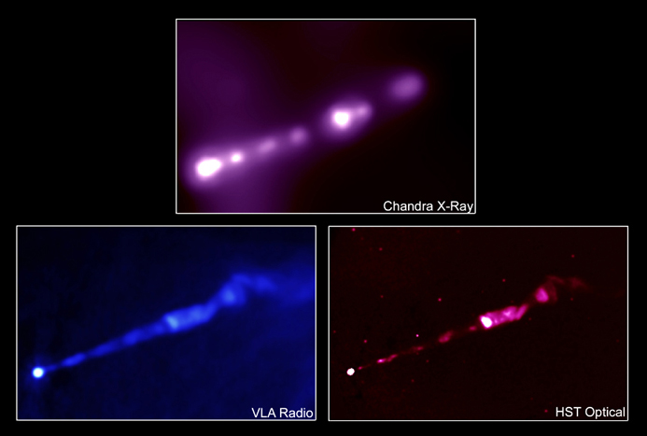
Classes of Variability Models
Internal Shocks / Shock-in-Jet
  Marscher & Gear (1985); Sokolov et al. (2004); Sokolov & Marscher (2005); Graff et al. (2008); Böttcher & Dermer (2010); Joshi & Böttcher (2011); Chen et al. (2011, 2012); Joshi et al. (2014); Zhang et al. (2014, 2015, 2016); …
Γ_{b}
Γ_{a}
Internal Shocks: likely sites of relativistic particle acceleration.
Most likely mildly relativistic, βγ ~ 1
In most works: Simple power-law or log-parabola electron spectra (from Fermi I / II acceleration) assumed with spectral index (~ 2) put in “by hand”.
Jet of M87 at different wavelengths

Slide 10
Classes of Variability Models
Internal Shocks / Shock-in-Jet
  Marscher & Gear (1985); Sokolov et al. (2004); Sokolov & Marscher (2005); Graff et al. (2008); Böttcher & Dermer (2010); Joshi & Böttcher (2011); Chen et al. (2011, 2012); Joshi et al. (2014); Zhang et al. (2014, 2015, 2016); …
  Predict correlated MWL variability
  Possibly explaining polarization-angle swings
  Difficulty explaining short (minute-scale) variability
(Zhang et al. 2014)

Slide 11
Monte-Carlo Simulations of Diffusive Shock Acceleration (DSA)
Gyration in B-fields and diffusive transport (pitch-angle diffusion) modeled by a Monte Carlo technique.
Shock crossings produce net energy gains (evident in the increase of gyroradii) according to principle of first-order Fermi mechanism.
(Summerlin & & Baring 2012)
Pitch-angle diffusion parameterized through a mean-free-path (λ_{pas}) parameter η (p):
λ_{pas} = η(p)*r_{g} ~ p^{α} (α ≥ 1)

Slide 12
Shock Acceleration Injection Efficiencies
Baring et al. (2017)
Non-thermal particle spectral index and thermal-to-non-thermal normalization are strongly dependent on η₀, α, and B-field obliquity!

Slide 13
Constraints from Blazar SEDs
If Synchrotron cooling dominates:
γ_{max} ~ B^{-1/2} [η(γ_{max})]^{-1/2}
hν_{sy} ~ 100 δ [η(γ_{max})]⁻¹ MeV (independent of B-field!)
Need large η(γ_{max}) to obtain synchrotron peak in optical/UV/X-rays
But: Need moderate η(γ ~ 1) for efficient injection of particles into the non-thermal accelerations scheme
Need strongly energy dependent pitch-angle scattering m.f.p.

Slide 14
Implications for Shock-Induced Turbulence
Gyro-resonance condition: λ_{res} ~ p
=> Higher-energy particles interact with longer-wavelength turbulence
Stirring Scale ~ R
Inertial Range
Energy density W(k)
Dissipation Scale
k_{stir} ~ 2π/R
k = 2π/λ
Turbulence level decreasing with increasing distance from the shock
High-energy (large r_{g}) particles “see” reduced turbulence
Large λ_{pas}

Slide 15
Numerical Methods
1. Electron Evolution
First-Order Fermi acceleration time scale:
for almost all electrons

Slide 16
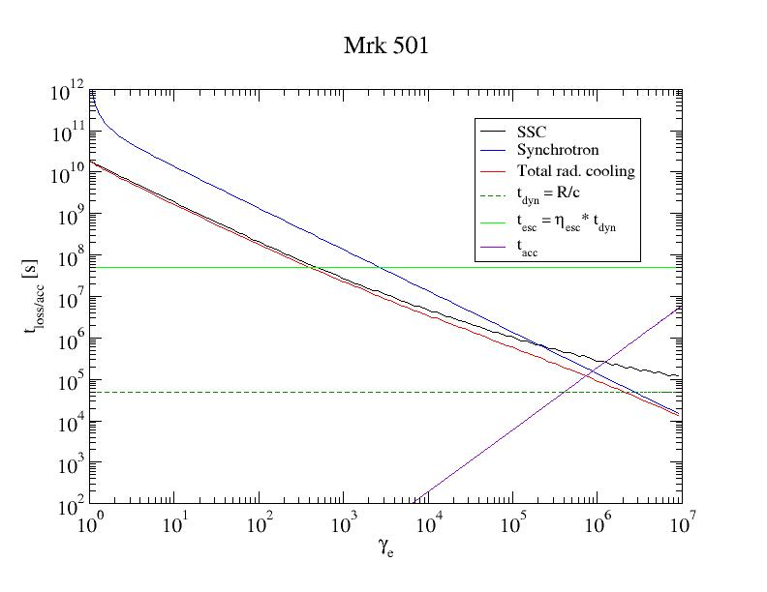
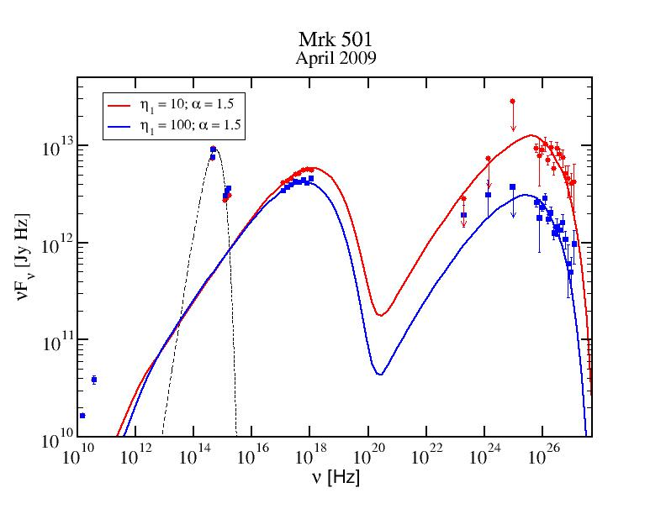
Electron Evolution Time Scales

Slide 17
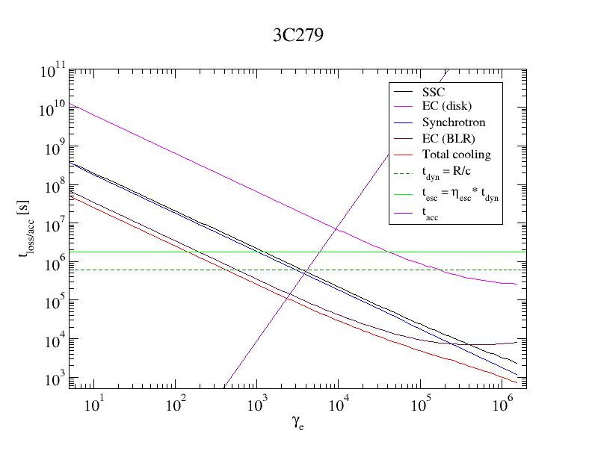
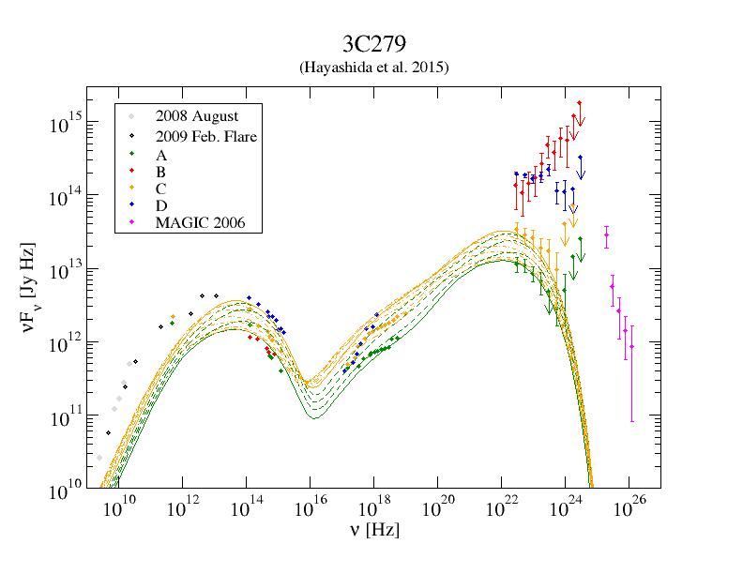
Electron Evolution Time Scales

Slide 18
Numerical Methods
1. Electron Evolution
First-Order Fermi acceleration time scale:
Typically approximated as instantaneous injection Q_{i}(γ);
Solve Fokker-Planck Equation for all particle species:
Diffusion in momentum space (stochastic acceleration)
Systematic energy gain/loss (radiative losses)
“Injection” (pick-up, rapid acceleration, parent particle decay)
Escape
Decay
(for unstable particles:
n, π±, μ±)
(Leptonic: Mastichiadis & Kirk (1997); Kirk & Mastichiadis (1999); Li & Kusunose (2000); Kusunose et al. (2000); Böttcher & Chiang (2002); …
Lepto-hadronic: Dimitrakoudis et al. (2012); Petropoulou (2015); Diltz et al. (2015); …)

Slide 19
Numerical Methods
1. Electron Evolution

Slide 20
Numerical Methods
2. Radiation Transfer
Direct iterative integration of radiation continuity equation
  Numerically inexpensive
  Inflexible geometry (usually
  one-zone, but see, e.g.,
  Joshi & Böttcher 2011,
  Joshi et al. 2014; Potter & Cotter
  2012, 2013, 2015; Richter &
  Spanier 2016)
Absorption
Emission
Escape
(Joshi et al. 2014)

Slide 21
Example: HBL Mrk 501
Prototypical TeV BL Lac object (with Mrk 421)
Typical flare durations
~ minutes – a few hours
(Furniss et al. 2015)

Slide 22
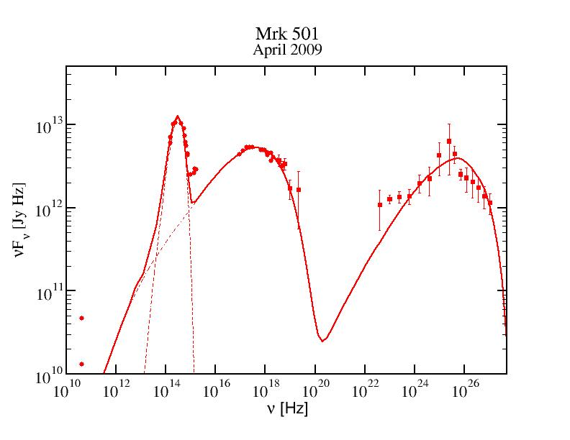
Example: HBL Mrk 501
λ_{pas} = 250 r_{g} γ^{0.5}
B = 0.075 G
δ = 30
R = 1.5*10¹⁵ cm
-> Δt’ ~ 10⁵ s
-> Δt_{obs} ~ 1 h
Baring et al. (2017)

Slide 23
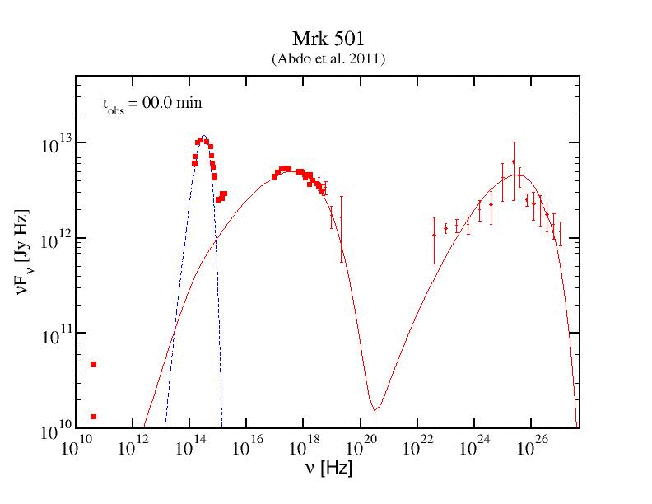
HBL Mrk 501 Flare
Spectral Evolution

Slide 24
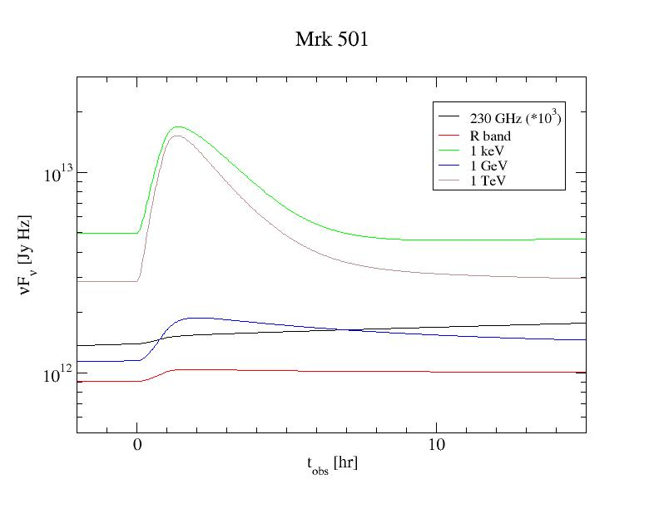
Model Light Curves

Slide 25
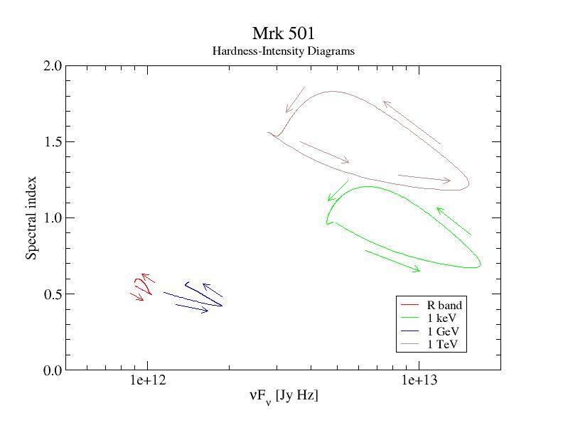
Hardness-Intensity Diagrams
SSC (HE)
Sy. (HE)
Sy. (LE)
SSC (LE)
Counter-clockwise spectral hysteresis, as expected if
t_{acc} << t_{cool}, t_{dyn}

Slide 26
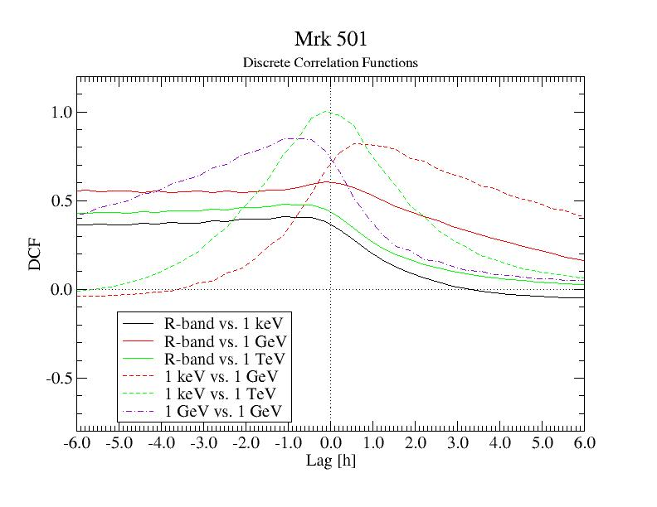
Discrete Correlation Functions
Optical poorly correlated with other bands
Strong (~ 0 lag) correlation between X-rays and VHE
Correlation between X-rays and GeV γ-rays (X-rays lead by ~ 1 hr)
Correlation between GeV and TeV (TeV leads by ~ 1 hr)

Slide 27
Example: FSRQ 3C279
Extended
flaring period
2013 – 2014
Variability time scale
~ 1 day
(Hayashida et al. 2015)

Slide 28
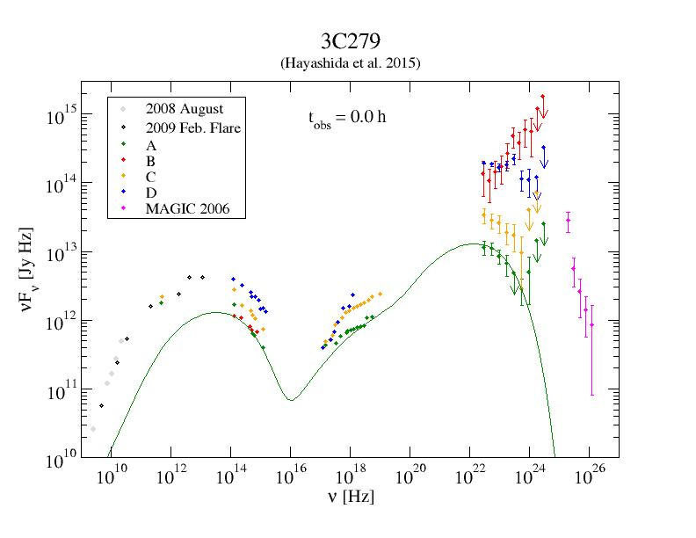
Example: FSRQ 3C279 (2013 – 2014)
λ_{pas} = 300 r_{g} γ²
B = 0.65 G
δ = 15
R = 1.8*10¹⁶ cm
→ Δt’ ~ few*10⁵ s
→ Δt_{obs} ~ few hr
γ-rays EC (Dust Torus) dominated:
u = 4*10⁻⁴ erg/cm³
T_{BB} = 300 K
A = Low State
C = Flare,
ΔF_{γ} / F_{γ} ~ ΔF_{opt} / F_{opt}
Note: Flares with strongly increasing Compton dominance would require additional parameter changes.

Slide 29
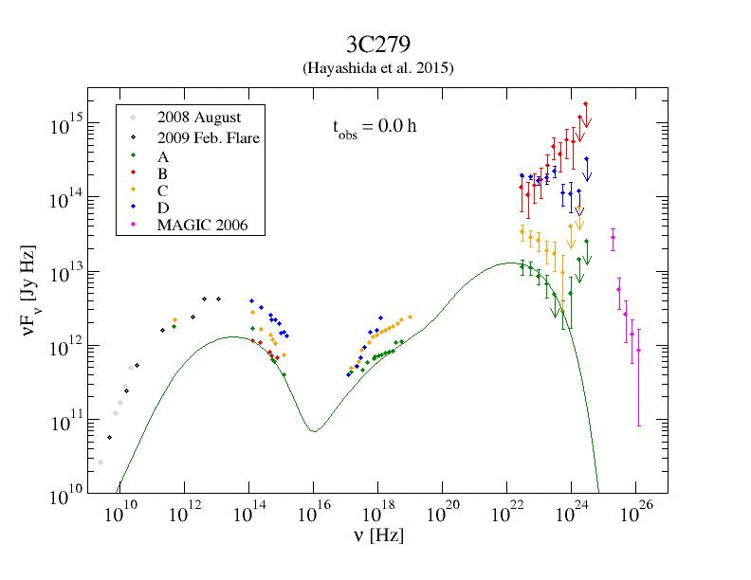
3C279 – Flare C

Slide 30
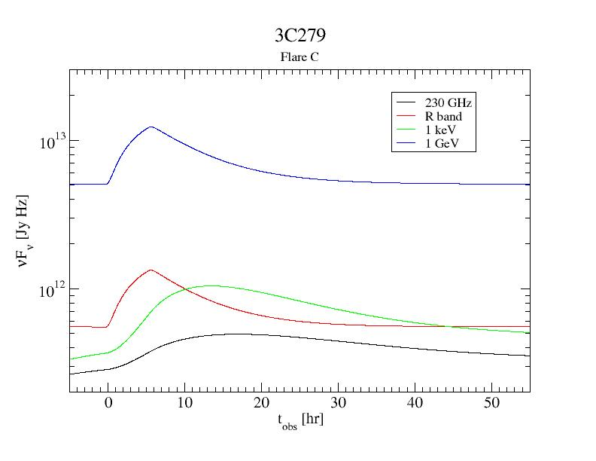
3C279 – Flare C
Model Light Curves

Slide 31
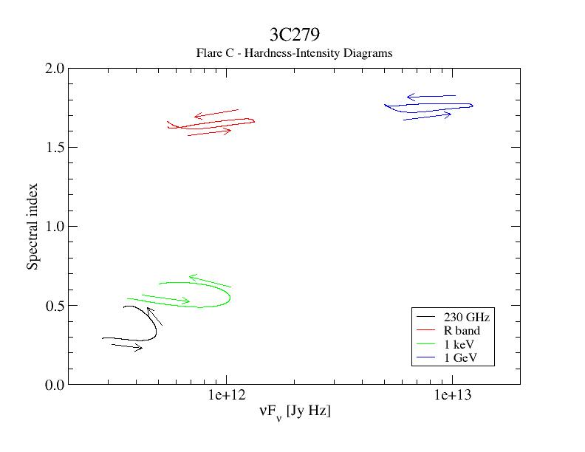
3C279 – Flare C
Hardness-Intensity Diagrams
EC (HE)
Sy. (HE)
SSC (LE)
Sy. (LE)

Slide 32
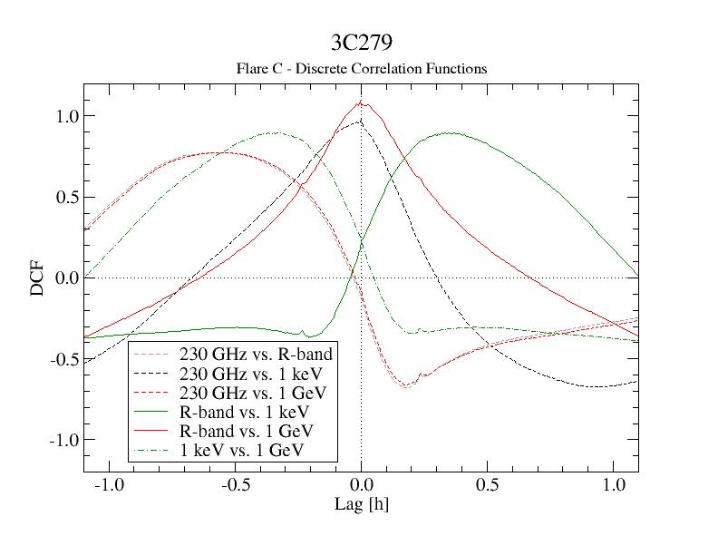
3C279 – Flare C
Discrete Correlation Functions
Optical and γ-rays well correlated
(0 lag)
X-rays and radio well correlated (0 lag)
X-rays and radio lag optical + γ-rays by
~ ½ hr)

Slide 33
Numerical Methods
2. Radiation Transfer
Monte-Carlo
  Flexible geometry
  Easy time tracking
  Possibility of polarization-dependent ray tracing
  Numerically expensive
(e.g., Chen et al., 2011, 2012; Zhang et al. 2015, 2016; …)
(Chen et al. 2015)

Slide 34
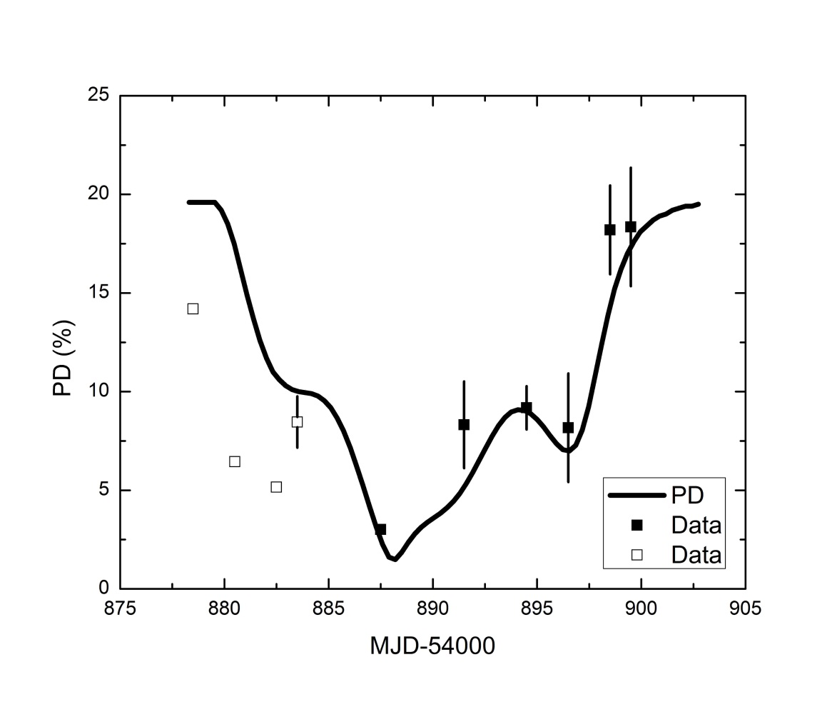
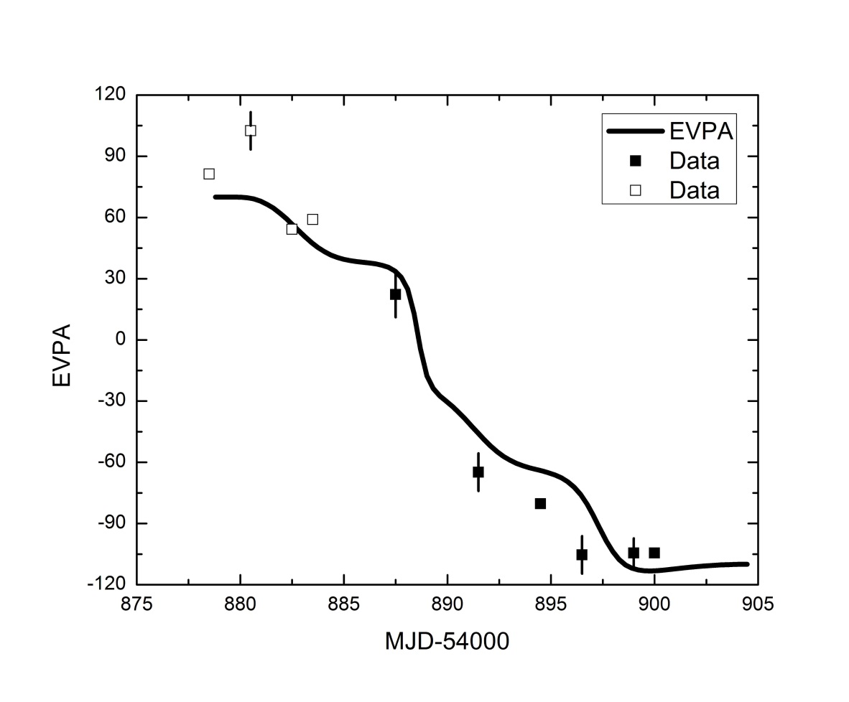
Numerical Methods
2. Radiation Transfer
Monte-Carlo
  Flexible geometry
  Easy time tracking
  Possibility of polarization-dependent ray tracing
  Numerically expensive
(e.g., Chen et al., 2011, 2012; Zhang et al. 2015, 2016; …)
Degree of Polarization
Polarization Angle
(Zhang et al. 2015)

Slide 35
Numerical Methods
3. Solutions in Fourier Space
Semi-analytical solution of electron dynamics and radiation transfer in Fourier space
-> Light curves and time lags from inverse-Fourier transforms and complex cross-products.
(Finke & Becker 2014, 2015; Lewis et al. 2016)
(Lewis et al. 2016)

Slide 36
Summary
0
Large variety of blazar variability models and numerical methods to solve time-dependent electron dynamics and radiation transfer.
Coupled MC Simulations of Diffusive Shock Acceleration and radiation transport reveal strongly energy-dependent mean-free-path to pitch-angle scattering.
Time-dependent simulations of shock-in-jet model with realistic particle injection from diffusive shock acceleration:
Characteristic counter-clockwise spectral hysteresis in all spectral bands.
Spectral time lags depending on blazar sub-class.
Supported by the South African Research Chairs Initiative (SARChI) of the Department of Science and Technology and the National Research Foundation of South Africa.

Slide 37
Backup Slides

Slide 38
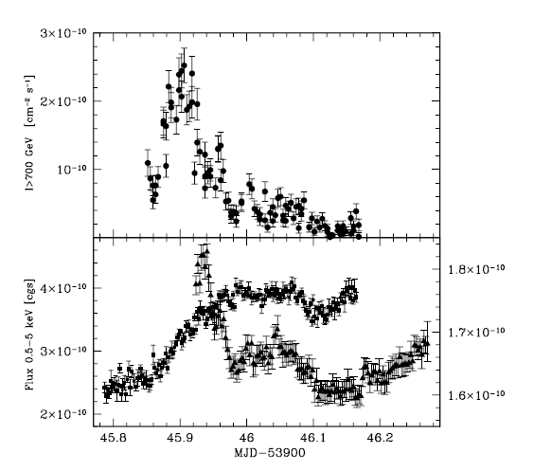
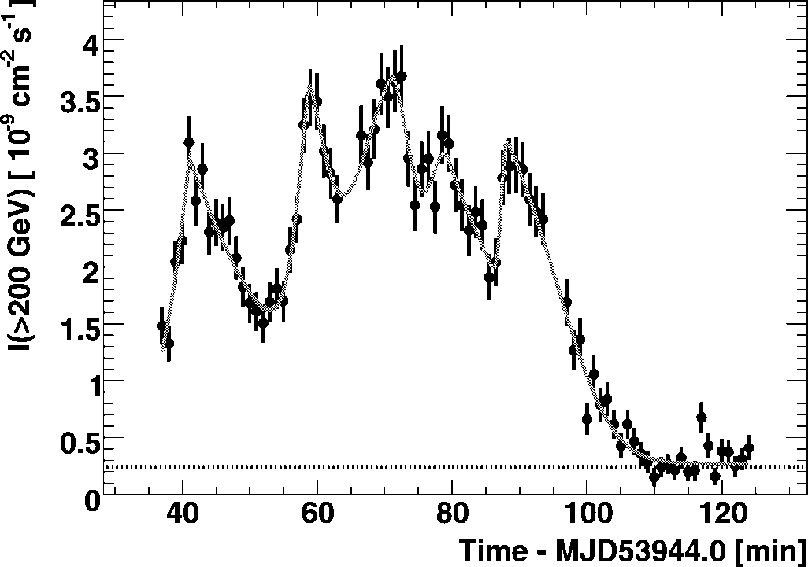
Blazar Variability - Challenges
Short Variability time scales
0
PKS 2155-304
VHE γ-rays
VHE γ-rays
Optical
X-rays
(Aharonian et al. 2007)
(Costamante et al. 2008)
Variability time scales ranging from years down to a few minutes

Slide 39
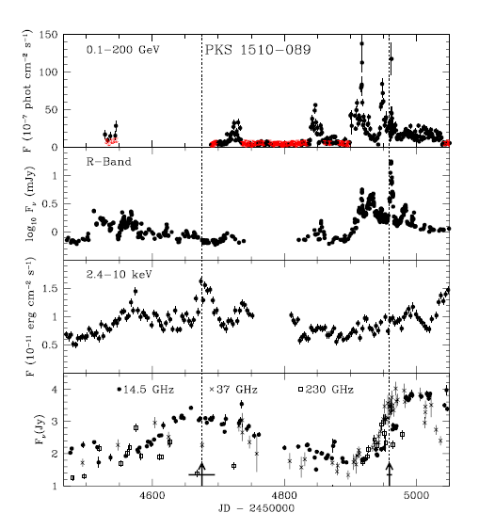
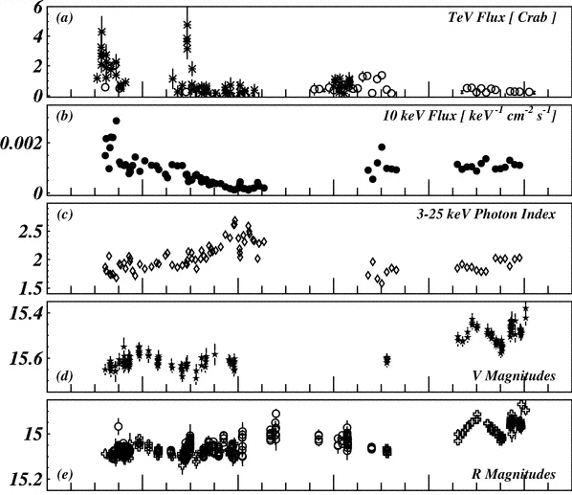
Blazar Variability – Challenges
Corelated / Uncorrelated Variability
1ES 1959+650 (2002)
PKS 1510-089 (2008 - 2009)
(Krawczynski et al. 2004)
(Marscher al. 2010)
Variability across wavebands sometimes correlated, sometimes not (-> Orphan flares)

Slide 40
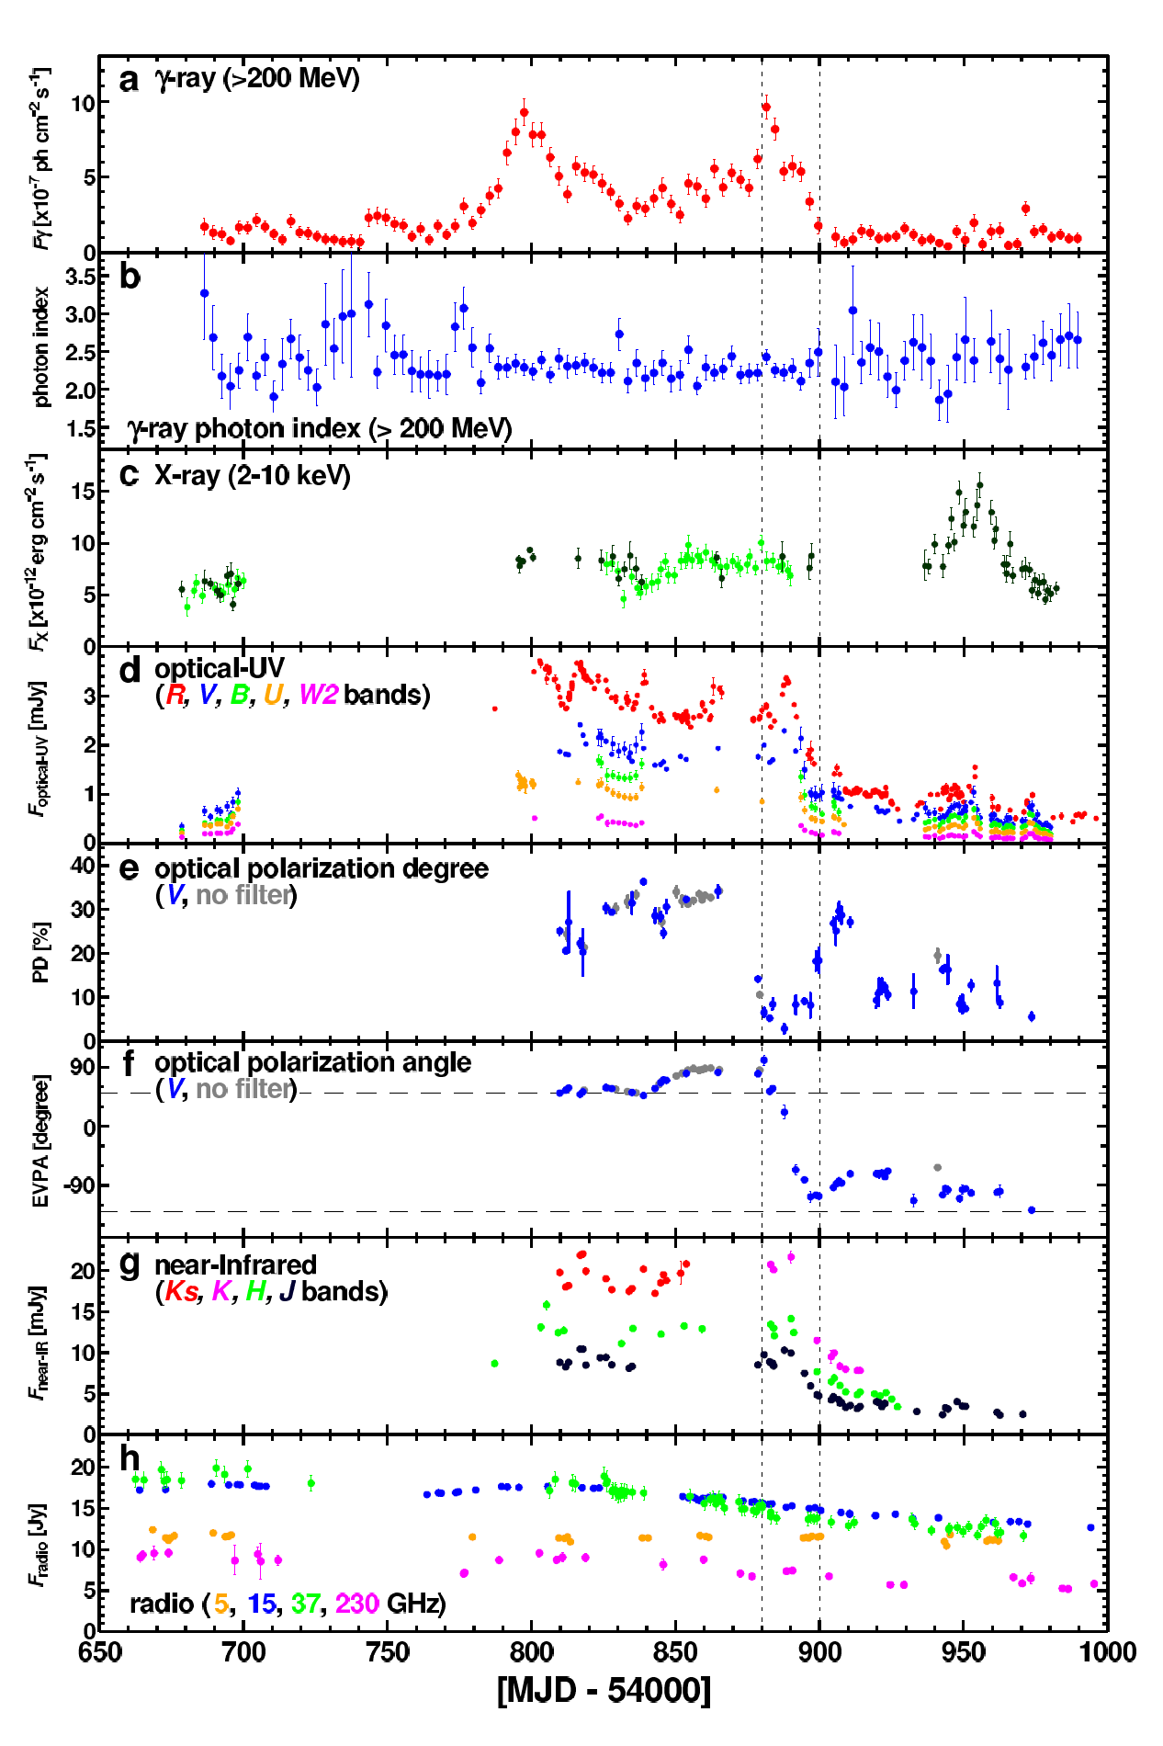
Polarization Variability
Both degree of polarization and polarization angles vary.
Swings in polarization angle sometimes associated with high-energy flares!
(Abdo et al. 2010)

Slide 41
Acceleration Indices for Oblique Shocks
(Summerlin & Baring 2012)
Non-thermal spectra as hard as n(p) ~ p⁻¹ achievable for moderately sub-luminal shocks.

Slide 42
Numerical Scheme
Injection spectra from turbulence characteristics + MC simulations of DSA
Injection from small acceleration zone (shock) into larger radiation zone
Time-dependent leptonic code based on Böttcher & Chiang (2002)
Radiative processes:
  Synchrotron
  Synchrotron self-Compton (SSC)
  External Compton (EC: dust torus + BLR + direct accretion disk)
L’
Shock injection “on” for
0 < Δt’ < L’/v’_{s}
Γ
β_{s}
Q_{e,s}(γ,t’) = Q_{e,s}(γ) H(t’; 0, Δt’)

Slide 43
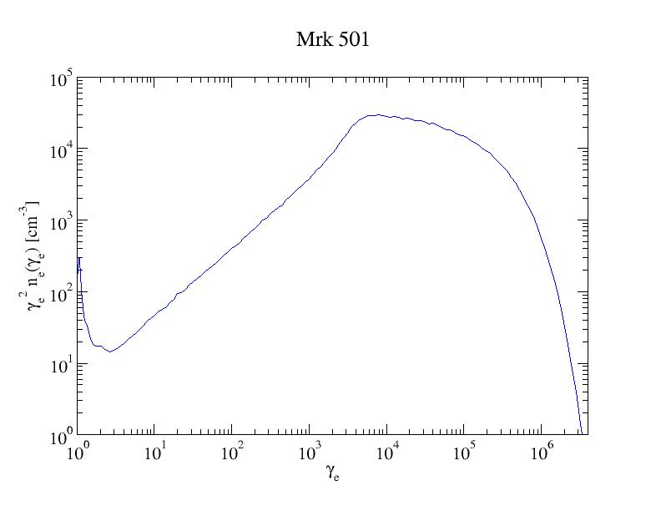
Equilibrium Electron Distribution

Slide 44
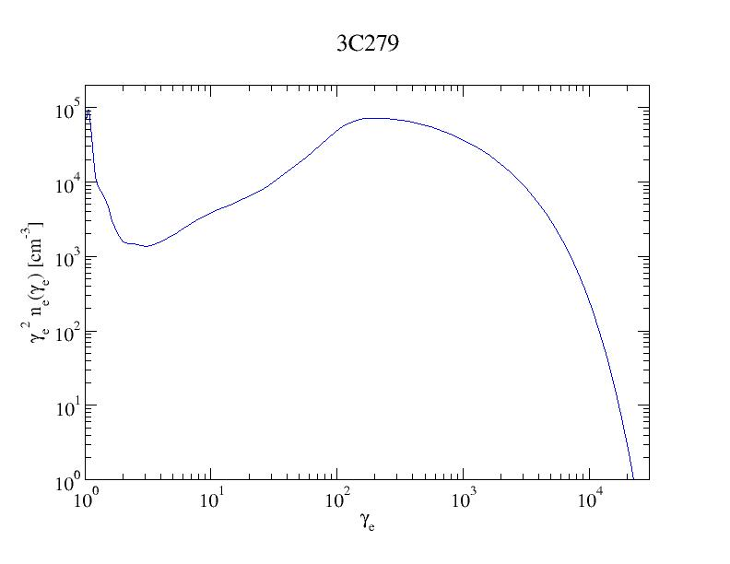
Equilibrium Electron Distribution

