Slide 1




Timing and Spectral Variability in Black Holes
Abbie Stevens
NSF Astronomy & Astrophysics Postdoctoral Fellow
Michigan State University & University of Michigan
alstev@msu.edu
@abigailstev
github.com/abigailstev

Slide 2
Outline
Variability in stellar-mass black holes
Spectral-timing analysis (incl. machine learning)
Red noise vs. interesting signals
Stingray: open-source spectral-timing software
STROBE-X: next-gen. broadband X-ray observatory

Slide 3
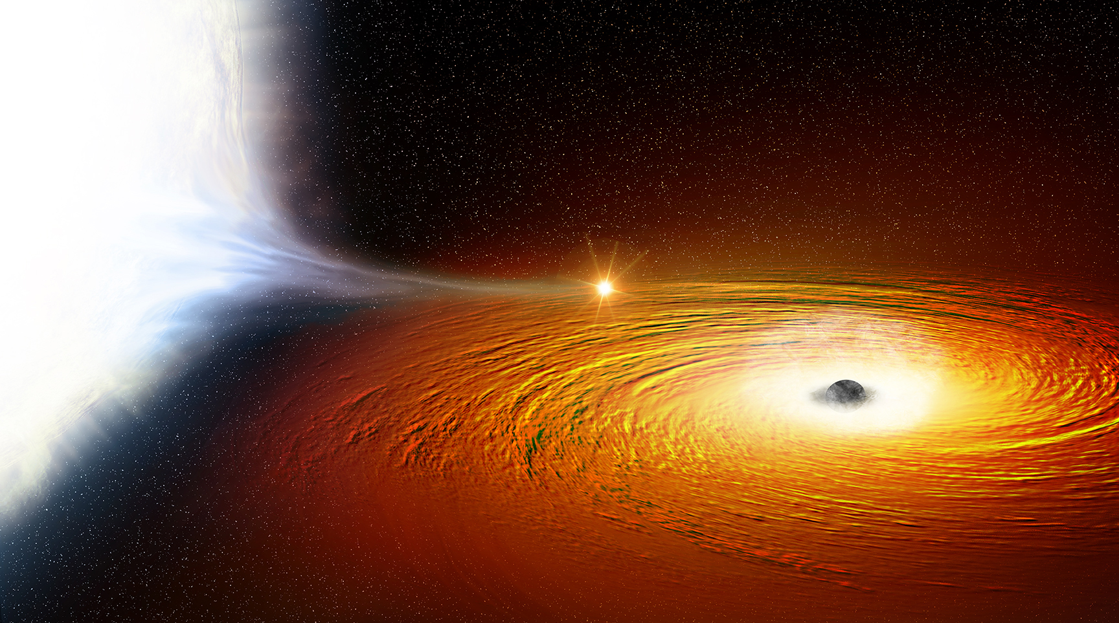
Variability in stellar-mass BHs
Many are transient: outburst over months/year
Low-mass X-ray binary
Companion star ≤ 1 M☉
Hot inner flow/ corona
Compact object
Accretion disk
Image: NASA/CXC/M. Weiss

Slide 4
Variability in stellar-mass BHs
Many are transient: outburst over months/year
Low-mass X-ray binary
Companion star ≤ 1 M☉
Hot inner flow/ corona
Compact object
Accretion disk
X-ray variability
Image: NASA/CXC/M. Weiss

Slide 5
Variability in stellar-mass BHs
Quasi-periodic oscillations (QPOs)
  High-frequency: 100’s Hz
    Hot blobs in Keplerian orbit at inner disk edge?
Strohmayer ‘01

Slide 6
Variability in stellar-mass BHs
Quasi-periodic oscillations (QPOs)
  High-frequency: 100’s Hz
    Hot blobs in Keplerian orbit at inner disk edge?
  Low-frequency: ~0.1-10’s Hz
    Precession of corona/hot flow? Magnetic warps in disk? Comptonized disk fluctuations?
Strohmayer ‘01

Slide 7
Variability in stellar-mass BHs
Quasi-periodic oscillations (QPOs)
  High-frequency: 100’s Hz
    Hot blobs in Keplerian orbit at inner disk edge?
  Low-frequency: ~0.1-10’s Hz
    Precession of corona/hot flow? Magnetic warps in disk? Comptonized disk fluctuations?
QPOs appear in intermediate spectral states:
both Comptonized and disk emission
Strohmayer ‘01

Slide 8
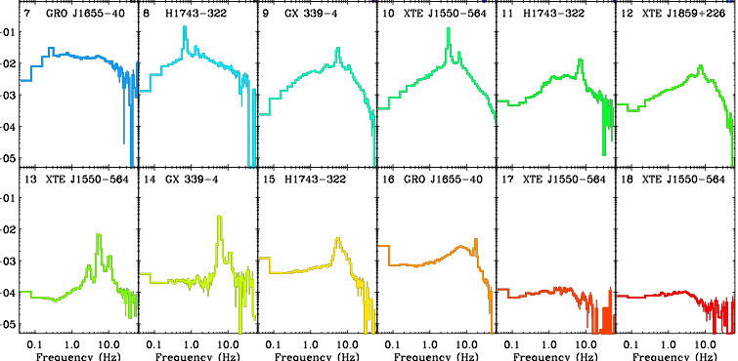
Variability in stellar-mass BHs
Broadband noise (band-limited noise): ≲ 1 Hz
  Propagating fluctuations in accretion disk?
Power x frequency
(Poisson-noise-subtracted)
Heil+15b

Slide 9
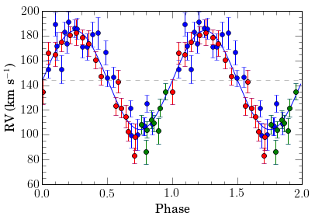
Variability in stellar-mass BHs
Orbital binary motion: period > 10 min
Bahramian+17
Britt+17
Optical radial velocity measurements of companion star
Power spectra of multiple epochs, multiple instruments, 10-60ks exposures

Slide 10
BH variability is hard to see by eye!
Light curves

Slide 11
BH variability is hard to see by eye!
Noise: Cygnus X-1
Signal: GRS 1915+105
Light curves
Power density spectra

Slide 12
The timing toolbox
Power spectra/periodograms
Bispectra, bicoherence
Coherence
See Uttley+14 for a review of techniques

Slide 13
The spectral-timing toolbox
Power spectra/periodograms
Bispectra, bicoherence
Coherence
rms and covariance spectra
Cross spectra, cospectra
Energy- and frequency-dependent time lags
Cross-correlation
Phase-resolved spectroscopy
Fourier
techniques
See Uttley+14 for a review of techniques
Notes:
Also mention m-w spectral-timing

Slide 14
AGN reverberation
👁
Corona/hot flow
Reflection
Accretion disk
Reverberation mapping: looking for “self” similarities between simultaneous light curves of different energies with cross spectral data products
See work by, e.g., Cackett, Fabian, Kara, Uttley, Wilkins, Zoghbi

Slide 15
AGN reverberation
👁
Corona/hot flow
Accretion disk
Reverberation mapping: looking for “self” similarities between simultaneous light curves of different energies with cross spectral data products
See work by, e.g., Cackett, Fabian, Kara, Uttley, Wilkins, Zoghbi

Slide 16
AGN reverberation
1H0707-495 (NLS1)
1.3Ms of XMM data
Kara+13b
Hard photons lag soft photons
Soft photons lag hard photons

Slide 17
AGN reverberation
1H0707-495 (NLS1)
1.3Ms of XMM data
Kara+13b
Hard lags: Comptonization of accretion fluctuations in disk
Soft lags: light travel delay of reflection

Slide 18
Gaussian processes (recap from yesterday)
Modeling the light curve in the time domain
CARMA models (Kelly+14)
Celerite (Foreman-Mackey+17)
ARIMA models (Zhang+18)
Kelly+14
Kelly+14

Slide 19
Machine learning for BH variability
GRS 1915+105: microquasar with 14 distinct variability states
Adapted from Huppenkothen+17

Slide 20
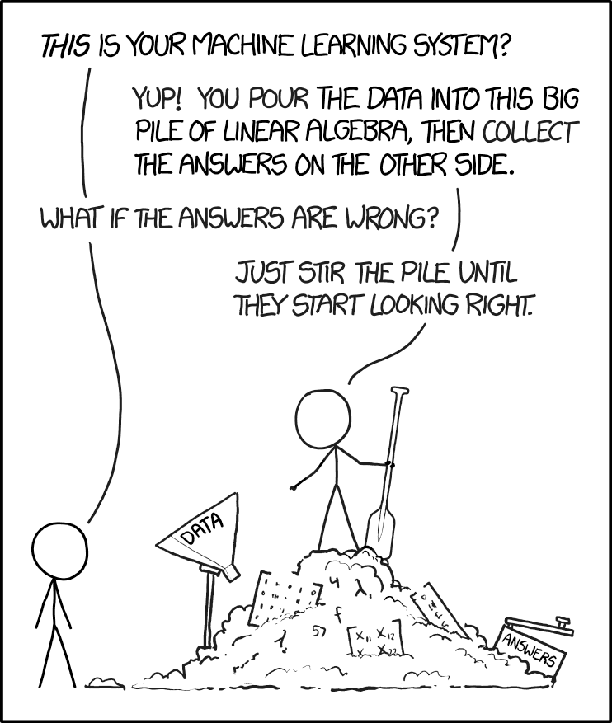
Machine learning for BH variability
GRS 1915+105: microquasar with 14 distinct variability states
How are the different variability patterns related?
  Machine learning!
Image: XKCD; h/t D. Huppenkothen

Slide 21
Machine learning for BH variability
States correlate with themselves (if in state χ, 85.9% of the time it stays in state χ)
Some states are more prone to transition to other states
Some states never transition to other states
Huppenkothen+17

Slide 22
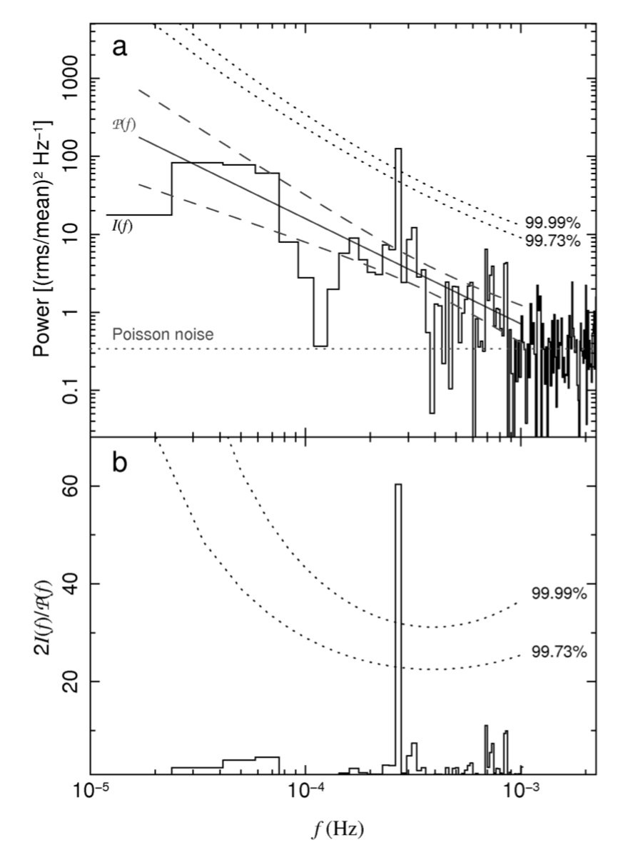
~1 hr periodicity in RE J1034+396
Gierlinski+08
Alston+14
NLS1, 91 ks in 2007 with XMM-Newton
Saw 16 ‘cycles’ (periods) in one uninterrupted observation!
Evenly-sampled time bins
Signal attributed to high-freq. QPO
  If at innermost stable circular orbit, M_{BH}~7x10⁶-1x10⁷ M☉

Slide 23
44 day low-freq. QPO in KIC 9650712
NLS1 in original Kepler field
30 minute cadence over 3.5 years: ~30 cycles
Tested periodicity via simulations (Uttley+02) and Lomb-Scargle periodogram
Smith+18b

Slide 24
Beware of red noise!
Red noise: steep power spectrum at low frequencies
Cannot apply standard peak-finding algorithms, since those assume white noise (see Vaughan & Uttley ‘06)
Bigger issue for SMBHs than stellar BHs due to timescales
Smith+18b
Red noise
White/Poisson noise
Fourier frequency

Slide 25
Red noise vs signals
PG 1302-102, CRTS data
Data looks periodic!
Vaughan+16 (figure); Liu+18

Slide 26
Red noise vs signals
PG 1302-102, CRTS data
Data looks periodic!
Uneven sampling, gappy data, only 1.5 cycles
Vaughan+16 (figure); Liu+18

Slide 27
Red noise vs signals
PG 1302-102, CRTS data
Data looks periodic!
(but it isn’t)
Uneven sampling, gappy data, only 1.5 cycles
Sampling a random red noise process in same way can look like a “periodic” signal
Also including LINEAR data
Vaughan+16 (figure); Liu+18

Slide 28
Red noise vs signals
PG 1302-102, CRTS data
Data looks periodic!
(but it isn’t)
Uneven sampling, gappy data, only 2 cycles
Also: claimed periodicity in J0045+41 disproven by Barth & Stern ‘18
Sampling a random red noise process in same way can look like a “periodic” signal
When in doubt, simulate!
Also including LINEAR data
Vaughan+16 (figure); Liu+18

Slide 29


Stingray: spectral-timing software
Open-source, community-driven and -developed, python, Astropy-affiliated package
Stingray: Python library of analysis tools
HENDRICS: shell scripting interface
DAVE: graphical user interface
Tutorials in Jupyter(/iPython) notebooks
github.com/StingraySoftware
Leads: D. Huppenkothen, M. Bachetti, A.L. Stevens, S. Migliari, P. Balm
Google Summer of Code students: S. Sharma (‘18); O. Hammad and H. Rashid (‘17); U. Khan, H. Mishra, and D. Sodhi (‘16)
Other major contributors: E. Martinez Ribeiro, R. Valles

Slide 30
Stingray: spectral-timing software
Library of time series analysis methods
  Power spectra, cross spectra, bispectra
  Lag-frequency & lag-energy spectra
  Rms & covariance spectra
  Coherence, cross-correlation
  Handles GTIs, pulsar & QPO searches
  Phase-resolved spectroscopy of QPOs
Simulator, modeling
Well-tested on X-ray timing data (RXTE, NuSTAR, XMM, some NICER); also used by a few people for radio timing

Slide 31
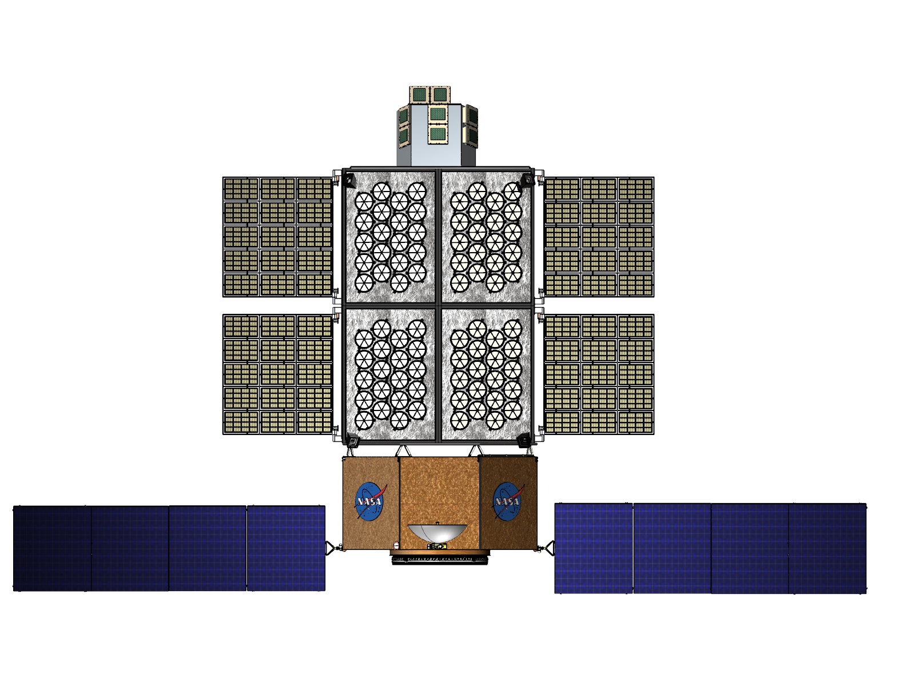

STROBE-X instrument concept
Flexible, high-throughput X-ray observatory with large area
Science drivers: spin distribution of BHs, X-ray reverberation, disk-jet connection, LIGO EM counterparts, GRBs, TDEs, etc!
Notes:
Upcoming X-ray missions have narrow FOV; very limited observing flexibility; serve specific needs: polarization, vh res spectroscopy, etc.
Flexible, high-throughput, very short timescales – enables unique science

Slide 32
STROBE-X instrument concept
Flexible, high-throughput X-ray observatory with large area
Science drivers: spin distribution of BHs, X-ray reverberation, disk-jet connection, LIGO EM counterparts, GRBs, TDEs, etc!
X-ray Concentrator
Array (0.2-12 keV)
Wide Field Monitor
(2-50 keV)
Large Area Detector
(2-30 keV)

Slide 33
STROBE-X instrument concept
Flexible, high-throughput X-ray observatory with large area
Science drivers: spin distribution of BHs, X-ray reverberation, disk-jet connection, LIGO EM counterparts, GRBs, TDEs, etc!
X-ray Concentrator
Array (0.2-12 keV)
Wide Field Monitor
(2-50 keV)
4 SSD camera pairs
70°x70° FOV per pair
4.12 sr sky coverage
300 eV energy resolution
1 arcmin position accuracy
Large Area Detector
(2-30 keV)

Slide 34


Resources
Understand assumptions of models, techniques; question your own assumptions about data, process
Periodicities and simulations: Vaughan & Uttley ‘06; Vaughan+16; Liu, Gezari, & Miller ’18; Barth & Stern ’18
Timing and spectral-timing: Vaughan ’13; Uttley+14
When in doubt, simulate!
Spectral-timing software: StingraySoftware.github.io
STROBE-X: see Ray+18 in SPIE
See also talks this morning & Thursday morning
GitHub: abigailStev
Email: alstev@msu.edu
Twitter: @abigailStev
✉️

Slide 36
STROBE-X instrument parameters
Effective area >5 m² @ 6 keV

Slide 37
Variability in stellar-mass BHs
Many are transient: outburst over months/year
Low-mass X-ray binary
Companion star ≤ 1 M☉
Disk
Corona/
hot flow
Hot inner flow/ corona
Compact object
Reflection
Accretion disk
X-ray variability
Image: NASA/CXC/M. Weiss

