Slide 1
RealPEP-P2 : Observation-based Weather Analysis and Nowcasting (QPN)
Presented by Mathias Emond and Silke Trömel
On the 9 th of October 2024

Slide 2
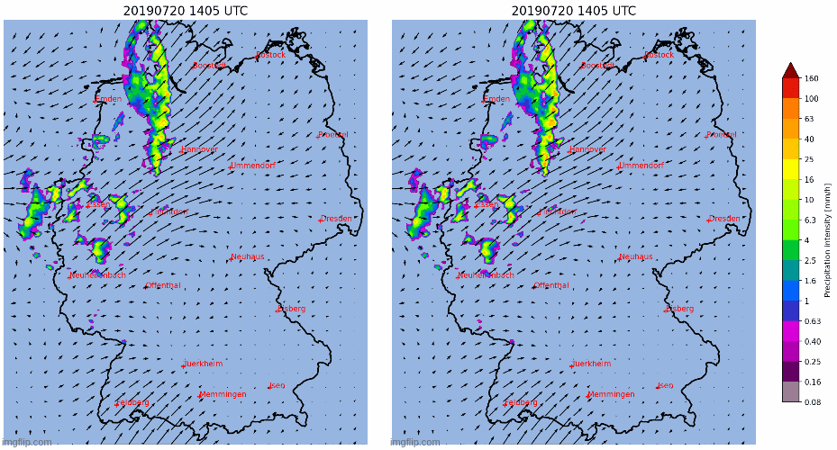
P2-Phase I
P2-Phase I: SPROG vs SPROG-LOC
SPROG
SPROG-LOC

Slide 3
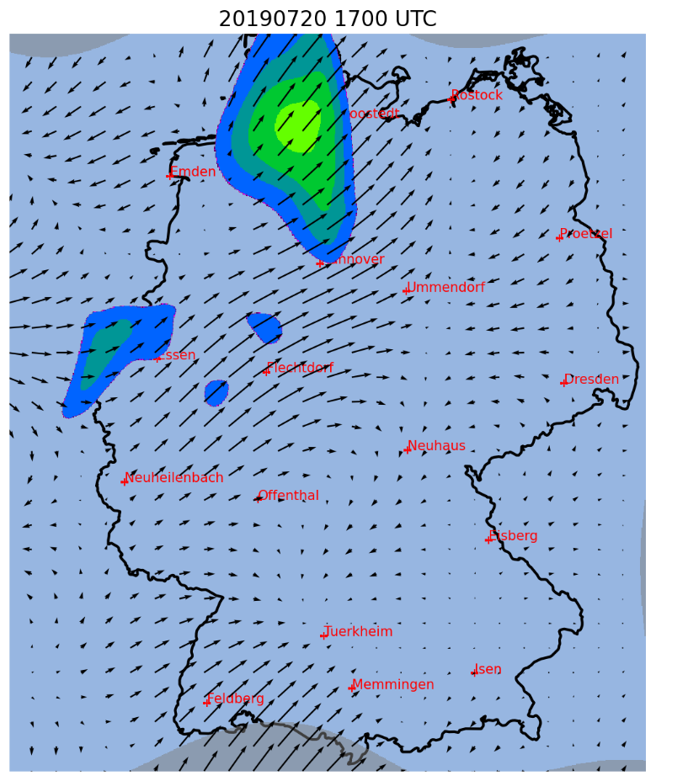
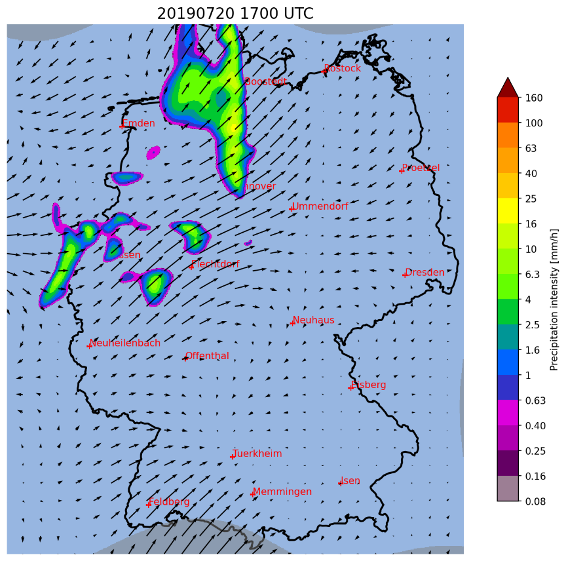
P2-Phase I
P2-Phase I: SPROG vs SPROG-LOC
SPROG
SPROG-LOC

Slide 4
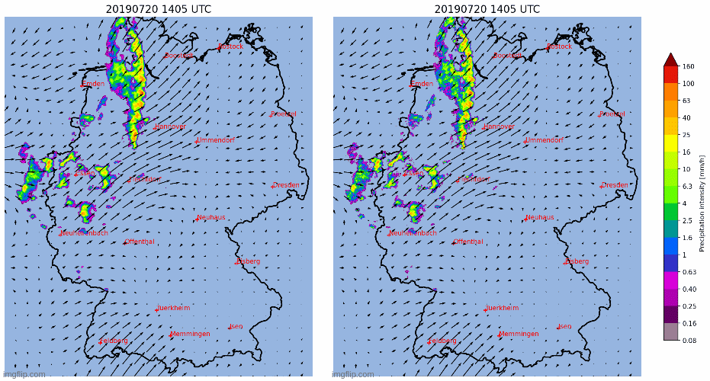
P2-Phase II
P2-Phase II: STEPS vs STEPS-LOC
STEPS
STEPS-LOC

Slide 5
P2-Phase II
Tasks for P2-Phase II:
Benchmark of SPROG-LOC and STEPS-LOC over 120 days of QPE from P1
Evaluation of the new QPE’s products uncertainties
Detection and quantification of updrafts using Z-DR columns and size sorting effect
Feeding of a machine learning neural network by satellite observations to include Convection Initiation
Detection of stratiform rain enhancement throught the study of $K_{DP}$ between -10°C and -15°C

Slide 6
P2-Phase II
Tasks for P2-Phase II:
Benchmark of SPROG-LOC and STEPS-LOC over 120 days of QPE from P1
Evaluation of the new QPE’s products uncertainties
Detection and quantification of updrafts using Z-DR columns and size sorting effect
Feeding of a machine learning neural network by satellite observations to include Convection Initiation
Detection of stratiform rain enhancement throught the study of $K_{DP}$ between -10°C and -15°C

Slide 7
P2-Phase II
Tasks for P2-Phase II:
Benchmark of SPROG-LOC and STEPS-LOC over 120 days of QPE from P1
Evaluation of the new QPE’s products uncertainties
Detection and quantification of updrafts using Z-DR columns and size sorting effect
Feeding of a machine learning neural network by satellite observations to include Convection Initiation
Detection of stratiform rain enhancement throught the study of $K_{DP}$ between -10°C and -15°C

Slide 8
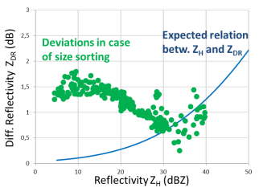
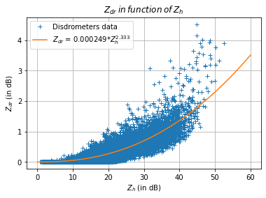
P2-Phase II
Size sorting detection using DSD’s values:
Principle of the detection algorithm
Disdrometers Data Tmatrix reconstructed

Slide 9
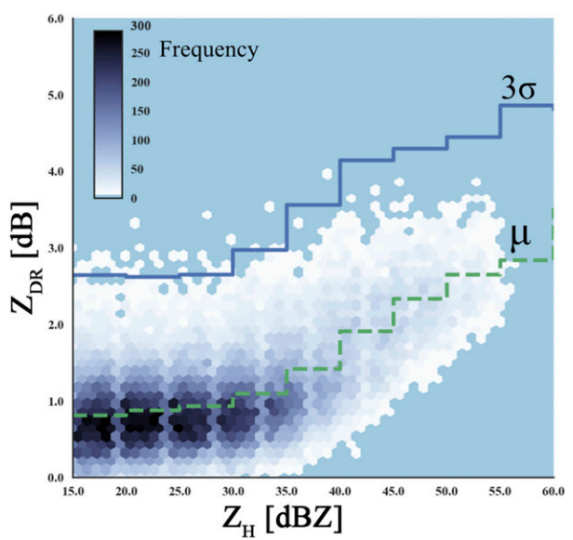
P2-Phase II
Size sorting detection with TRENDSS (Picca, 2018):
Use the Radar Data itself
Immune to $Z_{dr}$ biais
Spots Outliers of $Z_{dr}>3σ$
One set of 3 $Z_{h}−Z_{dr}$ relations by elevation angle
Tailored for each Radar

Slide 10
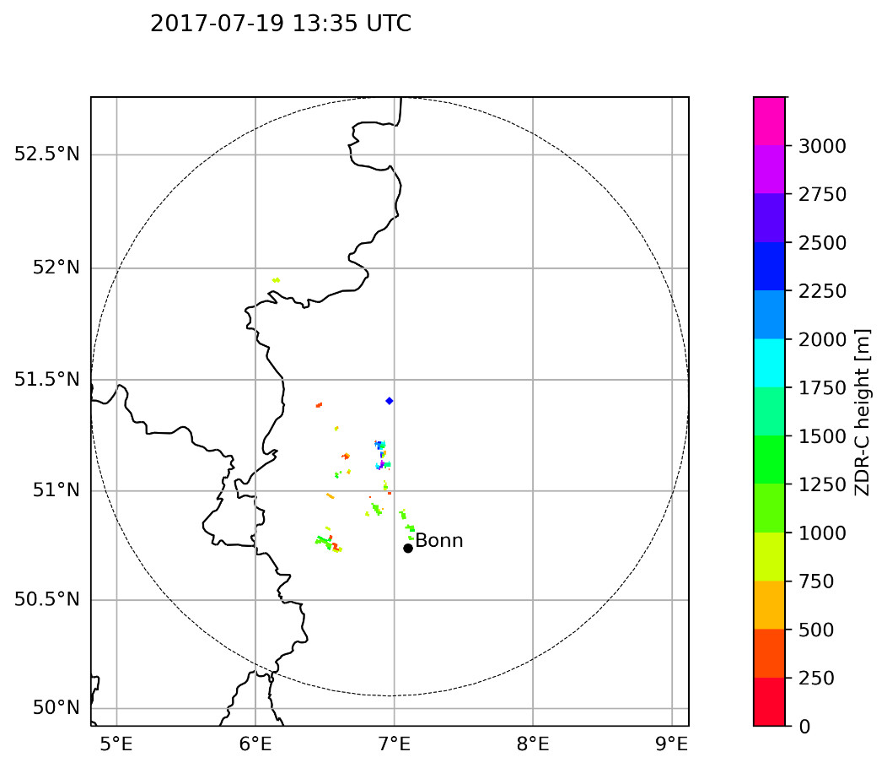
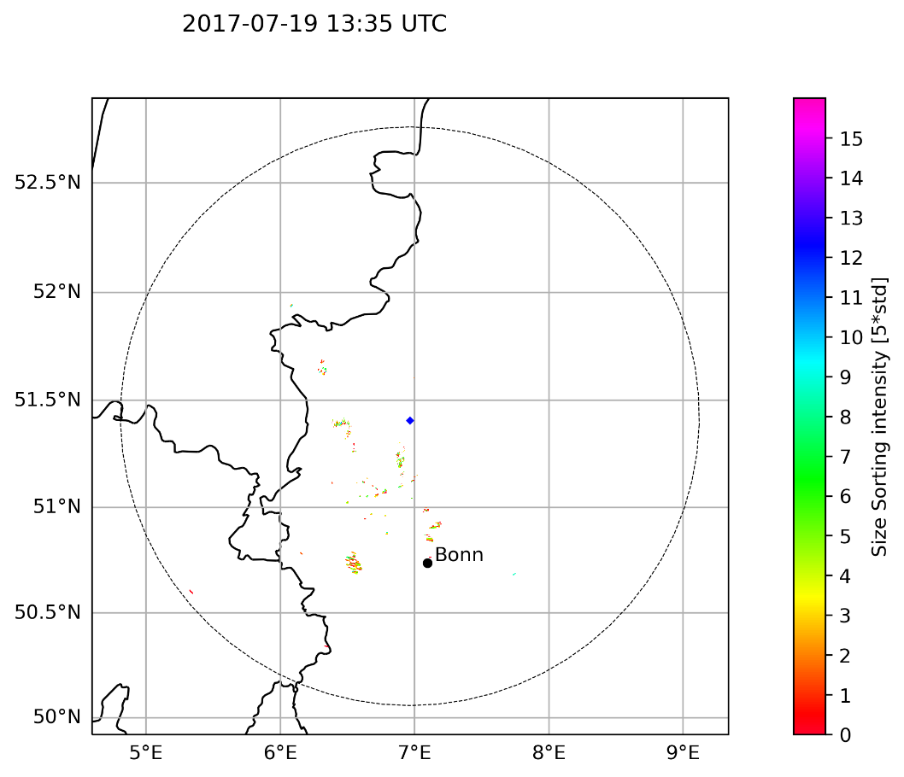
P2-Phase II
Snyder vs TRENDSS
Snyder
TRENDSS

Slide 11
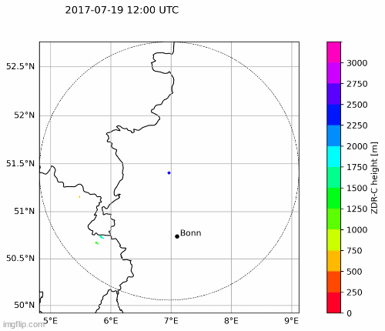
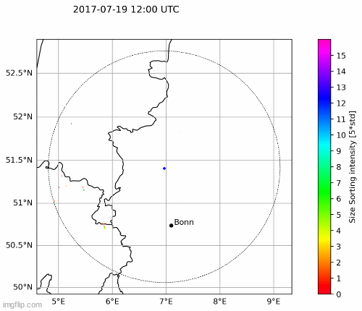
P2-Phase II
Snyder vs TRENDSS
Snyder
TRENDSS

Slide 12
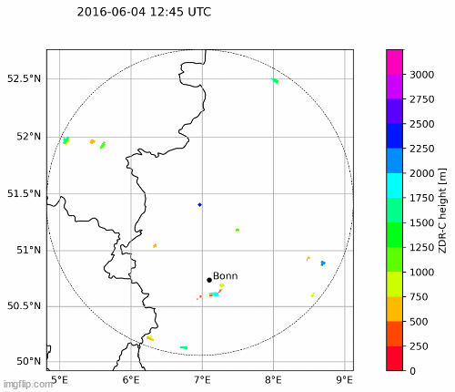
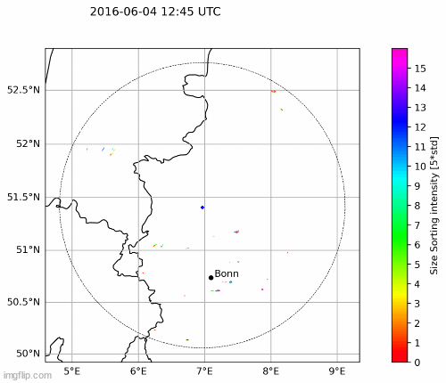
P2-Phase II
Snyder vs TRENDSS
Snyder
TRENDSS

Slide 13
P2-Phase II
A new technique : The ZDR hotspot technique (Vinzent Klaus and John Kraus, 2023)
« Identifying updrafts with $Z_{dr}$ hotspots » (2023)
Principle : Detects anomalously high values of $Z_{dr}$ relativelt to neighbouring gates (hotspots)

Slide 14
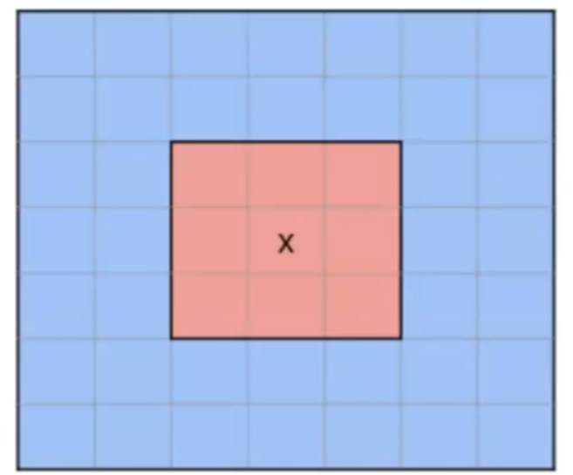
P2-Phase II
The ZDR hotspot technique

Slide 15
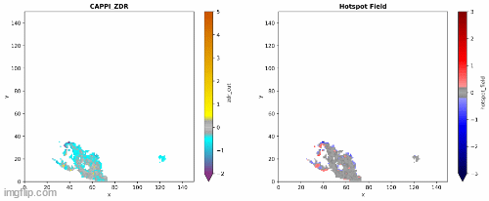
P2-Phase II
Hotspot on 2017-07-19 (-5°C) :

Slide 16
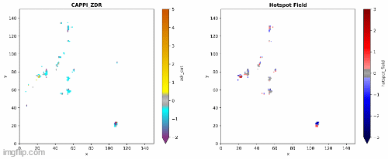
P2-Phase II
Hotspot on 2016-06-04 (-5°C) :

Slide 17
Thank you for your attention

Slide 18
Questions

