Slide 1
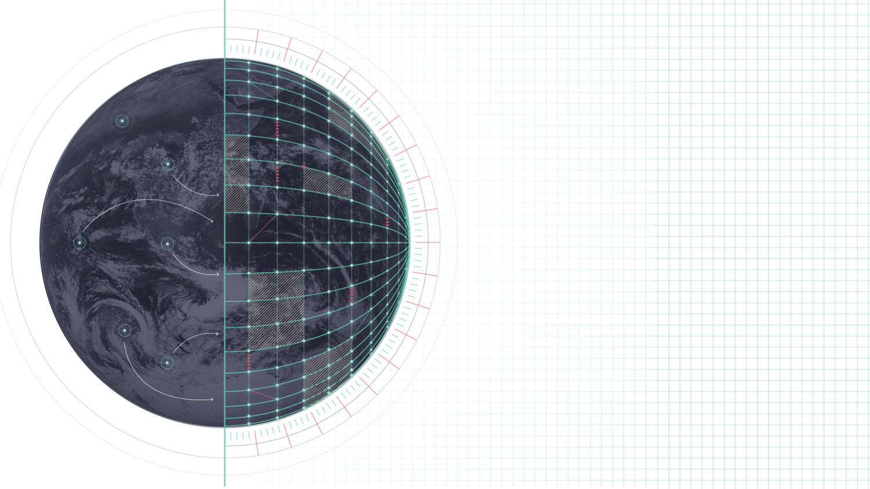
ECMWF – DESTINATION EARTH
PrePEP 2025 (Bonn)
Precipitation forecast enhancements in Destination Earth: advancing toward km-scale Global simulations
Estíbaliz Gascón, Benoît Vannière, Jasper Denissen, Maliko Tanguy, Ervin Zsoter, Irina Sandu
ECMWF
Notes:
Welcome slide

Slide 2
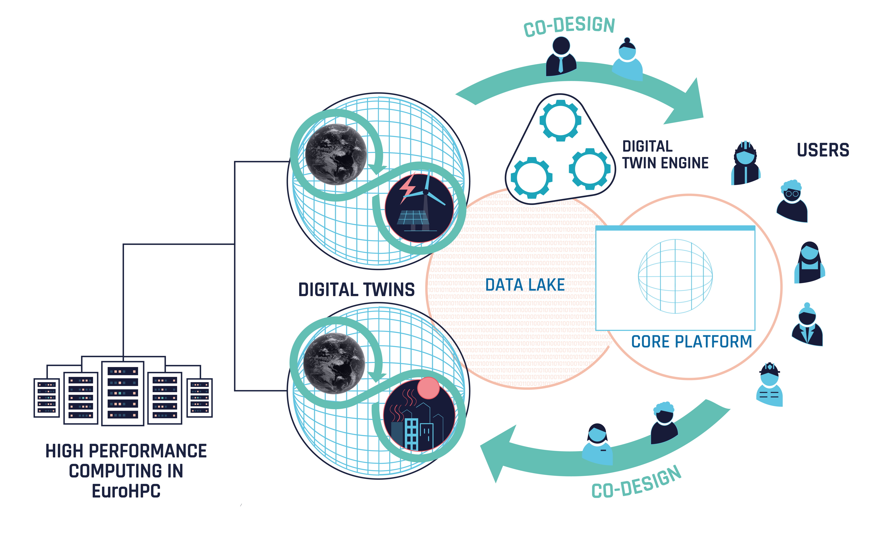
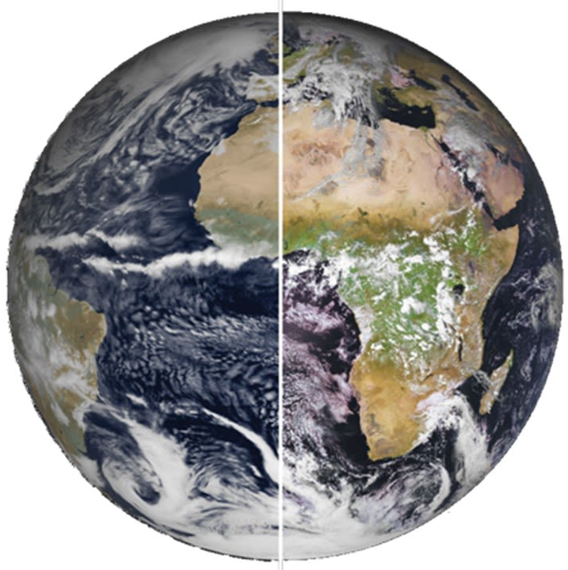
Destination Earth (DestinE) & the digital twins
DestinE: A European collaboration between ESA, ECMWF and EUMETSAT
Develop highly-accurate digital model (digital twin; DT) of the Earth system
  More than physics: Bringing together Earth-system physical and data-driven models and observations
  Realistic simulations: Indistinguishable from physical world
  Goal: Understand & simulate complex weather/climate interactions
  Applicability & interactivity: Allows testing scenarios and therefore supports decision making
simulations
observations

Slide 3
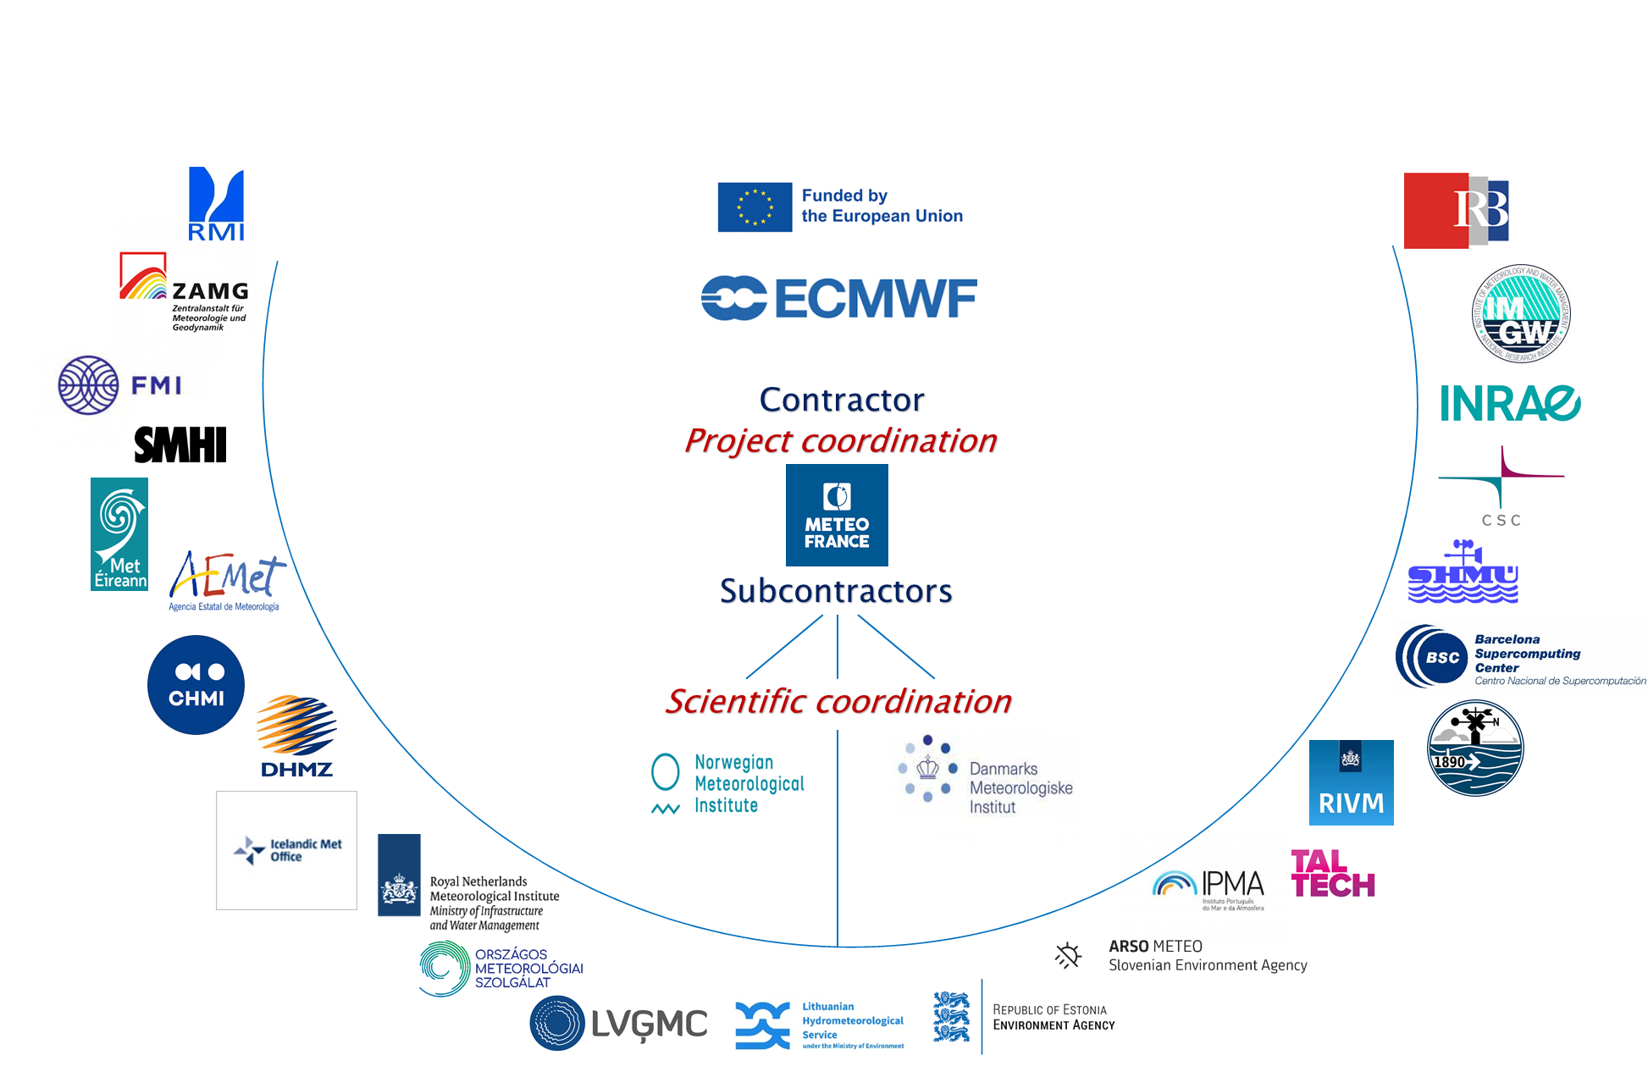

THE EXTREMES DT : A MAGNIFYING GLASS AT EXTREME WEATHER EVENTS
From daily worldwide simulation of extremes…
… to on-demand refinement over Europe
Global DT
On-Demand DT
IFS-NEMO
4.4km (¼ deg ocean)
Hourly outputs
Initialized at 00Z daily from ecmwf oper (9km)
Lead time 4 days
Impact sectors :
  CaMa-Flood
  Flexible prognostic aerosols
Arome, Harmonie-Arome, Alaro (Accord consortium)
750 to 500m
Sub-hourly outputs
Initialized on-demand
Lead time 2 days
Impact sectors :
  Hydrology (9+1 models), Storm surge
  Air-quality (7 models)
  Renewable energy (wind, solar)
  Thermal comfort, Wildfire, Frost

Slide 4
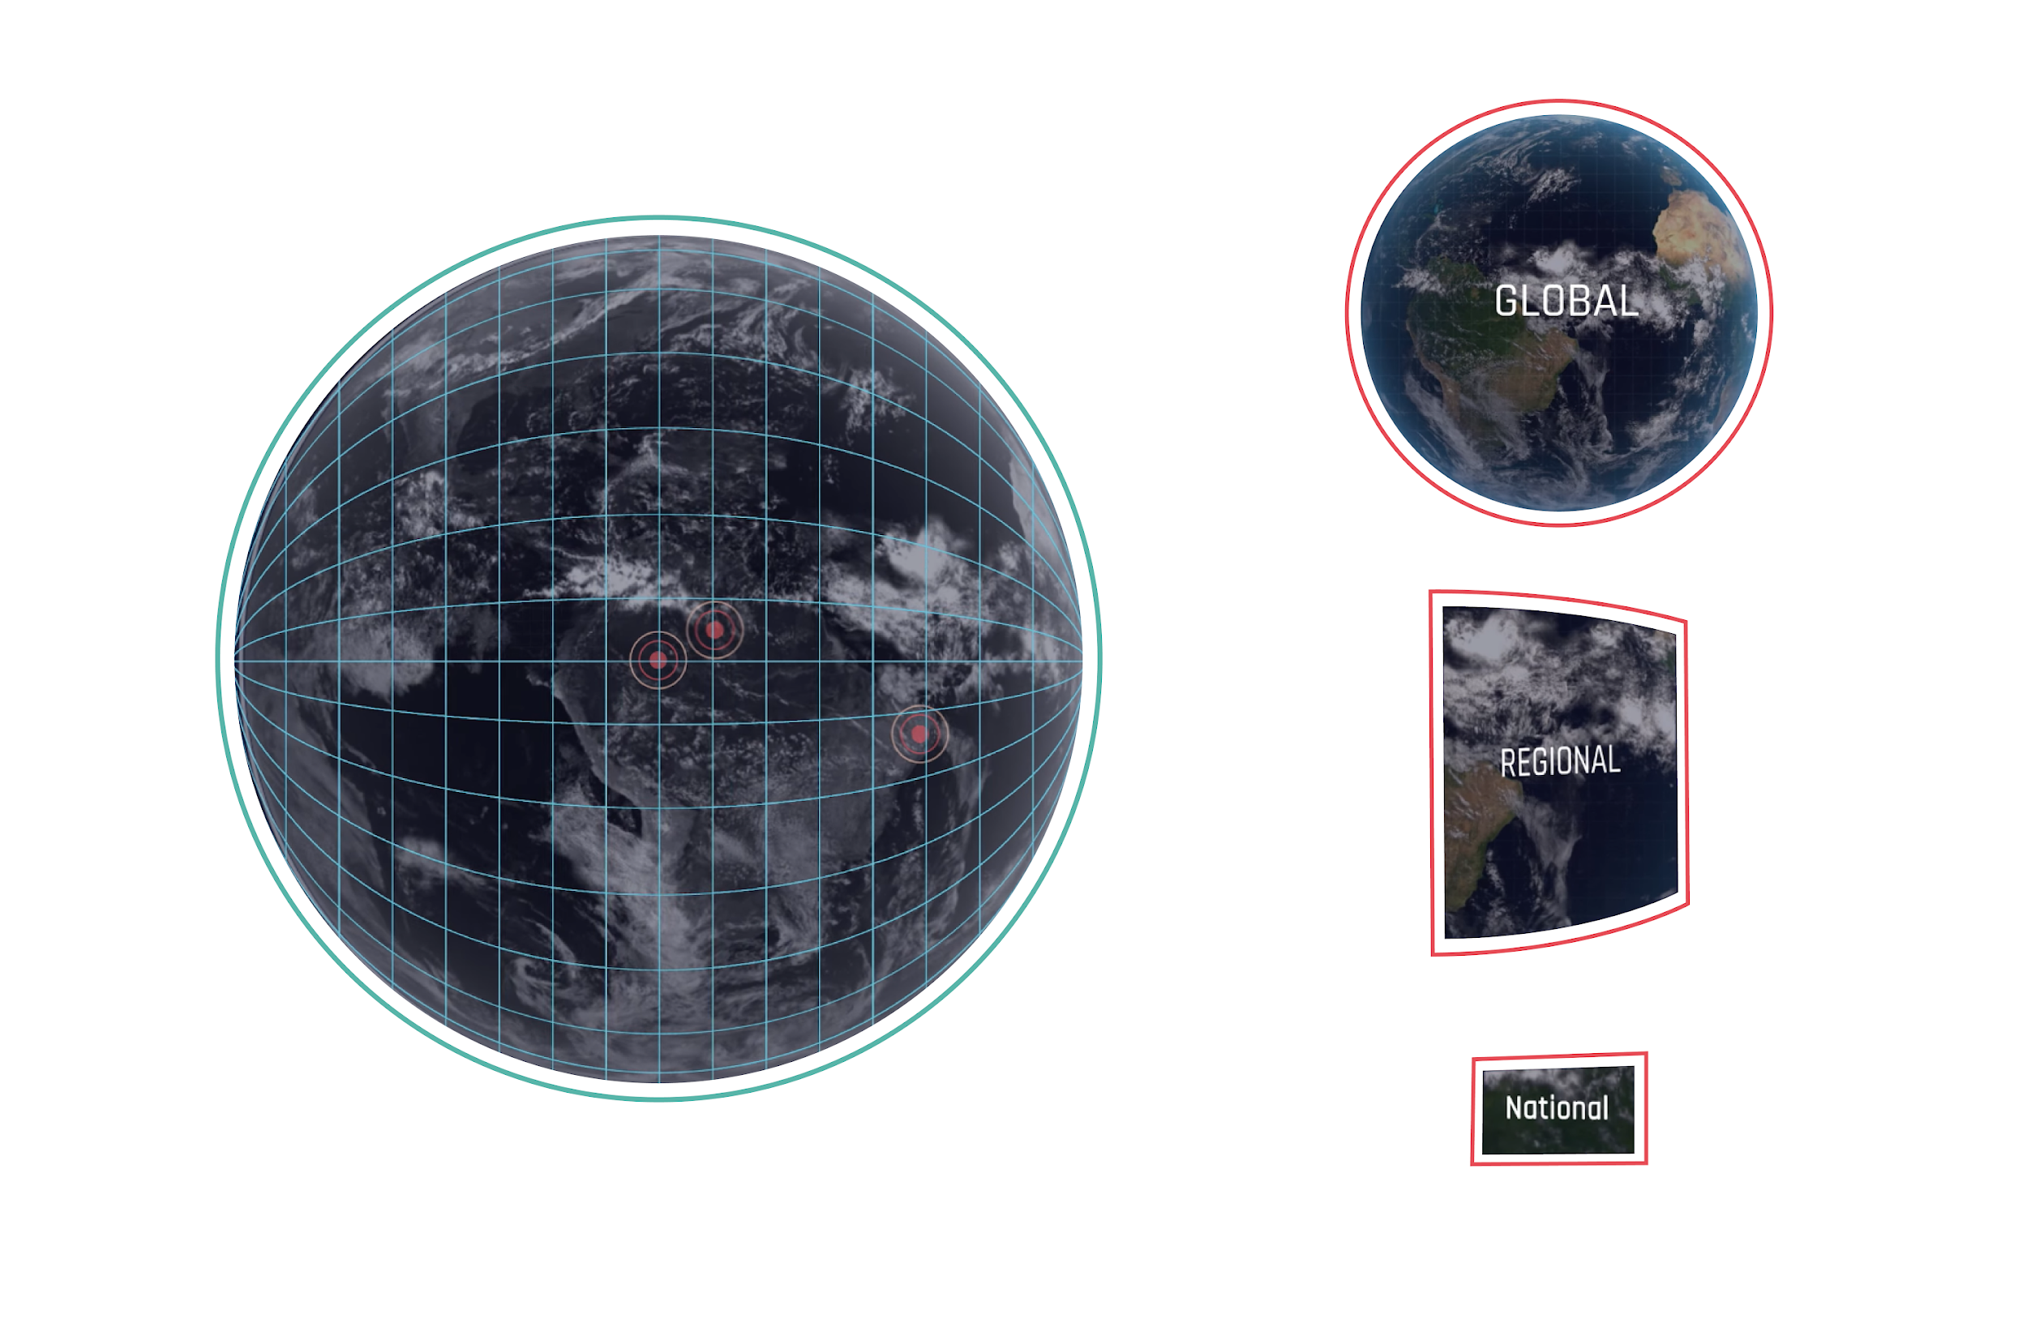




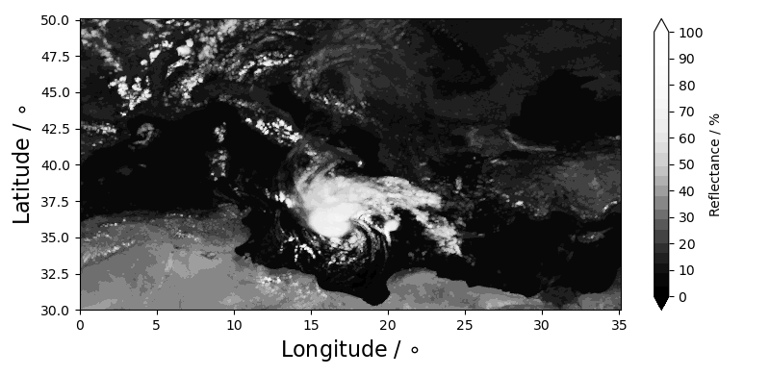
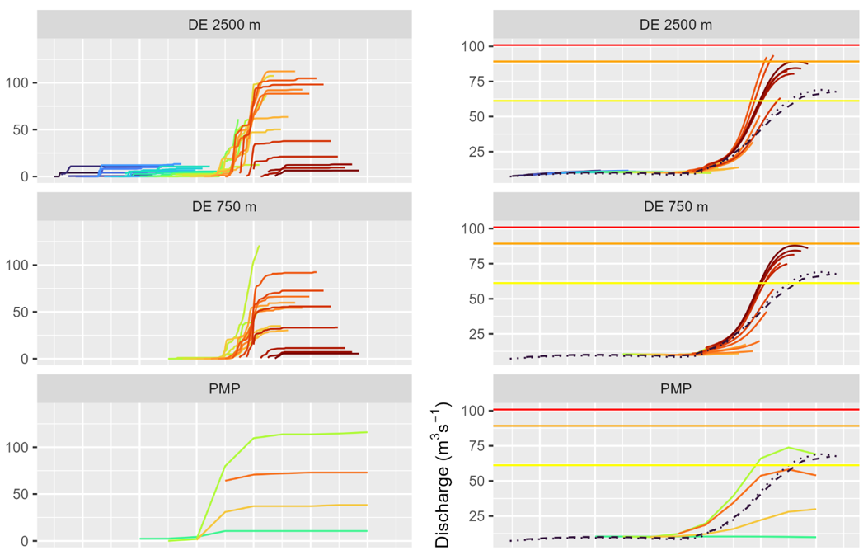
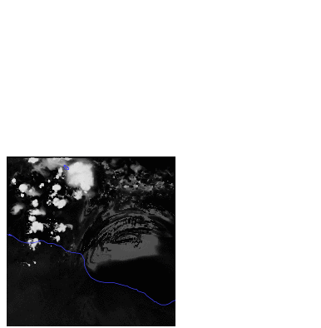
FROM WEATHER FORECAST TO IMPACT SECTORS
Medicane Ianos is approaching.
What will be the state of rivers in 48 hours?
DETECTION /
TRIGGERING
Impact-sector models:
Forecast evaluation for societal impacts
Daily and global monitoring of extreme events 4 days ahead at 4.4km
On-Demand regional forecasts of extreme events 2 days ahead at 500m
Acc. precipitation (mm)
early
ini
late
ini
River discharge
(m³ s⁻¹)
Storm Ianos, 2020-09-14 00Z, VT 2020-09-16 00Z

Slide 5
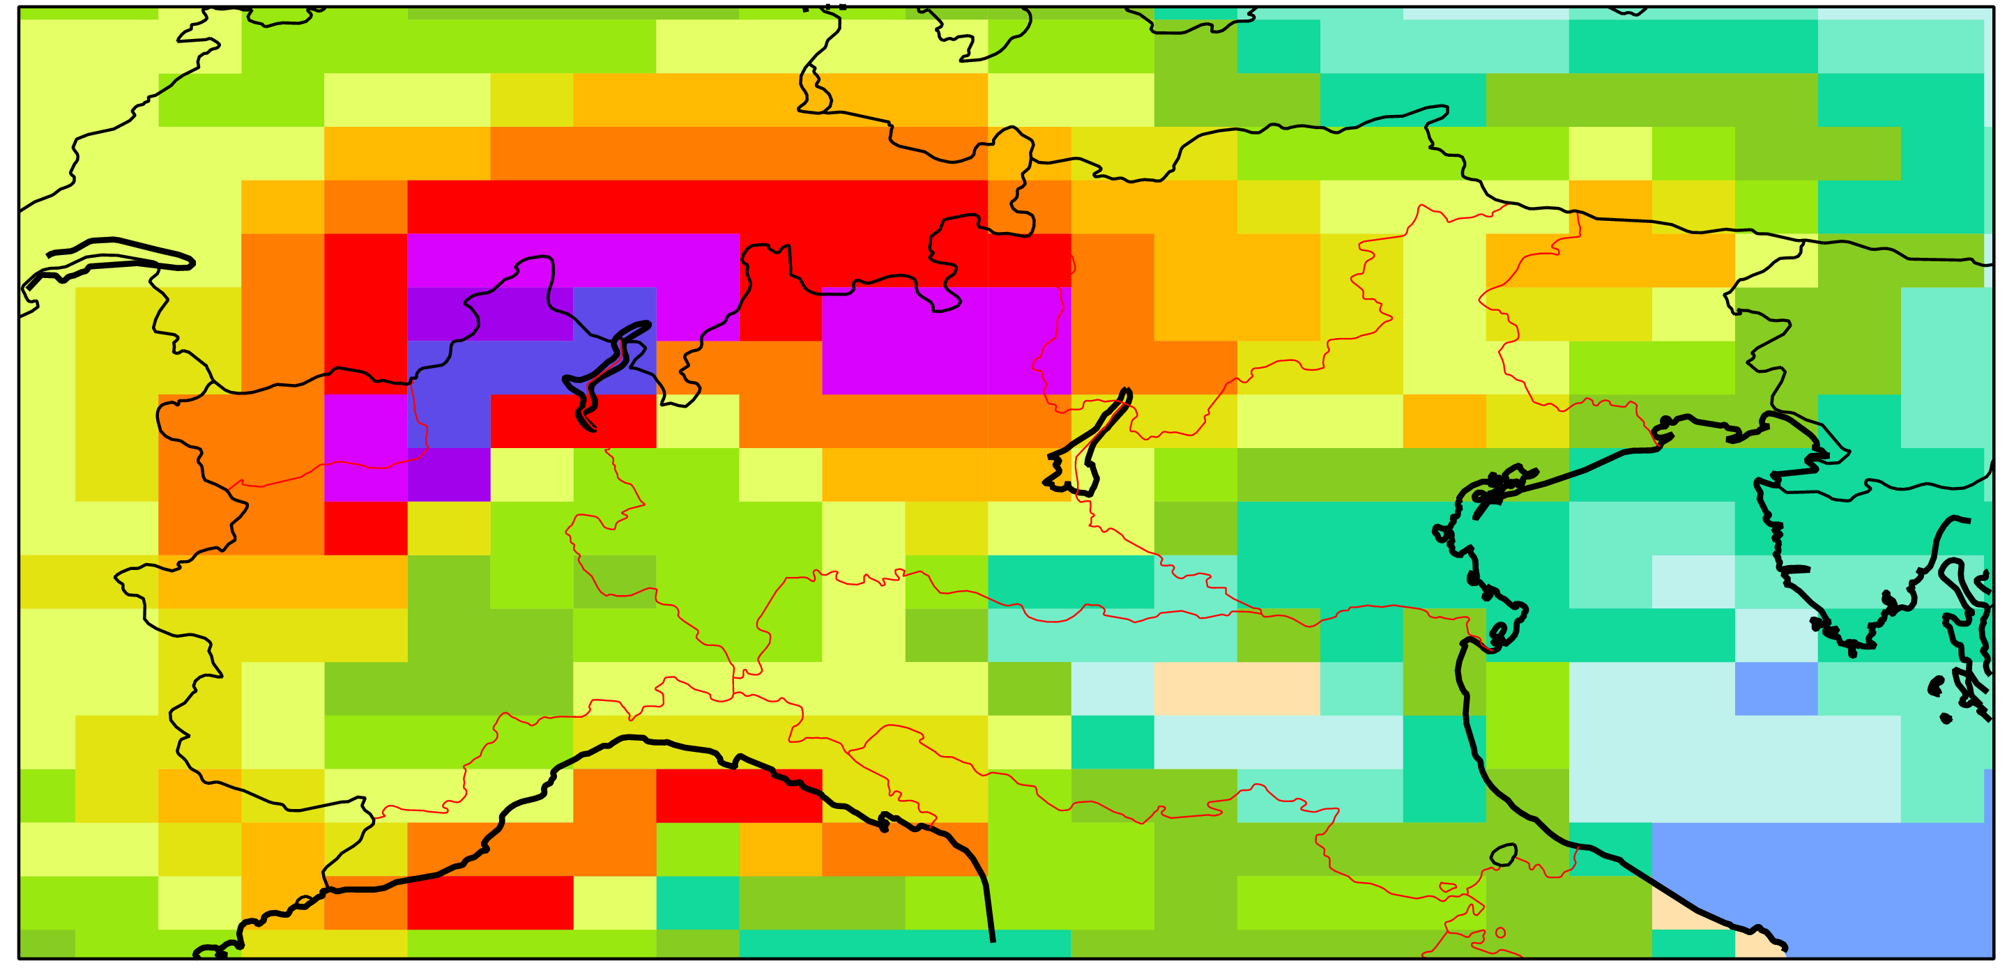
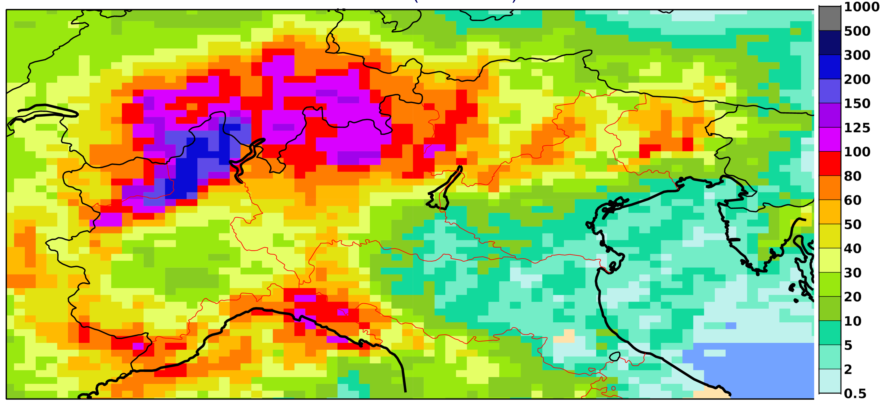
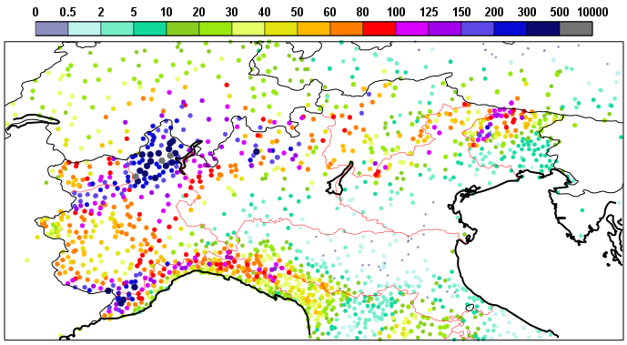
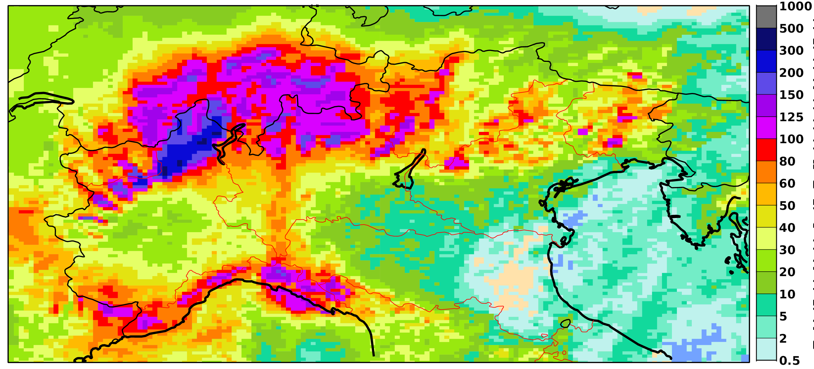
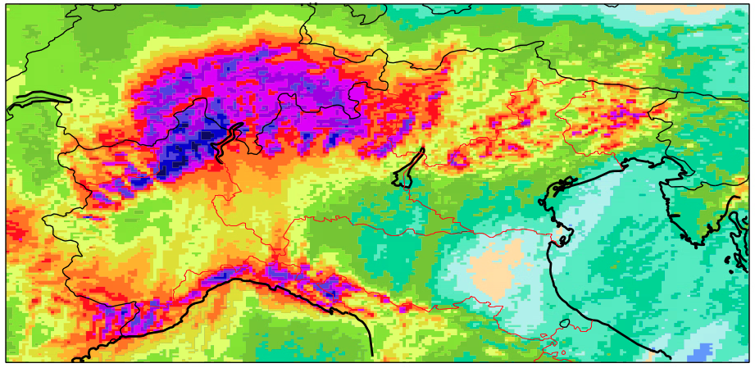
Does precipitation improve in km-scale simulations?
24h accumulated precipitation (mm)
Base time 01/10/2020 00 UTC (T+36h-T+60h).
IFS 29 km
IFS 9 km
Observations
IFS 4.5 km
IFS 2.8 km

Slide 6
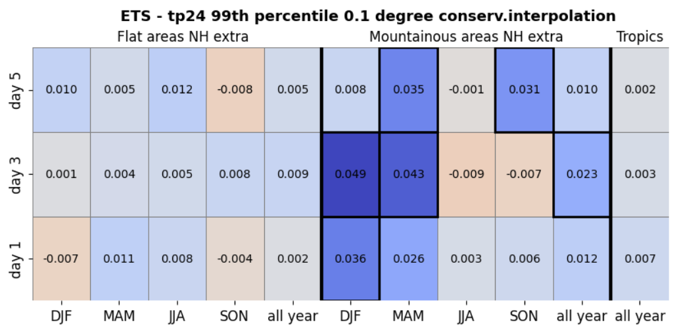
SCORECARDS for extreme precipitation
(using the Equitable threat score)
Tp24h > 99th percentile of the observations, defined for each condition.
Values correspond to the differences between DestinE (4.4 km) ETS – IFS (9km) ETS
Using nearest gridpoint for each SYNOP station location.
BLUE --> DestinE better than oper 9 km
ETS for 99th percentile tp24h. Conservative interpolation applied with 0.1 degrees (both models)
NH extratropics + Tropics

Slide 7
Winter and autumn in mountainous areas, significant improvement. Large-scale precipitation in better represented orography
No real improvement of tp24 extremes in DestinE for flat areas in the extratropics
More significant improvements at longer lead times in mountainous areas
Summer and spring, slight degradation (no significant): more convective activity, probably localised convection: double penalty issue?

Slide 8
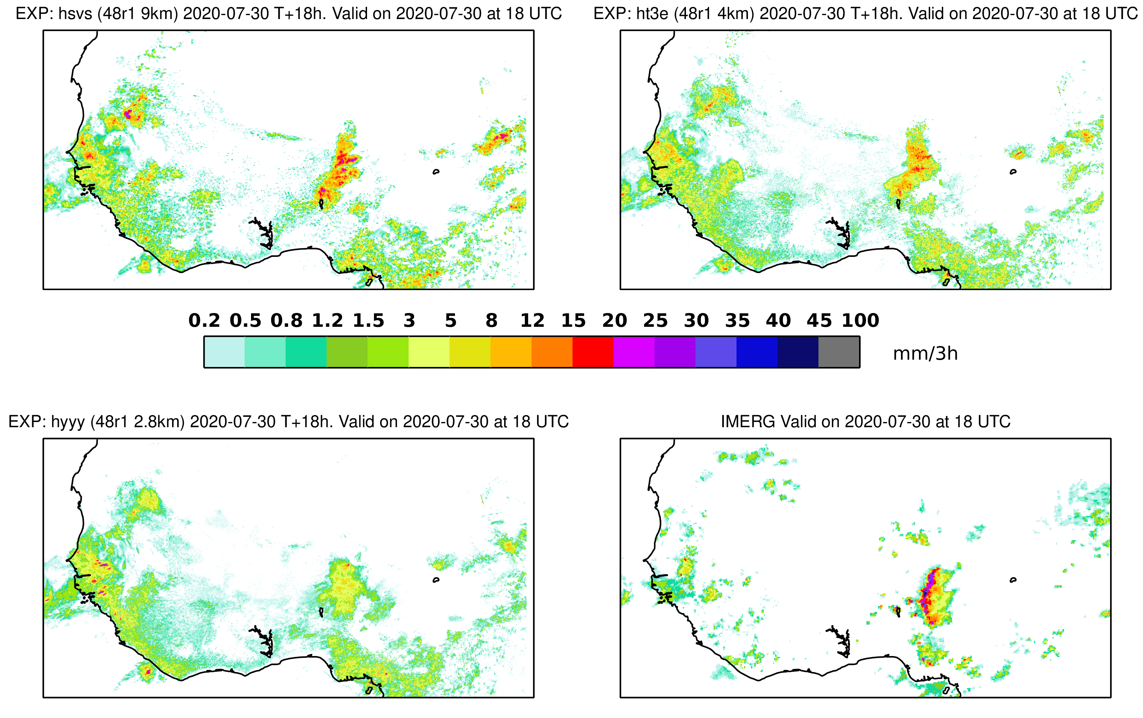
But… squall lines in tropical areas
3h accumulated precipitation. Base time 30/07/2020 00 UTC
IFS 9 km
DestinE 4.4 km
T+18h
exp 2.8 km
IMERG

Slide 9
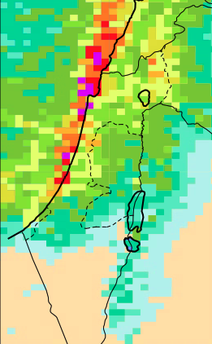
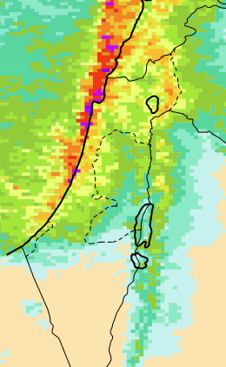
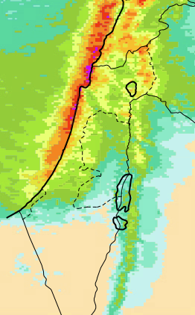
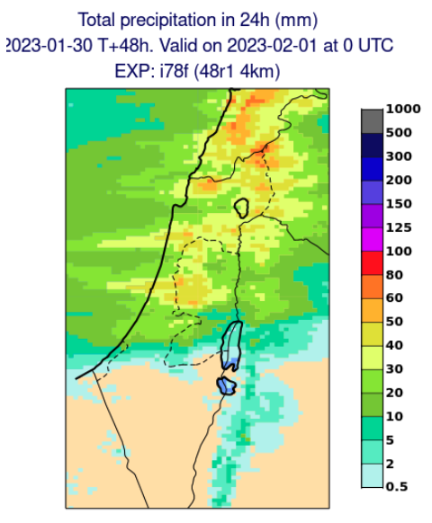
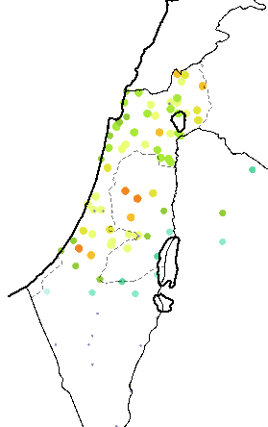
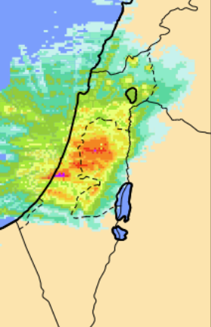
But…convective precipitation along the coast
Total precipitation in 24h (mm). Valid on 2023-02-01 at 00 UTC
IFS @ T+48 (init 2023-01-30)
OBS
9km
4.4km
2.8km
SYNOP
IMS radar

Slide 10
EXPLORING CHANGES IN THE MODEL PHYSICS:
Beyond the Limits of Resolution

Slide 11
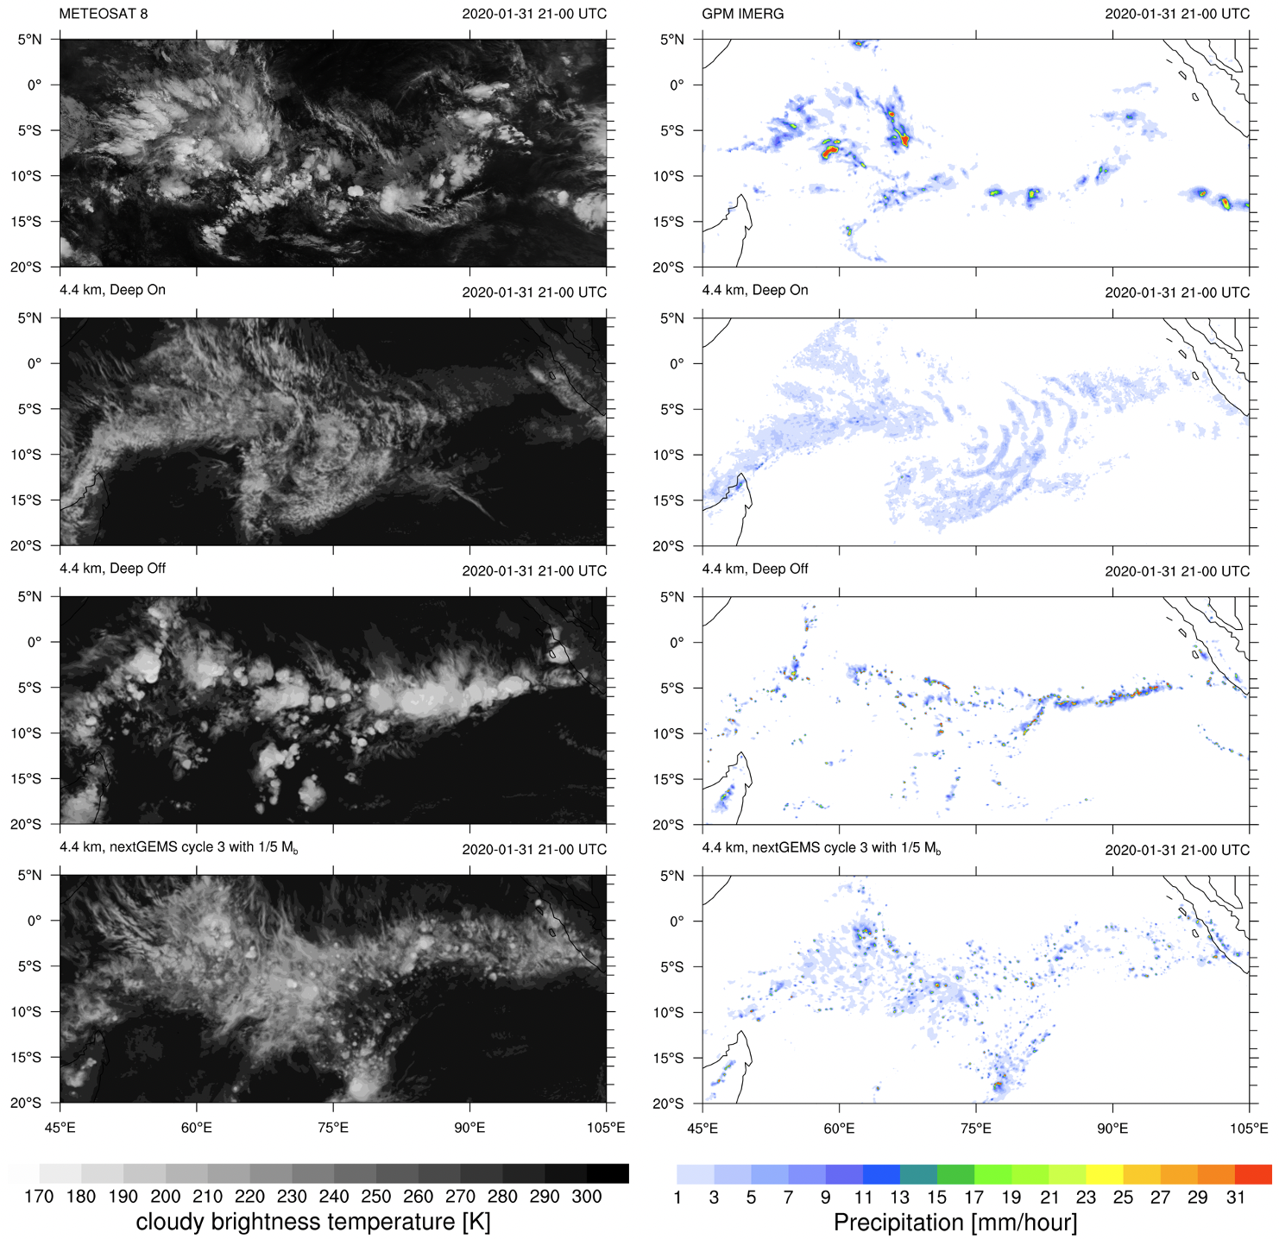

Can we turn off the parameterization of deep convection?
OBS
DEEP ON
DEEP OFF
… NO, but a careful modification of the scheme is required which optimizes both NWP scores and physical realism
CYCLE 3
Tobias Becker
Notes:
nextGEMS overview paper.
Mention work on Leonard term. => one possibility is that SL makes that it has lesser role (at least major diff between IFS and NICAM). Resolution at which the Leonard term is relevant. NICAM has shallow off.
ICON/NICAM supplementary material : IFS only. No shallow convection? Leonard.

Slide 12
DEVELOPING GLOBAL KM-SCALE FORECASTS : improving the model physics
Total precipitation in 24h (mm). Valid on 2023-02-01 at 00 UTC
IFS @ T+48 (init 2023-01-30)
OBS
4.4km
(reduced CBMF)
9km
4.4km
2.8km
SYNOP
IMS radar

Slide 13
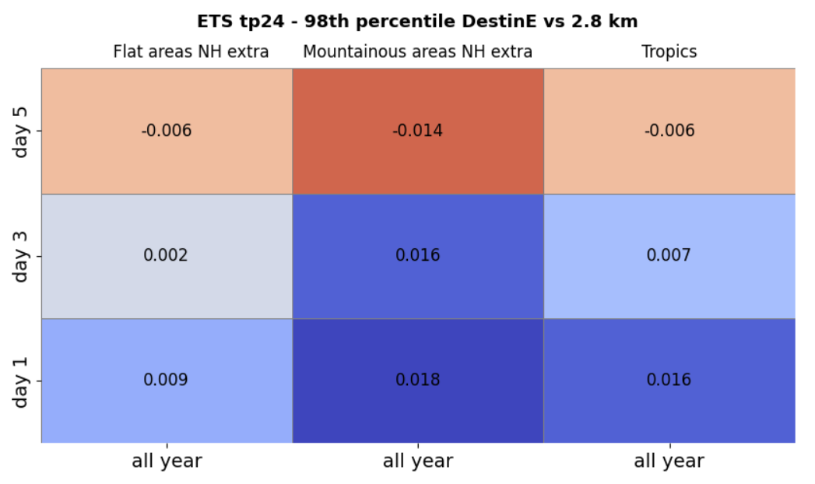
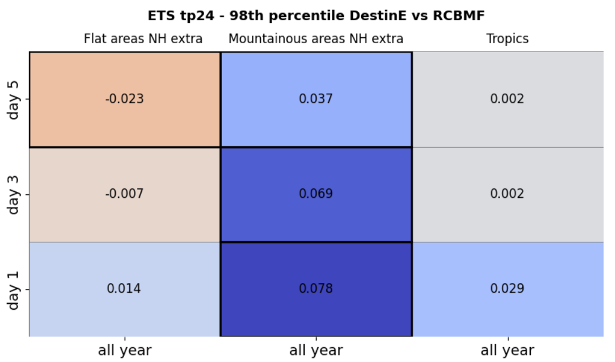
SCORECARDS for extreme precipitation: 2.8 km and rCBMF
BLUE --> 2.8 km better than DestinE 4.4 km
BLUE --> RCBMF better than DestinE 4.4 km

Slide 14
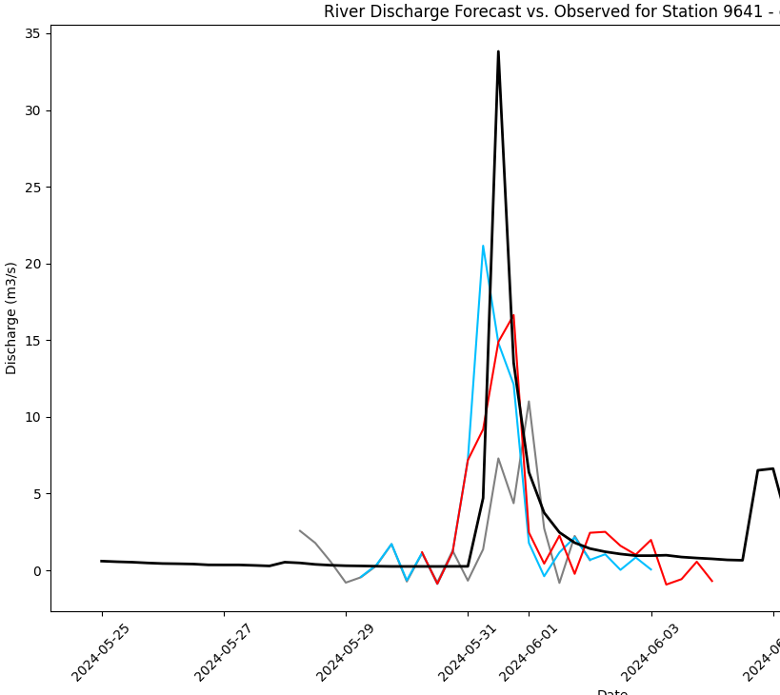
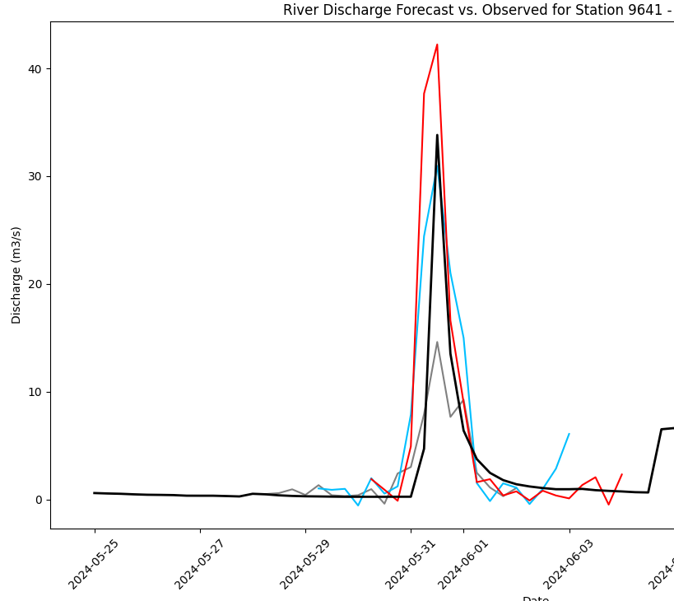
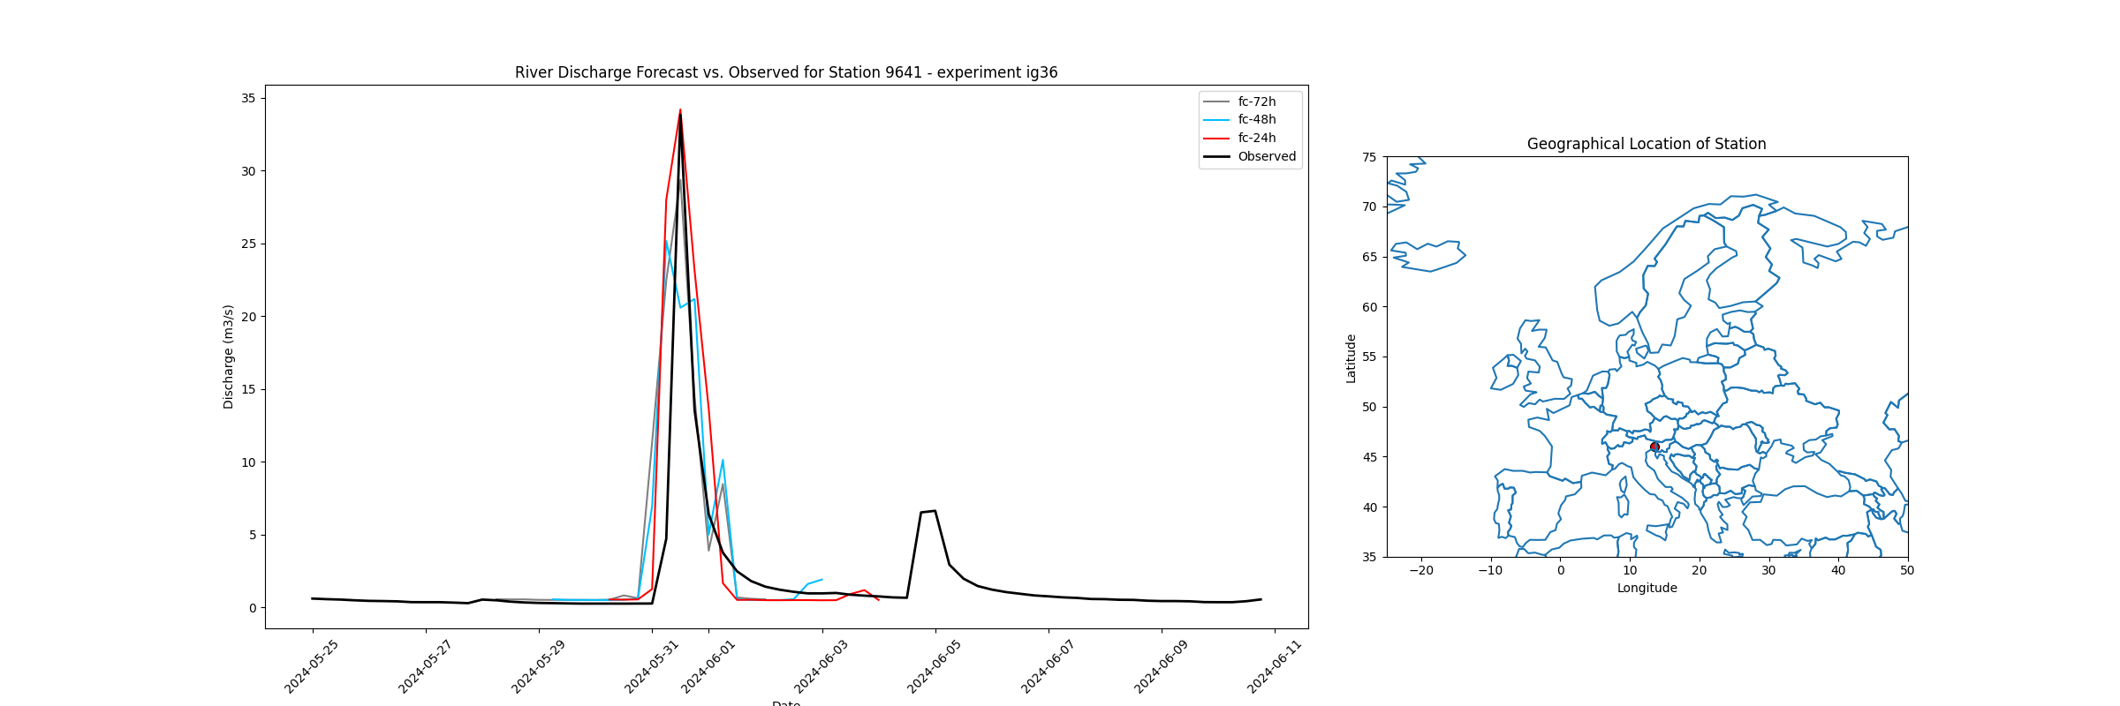
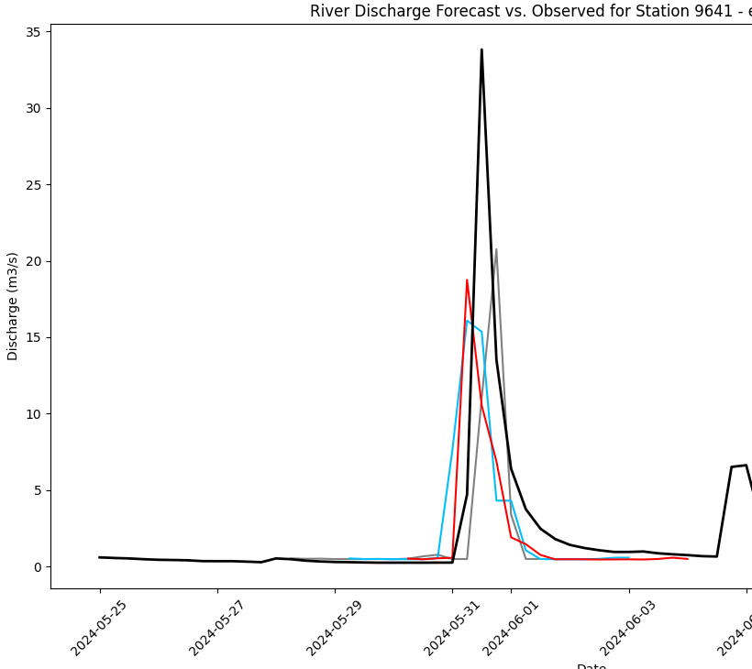
FROM WEATHER forecast to impact SECTOR MODELS
Maliko Tanguy
IFS oper 9 km
DestinE 4.4 km
Discharge m³/s
Discharge m³/s
Exp
2.8 km
RCBMF
Case study of FLOODS in northeast Italy on the 31 May 2024.
Higher horizontal resolutions in NWP models improve the river discharge prediction in this case study.
However, RCBMF experiment is not much better than the current operational IFS 9 km
Discharge m³/s
Discharge m³/s

Slide 15
DESTINATION EARTH
Thanks for
your attention!
https://destination-earth.eu/

