Slide 1
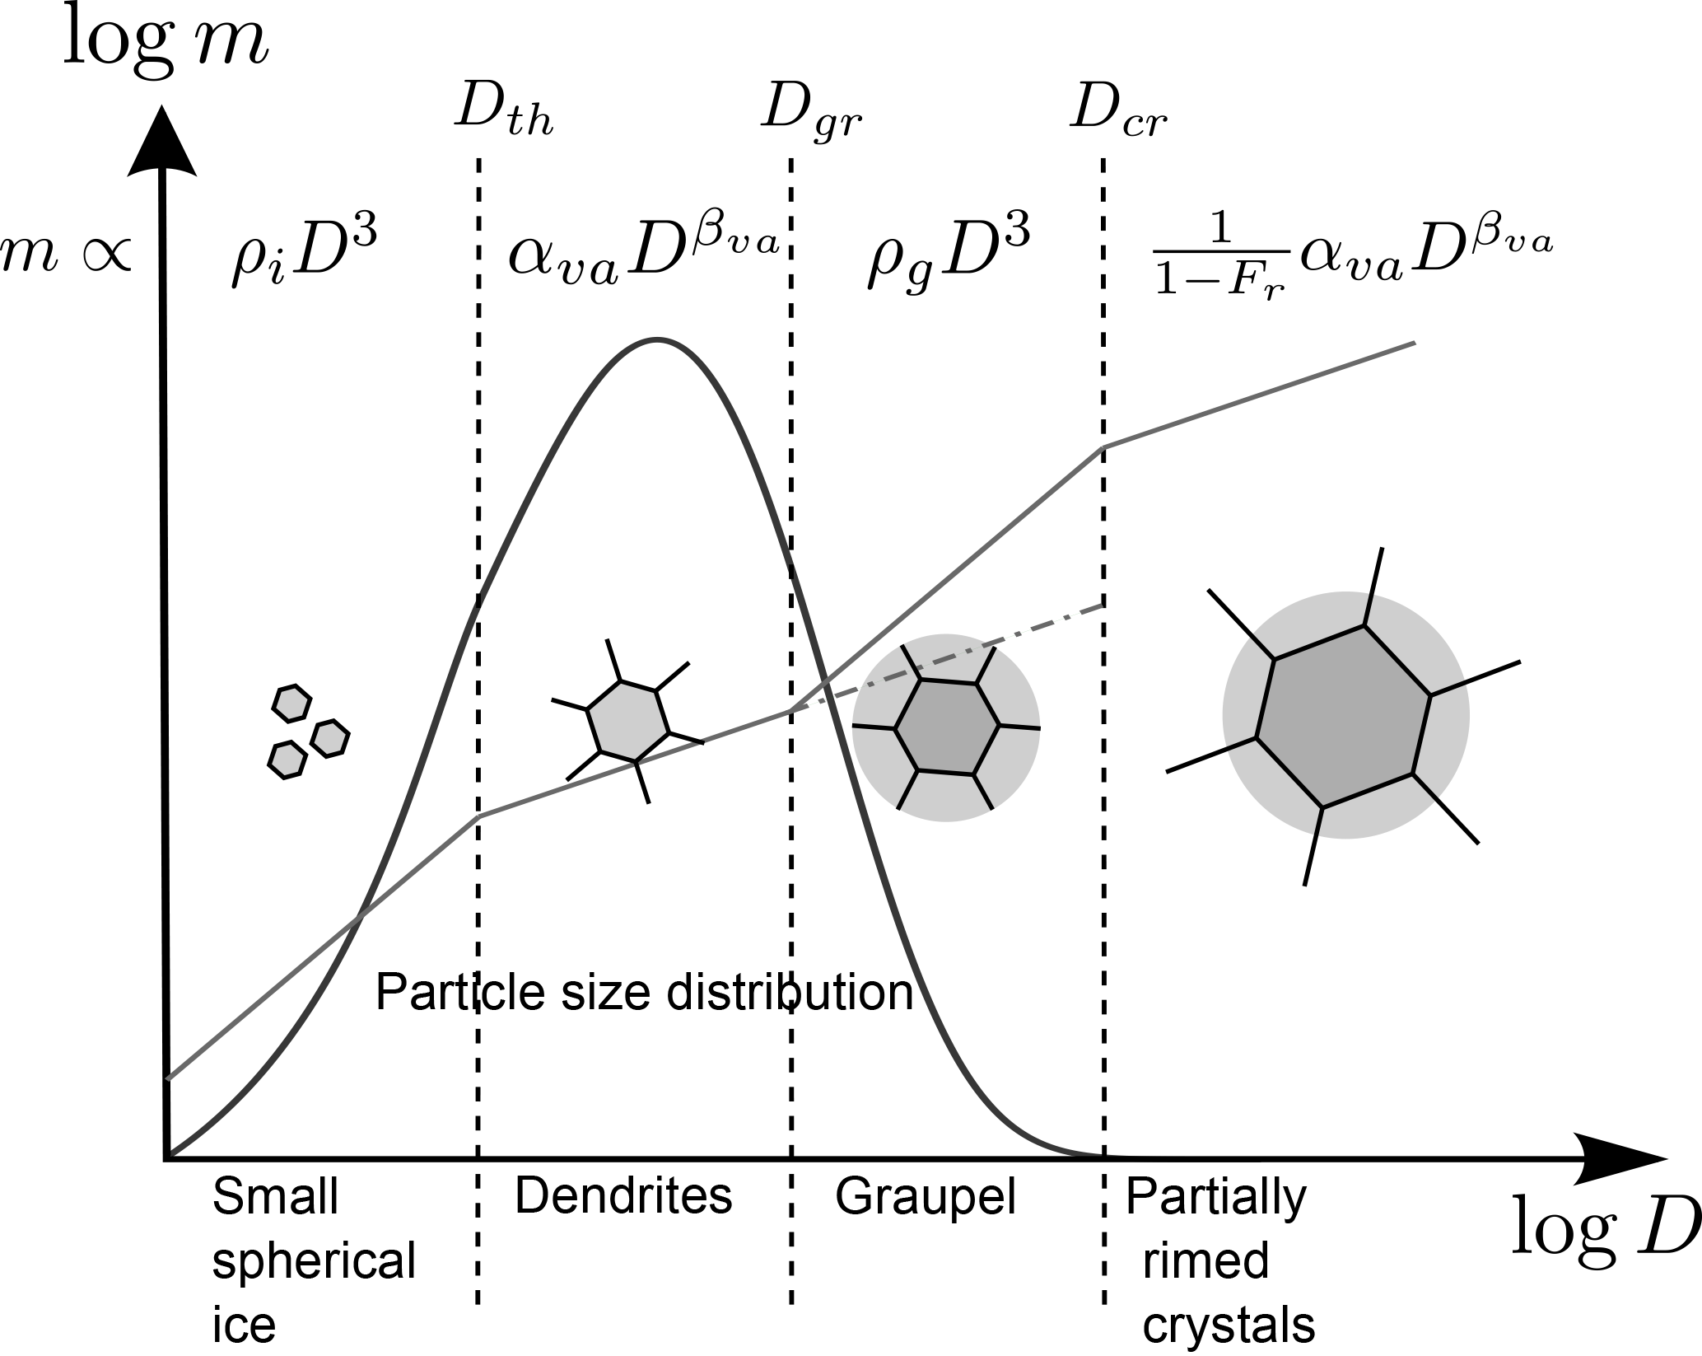
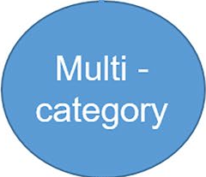
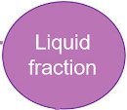
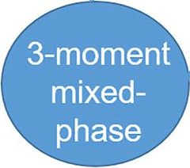
Simulating idealized supercells with the newest P3 v5 scheme
-----
Recoupling a microphysics scheme with ICON in an open & sustainable way
1) Marco Wurth, IMKTRO, KIT
2) Corinna Hoose, IMKTRO, KIT
3) Jason Milbrandt, ECCC
4) Melissa Cholette, ECCC
5) Hugh Morrison, NCAR

Slide 2
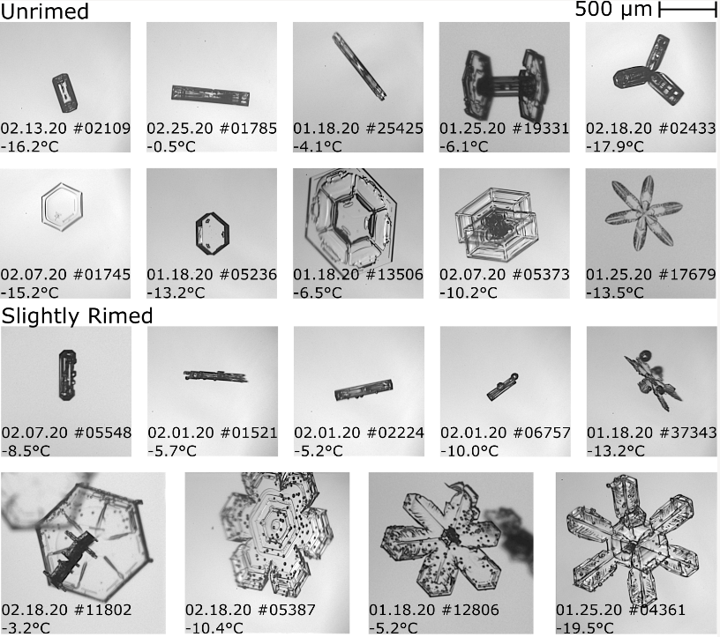
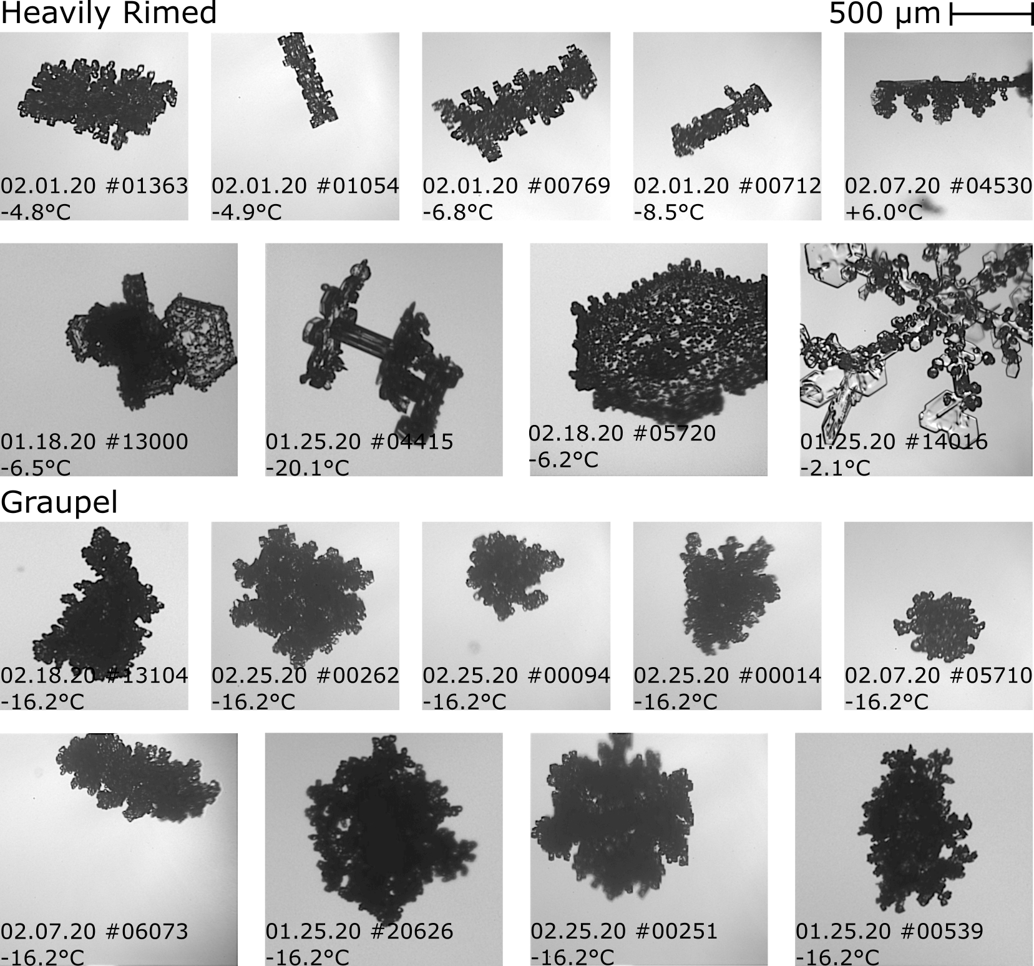
Different Approaches in Describing the Ice Phase
Describing the ice particle collective with a few variables
[Waitz et al., 2022, ACP]

Slide 3
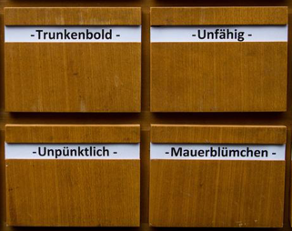
Different Approaches in Describing the Ice Phase
Describing the ice particle collective with a few variables
Classical
2-Moment Scheme
Classify
Different ice types
with fixed properties
Flexible:
number & mean size
Crystals
Aggregates
Graupel
Hail
[Waitz et al., 2022, ACP]

Slide 4
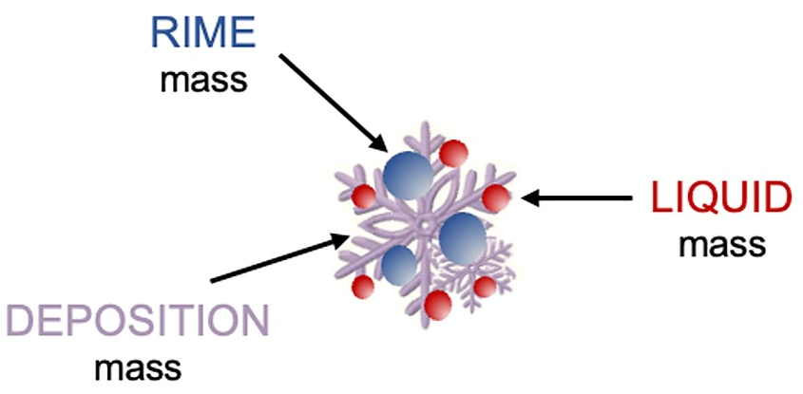
Different Approaches in Describing the Ice Phase
Describing the ice particle collective with a few variables
Classical
2-Moment Scheme
Classify
Describe
Predicted Particle Properties (P3)
Scheme
Different ice types
with fixed properties
Flexible:
number & mean size
“Free” ice
Flexible:
number & mean size
+ distribution shape
+ rime mass
+ rime density
+ liquid mass on ice
[+ aspect ratio]
Crystals
Aggregates
Graupel
Hail
[Waitz et al., 2022, ACP]

Slide 5
P3’s Approach in Describing the Ice Phase
Predicted Particle Properties (P3)
Scheme
“Free” ice
Flexible:
number & mean size
+ distribution shape
+ rime mass
+ rime density
+ liquid mass on ice
[+ aspect ratio]
[Dietlicher et al., 2018, GMD]

Slide 6
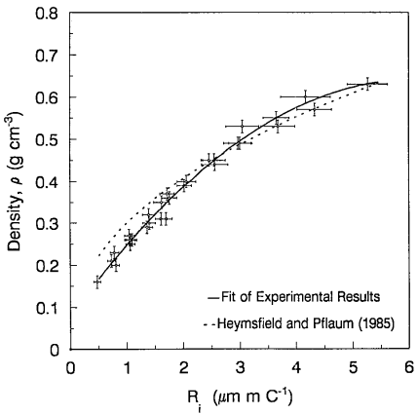
P3’s Approach in Describing the Ice Phase
[Cober and List, 1993, JAS]
Predicted Particle Properties (P3)
Scheme
“Free” ice
Flexible:
number & mean size
+ distribution shape
+ rime mass
+ rime density
+ liquid mass on ice
[+ aspect ratio]
instantaneous
[Dietlicher et al., 2018, GMD]

Slide 7
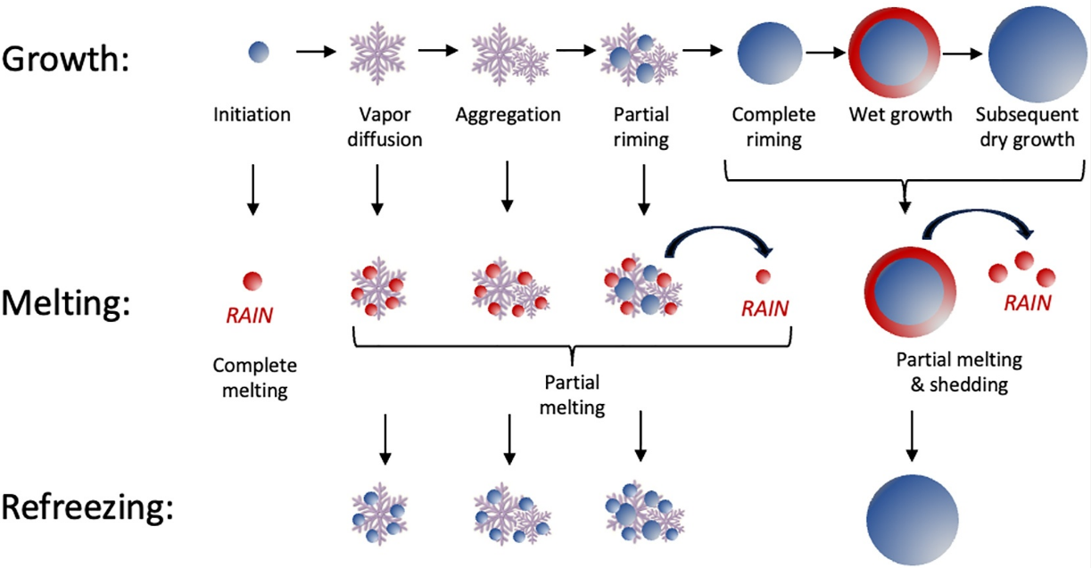
P3’s Approach in Describing the Ice Phase
Predicted Particle Properties (P3)
Scheme
“Free” ice
Flexible:
number & mean size
+ distribution shape
+ rime mass
+ rime density
+ liquid mass on ice
[+ aspect ratio]

Slide 8
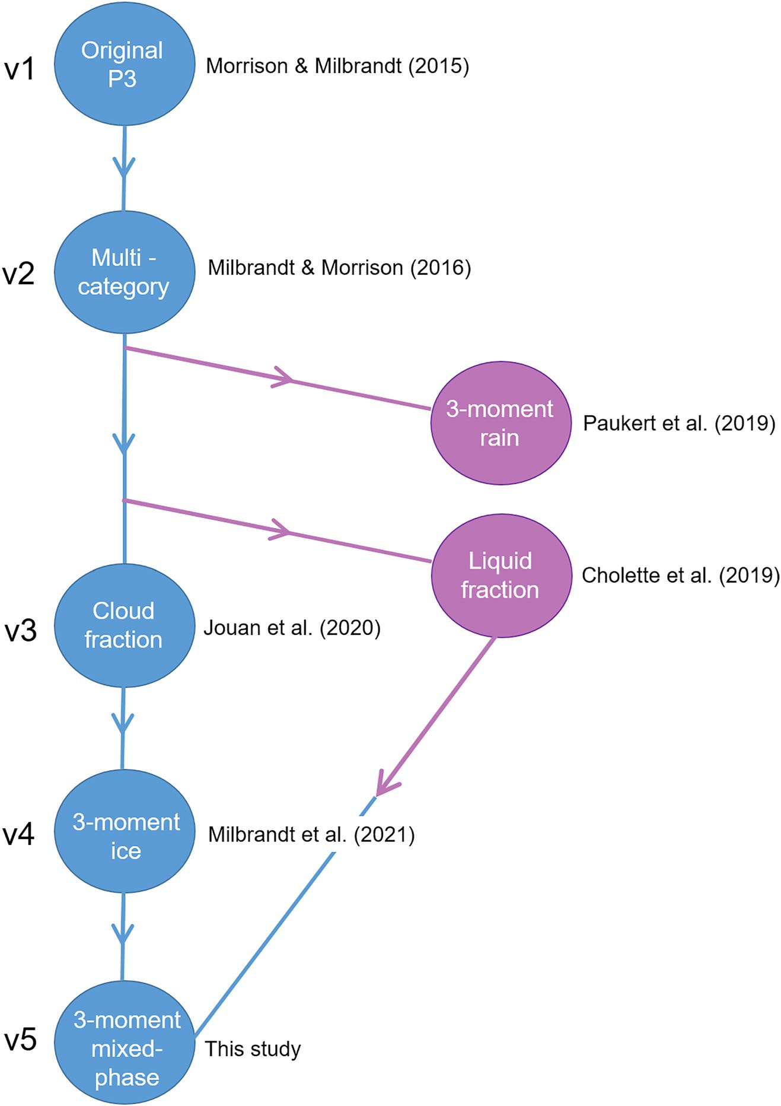
ICON + P3 v1 before
Juha Tontilla, Andrew Barrett (2016-2022):
→ Integration of P3 v1 into ICON in private branch
→ New P3 and new ICON versions
→ Reintegration needed

Slide 9
ICON + P3 v5 now
Juha Tontilla, Andrew Barrett (2016-2022):
→ Integration of P3 v1 into ICON in private branch
→ New P3 and new ICON versions
→ Reintegration needed
→ More sustainable integration desired
Merge into
P3 codebase
github.com/P3-microphysics

Slide 10
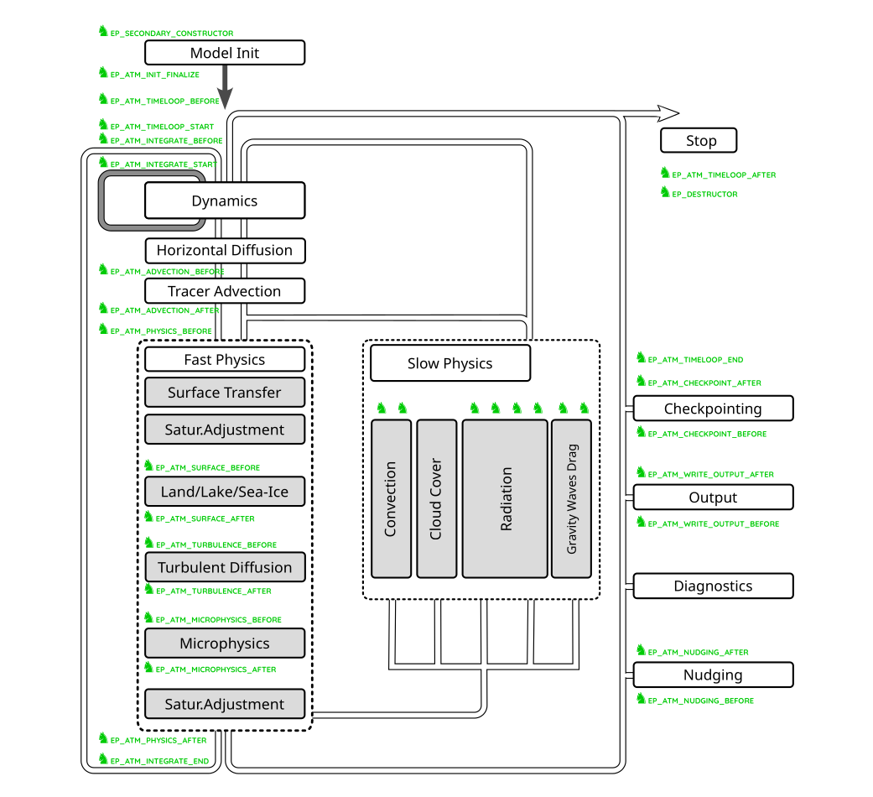
Coupling P3 to ICON with ComIn

Slide 11
Coupling P3 to ICON with ComIn
Call p3_init() that loads LUTs
Initialize P3 tracer fields
Update reff
Call p3_main()
Update ICON’s precipitation vars
Merge and save reff
Update through lateral boundaries

Slide 12
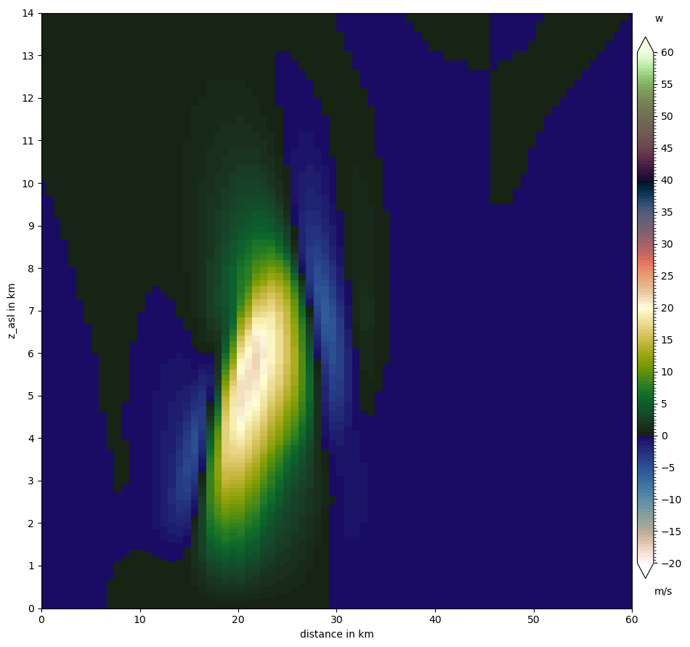
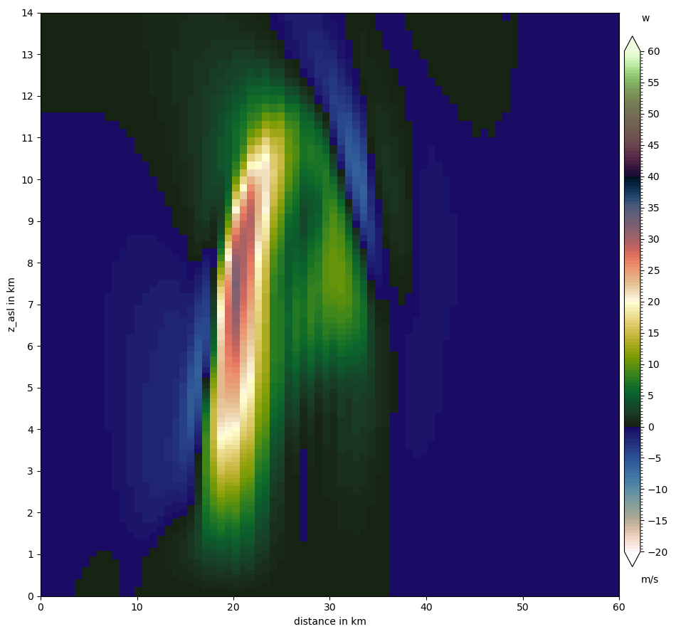
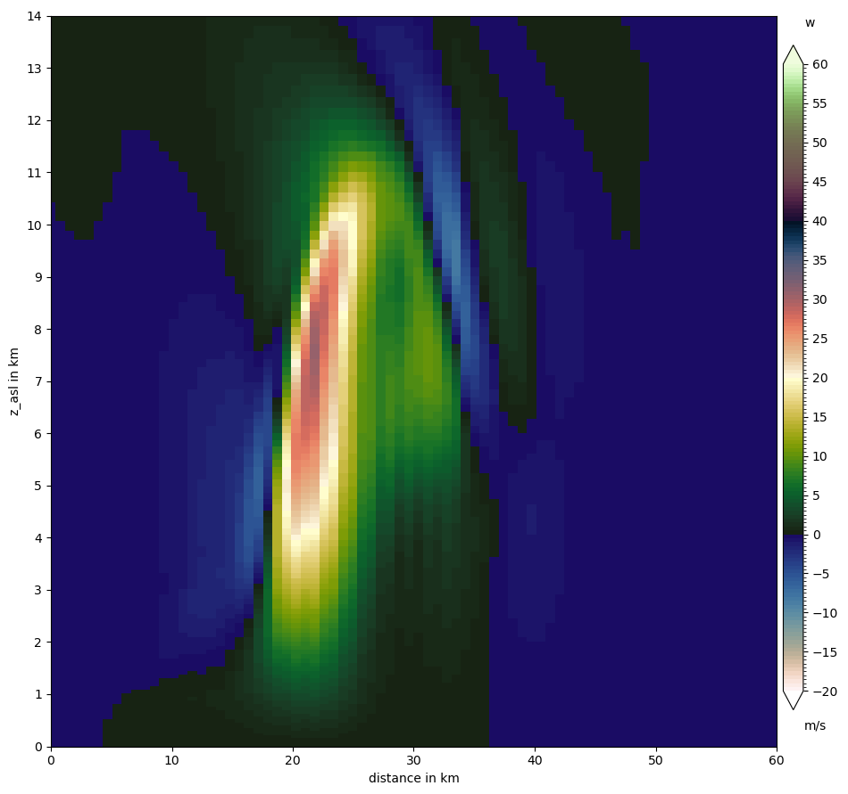
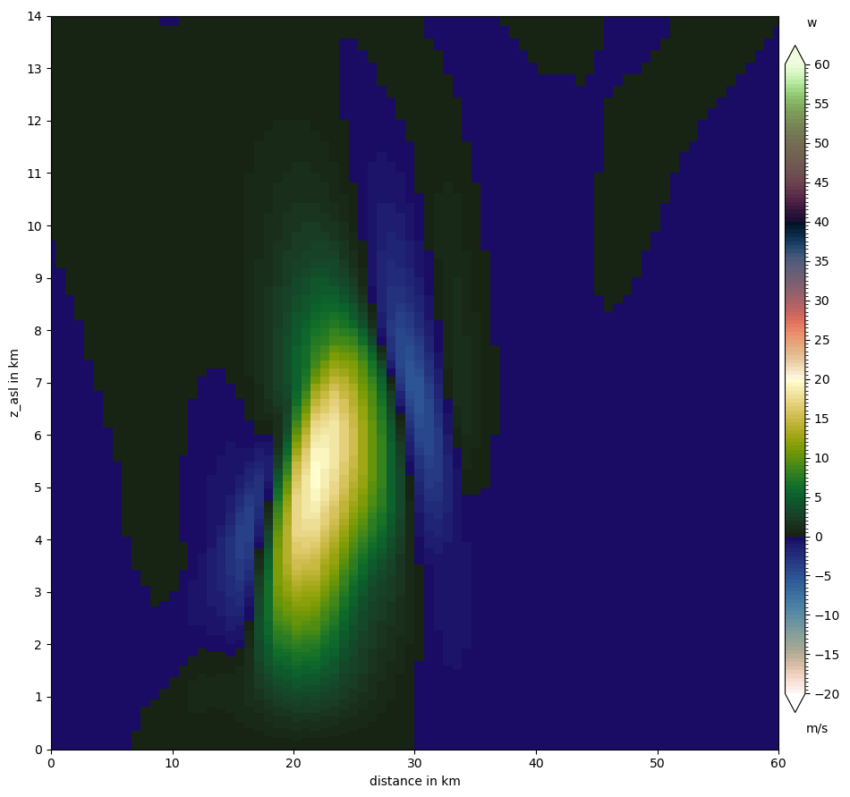
Coupling tests: Initial updraft after 16min
2-Moment Scheme
P3 Scheme (2Cat., 3M)

Slide 13
Coupling tests: Initial updraft after 22min
2-Moment Scheme
P3 Scheme (2Cat., 3M)
Coupling successful

Slide 14
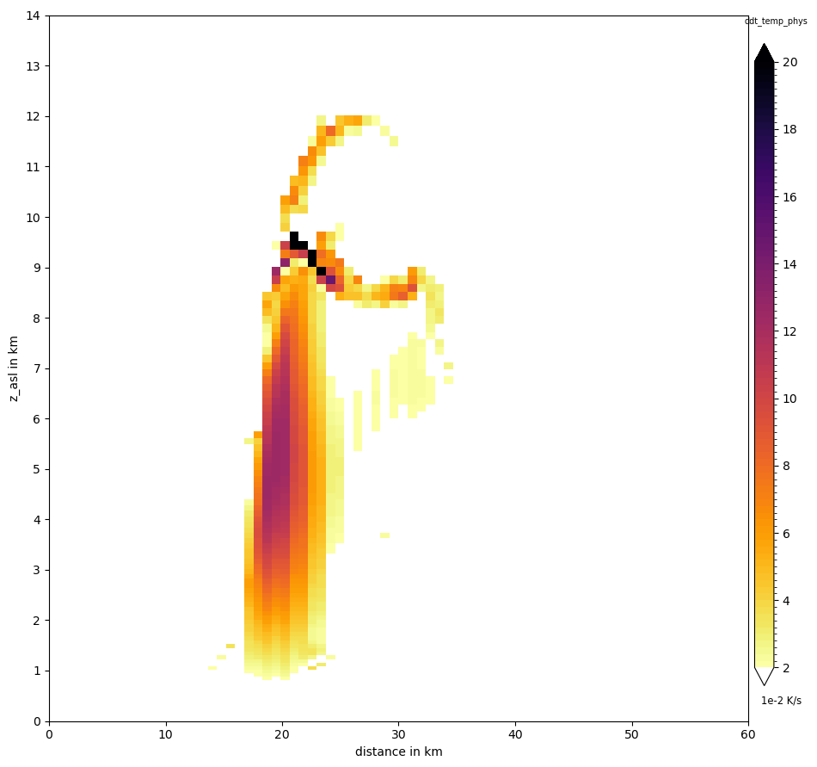
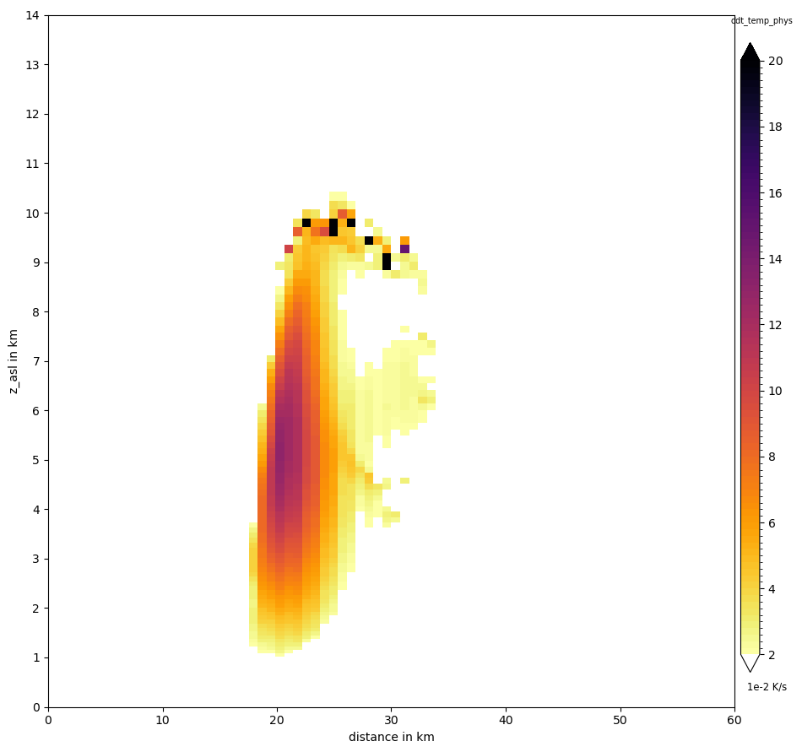
Coupling tests: Microphysical heating rate after 22min
2-Moment Scheme
P3 Scheme (2Cat., 3M)
Coupling successful

Slide 15
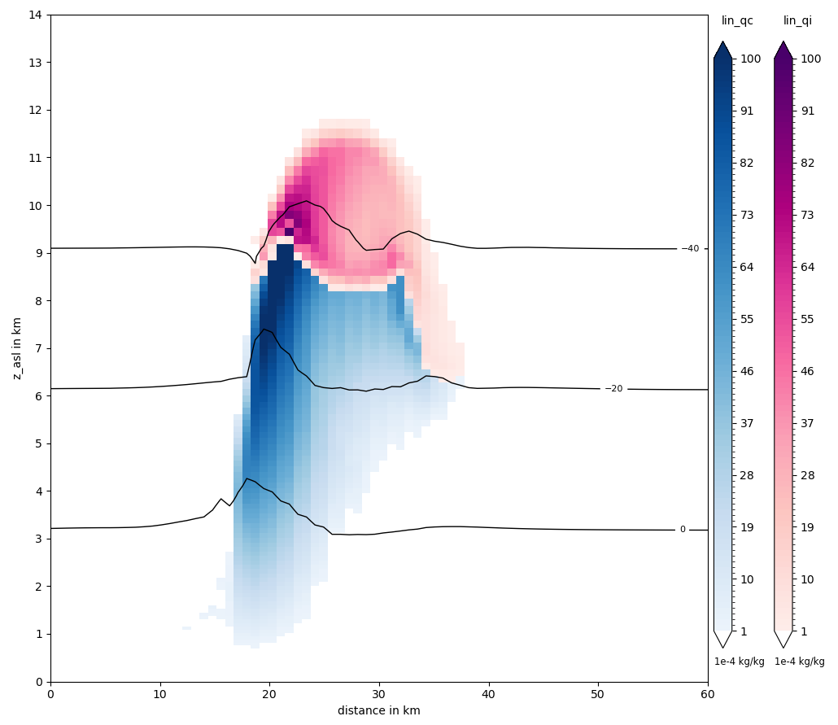
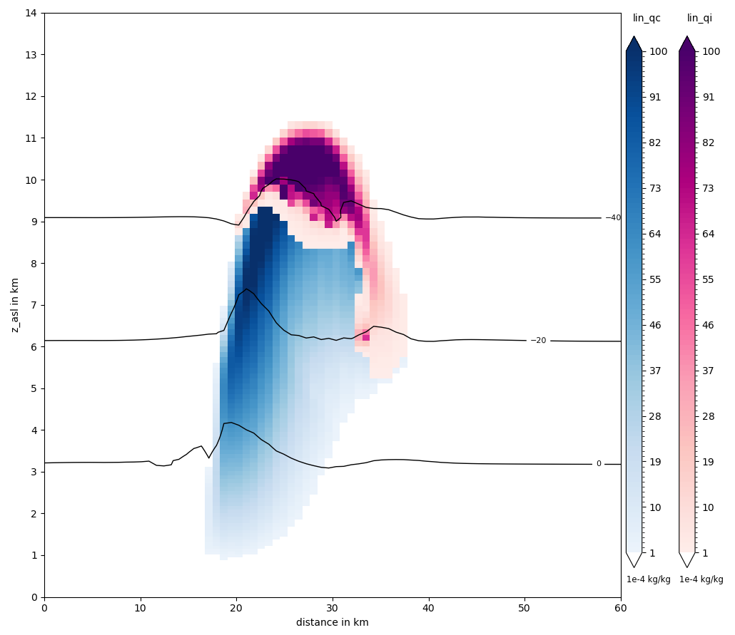
Coupling tests: Hydrometeors after 22min
2-Moment Scheme
P3 Scheme (2Cat., 3M)
Coupling successful

Slide 16
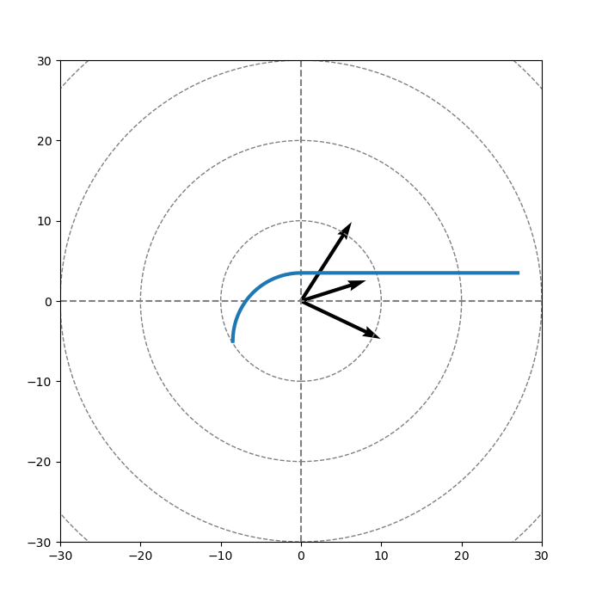
Idealized Test Case: Quarter-circle WK profile + Warm bubble
Torus Grid: Double periodic boundaries
Homogeneous Weisman-Klemp (1982) profile with qv=14 g/kg
Hodograph from WRF test case implementation
2K warm bubble in boundary layer
No surface scheme, no radiation
Resolution: 1km, 5s
Simulation time: 2h
P3 without liquid fraction / no mixed phase particles
Custom CCN activation with 1300 cm-3
LM
2km
7km
MW
0km
RM

Slide 17
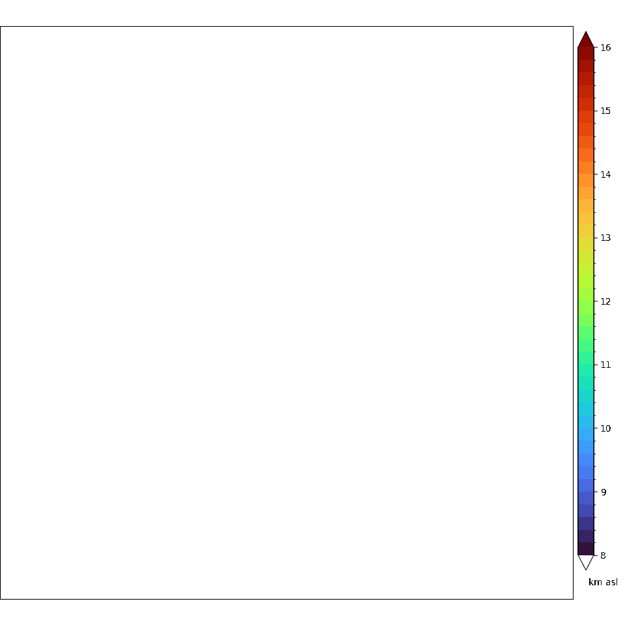
Idealized Test Case: Splitting supercells
P3 Scheme (2Cat., 3M)

Slide 18
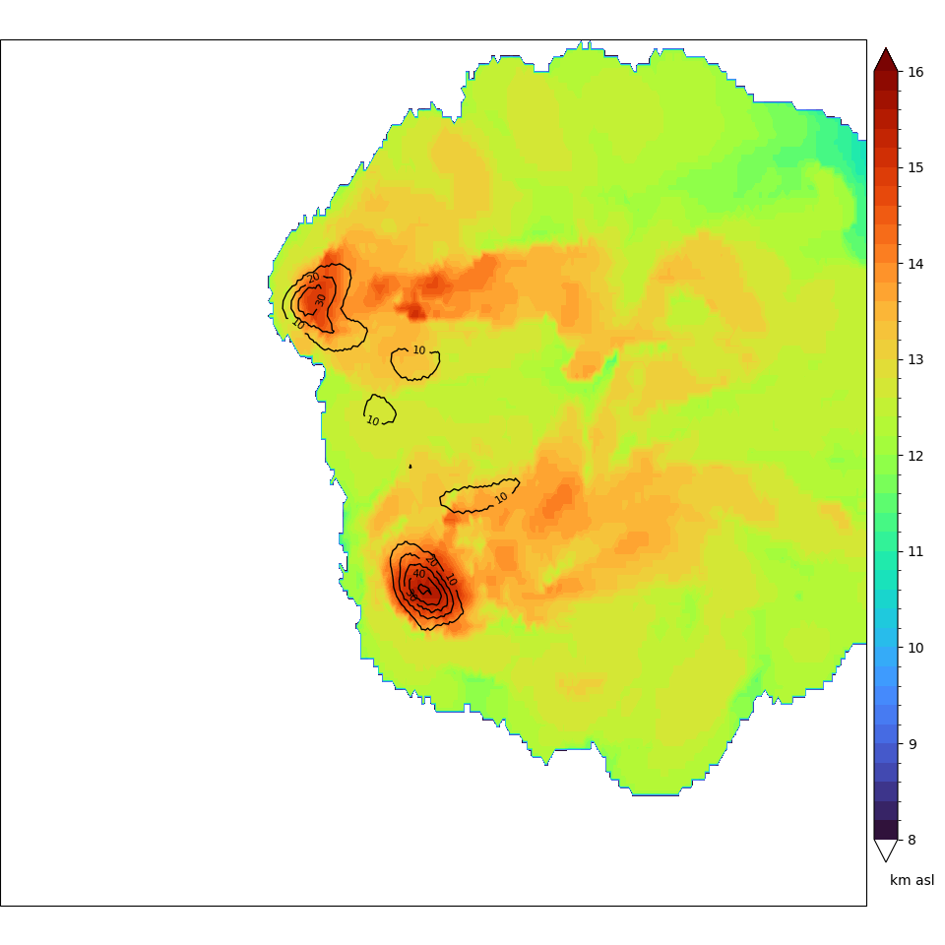
Idealized Test Case: Splitting supercells
P3 Scheme (2Cat., 3M)

Slide 19
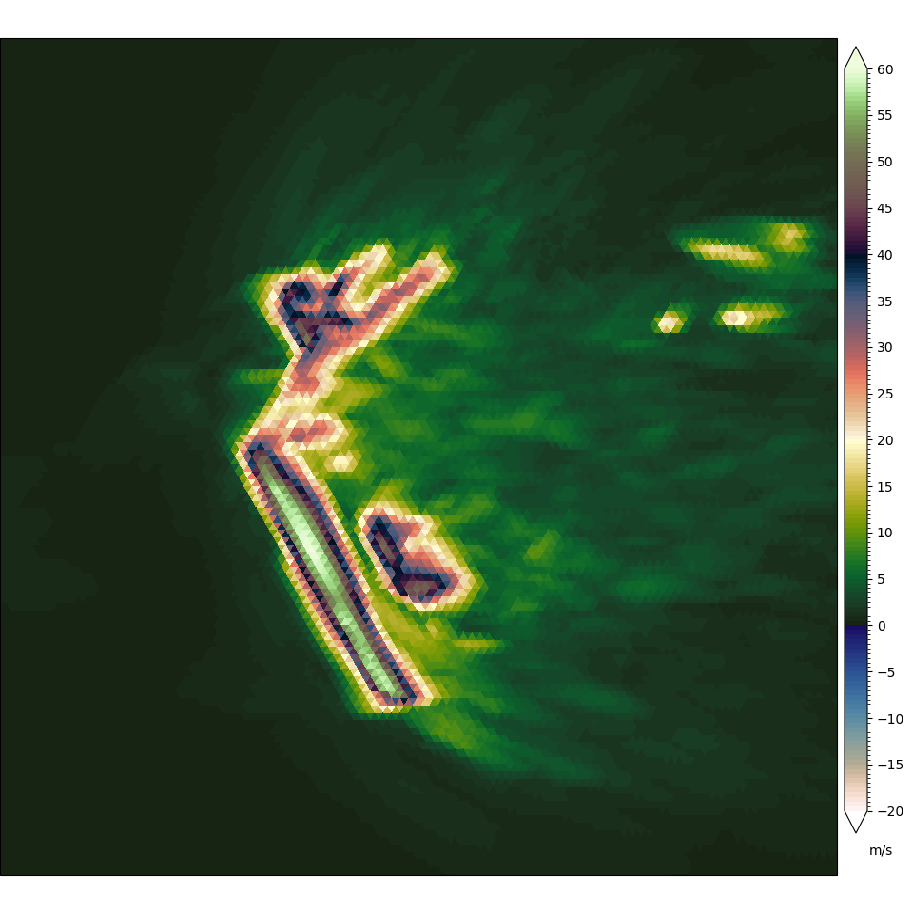
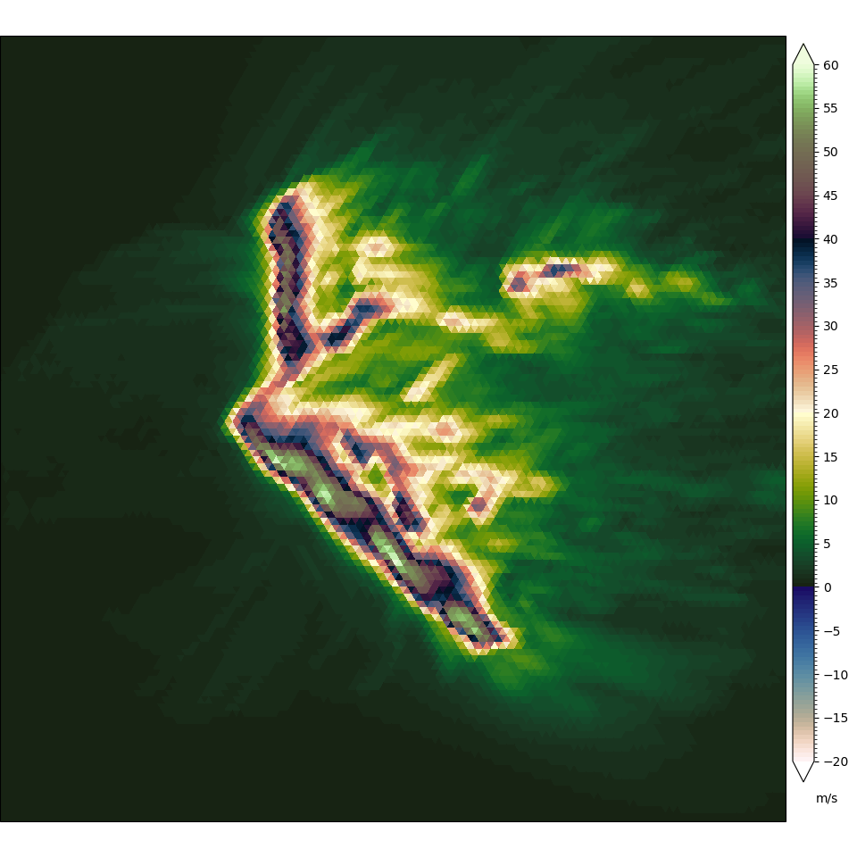
Scheme Comparison: Updraft tracks
2-Moment Scheme
P3 Scheme (2Cat., 3M)
LM
MW
RM

Slide 20
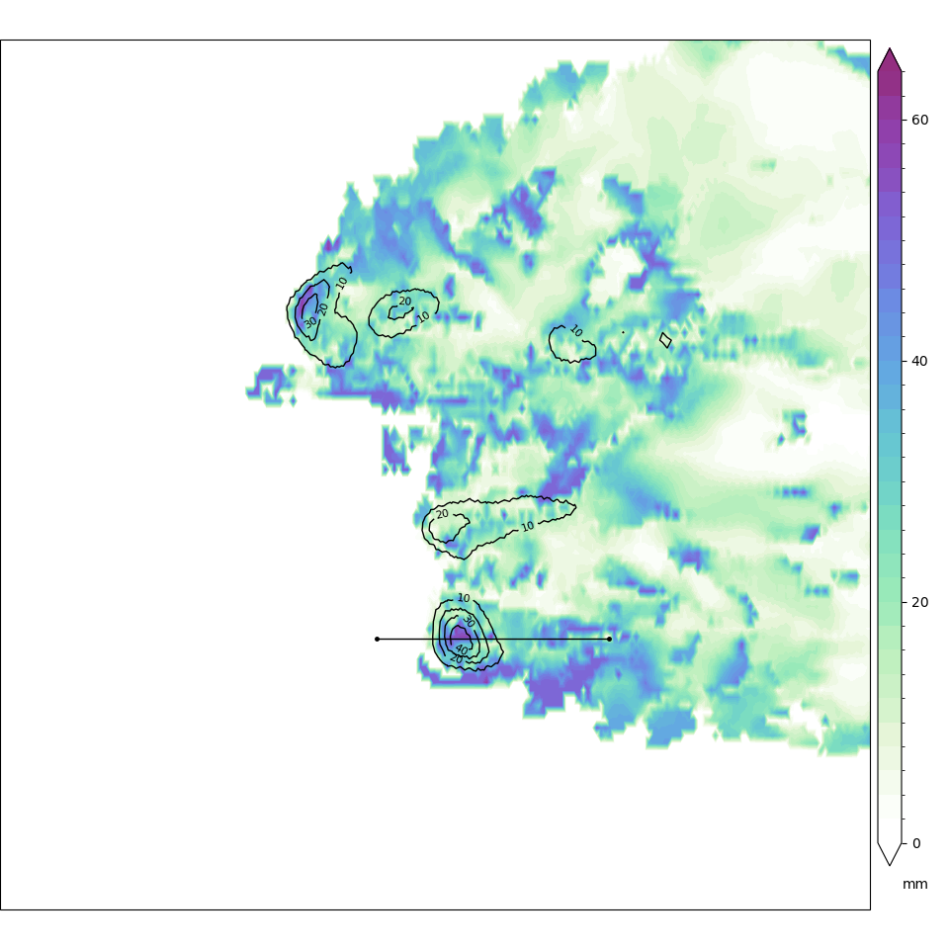
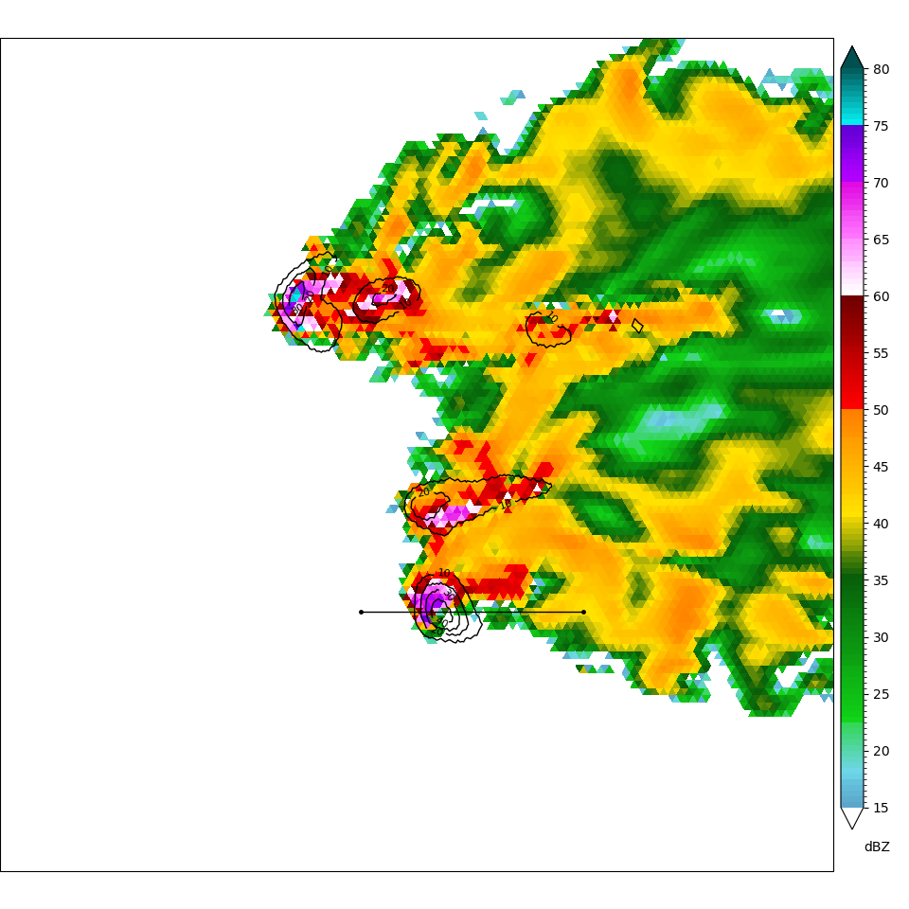
Idealized Test Case: Hail core
Dmean (largest ice) at 4km
Zh at 600m
P3 Scheme (2Cat., 3M)
P3 Scheme (2Cat., 3M)

Slide 21
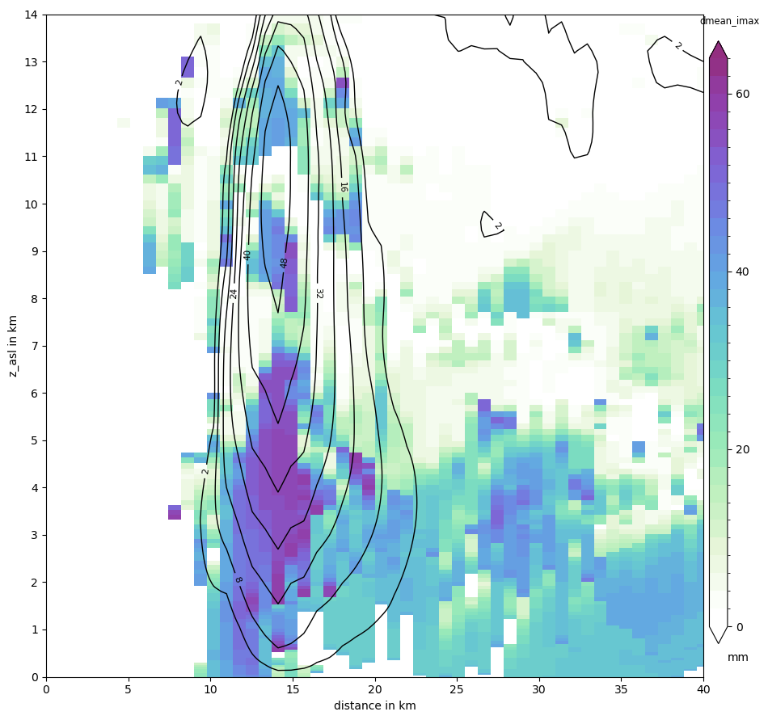
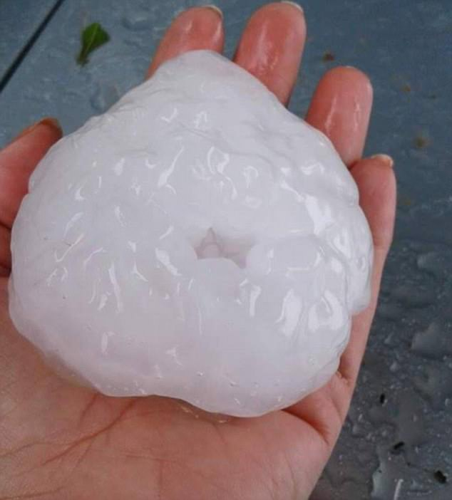
Idealized Test Case: Hail core
Dmean (largest ice) at 4km
P3 Scheme (2Cat., 3M)
P3 Scheme (2Cat., 3M)

Slide 22
Conclusions & Outlook
Successfully re-coupled P3 v5 with ICON using ComIn
Latent heating feedback very similar in both schemes (under high CCN)
First tests of idealized splitting supercells done: got expected storm motions
In P3 (2Cat., 3M, no Liqfr) clear hailcore simulated with baseball-sized hail
Many areas to explore now: Liquid fraction processes, SIP, riming parameterization
Paper for GMD in work
Plugin will be made available soon until merging into official P3 main code done
Investigate realistic case hail cells of RELAMPAGO-CACTI campaign

Slide 23
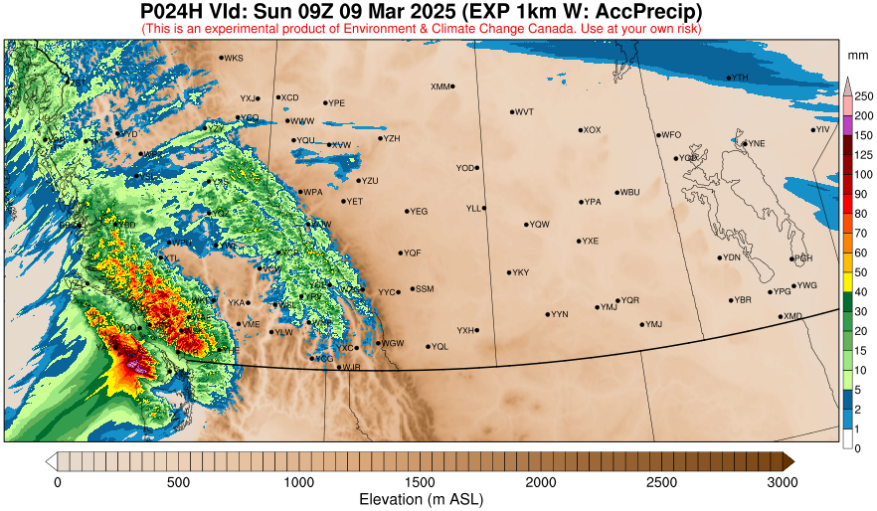
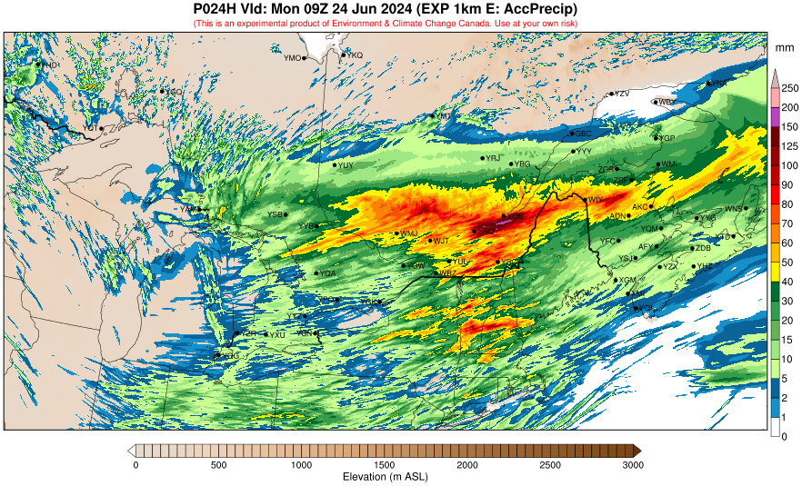
Semi-operational GEM+P3 domains
https://hpfx.collab.science.gc.ca/~rum001/exp_1km/exp_1km_e/current/index.html

Slide 24
Thanks & Questions
I want to be
partly rimed!
Break the traditional category boundaries, free the ice and use ICON+P3!

