Slide 1




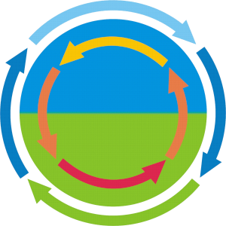
Prognostic ParFlow integrated hydrologic model applications at stakeholder-scale over central Europe
2025-03-17 I Klaus Goergen^{1,2}, Alexandre Belleflamme^{1,2}, Suad Hammoudeh^{1,2}, and Stefan Kollet^{1,2}
¹Institute of Bio- and Geosciences (IBG-3, Agrosphere), Research Centre Jülich (FZJ), Jülich, Germany
²Centre for High-Performance Scientific Computing in Terrestrial Systems (HPSC TerrSys), Geoverbund ABC/J, Jülich, Germany
k.goergen@fz-juelich.de, https://www.fz-juelich.de/profile/goergen_k
CRC1502
DETECT
sfb1502.de

Slide 2
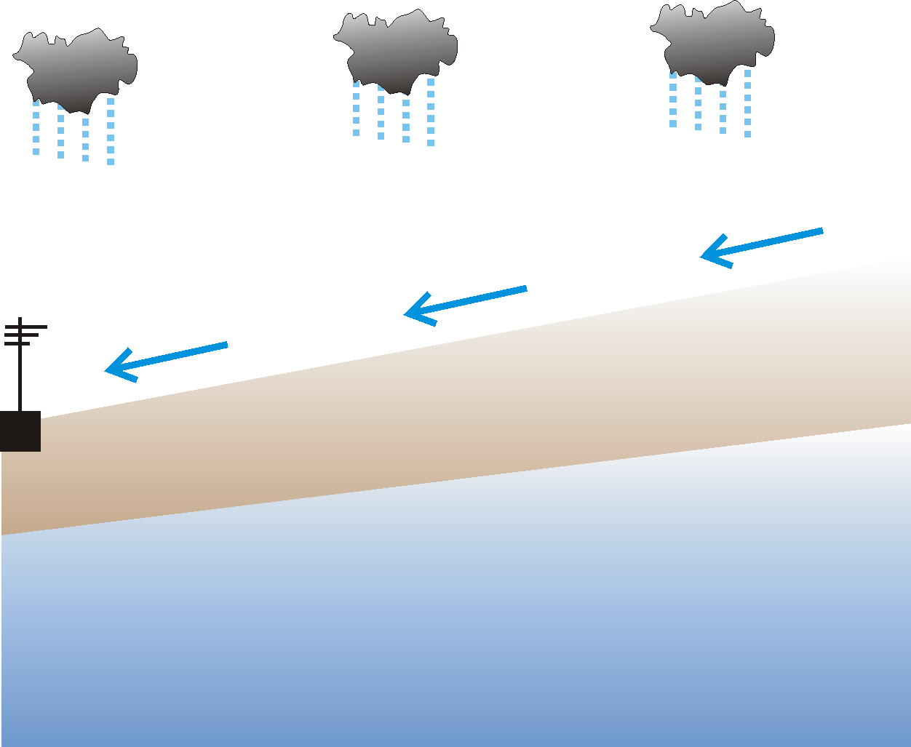
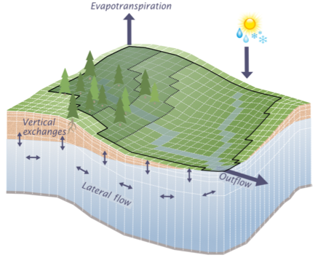
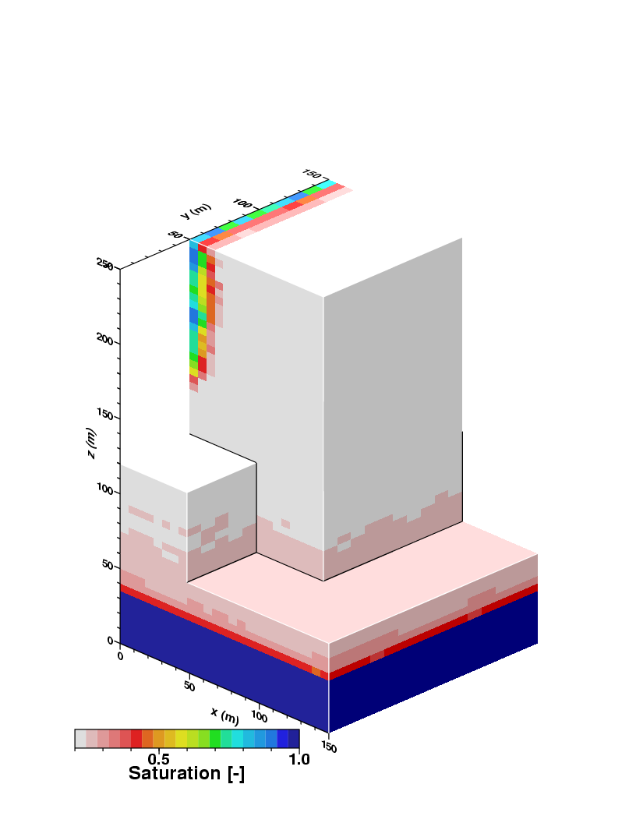
Integrated modelling of terrestrial systems group (S. Kollet)
Our interest: Terrestrial water cycle functioning, interactions, feedbacks (G2A), and changes
ECMWF
ParFlow integrated hydrological model (github.com/parflow)
Physically based model,
explicit representation of transport processes and feedbacks
2D/3D surface and subsurface hydrodynamics are treated in continuum approach
Land-atmosphere interactions through Common Land Model (CLM)
Consistent terrestrial water cycle representation
Integrated HM with 3D hydrodynamics
Atmospheric Forcing
CLM
Vegetation
Ground Surface
Condon and Maxwell
(2017, HESS)
Infiltration Front
Vadose Zone
ParFlow
Added value of IHMs, e.g., due to: Redistribution of surface and groundwater, streamflow aquifer interactions, ponding / flowing water in convergence zones, evolution of river networks, km-scale heterogeneity, hill-slope processes
Saturated Zone
Water Table
Realistic process representation
ParFlow overview: Kuffour et al. (2020, GMD)

Slide 3
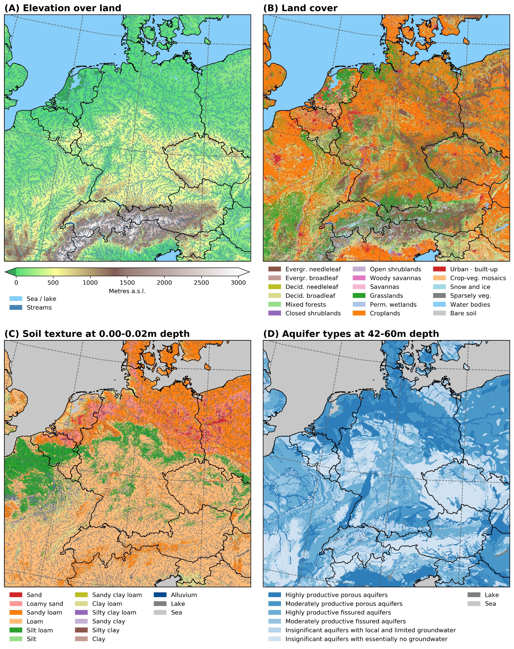
Prognostic ParFlow simulations for water resources
DE06: “Hydrologic Germany”, 611m resolution, 2000x2000x15 grid points, to 60m depth w/ ParFlow/CLM
After 2018/2019 droughts: Setup DE06 in co-design approach with agriculture stakeholders for water resources
Careful setup of hydro-facies distributions and soil hydraulic properties
Extensive spinup
No calibration or tuning
IGBP type land cover from CORINE USDA soil types from SoilGrids textures IHME hydrogeological types
0-0.02m depth
42-60m depth
Van Genuchten parameters from ROSETTA
Belleflamme et al. (2023, Frontiers in Water)

Slide 4





System for daily DE06 quasi-operational monitoring/forecasting runs
Also available: HRES-driven climatology is from 2011, workflow is on JSC/JUWELS HPC GPU Booster
Portal for farming community
ParFlow/CLM
seasonal
predictions
every 3 months
Every 3 months
+ 7 months
SEAS = 50-member, probabilistic
ECMWF seasonal predictions
SEAS01 – SEAS02 … SEAS50
d_{n} h0-h5136 (7 months)
Dissemination
ECMWF medium-range forecast
HRES – ENS01 – ENS02 … ENS50
d_{n} h0-h240
General public
interface
Daily forecast ensemble
+ 10 days
HRES = deterministic
ENS = 50-member, probabilistic
ParFlow/CLM
medium-range
forecasts
every / 2nd day
Initial conditions
ECMWF medium-range forecast
HRES – ENS01 – ENS02 … ENS50
d_{n+1} h0-h240
IC
Data portal
ParFlow/CLM
historical
time series
combination of
24hr HRES
forecast
HRES
d_{n-2} h0-h24
IC
HRES
d_{n-1} h0-h24
IC
HRES
d_{n} h0-h24
Experimental Water Resources Bulletin
d_{n-1}
d_{n}
d_{n+1}
Belleflamme et al. (2023, Frontiers in Water)

Slide 5
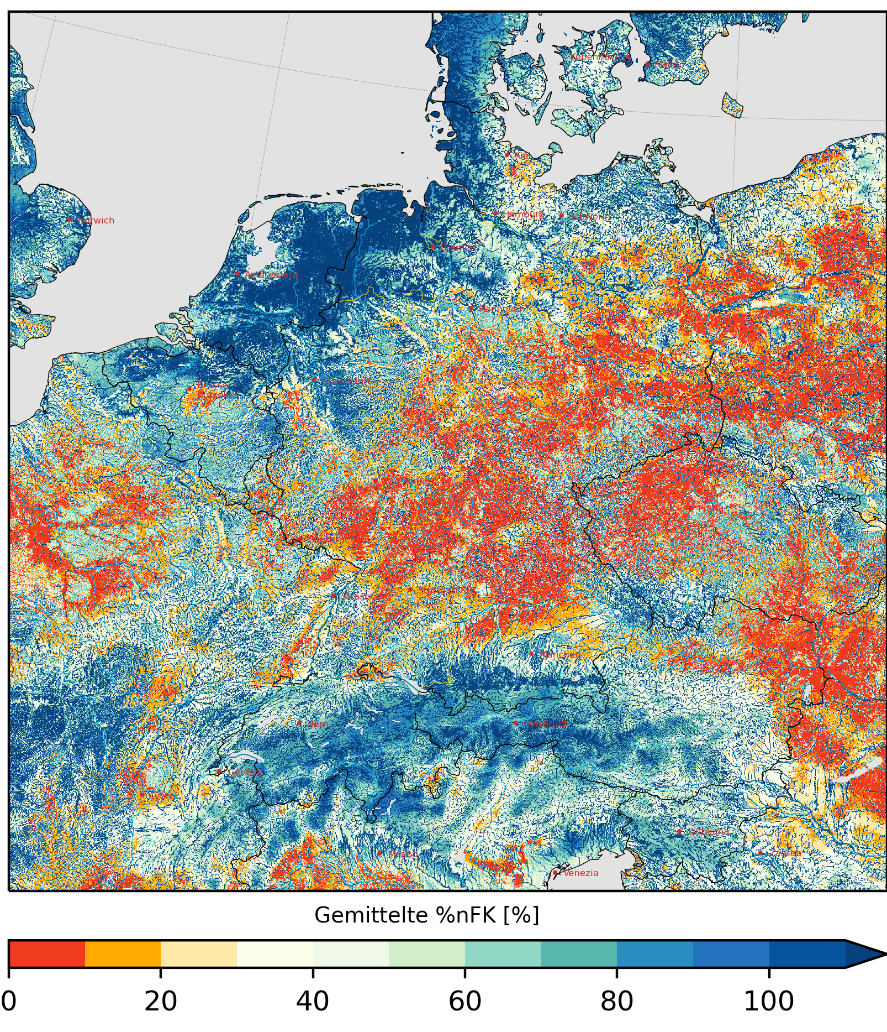
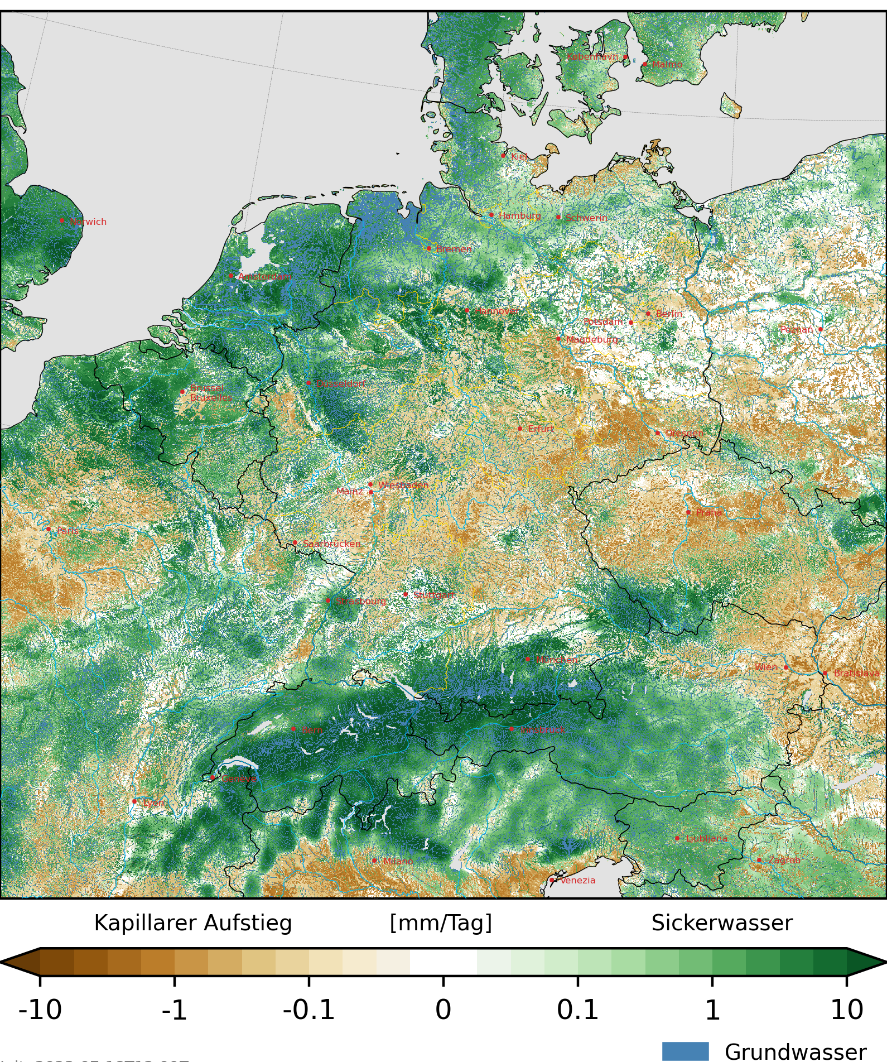
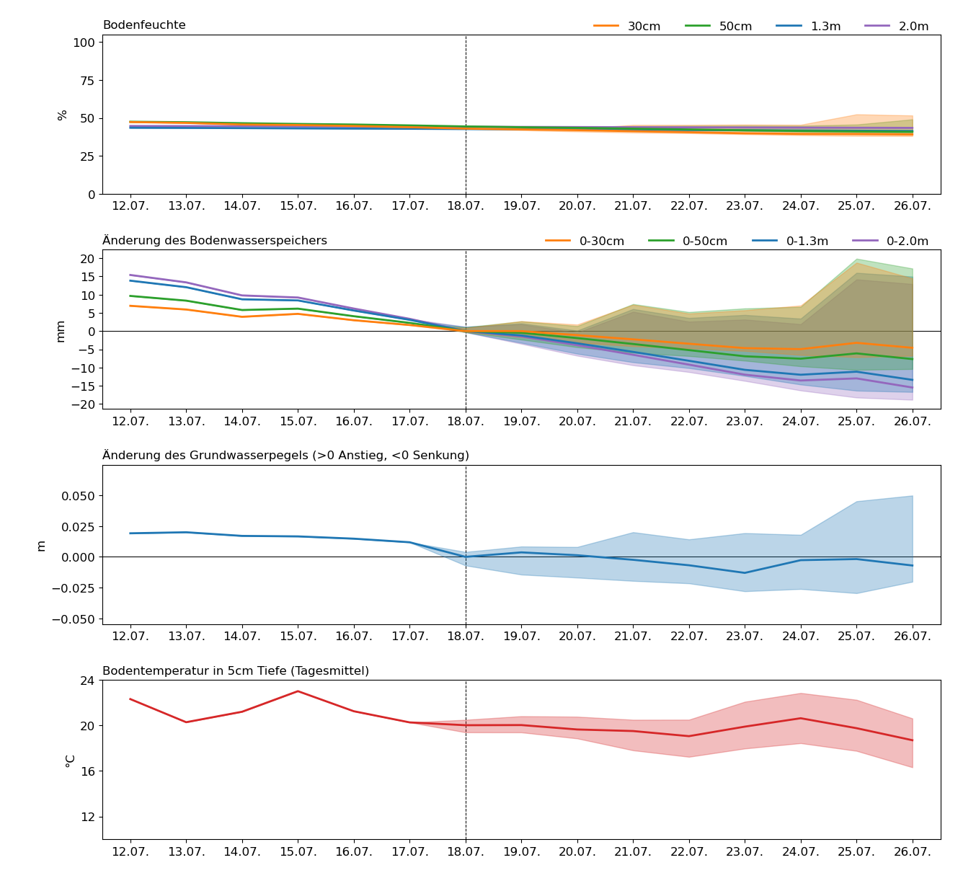
Agriculture stakeholder information needs define our products
Towards a more weather extremes-resilient agriculture www.adapter-projekt.de
e.g., water stress impacts
e.g., leakage of nutrients, GW recharge
e.g., 8+ diagnostics daily
Plant available water
2023-07-25 daily mean, 0-30cm depth
Seepage water / capillary rise
2023-07-25 daily sum, 30cm depth
Soil water saturation (end of day)
Subsurface water storage change (end of day)
Water table depth change (end of day)
Soil temperature in 5cm depth (daily mean)
Fraction of total PAW [%]
Capillary rise [mm/day] Seepage water
3x3km2 timeseries, including uncertainties
Belleflamme et al., (2023, Frontiers in Water)
Groundwater

Slide 6
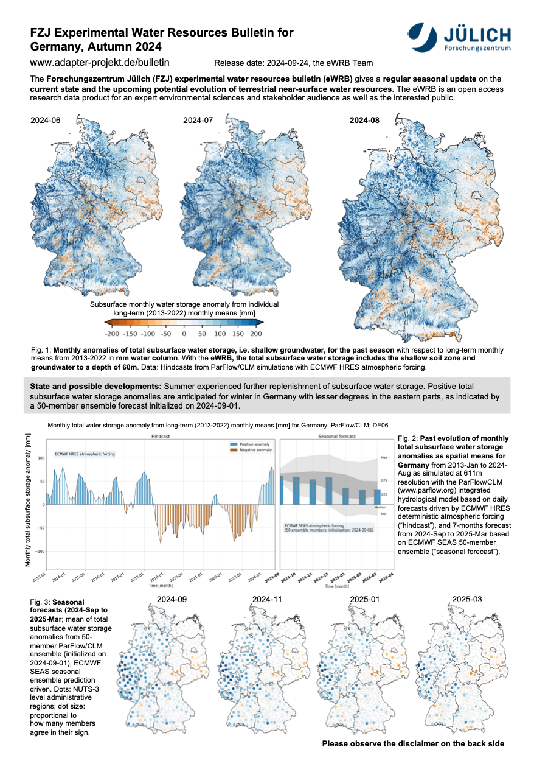
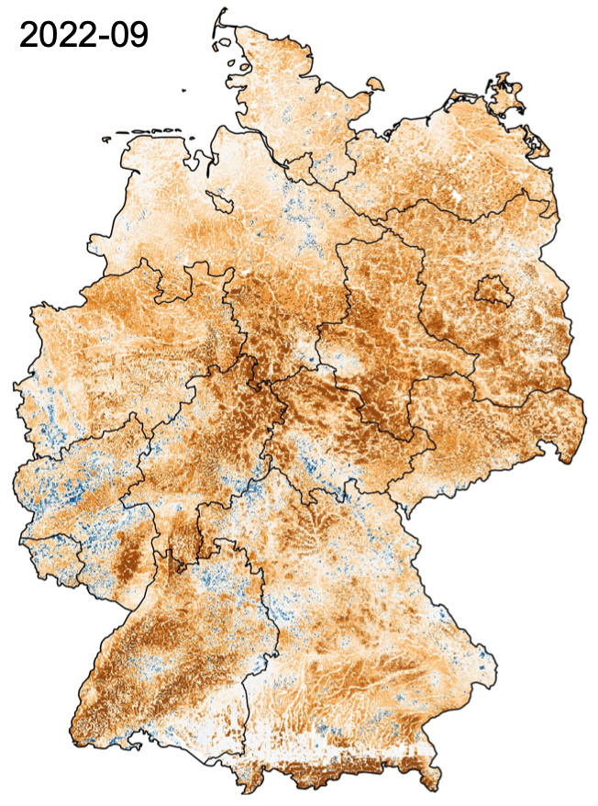
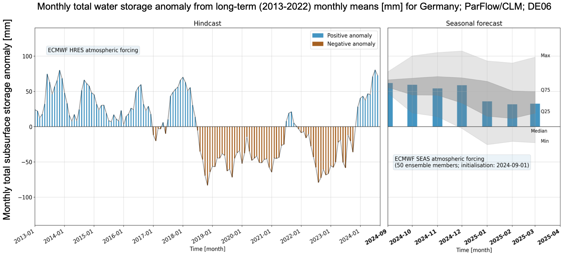
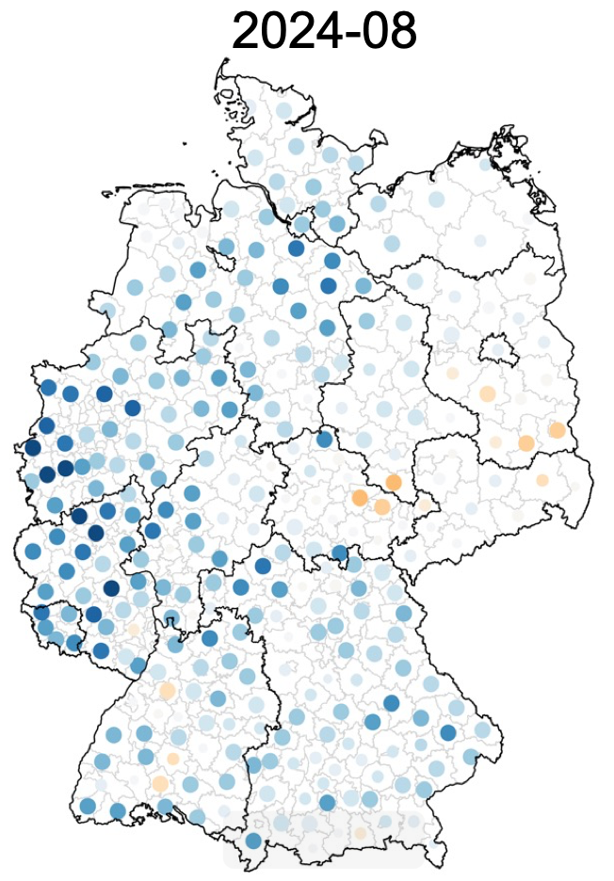
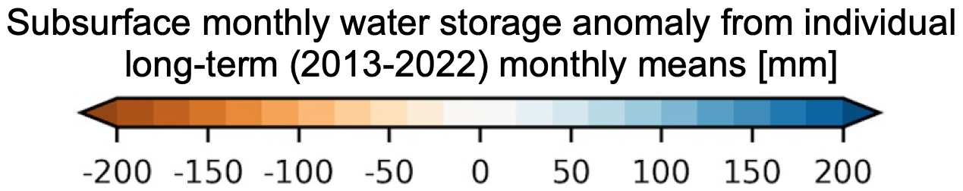
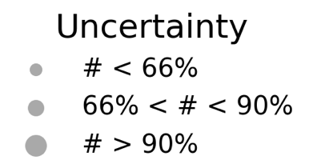
Experimental Water Resources Bulletin (eWRB)
Seasonal predictions of subsurface water storage www.adapter-projekt.de/bulletin/index_en.html
Hydrometeorological extremes, recent severe droughts, well captured
Hindcast, deterministic ECMWF/HRES forcing
50-member seasonal forecast
2022-09
2024-08
Belleflamme et al. (under prep.), Hammoudeh et al. (under prep.)

Slide 7
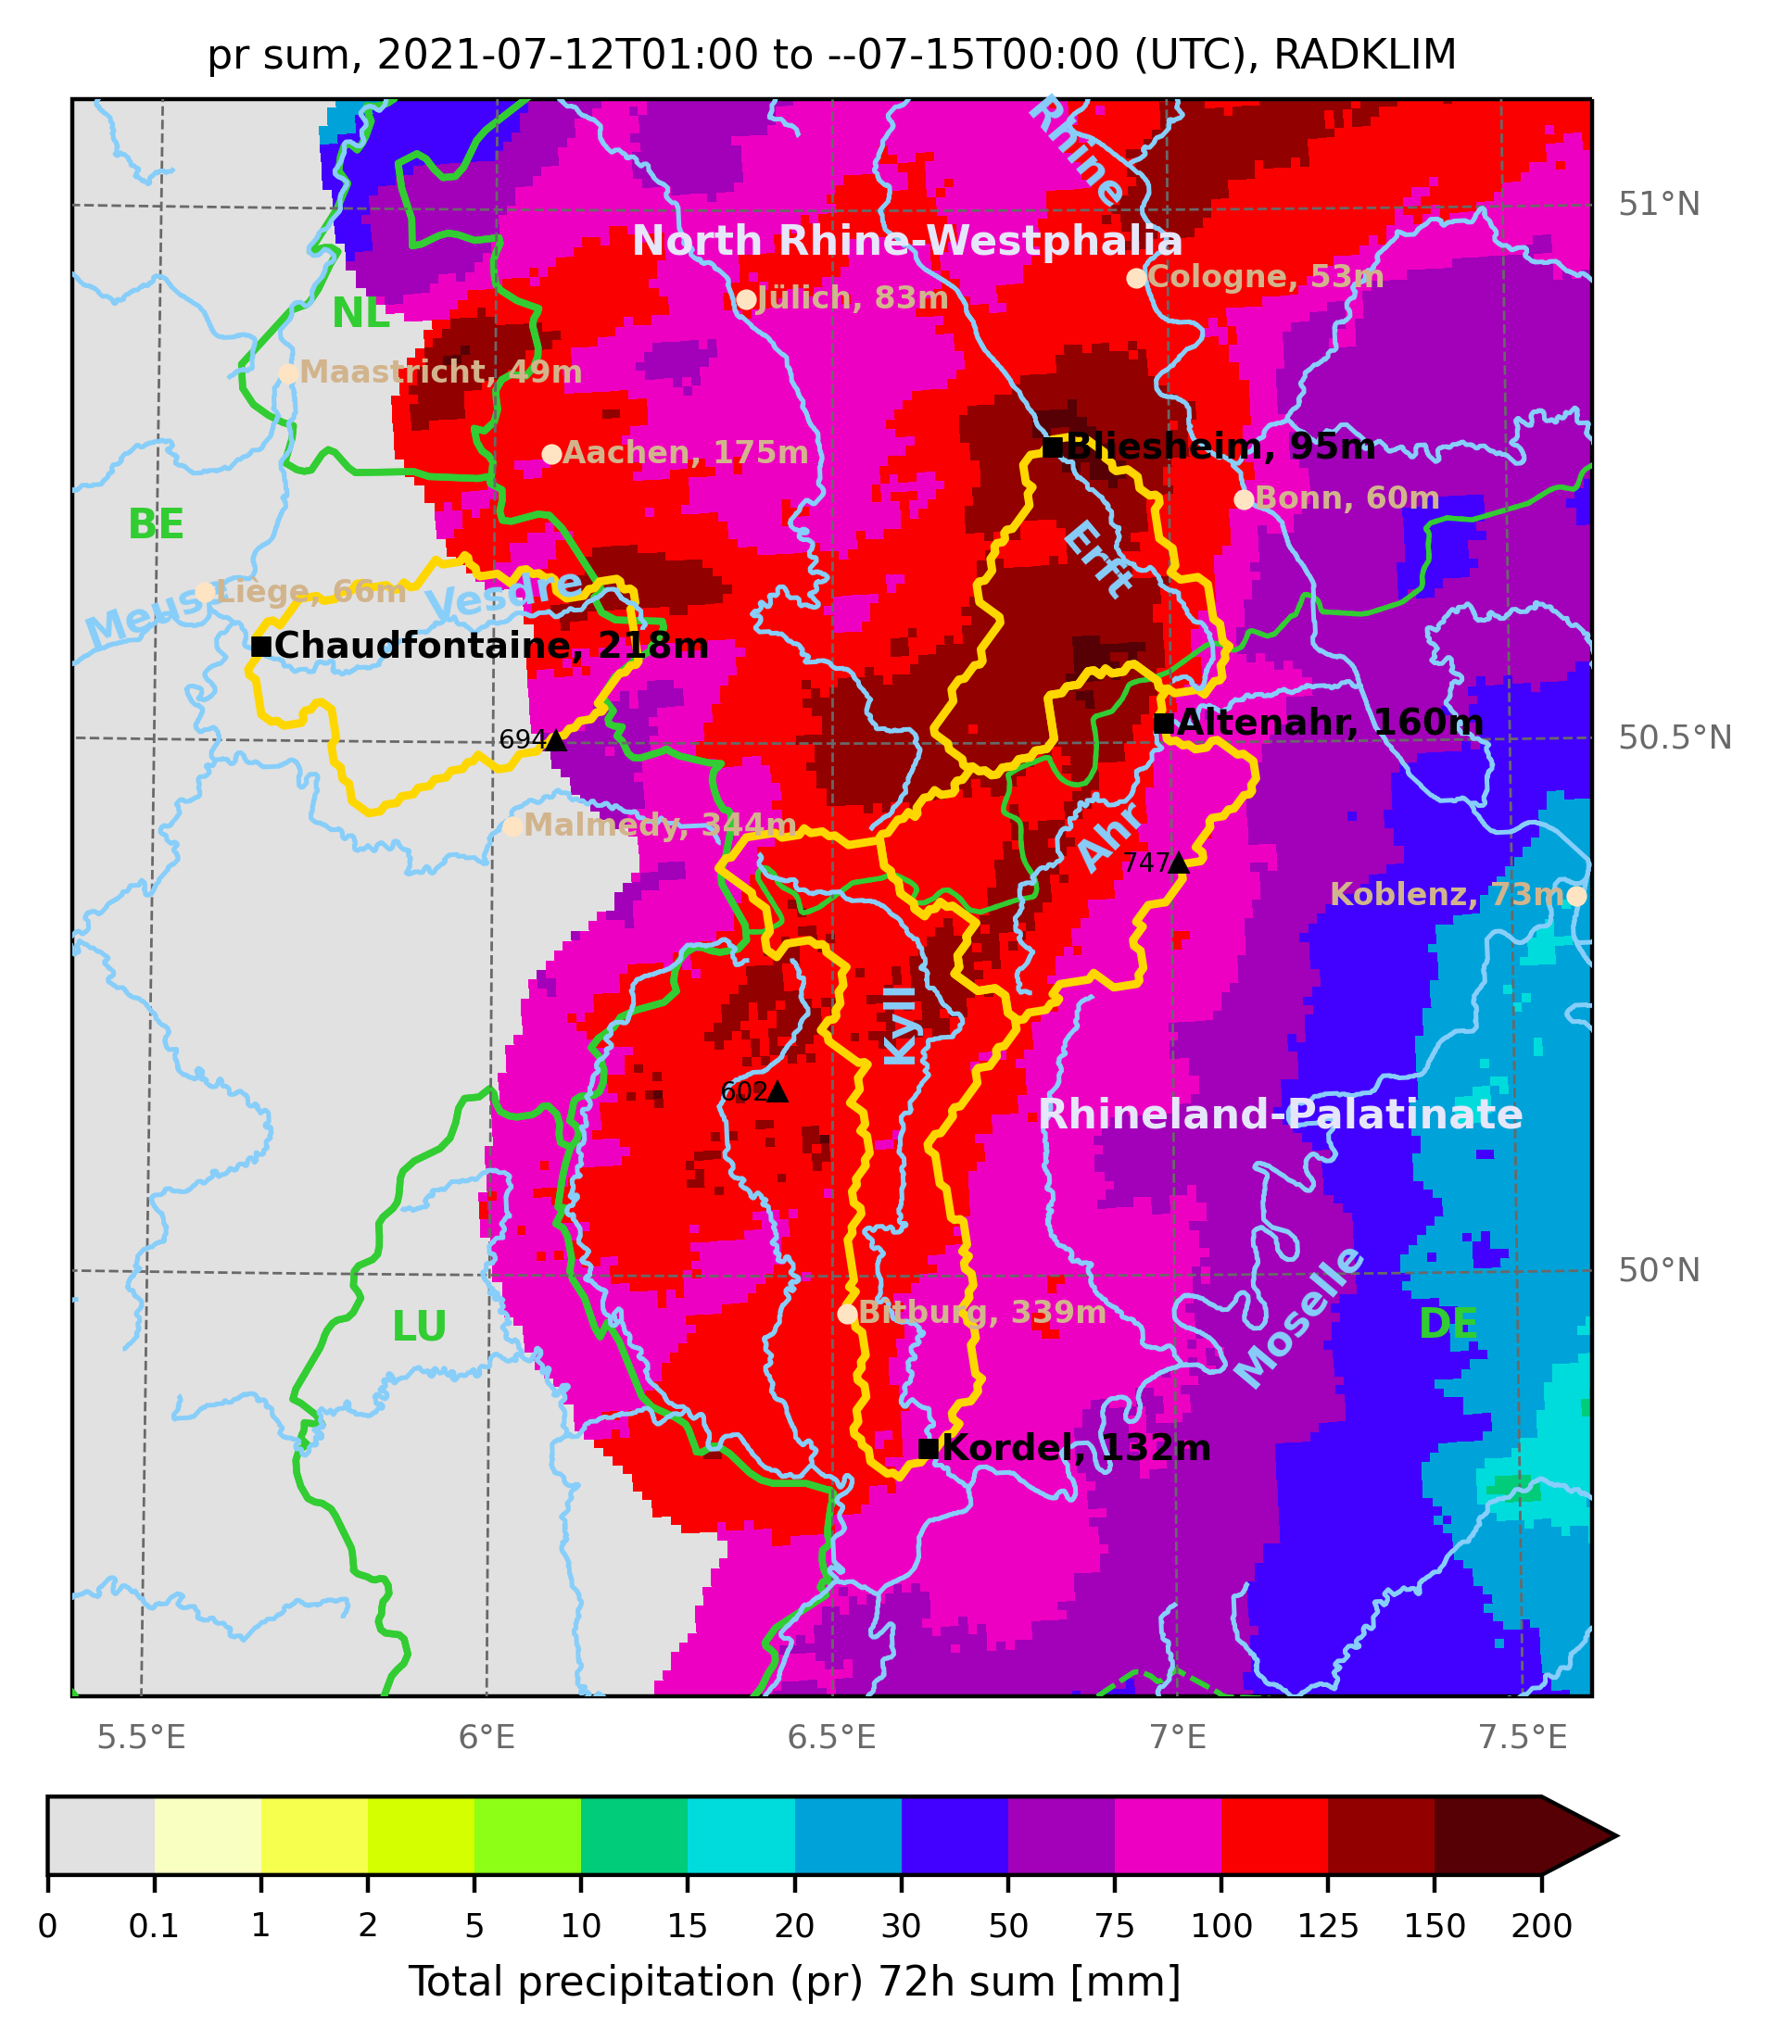
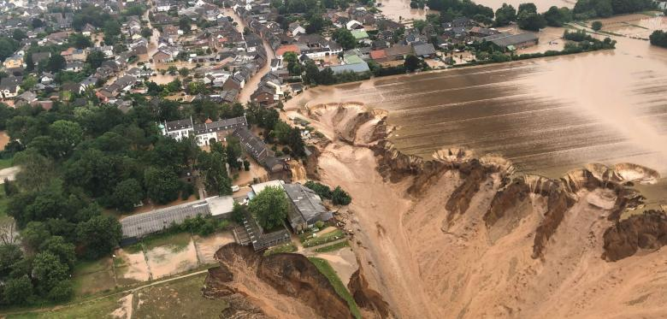
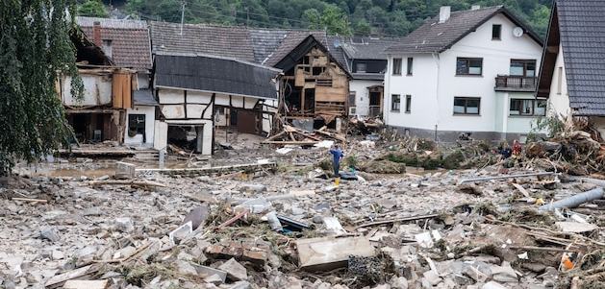
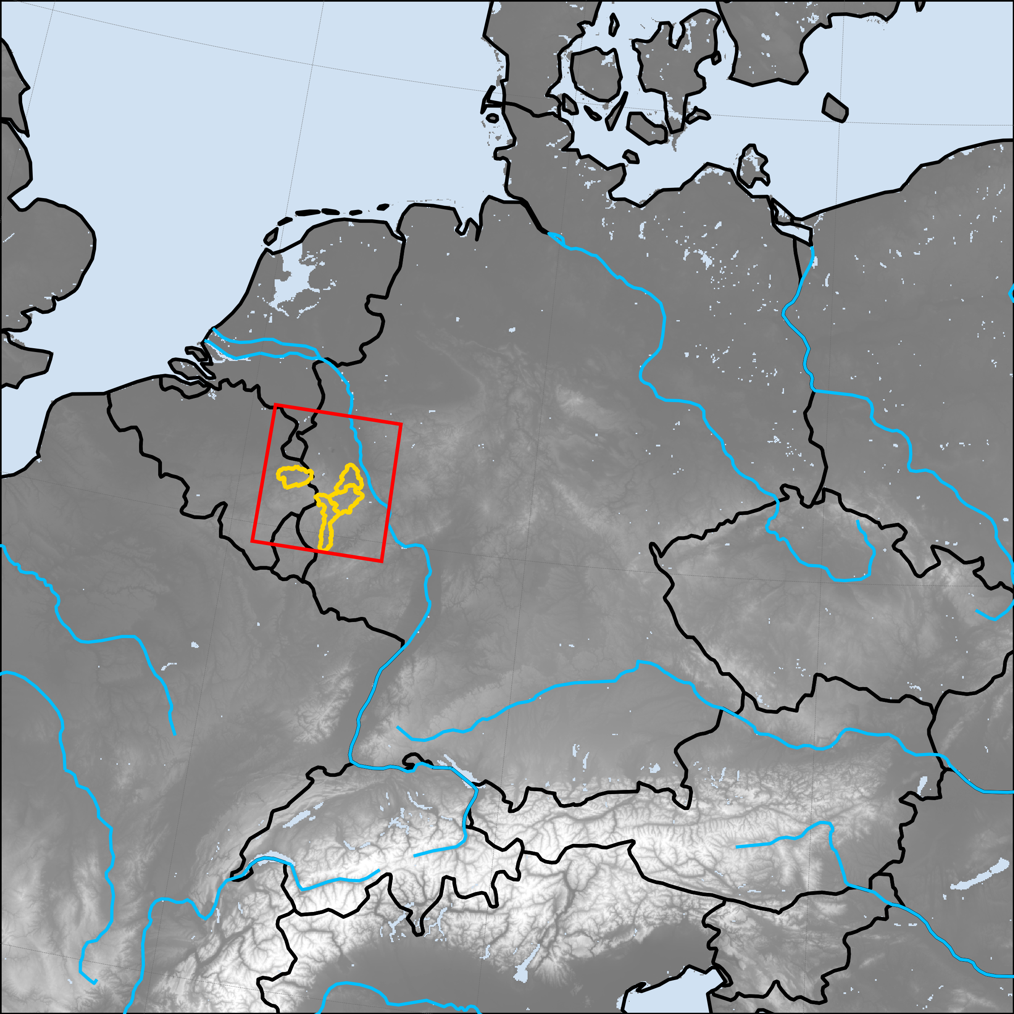
w/ DE06: Analyse unprecedented Central Europe 2021-07-14/15 flood
Goal: Process-based analysis to demonstrate the prognostic capabilities of ParFlow/CLM DE06 ensemble
72h (-07-12 to 14) radar precipitation sum RADKLIM
Sustained, intense, widespread rainfall from a quasi-stationary low
Rainfall event affected complete Eifel-Ardennes low mountain ranges drainage network
NWP models predicted July ‘21 precipitation extremes
Major natural hazard in north-western Europe (many casualties, high damages)
E.g., Ahr catchment:
  70mm July long-term mean,
  115mm/72h from 2021-07-12 to 14,
  100mm/12h during 2021-07-14 afternoon
missing
values
Erftstadt-Blessem, Erft
www.welt.de
Schuld, Ahr
www.focus.de
Vesdre
669km²
Chaudfontaine gauge
Ahr
753km²
Altenahr gauge
Domain subset: ≈150x150km²
Heavily affected catchments:
Ahr, Vesdre, Kyll, Erft

Slide 8
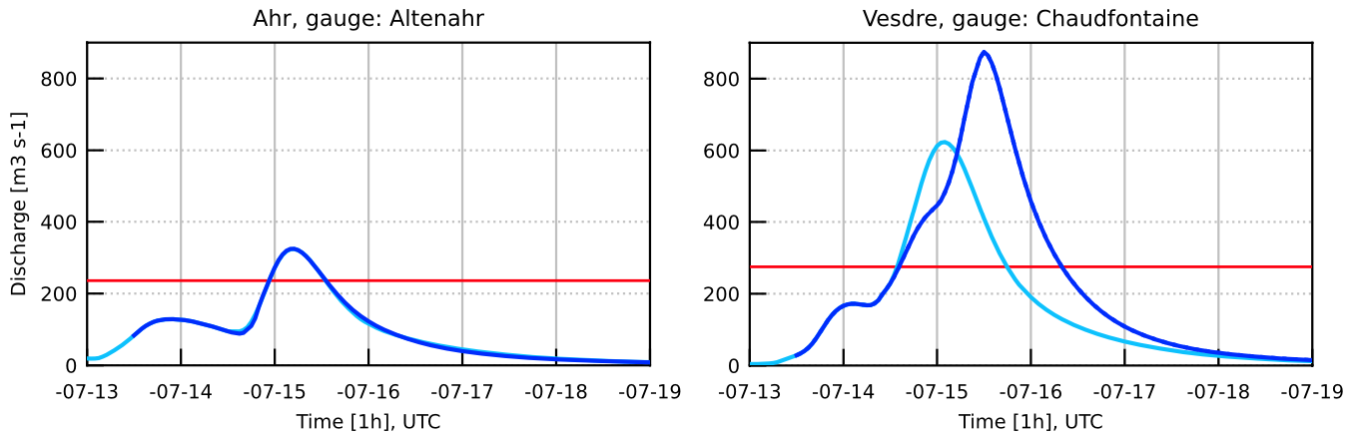
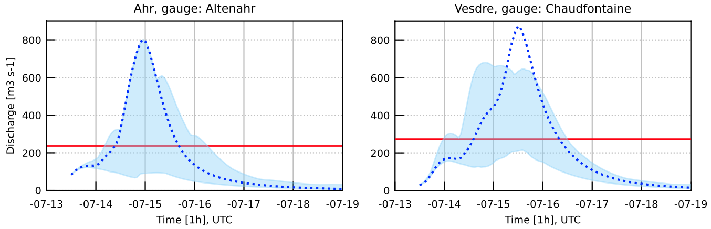
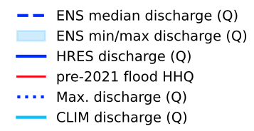
Dynamics and order of magnitude of discharge can be reproduced
Use DE06 as-is for process analysis; no focus on forecast skill or an exact event reproduction
Discharge, Ahr river at gauge Altenahr
Discharge, Vesdre river at gauge Chaudfontaine
DE06 ENS41
DE06 HRES
Highest discharge ensemble member
Deteministic HRES
atmospheric forcing:
too low discharge
Based on Parflow overland flow
ParFlow/CLM DE06
ECMWF HRES, ENS forcing
Initialisation: 2021-07-13_12UTC
Reconstructed: Q_{peak}=1000-1200m³s⁻¹
at Altenahr (Roggenkamp Herget,
2022, HYWA); Q_{peak}=680m³s⁻¹
at Chaudf. (pers. comm. Uni Lüttich)
HHQ_{pre21}=236m³ s⁻¹
HHQ_{pre21}=275m³ s⁻¹
Large precipitation bandwith leads to highly differing discharge peaks; same with QPEs from radar observations (Saadi et al., 2023)
Tuning, e.g., possible via streamflow parametrisations (Manning’s coefficient, but roughness unknown or not represented)
The DE06 water resources forecast “as is” captures extreme flood event w/o additional calibration / tuning
Goergen et al. (under rev.)

Slide 9
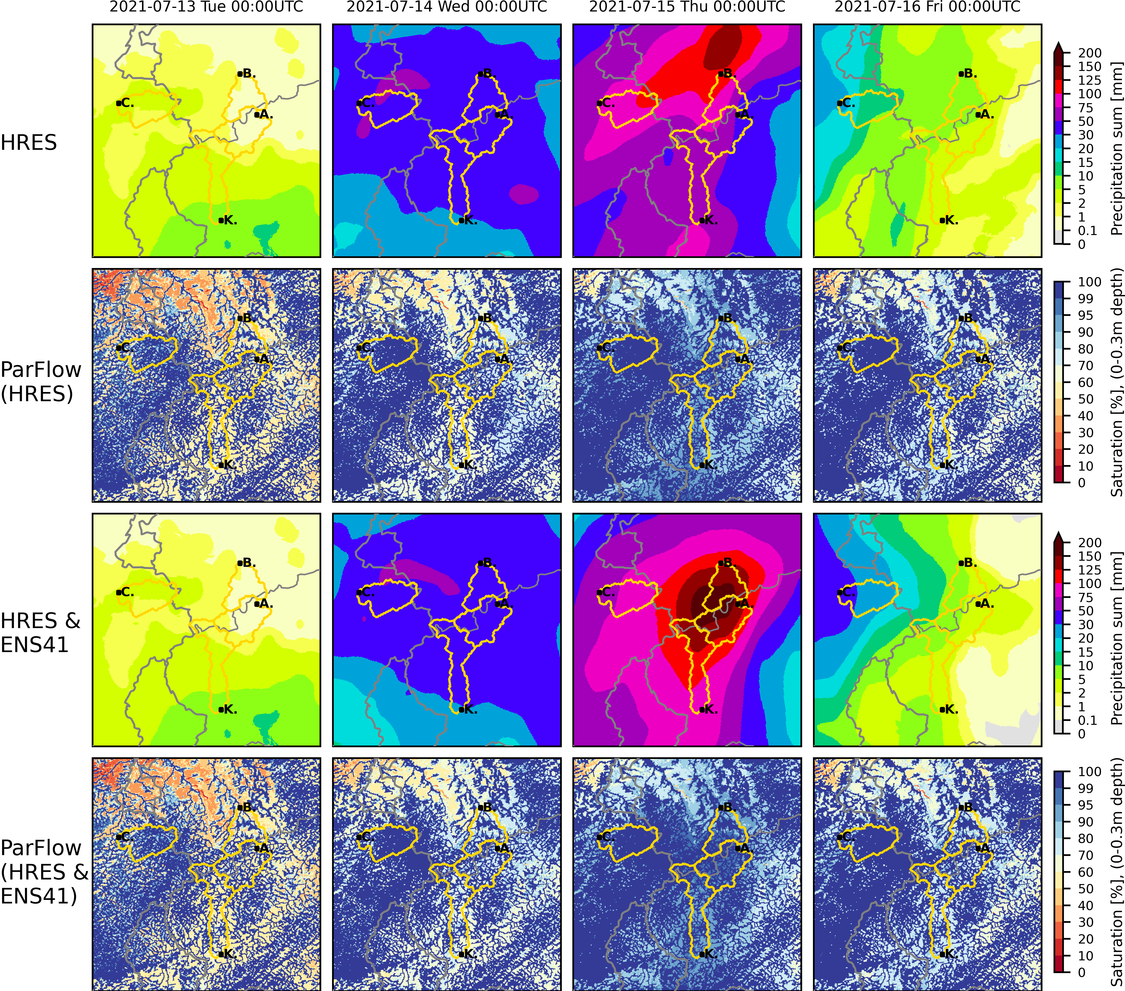
The soil almost reached saturation during the event
Maximum average soil saturation (0-30cm) over the 4 catchments is 91-97%
Our interest is in the physical processes
No infiltration excess
overland flow
Very low overland flow outside river channels
High exfiltration in the valleys
We hypothesize that there was a strong pressure response of the system
Vesdre: Different preconditioning; higher saturation at the onset
2021-07-12_01-24UTC, Mon 2021-07-13_01-24UTC, Tue 2021-07-14_01-24UTC, Wed 2021-07-15_01-24UTC, Thu
Ensemble
member:
2021-07-13_00UTC, Tue 2021-07-14_00UTC, Wed 2021-07-15_00UTC, Thu 2021-07-16_00UTC, Fri
before after
Relatively homogeneous soil hydraulic properties between catchments

Slide 10
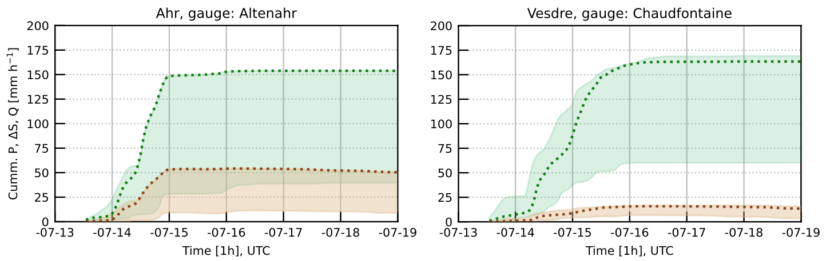
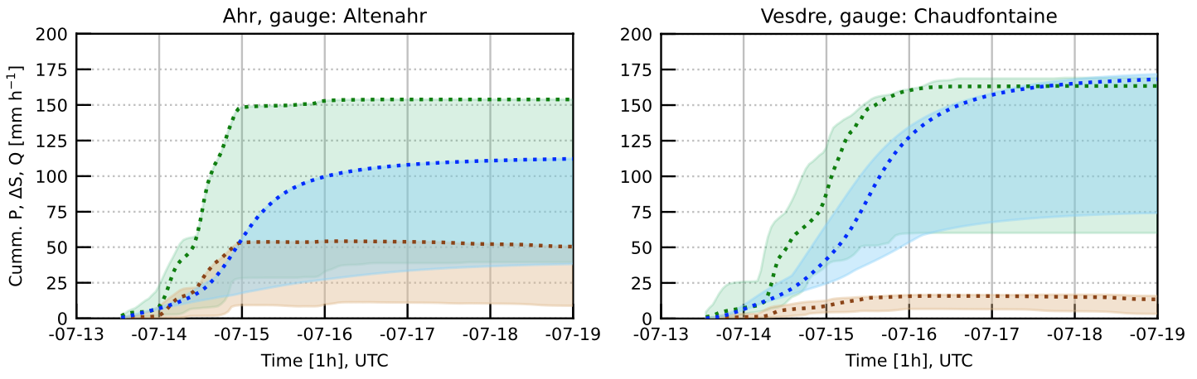
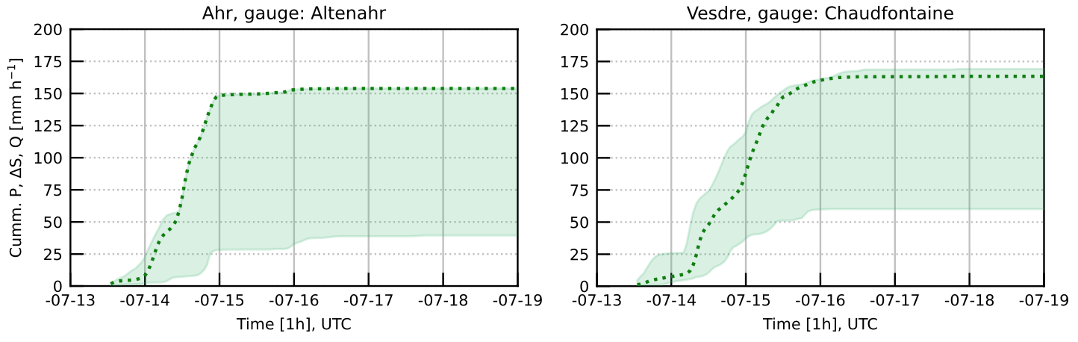
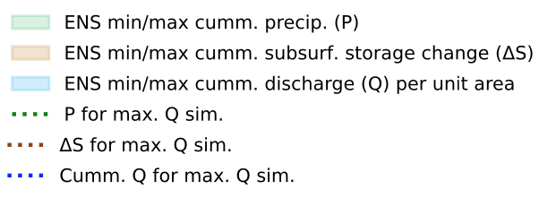
Strong buffer effect through subsurface storage
Up to 1/3 of the precipitation can infiltrate in the Ahr catchment, avoiding even higher discharge peaks
Highest discharge ensemble member
DE06 ENS41
Ahr river
catchment
DE06 HRES
Vesdre river
catchment
Precipitation
Discharge
Subsurface storage change
Cummulative sums [mm h⁻¹] of
mean precipitation,
total subsurface storage change, discharge per unit catchment area
Ahr catchment: Increase in subsurface storage mitigates stream flow response, despite 70% saturation (14.7. 00UTC)
Vesdre catchment: Initially higher saturation, less subsurface buffer, about all precipitation transformed into discharge
Due to surface and subsurface water interaction, dynamics is different than for flash floods (no infiltration excess overland flow)

Slide 11
Conclusions and outlook
IHM ParFlow/CLM with DE06 setup is an applied, highly versatile monitoring and forecasting system
Use for water resources applications and hydrometeorological extreme events
Uncalibrated physics-based ParFlow IHM can capture dynamics and magnitude the July 2021 flood event
For the Ahr, the subsurface could absorb about 1/3 of the precipitation, mitigating the stream flow response
asdasd
Outlook
The physical representation of groundwater-surface water interactions affords hypothesis testing and will be used for more in-depth process analysis of the 2021 flood event
With new exascale JSC/JUPITER HPC a pan-European forescast domain (EU06) seems feasible
Combination of added value of ParFlow IHM and high-resolution atmospheric models in coupled ESMs

