Slide 1
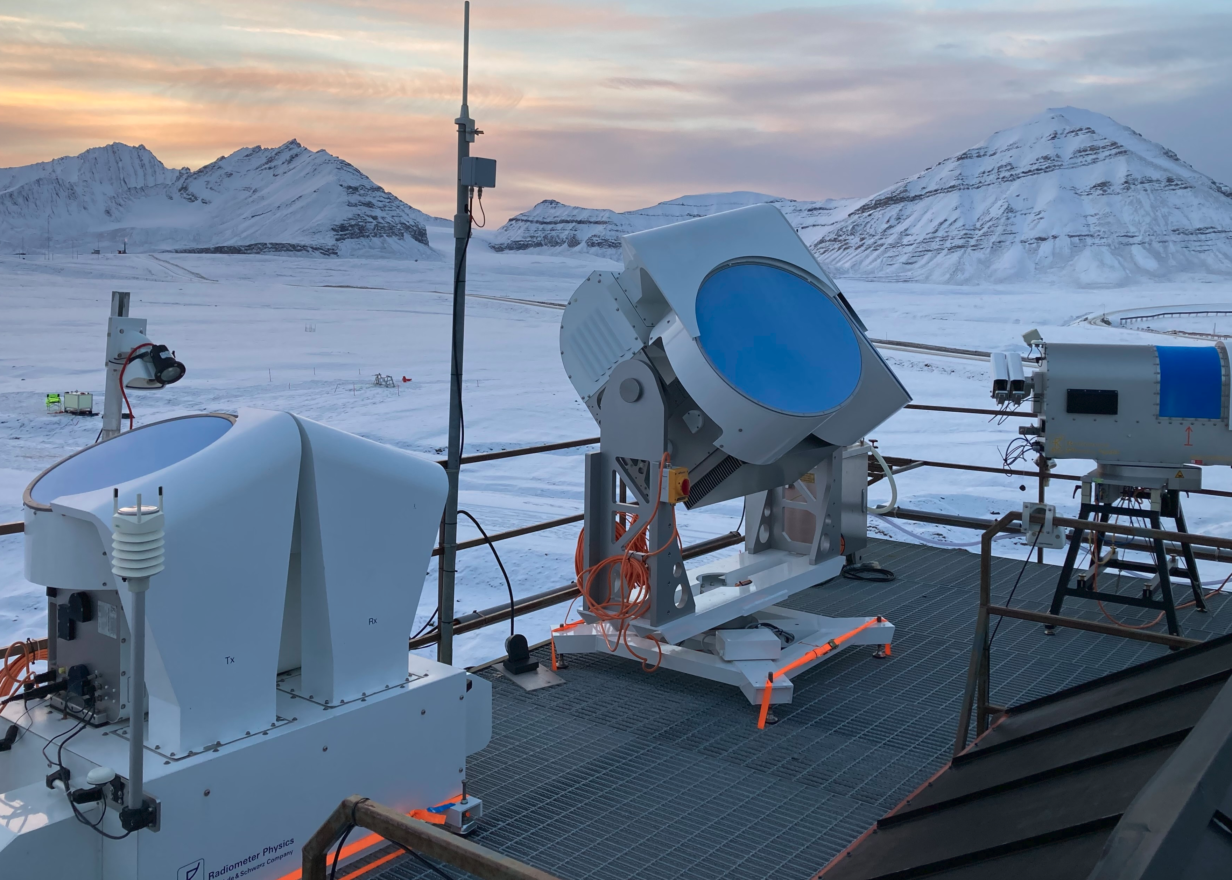




How important is turbulence for the formation of snow aggregates and rimed particles in Arctic clouds?
Stefan Kneifel (LMU) and Giovanni Chellini (U. Köln)

Slide 2
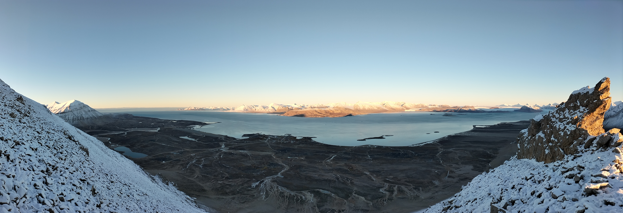
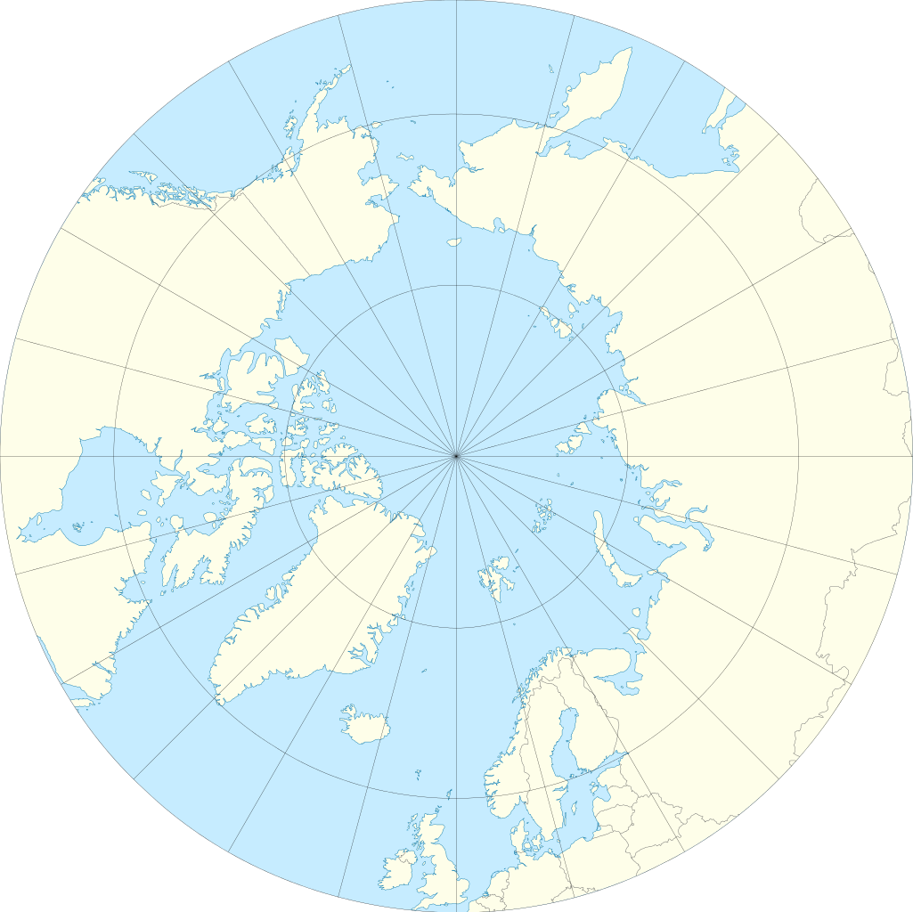


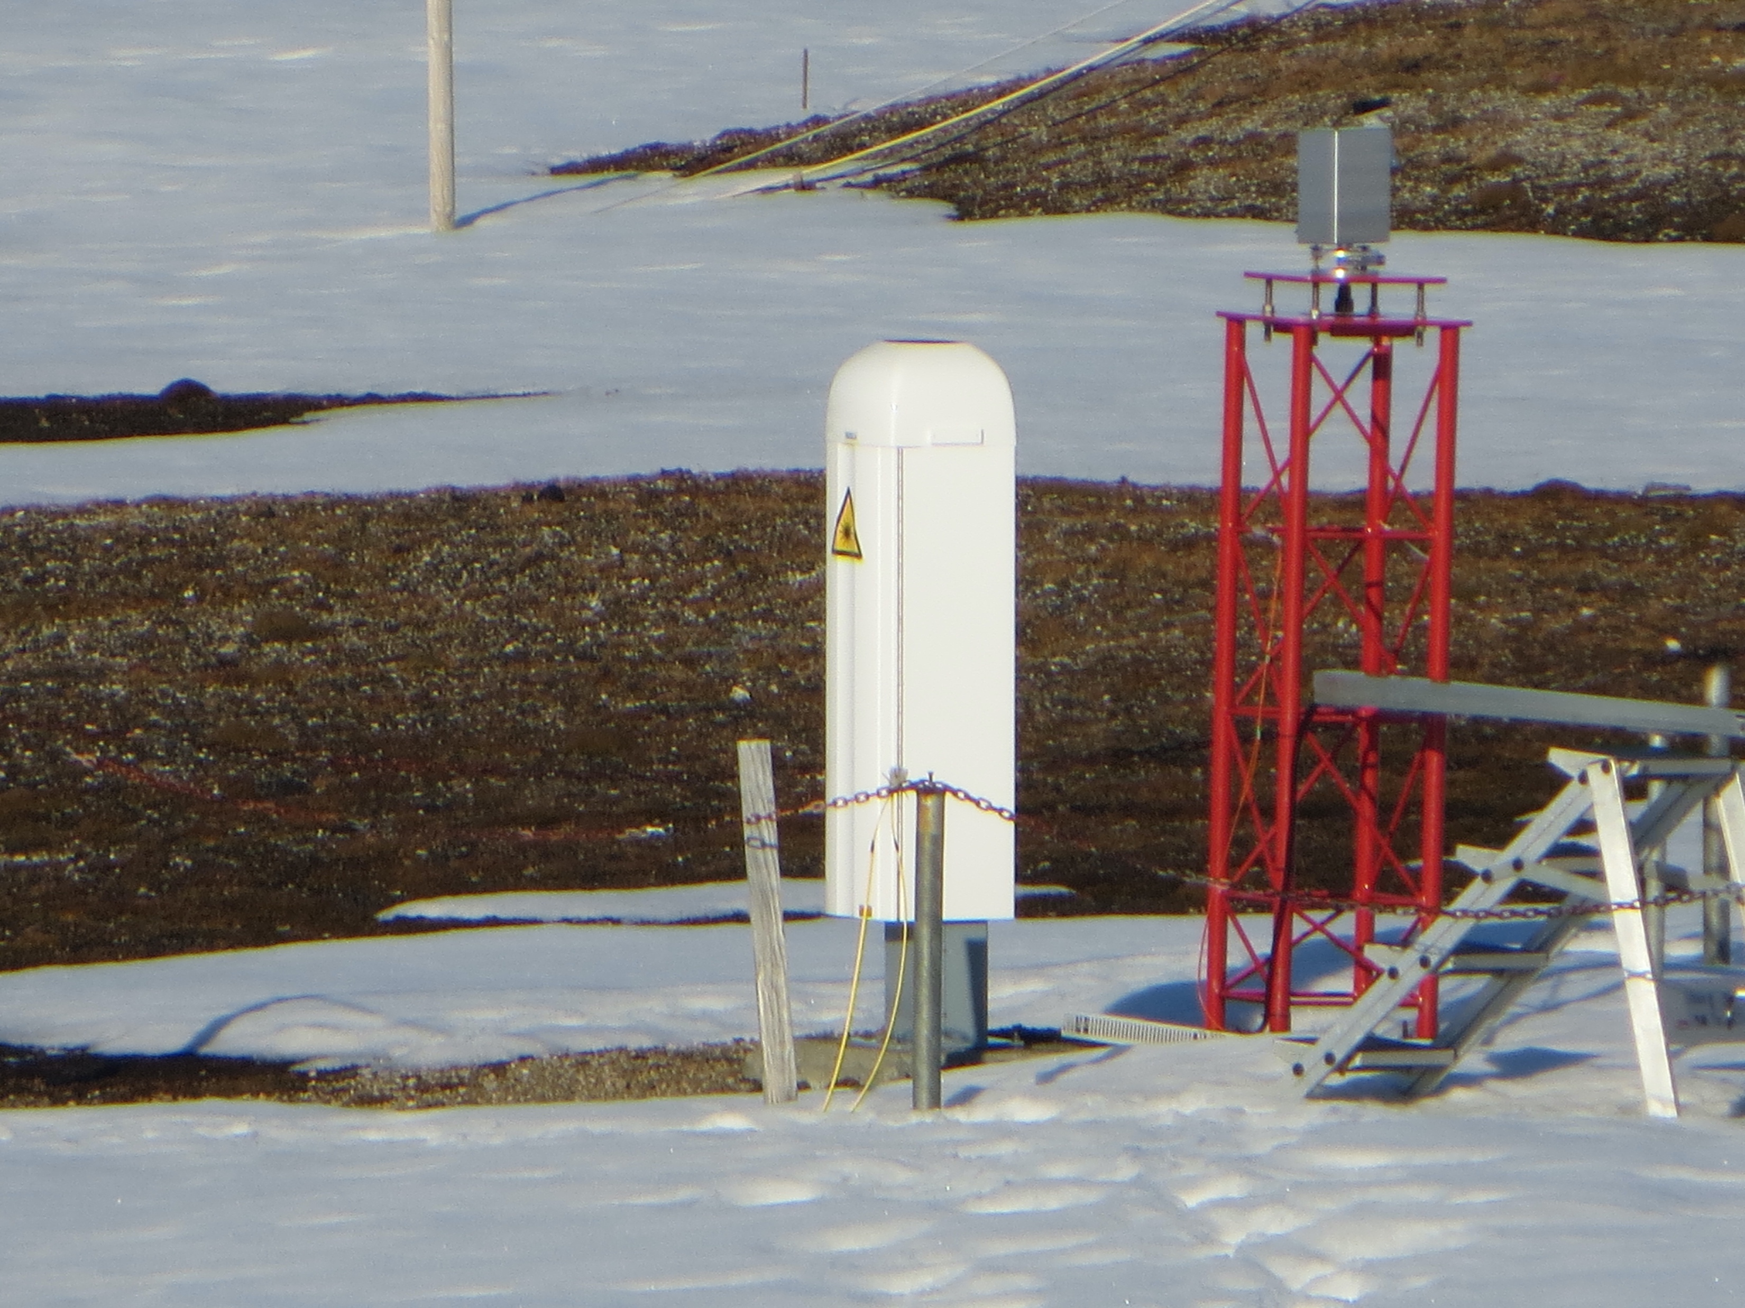
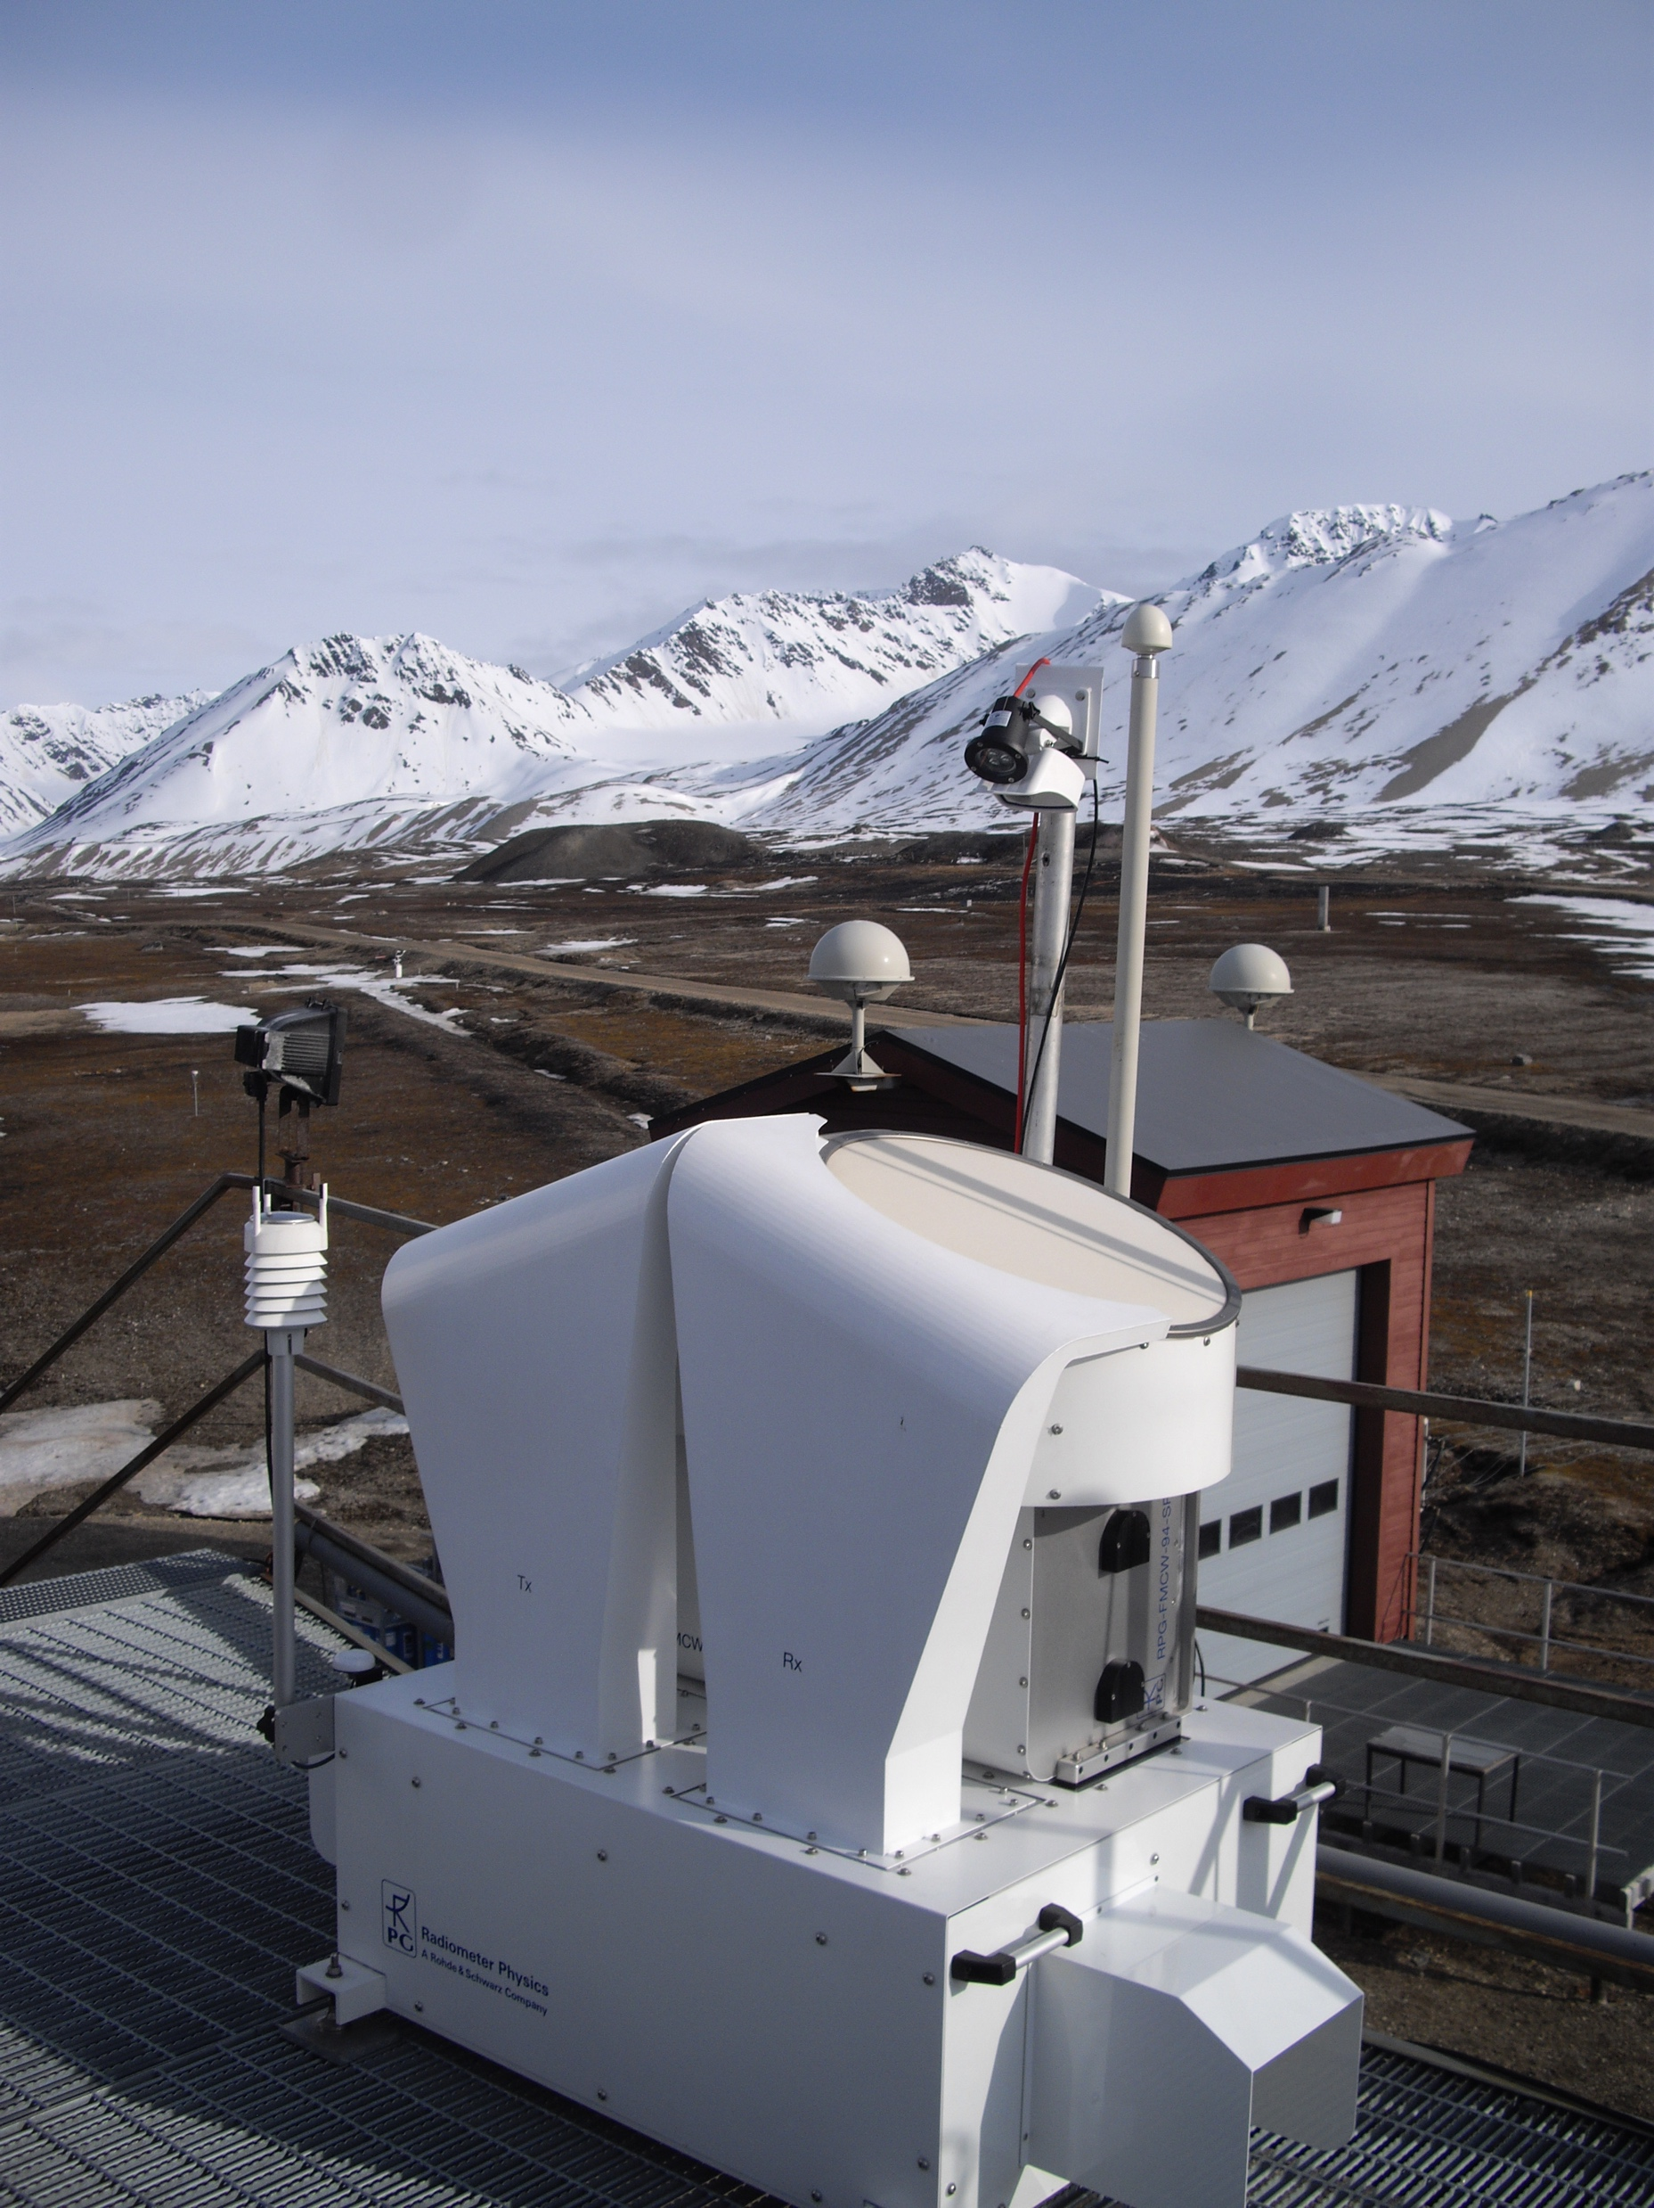
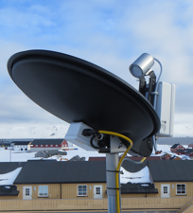
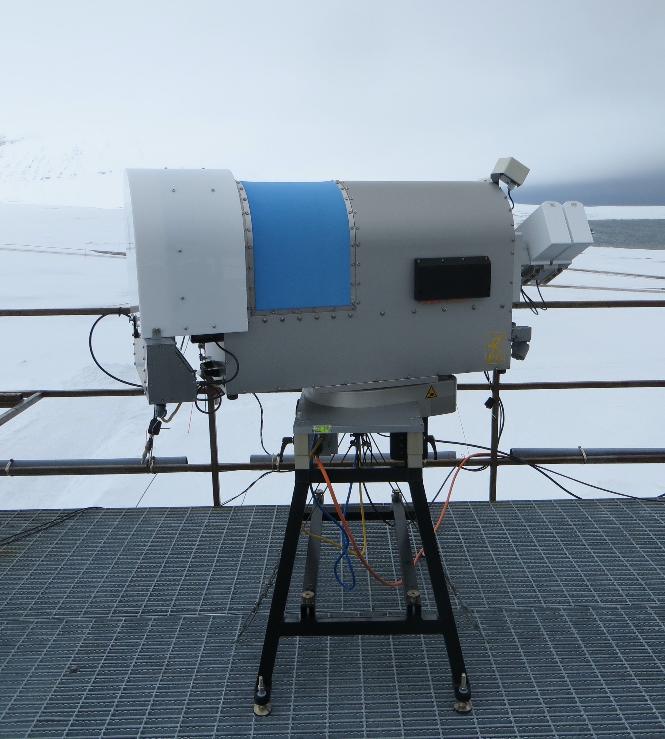
AWIPEV site, Ny-Ålesund, Svalbard
Ny-Ålesund, Svalbard
(78.9°N, 11.9°E)
Long-term dataset of:
Data collected at German-French Research Site AWIPEV
Research Project: Arctic Amplification AC³ (www.ac3-tr.de)
94-GHz FMCW radar
24-GHz Micro-Rain radar
Microwave radiometer
Ceilometer
35-GHz dual-pol FMCW radar
since Sep 2017
since Oct 2021

Slide 3
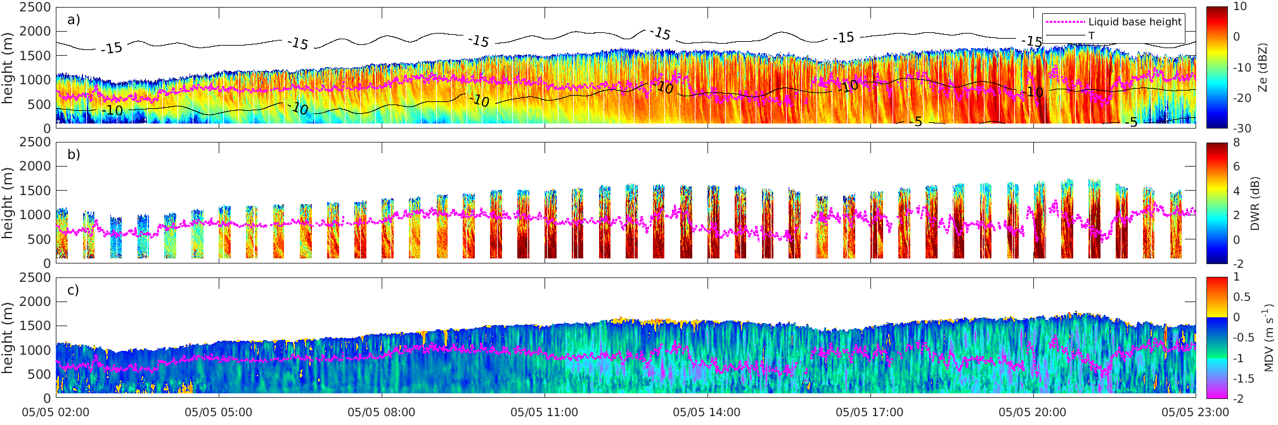
Arctic Mixed-Phase Clouds (A-MPCs)
A-MPCs and precipitation
Liquid droplets at cloud top, maintained by turbulence
Precipitation is sink for moisture and INP
Simulations showed: Whether MPC precipitates or not can drastically alter its lifetime and spatio-temporal evolution
Selection criteria
Cloud-top height < 2500 m
Liquid and ice coexisting (from Cloudnet target classification)
Minimum duration 1 hour (with gaps allowed)

Slide 4
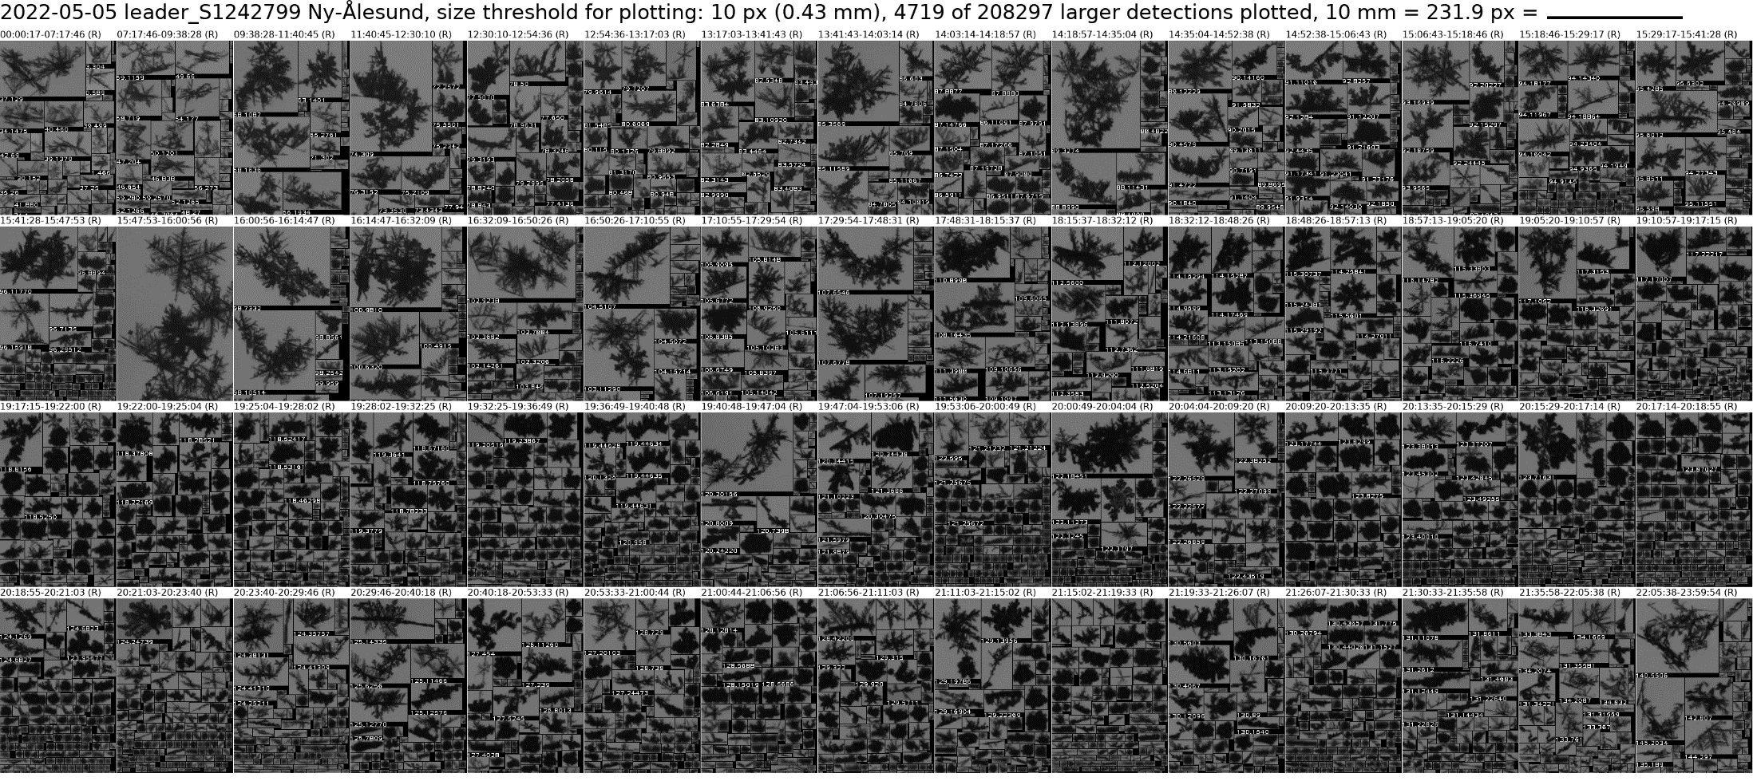
Dual-Wavelength Ratio (DWR)
Purple: Liquid base
Ratio of linear reflectivity factors or in dB: DWR_{Ka,W} = Ze_{Ka} – Ze_{W}
Strongly related to mean particle size → Indicator for aggregation
Video In-Situ Snowflake Imager VISSS (Maahn et al., 2023)
10mm
DWR due to differential attenuation negligible as liquid is mostly on the top and water vapor content is low

Slide 5
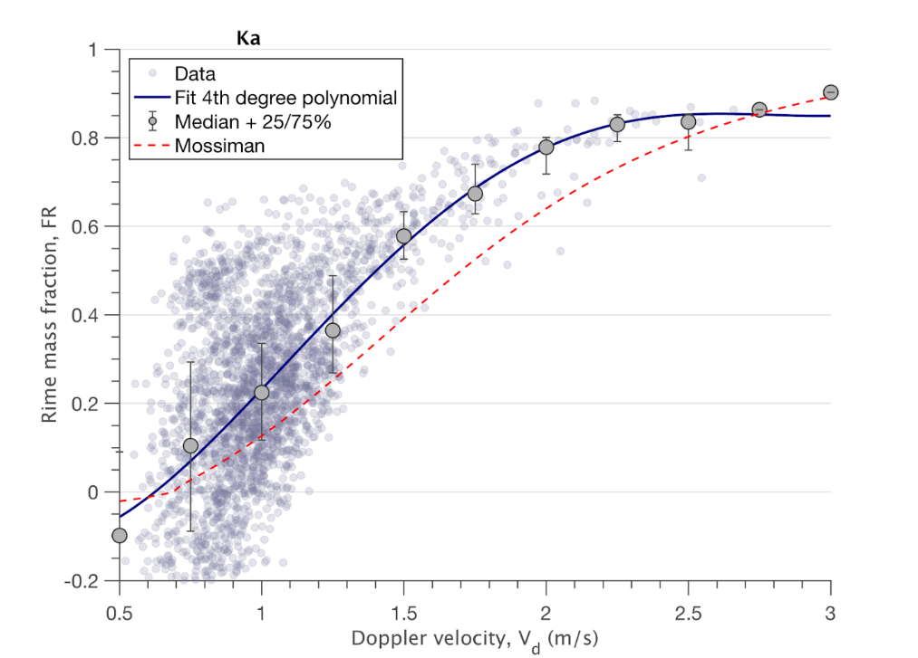
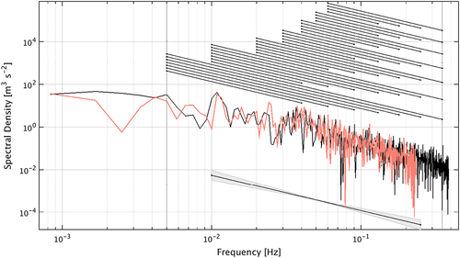
Mean Doppler velocity (MDV)
Detection of riming (Kneifel&Moisseev, JAS, 2020)
Eddy Dissipation Rate Retrieval (Borque et al., JGR, 2016)

Slide 6
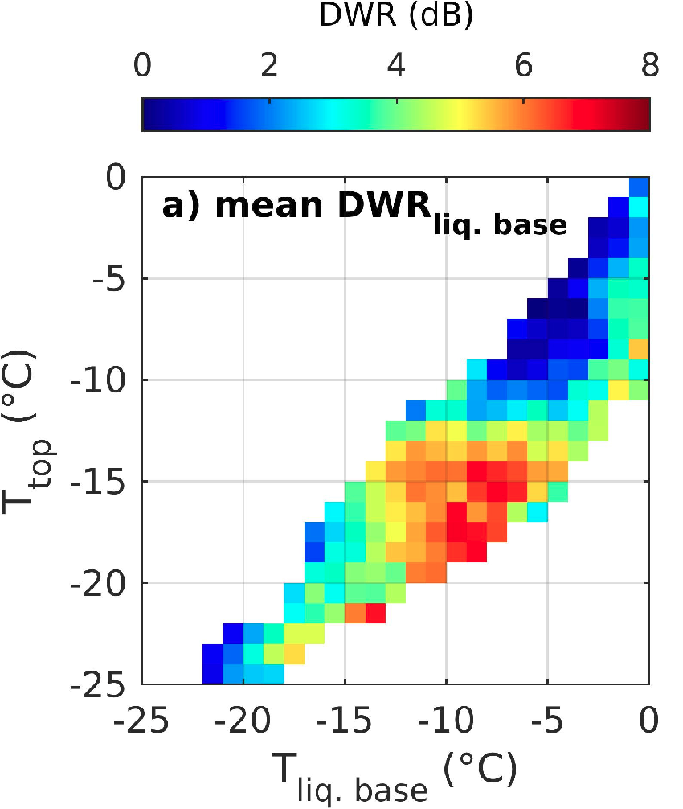
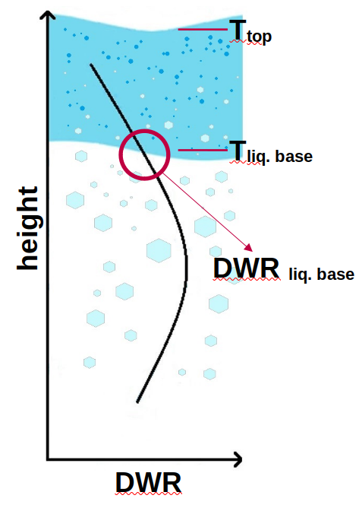
Under which conditions do we find aggregation or riming in A-MPCs?
Large aggregates mainly if the liquid layer is, at least partly, at T between
-20 and -12°C
(Chellini et al., JGR, 2022)

Slide 7
Under which conditions do we find aggregation or riming in A-MPCs?
No large particles when CTT > -10°C
But: Larger MDV as in the dendritic growth zone
(Chellini et al., JGR, 2022)

Slide 8
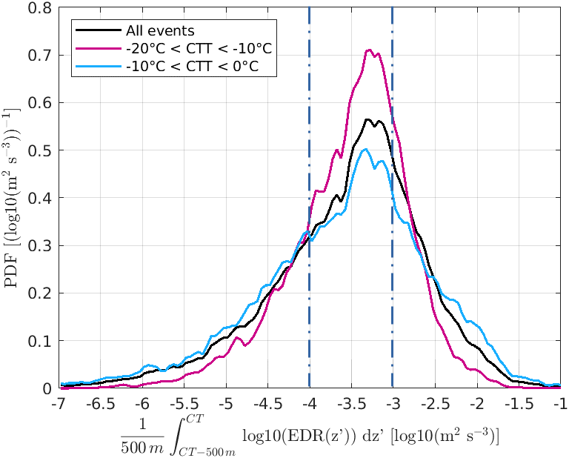
Analysis idea: Use A-MPCs to study impact of turbulence on collisional processes
Riming and aggregation are both collisional processes
Possible effects of turbulence:
  Clustering, collisions more likely
  Broader velocity spectrum
  More collisions, higher impact energy
Events classified based on:
CTT:
  -20 to -10°C → aggregation and riming
  > -10°C → predominantly riming
Average EDR in uppermost 500 m:
  < 10⁻⁴ m² s⁻³ → low
  between 10⁻⁴ and 10⁻³ m² s⁻³ → intermediate
  > 10⁻³ m² s⁻³ → high

Slide 9
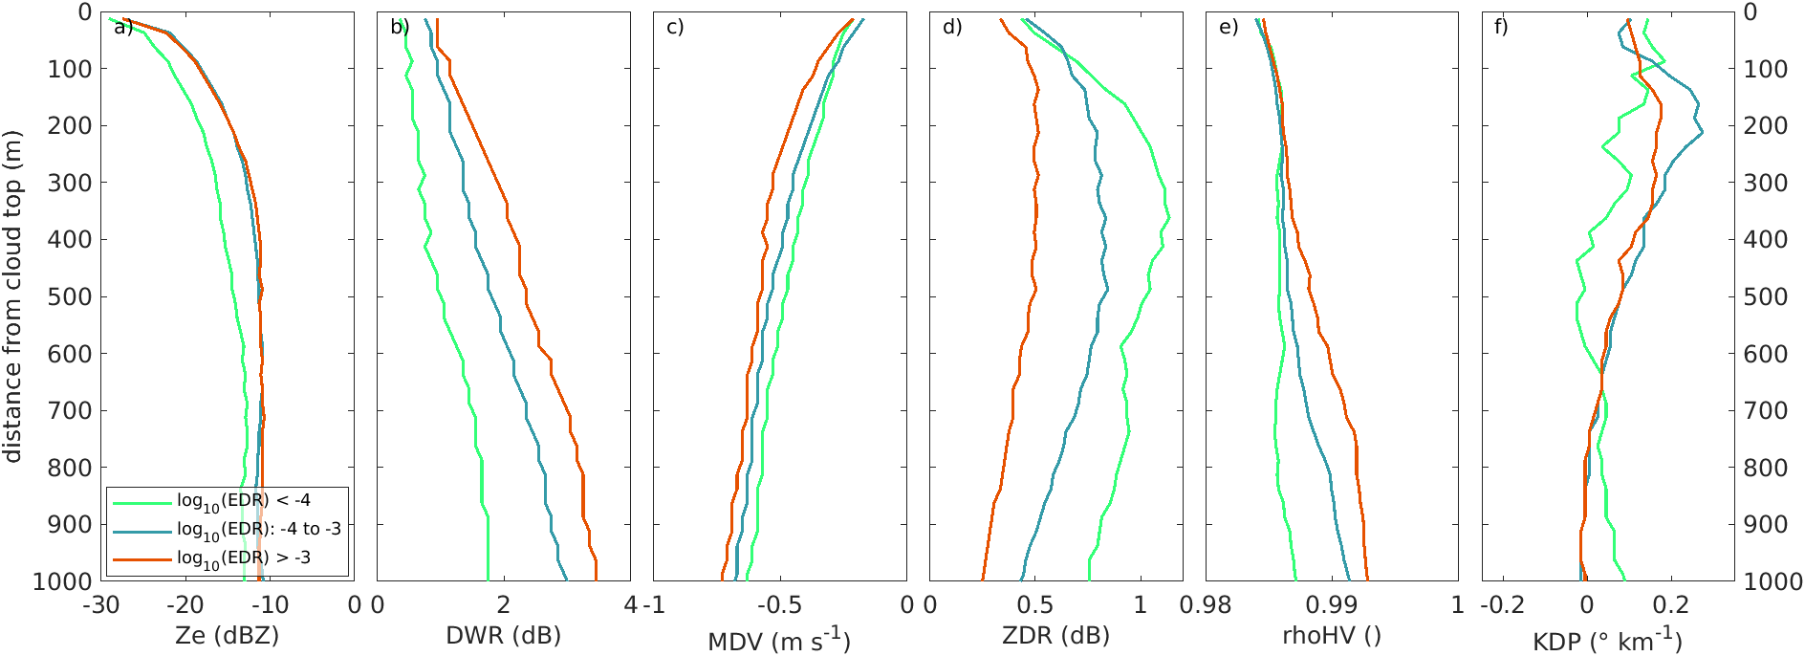
Impact of turbulence in the aggregation dominated temperature regime
(Chellini & Kneifel, GRL, 2024)
CTT: -20…-10°C
Ze (dBZ)
Reflectivity
DWR (dB)
Particle size
MDV (m s⁻¹)
Fall velocity
ZDR (dB)
Asimmetry
KDP (° km⁻¹)
Concentration
Higher EDR correlated with:
Larger, more spherical particles, low velocity ⇒ larger aggregates
Increasing KDP ⇒ higher fragmentation due to higher collision rates?

Slide 10
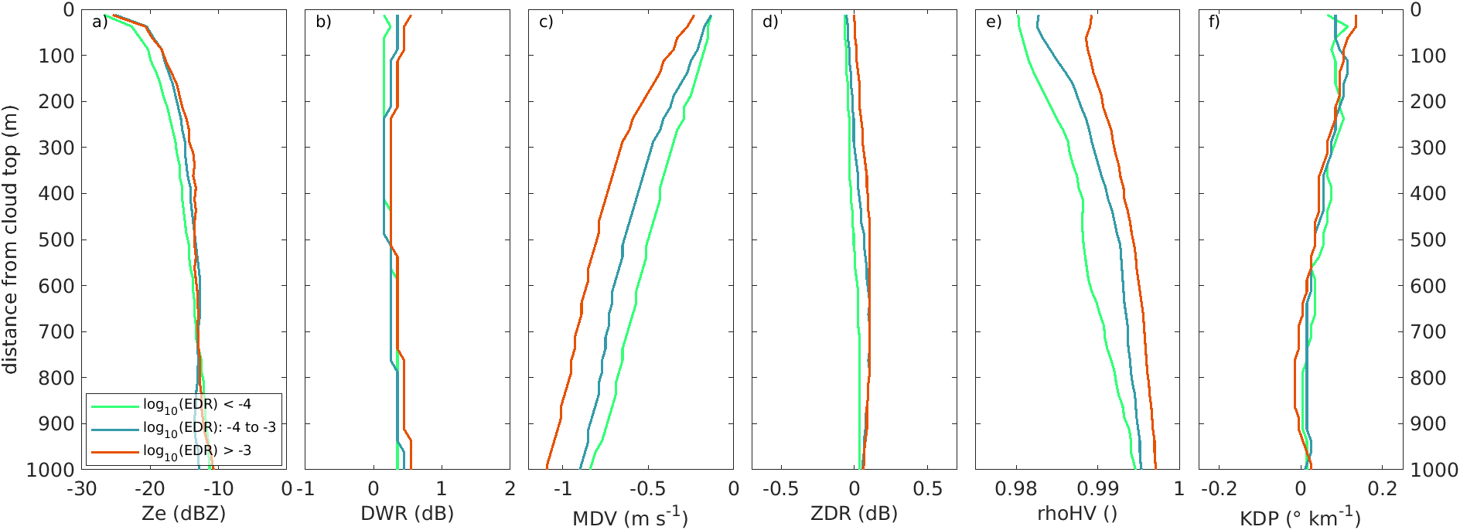
Impact of turbulence in the riming dominated temperature regime
(Chellini & Kneifel, GRL, 2024)
CTT: >-10°C
Ze (dBZ)
Reflectivity
DWR (dB)
Particle size
MDV (m s⁻¹)
Fall velocity
ZDR (dB)
Asimmetry
KDP (° km⁻¹)
Concentration
Higher EDR correlated with:
Higher MDV but similar DWR ⇒ particles potentially more rimed

Slide 11
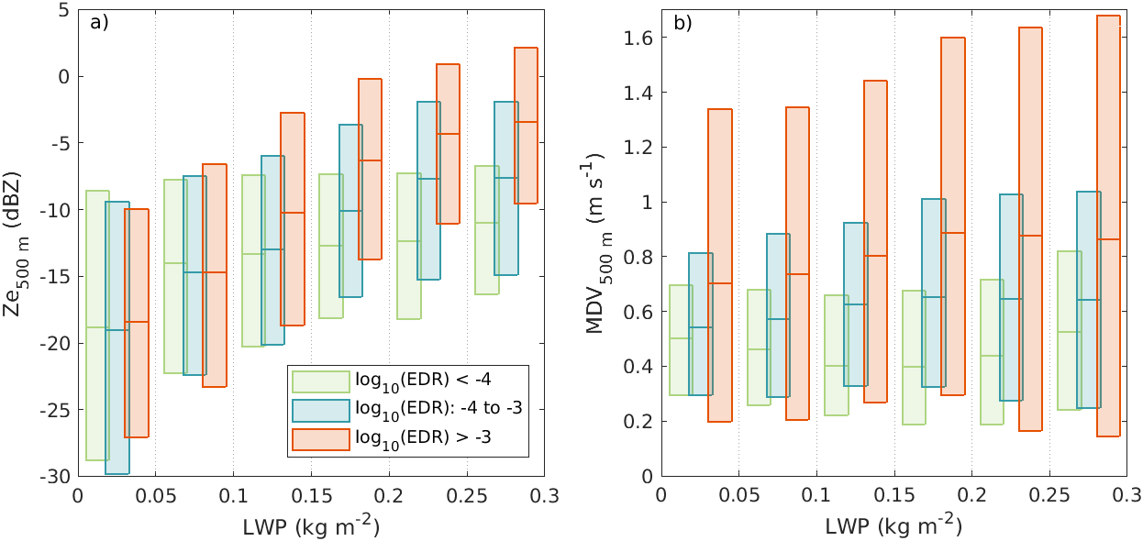
Dependency of riming on turbulence and liquid water path (LWP)
(Chellini & Kneifel, GRL, 2024)
1) MDV and Ze increase with LWP and EDR
2) increasing LWP alone doesn’t increase MDV or Ze in the low EDR class (green)
→ turbulence seems to be a necessary ingredient for riming in A-MPCs!

Slide 12
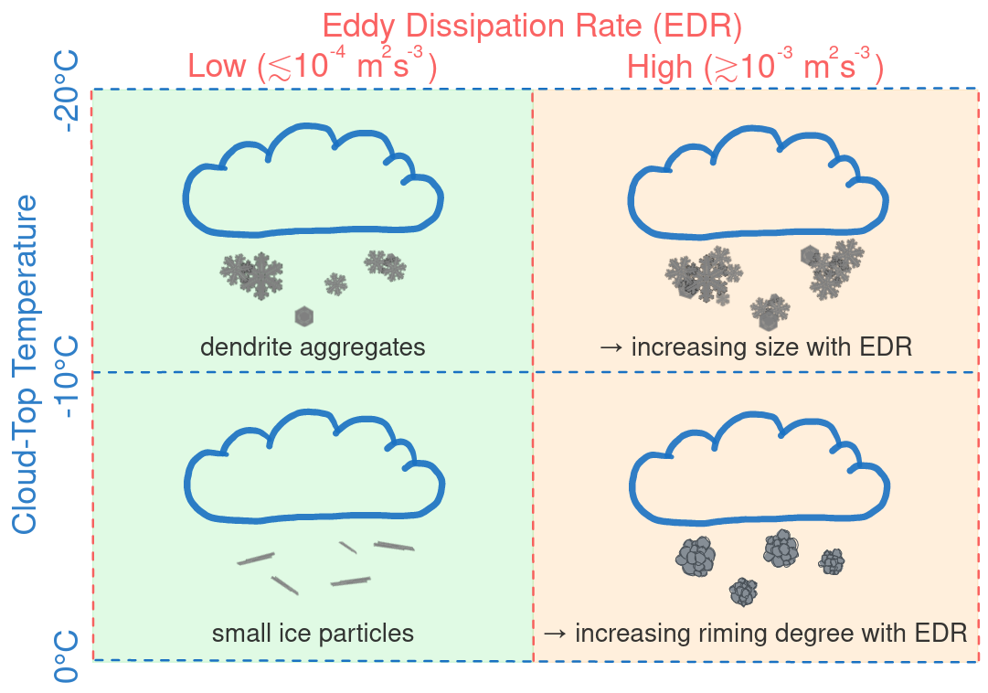
Conclusions
Liquid-layer temperature determines major ice-growth processes
Aggregation:
At temperatures compatible with dendritic growth
Increasing EDR linked with increasing collision rates
→ larger particles and enhanced secondary ice
Riming:
At temperatures > -10°C
Turbulence key component to trigger riming
Further reading: G. Chellini, PhD thesis, available https://kups.ub.uni-koeln.de/72320/

Slide 13
Backup Slides

Slide 14
Study 1:
Chellini et al. (2022) - Ice Aggregation in Low‐Level Mixed‐Phase Clouds at a High Arctic Site: Enhanced by Dendritic Growth and Absent Close to the Melting Level - JGR:A
94-GHz cloud radar:
24-GHz precip. radar:
Study 2:
Chellini et al. (2023) - Low-level mixed-phase clouds at the high Arctic site of Ny-Ålesund: a comprehensive long-term dataset of remote sensing observations - ESSD
Sep 2017 - Feb 2021
# cases: 1042
94-GHz cloud radar:
35-GHz dual-pol cloud radar:
Study 3:
Chellini and Kneifel (2024) - Turbulence as a key driver of ice aggregation and riming in Arctic low-level mixed-phase clouds, revealed by long-term cloud radar observations - GRL
Oct 2021 - Dec 2022
# cases: 554

