Slide 1

Preparing the two-moment microphysical scheme for operational forecasts using radar and satellites
* Seamless INtegrated FOrecastiNg sYstem
*
German Weather Service (DWD)
Alberto de Lozar, Sophie Löbel, Kobra Khosravian, Daniela Littmann, Jana Mendrok, Uli Blahak

Slide 2
SINFONY RUC is running every day
ICON-Rapid Update Cycle (RUC)
ICON-D2
It runs every hour.
Results arrive ~35 min after last assimilation.
Assimilation of less conventional observations and shorter Latent-Heat Nudging in forecast.
Often boundary conditions from an older IEU.
More complex two-moment microphysics and radar operator (Mie). Shallow-convection only.
It runs every three hours.
Results arrive ~1:15 h after last assimilation.
Almost all observations are assimilated.
Newer boundary conditions.
Simple one two-moment microphysics and radar operator (Rayleigh). Gray-zone tuning.
But same domain and grid size. ICON-RUC starts every day from ICON-D2 analysis on 3UTC.
ICON-RUC is running in evaluation mode for two years. Since July in technical-operational mode.
PrePEP 2025

Slide 3

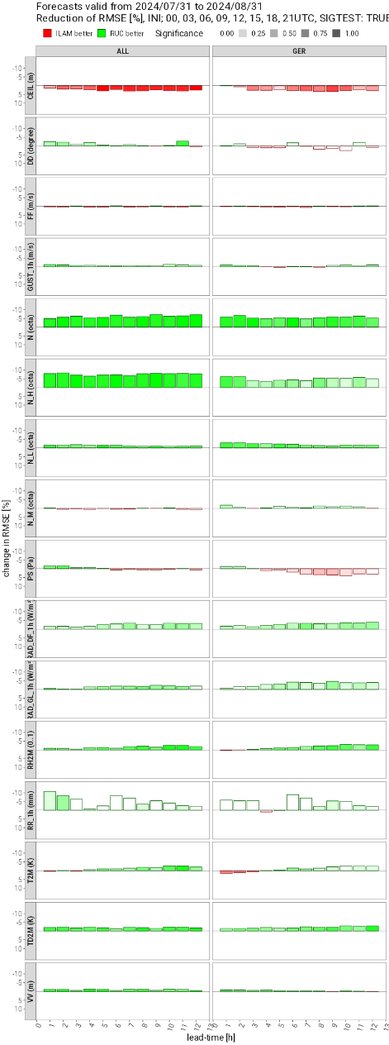
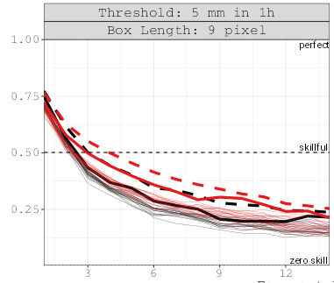
Good Summer (08.24)
On our first month (August) almost all scores show a better performance of the RUC over ICON-D2.
As an example, score cards based on SYNOP station (left) and precipitation (right) are shown.
RUC
ID2
FSS
Leading time (h)
PrePEP 2025

Slide 4
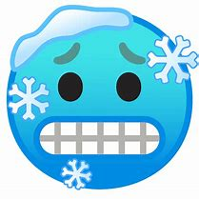
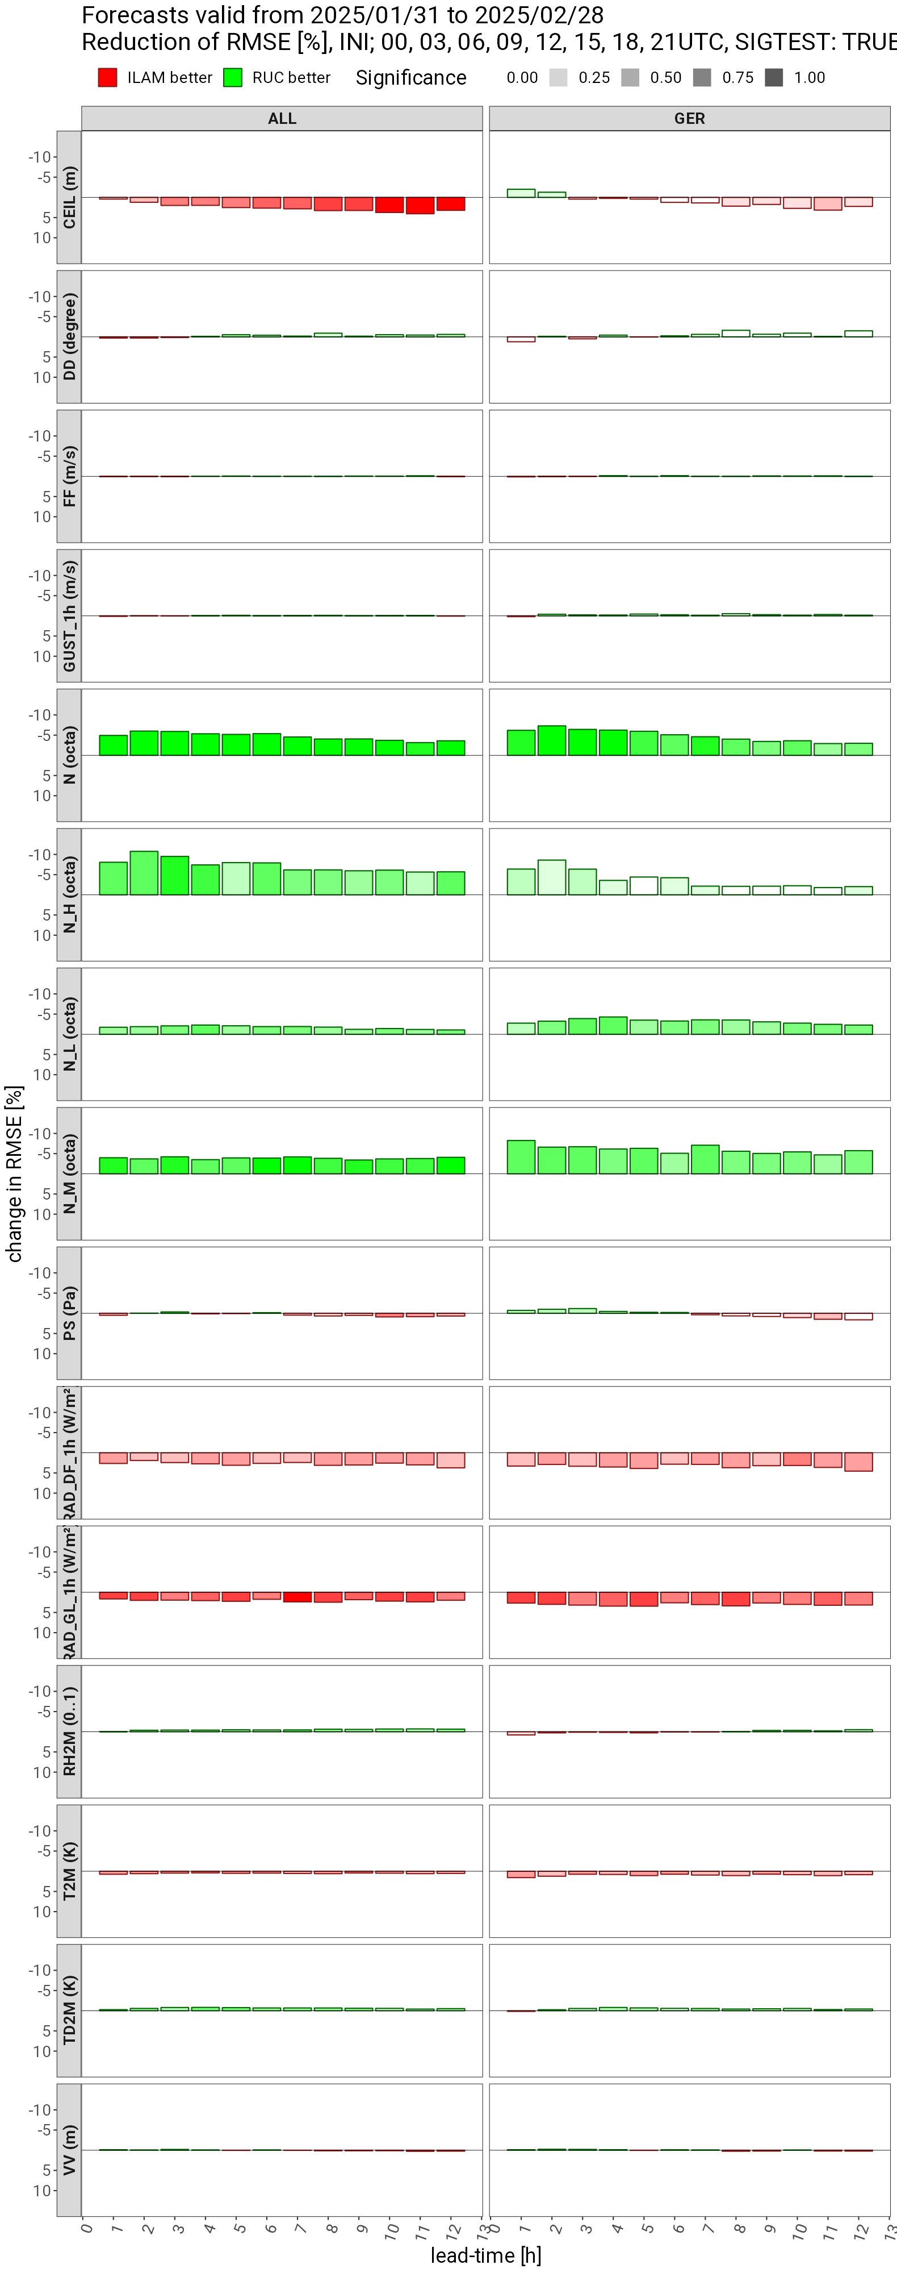
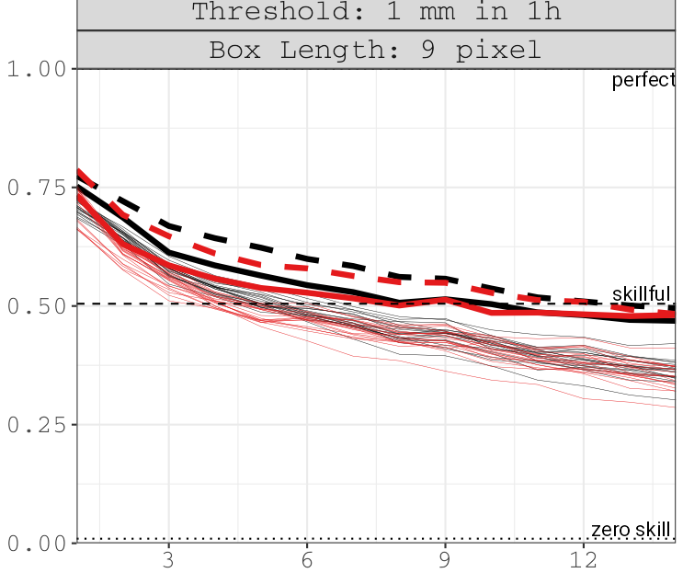
But Winter is always worst than Summer (02.25)
On our last winter month (February) show a performance comparable to ID2.
As an example, score cards based on SYNOP station (left) and precipitation (right) are shown.
RUC
ID2
FSS
Leading time (h)
PrePEP 2025

Slide 5
Can we make the model more realistic in winter?
  Learning from literature
  Learning from satellites
Does it produce better scores?
PrePEP 2025

Slide 6
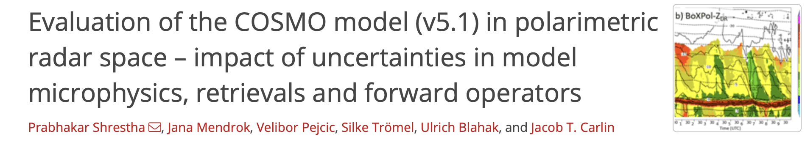
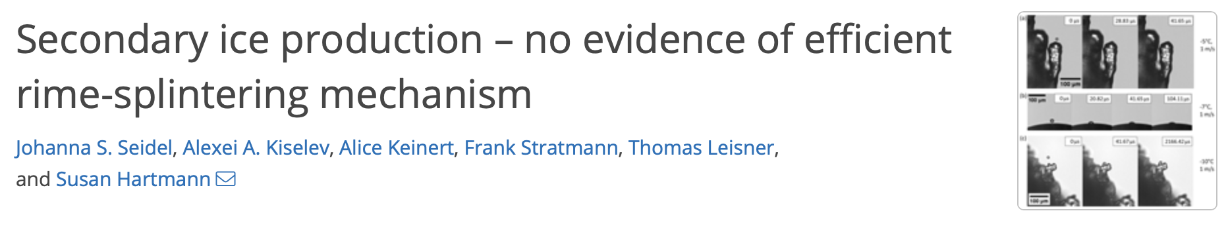
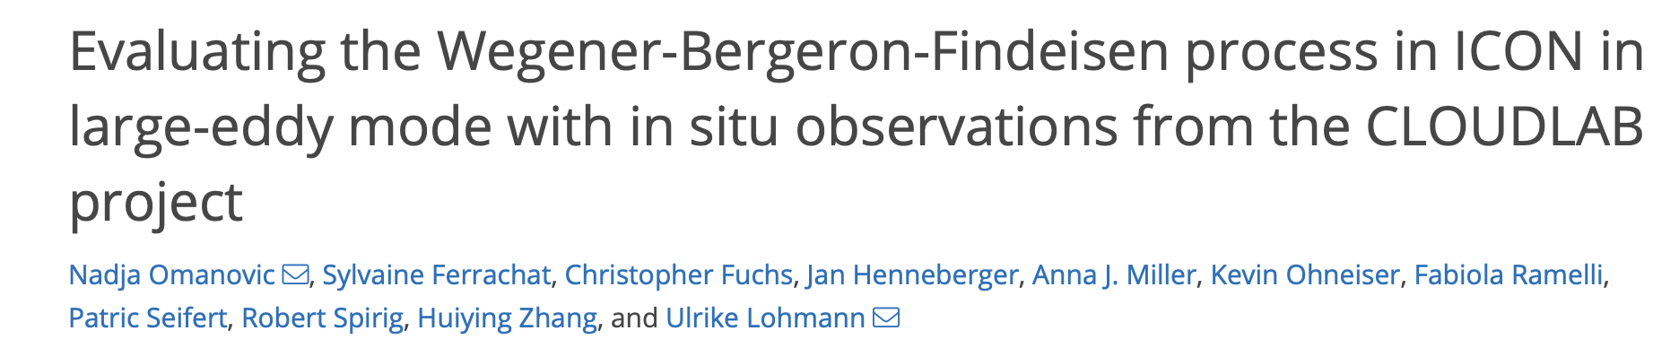
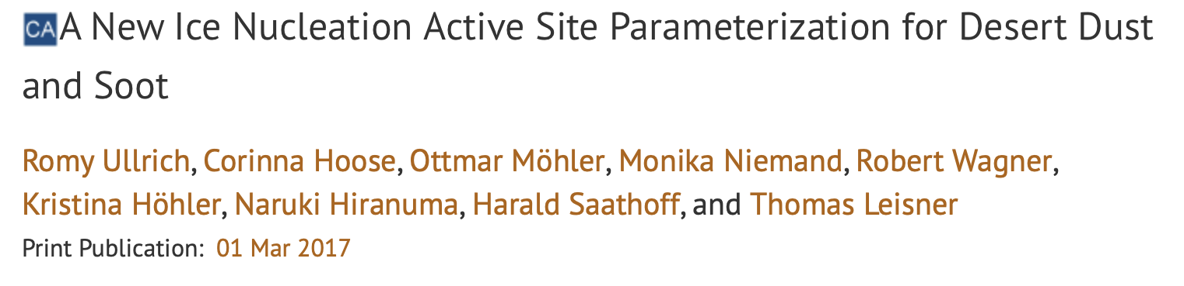
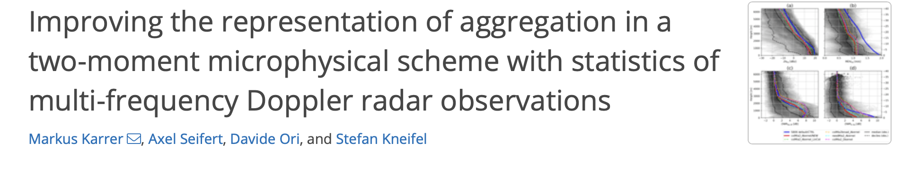
Looking at the literature (incomplete)
PrePEP 2025

Slide 7

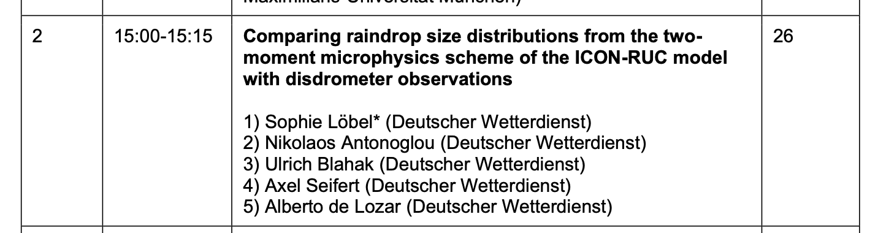
Looking at the literature (incomplete)
PrePEP 2025

Slide 8
Looking at the literature
Too much graupel
Still not clear mechanism for ice multiplication
Slow grow of snow/ice in presence of cloud water (WBF)
Raindrops too small
Better ice nucleation scheme.
Snow is too fast
PrePEP 2025

Slide 9
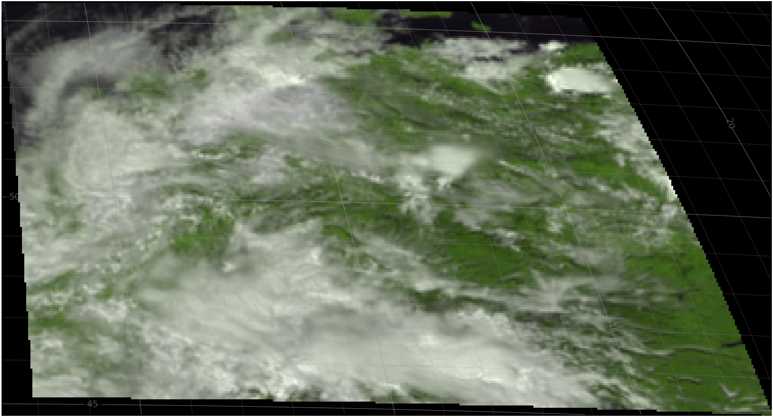
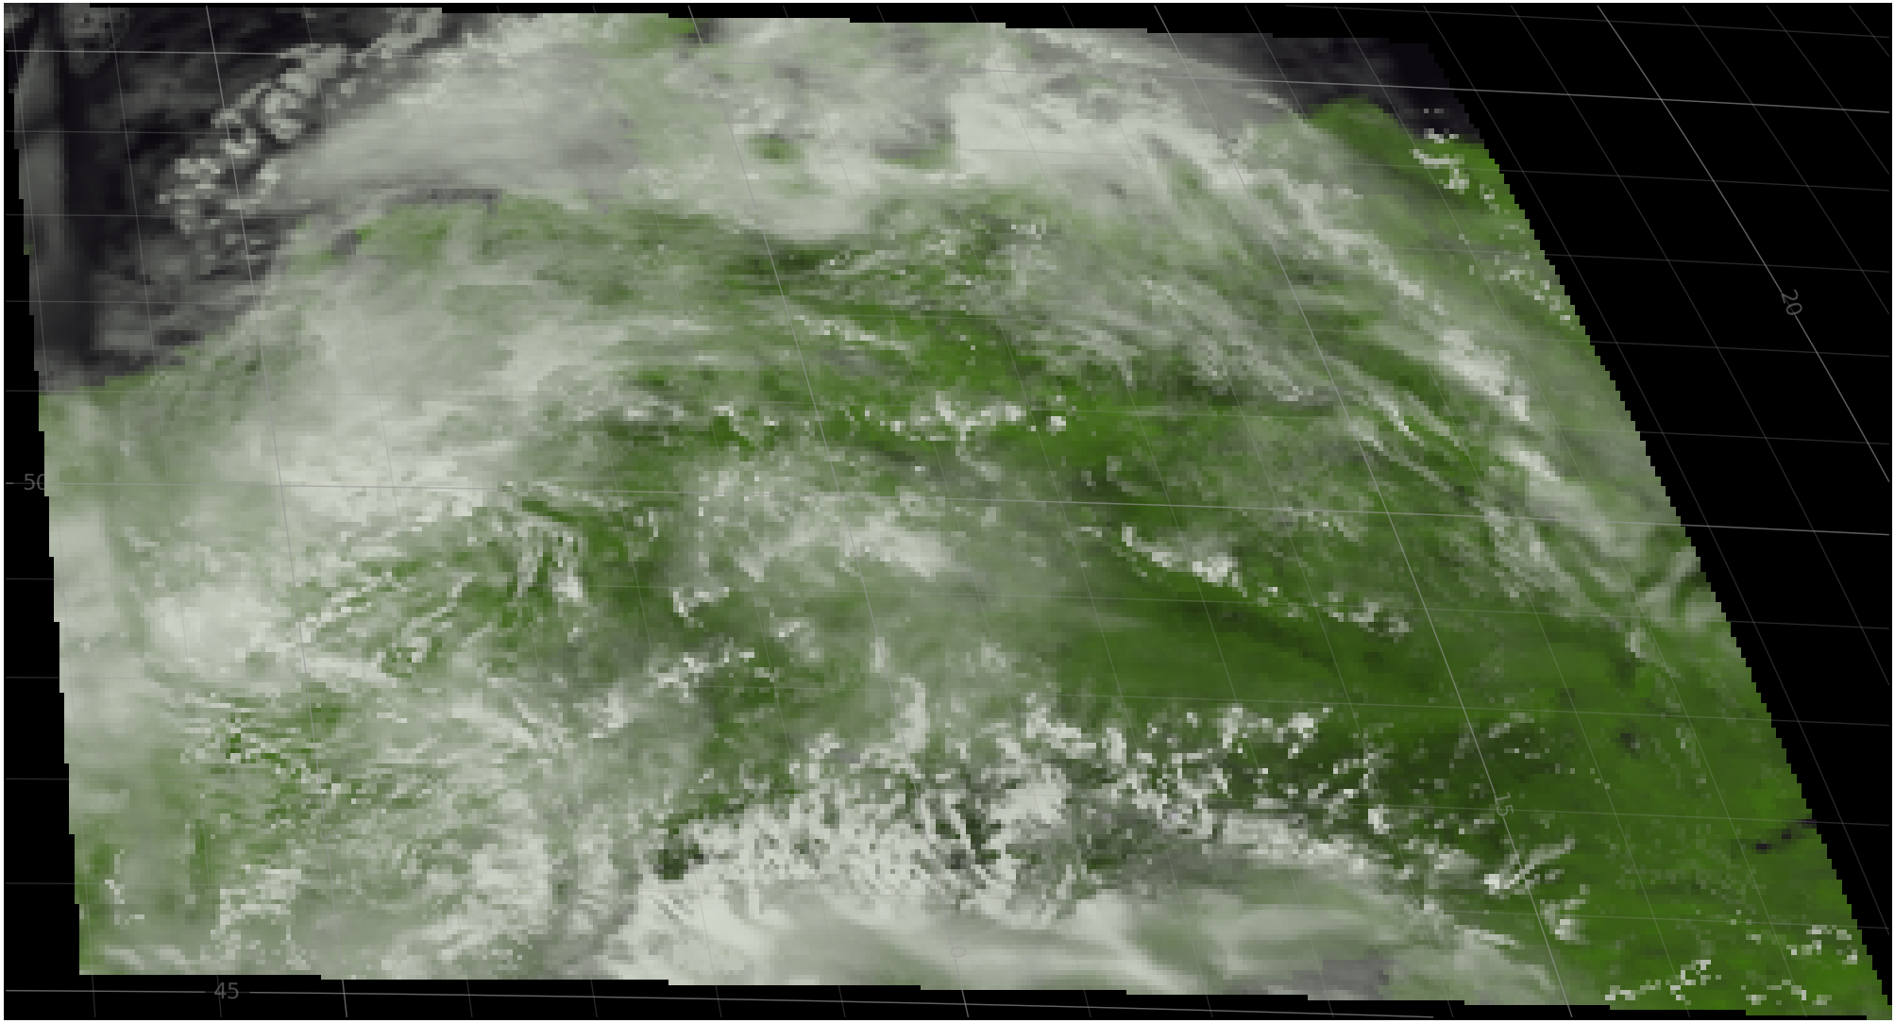
Looking at clouds (with SEVIRI)
Microphysical tuning with satellite information (RTTOV).
Satellite information provides information about cloud cover and hydrometeors size and phase. Therefore, it is important to provide the model effective radius to the forward operators.
All comparison in observational space. Reliable only on summer (snow).
Observation
Model
0.6 μm visible channel (~ cloud thickness)
PrePEP 2025

Slide 10
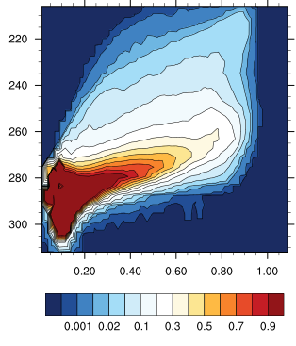
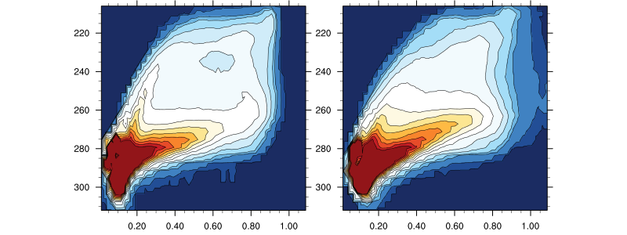
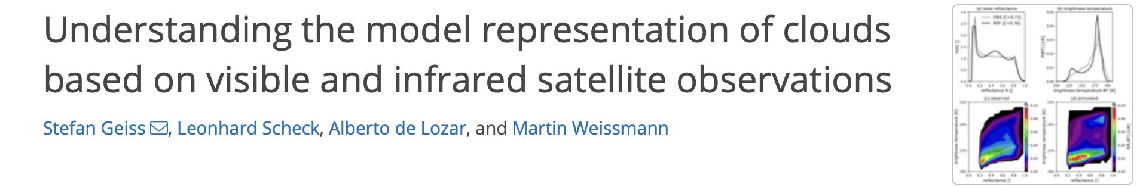
Looking at clouds (with SEVIRI)
RUC
Experimental
Observation
high thick clouds
10.8 μm IR channel (~ cloud height)
Too few middle clouds
Too many low thick clouds
Low thin clouds
0.6 μm visible channel (~ cloud thickness)
PrePEP 2025

Slide 11
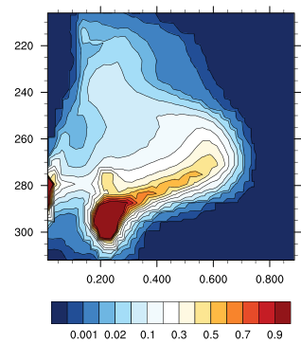
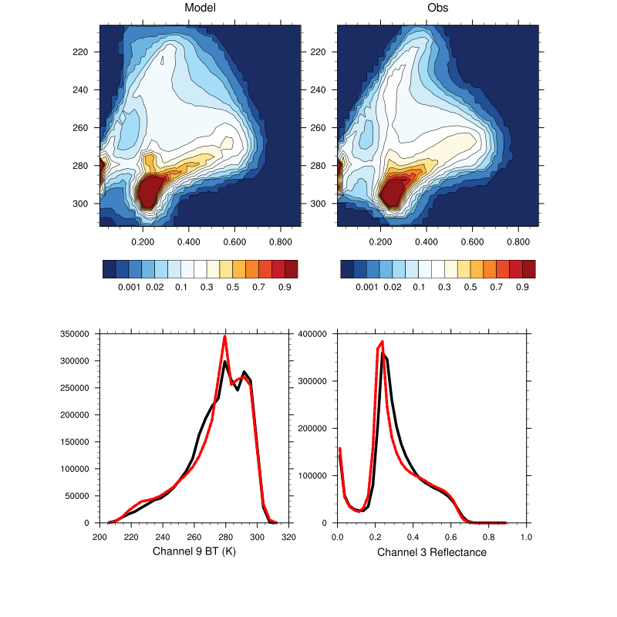
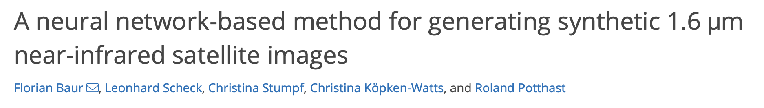
New satellite channel for particle size
RUC
Experimental
Observation
Large ice >Small Ice
High ice too large
10.8 μm IR channel (~ cloud height)
Few middle ice clouds
Toom any small droplets
Large Drops >Small Drops
1.2 μm visible channel (~ particle size/phase)
PrePEP 2025

Slide 12
Relevant Microphysics changes
More ice clouds:
  A more modern (Ullrich 2017) ice nucleation scheme.
  No sticking for ice-ice collisions below -40 C/ Reduced sticking efficiency for ice-snow collisions.
  Assume needles for the ice capacitance (instead of flakes).
  Slower the snow velocity (similar to Karrer et al. 2021).
  Radiation is compensated by increasing the effective radii of liquid subgrid-scale clouds.
More snow, less graupel
  Slow down the snow to graupel process (now it uses the original value of Seibert Beheng 2006).
  Use different refraction index approximation for the calculation of reflectivity in the bright band (to offset very high reflectivities due to larger graupel)
More precipitation from stratiform clouds/larger rain drops:
  Change the calculation of rain number concentration resulting from the melting process.
  Remove unphysically-small rain droplets in the freezing process.
  Remove artificial limitation in the WBF process (ice/snow growth from cloud water).
PrePEP 2025

Slide 13

Using satellite data with RTTOV (L. Scheck, LMU)
RUC
New
Observation
Experimental
high thick clouds
10.8 μm IR channel (~ cloud height)
Too few middle clouds
Too many low thick clouds
Low thin clouds
0.6 μm visible channel (~ cloud thickness)
PrePEP 2025

Slide 14
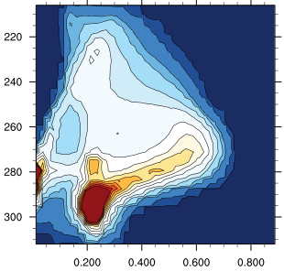
New satellite channel for particle size
RUC
New
Observation
Experimental
Large ice >Small Ice
High ice too large
10.8 μm IR channel (~ cloud height)
Few middle ice clouds
Toom any small droplets
Large Drops >Small Drops
1.2 μm visible channel (~ particle size/phase)
PrePEP 2025

Slide 15
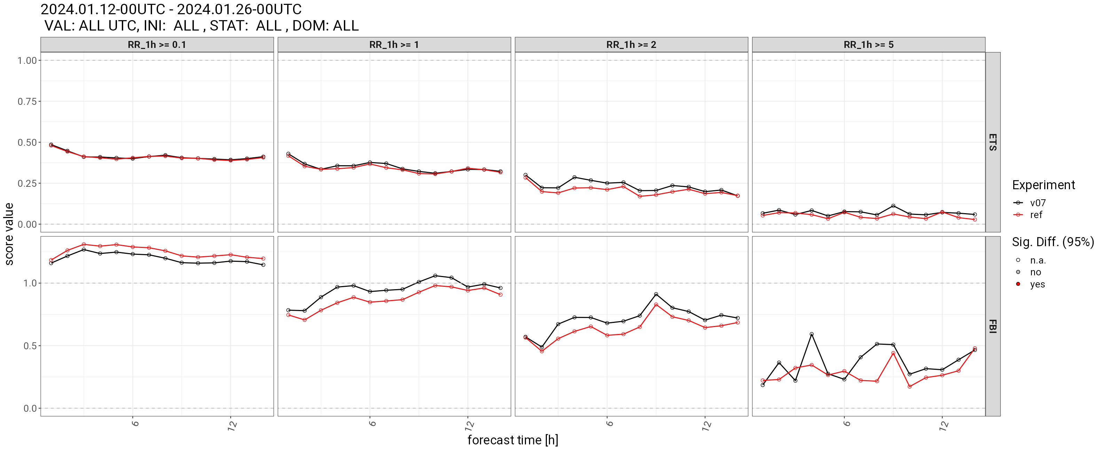
Forecasts from Assimilation Experiments
We have run an assimilation experiment for three weeks in winter 2024.
The bias in precipitation clearly improved. It produces less drizzle and more-frequent RR>1mm/h. FSS also improves.
Scores from radio-sondes significantly improve, but surface scores are more mixed.
0.1 mm/h
1 mm/h
2 mm/h
RUC
ID2
perfect
Bias
Leading time (h)
PrePEP 2025

Slide 16
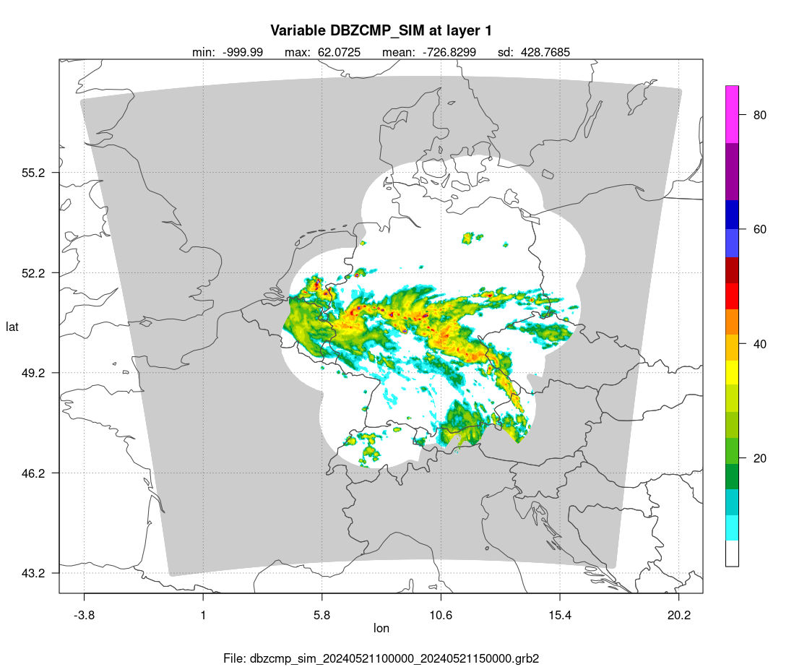
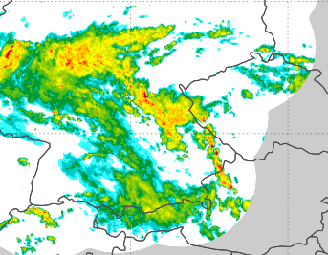
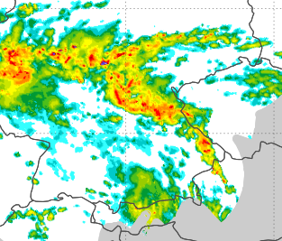
We want better reflectivity structures
The model produce too-broad reflectivity structures
This causes problems too our cell-detection algorithm
  It detects very-large unrealistic convection cells that are unrealistic and look bad in the visualization of the derived products.
  It detects too-few small cells.
Observation
New
RUC
+3h forecast
PrePEP 2025

Slide 17

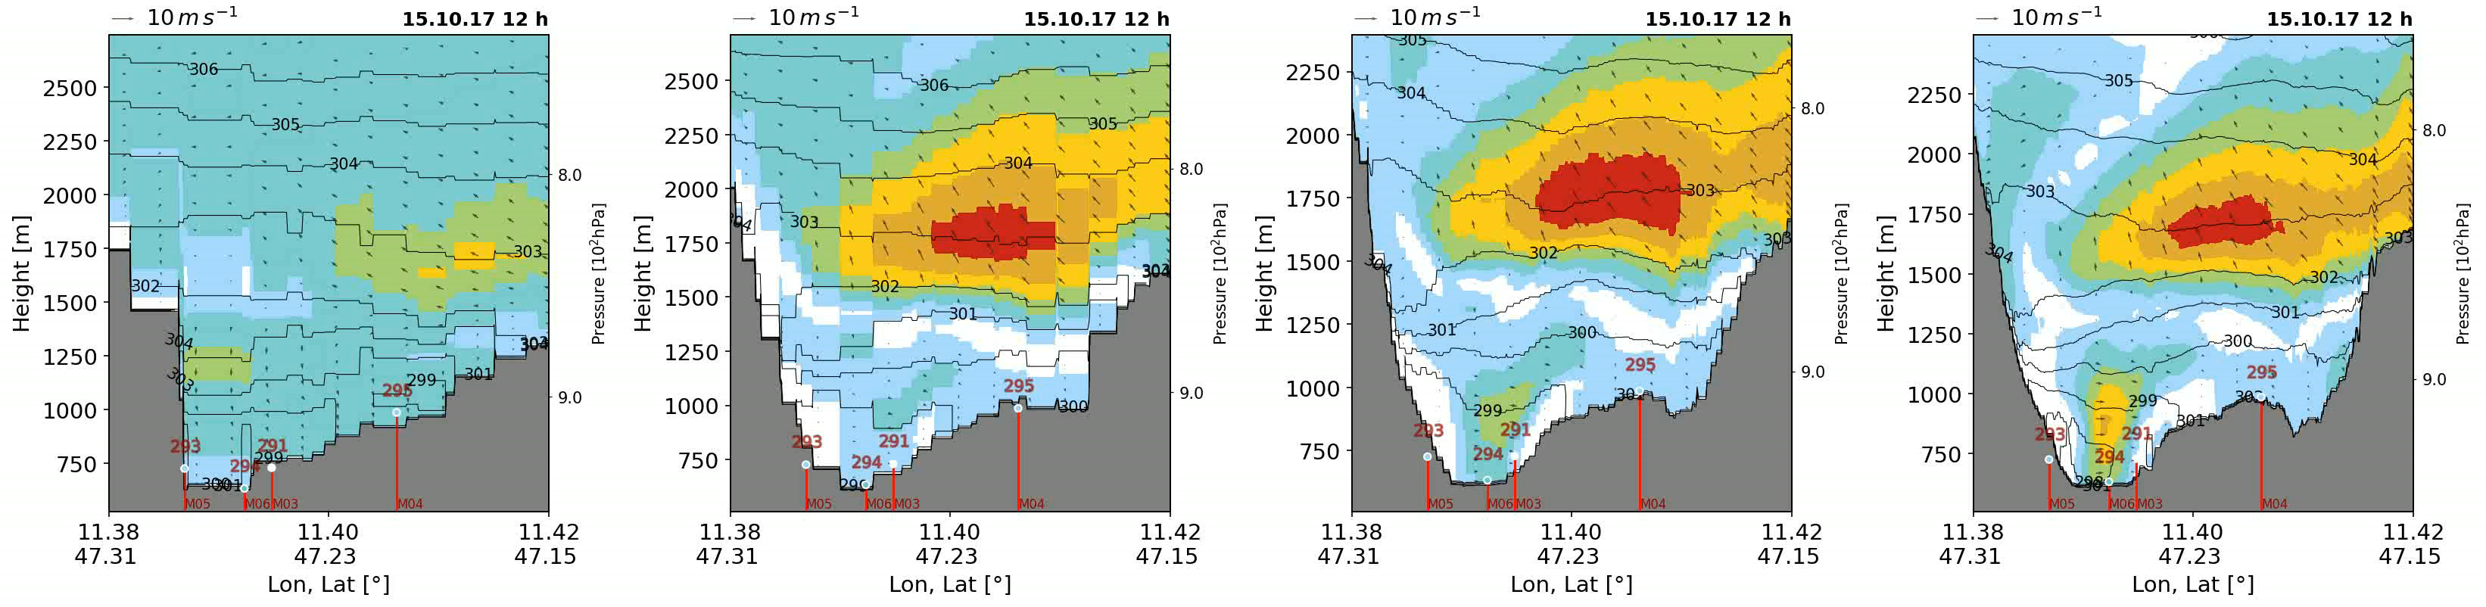
Conclusions/Outlook
The RUC is running. It produces very good results in summer and reasonable ones in winter.
We are working in a mayor update of the microphysics. We aim for a more consistent and physically-based model (not only standard verification).
Development is still in process and will continue for the next years. Our current focus is also on:
  Ensemble spread (Sophie Löbel)
  Use new observations like disdrometers
  (Sophie Löbel) or polarimetry (Kobra Khosravian,
  Jana Mendrok)
  Run at hectometer resolutions
  (GLORY, Daniela Littmann)
  Improve radar forward operator
  (Jana Mendrok, Uli Blahak)
∆x = 2 km
∆x = 1 km
∆x = 0.5 km
∆x = 0.25 km
PrePEP 2025

Slide 18
We want better reflectivity structures
The model produce too-broad reflectivity structures.
This causes problems too our cell-detection algorithm
  It detects very-large unrealistic convection cells that are unrealistic and look bad in the visualization of the derived products.
  It detects too-few small cells.
Observation
RUC
+3h forecast
SINFONY Day, 2024

Slide 19
Closer examination
The snow/graupel ratio is too low (too much graupel) when compared with other models (like our 1mom).
  Too-broad high-reflectivity structures due to graupel.
  Too-few middle clouds as snow is depleted.
  Snow does not have time to grow to produce precipitation in winter.
SEVIRI satellite observations show we have too-few high clouds and too many low clouds:
  Too-few ice clouds might reduce precipitation in winter.
Radar polarimetry suggests that the rain droplets might be too small in the model
  This might reduce the rain efficiency from stratiform clouds.
SINFONY Day, 2024

Slide 20
Further changes
Further Improvements/Corrected bugs:
  Bug in the effective radius calculation.
  Improved formulation of melting (it does not assume infinitely available liquid water).
  Physically-based formulation the bright band in EMVORADO
  Consistent assumptions for the attenuation in reflectivities. We distinguish attenuation from dry (corrected in observations) and wet (mostly not corrected) hydrometeors.
SINFONY Day, 2024

Slide 21
Good Summer
ESSL responded positively to the RUC and observed better performance as ICON-D2.
ICON-RUC produces reasonable results for significant precipitation accumulation but tends to underestimate the areal extent of such precipitation.
Forecasts for large hail from both ICON-RUC and ICON-RUC EPS were generally considered highly useful and of good quality.
3h RW Radar Precipitation
3h RUC Precipitation
3h ICON-D2 Precipitation
PrePEP 2025

Slide 22
So, how has it been?
We have had a very good performance in summer. Scores and subjective verification by forecasters (Wettervorhersage and ESSL) show a clear advantage of the RUC over ICON-D2 (apart form the earlier available predictions).
We are not doing that well in winter, although earlier availability of predictions can still be an advantage. Precipitation scores are still better in ICON-D2 and the feedback from flight meteorology (Flugwetterdienst) was more mixed. One important bug in the visibility diagnostic has been identified.
This is not surprising to us, because most development has been focused on Summer Weather. Besides some Newbie Nuisances (“Kinderkrankheiten”) are unfortunately expected.
SINFONY Day, 2024

Slide 23
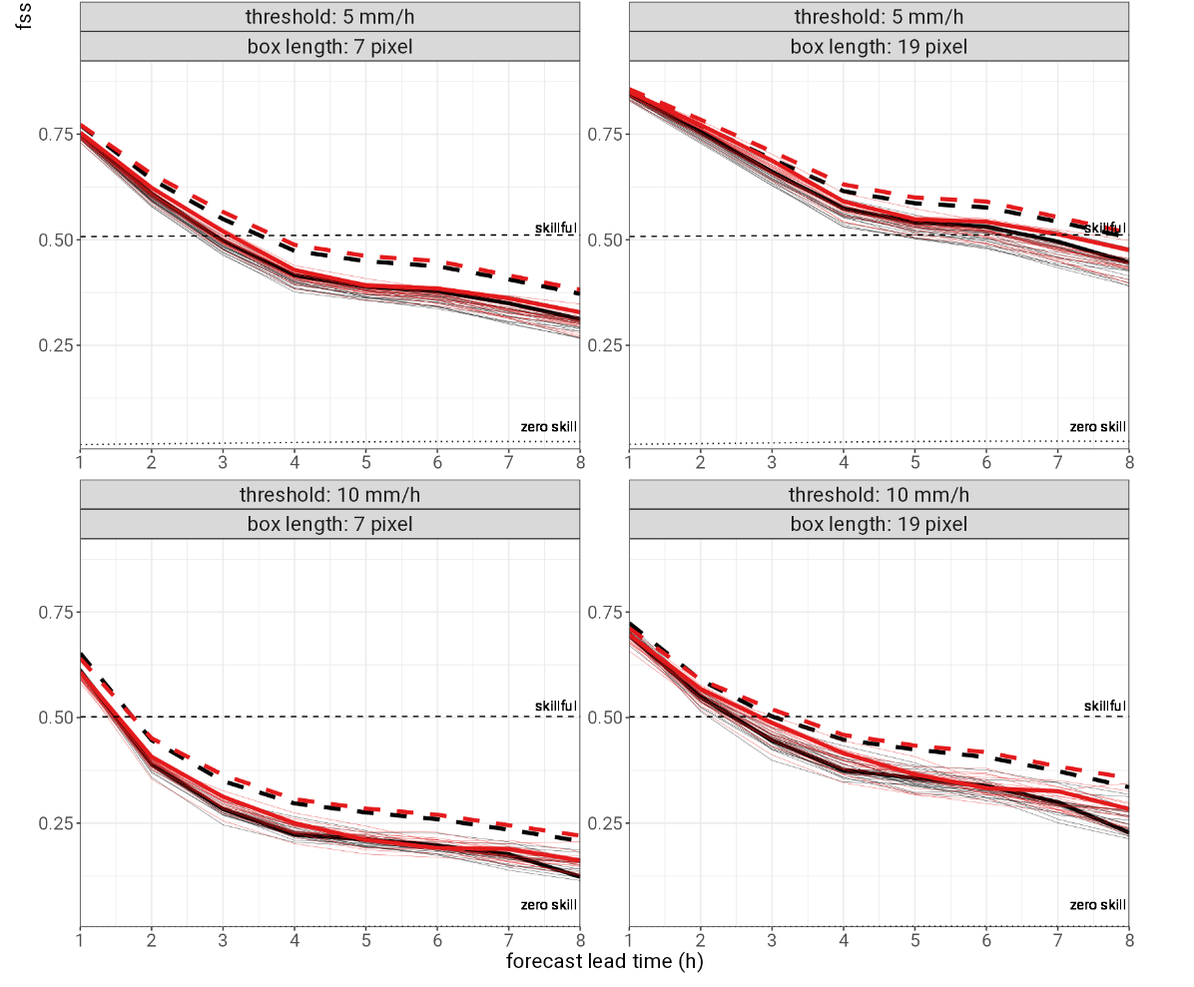
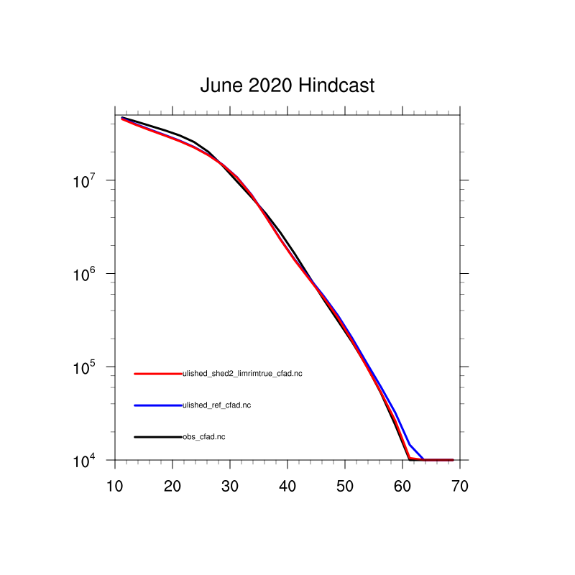
Shedding of graupel/hail improves deep convection
We allow for shedding of liquid water in large graupel and hail. This physical process limits the production of very large hydrometeors, and their associated large reflectivities and extreme rain rates.
We have make more demanding the transition from large snowflakes to graupel.
These changes slightly improve scores for high rain rates.
Frequency
Reflectivity (dBZ)
SINFONY Day, 2024

Slide 24
Two-moment microphysics
Radar
Radiation
RTTOV
Microphys.
Consistent
Our operational microphysical scheme has a prognostic equation for the mass concentration (q) of each hydrometeor (cloud water, rain, ice, snow and graupel): it does not produce very high reflectivity.
The two-moment-scheme of Seifert and Beheng (2006) can provide more
realistic reflectivities because:
  Additional prognostic equation for number concentrations (N).
  Reflectivity is highly non linear:
  Additional hail class allowing for large hail particles.
We have coupled the two-moment scheme to radiation
through the calculation of an effective radius:
Radar and satellite forward-operators (RTTOV) are also consistent
with the assumptions and calculations from the microphysics.
R ~ r⁶~(q/N)²
r ~ a(q/N)^{b}
SINFONY Day, 2024

Slide 25
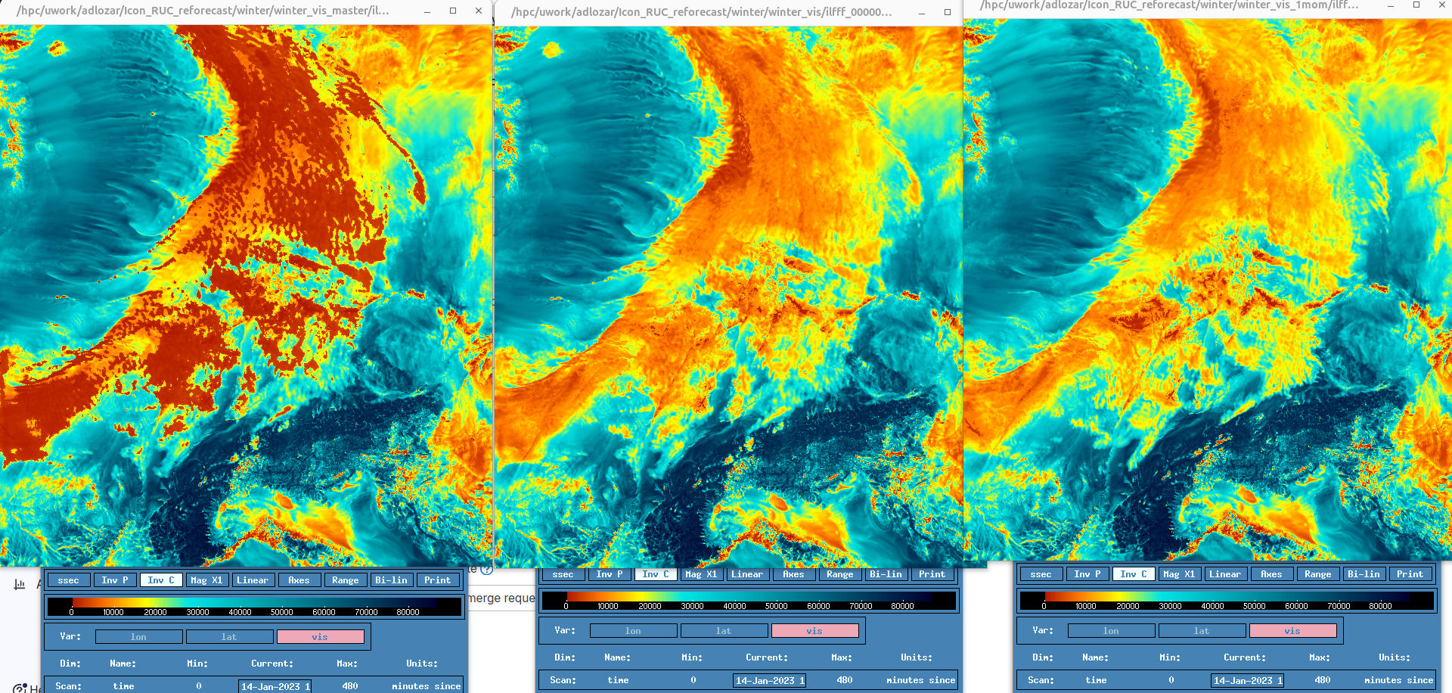
Visibility bug
Our colleagues from flight meteorology made us aware that the visibility diagnostic of the RUC was unrealistic in rainy conditions (Thanks!).
Further investigations revealed a bug due to different assumptions in one and two-moment schemes.
Together with Tobias Göcke we have implemented a hotfix that will be released soon. A better diagnostic (tailored for the 2-moment scheme) is planned for SINFONY 3.0.
RUC
RUC + Hotfix
ICON-D2 Routine
SINFONY Day, 2024

Slide 26
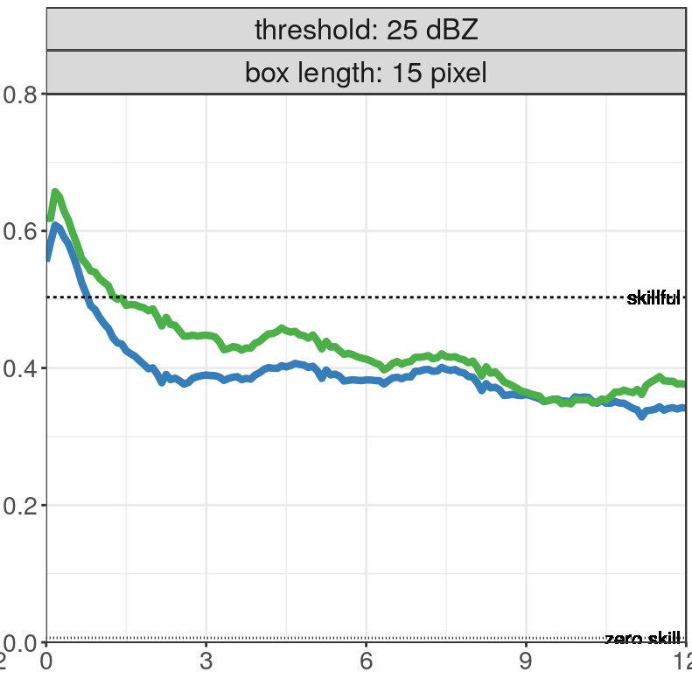
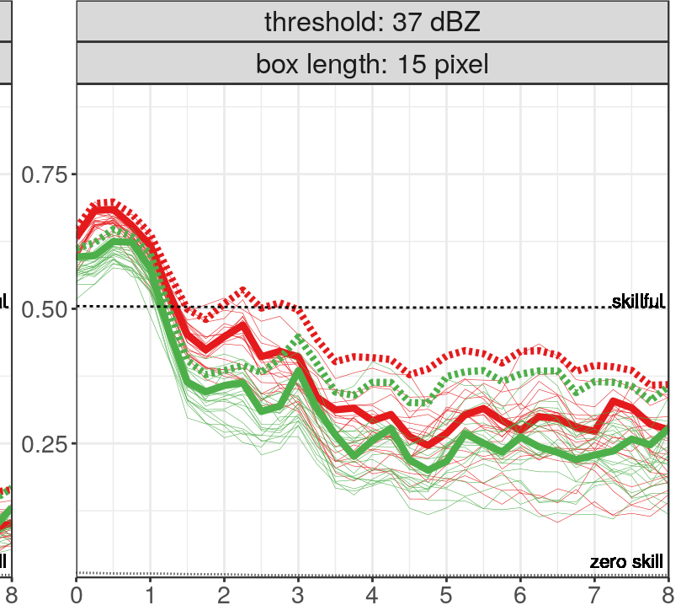
Changes in 2023 (experiments by K. Khosravian)
Reduced collision efficiency of graupel by 50%.
Faster graupel velocity according to Heymsfield et al. (2018).
Graupel can form for T > -3.
Lower limit of Connoly et al. (2012) for snow sticking efficiency.
Old Bright Band Settings in EMVORADO
Corrected bug in melting scheme.
Bright Band for T>-3
Reduced snow terminal velocity (similar to M. Karrer er al. (2021)).
The RUC branching from operational allows for simulating interesting days only: we have chosen five days in last summer for testing. The reduced cost allows for ensemble forecast.
Winter verification is still done with a continuous experiment over 12 days (only deterministic verification).
New
Old
New
Old
Bad FSS Good
Winter 2022
Summer 2022
Lead time [h]
SINFONY Day, 2024
26

Slide 27
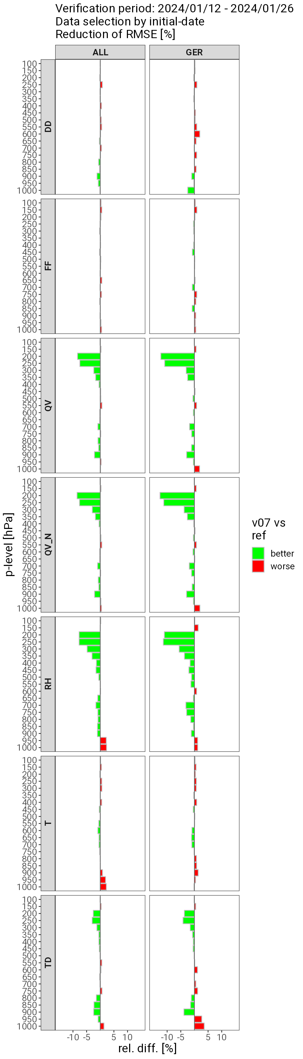
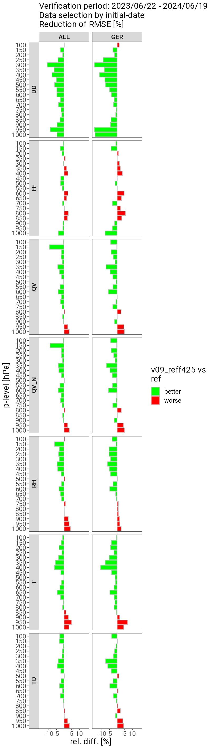
Forecasts from Assimilation Experiments
RUC
ID2
PrePEP 2025

Slide 28
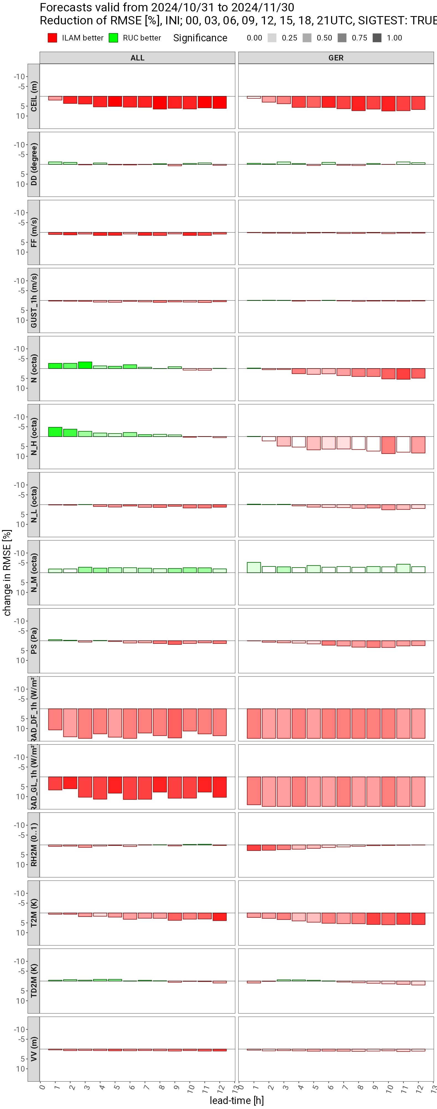
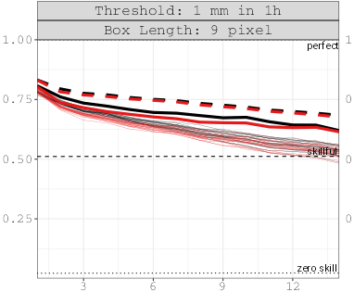
But Winter is always worst than Summer (11.24)
On our last month (November) almost all scores show a worst performance of the RUC over ICON-D2.
As an example score cards based on SYNOP station (left) and precipitation (right) are shown.
RUC
ID2
FSS
Leading time (h)
SINFONY Day, 2024

Slide 29
Infrastructure: play with the RUC outside the DWD
New namelist for the two-moment scheme. Most development visible through namelist changes.
  &twomom_mcrph_nml
Two Buildbot tests has been created with the pre-operational RUC configuration (in merge request):
  checksuite.nwp/nwpexp.run_ICON_24_R19B7_RUC_ass
  checksuite.nwp/nwpexp.run_ICON_25_R19B7_RUC_fc
The two-moment microphysical scheme has been fully ported to the GPU (A. Laubert, MeteoSwiss):
  LHN soon to come
  The coupling with radiation is not yet optimized for operational runs (speed).
SINFONY Day, 2024

Slide 30
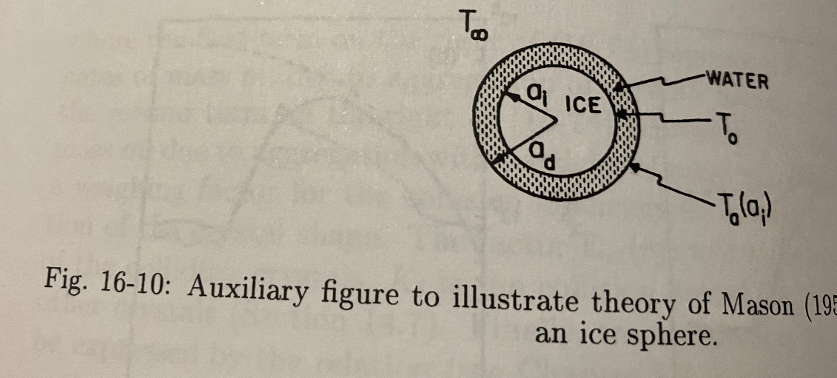
New melting of graupel/hail
The model assumes that graupel/hail are covered by a liquid film due to melting. The evaporation of the liquid slows down the melting process.
The problem is how to account for the liquid phase. In the two-moment scheme all melted water goes to the rain phase.
Current two moment scheme ignores the evaporative cooling of liquid in the atmosphere (while keeping the slower melting), but it also considers the direct sublimation of graupel/hail. This is not very consistent.
We have implemented a new melting scheme in which the evaporated liquid goes to the melted phase. There is no sublimation as far as rain water is available (coated particle).
This produces a bit more precipitation on the surface and potentially less cold pools (only tested in winter).

Slide 31
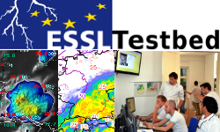
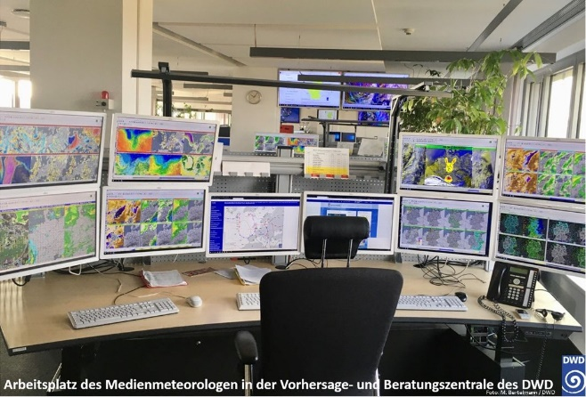
Evaluation by DWD forecasters and ESSL
Apart from our verification suite we let the model to be evaluated by our warning-forecasters and European Severe Storm Laboratory (ESSL). Both groups provide a subjective evaluation of the model in severe weather conditions, which complements our verification suite.
Last year the reviews were mostly positive, with both groups seeing an added value of the SINFONY forecasts. Some critics were:
  incorrect the Z-R relationship.
  when asked about cold pools and gusts we get quiet mixed answers: too strong, too weak, ok. Maybe this means they are right, but we should have a closer look.
  A few cases with missing convection. Often delayed convection
This year reports were quite positive from the ESSL, but little feedback from DWD due to lack of resources.
summer
ICCARUS WG, 2024

Slide 32
The high-reflectivities inconsistency
The problems
EMVORADO calculates the attenuation along the ray propagation. On the other hand, POLARA uses a correction to remove the attenuation from radar signal. This is not consistent.
The bright band correction (increase of reflectivity due to partially-melted graupel) is calculated using a very simple parameterization, which is independent of the microphysics. We have used this parameterization used for tuning in the past years.
ICON model field reflectivities are calculated without attenuation correction. They tend to be very large.
New developments (Uli’s)
New implementation of Bright-Band correction consistent with microphysics. The parameterization is based on previous calculations at which temperature and at which size we can obtain wet graupel. This new parameterization tends to reduce high reflectivities.
Reduction of very-high large hail and graupel particles by introducing shedding.
Slow down of graupel creation. The collision of small droplets and large ice does not produce graupel any more.

Slide 33
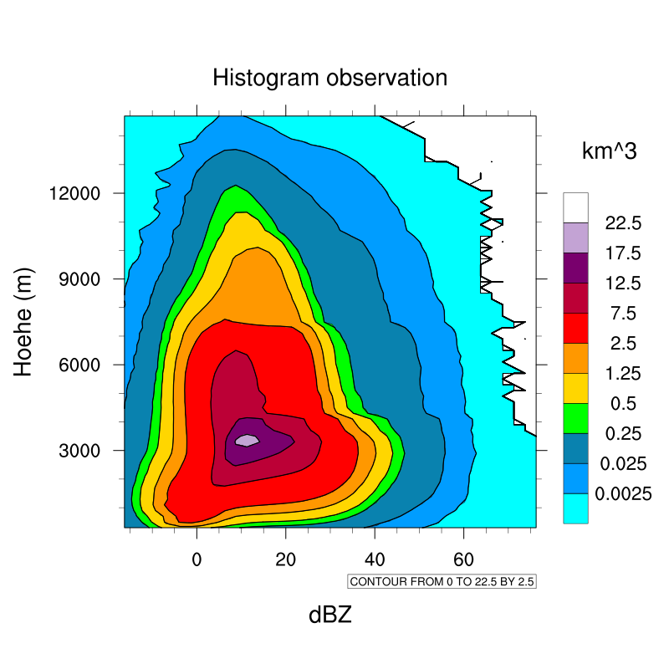
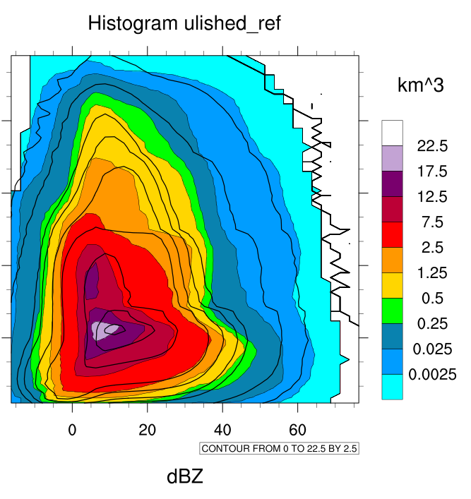

Shedding (all with attenuation)
Reduction of very-high large hail and graupel particles by introducing shedding.
Slow down of graupel creation. The collision of small droplets and large ice does not produce
A small step in the right direction. Very high reflectivities are reduced a bit.

Slide 34
Shedding (all with attenuation)
Reduction of very-high large hail and graupel particles by introducing shedding.
Slow down of graupel creation. The collision of small droplets and large ice does not produce
A small step in the right direction. Very high reflectivities are reduced a bit.

Slide 35
High-clouds changes
More ice clouds:
INAS ice nucleation scheme (from KIT)
More active ice nucleation (SSI = SSI + 0.2), justified by fluctuations.
Avoid ice aggregation below -40 C
More realistic water clouds (reff closer to 5mm)
CCN of sub-grid scale clouds multiplied by two. This puts the reffective radius of grid-scale and sub-grid scale clouds in a similar range.
Snow more according to experiments
Original snow velocity from Seifert and Beheng (slower for large snow).
Original Connley sticking efficiency (current in RUC divided by two).
ICCARUS WG, 2024

Slide 36
The high-reflectivities inconsistency
The problems
EMVORADO calculates the attenuation along the ray propagation. On the other hand, POLARA uses a correction to remove the attenuation from radar signal. This is not consistent.
The bright band correction (increase of reflectivity due to partially-melted graupel) is calculated using a very simple parameterization, which is independent of the microphysics. We have used this parameterization used for tuning in the past years.
ICON model field reflectivities are calculated without attenuation correction. They tend to be very large.
New developments (Uli’s)
New implementation of Bright-Band correction consistent with microphysics. The parameterization is based on previous calculations at which temperature and at which size we can obtain wet graupel. This new parameterization tends to reduce high reflectivities.
Reduction of very-high large hail and graupel particles by introducing shedding.
Slow down of graupel creation. The collision of small droplets and large ice does not produce graupel any more.

Slide 37
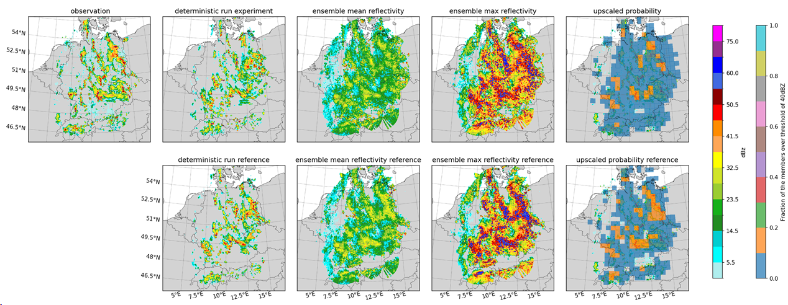
Ensemble experiments (S. Ulbrich, S. Löbel)
Nine selected days from 2022/2023 summer divided into strong and weak convective forcing.
Verification on the fly: Ensemble forecast each hour without filling the hard drive
We are exploring ensemble spread scores for convection.
ICCARUS WG, 2024

Slide 38
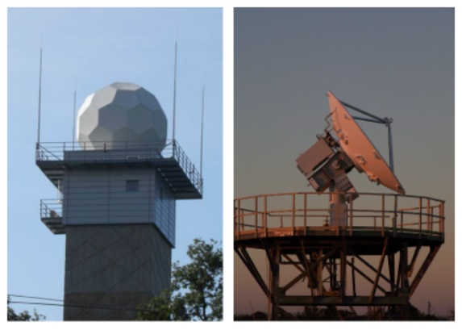
Discussion Z-R Relationship
Winter
In winter, the results are more difficult to interpret. The mode (max of pdf) is realistic, but the pdf are highly different. In model we observe a lot of cases with little precipitation and high reflectivity while in RW the distribution is more symetric.

Slide 39
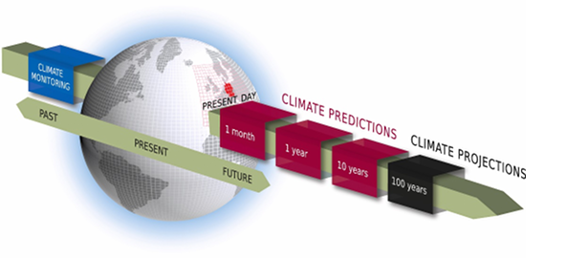
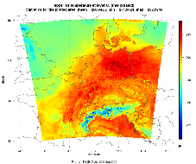

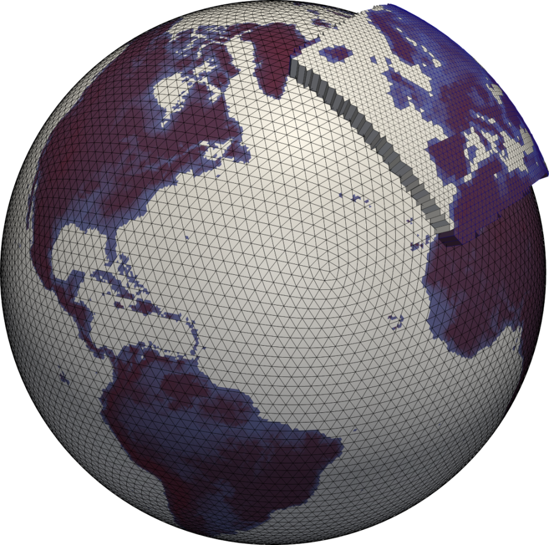
Forecasting time scales and -frameworks
NWC
1km 0-3h
ILAM RUC
1-2km 0-12h
ICON LAM
ICON EU
ICON Global
2km 0-30h
6.5km 0-120h
13km 0-180h
Seasonal Prediction
-> 12 month
Climate Projection
-> 10-100 years
Update
5 min
Update
1h
Update
3h
Products & Visualisation
Update
6h
SINFONY
Update 12h
time range

Slide 40




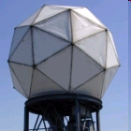

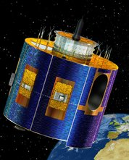
Combined products:
Concept and prospective use in the warning business
Gridded precip / reflectivity ENS
Nowcasting-
ENS (5‘ updates)
To forecasters
Cell object ENS (ident, tracking)
NWP informations in Nowcasting
Life cycle
To (semi)-automatic warning systems
Combined products
„Best of both worlds“:
Optimal skill for each lead time
Assimilation of „cell objects“
To flood warning authorities
*)
KENDA-LETKF
ENS data assimilation
ICON-RUC-ENS (1 h updates) Δx = 2 / 1 km
To DWD WarnWetter App
ICON-LAM
t₀
Fcst lead time

Slide 41
Principle of INTENSE
(INTegration of ENSembles of NWP and Extrapolation)
Idea from Nerini et al. (2019)
Nowcasting-ENS
NWC für Δt
EnKF Korr.
EnKF Korr.
NWC für Δt
Combined ensemble
NWV-ENS, towards which to pull the Nowcasting
Δt
Δt

Slide 42
The SINFONY Rapid Update Cycle (ICON-RUC)
time
2h
8 h
48 h
Nowcasting
ICON-RUC (Evaluation mode)
ICON-D2
With the ICON-RUC we aim for a seamless transition from Nowcasting.
We aim to capture small/medium convective structures that are visible in the radar. This is achieved by:
  Results arrive 45 minutes after last assimilation and the model runs every hour: predictions are 0:45-1:45 h old (in ICON-D2 predictions are 1:15-4:15 h old).
  Assimilation of reflectivities and radar wind observations: this is also in ICON-D2 (as a result of this project), but the ICON-RUC can assimilate more reflectivity observations.
  More realistic reflectivities: two-moment microphysics and more realistic reflectivity operator.

Slide 43
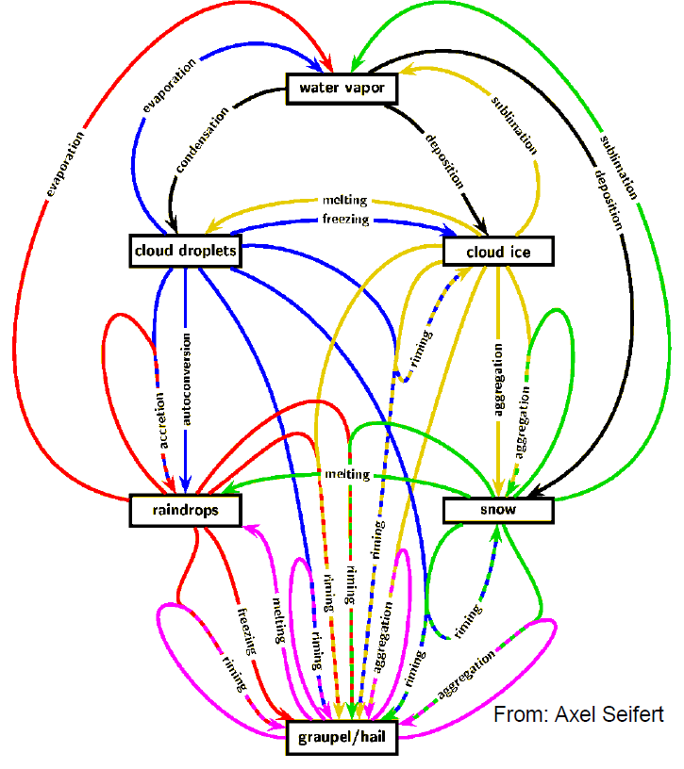
Adjusting the two-moment microphysics
  The two-moment scheme has never previously been used in operational mode. The initial performance was clearly worst than our operational ICON.
  There are many uncertain processes and parameters in microphysics. Most parameters are taken from laboratory experiments, observations on few campaigns, or comparison with high- resolved simulations in case studies.
  We have reevaluated many of these parameterizations from a top-down approach, based on the results of hindcast experiments over Germany.
  In the hindcasts we compare with “traditional” observations (surface stations and radiosondes), but also with radar and satellite observations in order to obtain a more realistic simulation of clouds and precipitation.

Slide 44
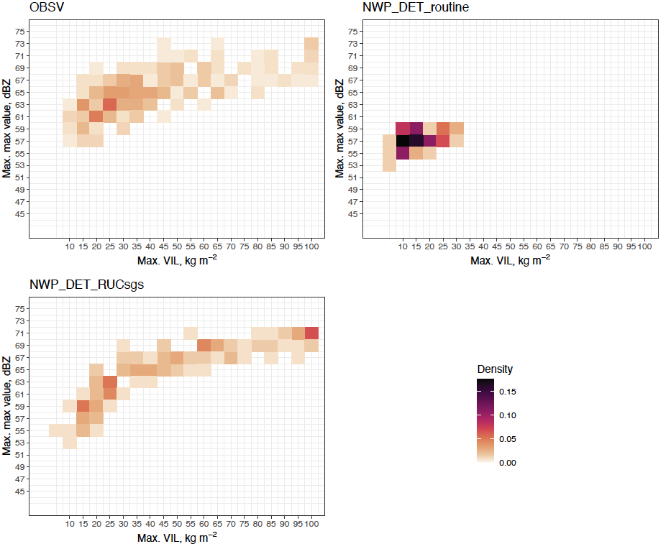
KONRAD3D cells from RUC simulated PPI volume scans
The RUC produces less cells than in the observations, but more that in the routine configuration.
KONRAD3D derives different cell properties (VIL, dBZmax, echoTop): cells in the routine have less VIL and dBZ. The RUC produces much more realistic cells, as shown by density histograms for long-lived cells (>60min).
Obs
ICON-D2
RUC
Max. VIL vs. max. dBZ
44

Slide 45
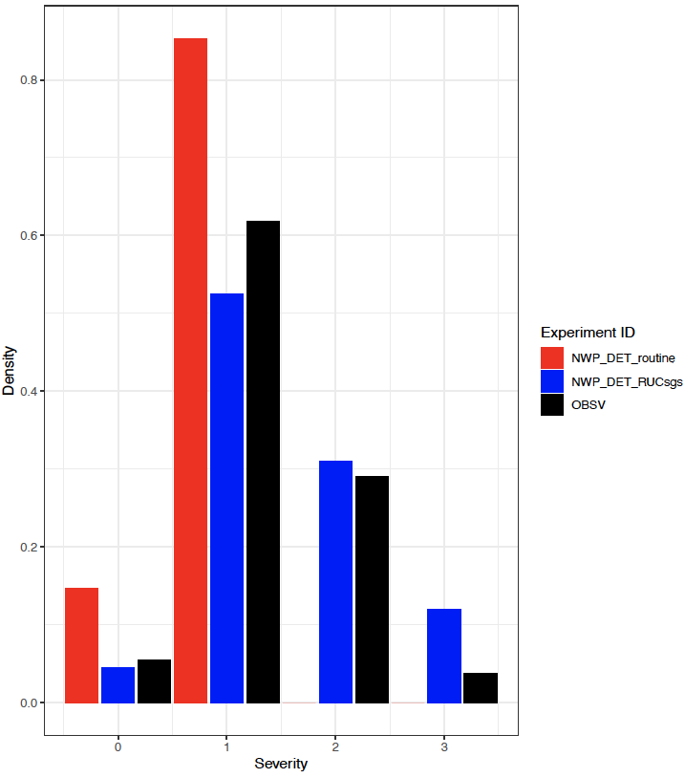
Properties of simulated cells from RUC
Routine
RUC
Observation
The more realistic properties translates into a better prediction of cell severity by RUC.
45

Slide 46
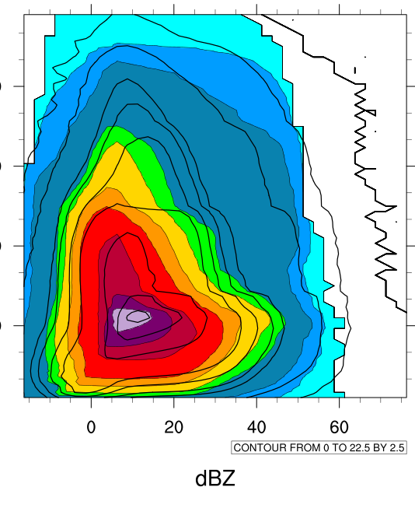

Radar CFADS: precipitation
Observation
1 mom
2mom
The CFADS become more realistic for high clouds ( above 9km).
Too-high reflectivities for middle clouds (4-6 km).

Slide 47

How doe we tune: Statistics form Hindcast Experiments
Hindcast: model run in summer convection time with boundary conditions from short ICON-EU forecasts started from reanalysis.
There is no assimilation, the model is forced to real weather through the boundary conditions. Hindcast runs provide the model climatology.
ICON-EU
ICON-EU
D2 Domain (2.1 km)

Slide 48

Enhanced Ice-ice conversion rate
The initial scheme produced too many small ice particles. These particles are radiatively active and cool the model too much.
We have enhanced the ice-ice collision to snow process by:
  Eliminate the minimum size of ice for collisions.
  Enhance the velocity that accounts for turbulent fluctuations of ice particles.
The final ice concentrations are comparable to the one-moment scheme.
ICON All Staff Meeting 2022

Slide 49
Slower Graupel Velocity
Former 2-mom
Seifert and Beheng (2006)
New
Heymsfield & Wright (2014)
Graupel Velocity (m/s)
Diameter (cm)
Stratiform systems were small when looking at reflectivities/precipitation.
The old configuration featured a relatively fast sedimentation velocity for graupel. Recent measurements suggest that a lower velocity might be more realistic.
Reducing the sedimentation velocity produces wider reflectivity regions, but also more intense reflectivity cores.
ICON All Staff Meeting 2022

Slide 50


New Capacitances for ice and snow
Former 2-mom
Former 2-mom
New
New
aggregates
rosettes
Westbrook, Hogan and Illingworth, JAS 2007
The capacitance scales the growth/evaporation rate of the hydrometeors. It mainly depends on the hydrometer geometry.
Most models assume that the hydrometeors are spherical and therefore have a large capacitance. Simulation studies at the microphysical level suggests that this assumed value might be too high.
Assuming smaller capacitances reduces the latent heat release in updrafts, thus reducing the high reflectivities and precipitation.
ICON All Staff Meeting 2022

Slide 51

Reflectivity scores (14 days in 07.21)
These are forecasts from two assimilation experiments.
We see a clear advantage of the two-moment scheme for high reflectivities.
This behavior is very consistent for all model configurations we have tested (also for COSMO).
Very high reflectivities are very hard for a 2km scale model.
Routine
2-mom

Slide 52

Precipitation Scores (May 2022)
The routine (in read) performs better in the first hour: this is partly because Latent-Heat Nudging works better and longer.
We see a less abrupt decay of the scores in the RUC. This is even more clear with reflectivity.
It seems worse for the 5mm/h threshold but June is showing the opposite trend.
We do not run EMVORADO in the Routine forecasts and it is therefore not that easy to compare results in reflectivity space.
Routine
2-mom RUC

Slide 53
Future work (only related to the model)
First evaluation of the SINFONY-RUC by ESSL and by our forecasters.
Assimilation of SEVIRI visible channels (soon), reflectivity objects and lighting (work in progress).
Evaluation reflectivity objects (POLARA) from the model.
Investigation of hydrological products for flood prevention.
Exploration of 1km resolution in nested domains. First results have not shown significant improvements.
Use shallow-convection stochastic scheme in RUC.
ICON All Staff Meeting 2022

Slide 54

Comparison in observation space: CFADS
CFADS are two-dimensional histograms that show how often do reflectivites/reflectances occur at certain heights. These histograms provide information about the large hydrometeors.
Experiments are done for a month without assimilation and best boundary conditions.
Height (m)
Hist = Hist + 1
Reflectivity (dBZ)
SINFONY Day, 2024

Slide 55
We want a better winter
The difference between summer/winter can be attributed to:
  Different role of ice microphysics.
  Change from convective (more in summer) to stratiform (more in winter) precipitation.
Most previous development have been focused on convection. We need to improve stratiform cold clouds without breaking the convective clouds.
We can make use of new satellite products and to produce more physical clouds according to observations.
SINFONY Day, 2024

