Slide 1
Operational Hydrologic Ensemble Forecasts in Small Catchments – Implementing New Products for Precipitation Estimation and Seamless Predictions
Jens Grundmann & Michael Wagner
TU Dresden, Chair of Hydrology
PrePEP Bonn // 18. März 2025

Slide 2
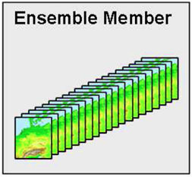
Introduction: HoWa-PRO
QPE with radar+CMLs
Hydrologic
Ensemble Forecast
Prob. Warning
User dialogue
Small catchments and voluntary flood defence forces
Benefit?
Communication of uncertainties?
Suitable warning products?
Q
!
Meteo. ensemble
forecast
DWD + Uni Augsburg
Zeit
TU Dresden
LHWZ + PIKOBYTES
Is there a benefit of upcoming new data products?

Slide 3
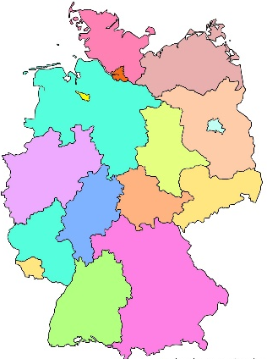
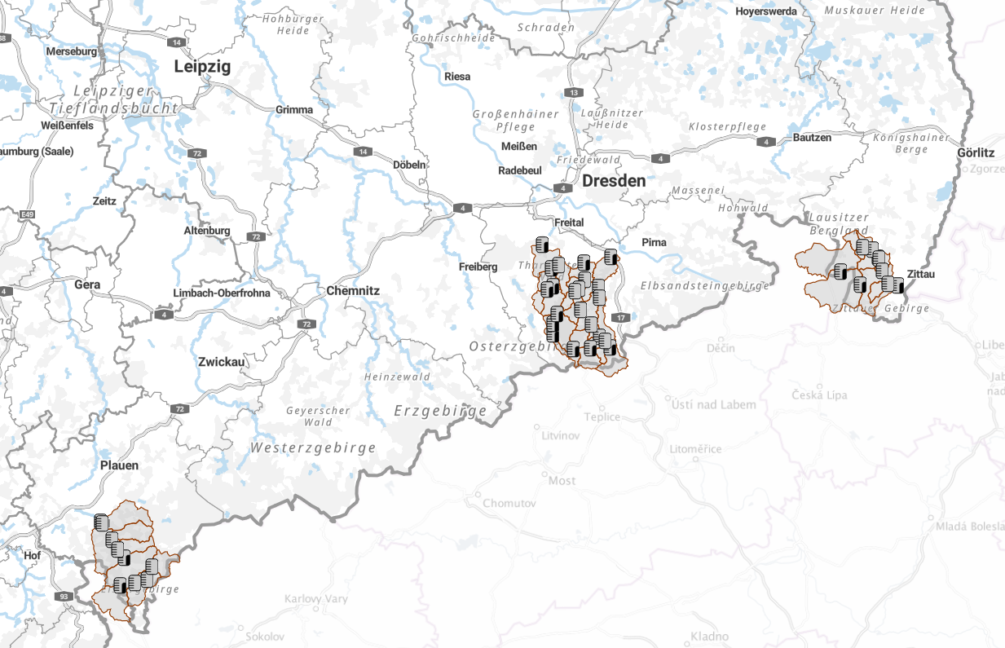
Introduction: Saxony and pilote regions
Oberlausitz
Mandau
Zittau 6 (277 km²)
Großschönau (161 km²)
Seifhennersdorf (74.9 km²)
Niederoderwitz (28.8 km²)
Osterzgebirge
Rote Weißeritz
Hainsberg 5 (160 km²)
Reichstädt (12.7 km²)
Dippoldiswalde (77.4 km²)
Schmiedeberg (53.7 km²)
Bärenfels (6.77 km²)
Lockwitzbach
Kreischa (22.9 km²)
Müglitz
Dohna (200 km²)
Lauenstein 4 (75.4 km²)
Geising (26.2 km²)
Vogtland
Weiße Elster
Oelsnitz (328 km²)
Adorf 1 (170 km²)
Bad Elster (47,7 km²)

Slide 4
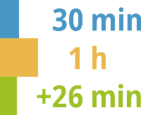
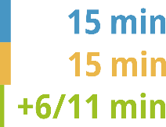
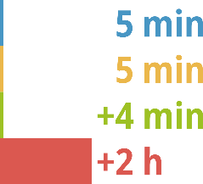
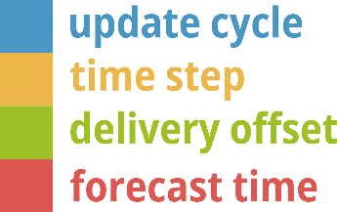
Used data products of DWD for demonstrators
EFShowa
EFSadv
RadolanRW
pyRADMAN
Established Data
Prototypic Data
RadolanRV
INTENSE seamless ensemble now- to forecast
IconD2
IconD2
IconD2EPS
Legend
Data type Properties
Radar data
IconEU
Nowcast
Forecast
Prototypic Forecast

Slide 5
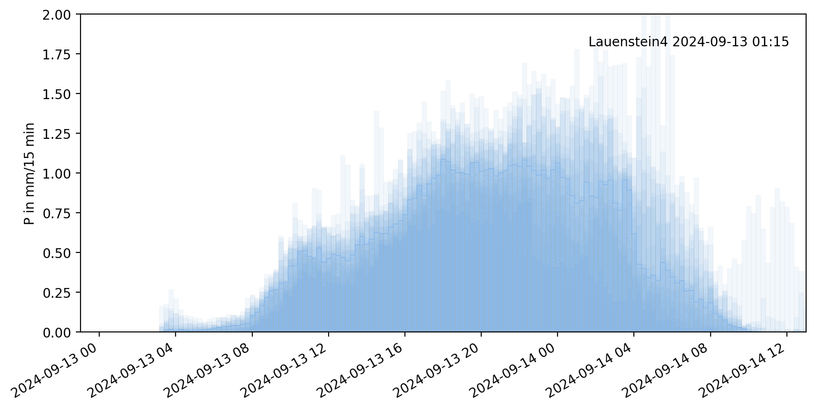
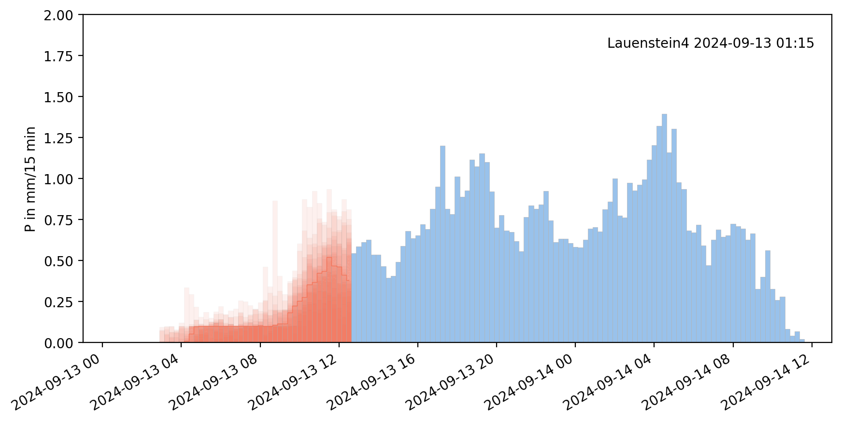
blue | Measured values
green | Nowcast
blue | Forecast
red | seemless forecast
Used data products of DWD for demonstrators
Example Lauenstein@Müglitz (Osterzgebirge)
EFShowa (radRW, radRV, IconD2EPS) → radRW, updated each 30 min
EFSadv (pyRADMAN, INTENSE, IconD2) → pyRADMAN, updated each 15 min
Product | Dx | dt | Update | Forecast horizon | Delivery offset
RadolanRW | ~1 km | 1 h | 30 min | - | 26 min
pyRADMAN | ~1 km | 15 min | 15 min | - | 6/11 min
RadolanRV | ~1 km | 5 min | 5 min | 2 h | 4 min
IconD2 | ~2 km | 15 min | 3 h | 48 h | 75 min
IconD2EPS | ~2 km | 15 min | 3 h | 48 h | 140 min
IconEU | ~4 – 7 km | 1 – 6 h | 3 – 6 h | 48 – 120 h | 230 min
INTENSE | ~2 km | 15 min | 0.5 – 2 h | 12 h | 25 min

Slide 6
Operational hydrologic Ensemble Forecast System (hydEFS)
FloodSentinel
Data
Radar
Radolan RW
pyRADMAN
Nowcast
Radolan RV
Radvor RQ
Forecast
ICON-D2(-EPS)
ICON-EU(-EPS)
Seamless
Sinfony INTENSE
Q (runoff)
weatherDataHarmonizer
https://gitlab.hrz.tu-chemnitz.de/ihmtud/weatherdataharmonizer/
Automatic retrieval, partly converted to NetCDF
OSW-API
Sentinel
Control
Analysis
Visualization
Criteria exceedance in domain
Time
yes
New products
Forecast persistence
Forecast quality
SentinelVisualizer
Timeseries
Persistence
Comparison
Time step
WeatherDataHarmonizer (time step, spatial resolution, coverage, format)
Standardized Precipitation
Criteria type
Domain
Region (gauge, node)
Criteria exceedance in region
yes
Hyd. Model
HYDforecast (time, time step, region, model, counter)
WeatherDataAnalysis (time, domain)
Counter
Visualization
Rest-API
Web Demonstrator
Model: DeHM, KiWaNA
Preprocessing
Simulation (ensemble)
Postprocessing
…
Standardized Output
HYDforecast analysis (time, region)

Slide 7
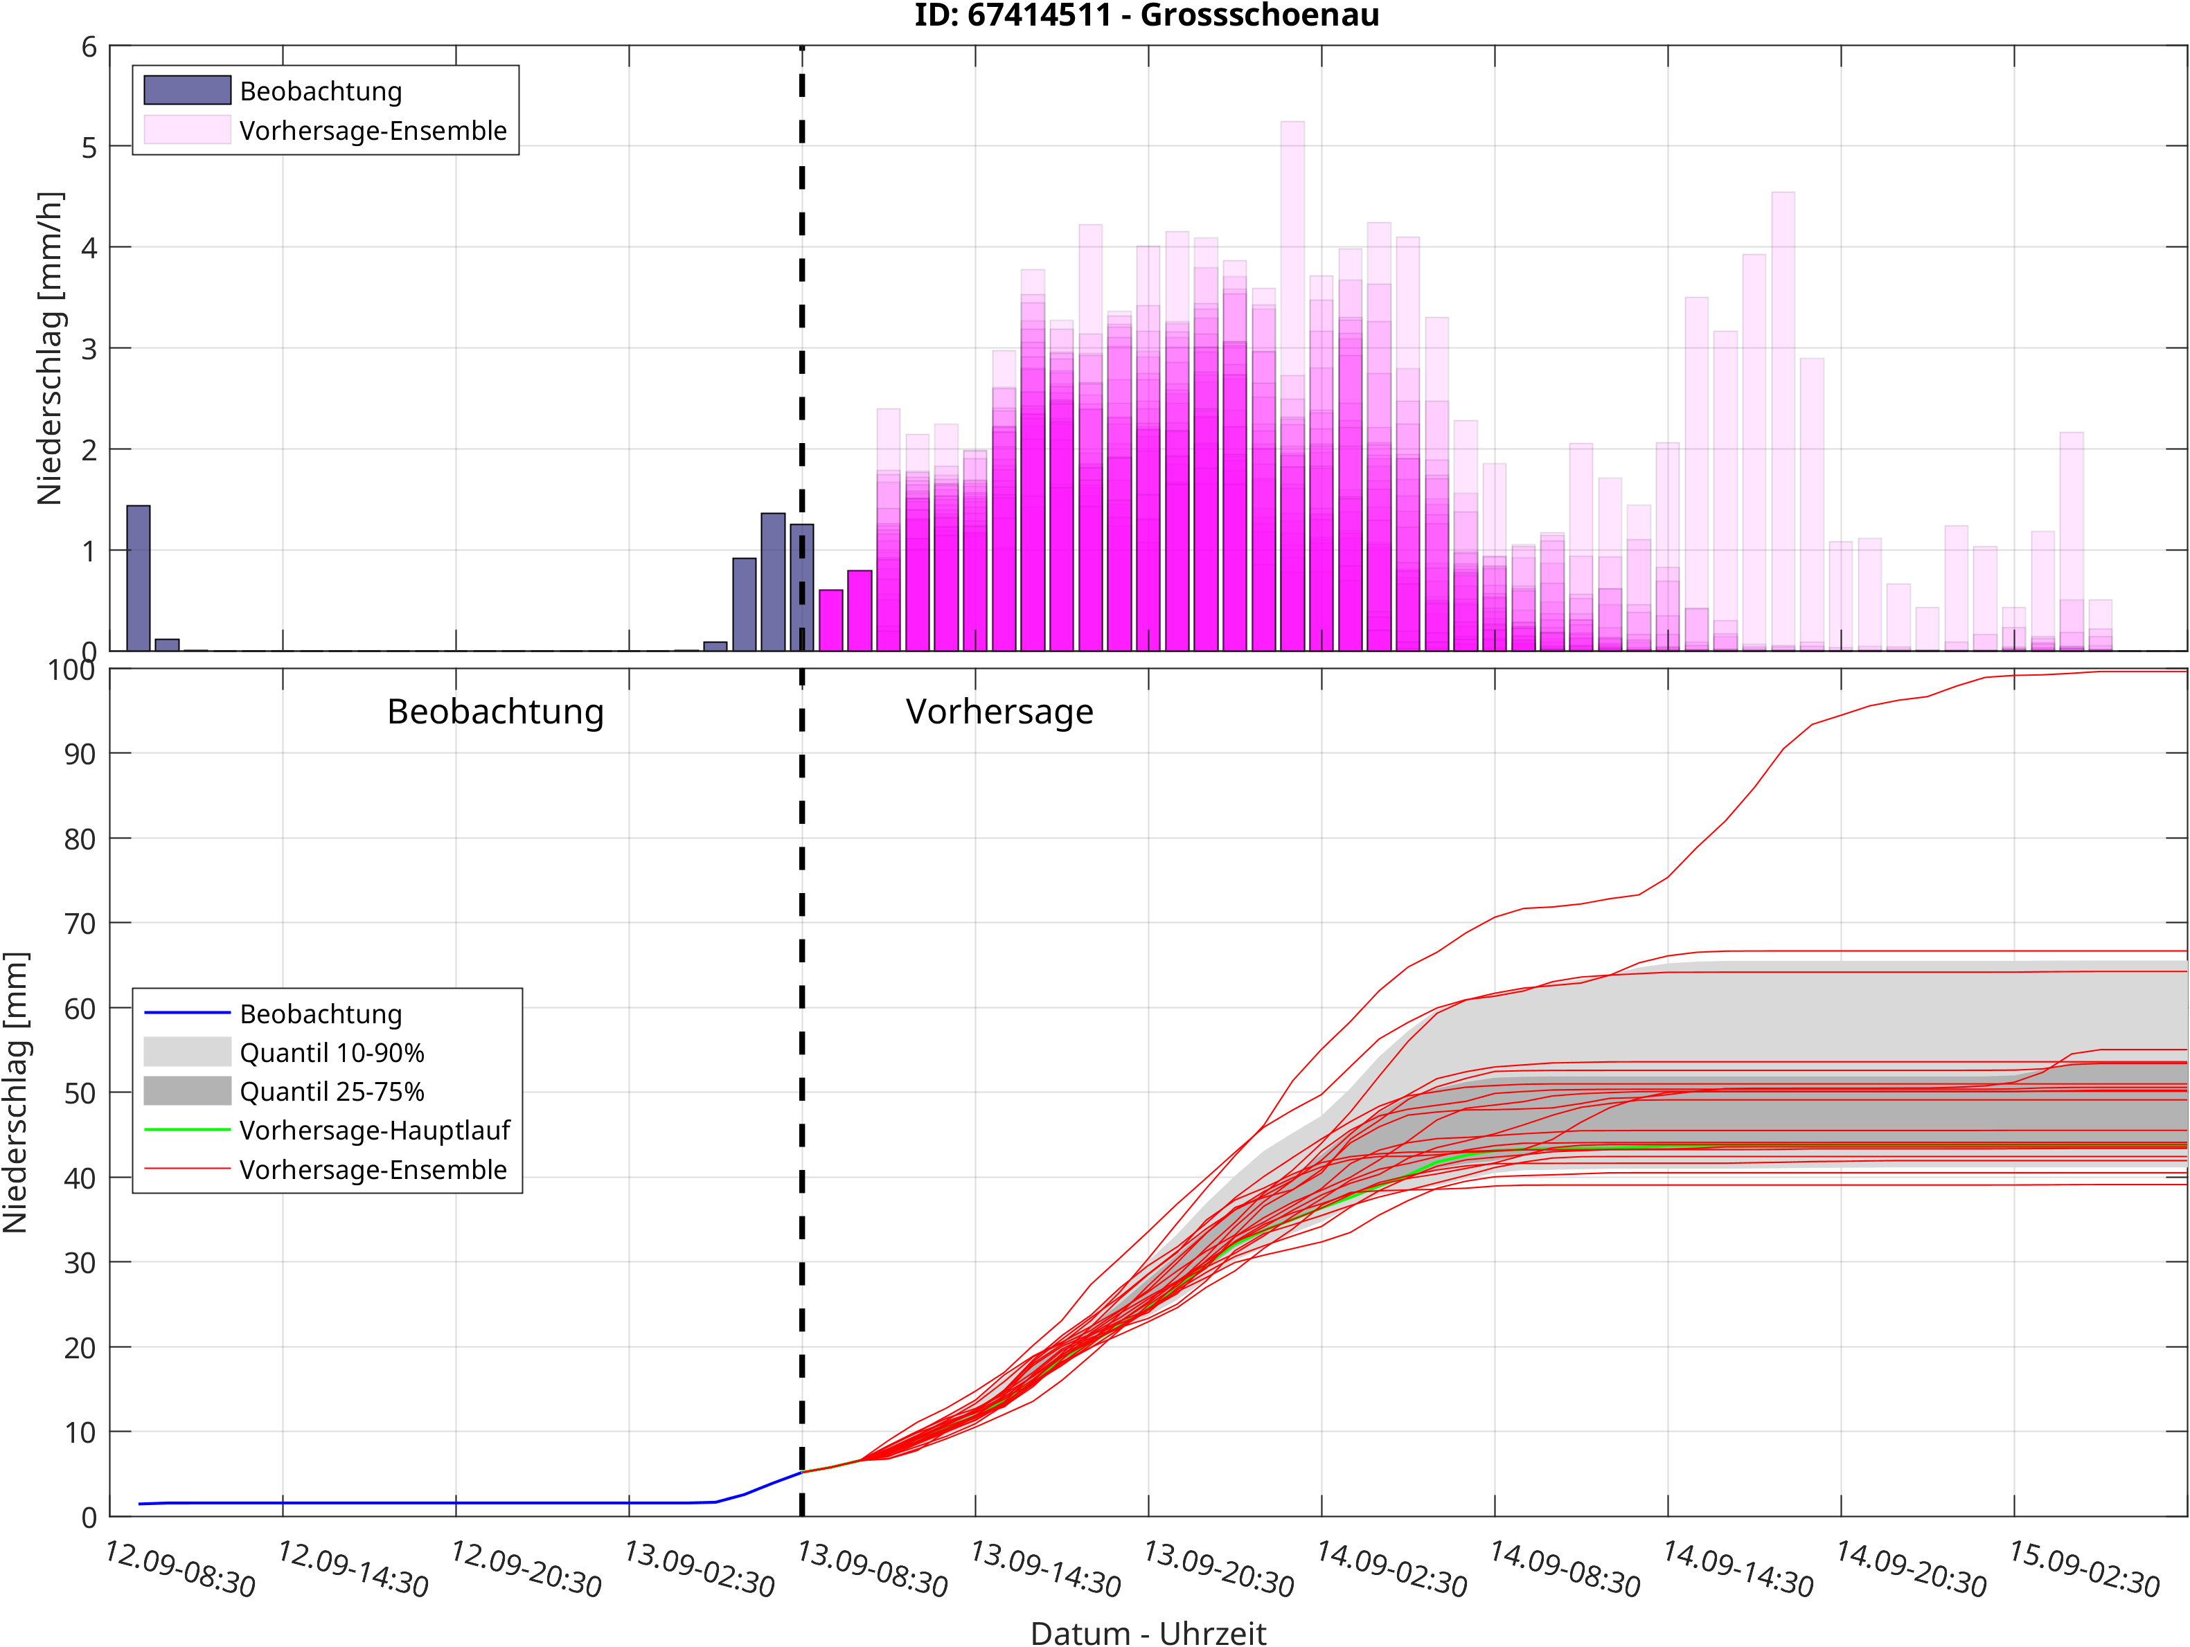
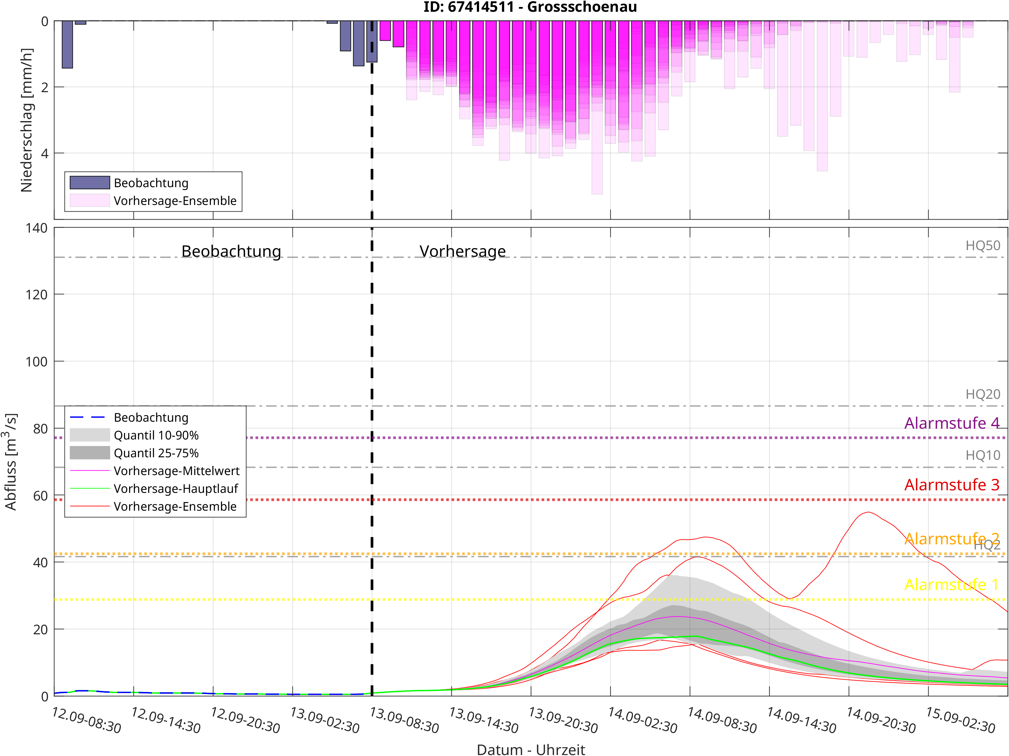
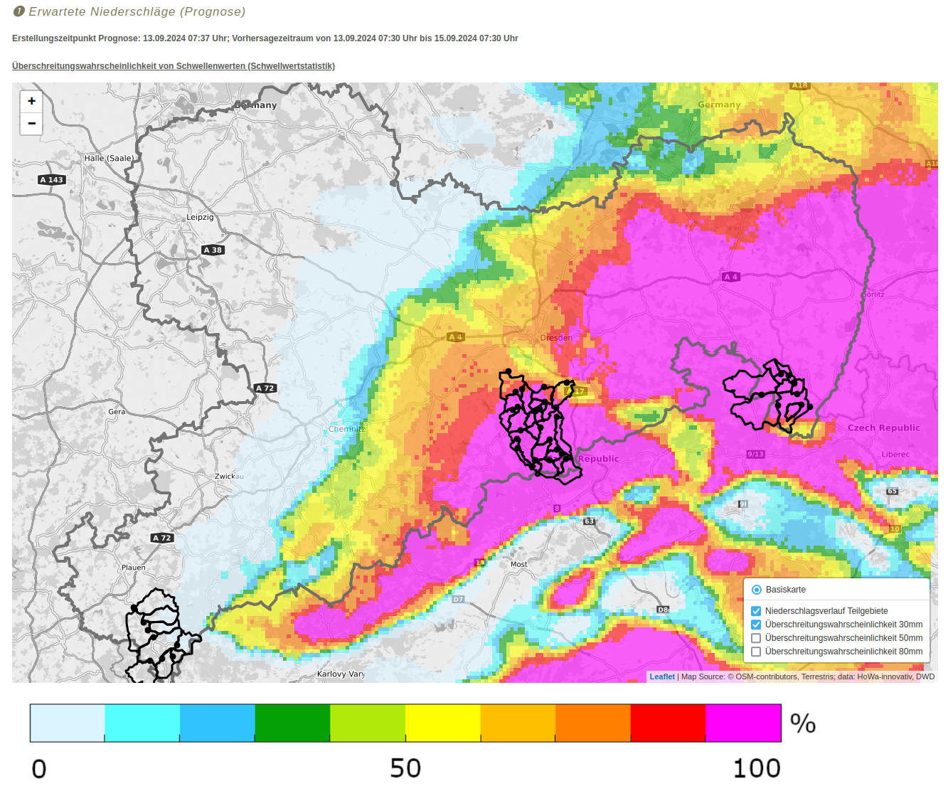
Web-demonstrators – EFShowa & EFSadv
EFSadv
http://howa-innovativ.hydro.tu-dresden.de/WebDemoEFSadv/
Web-demonstrators
Rainfall exceedance probability
Rainfall amounts (quantiles)
Expected runoff (quantiles & thresholds)
Easy to read flood warning
EFShowa
http://howa-innovativ.hydro.tu-dresden.de/WebDemoLive/

Slide 8
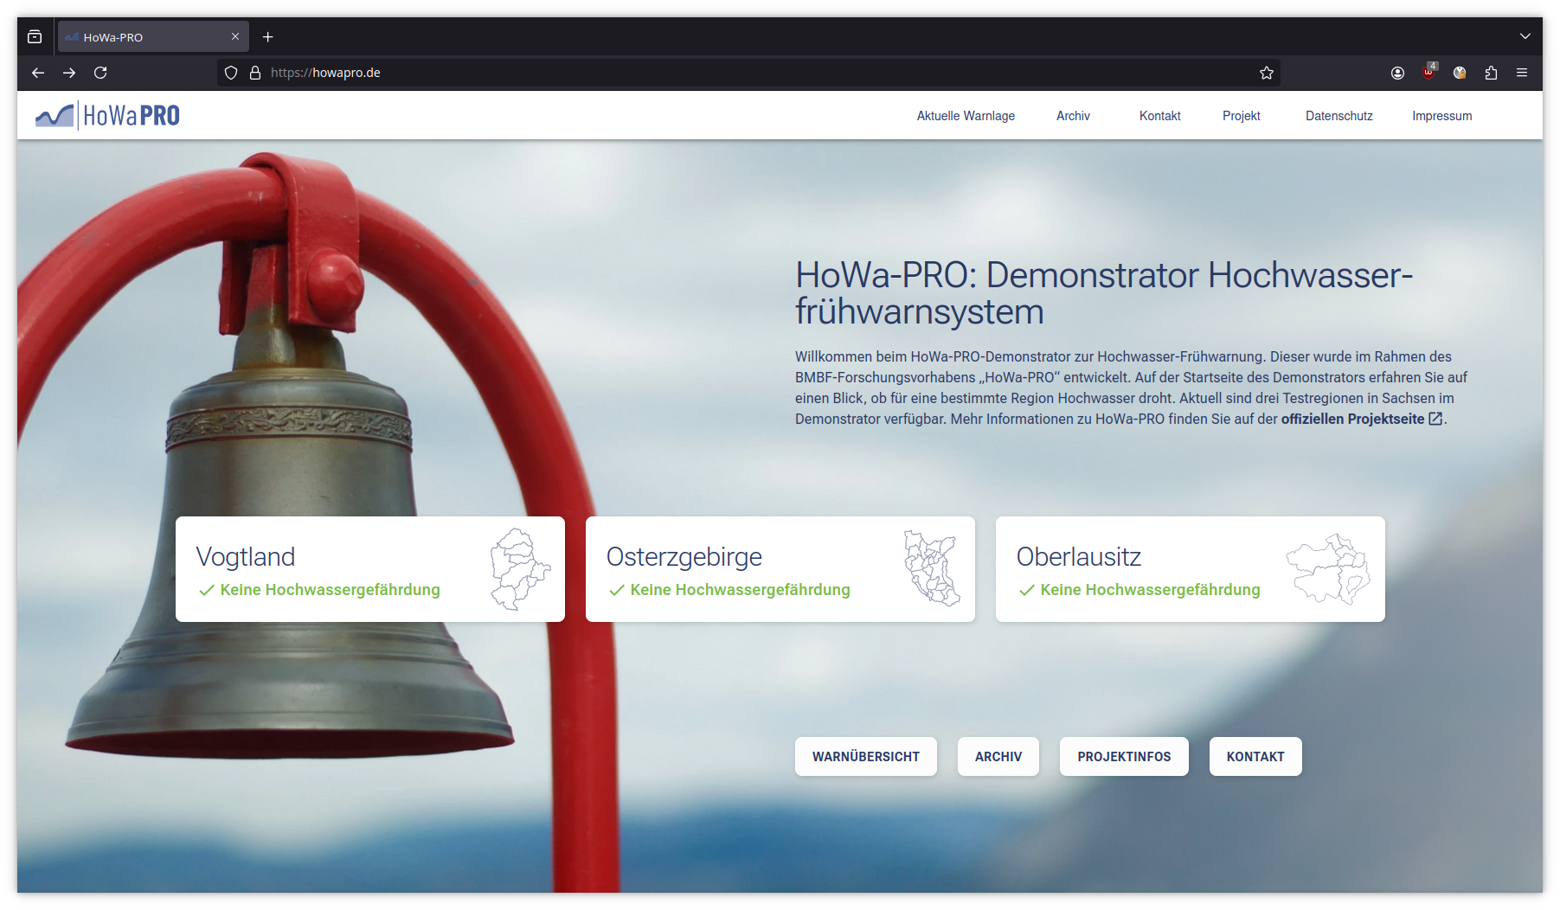
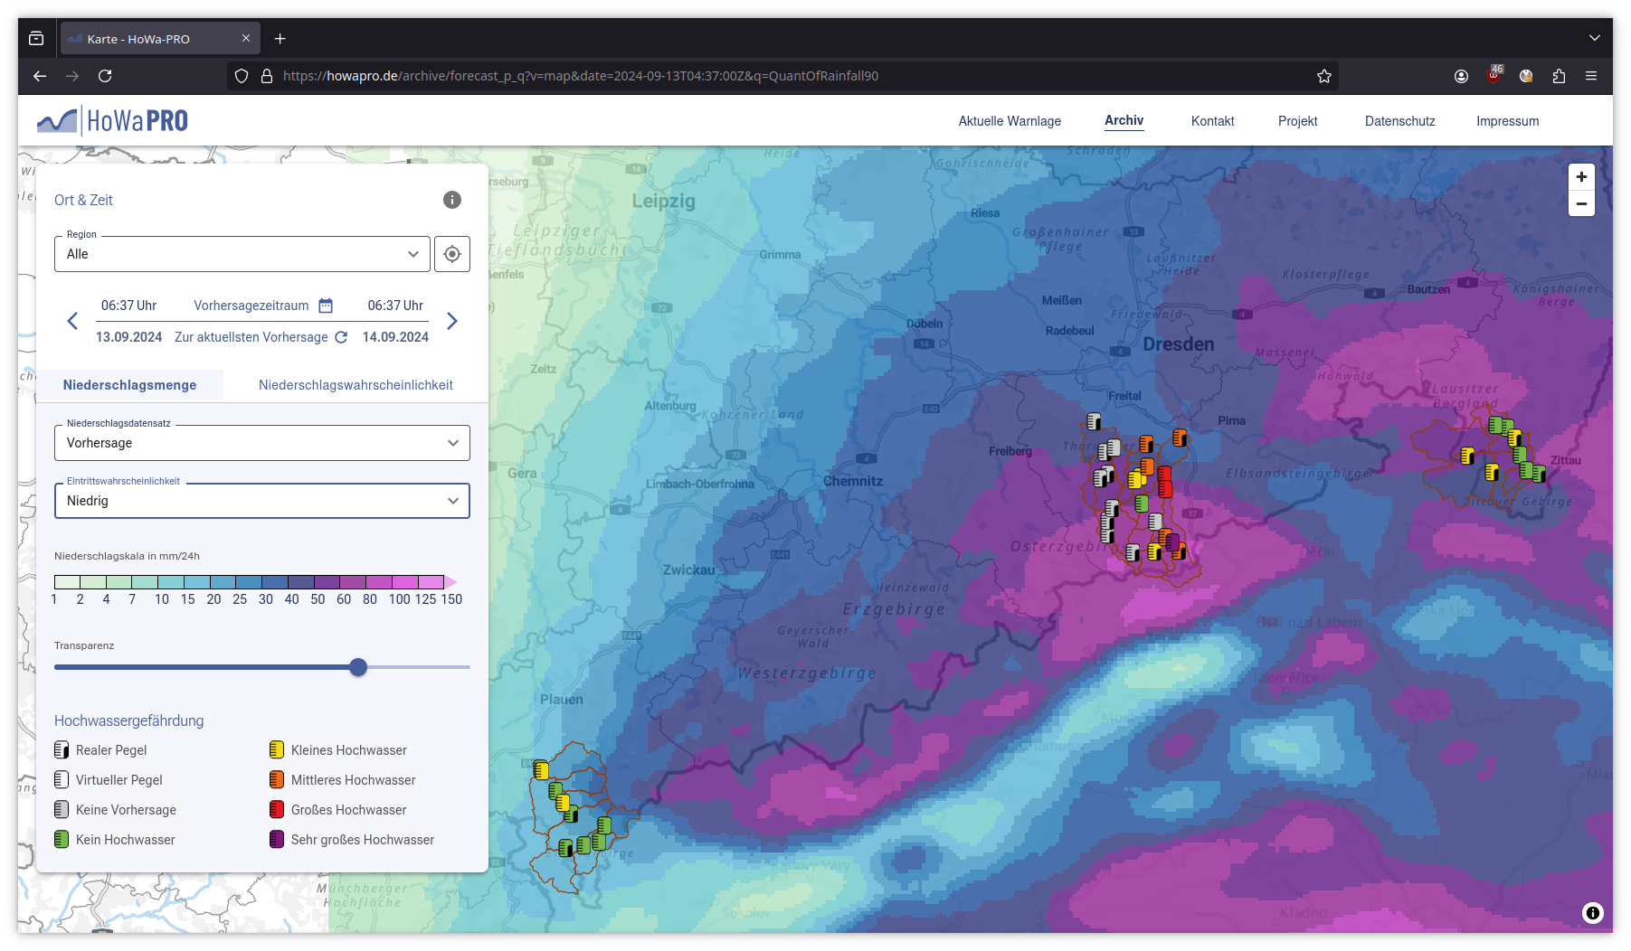
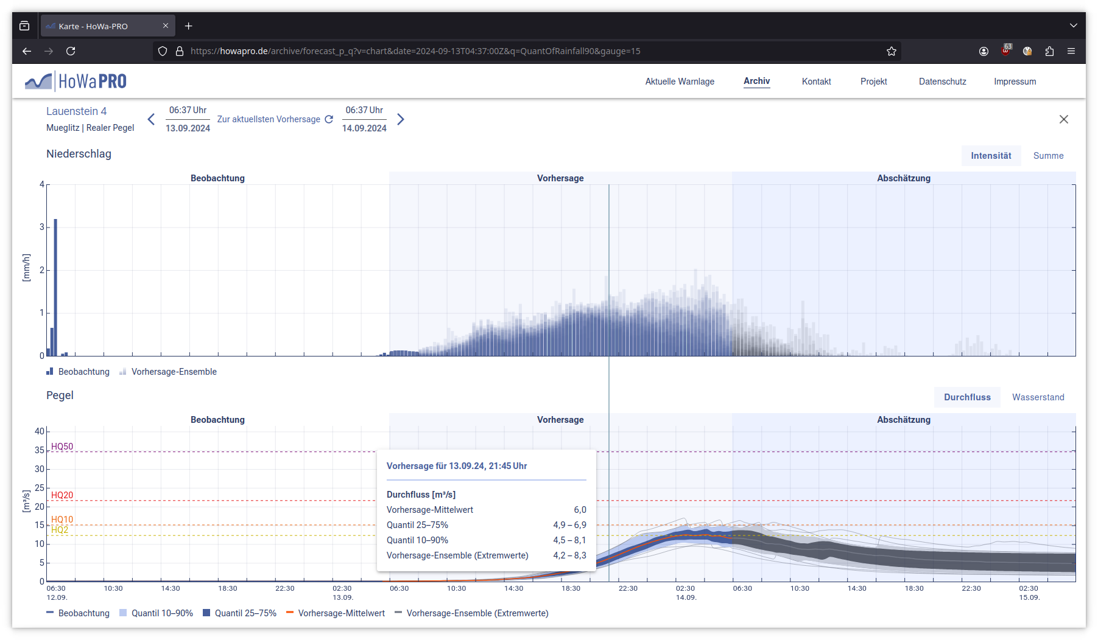
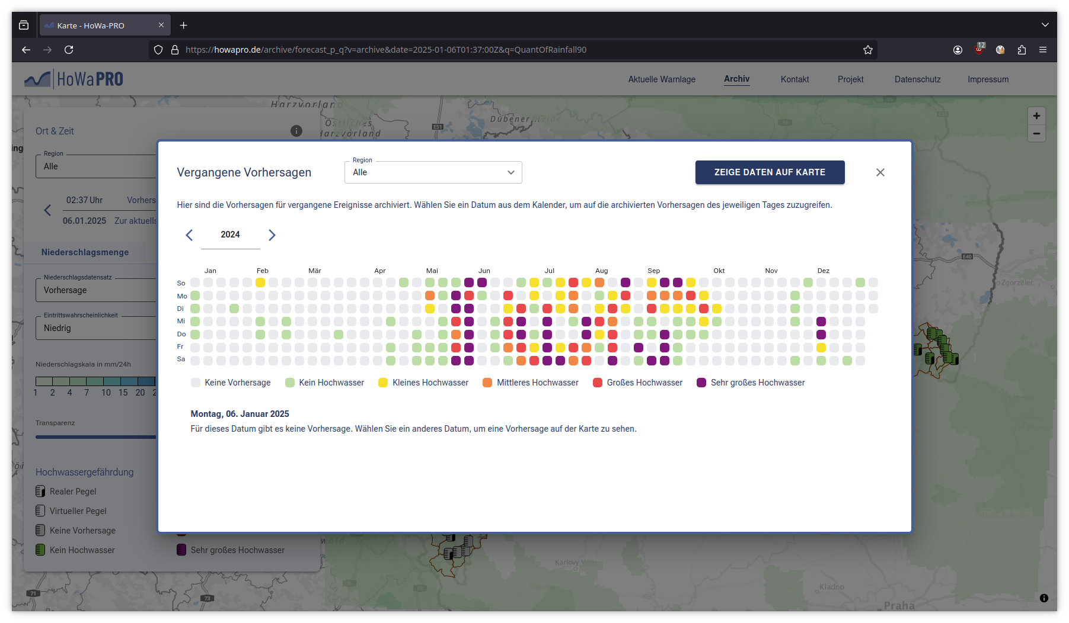
Demonstrator – howapro.de
Warning application https://howapro.de
More modern design and UI
Regional overview
Hydrographs for real and virtual gauges
Archive and API
Used for trainings
Useable on smart phones
https://howapro.de

Slide 9
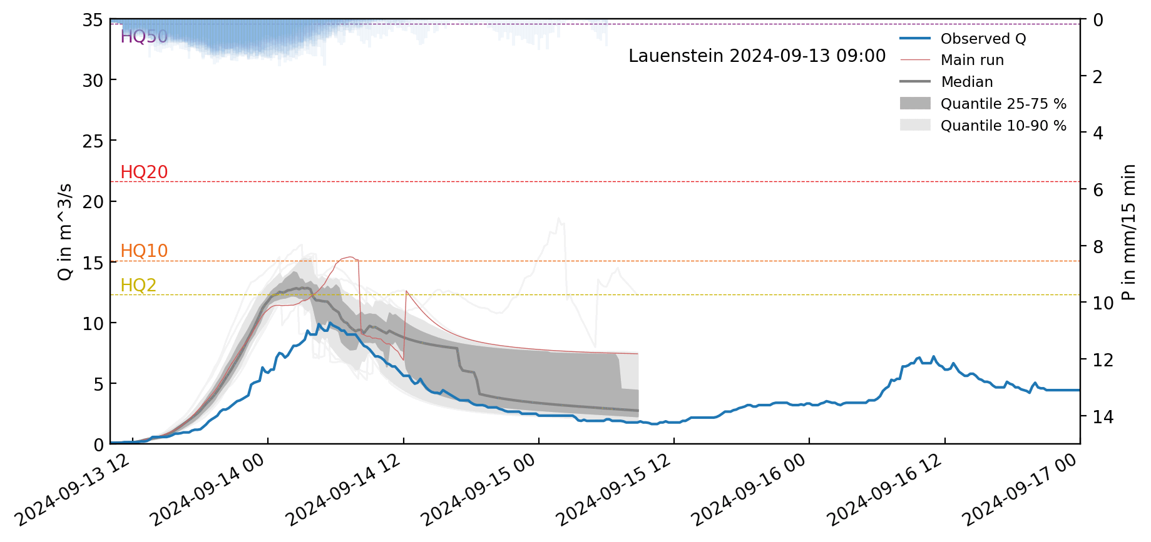
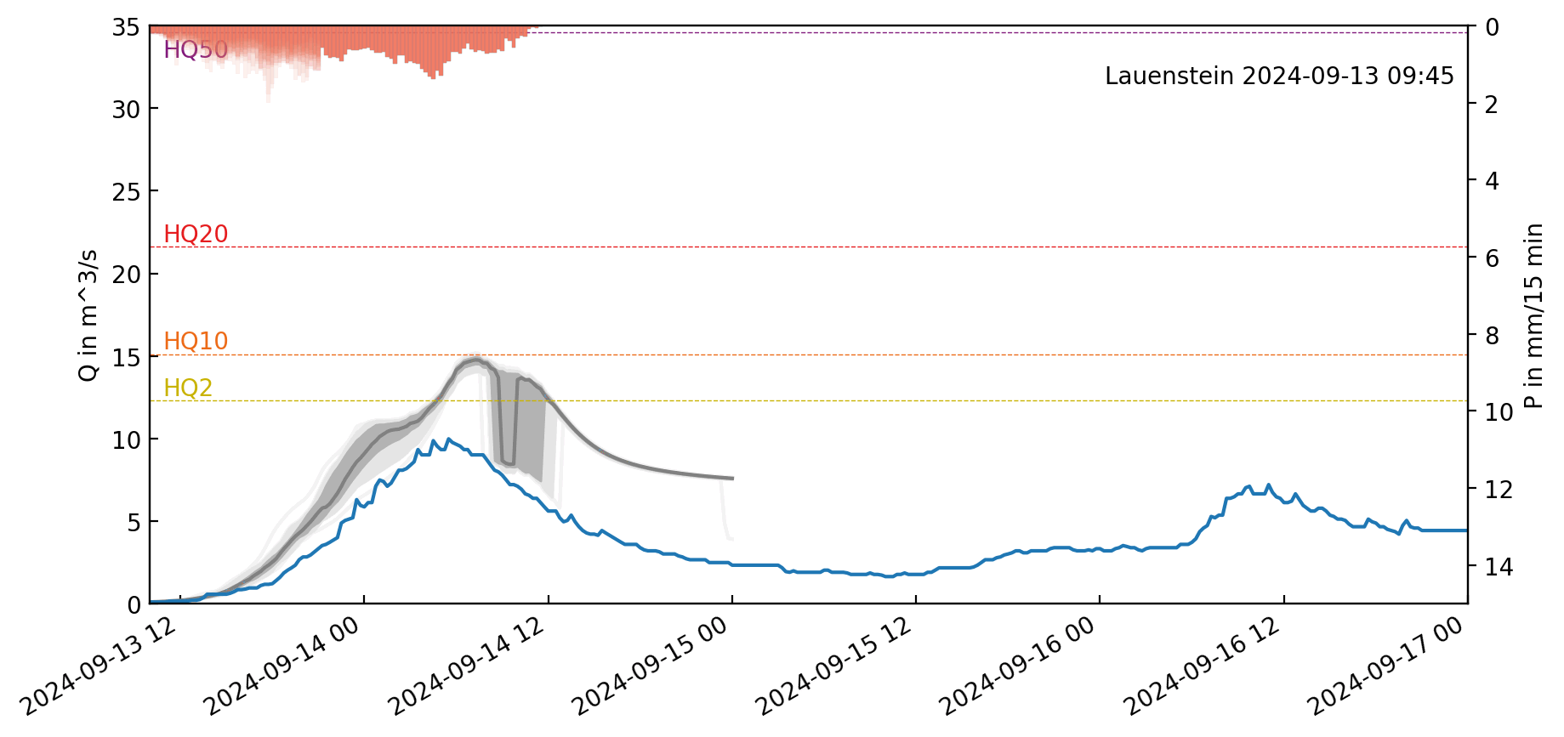
Evaluation
Operationel ensemble forecast: 13.09. – 16.09.2024 in Lauenstein@Müglitz
Impact of controled flood reservoir
EFShowa
EFSadv

Slide 10
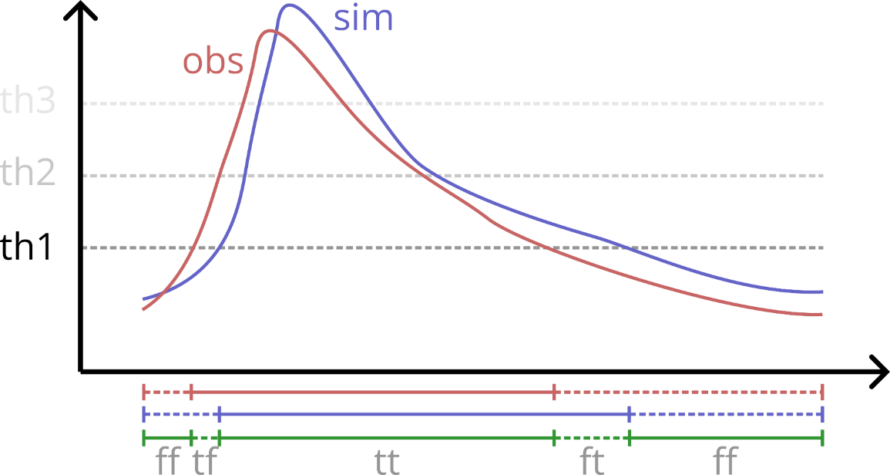
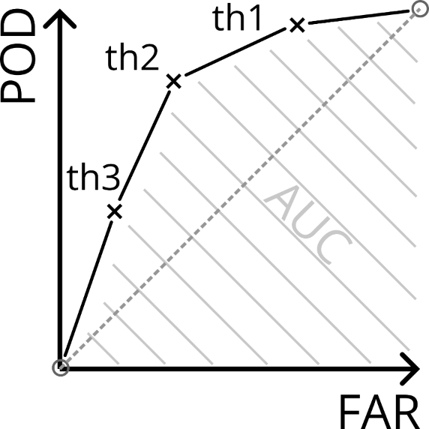
Evaluation
Area Under Curve (AUC) – Theorie
th1 |  | sim
 |  | true | false
obs | true | tt | tf
 | false | ft | ff
$$POD=tt/(tt+tf)$$
$$FAR=ft/(ft+ff)$$
POD: probability of detection
FAR: false alarm ratio
+ other metrics based on contingency table (e.g. ACC, CSI, f1, …)
and goodness-of-fit indicators (e.g. KGE, NSE, nRMSE, ….)
Runoff at gauges & mean areal rainfall of catchments → quantiles and forecast horizons

Slide 11
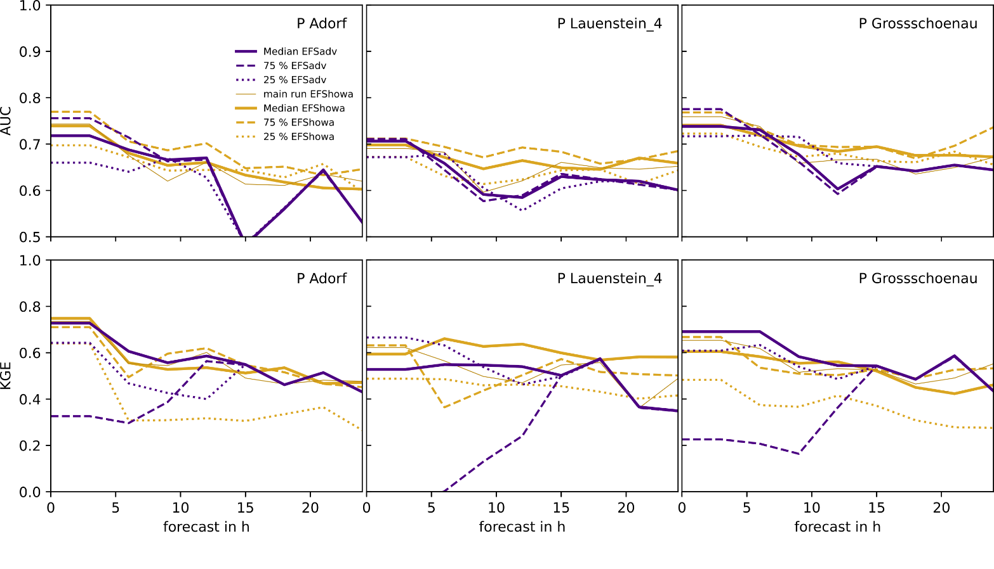
Evaluation – Ensemble over period (01.12.2023 – 31.12.2024)
Mean areal rainfall of catchments
EFShowa: 5152 forecasts
EFSadv: 5032 forecasts → ~29 % of potential forecasts
Mean areal rainfall
Observation: RadolanRW
dt = 3 h sum
main run, median, 25%-, 75%-quantiles
AUC
KGE
west
middle
east

Slide 12
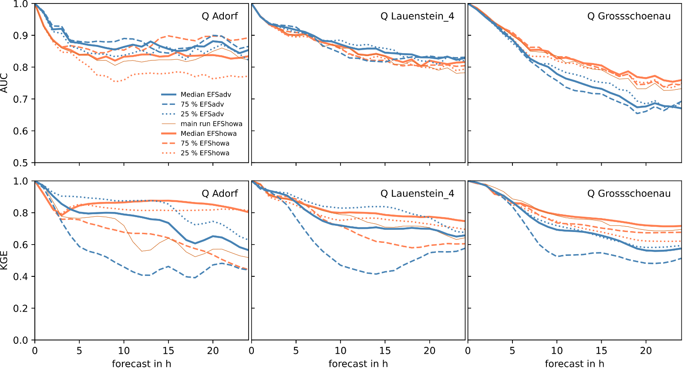
Evaluation – Ensemble over period (01.12.2023 – 31.12.2024)
Runoff at gauge stations
EFShowa: 5152 forecasts
EFSadv: 5032 forecasts → ~29 % of potential forecasts
Runoff
Observation: Gauge
dt = 1 h
main run, median, 25%-, 75%-quantiles
AUC
KGE
west
middle
east

Slide 13
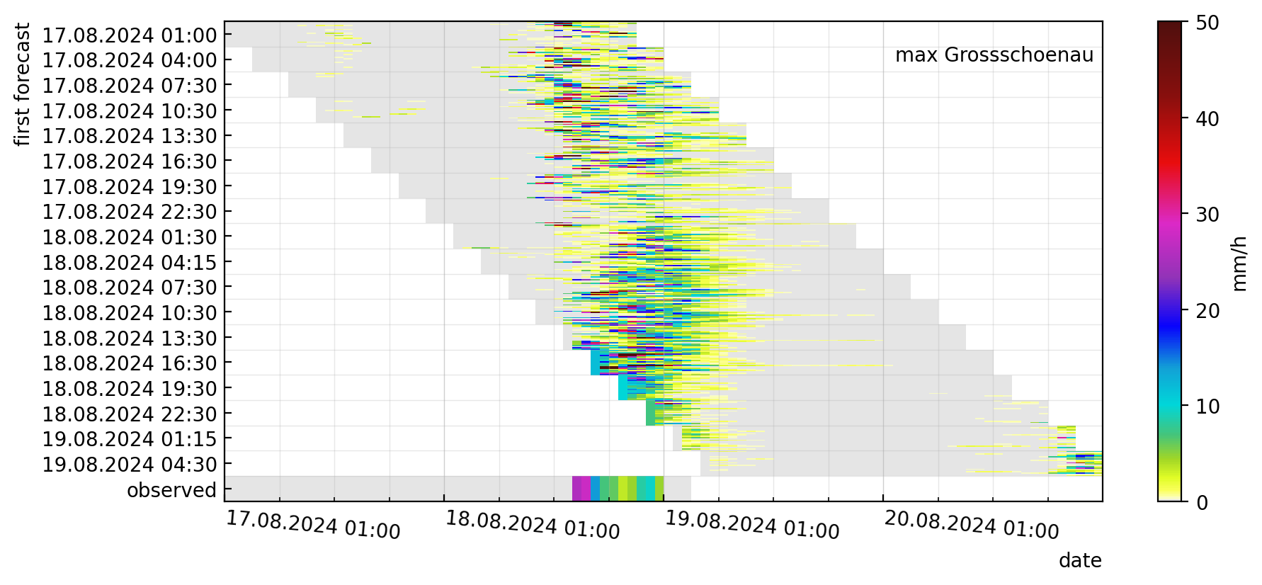
Evaluation – Event based (17.–21.8.2024)

Slide 14
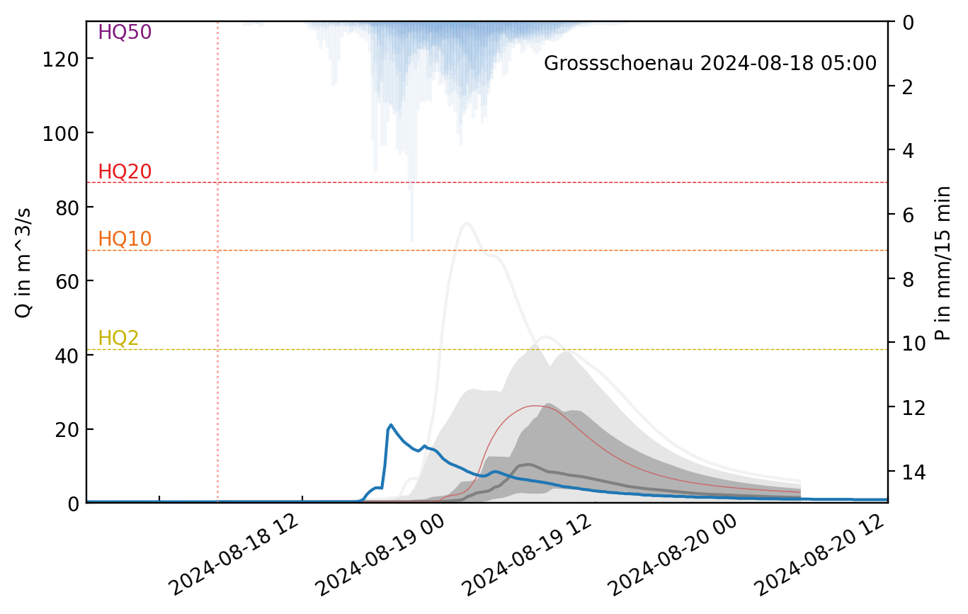
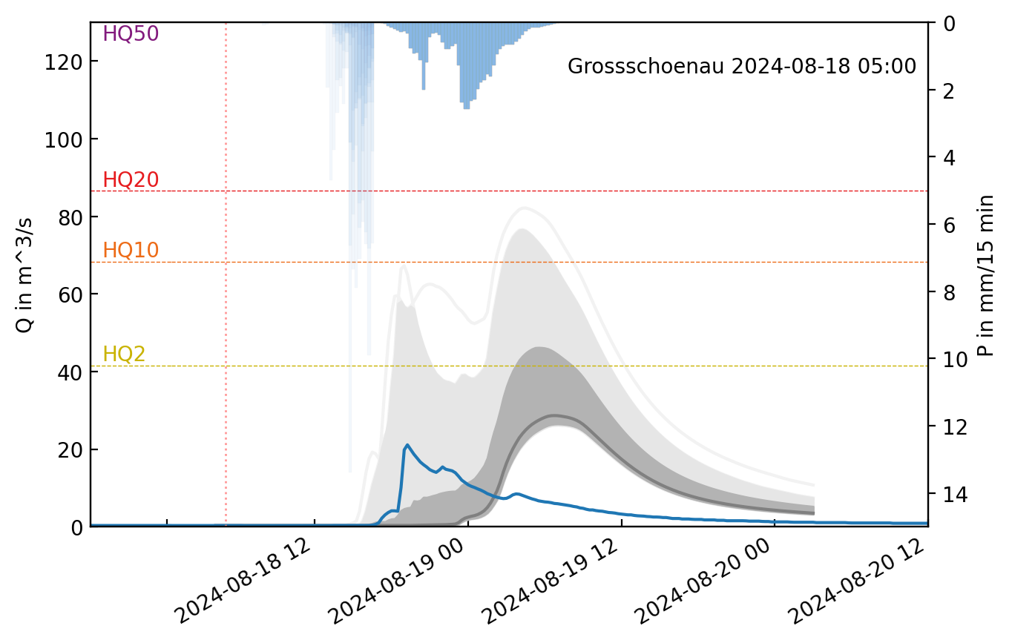
Evaluation – Event based (17.–21.8.2024)
Max intensity
Mean areal rainfall
18.08. 01:30
04:15
07:30
10:30
13:30
16:30
19:30
22:30
19.08. 01:15
04:30
observed
EFShowa
18.08. 01:15
04:15
07:15
10:15
13:15
16:15
19:15
22:15
19.08. 01:15
04:15
observed
EFSadv

Slide 15
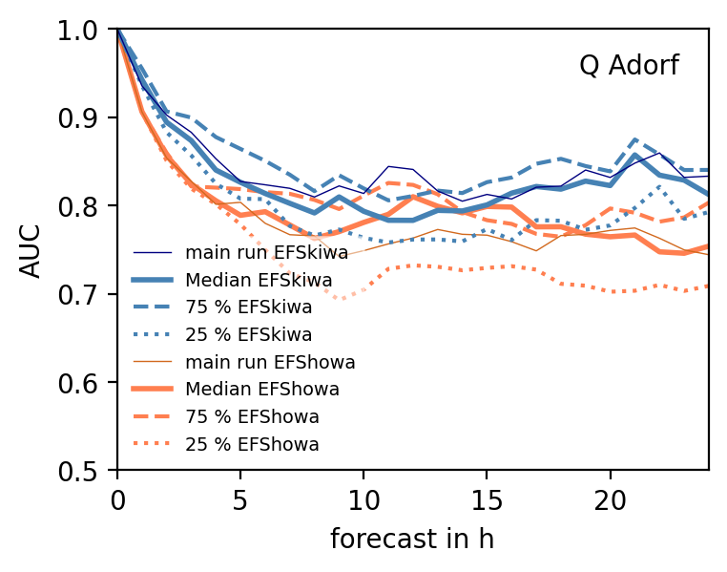
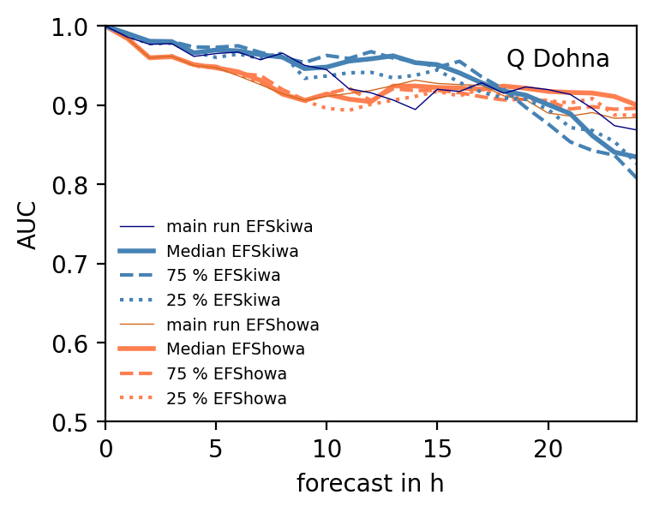
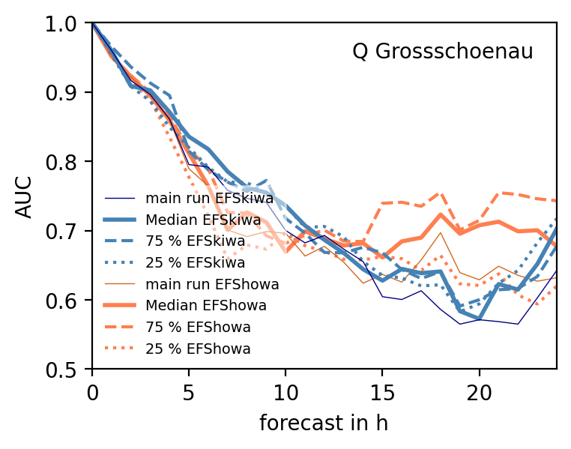
Conclusions
Hydro-meteorologic ensemble forecasts allow for flood early warning
FloodSentinel: scalable ensemble forecast system for small catchments
Web-demonstrators with established and prototypic precipitation data of DWD since mid/end 2023 (ESFhowa & ESFadv)
EFSadv: earlier delivery, frequent updates, forecasts starts with ensemble
Evaluation over period: benefits of EFSadv for first forecast hours depending on region (decreasing from west → east)
Evaluation event based: better timing of EFSadv visible
Evaluation of runoff forecasts depends on quality of hydrologic model → check with regional AI-model
west
middle
Next Steps
Evaluation: longer period with more extremes, additional metrics e.g. CRPS(S)
Combination of INTENSE with IconD2EPS – longer forecast horizon
east

