Slide 1
From flood forecast to mitigation
Dr. Natalie Stahl-van Rooijen
Bavarian Environmental Agency
Flood Forecasting, Models & Uncertainty
Organization flood warning service
Flood 2024 from forecast to mitigation
Natalie.Stahl-vanRooijen@lfu.bayern.de
Notes:
I want to tell you something about the practice of flood information and warning in Bavaria, after some preliminary words I’ll speak about the products and the organization of the flood information service and the flood forecasting, models and uncertainty of forecasts.
But before speaking of techniques and improvements of flood warning we have to consider that effective warning mainly depends on the awareness and preparedness of the recipients of the warning.
Today the enhancement in information media i.e. the internet has led to a much better reachability of flood information and warning for everyone.

Slide 2
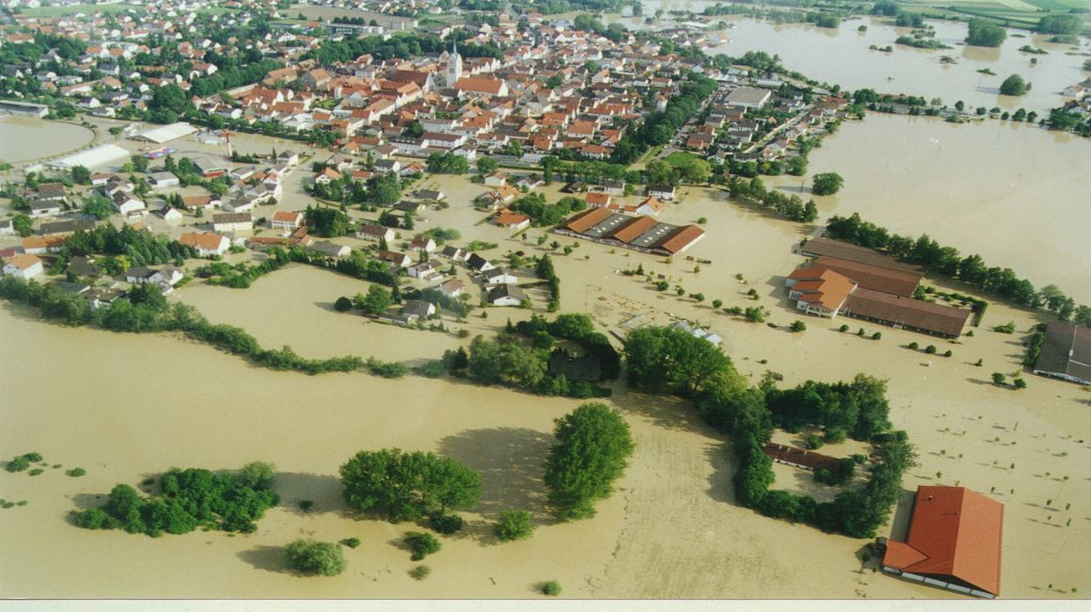
After Flood 1999 – flood forecasts are being initialized for Bavaria

Slide 3
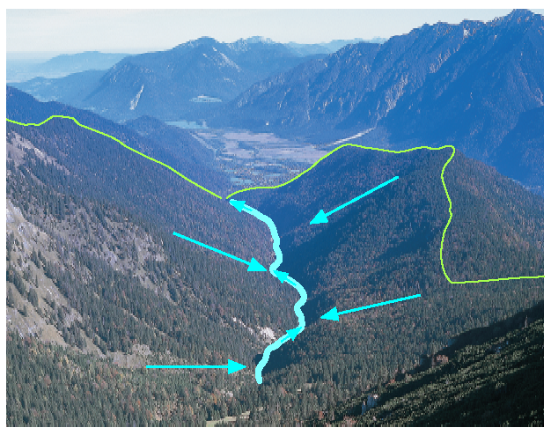
Flood Forecast Model System
River basin models with rainfall-runoff / water balance
and flood-routing components
LARSIM
Hydrodynamic models (1D - hydraulic models)
SOBEK (WAVOS): Main
FLUX/FLORIS: Inn, Lech, Danube
Notes:
• The forecast system covers deterministic rainfall runoff models and hydrodynamic mod-els for the larger streams Main, Danube, Lech and Inn.
• The basis for the flood routing model at the Main River is the hydrodynamic model WA-VOS of the German Federal Institute of Hydrology. The hydrodynamic model FLUX FLORIS is run for the Danube, the Lech and for the Inn River. The standard operating regulations of the hydropower stations are included in these models.

Slide 4
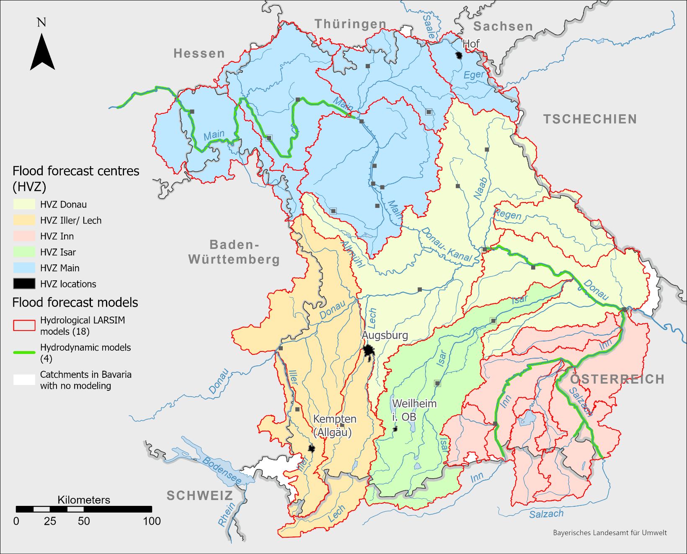
Flood Forecast models
Flood forecast models in Bavaria and implemented forecasts from neighbouring states
TYROL
Notes:
The operational flood forecast model system works in a so-called served operation. First, the rainfall–runoff models have to be run to the connecting gauge or knot for the hydrodynamic model. External flood forecasts from our neighbouring states Baden-Württemberg, Tyrol and Salzburg for the tributaries are implemented in the system. On the other hand we deliver our forecasts to Czech Republic und to Salzburg.
For example, for the Inn catchment, flood forecasts are needed for the Inn upstream of Kufstein which are supplied by the federal state of Tyrol (Austria) and for the Inn tributary Salzach, supplied by the federal state of Salzburg (Austria). The Salzach River is within the responsibility of the federal government of Salzburg. Salzach and Inn built the boarder, so we do have some need for consistent information between the left and right bank and discharge information. For this we work close together and meet at least once a year with the Austrian forecast centers for information and harmonization.
The hydrological forecasts are calculated daily on business days and more frequently during flooding periods in five regional flood forecast centres.
In case of a flood event the flood forecasts are calculated three or four times per day at defined points of time. If necessary, the flood forecasts are updated every hour.
The decision-makers within the Bavarian Water Management Authority can access the results, i.e. forecasts for around 600 gauging stations over whole of Bavaria.
Additionally, the forecasts of about 200 selected gauging stations are published in the web site hnd.bayern.de for a horizon of 6–24 h depending on the catchment area, at some points we offer a 48 h trend.
Using rainfall–runoff models, the forecast period is limited by the precipitation forecast. To adjust to the COSMO-EU model of the German Weather Service, 96 h forecasts are produced by default. At present, the hydrodynamic models are run for 48 h forecasts.

Slide 5
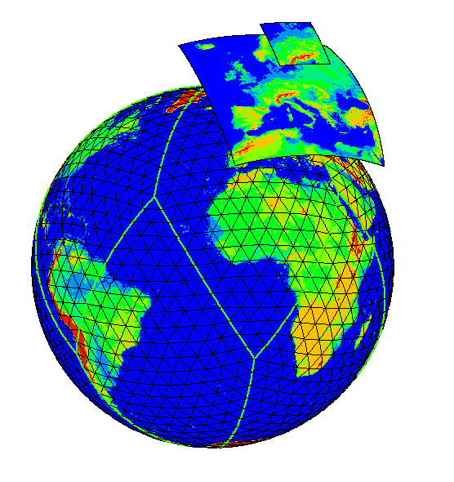
Numerical Weather Forecast: deterministic product range
ICON-RUC (DWD, DEU, regional)
grid 2.2 km, forecasts up to 14 h
ICON-D2 (DWD, DEU, regional)
grid 2.2 km, forecasts up to 48 h
ICON-EU (DWD, DEU, Central Europe)
grid 6.5 km, forecasts up to 120 h
ICON (DWD, DEU, global)
grid 13 km, forecasts up to 7 d
SNOW 4 (DWD, DEU, Central Europe)
grid 2.8 km, forecasts up to 72 h
ECMWF (ECMWF, GB, global)
grid 7 km, forecasts up to 15 d
GFS (NOAA, USA, global)
grid 30 km, forecasts up to 7 d
INCA-seamless (GeoSphere Austria, Alpine region and parts of Danube basin)
grid 1 km, forecasts up to 61 h
Notes:
The German Weather Service provides us with the most numerical weather forecast models and these are used preferably. In particular, these are:
The high resolution model ICON-D2, with a grid length of only 2.2 km and 65 layers at a total of 35 million grid points, has been delivering forty-eight-hour forecasts for Germany 8 times per day, in particular for the warning of dangerous weather systems such as storm and thunderstorms. The lateral boundary values are derived from ICON-EU forecasts.
AROME HD (METEO FRANCE, Western Europe)
grid 1.3 km, forecasts up to 42 h
MOSMIX…
The horizontal domain and vertical levels of the ICON-RUC are exactly the same as for the ICON D2. However, the cloud microphysics parametrization is more complex and the update cycle is hourly.
For Europe the regional model ICON-EU, with a grid length of 6.5 km on 74 layers, uses a total of 49 million grid points to provide detailed weather forecasts for up to five days in advance. During computation the ICON-EU receives the ICON forecasts as lateral boundary values.
With a grid length of 13 km on 120 vertical layers, the global model ICON calculates at a total of 354 million grid points the temporal evolution of weather parameters, such as air pressure, wind, water vapour, clouds and precipitation for up to seven days in advance.

Slide 6
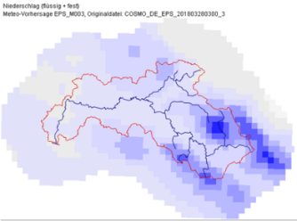
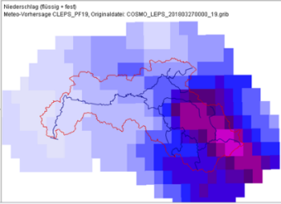
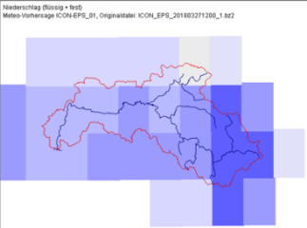
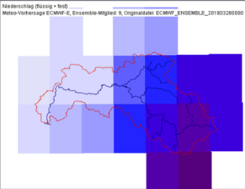
Numerical Weather Forecast: Ensemble-Models
Ensemble-Model | SINFONY-RUC-EPS | ICON-D2-EPS | COSMO-LEPS | ICON-EU-EPS | EZMWF-ENS
Grid [km x km] | 2,2 x 2,2 | 2,2 x 2,2 | 7 x 7 | 13 x 13 | 13 x 13 26 x 26
Number of members | 20 | 20 | 20 | 40 | 50
Forecast up to | 14 hours | 2 days | 5 days | 5 days | 15 days
Model runs a day | 24 | 8 | 2 | 2 | 2
+ Hydrological Ensembles (variations of T, N, soil moisture, …)
+ poor man ensembles
Notes:
Intro: big number of available meteorological forecasts/ensembles leads to many forecasts at the gauges; problem is not processing but visualisation/dealing with the results
Ensembles: 380 weather forecasts per day to compute => assuming 200 forecast gauges => > 70.000 forecasts to check/visualize per day
Automated ensemble forecasts are not checked
=> aggregation/post-processing/filtering needed
Qualitiy checked forecasts as a main forecast from the experts in the flood forecast centre
COSMO-DE-EPS were recently replaced by ICON-D2-EPS (similar parameters as COSMO-DE-EPS; model tailored for convective precipitation)
Simulation of further poor man‘s ensembles for internal purposes (e.g. classical PEPS, variations of temperaure, soil moisture, …)
Regular operationl forecast: a single operator manually checks and publishes approx. 200 forecasts each morning, takes approx. 1h

Slide 7
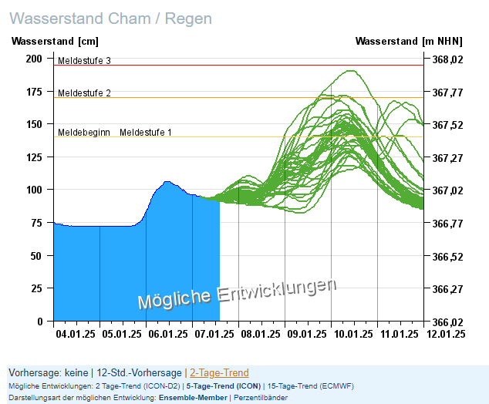
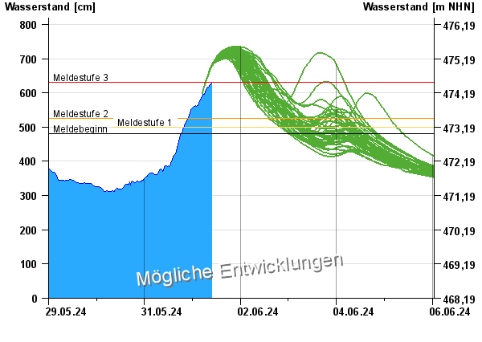
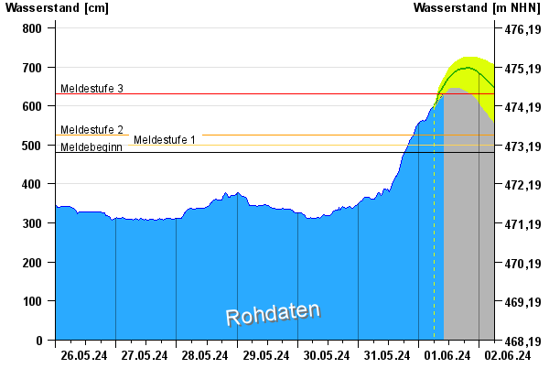
Organization flood warning service
Products: Flood Forecasts – internet presentation:
Used for warning: Deterministic forecast
Short term 6 to 24 hours dependent on catchment size
Medium range 24 to 48 hours (trend)
Additional information:
Ensemble forecasts (2 days to 15 days)
Notes:
Hydrological forecasts have become an important part of the flood information service in Bavaria, since hydrological models cover almost the total area of Bavaria. For the public we offer for 140 gauging stations
Short term forecasts from 6 to 24 hours dependent from catchment size
Medium range forecasts of 48 hours

Slide 8
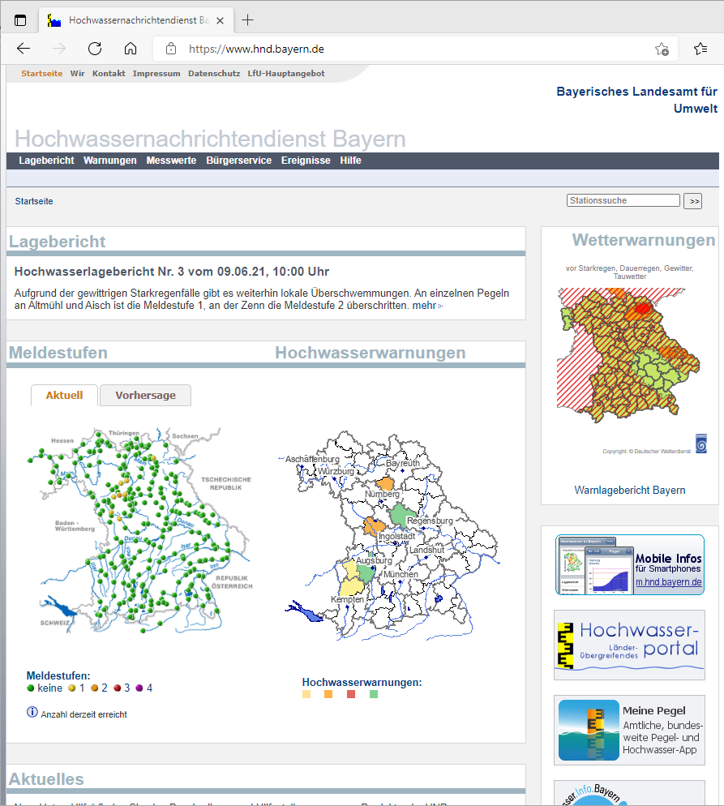
Organization flood warning service
Three Warning levels
Early warning (1-2 days ahead)
Warning of minor flooding at alert level 1 or 2
Warning of severe flooding at alert level 3 or 4
Notes:
Warning levels
Early warning (1-2 days ahead)
Warning at minor flooding of alert level 1 or 2
Warning at severe flooding of alert level 3 or 4

Slide 9
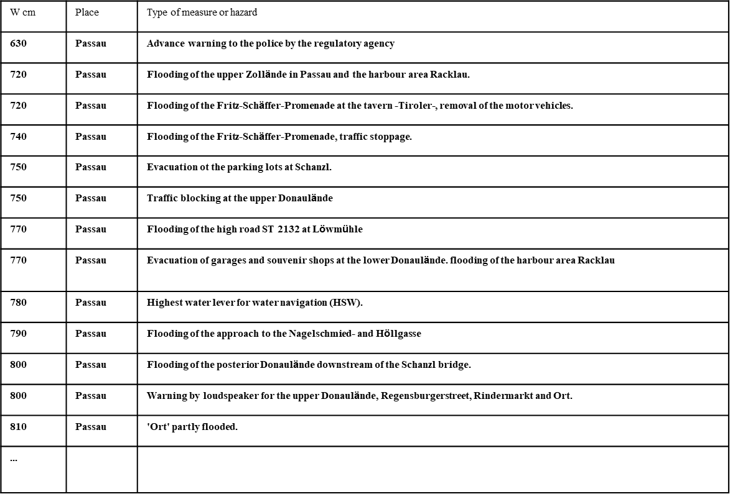
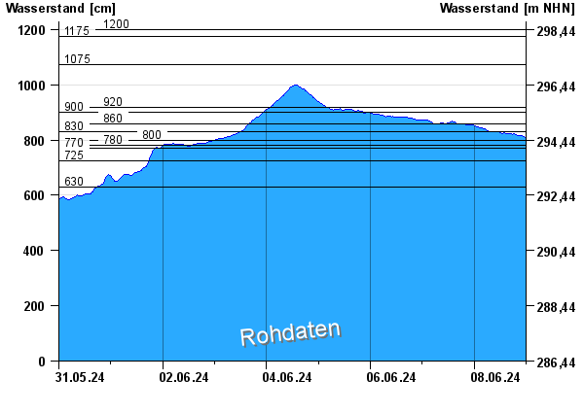
Organization flood warning service
Products: Water lavel triggers action – Passau Donau

Slide 10
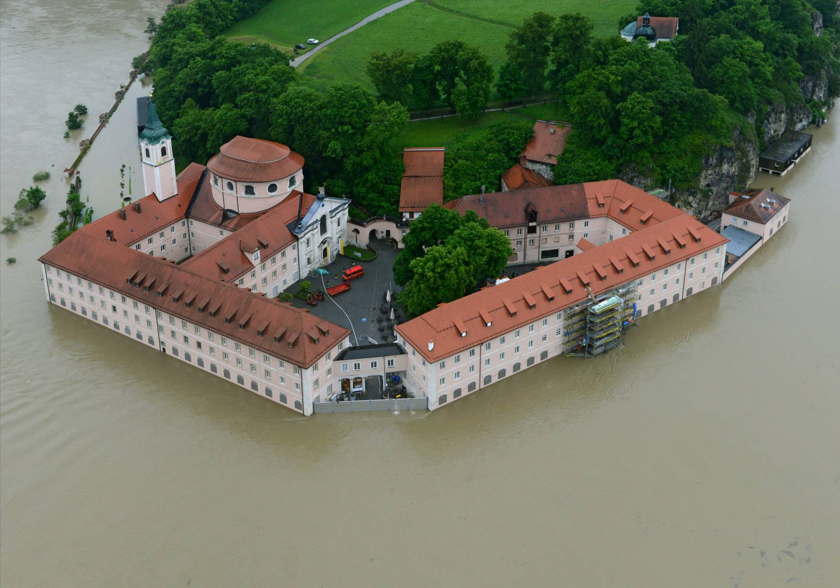
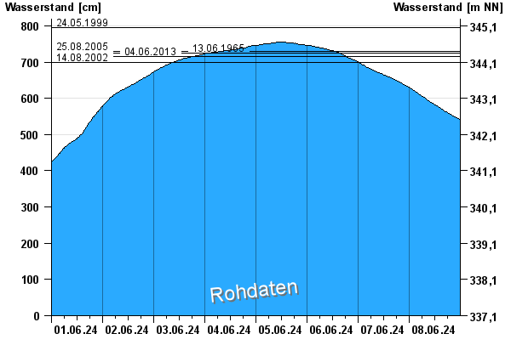
Organization flood warning service
Products: Water level triggers action - Kloster Weltenburg Mobile Protection
Comparison with historic floods
2013-06-03 Kloster Weltenburg / Donau
Notes:
Timely warning of flood hazard is an essential part of precautious flood protection. Prolongation of the forecast lead time enables more substantial protection measures like the building up of mobile walls.

Slide 11
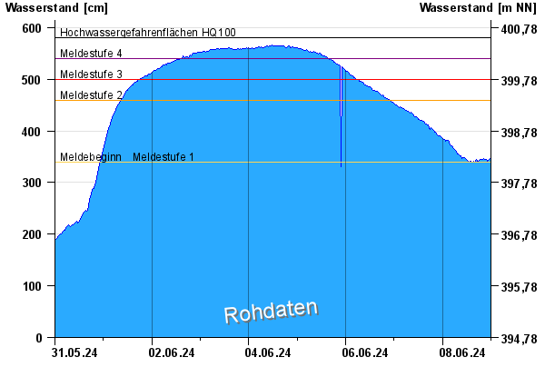
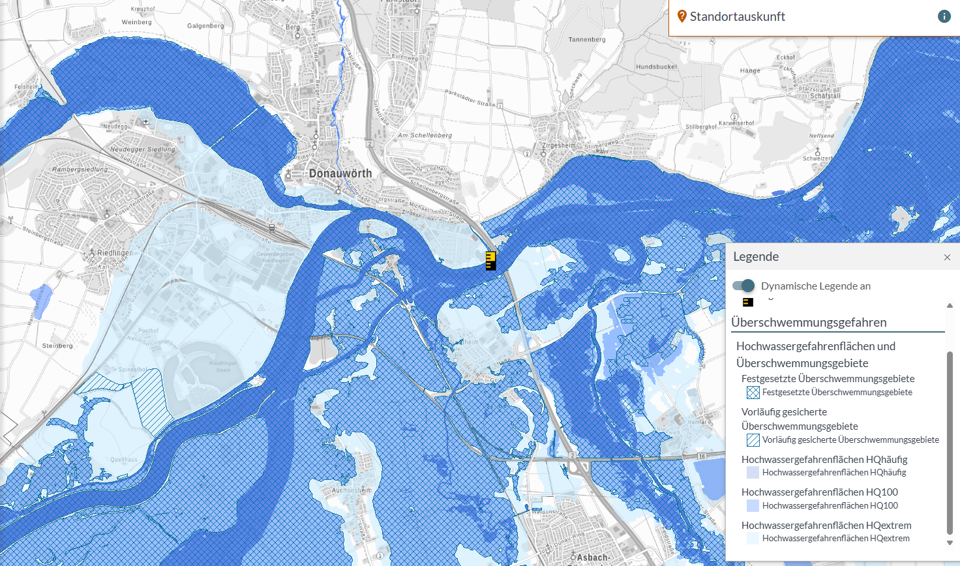

Organization flood warning service
Products: Connecting water level to flood inundation maps
Donauwörth EU flood directive medium probability flood 100a
Notes:
Two more level marks are connected to the inundation maps created in the imple-mentation of the EU flood directive, showing the extent and expected water depths of an area flooded in a low probability scenario (10y-flood) and in a medium probability scenario (100y-flood) (Donauwörth nur HQ100).

Slide 12
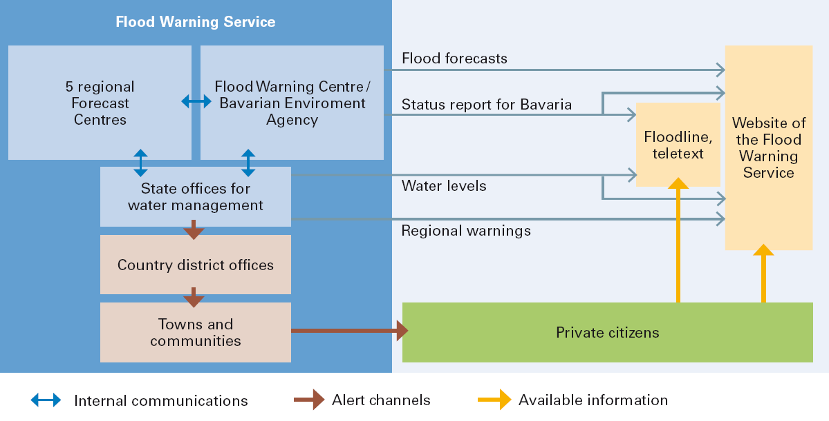
Organization of the flood warning service (HND)
(App)
Notes:
In Germany flood warning in river basins and on lakes is the responsibility of the federal states. For this purpose, Bavaria has set up a Flood Warning Service (HND) in 1902 that collects data on water levels, runoff and precipitation, analyses this information, draws up flood alert plans and warns people affected.
Connected to the Flood Warning Service are the state offices for water management, the county district offices, towns and communities. The coordinating unit is the Flood Warning Centre in the Bavarian Environment Agency.
Five regional Flood Forecast Centres are responsible for calculating and preparing flood predictions for the basins of the rivers Main, Danube, Isar, Iller/Lech and Inn respectively.
The respective centres are put into intense action as soon as rivers or lakes are expected to rise above defined threshold values. The water levels at the gauging stations are available at least on an hourly basis and flood forecasts are updated continuously.
The state offices for water management put out regional alerts, while the Flood Warning Centre issues a flood status report for all Bavaria.
Alert plans make sure that this information is passed on through the county district offices to the affected towns and communities.
The alert plans specify who is to be warned, when and how, and what measures are to be taken at which gauge levels.
Towns and communities are the last link in the alert channel and play a particularly important role.
The local authorities and emergency services have plans of endangered areas or buildings and plans for the organisation of flood defence systems.
The flood warnings have to be actively transmitted to the concerned recipients. Once warned, the recipient has the responsibility to inform himself about the threatening flood.
For this purpose, the state offices for water management, the regional flood forecast centres and the flood information centre provide updated data, forecasts and flood reports via the website as well as flood news via a telephone service to the public and authorities. Actual water levels of all gauging stations are provided via TV-text and telephone service.

Slide 13





Flood 2024 from forecast to mitigation
Weather system
What were the challenges for a correct warning?
Information for Mitigation: green adapted action possible – red missing information
Max. water levels
Time (start, peak, warning levels)
location
Notes:
Yellow high uncertainty

Slide 14
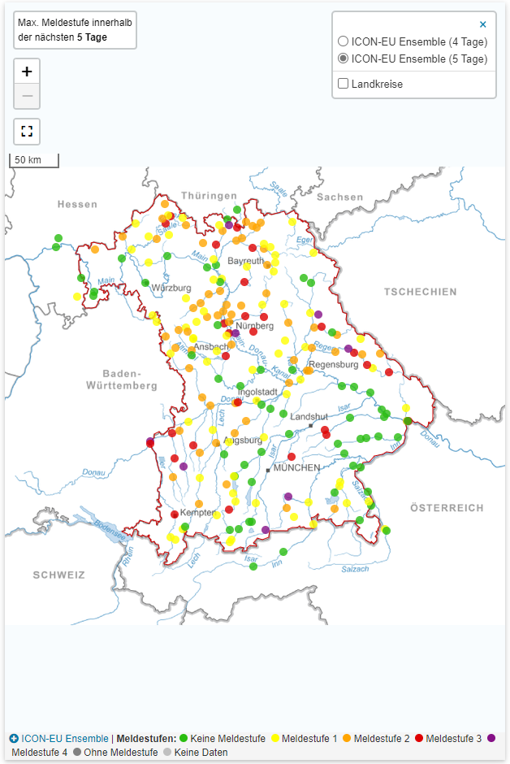
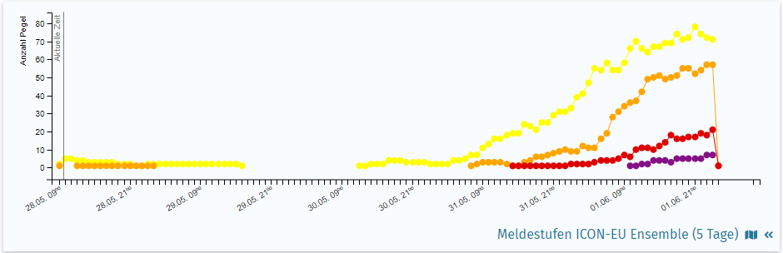
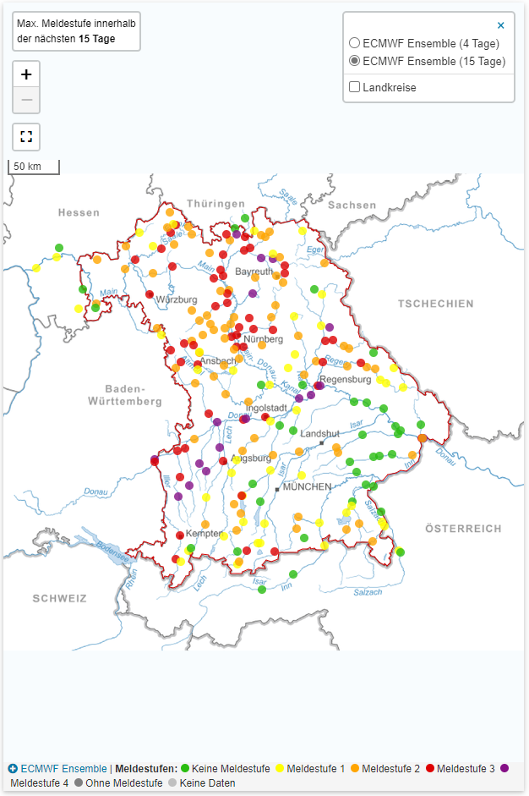
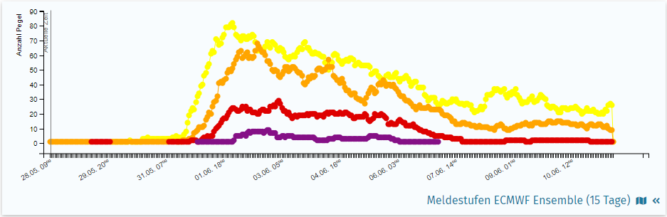

Limits of early warning – weather prediction and discharge forecast 28.05.2024
event start 31.05.2024
?????
Dashboard – Information for water authorities – example ensembles
Notes:
3 days ahead forecast
Different models:
- different water levels but somewhere level 4 high danger (orange – medium correct forecast)
different areas affected, localisation level 4 not possible (red – not sufficient forecast)
begin of event in all models the same (green – correct forecast – scale Bavaria)
What do you do? You can see an upcoming event, but for a warning this is to few information
29.05.2024 Information for participants in the flood warning service, ministries to keep staff available for the public holidas
30.05.2024 Information for the public that there will be a flood starting on Friday (31.05) , but uncertainty is still to high for more detail warnings.

Slide 15


Flood information service
29.05.2024, Wednesday
Information: Potential weather situation for a large to very large flood from Friday 31.05. to 04.06.2024
Action: advance information via the warning channel for “service readiness for large floods”, information Ministry of the Interior, flood staff of Ministry of Environment and Consumer Protection
30.05.2024, Thursday (public holiday)
Information: uncertainty is still to high for detailed warnings
Action: Pre-Information on the flood situation for the public
31.05.2024, Friday
Action: official (pre-)warnings of the affected water management authorities, continuously adapted during the event
Challenges for flood forecasting:
Extreme event: Water level-discharge relationships, Overflow of protective structures
Precipitation forecast

Slide 16
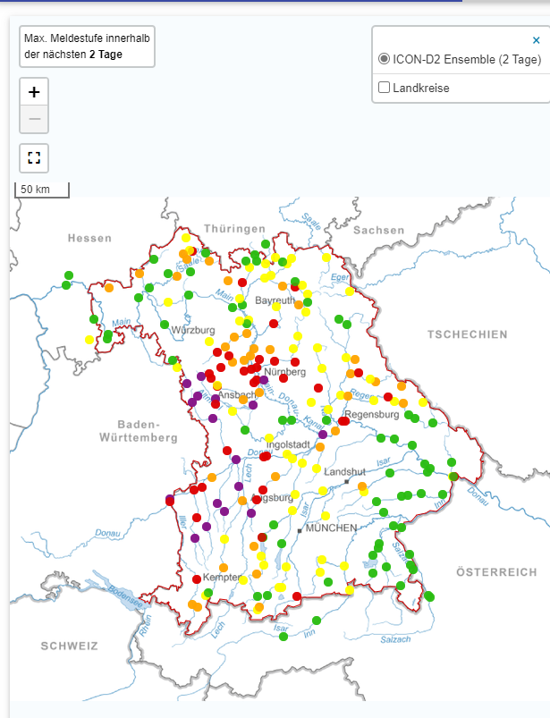

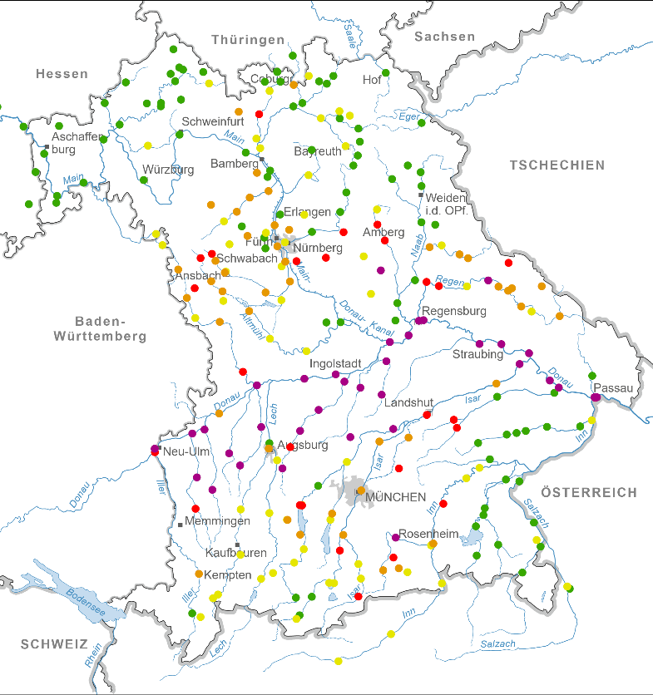


28.05.2024
31.05.2024 14:00
Real Max flood-event
???
12-24 h
Notes:
Will the prediction of the ensembles improve as we get closer to the event? Where exactly are the problems in the prediction? To analyze this in more detail, let's take another look at Friday's deterministic forecast

Slide 17
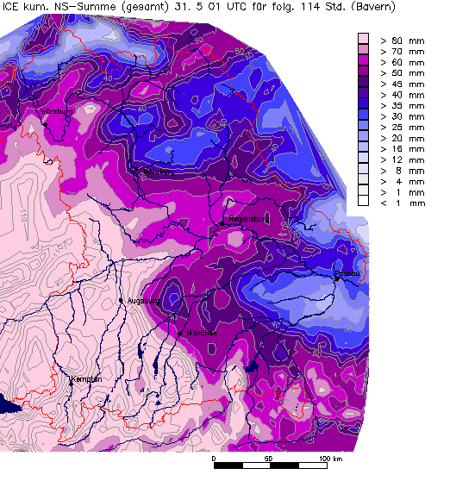
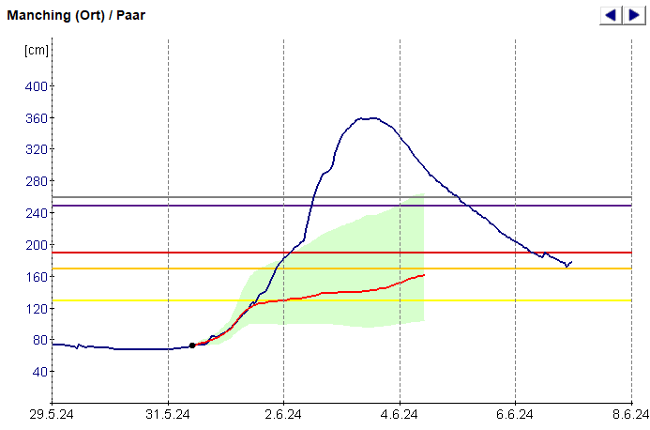
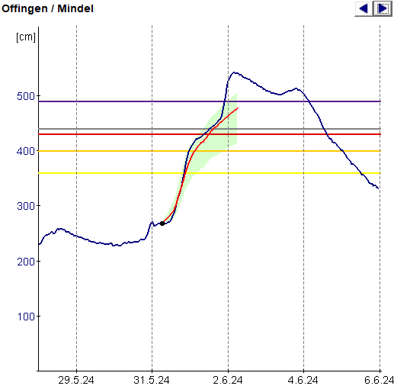

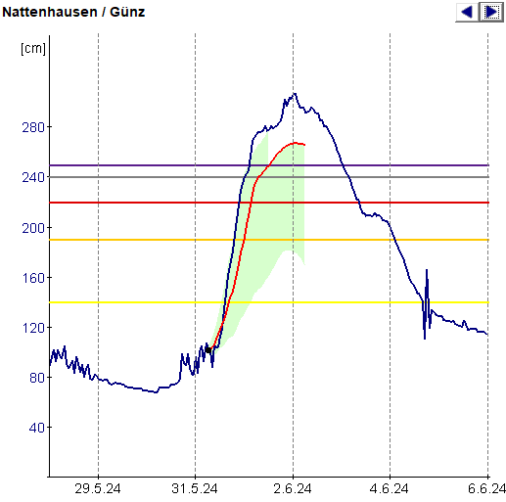
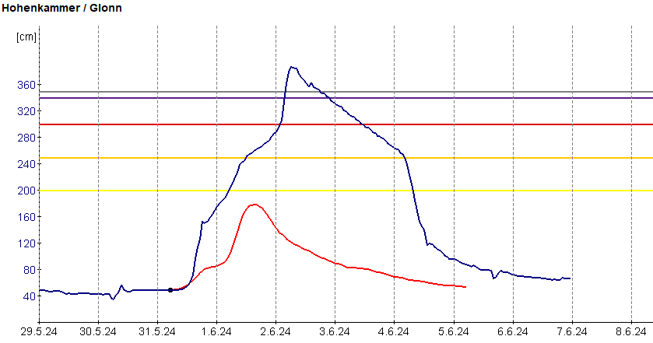

Forecast – Friday event starts
Fr. 31.05.2024 6:00 forecast
Notes:
For the Günz, the westernmost gauge, the forecast of the peak is very good from the time (18 h forecast before), the height at the highest warning level, but approx. 30 cm too low
- For the Mindel, just a little further east, the forecast is also very good in terms of the course, but the peak came unexpectedly earlier and higher 20 hours later (not included in the forecast)
-For a long time, the forecast for the Paar catchment area further east was that the area was no longer in the center of the heavy precipitation, but it was over-rained just as much as Günz and Minde, only a little later
You can see a very sharp boundary in the precipitation forecast that separates extreme precipitation from low precipitation.
This is the reason for the very different quality of the forecasts for the catchment areas. For the regions at the center of the precipitation it fits very well, for the regions at the edge, a miscalculation in the location makes a very big difference in the expected water level.

Slide 18
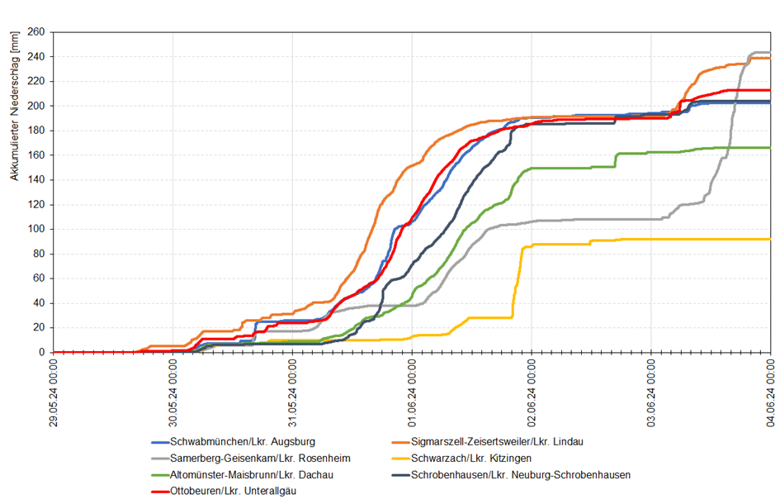
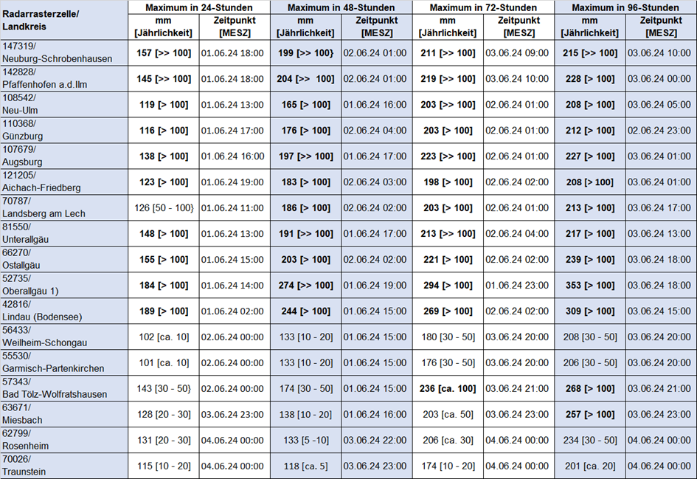
Precipitation for different areas in Bavaria
Annuality >> 100

Slide 19
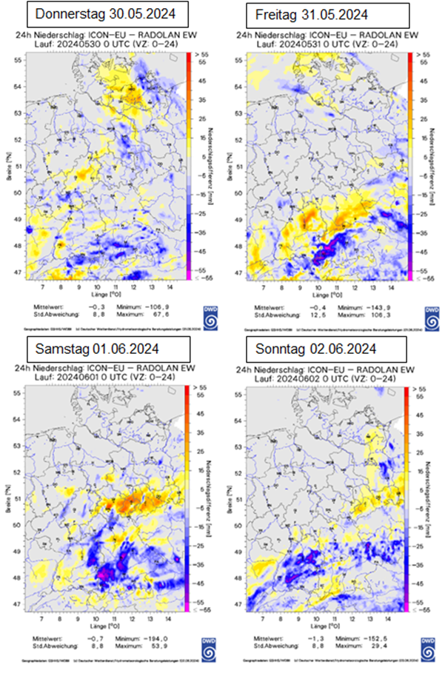
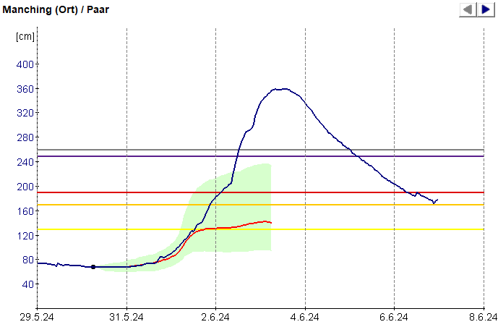
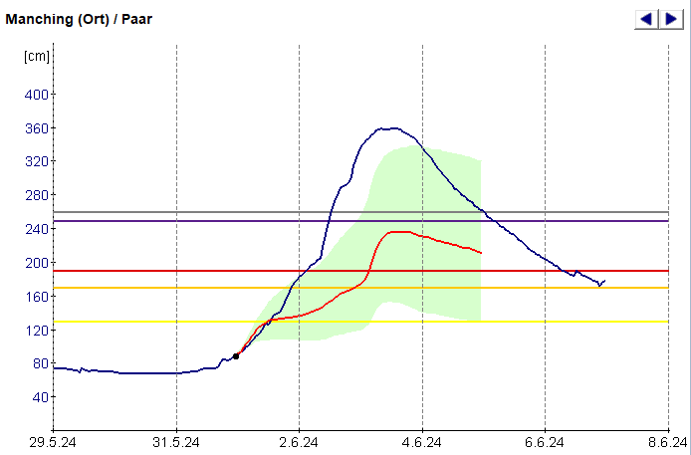
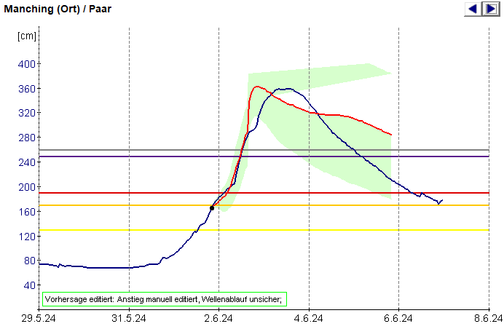
Forecast for Paar: underestimated during the whole event
Do. 30.05.2024
Fr. 31.05.2024
ICON-EU underestimates rainfall
Sa. 01.06.2024 00:00 Uhr
Sa. 01.06.2024 20:00 Uhr
rainfall meassured - forecast correct
Notes:
Die Vorhersagen für Manching zeigen die selben Probleme wie für Mühlried.
Man sieht an den Beispielen, dass wir das spätere Ausmaß erst im Verlauf des Samstags vorhersagen konnten, was auch eine Folge der Verlagerung des Niederschlagsschwerpunkts in den Vorhersagen ist.
Der beobachtete Anstieg der Wasserstände konnte durch das Modell nicht nachvollzogen werden, sodass manuelle Eingriffe erforderlich waren (das Modell wollte einen wesentlich steileren Anstieg simulieren, was vermutlich daran liegt, dass der Wellenablauf mit Deichüberströmungen im Modell nicht korrekt abgebildet wird).
Der lange, „fahnenartige“ Abfall hängt vermutlich auch damit zusammen, dass die W-Q-Beziehungen an einigen Oberliegerpegeln nicht mehr gepasst haben (insbesondere Altenfurt / Weilach) und deshalb insgesamt zu große Wassermengen im Modell unterwegs waren.

Slide 20
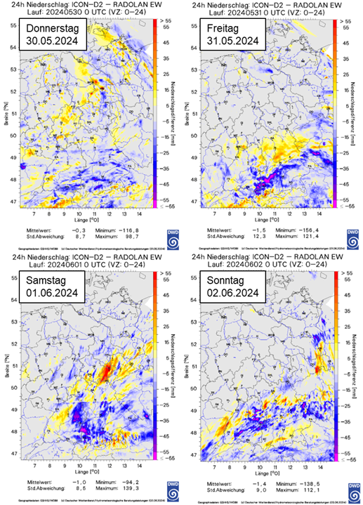
ICON-D2-Verification
colour range
ICON-D2 overestimates rainfall
ICON-D2 underestimates rainfall

Slide 21
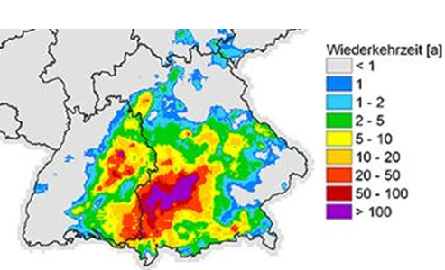
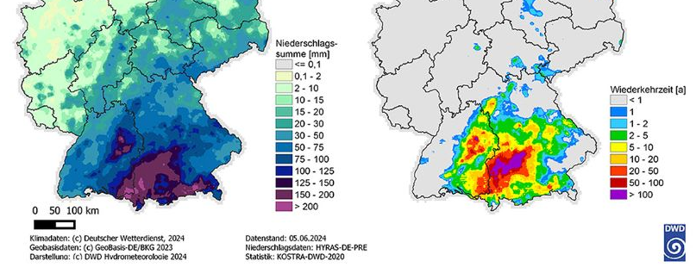
Rainfall distribution June 2024 with statistics
The precipitation forecasts were significantly too low, especially for the most affected region (> N100)
even the highest ensembles did not reflect this development
Affected region: normally not high precipitation compared to alpine regions > severe event
Notes:
With climate change we monitor more intensely rainfall over bigger areas and not only due to orographic processes in mountain regions, where this intensive rain is more often. Beyond the mountain regions those intense rainfall case more inundation in the smaller rivers.

Slide 22


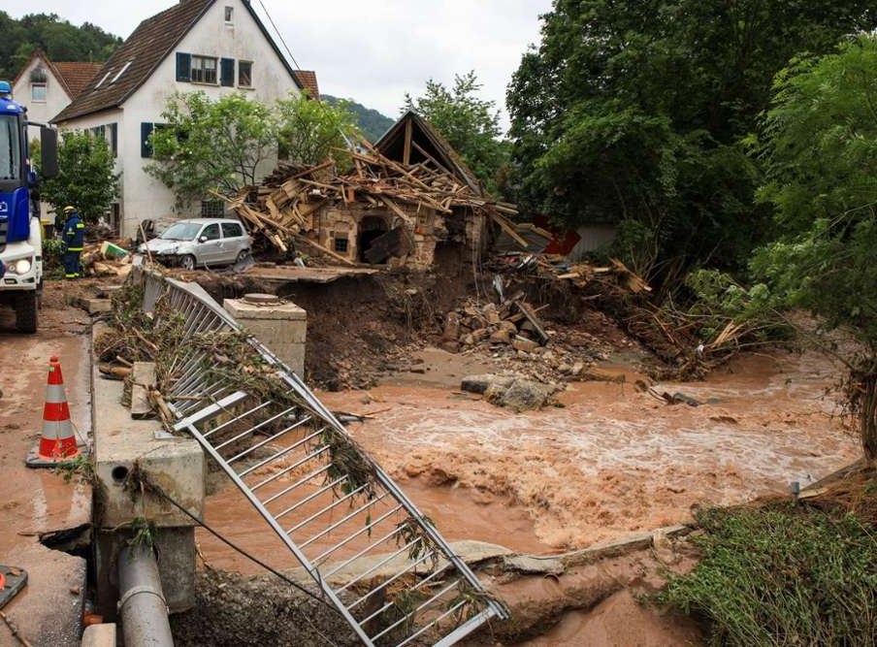
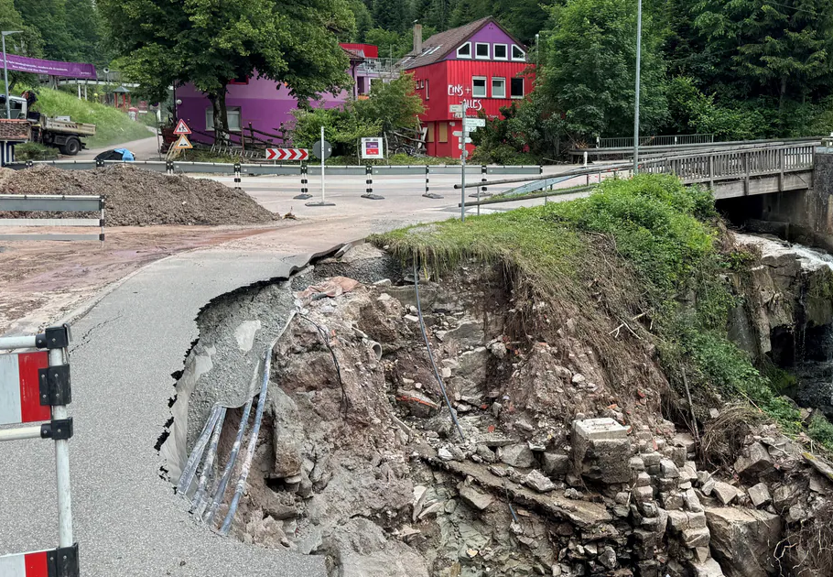
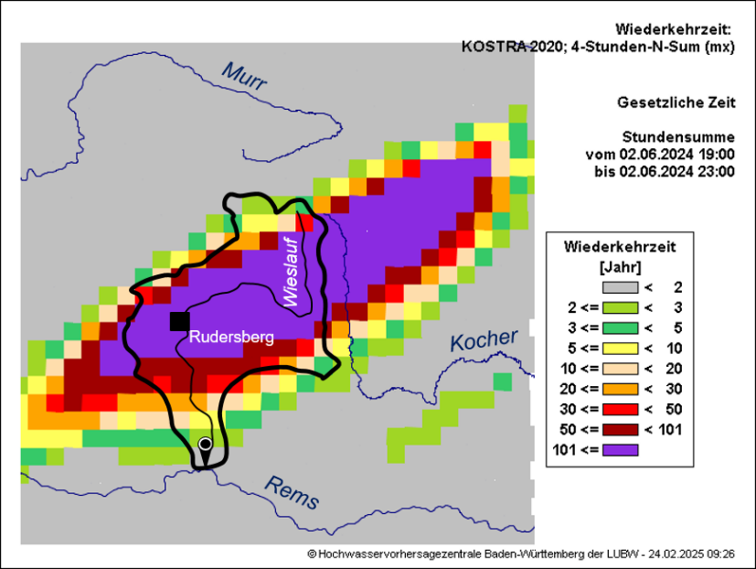
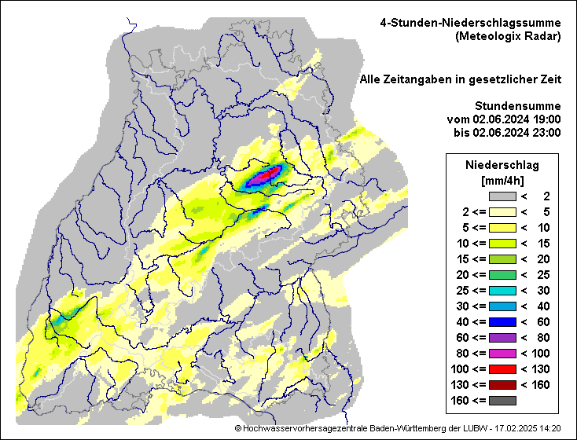
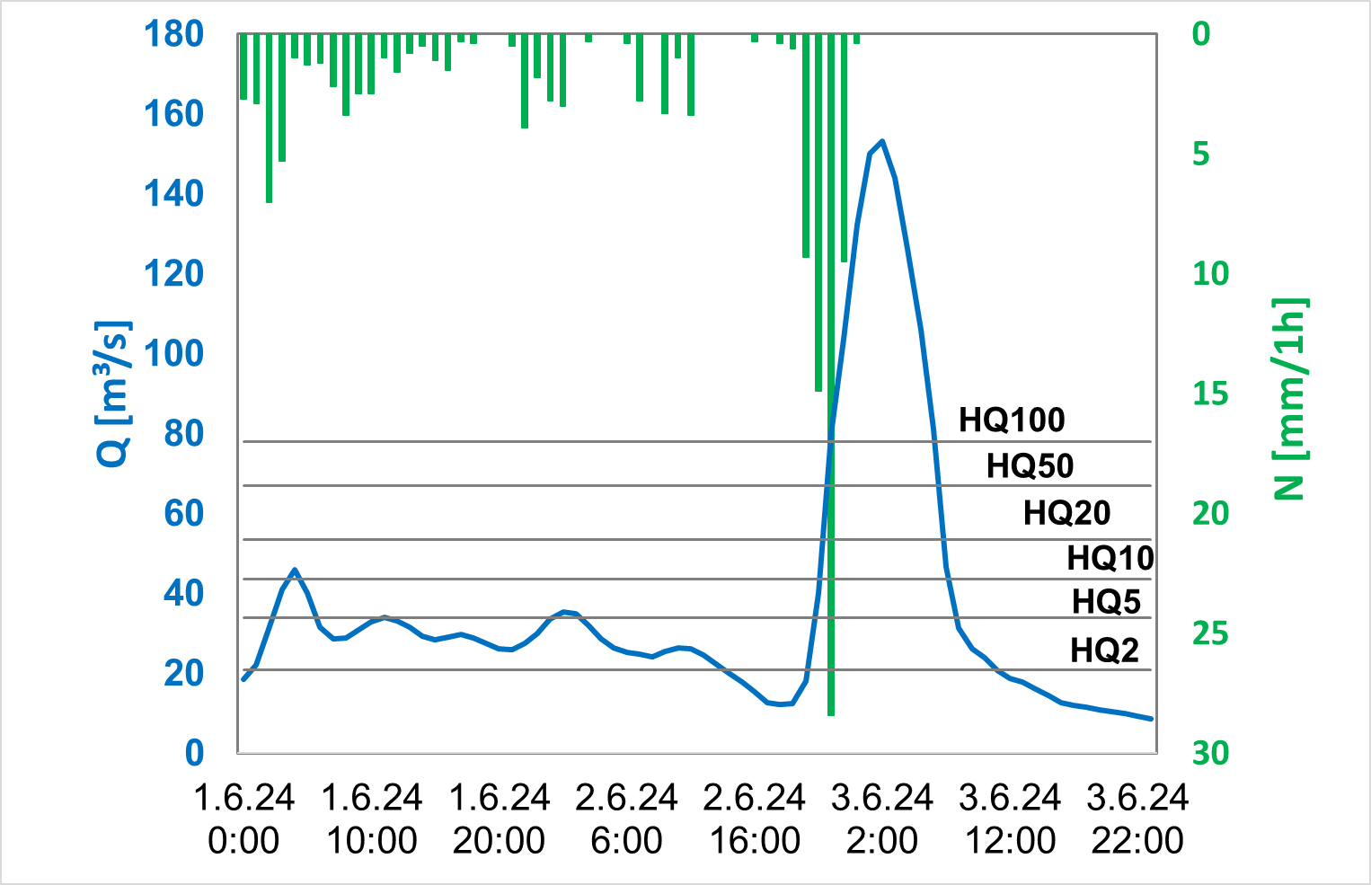
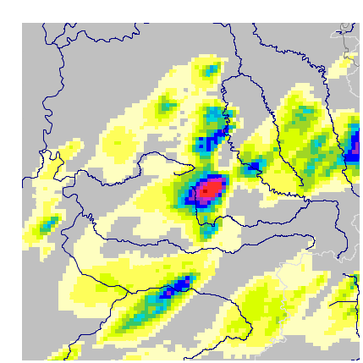
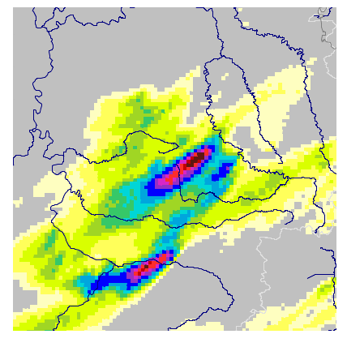
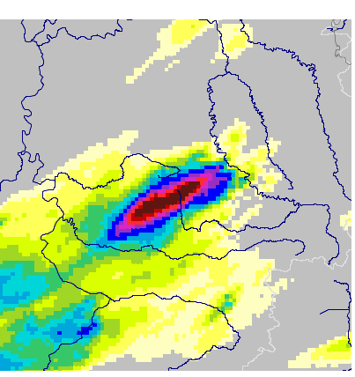
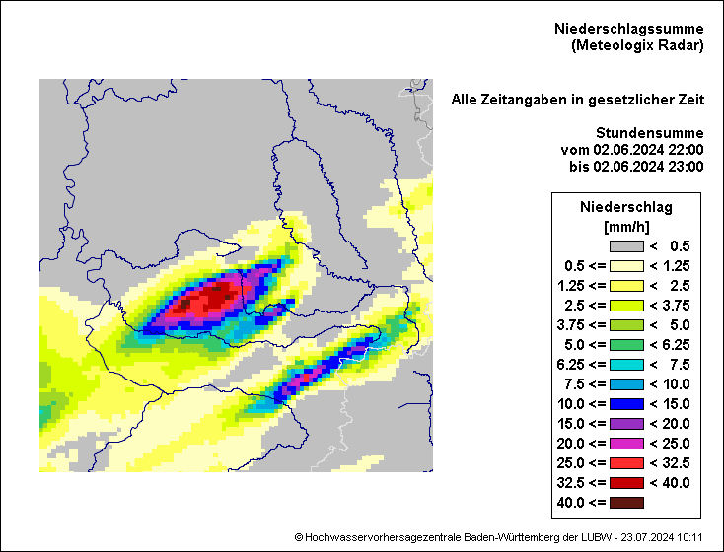
O. Kiseleva*, D. Elfgang, M. Bremicker, U. Badde, J. Weimper
*DWD
Observation: 02.06.24 - 03.06.24
Heavy Precipitation
Flooding
Radar
4h Accumulated Precipitation in mm
19 - 23 CEST on 02.06.24
Return period
for 4h-Precipitation (Radar and KOSTRA-DWD-2020)
N-Sum 4h → up to 140 mm/4h!
N-Sum 4h → above 100a!
Rudersberg / Wieslauf
Wieslauftal near Rudersberg
Gauge: Haubersbronn /Wieslauf (76 km²)
Haubersbronn /Wieslauf
(76 km²)
Rudersberg-Michelau
LUBW-Station
N-1h-Sum in mm
up to 55 mm/h!
The precipitation cell persisted over an area for several hors!
HQ >>> 100a
HHQ on June at 02:00 CEST since 1949
19-20 CEST
20-21 CEST
21-22 CEST
22-23 CEST
Notes:
We are working together with the German Weather Service on a co-design project to improve forecasting from the perspective of flood forecasting needs. I would therefore like to take this opportunity to refer to the evaluations from Baden-Württemberg, which was also very badly affected by the floods. Ms. Kiseleva has prepared a poster and can present verification examples from Baden-Württemberg. I would therefore like to take this opportunity to briefly advertise this and encourage you to take a closer look at these examples in the poster session.

Slide 23
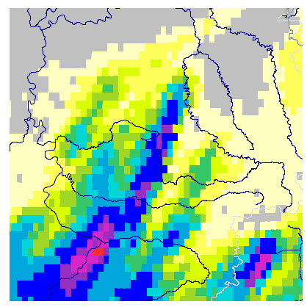
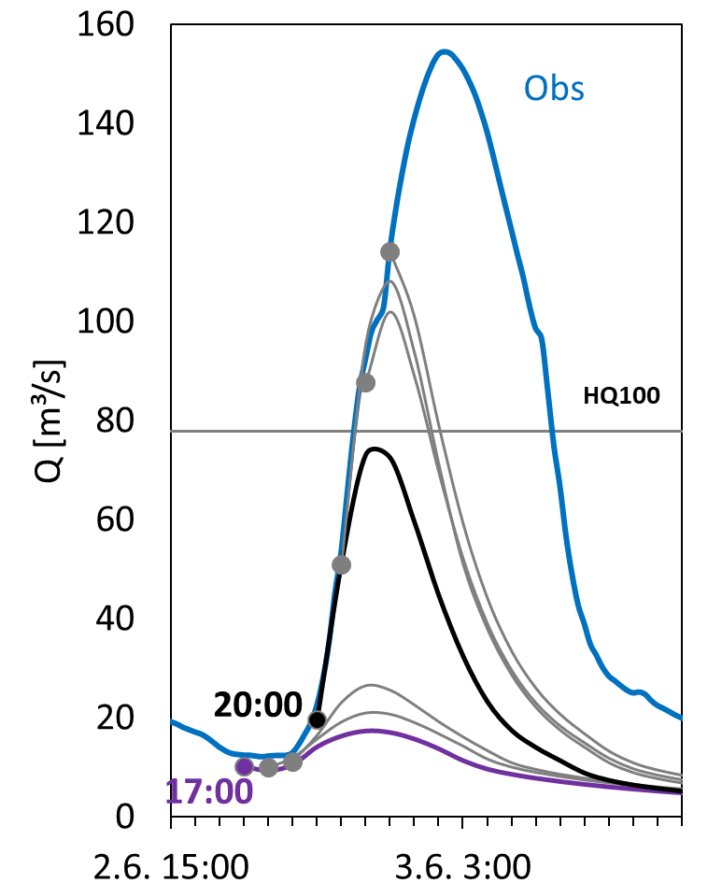








O. Kiseleva*, D. Elfgang, M. Bremicker, U. Badde, J. Weimper
*DWD
Forecast: 02.06.24 - 03.06.24
ICON D2 det, DWD
VHS 48h
LARSIM
Sinfony- Intense EPS, DWD VHS 12h, 21 member
LARSIM
HVZ „Best Guess“-Forecast upto 48h based on ICON-D2 Forecast
Sinfony- Intense - in operational test mode since summer 2024
4h Accum. Precipitation in mm
19 - 23 CEST on 02.06.24
4h Accum. Precipitation in mm: 19 - 23 CEST on 02.06.24
T_FC: 17 CEST
T_FC: 17 CEST
T_FC: 19 CEST
m14 (max)
m00 (min)
m00 (~median)
T_FC - Forecast Time
T_FC: 20 CEST
T_FC: 18 CEST
T_FC: 20 CEST
m14 (max)
m00 (min)
m00 (~median)
4h-N-Sum in 20 -00
ICON D2 vs Sinfony- Intense EPS:
Intense: Up-to-date information through hourly rapid updates. Clear detection of the cell by 19 CEST in every ensemble member
Intense: High variability in forecasts between ensemble members at earlier forecast times (17 und 18 CEST) : ranging from mean flow to HQ100

Slide 24

Were the task forces able to properly mitigate the flood?
Notes:
I hope you got some insights in our work in flood warning and forecast. Bild will sagen:
With extreme rainfall events we see always, that the difference between the center of precepitation and the sourroundings enorm ist. Daher haben kleine Abweichungen in der Lokalisation der Niederschläge sehr große Auswirkungen auf die hydrologische Vorhersage für Einzugsgebiete und die Gefahrenabwehr. Die Ensembles der ICON Kette unterscheiden sich meist mehr in der Höhe als in der räumlichen Lage.

