Slide 1

How ML is transforming our approach to seamless weather forecasting
PrePEP Conference, Seamless Prediction
Bonn, 19.03.2025
Daniele Nerini
with contributions from
Verena Bessenbacher, Jonas Bhend, Oliver Fuhrer, Ophélia Miralles, Carlos Osuna, Andreas Pauling, Albero Pennino, Radi Radev, Francesco Zanetta, Ioannis Sideris
Contact: Daniele.Nerini@meteoswiss.ch

Slide 2
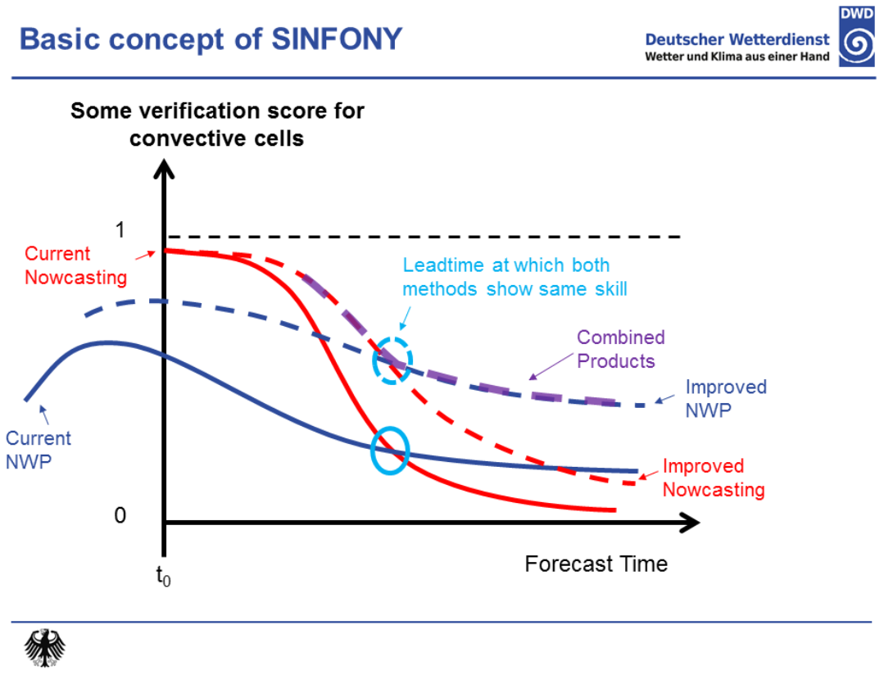

How to Seamless
“Full-stack” seamless forecast
days
0 1 2 3 4 5 15 45
lead time
0
ensemble member
100
INCA analysis
INCA forecast
ICON-CH1-EPS
ICON-CH2-EPS
ECMWF IFS
ECMWF IFS EXT
Source: https://www.dwd.de/DE/forschung/forschungsprogramme/sinfony_iafe/sinfony_node.html

Slide 3

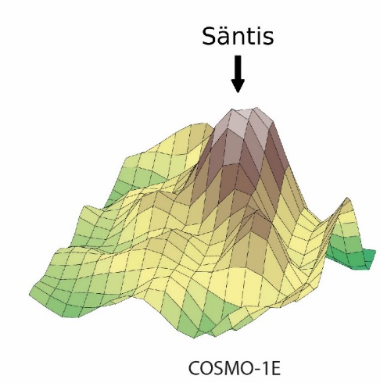
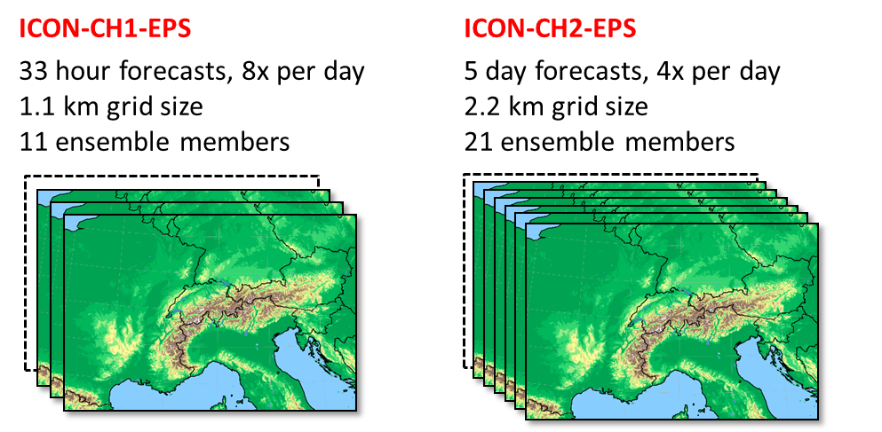

Improving NWP
ICON-CH1-EPS und ICON-CH2-EPS
Same grid resolution, but more accurate topography
3-8x in compute capacity would be needed for running ICON @ 500m !
Notes:
New formulation of the pressure gradient solver in ICON allows for steeper topography.

Slide 4
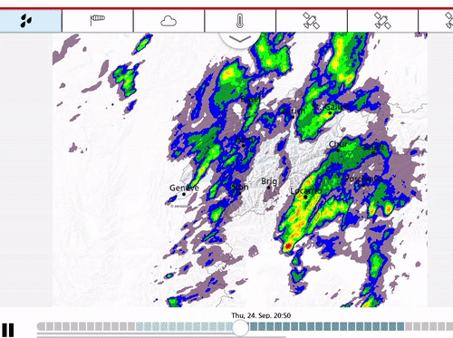
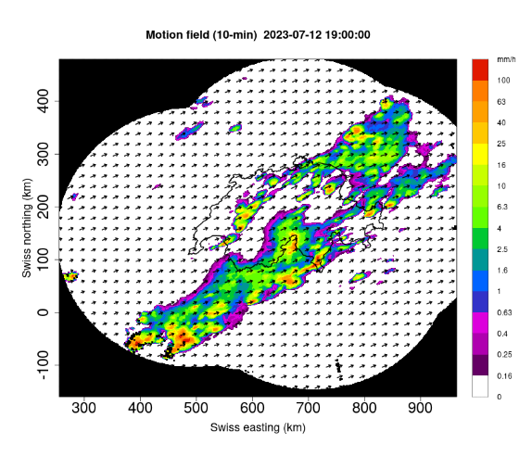
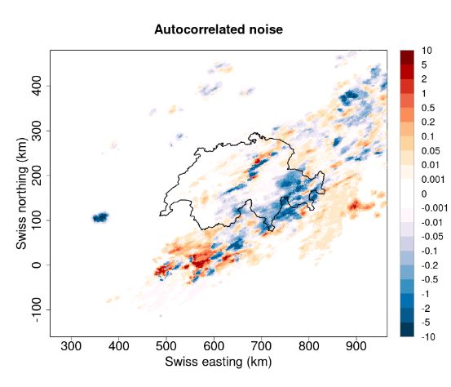
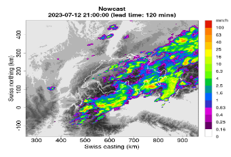
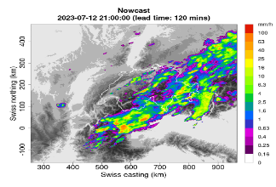
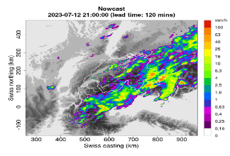
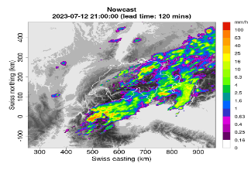
Improving nowcasting
Realistic and seamless
Optical flow
Nowprecip is MeteoSwiss’ operational precipitation nowcasting system.
10min / 1km res, +6 hrs
Nowprecip =
  radar extrapolation + stochastic perturbations + tendency from NWP
Ensemble
Growth-decay maps
Sideris et al. (QJRMS, 2020)
Notes:
NowPrecip uses the NWP for (a) merging, (b) building the motion field (the motion field is dynamic: we compute the optical flow for time 0 (radar-based) and times +2,+4,+6 (NWP-based) and then we connect everything to get a final smoothly-evolving motion field), (c) topographic growth-decay (NWP-based)—useful for orographic precipitation, (d) new pixels to maintain the total number of wet-pixels (so there is a need for precip generation from zero) : the locations of the NWP wet pixels can be used for this (there is also another mechanism not connected to NWP). This last method did not exist in NP1.

Slide 5
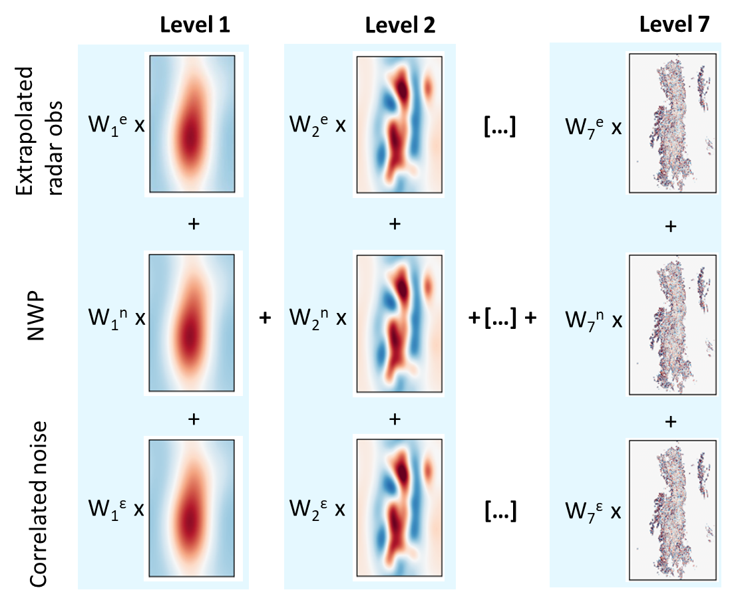
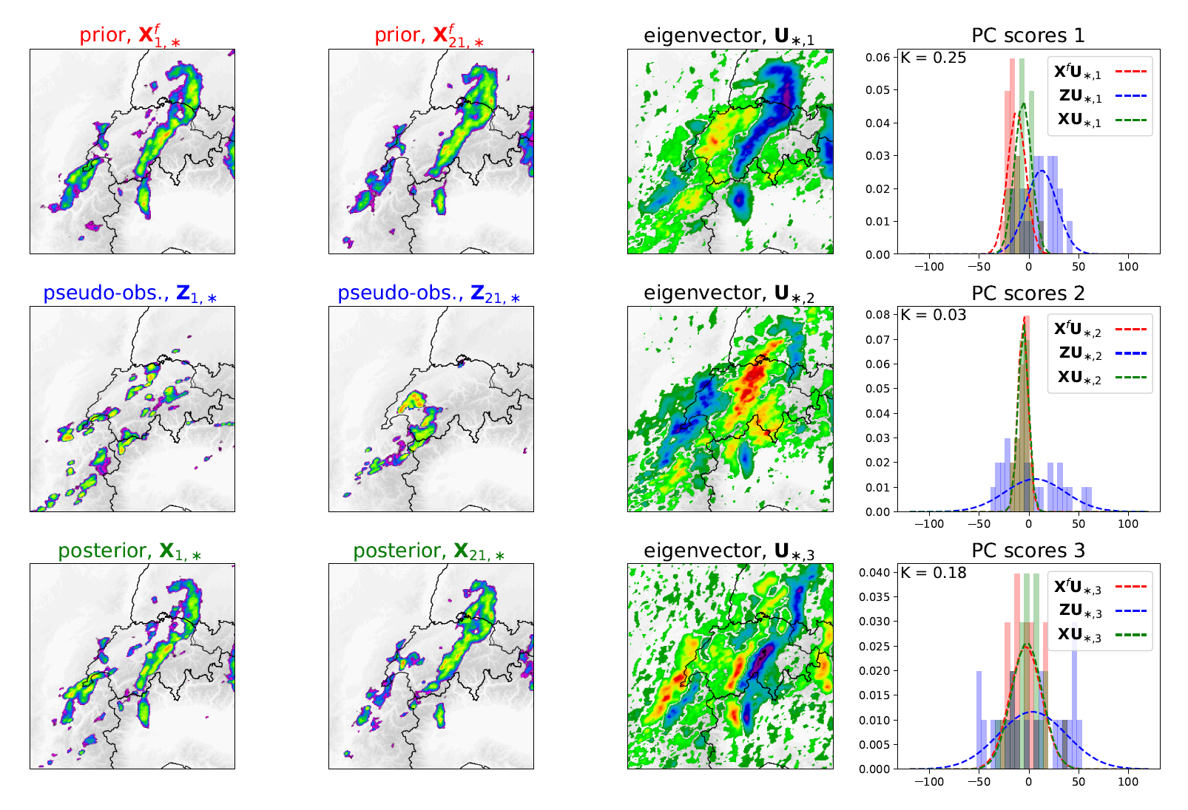
Improving blending
Scale dependent (STEPS)
Bayesian update (EnKF)
Imhoff et al. (QJRMS, 2023)
Nerini et al. (Weather Rev, 2019)

Slide 6
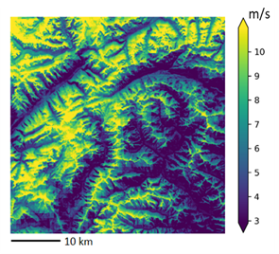
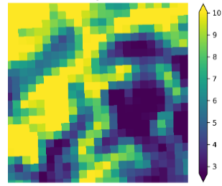
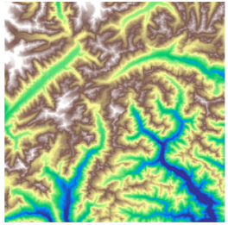

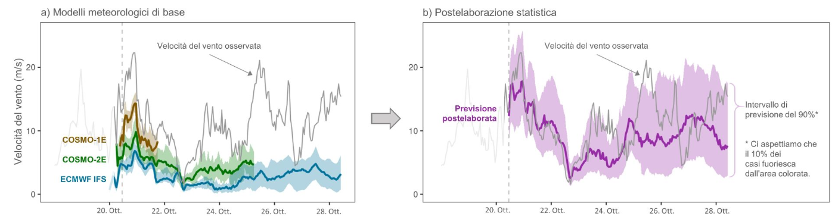
Statistical Postprocessing for seamless forecasting
Wind @ 50m
Raw forecast @ 2km
DEM @ 50m
Station obs
Statistical model
+
+
Raw forecasts
Postprocessing
Wind speed [m/s]

Slide 7
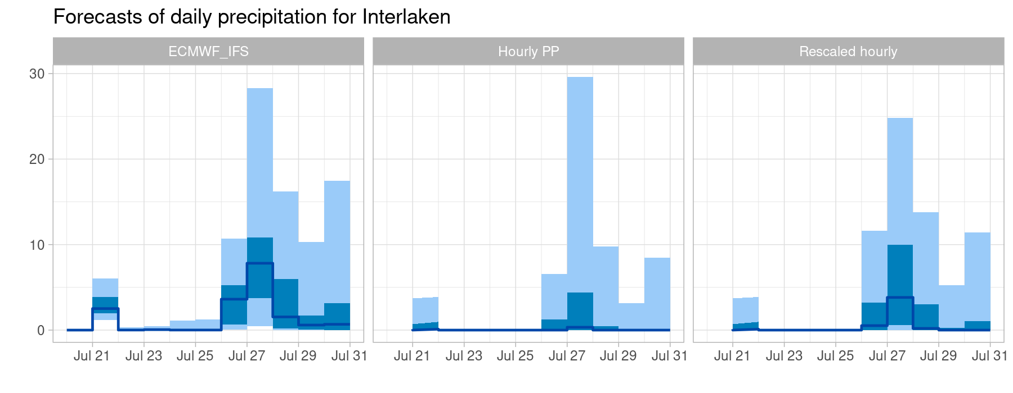
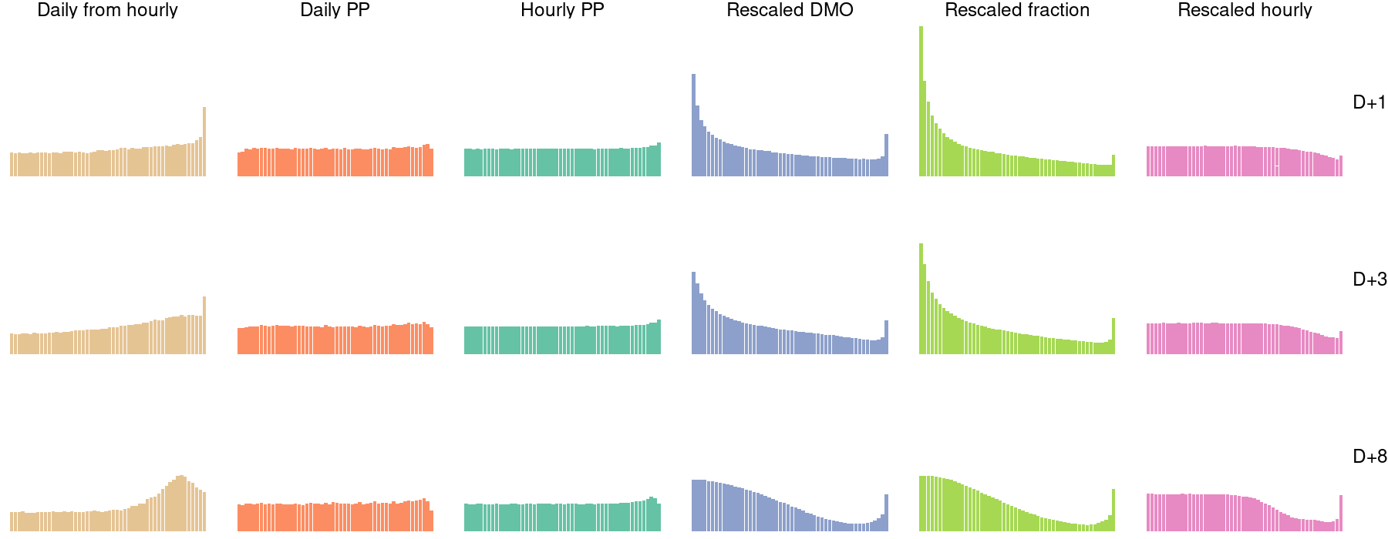
Postprocessing at multiple temporal scales
Problem:
Univariate PP on hourly precip. +
limited predictability of hourly precip.
→ climatological pred. (very little rain) → we lose rain in daily accumulations
Solution:
Rescale hourly postprocessed precip. with daily postprocessed precip.
but remaining issues with calibration →
Daily from hourly PP
Daily PP
Hourly PP
Rescaled hourly PP
D+1
D+3
D+8

Slide 8
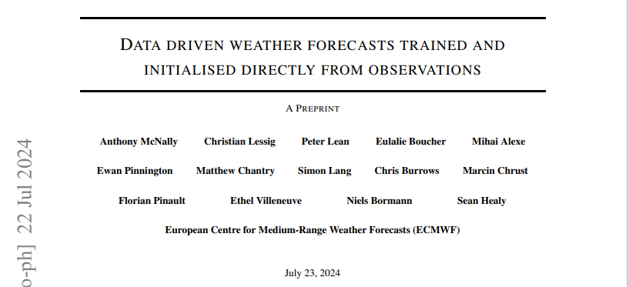
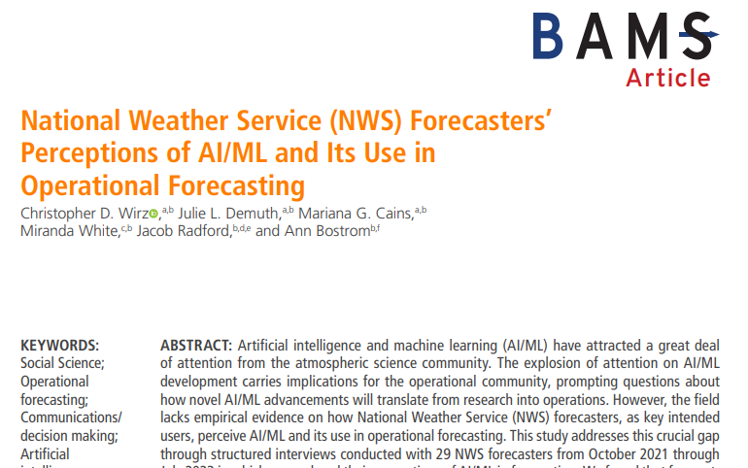
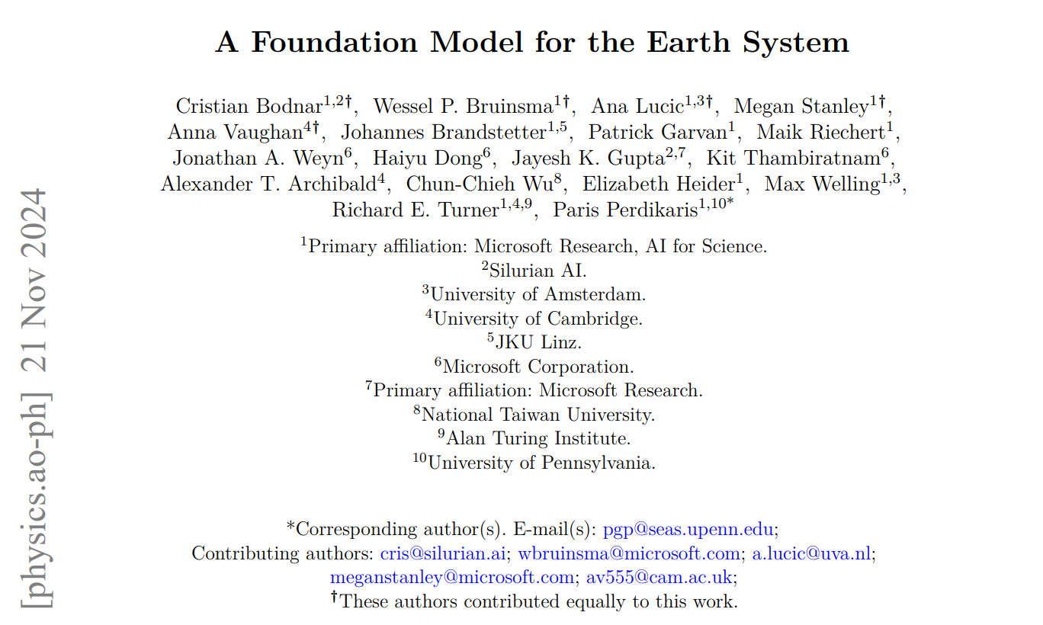
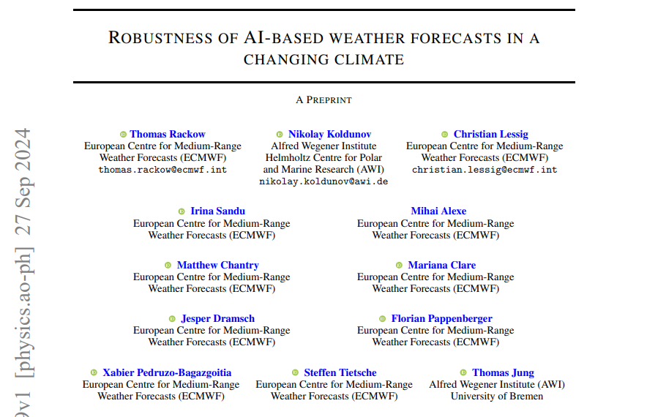
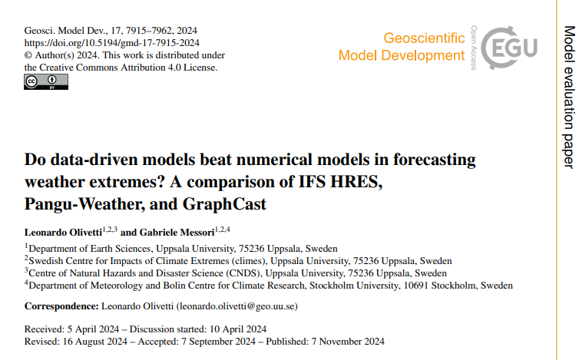
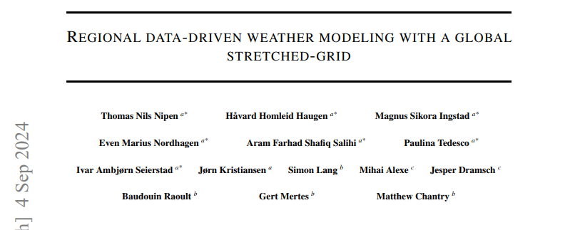
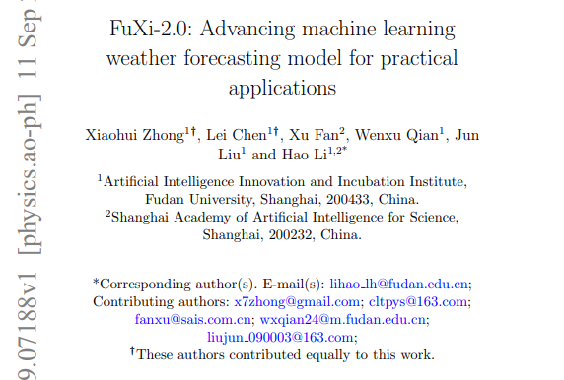
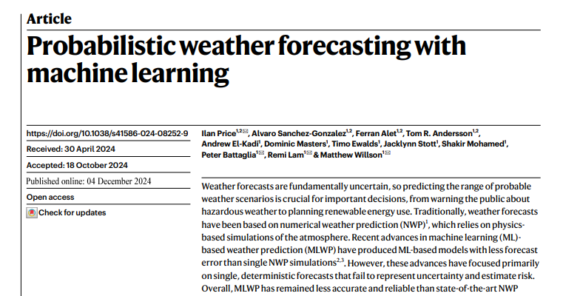
Machine Learning

Slide 9

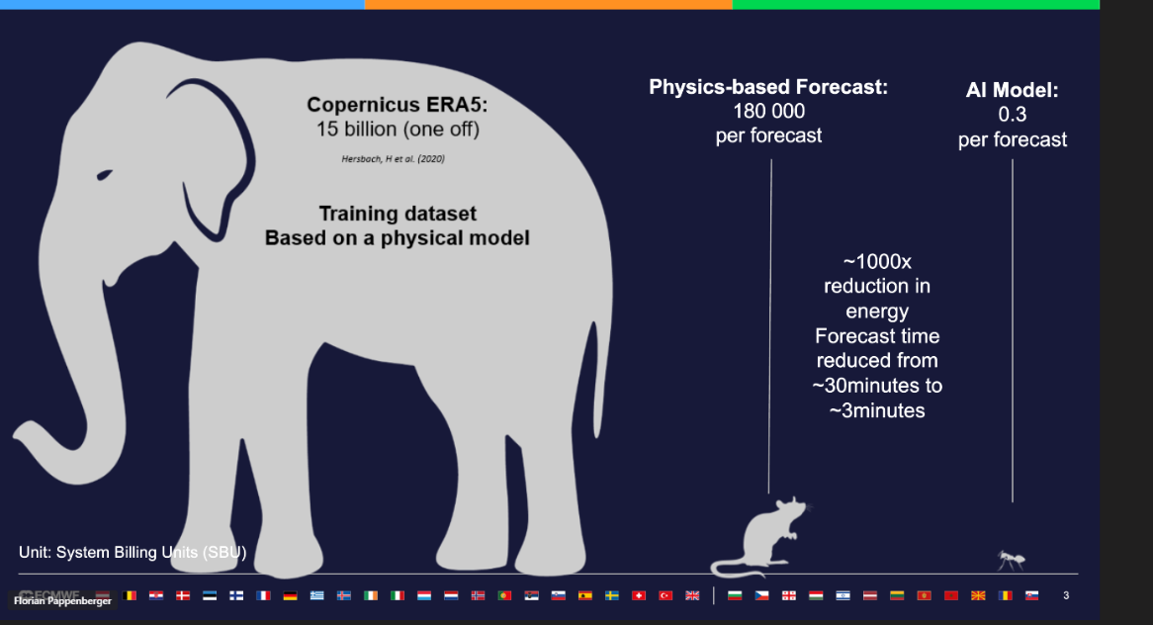
AIFS goes Operational (Feb 25, 2025)!
https://www.ecmwf.int/en/about/media-centre/news/2025/ecmwfs-ai-forecasts-become-operational
Notes:
Not just publication and press articles, but actual operational models making an impact.
Available for free
reduction of approximately 1,000 times in energy use for making a forecast.
62 minues before IFS

Slide 10
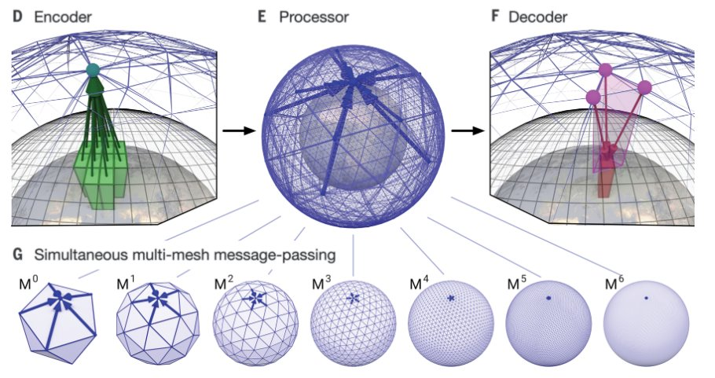
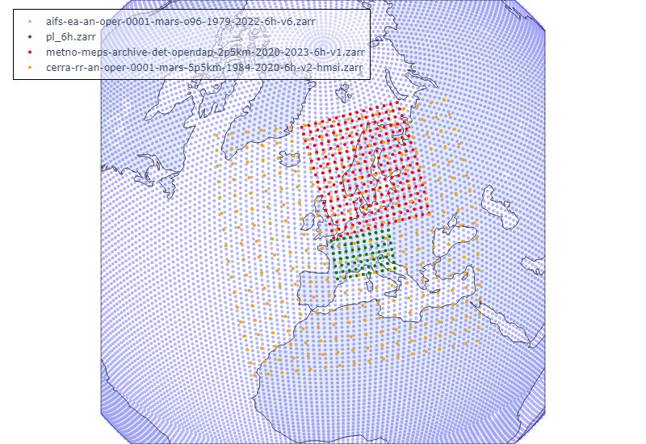
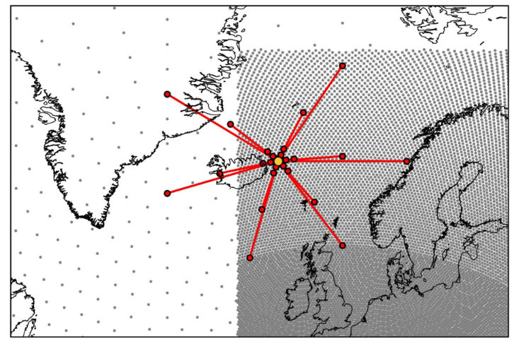
Model architecture
Graph-based: use graph neural networks to encode and process input data in a flexible way.
Autoregressive: rollout forecast iteratively, typically with 6h steps.
Stretched-grid: high-resolution over a localised domain of interest and lower resolution elsewhere with seamless information passing across boundaries.
Remi et al. (Nature, 2023), "GraphCast"

Slide 11
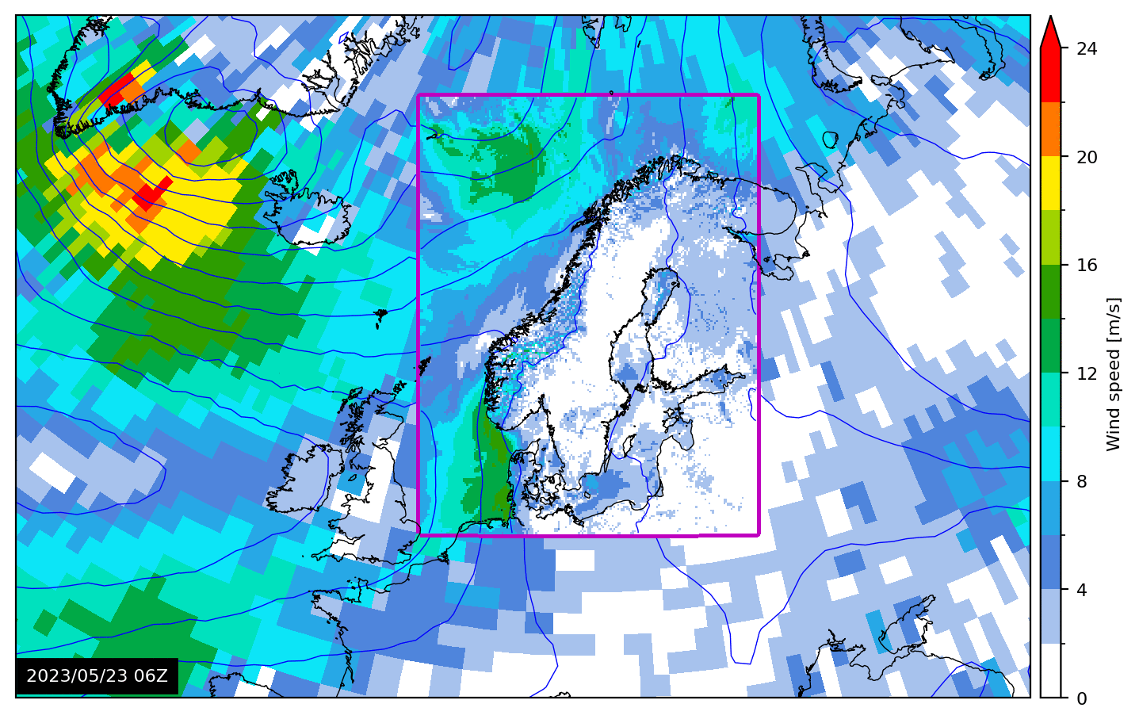
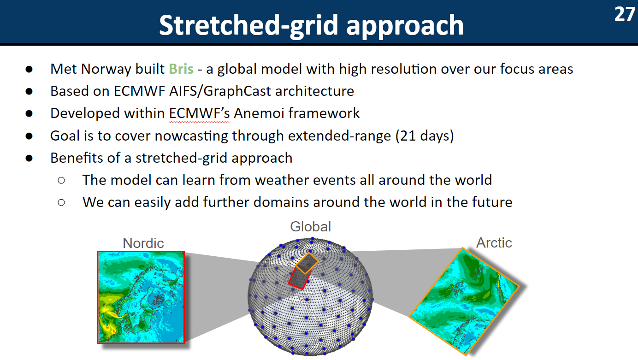
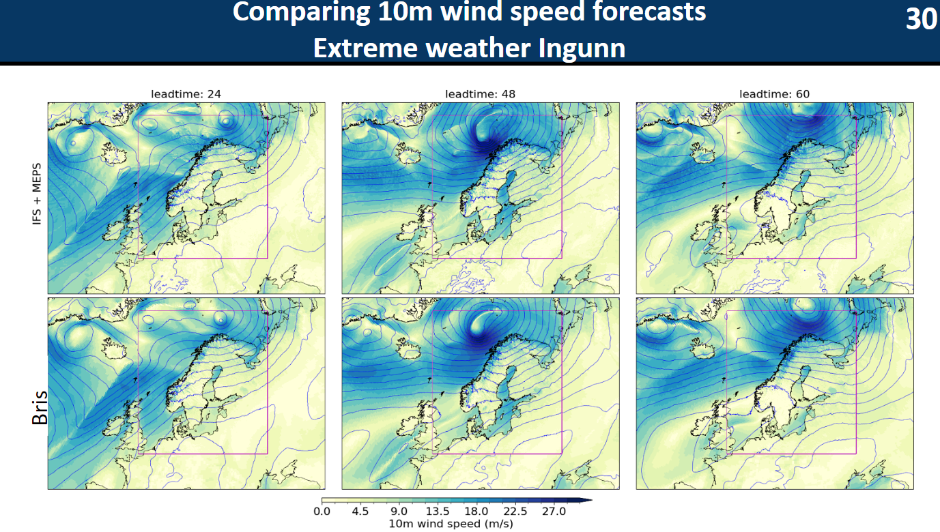
Regional Emulators
Nipen et al. (arXiv, 2024)

Slide 12

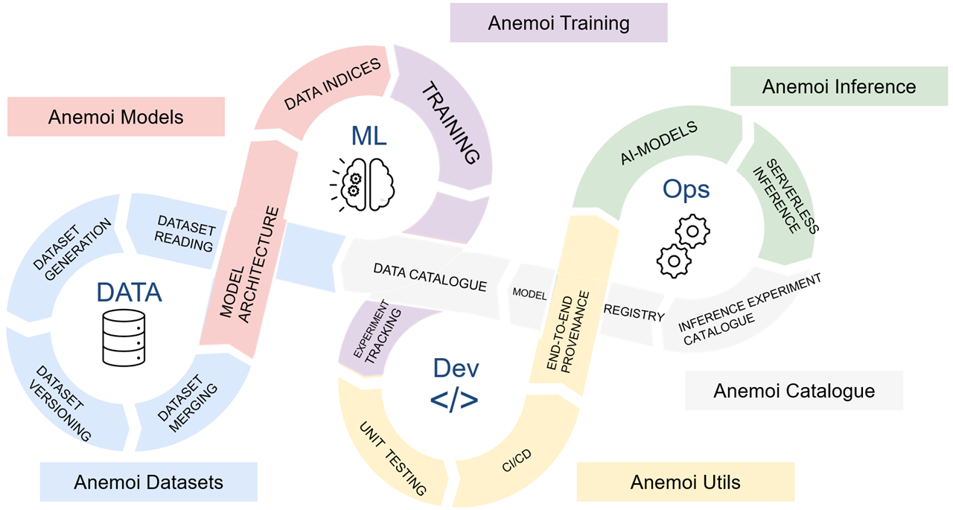
Anemoi Framework
Provide cutting-edge ML tools for meteorological applications covering the whole ML lifecycle.
Foster a collaborative and open-source ecosystem.
Facilitate R2O, reduce maintenance.

Slide 13
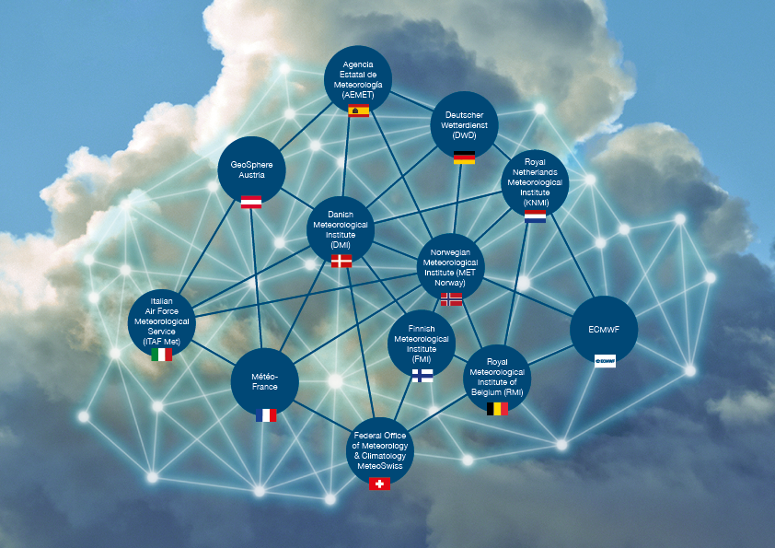
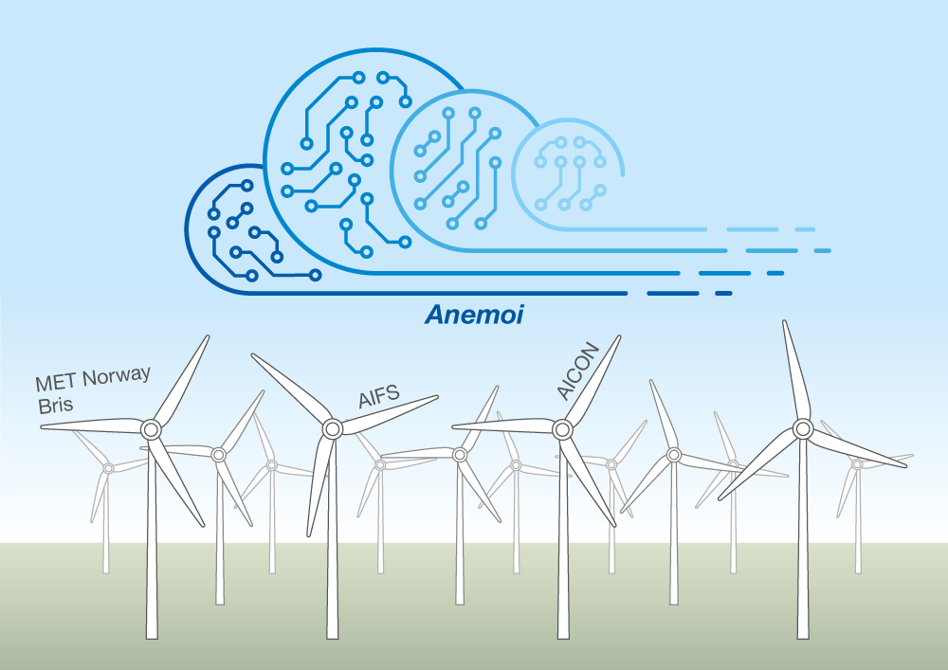
Anemoi Community
Collective expertise of 12 European meteorological institutions, led by ECMWF.
Over 40 contributors, 700 pull requests and counting.

Slide 14
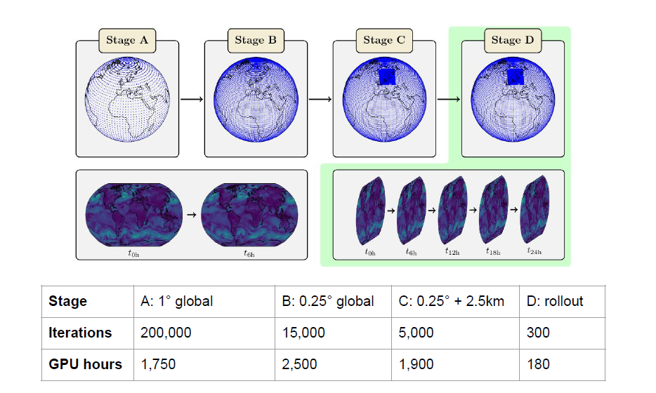
Data-driven regional forecasting
Transfer Learning:
Sequentially adapt the model to more complex tasks.
Harness the greater data availability of ERA5.
Gradually refines the model, allowing it to reach a local minima.
Drastic increase in performance vs starting directly at stage C.
ECMWF to provide pre-trained Stage B models!
Nipen et al. (arXiv, 2024)

Slide 15
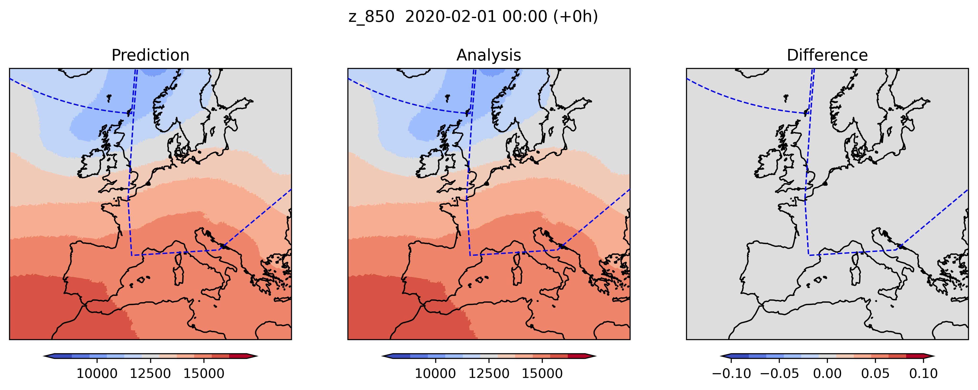
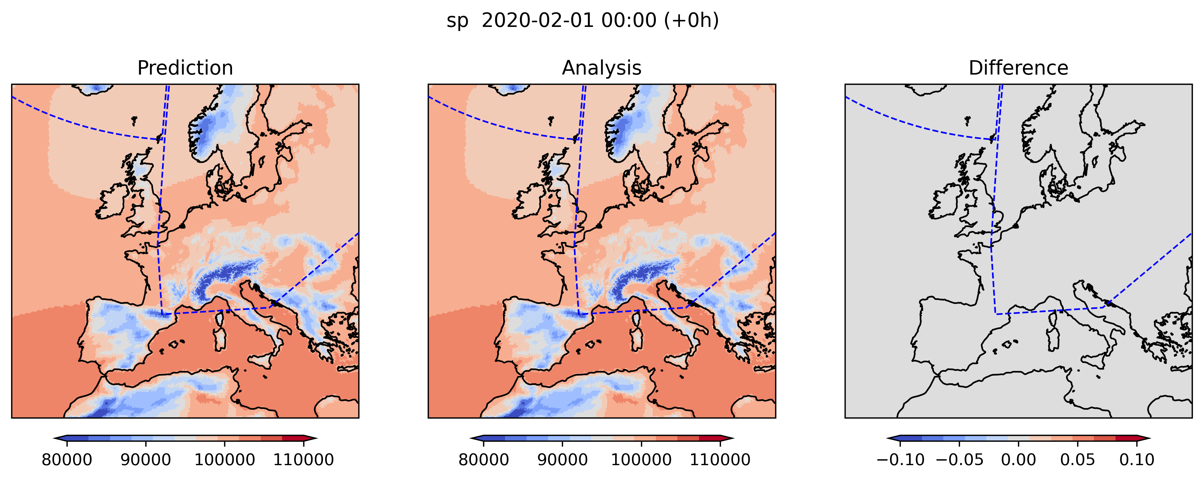
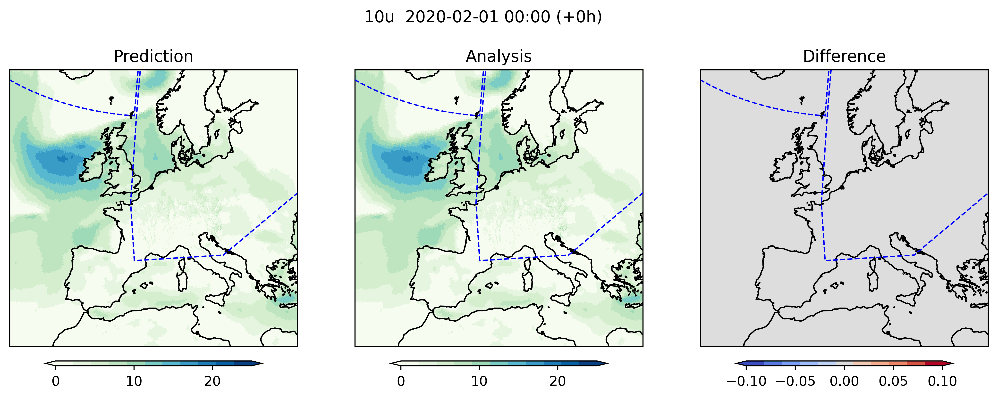
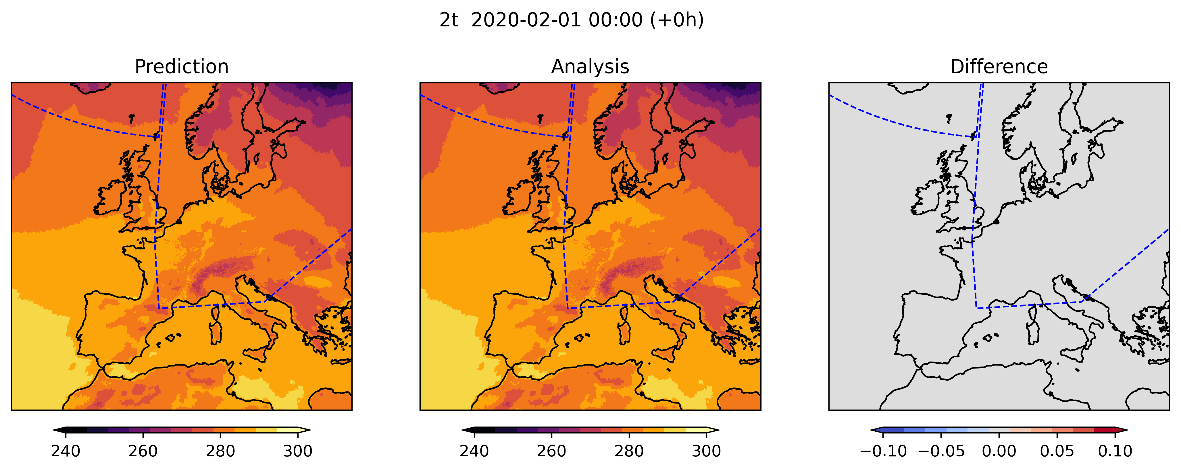
AICON Results
NWP Seminar
23.01.2025

Slide 16
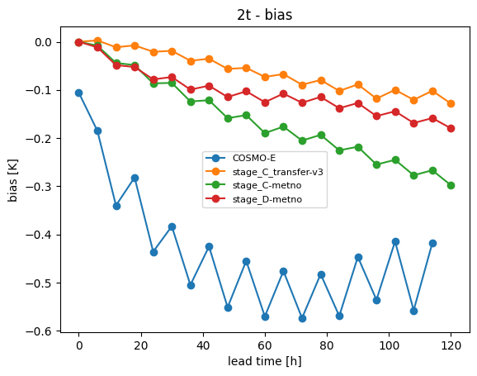
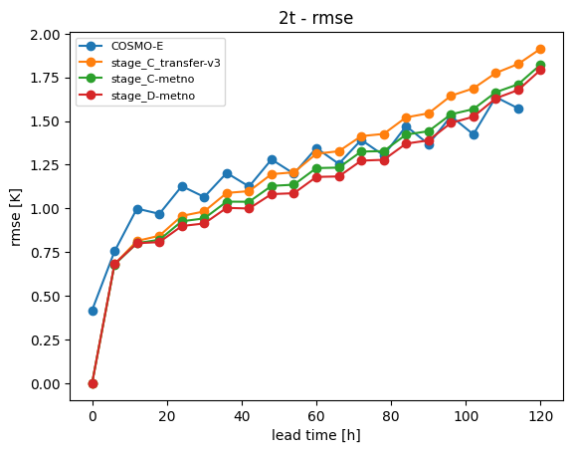
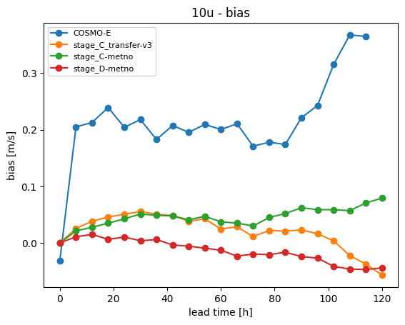
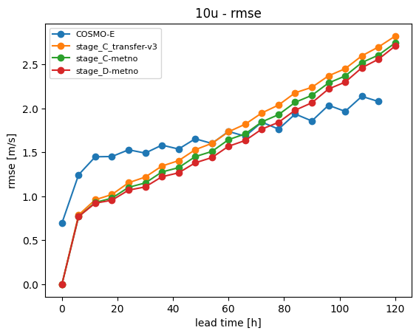
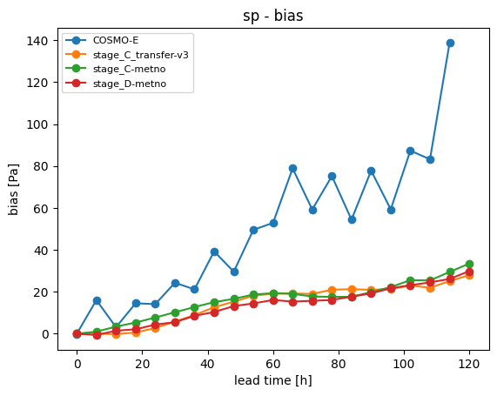
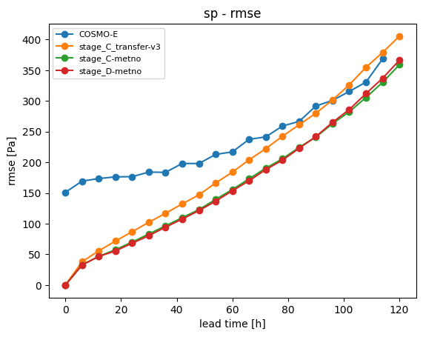
AICON „Verification“

Slide 17
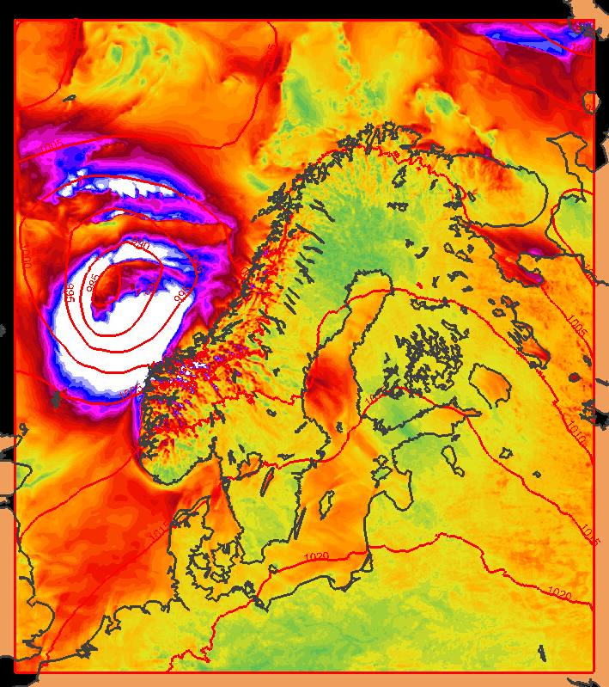
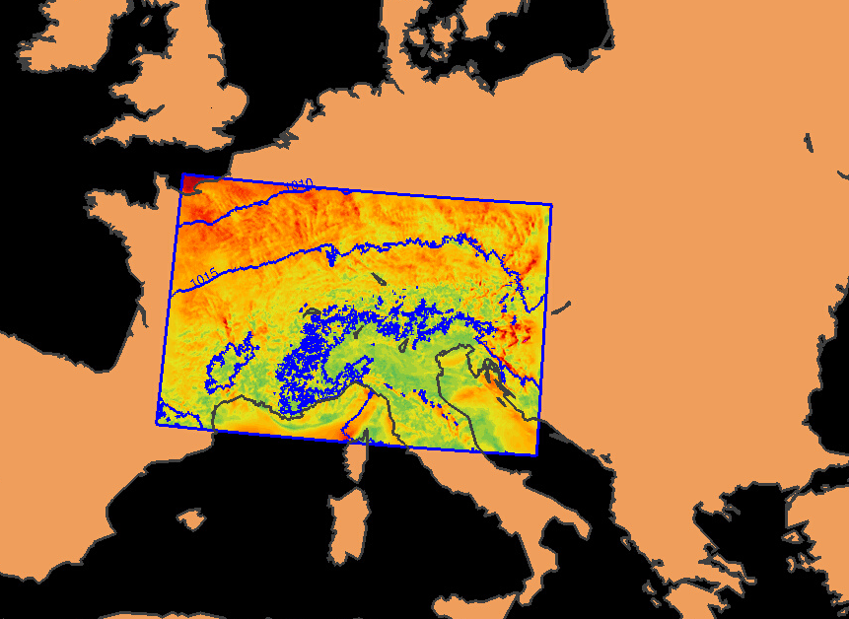
Running Bris in Switzerland
Trained on:
MEPS 2.5km analyses 2020-2023
1000 * 950 grid points
Biggest mountain: 2019 m
Inference on:
COSMO 2.2km analyses
290 * 582 gridpoints
Biggest mountain: 3867 m
Notes:
Run MetNo model in Swiss domain – took only a few hours!

Slide 18
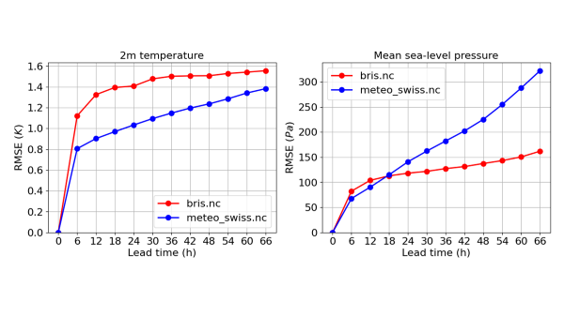
How robust are stretched-grid models?
Running Bris on the Swiss domain
Notes:
Identified issue with growth of error in pressure (probably a symptom of a problem at the synoptic scale)

Slide 19
1) Predict analysis from analysis
2) Predict obs targets from analysis ICs
3) Augment analysis driven ML with obs
e.g. current AIFS
e.g. fine tune AIFS to predict SYNOPs
e.g. obs not used by 4D-Var
t+0
t+N
t+0
t+N
t+0
t+N
model space
model space
model space
latent space
latent space
latent space
obs space
obs space
obs space
Augmenting existing analysis driven approaches with observational data
4) Learn the analysis
5) Predict future analysis from obs
6) Predict future obs from obs
e.g. emulate 4D-Var
e.g. make predictions in model space
use reanalysis as truth
e.g. make predictions in obs space, using obs as truth
t+0
t+N
t+0
t+N
t+0
t+N
model space
model space
model space
latent space
latent space
latent space
obs space
obs space
obs space
Initializing + learning from observations
Direct Observation Prediction – making a forecast directly from observations
Courtesy of Matthew Chantry (ECMWF)
Notes:
So there are several scenarios that we can consider with data-driven forecasting models and how to introduce the use of observations into them,
The first is the current AIFS or Graphcast ect,
One idea would be to augment these models with observation data
If you drive the ML model with direct observations and if you predict direct observations, then what you’re doing is DA, nowcasting, postprocessing, downscaling all in a single model.
→ You can do more things in one go. Start thinking about novel ways of doing things and putting things together

Slide 20


Data Assimilation – Multiple Encoders/Decoders
Blue points is the standard analysis input
Green points secondary data source (e.g. observations)
Multiple encoders in sequence
Encoder 0 encodes the analysis input
Encoder 1 encodes the secondary input through a fuser (perceiver)
Multiple decoders (similar to single decoder case)
Courtesy of MetNorway

Slide 21


Time Interpolator
Training a model directly at 1h steps would decrease model skill during long rollouts.
Time interpolation allows to progressively produce finer temporal resolution forecasts while maintaining model skill at long lead times.
Hourly 2m Temperature
Courtesy of MetNorway

Slide 22

Putting it together: Seamless RUC
Components
Conventional DA (KENDA)
Forecaster (6 hourly outputs)
Time interpolator (hourly outputs)
Data assimilator
Seamless by design.
Notes:
Possible designed of a RUC implemented with ML and anemoi
Resusing components from the anemoi community
Challenges: amount of data produced
“Seamless by design”

Slide 23
Wrap up
Conventional approach is “post-hoc” seamless
  Blend of forecasts that historically have been developed in separated communities.
ML is changing the traditional boundaries of how things are being done
  DA, nowcasting, postprocessing, downscaling – all in a single model!
New community are forming around ML, offering synergies and enabling quicker adoption.
  Anemoi: sharing data and sharing models!
MeteoSwiss is building an ML-based model that can be competitive in quality for nowcasting-, short, and medium-range forecasts (“Seamless RUC”).

Slide 24
More questions? Get in touch! Daniele.Nerini@meteoswiss.ch

Slide 25


Spatial resolution
Major source of predictability in the Alpine region
But 3-8x in compute capacity would be needed for running ICON @ 500m
On-demand “Extreme DT” @ 500 m resolution from Destin-E
https://www.ecmwf.int/sites/default/files/elibrary/072024/81574-destination-earths-digital-twins-and-digital-twin-engine-state-of-play.pdf

Slide 26


Ensembles
CRPS
Diffusion (Flow Matching)
Used by ECMWF, Metno
Used by Google

Slide 27


pysteps or Standing on the Shoulders of Giants
https://github.com/pySTEPS/pysteps
Laroche & Zawadzki (1995). Retrievals of Horizontal Winds from Single-Doppler Clear-Air Data by Methods of Cross Correlation and Variational Analysis.
Germann & Zawadzki (2002). Scale-Dependence of the Predictability of Precipitation from Continental Radar Images. Part I: Description of the Methodology.
Germann & Zawadzki (2004). Scale-Dependence of the Predictability of Precipitation from Continental Radar Images. Part II: Probability Forecasts.
Seed (2002). A Dynamic and Spatial Scaling Approach to Advection Forecasting.
Bowler et al (2006). STEPS: a probabilistic precipitation forecasting scheme which merges an extrapolation nowcast with downscaled NWP.
Seed et al (2013). Formulation and evaluation of a scale decomposition-based stochastic precipitation nowcast scheme.
Roberts & Lean (2008). Scale-selective verification of rainfall accumulations from high-resolution forecasts of convective events.
Wernli et al (2008). Sal — A novel quality measure for the verification of quantitative precipitation forecasts.

Slide 28

A scale-dependent blending method
Per ensemble member:
Fast-Fourier transform to different spatial scales
Pulkkinen et al., 2019
Blending weights depend on initial and expected future skill
Imhoff et al. (QJRMS, 2023)

Slide 29

One forecast to rule them all
days
0 1 2 3 4 5 15 45
lead time
0
WHERE
ensemble member
WHEN
INCA analysis
INCA forecast
ICON-1
ICON-2
ECMWF IFS
ECMWF IFS EXT
100
WHAT

Slide 30

Radar data assimilation with Latent Heat Nudging
Method: modification of diabatic (latent) heating rates in order to simulate the observed precipitation rates
Realisation: add nudging increment to temperature tendency
Radar: Rain
Model: No rain
LHN warms up
LHN
NOLHN
Radar
6-12h Precipitation Forecast (19.06.2007)

Slide 31
Double image effect
Example of double image effect and smoothing during a linear blending
procedure of idealized storm cells in an extrapolation (EXT) and numerical model (NWP) forecasts. Adapted from Hwang et al. (2015), their Fig. 2.

Slide 32

Types of Weather Models
Espeholt et al. (Nat Commun, 2022)

Slide 33



MetNet3
“Densification” of in-situ observations
Andrychowicz et al. (ArXiv, 2023)
Courtesy of Leonard Knirsch

Slide 34
Lesson learned 1:
Under-exploitation of the error structure
Forecast errors are assumed to be iid.
No matter how close individual observations (in space and/or time), we assume that the forecast errors are uncorrelated.
In reality forecast errors are correlated.
e.g. if we know the forecast error at time t, the forecast error at time t+1 is likely similar.

Slide 35
Lesson learned 2:
Low average error isn't good enough
Doing well on training set → Doing well on test set → Doing well on business metrics/needs
Performance on disproportionally important examples
  Lose trust
  Doesn't necessarily impact average metrics (weights all sample equally)
Performance on key slices of dataset
  Populated areas.
  Specialized users.
Rare classes
  High-impact events
  Under-represented station sitings (e.g., urban, slopes, lakes, ...)

