Slide 1

Nowcasting extreme rainfall over the UK
Katie Norman (she/her/hers)
Precipitation Processes - Estimation and Prediction, 20th March 2025
Matt Clark, Ed Pavelin, Andrew McNaughton, Anna Booton, Billie Mackenzie, Graeme Kelly, Brian Golding, Rosie Nation, Dan Suri, Will Rosling, Emma Hattersley
Notes:
Introduce team

Slide 2
Overview
Context for Nowcasting in the UK
Overview of PLUVIA
Evolution of operational services at the Met Office
Evaluation at the Summer 2024 Nowcasting testbed
Notes:
I’ll first talk about the context for this work
Team formed 5 years ago after a lull in nowcasting work
An overview of our progress and future thinking

Slide 3
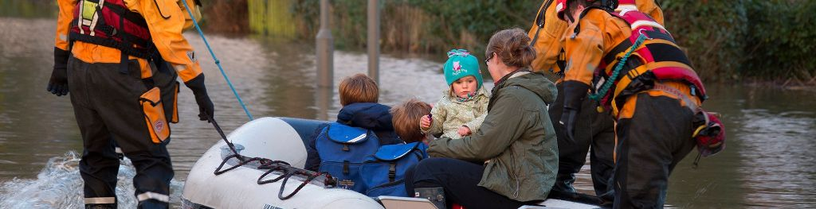
Rapid-onset flooding from intense rainfall
Flood Forecasting Centre: “Rapid flooding is any flooding that starts within 6 hours of rain. It is caused by water getting trapped in urban low spots or overflowing drains and flow from small streams and rivers.”
Kendon et al (2023) found that: “a future intensification of short-duration rain in summer, with significantly more events exceeding the high thresholds indicative of serious flash flooding”
2022 | Good or Excellent Guidance | Poor or Very Poor Guidance
All weather warnings | 80-85% | 5-10%
Shower and Thunderstorm related warnings | 40-45% | 40-45%
www.metoffice.gov.uk © Crown Copyright 2025, Met Office
Notes:
At the time the team was formed, we had a focus on thunderstorm nowcasting – NSWWS change in 2018.
The motivation remains as----performance of NSWWS
In the UK climate, rainfall is seen as the primary hazard from thunderstorms, and is the focus of the team.
There are several related types of flooding that result from short period intense rainfall. RF def.
People are at risk through …….driving through floodwater, subterranean urban infrastructure, proximity to minor watercourses.
4.6 million properties are at risk of SWF in England, on the national risk register.
these events are likely to become more frequent.

Slide 4
Analysis of surface water flooding events associated with deep moist convection in the UK
Matt Clark
Events distributed across a wide range of synoptic regimes. Most cases relate to mesoscale features.
It’s a matter of “time” – flow aligned lines, slow cell advection velocities and back-building allow more rainfall to fall in one place.
Most often occurs in relatively low-CAPE, low-shear environments (median values of MUCAPE and effective bulk wind shear of 561 J kg-1 and 13.8 knots, respectively).
103 events 2015 – 2021
synoptic-scale, mesoscale and storm-scale environments explored using ERA5 reanalysis, satellite and radar.
www.metoffice.gov.uk © Crown Copyright 2025, Met Office
Notes:
When we started, Matt Clark looked in more detail at the meteorology of recent surface water flood events.
He found about 100 events in a 6 year period and looked at ERA5, radar and satellite to determine the environments and storm morphologies

Slide 5
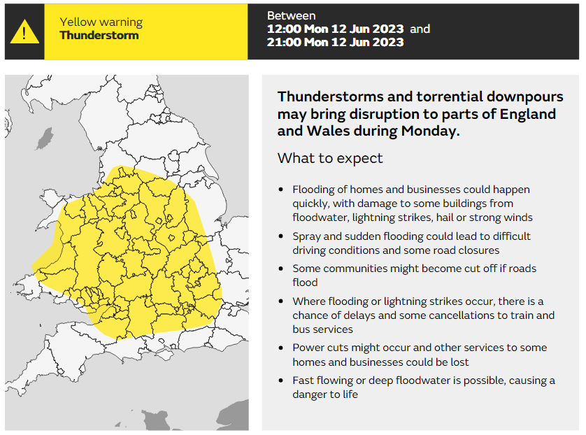
Why nowcasting?
Thunderstorm warning issued at 10:00 BST Sun 11th June (about 24 hours ahead)
www.metoffice.gov.uk © Crown Copyright 2025, Met Office
Notes:
This is an example warning for thunderstorms. – low risk or medium impacts – typical summer warning.
Often it is not possible to predict exactly where might be worst affected until the first rain starts to fall – perhaps up to two hours before the impacts are felt.
The skill of NWP allows us to issue broad warnings for thunderstorms over 24 hours in advance. But…

Slide 6
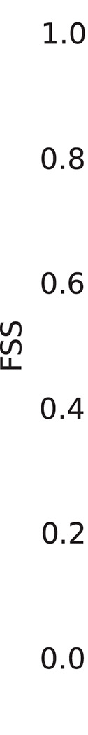
Why nowcasting?
The requirement for accurate 5-day forecasts makes it difficult to draw close enough to the observations assimilated to produce accurate very short-range forecasts.
Simonin et al. (2017): >1mm in an hour in convective events is forecast better by extrapolating rainfall radar (blue) than by NWP (red) 1.5 – 2 hours ahead.
www.metoffice.gov.uk © Crown Copyright 2025, Met Office
Simonin et al. (2017) https://doi.org/10.1002/qj.3136
Notes:
To achieve this skill at longer lead times, we cannot pull close enough to obs for accurate very short range forecasts.
As shown by Simonin et al…

Slide 7
Overview
Context for Nowcasting in the UK
Overview of PLUVIA
Evolution of operational services at the Met Office
Evaluation at the Summer 2024 Nowcasting testbed
Notes:
I’ll first talk about the context for this work
Team formed 5 years ago after a lull in nowcasting work
An overview of our progress and future thinking

Slide 8
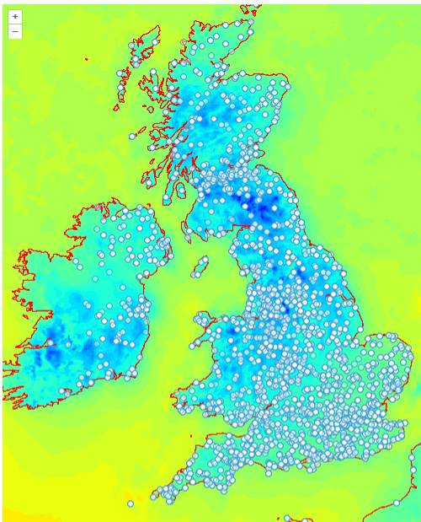
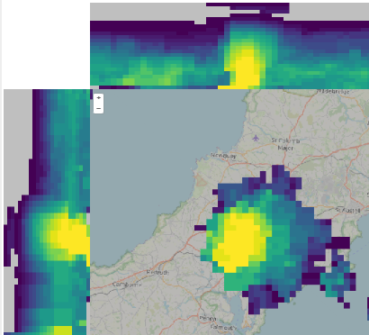
WOW > 1000 regularly reporting sites
from the public
What is PLUVIA?
Combines observations and NWP to produce analyses that can draw closer to observations than NWP.
Uses alternatives to a physical simulation (e.g. Ensemble Forecast Adjustment, Kalman Filter) to generate nowcasts that have greater skill than NWP in the first few hours of the forecast.
Developed to support the conceptual models used by Operational Meteorologists and Hydrometeorologists.
3D radar composites give us detailed information on the structure of storms
Notes:
PLUVIA is the name we’ve given to our collection of nowcasting systems in/tobe developed.
PLUVIA is designed to bridge the skill gap between NWP and what can be achieved using other methods.
Whilst NSWWS was the main original motivation, PLUVIA nowcasts have the potential to feed into other products and services.
In the next slides I will speak to the main current components of PLUVIA, and our plans for their evolution. It’s sparse on timescales as we are currently going through a process of reprioritisation.

Slide 9
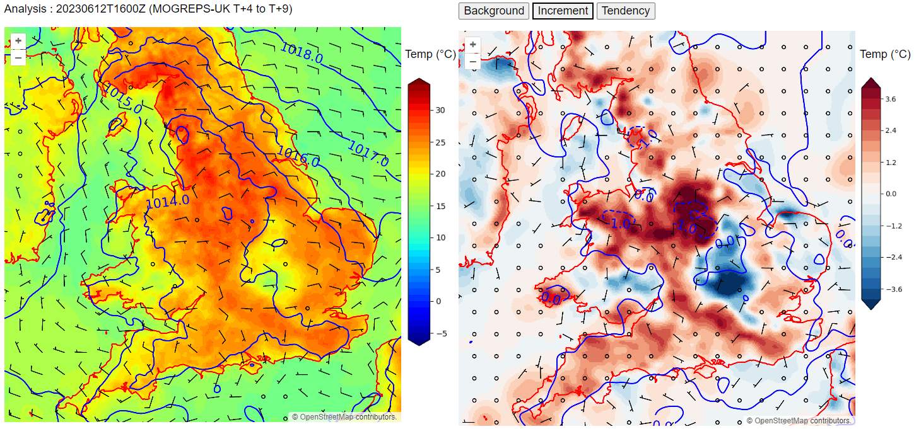
PLUVIA Mesoanalysis
Time-lagged 18-member ensemble NWP background from MOGREPS-UK
Combined with temperature, dewpoint, wind and pressure observations from WOW using Ensemble Optimal Interpolation (EnOI) to produce an analysis
Analyses of near-surface temperature, dewpoint, pressure, wind are much more timely than those from NWP, and draw more closely to the observations.
Currently hourly, available at T+12 minutes.
Allows an ingredients-based approach to be implemented by Operational Meteorologists, and the identification of mesoscale features.
Notes:
PLUVIA Mesoanalysis is a near-surface analysis. It draws more closely to the observations to produce an analysis that better matches and supports the situational awareness of operational meteorologists. It is used in several ways
to understand the pre-convective environment in terms of the necessary ingredients for convection initiation
Identify the existence of, timing, location and intensity of mesoscale features evident near the surface (e.g. sea breeze fronts and convergence lines, cold pools)
to monitor how short-range forecasts from NWP compare to observations.
We need to add some post-processing functionality before we can do a final cross-validation. .

Slide 10
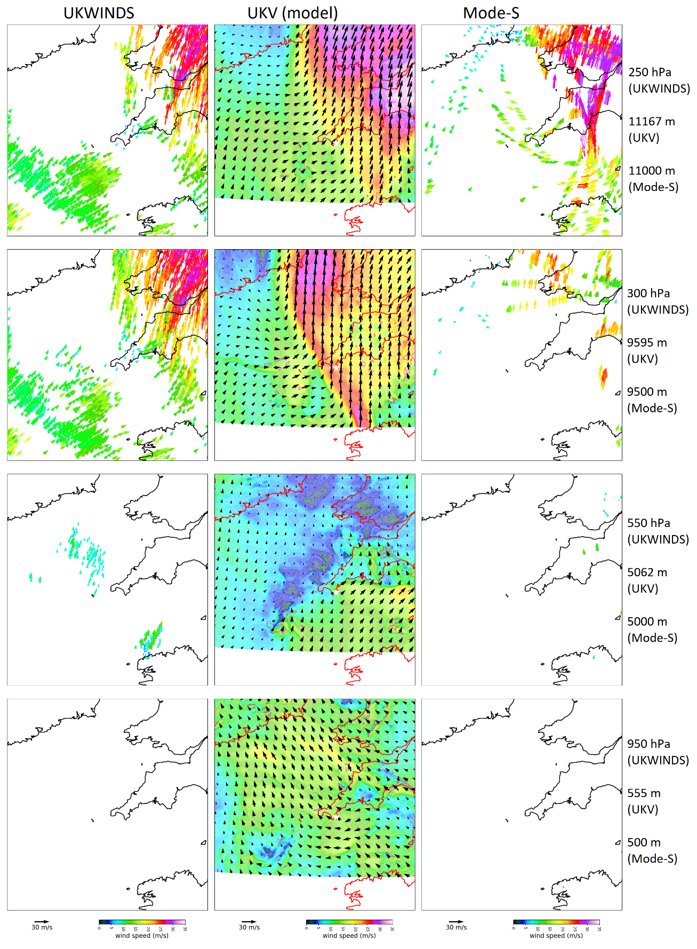
Extending to 3D
Ed Pavelin and Matt Clark
Flash flooding event in South-West England from a near-stationary storm.
Upper-level wind observations from satellite atmospheric motion vectors (left) and MODE-S (right) are much lower than the model (centre)
Convective cells likely to be slower-moving and associated with flooding impacts.
Atmospheric Motion Vectors from Satellite
UKV model
Winds from aircraft
(MODE-S)
250 hPa wind
www.metoffice.gov.uk © Crown Copyright 2025, Met Office
Notes:
We’re interested in the vertical wind profile to forecast storm motion and storm mode. Temperature profiles how unstable the atmosphere is.
Critically, storm motion is very directly related to the amount of rainfall that can accumulate.
This is an example of where the model does not draw close to the observations. The Upper level wind analysis from the UKV shows higher speeds than those observed by satellite and aircraft. Whilst this isn’t the full picture for the Coverack storm, it helpfully illustrates how a 3D mesoanalysis could support warnings for rainfall from slow-moving storms.

Slide 11
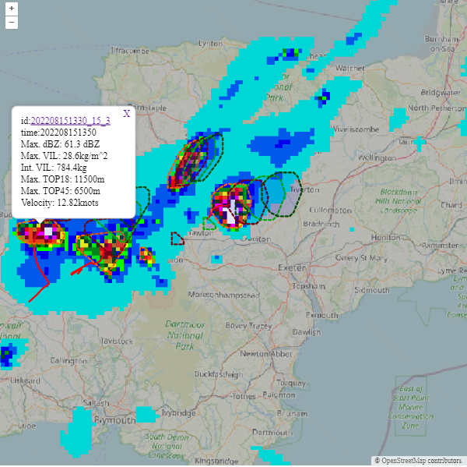
PLUVIA Cell Tracker
Andrew McNaughton
Vertically-Integrated Liquid estimated from 3D radar (kg/m^2)
Convective cells are identified and tracked using a Vertically-Integrated Liquid (VIL) field derived from the 3D mosaic of radar reflectivity over the UK.
Optical Flow and an object-based Kalman Filter are used to forecast the trajectory of individual storms
Based on Muñoz et al (2018) with enhancements for probabilistic output.
Forecast objects at T+20, T+40 and T+ 60 minutes
Characteristics of the selected storm cell
Muñoz et al (2018). Enhanced object-based tracking algorithm for convective rain storms and cells. Atmos. Res, 201, 144-158.
www.metoffice.gov.uk © Crown Copyright 2025, Met Office
Notes:
The PLUVIA cell tracker provides further support in monitoring and forecasting the motion of individual thunderstorms or showers. The tool is well-used by op mets for understanding the characteristscs of cells for hazard forecasting.

Slide 12
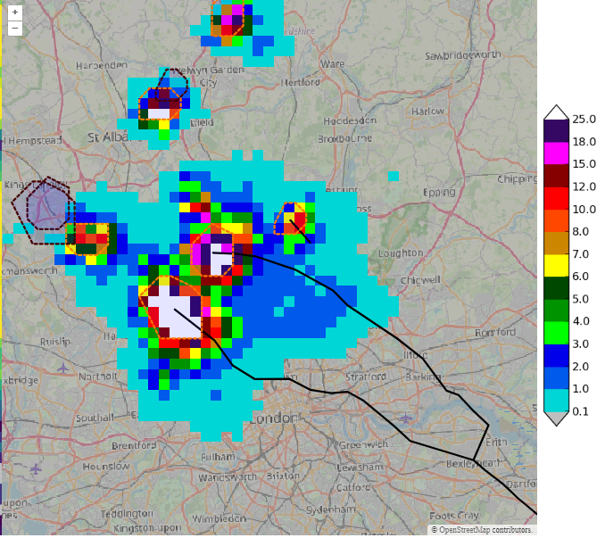
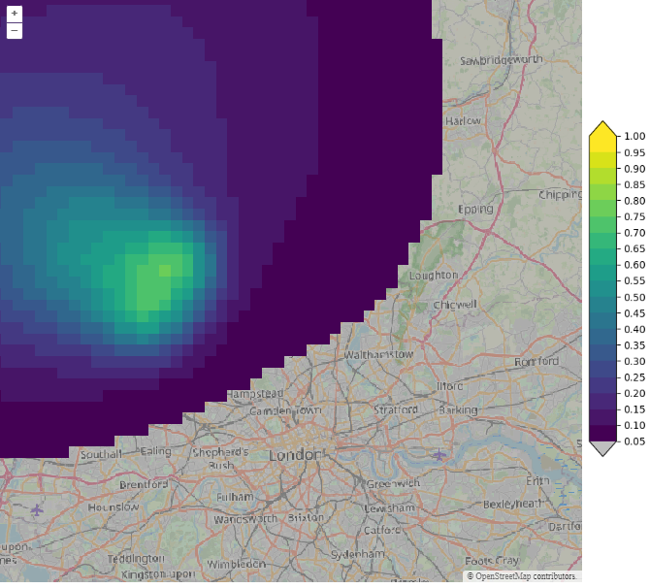
Introducing a Kalman Filter for Probabilistic nowcasts
Andrew McNaughton
Left: Vertically integrated liquid (kg/m3), with cells identified by dashed lines. Arrows connect identified cells with their forecast location in 30 minutes.
Right: New probabilistic forecast showing the probability of a storm passing in the next 60 minutes.
Wang et al (2024): Uncertainty Estimation For Convective Cell Nowcasting: A Kalman-filter Implementation Of Enhanced TITAN​. ERAD 2024.

Slide 13
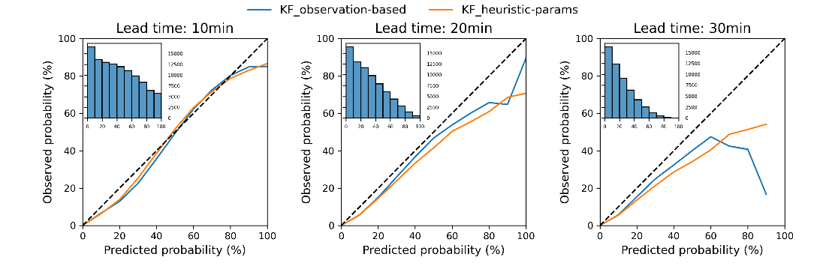
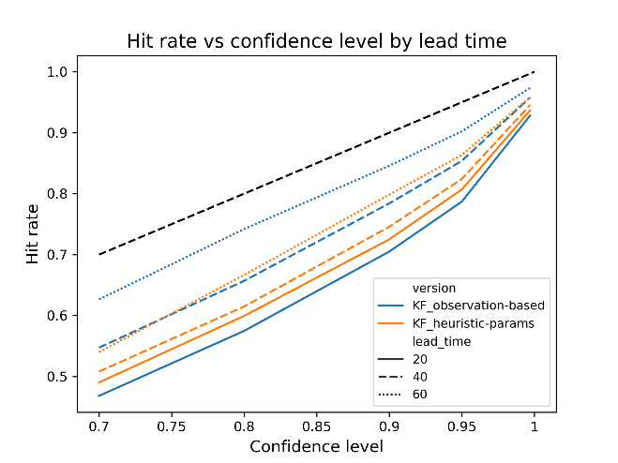
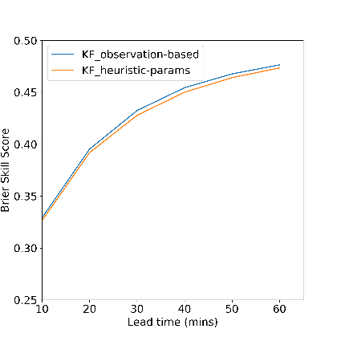



Probabilistic evaluation
RELIABILITY DIAGRAMS
Reliability diagrams show good agreement between observed and predicted probabilities.
Consistently positive Brier Skill Scores at all lead times show gain in skill from using probabilistic model over deterministic one.
Observation based parameters show generally lower hit rates at shorter lead times than heuristic parameters but perform better at longer lead times.
HIT RATES
BRIER SKILL SCORE
$$BSS=1 −\frac{BS}{BS_{ref}}$$
Forecast centroid and confidence disc
Observed centroid = HIT
Observed centroid = MISS
Wang et al (2024): Uncertainty Estimation For Convective Cell Nowcasting: A Kalman-filter Implementation Of Enhanced TITAN​. ERAD 2024.
Andrew McNaughton

Slide 14
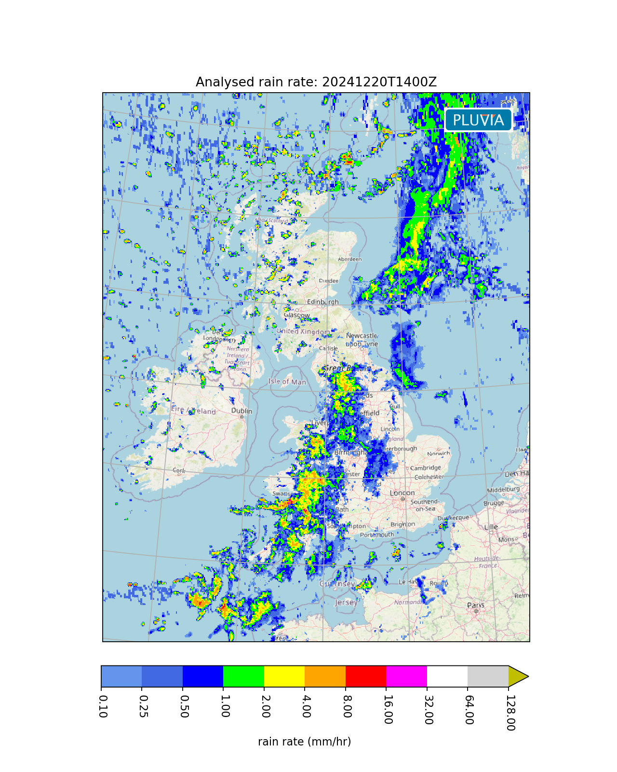
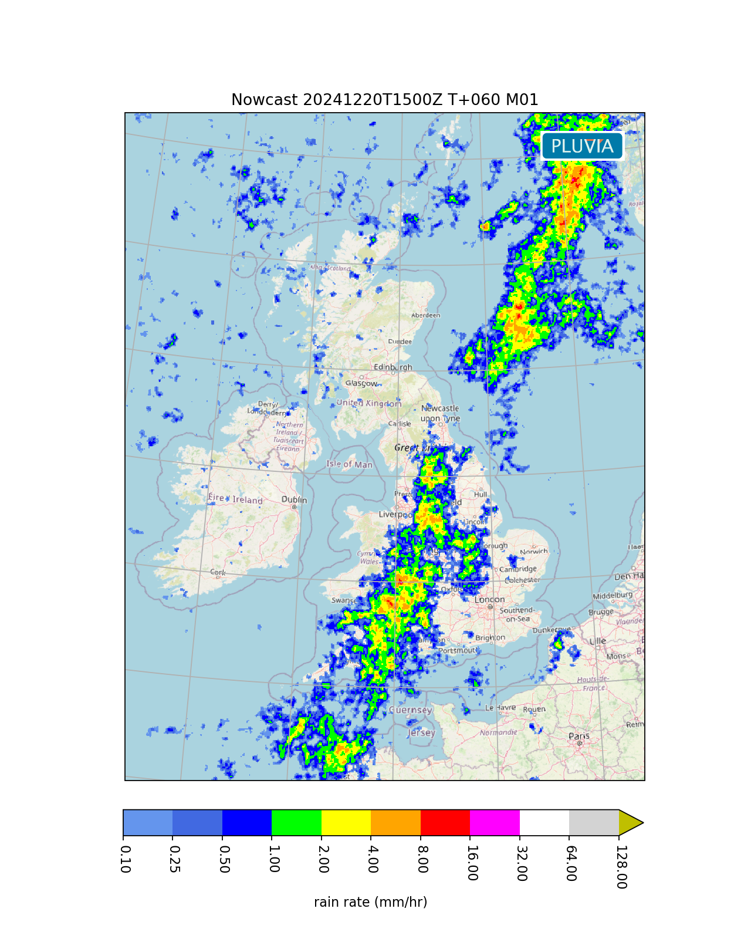
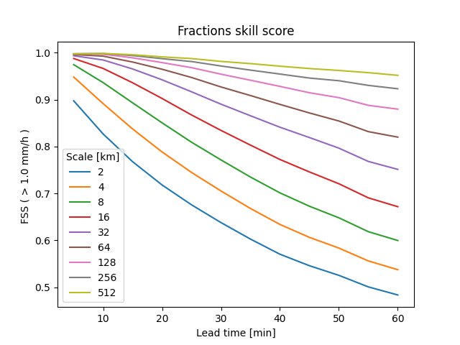
PLUVIA Precip
Analysis
Ed Pavelin
A framework for field-based rainfall analysis, nowcasting and verification.
Analysis: Currently uses radar and satellite. Ambition to extend to use WOW and possibly microwave links.
Nowcast: Support for multiple nowcasting models, e.g.: Lagrangian Persistence, STEPS ensemble nowcasts and Machine Learning models.
Verification
For skill in convection, we must go beyond rainfall-only inputs.
Nowcast
Verification
www.metoffice.gov.uk © Crown Copyright 2025, Met Office
Notes:
When we talk about nowcasting, many people will first think of the use of Optical Flow to do radar extrapolation. Using recent radar rainfall, to predict future radar rainfall. It provides skill over the NWP. Our current STEPS2 system will retire 2027. These nowcasts can be presented to the public, they are well-used in river catchment models to support flood warning by our partners. As well as a breaking change meaning STEPS 2 will retire in 2 years, there are also performance concerns over the nowcast which have led to it being less well-used than we would like. PLUVIA precip is a framework for running and evaluating many different models for precipitation nowcasting. This will support the team in growing our knowledge and being able to evaluate the options available to us for replacing STEPS2.
Whilst there is additional skill in these types of nowcasts, they are limited by their rainfall-only input. For a step change in skill in showers and thunderstorms, we need to consider a broader range of inputs to a ML model.

Slide 15
Overview
Context for Nowcasting in the UK
Overview of PLUVIA
Evolution of operational services at the Met Office
Evaluation at the Summer 2024 Nowcasting testbed
Notes:
I’ll now share some of the changes made as part of the evolution of our operational services.

Slide 16
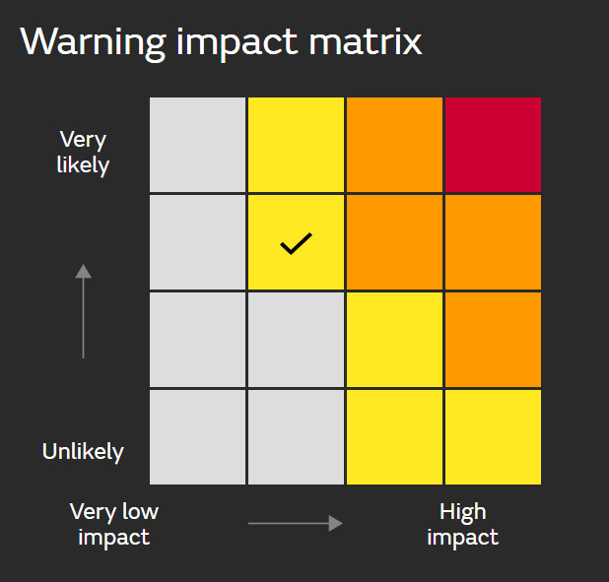
National Severe Weather Warning Service
Impact and likelihood-based warning matrix.
Warnings issued to the public and used by emergency responders for planning and response to severe weather
-> More localised and short-notice warnings for severe weather associated with summertime convection.
www.metoffice.gov.uk © Crown Copyright 2025, Met Office
Notes:
One of our original motivations was improving our NSWWS.
We have three warning levels which are calculated using a combination of the severity of impacts and their likelihood. Warnings can be for rain, snow, lightning, thunderstorm, fog, wind or ice.
Whilst originally designed for mid-latitude storms, we aimed to use it more for short-range warnings.

Slide 17
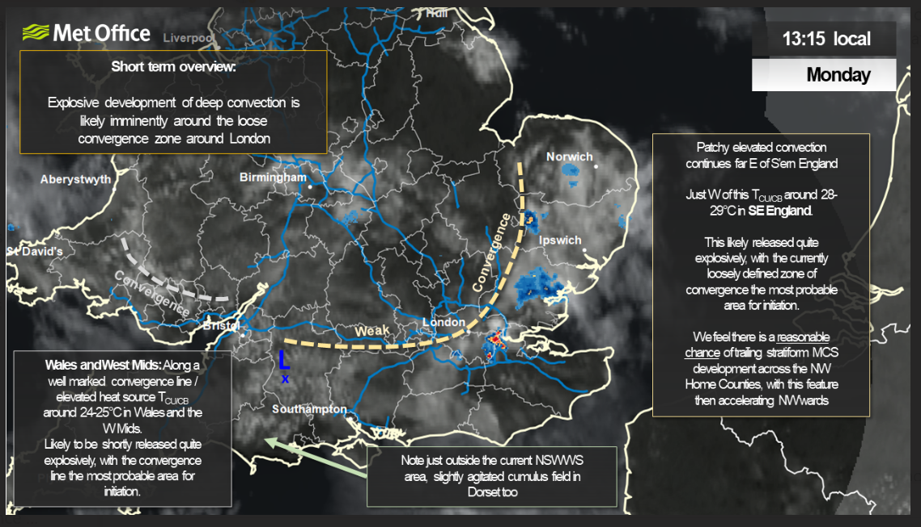
Improved nowcasting services during summertime convection
Training
PLUVIA nowcasting tools
Observations
Forecasts
www.metoffice.gov.uk © Crown Copyright 2025, Met Office
Notes:
A programme of training was implemented for our Op Mets to improve their skill in convective nowcasting.
For the last few years we have had a dedicated forecaster on or ahead of convective days to give additional guidance. (example on the slide)
Trial access to PLUVIA prototypes
Improved access to observations and forecasts.

Slide 18

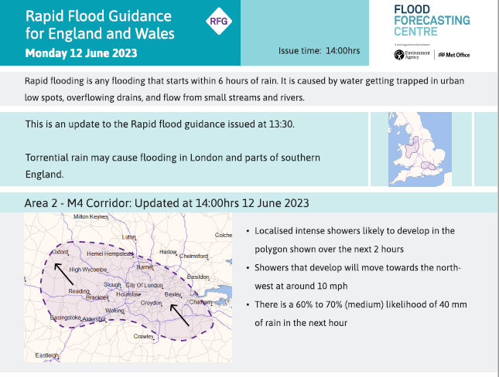
Rapid Flood Guidance
Flood Forecasting Centre delivered a trial Rapid Flood Guidance service for England during the Summer 2024.
Overview map showing areas affected.
More detailed map of one of the affected areas
Summary of meteorology and likelihood of high rainfall totals.
www.metoffice.gov.uk © Crown Copyright 2025, Met Office
Notes:
Building on this further, hydrometeorologists at the FFC trialled a new service last year called Rapid Flood Guidance.
Aimed at emergency responders (emailed a pdf)
Updated several times a day.
The pdf contains an overview map and then a summary of the hazards and outlook for smaller regions at risk.

Slide 19
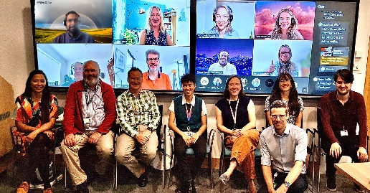
Summer Nowcasting Testbed 2024
Matt Clark, Will Rosling, Emma Hattersley, Dan Suri, Rosie Nation, Brian Golding
90 participants from 11 countries
5 weeks in June/July 2024
Nowcasting experiments each afternoon
Visualisation, surface water flood model evaluation, and warnings activities on different mornings.

Slide 20
Summer Nowcasting Testbed 2024
Matt Clark, Will Rosling, Emma Hattersley, Dan Suri, Rosie Nation, Brian Golding
Teams of 1 Operational Meteorologist, 1 Scientist, (both Met Office) and 1 or more participants from other organisations were set two tasks:
Refining a warning polygon for a pre-defined convective hazard, through the afternoon to focus on the areas most impacted.
(2) Predicting point (grid box) one-hour rainfall totals for locations nowcast to be most impacted. (Golding et al (in prep)).
In addition to the polygons and point forecasts, teams were asked which tools were most useful for making their nowcasts.

Slide 21
Summer Nowcasting Testbed 2024
Matt Clark, Will Rosling, Emma Hattersley, Dan Suri, Rosie Nation, Brian Golding
Category | Mesoanalysis rated “Useful” or “Very Useful” (% responses) | Cell Tracker rated “Useful” or “Very Useful” (% responses)
Maritime convection advecting onto windward coasts, without significant overland/diurnal intensification | 11 | 30
Marginal/weak and generally isolated convection within frontal zone invigorated by upper forcing/surface heating | 25 | 29
Deep surface-based convection, banded showers forming along trough/convergence zone. | 30 | 65
Surface-based convection along a surface front, e.g. line convection on a cold front | 34 | 35
Scattered or widespread deep instability associated with surface heating and relatively cold air aloft | 29 | 58
Widespread deep instability within a warm plume, possibly with Elevated Mixed Layer, typically ahead of weak/slow-moving front or within a warm sector | 34 | 62

Slide 22
Summary
The PLUVIA Cell Tracker and Mesoanalysis have been developed to support Operational Meteorologists in nowcasting and warning for hazards associated with deep moist convection, in particular extreme rainfall.
Recent advances in science and operations have allowed the Flood Forecasting Centre to offer a new Rapid Flood Guidance Service.
PLUVIA has been evaluated in a testbed environment. We found that PLUVIA was most useful in situations where more intense convection was likely or present.

Slide 23
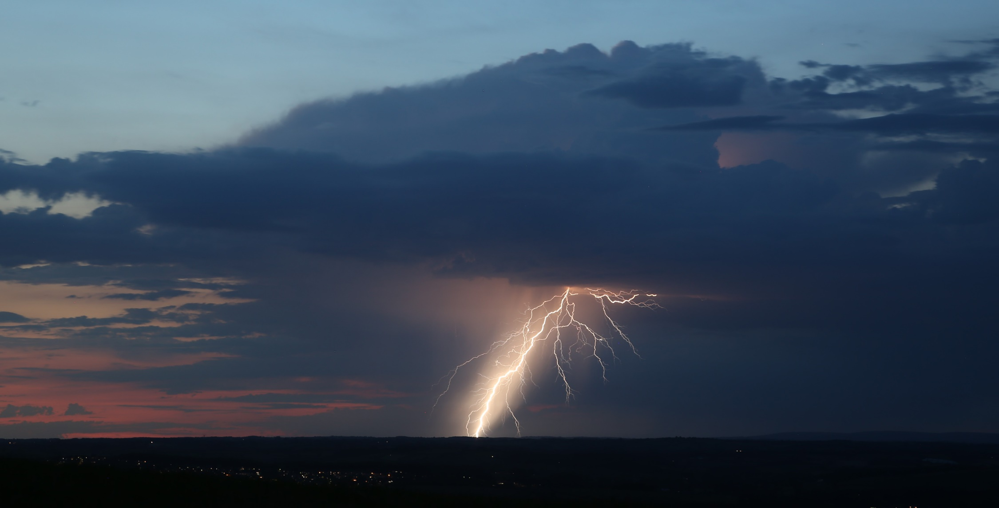
Thank you for your attention.
This is the first time this work has been presented to MOSAC in detail. We welcome your comments and feedback on the scope and ambition of the work we envision, and its fit with the wider work of the Met Office.
11th August 2024. North Devon. Photo credit: Matt Clark

