Slide 1
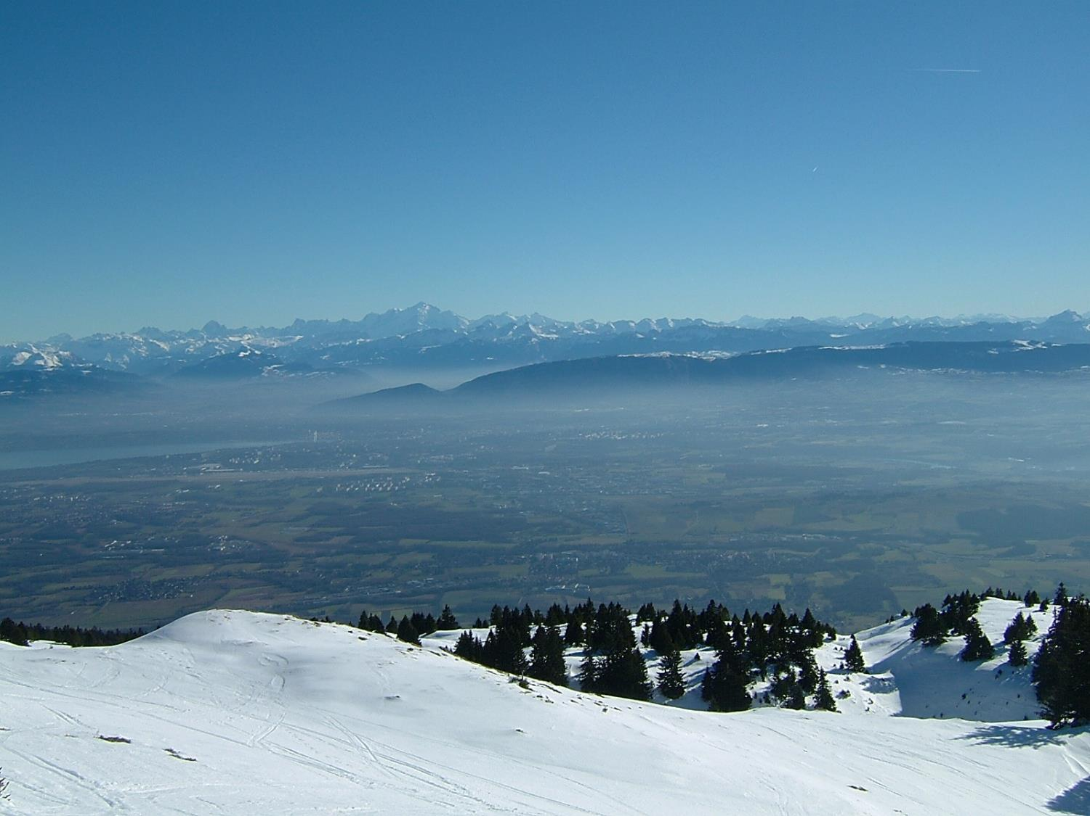
Physics at the FCCs
a story of synergy and complementarity
see recent metings:
FCC physics workshops
2017 https://indico.cern.ch/event/550509/
2018 https://indico.cern.ch/event/618254/
FCC week in Amsterdam
https://indico.cern.ch/event/656491/
Alain Blondel, University of Geneva
with many thanks to the FCC collaborators!
Photo J. Wenninger

Slide 2
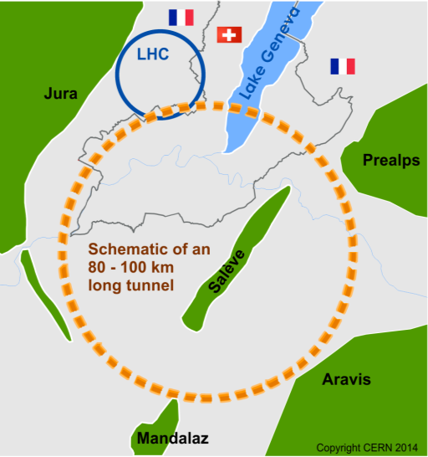
The Future Circular Colliders
CDR and cost review to appear Q4 2018 for ESU
International collaboration to Study Colliders fitting in a new ~100 km infrastructure, fitting in the Genevois
Ultimate goal:
100 TeV pp-collider (FCC-hh)
→ defining infrastructure requirements
Two possible first steps:
e⁺e⁻ collider (FCC-ee)
High Lumi, E_{CM} =90-400 GeV
HE-LHC 16T ⇒ 28 TeV
in LEP/LHC tunnel
Possible addition:
p-e (FCC-he) option
~16 T magnets
The way by FCC-ee is the probably the fastest and cheapest way to 100 TeV.
That combination also produces the most physics.
It is now the prefered scenario.
https://cerncourier.com/cern-thinks-bigger/
Its also a good start for a μμC!
From European Strategy in 2013: “ambitious post-LHC accelerator project”
Study kicked-off in Geneva Feb 2014

Slide 3
SYNERGY

Slide 4
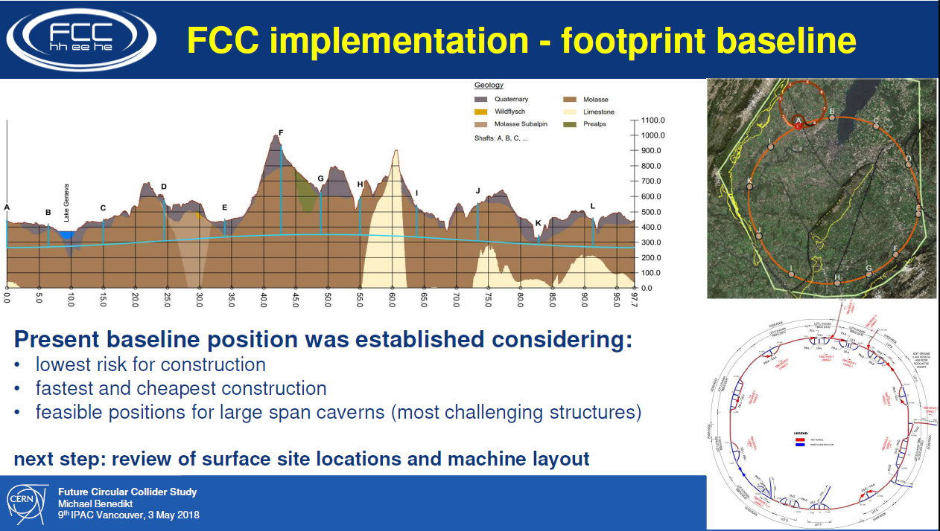
Sharing the same tunnel

Slide 5

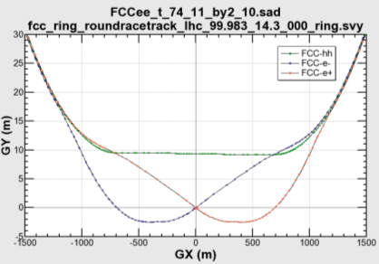

common layouts for hh & ee
11.9 m
IP
30 mrad
FCC-hh/
ee Booster
9.4 m
0.6 m
Lepton beams must cross over through the common RF to enter the IP from inside.
Only a half of each ring is filled with bunches.
Common
RF (tt)
Common
RF (tt)
Max. separation of 3(4) rings is about 12 m:
wider tunnel or two tunnels are necessary around the IPs, for ±1.2 km.
IP
FCC-ee 1, FCC-ee 2,
FCC-ee booster (FCC-hh footprint)
Asymmetric IR for ee, limits SR to expt
2 main IPs in A, G for both machines
Notes:
Check with Katsunobu to have latest layout.
Check with detector people if 9 m offset is acceptable for ee detector

Slide 6
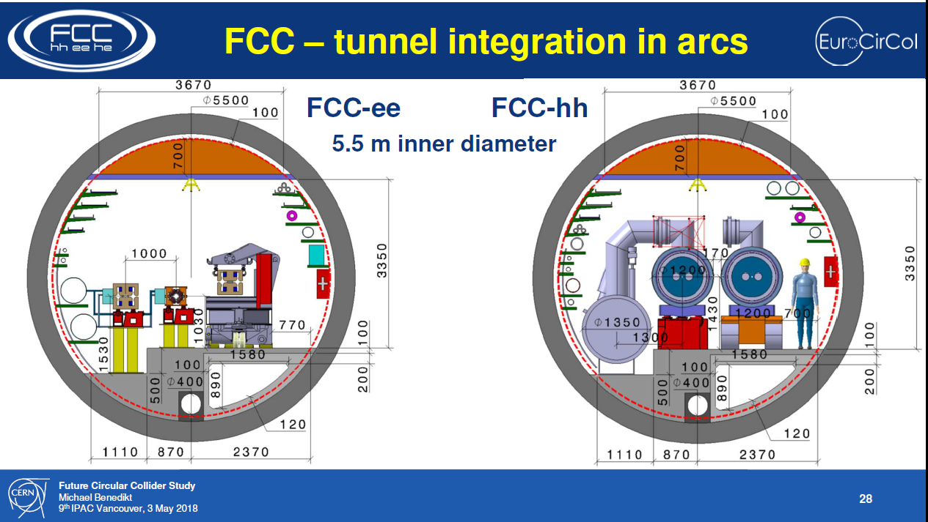

Slide 7
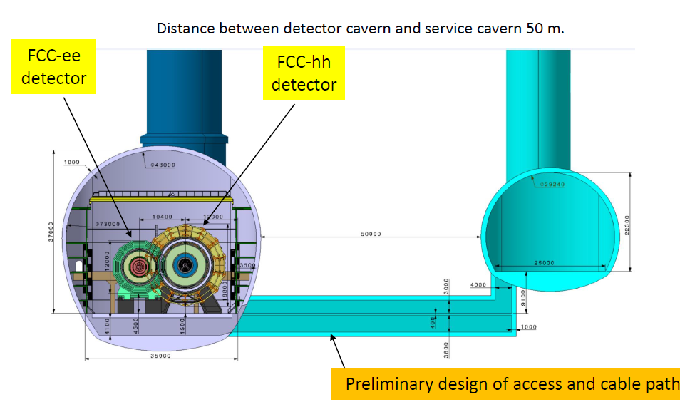
The same caverns

Slide 8
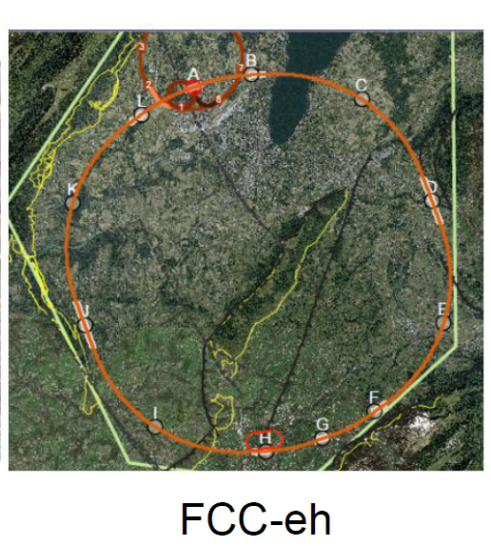
LHeC or FCC-eh function as an add-on to LHC or FCC-hh respectively:
additional 10km cicumference
Electron Reciculating Linac ERL.
The possibility to collide FCC-ee with FCC-hh is not considered in the framework of the study
In the case of FCC-eh it could profit from the -- then existing -- FCC-hh,
and, perhaps, from considerable RF of the -- then dismantled -- FCC-ee

Slide 9
COMPLEMENTARITY

Slide 10
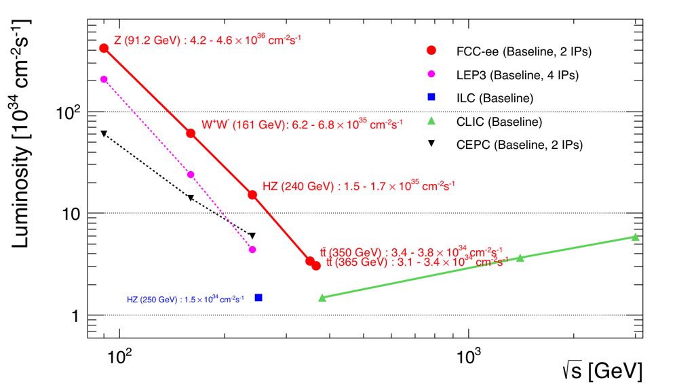
Z WW HZ tt
FCC-ee
LEPx10⁵!
Event statistics :
E_{CM} errors:
Z peak E_{cm} : 91 GeV 5 10¹² e+e- → Z
WW threshold E_{cm} : 161 GeV 10⁸ e+e- → WW
ZH threshold E_{cm} : 240 GeV 10⁶ e+e- → ZH
‾tt threshold E_{cm} : 350 GeV 10⁶ e+e- →‾tt
LEP x 10⁵
LEP x 2.10³
Never done
Never done
100 keV
300 keV
1 MeV
2 MeV
Great energy range for the heavy particles of the Standard Model.

Slide 11
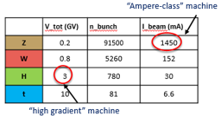
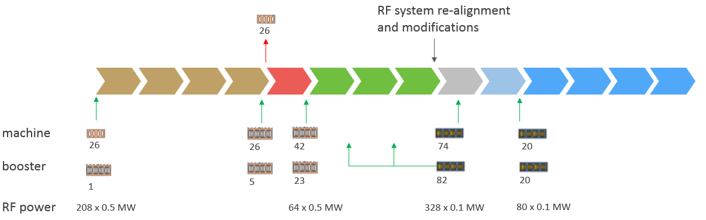
IMPLEMENTATION AND RUN PLAN
Three sets of RF cavities for FCCee & Booster:
Installation as LEP ( ≈30 CM/winter)
high intensity (Z, FCC-hh): 400 MHz mono-cell cavities, ≈ 1MW source
high energy (W, H, t): 400 MHz four-cell cavities, also for W machine
booster and t machine complement: 800 MHz four-cell cavities
Adaptable 100MW, 400MHz RF power distribution system +High effciency
➔ Spreads the funding profile
HL-LHC
Z 150 ab⁻¹
W 10 ab⁻¹
ZH thresh 5ab⁻¹
tt thresh + tt 365 1.5ab⁻¹
4 years
2 yr
3 years
5 years
indicative: total ~15 years
O(1/3) of the machine cost
comes O(10) years after start

Slide 12
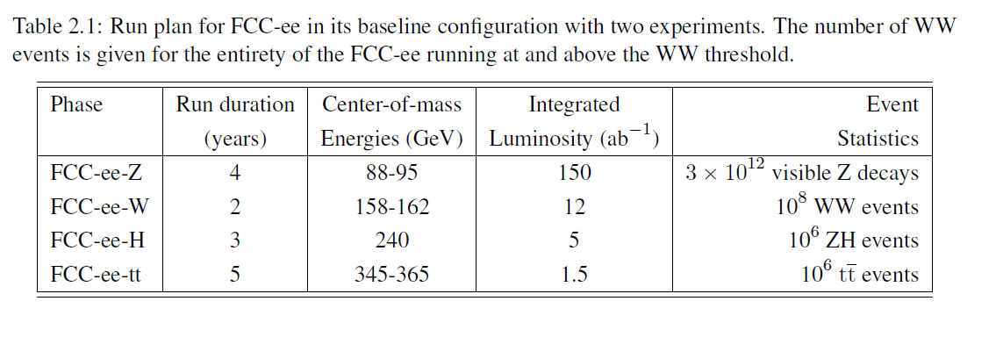
from the CDR

Slide 13

FCC-ee discovery potential
Today we do not know how nature will surprise us. A few things that FCC-ee could discover :
EXPLORE 10-100 TeV energy scale (and beyond) with Precision Measurements
(stat 300…)
-- ~20-50 fold improved precision on many EW quantities (equiv. to factor 5-7 in mass)
m_{Z,} m_{W}, m_{top} , sin² θ_{w}^{eff} , R_{b} , α_{QED} (m_{z}) α_{s} (m_{z} m_{W} m_{τ}), Higgs and top quark couplings
possibly 5σ discovery of Higgs self coupling
DISCOVER a violation of flavour conservation or universality and unitarity of PMNS @10⁻⁵
-- ex FCNC (Z --> μτ , eτ) in 5 10¹² Z decays and τ BR in 2 10¹¹ Z→ τ τ
+ flavour physics (10¹² bb events) (B→s τ τ etc..)
DISCOVER dark matter as «invisible decay» of H or Z (or in LHC loopholes)
DISCOVER very weakly coupled particle in 5-100 GeV energy scale
such as: Right-Handed neutrinos, Dark Photons etc…
+ and many opportunities in – e.g. QCD (H→ gg) etc….
NB Not only a «Higgs Factory», «Z factory» and «top» are important for ‘discovery potential’
“First Look at the Physics Case of TLEP”, JHEP 1401 (2014) 164 CDR frozen today

Slide 14

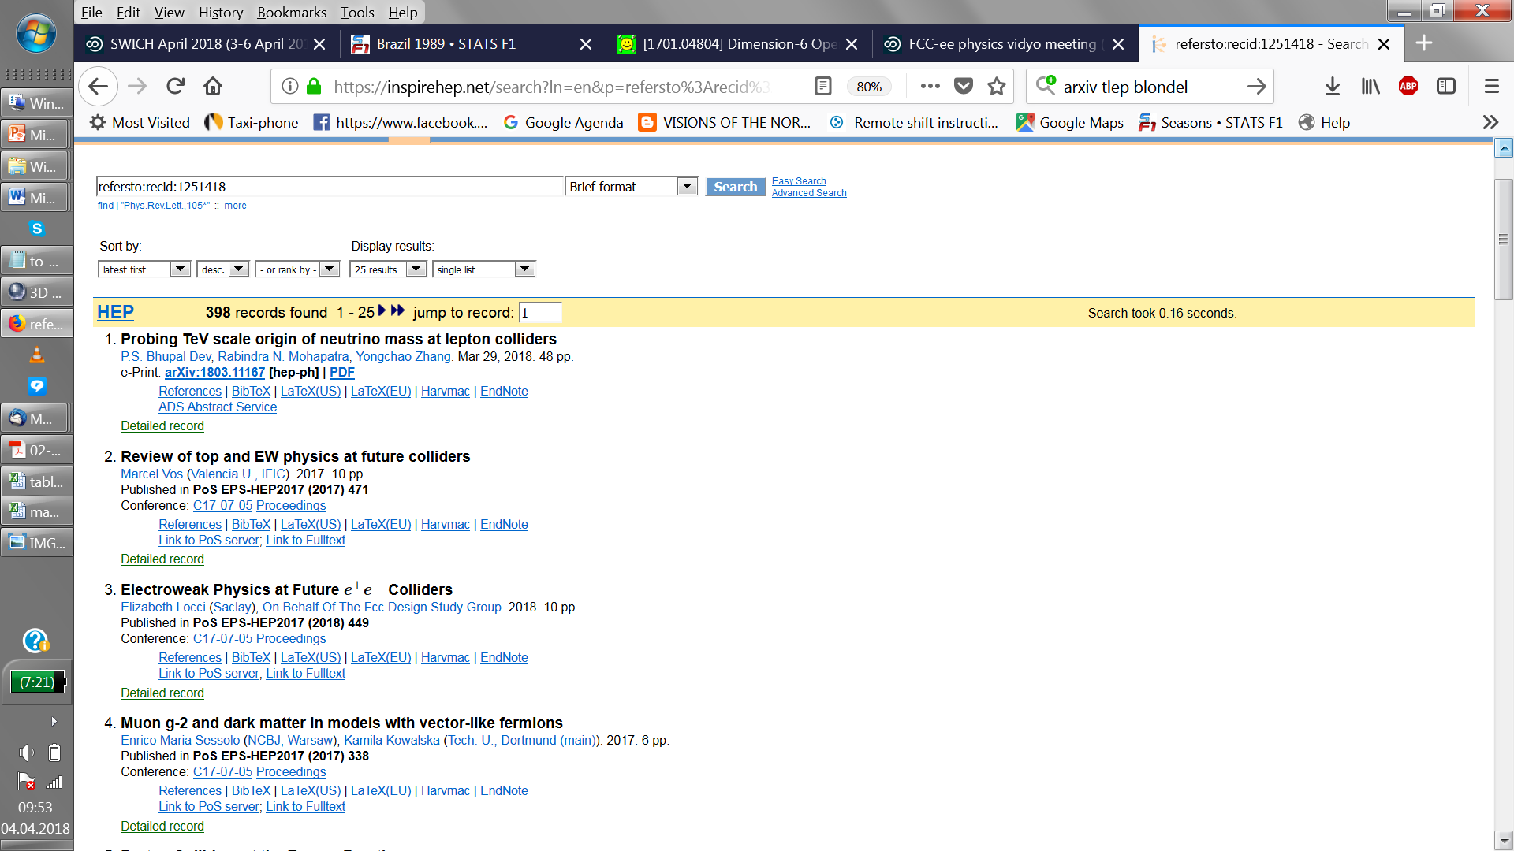

«First look of the physics case of TLEP» (original name of FCC-ee): 451 quotes today
Much more than a Higgs factory!

Slide 15
A sample of observables (more coming)
Observable | Measurement | Current precision | FCC-ee stat. | Possible syst. | Challenge
m_{Z} (MeV) | Lineshape | 91187.5 ± 2.1 | 0.005 | < 0.1 | QED corr.
Γ_{Z} (MeV) | Lineshape | 2495.2 ± 2.3 | 0.008 | < 0.1 | QED / EW
R_{l} | Peak | 20.767 ± 0.025 | 0.001 | < 0.001 | Statistics
R_{b} | Peak | 0.21629 ± 0.00066 | 0.0000003 | < 0.00006 | g → bb
N_{ν} | Peak | 2.984 ± 0.008 | 0.00004 | < 0.001 | Lumi meast
sin²θ_{W}^{eff} | A_{FB}^{μμ} (peak) | 0.23148 ± 0.00016 | 0.000003 | <0.000005 | Beam energy
1/α_{QED}(m_{Z}) | A_{FB}^{μμ} (off-peak) | 128.952 ± 0.014 | 0.004 | < 0.004 | QED / EW
α_{s}(m_{Z}) | R_{l} | 0.1196 ± 0.0030 | 0.00001 | <0.00016 | New Physics
*
*
Observable | Measurement | Current precision | TLEP stat. | Possible syst. | Challenge
m_{w} (MeV) | Threshold scan | 80385 ± 15 | 0.6 | < 0.3 | beam eneergy
Γ_{W} (MeV) | Threshold scan | 2085 ± 42 | 1.5 | <1.5 | EW Corr.
N_{ν} | e⁺e⁻→ γZ, Z→ νν, ll | 2.92 ± 0.05 | 0.001 | < 0.001 | ?
α_{s}(m_{W}) | B_{had} = (Γ_{had}/Γ_{tot})_{W} | B_{had} = 67.41 ± 0.27 | 0.00018 | < 0.0001 | CKM Matrix
Observable | Measurement | Current precision | TLEP stat. | Possible syst. | Challenge
m_{top} (MeV) | Threshold scan | 173340 ± 760 ± 500 | 20 | <40 | QCD corr.
Γ_{top} (MeV) | Threshold scan | ? | 40 | <40 | QCD corr.
λ_{top} | Threshold scan | μ = 1.2 ± 0.3 | 0.08 | < 0.05 | QCD corr.
ttZ couplings | √s = 365 GeV | ~30% | ~2% | <2% | QCD corr
University of Geneva
28 March 2018
* work to do: check if we cant improve

Slide 16
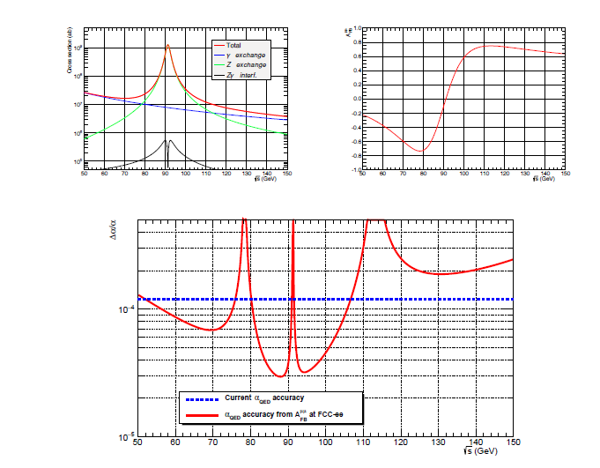
measurement of
α_{QED} (m_{Z} ) from
Z-γ interference
scan points

Slide 17
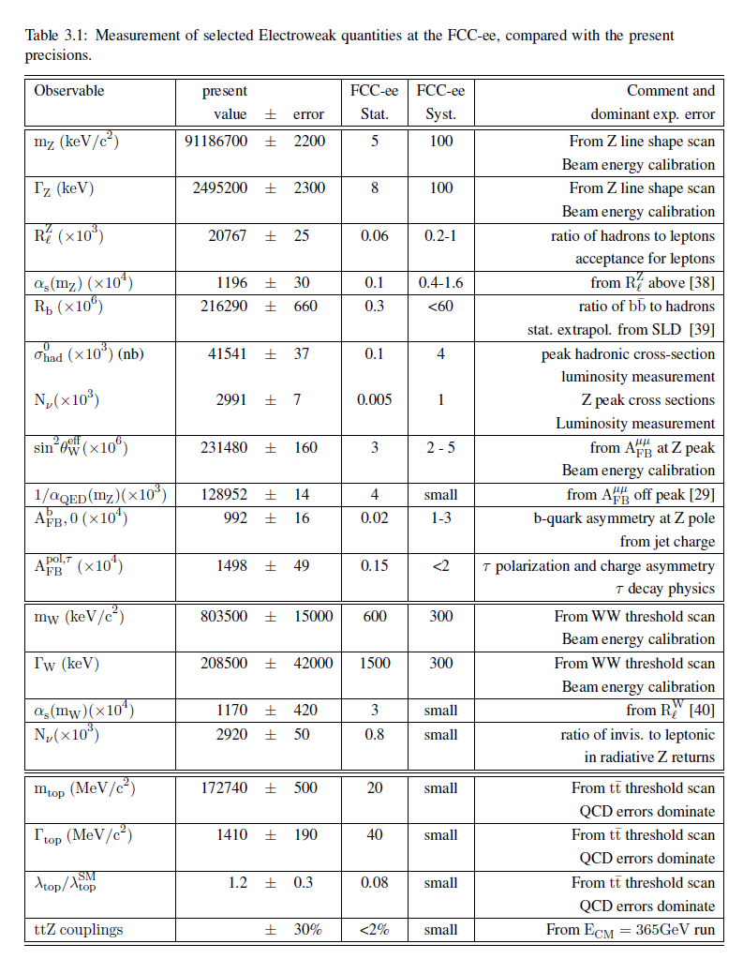
table from the CDR
simulations reveal
experimentation
is very clean
-- vtx detector can
be brought close to IR
to d=1.2cm

Slide 18
HIGGS FACTORY
Higgs provides a very good reason why we need a lepton (e+e- or μμ) collider

Slide 19
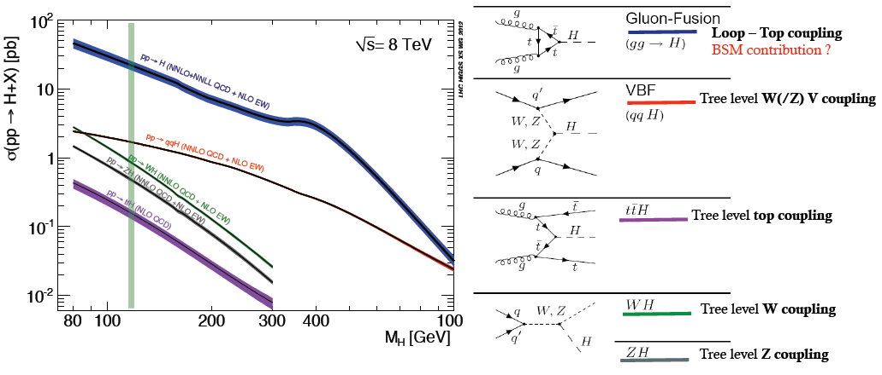
THE LHC is a Higgs Factory…BUT
several tens of Million Higgs already produced… > than most Higgs factory projects.
difficult to extract the couplings because σ_{prod} uncertain and Γ_{H} is unknown (invisible channels) → must do physics with ratios.
σ_{i→f} ^{observed} ∝ σ_{prod} (g_{Hi} )²(g_{Hf})²
Γ_{H}
relative error scales with
1/purity and 1/√efficiency of signal

Slide 20
Higgs production mechanism
“higgstrahlung” process close to threshold
Production xsection has a maximum at near threshold ~200 fb
10³⁴/cm²/s ➔ 20’000 HZ events per year.
e⁻
H
Z – tagging
by missing mass
Z*
e⁺
Z
For a Higgs of 125GeV, a centre of mass energy of 240-250 GeV is optimal
➔ kinematical constraint near threshold for high precision in mass, width, selection purity

Slide 21
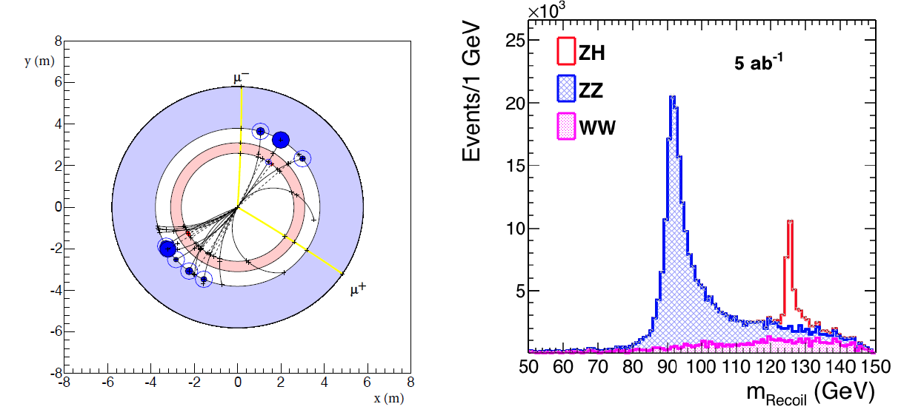
e+e- : Z – tagging by missing mass
total rate ∝ g_{HZZ}²
ZZZ final state ∝ g_{HZZ}⁴/ Γ_{H}
measure total width Γ_{H}
g_{HZZ} to ±0.2% and many other partial widths
empty recoil = invisible width
‘funny recoil’ = exotic Higgs decay
easy control below theshold
e⁻
H
Z*
e⁺
Z

Slide 22
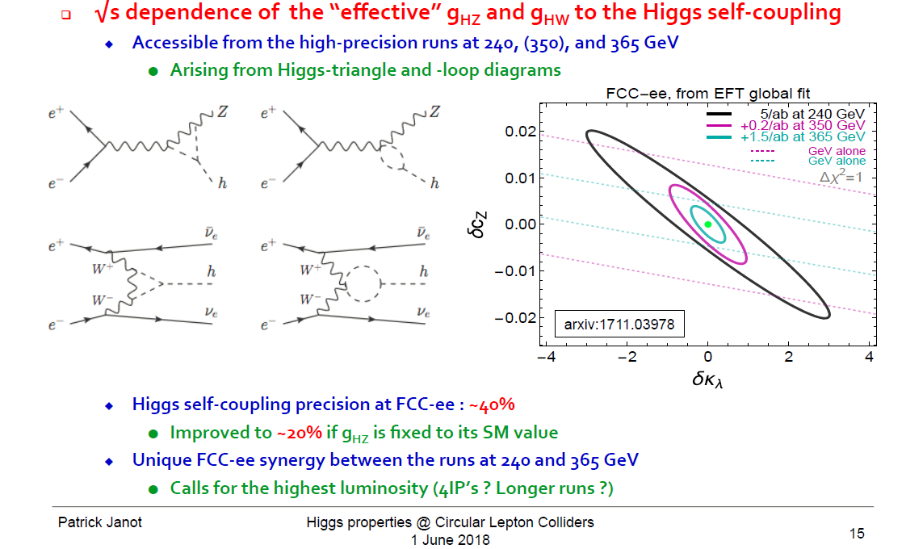
Higgs self-coupling λ_{H} (How H, W, Z get masses…)
The FCC-ee does not produce pairs of Higgses from which one can extract λ_{H}
but the ZH cross-section receives a E_{cm} - dependent correction from it.
investigating now : the possibility
of reaching 5σ observation of
Higgs self coupling at FCC-ee:
need 4 detectors
+ recast of running scenario
«Beyond the baseline»
arXiv:1809.10041v1

Slide 23
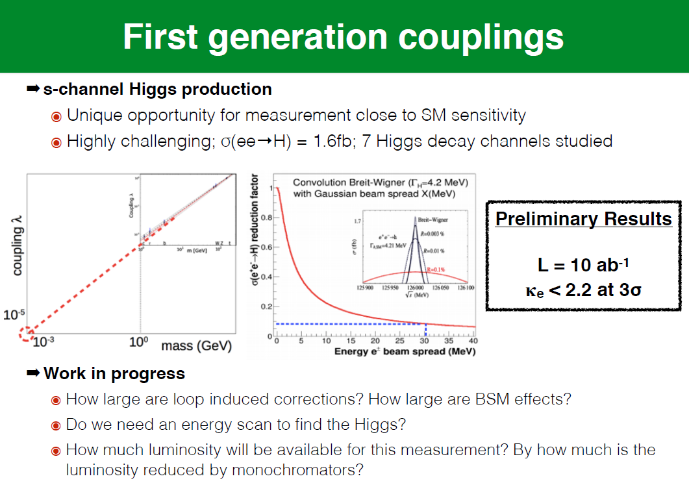
«Beyond the baseline»

Slide 24
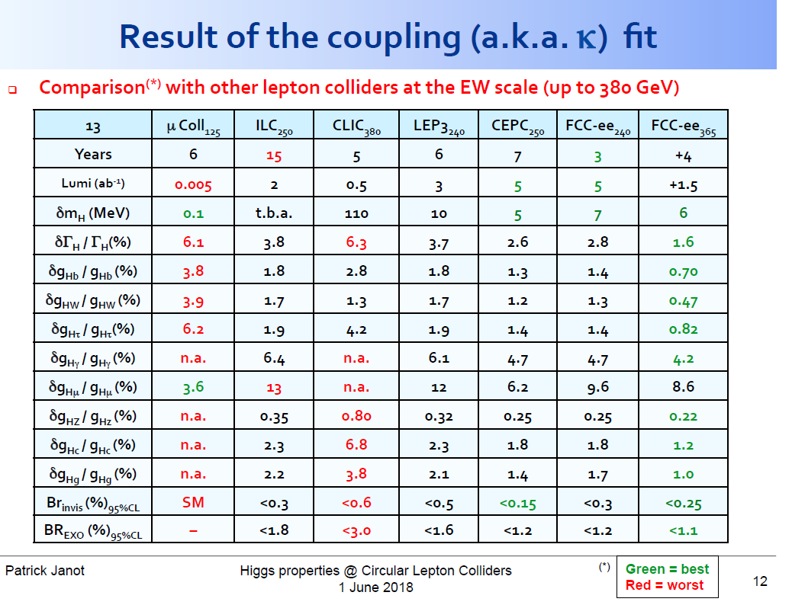

Slide 25
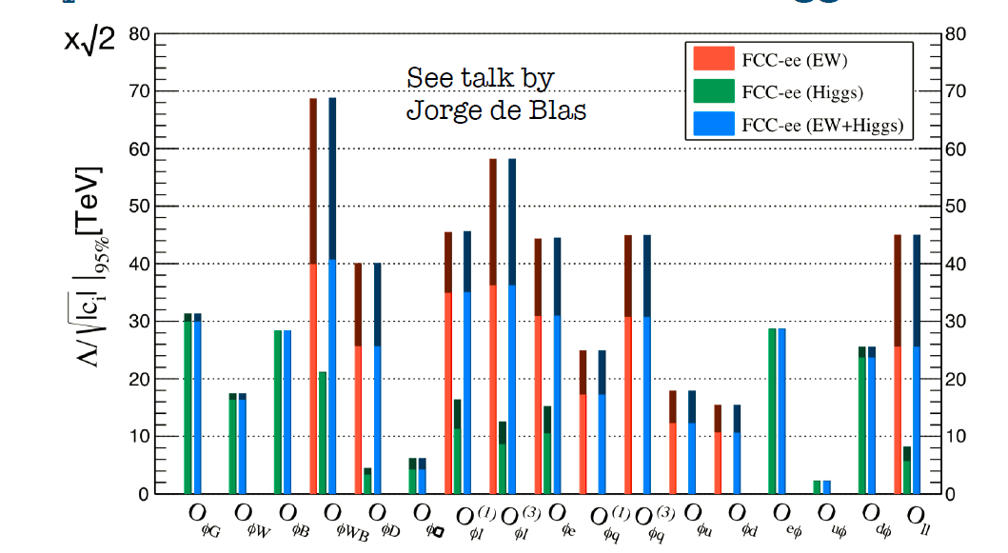
many EFTs !
Λ (TeV)
w/o theory uncertainties
with current
theory uncertainties
J. De Blas, Jan. 2017
Conclusion from Precision Calculations Mini-Workshop in January 2018:
The necessary theoretical work is doable in 5-10 years perspective, due to steady progress in methods and tools, including the recent completion of NNLO SM corrections to EWPOS. This statement is conditional to a strong support by the funding agencies and the overall community. Appropriate financial support and training programs for these precision calculations are mandatory.
Several EFTs will achieve sensitivity exceeding 50 TeV (decoupling physics!)
junction with FCC-hh EFTs under progress by Jorge de Blas → CDR

Slide 26
100 TeV

Slide 27
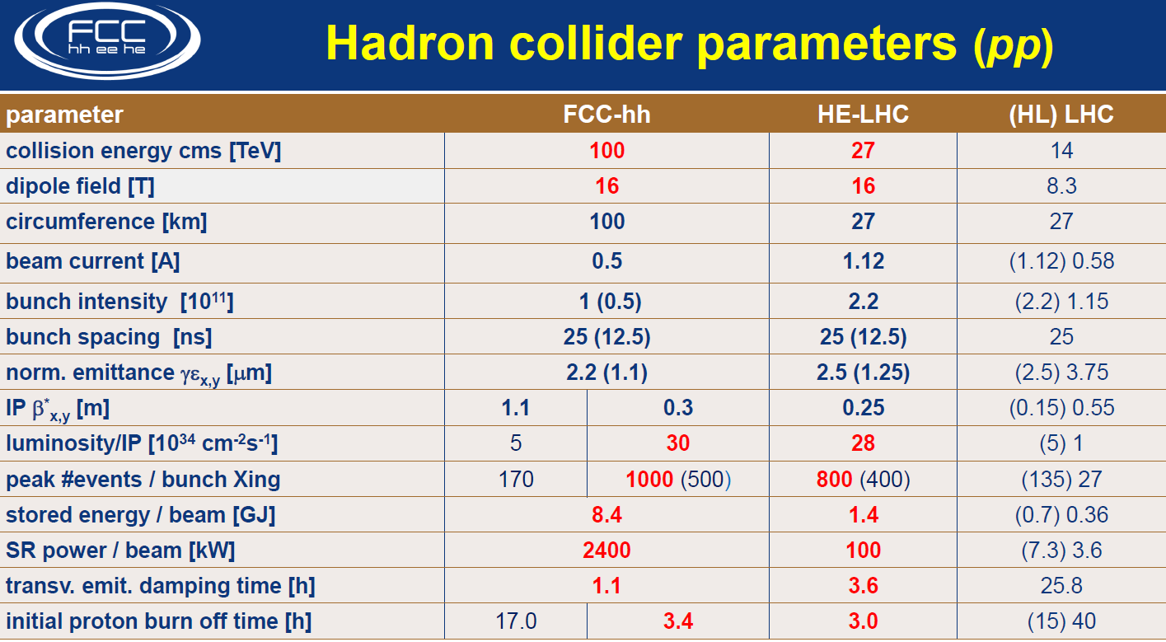

Slide 28
FCC-hh discovery potential
Highlights
FCC-hh is a HUGE discovery machine (if nature …), but not only.
FCC-hh physics is dominated by three features:
-- Highest center of mass energy –> a big step in high mass reach!
ex: strongly coupled new particle up to >30 TeV
Excited quarks, Z’, W’, up to ~tens of TeV
Give the final word on natural Supersymmetry, extra Higgs etc.. reach up to 5-20 TeV
Sensitivity to high energy phenomena in e.g. WW scattering
-- HUGE production rates for single and multiple production of SM bosons (H,W,Z) and quarks
-- Higgs precision tests using ratios to e.g. γγ/μμ/ ττ/ZZ, ttH/ttZ @<% level
-- Precise determination of triple Higgs coupling (~3% level) and quartic Higgs coupling
-- detection of rare decays H→ Vγ (V= ρ,ϕ,J/ψ,ϒ,Z…)
-- search for invisibles (DM searches, RH neutrinos in W decays)
-- renewed interest for long lived (very weakly coupled) particles.
-- rich top and HF physics program
-- Cleaner signals for high Pt physics
-- allows clean signals for channels presently difficult at LHC (e.g. H→ bb)

Slide 29
FCC-hh discovery potential
Physics at a 100 TeV pp collider: CERN Yellow Report (2017) no.3
1) Standard Model processes: https://arxiv.org/pdf/1607.01831v1.pdf
2) Higgs and EW symmetry breaking studies: https://arxiv.org/pdf/1606.09408v1.pdf
3) Βeyond the Standard Model phenomena: https://arxiv.org/abs/1606.00947
4) Heavy ions at the Future Circular Collider: https://arxiv.org/abs/1605.01389
Now proceeding to ascertain these cross-section calculations with real detector and simulations…

Slide 30
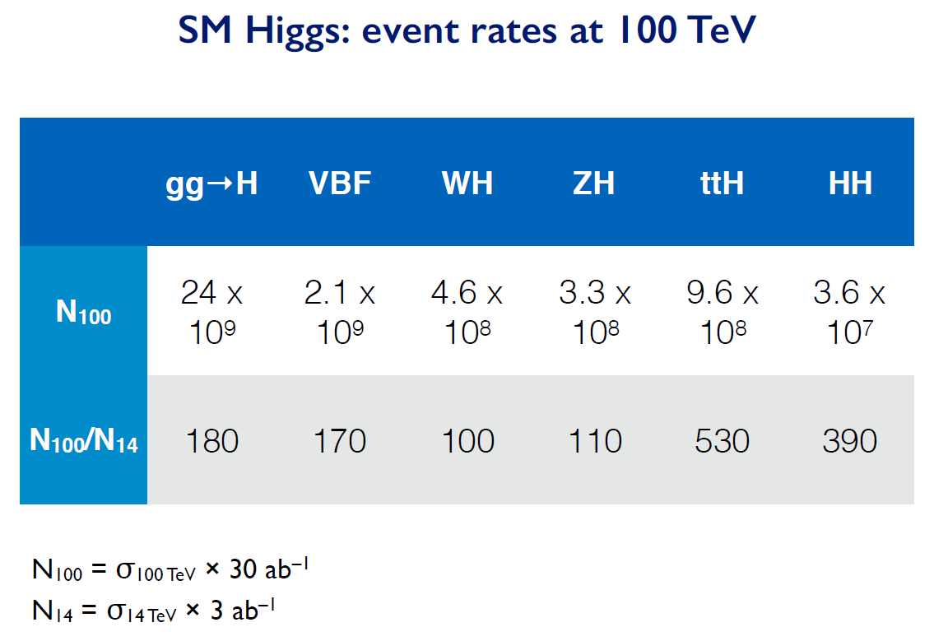

Slide 31
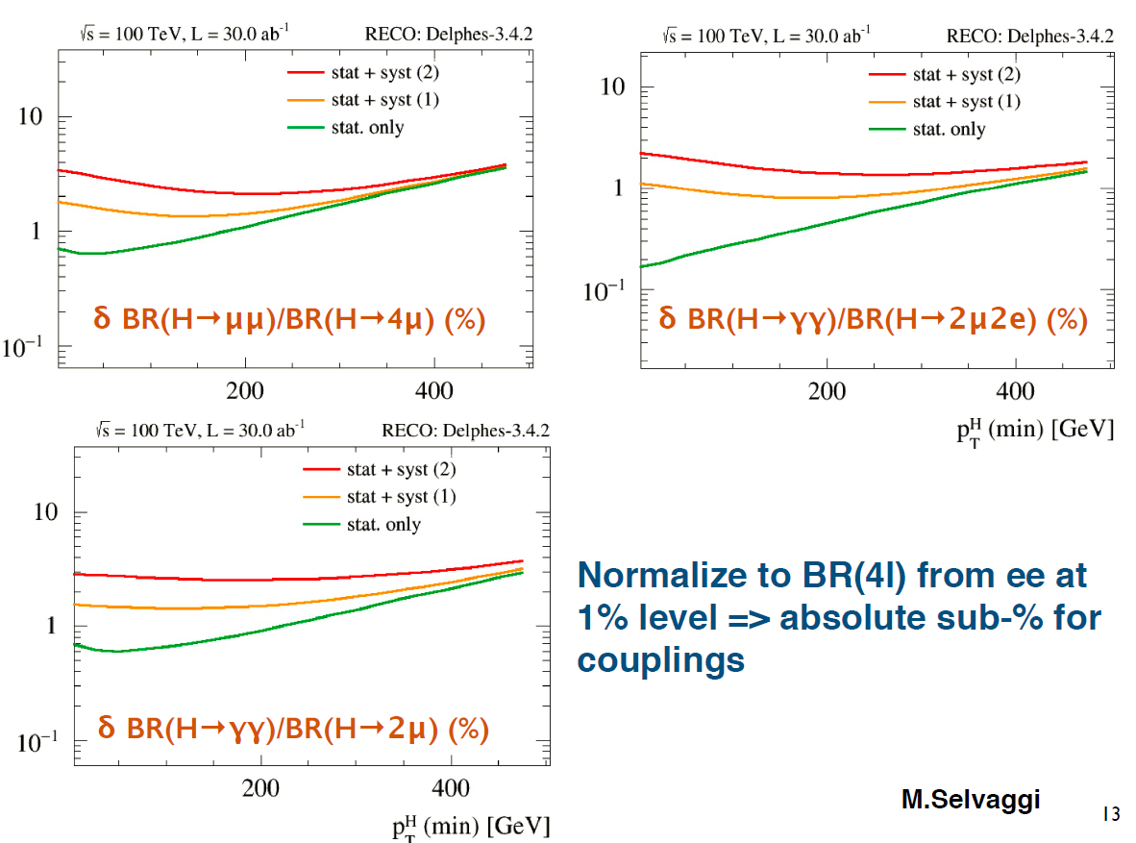
For rare decays (μμ, γγ, γZ) normalize to H→ ZZ well measured at FCC-ee

Slide 32
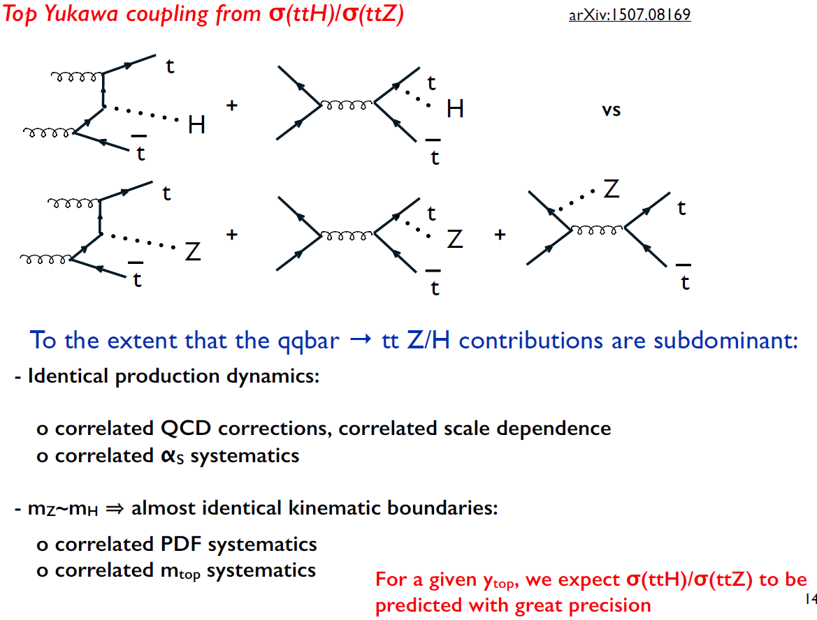


Slide 33
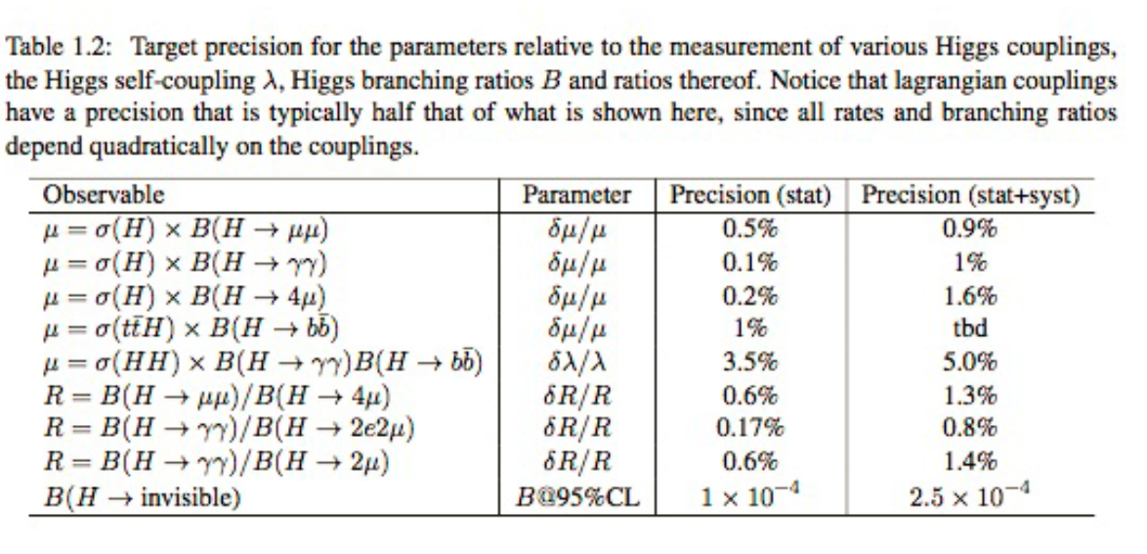
Higgs at FCC-hh
λ_{H} at the few percent level
To reach a precision on λ_{H} at the few percent level requires a linear collider of at least 3TeV
(ILC 500 GeV can obtain a ±30% indication and CLIC 3TeV estimate is ±10%)

Slide 34
PHYSICS COMPLEMENTARITY
Some examples
Higgs Physics -- ee → ZH fixes Higgs width and HZZ coupling , (and many others)
-- FCC-hh gives huge statistics of HH events for Higgs self-coupling and ttH
and rare decays, including invisible.
Search for Heavy Physics
-- ee gives precision measurements (m_{Z} m_{W} to < 0.6 MeV, m_{top} 10 MeV, etc…)
sensitive to heavy physics up to … 100 TeV (for weak couplings)
-- FCC-hh gives access to direct observation at unprecedented energies
Also huge statistics of Z,W H and top → rare decays
QCD -- ee gives α_{s} ± 0.0002 (R_{had} at Z, W and taus)
also H→gg events (gluon fragmentation!)
-- ep provides structure functions and α_{s} ± 0.0002
-- all this improves the signal and background predictions
for new physics signals at FCC-hh
Heavy Neutrinos -- ee: very powerful and clean, but flavour-blind
-- hh and eh more difficult, but potentially flavour sensitive
NB this is very much work in progress!!

Slide 35
g_{Hxx} | FCC-ee | FCC-hh | FCC-eh
ZZ | 0.22 % | < 1% *
WW | 0.47%
Γ_{H} | 1.6%
γγ | 4.2% | <1%
Zγ | -- | 1%
ttH | 13% | 1%
bb | 0.7% |  | 0.5%
ττ | 0.8%
cc | 0.7% |  | 1.8%
gg | 1.0%
μμ | 8.6% | 1-2%
uu,dd | H→ ργ? | H→ ργ?
ss | H→ φγ ? | H→ φγ ?
ee | ee → H
HH | 40% | ~3-5% | 20%
inv, exo | <0.55% | 10⁻³ | 5%
HIGGS PHYSICS
Higgs couplings g_{Hxx} precisions
hh, eh precisions assume
SM or ee measurements
FCC-hh : H→ ZZ to serve
as cross-normalization
for ttH, combination of
±4% (model dependent)HL-LHC
with FCC-ee will lead to
ttH coupling to ± 3%...
model independent!
for g_{HHH} investigating : the possibility of reaching 5σ observation at FCC-ee:
4 detectors
+ recast of running scenario

Slide 36
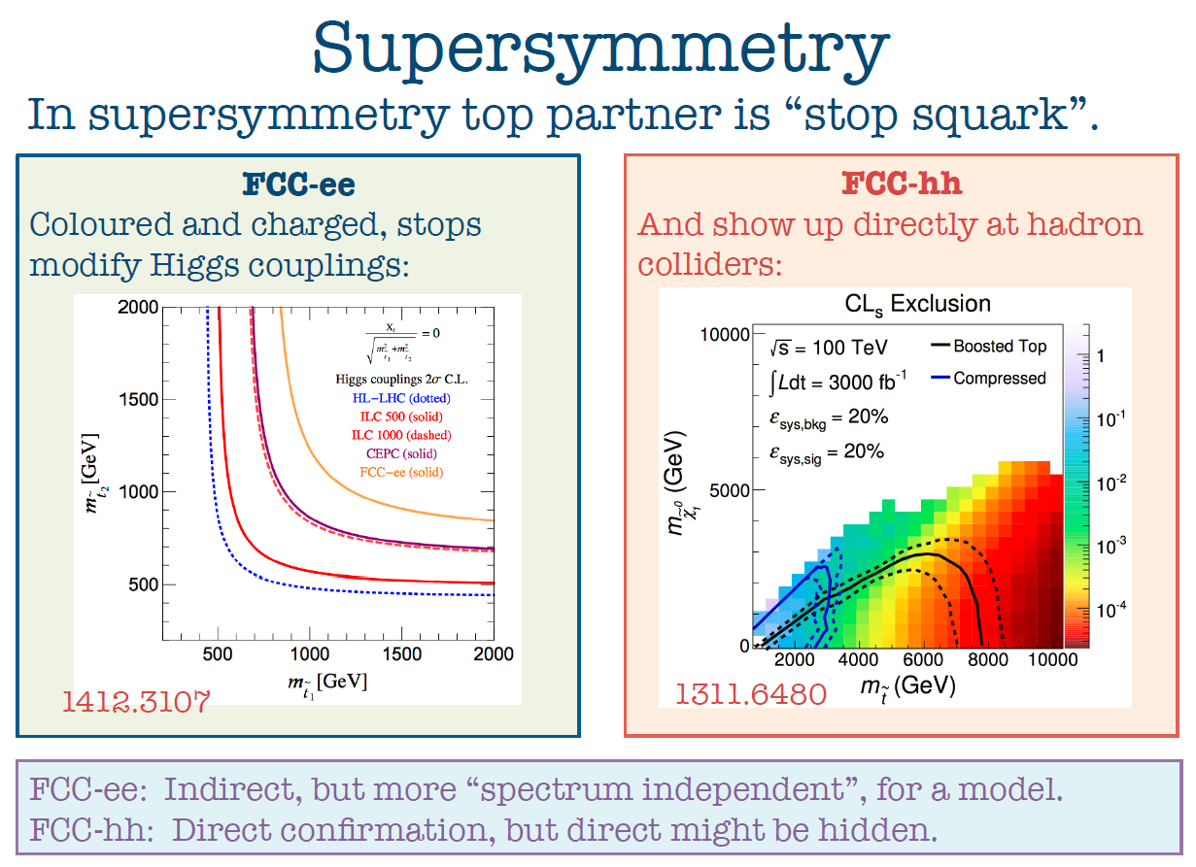

Slide 37
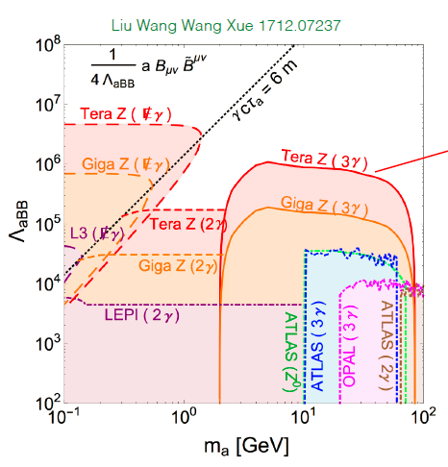


Direct discovery of Very rare events

Slide 38
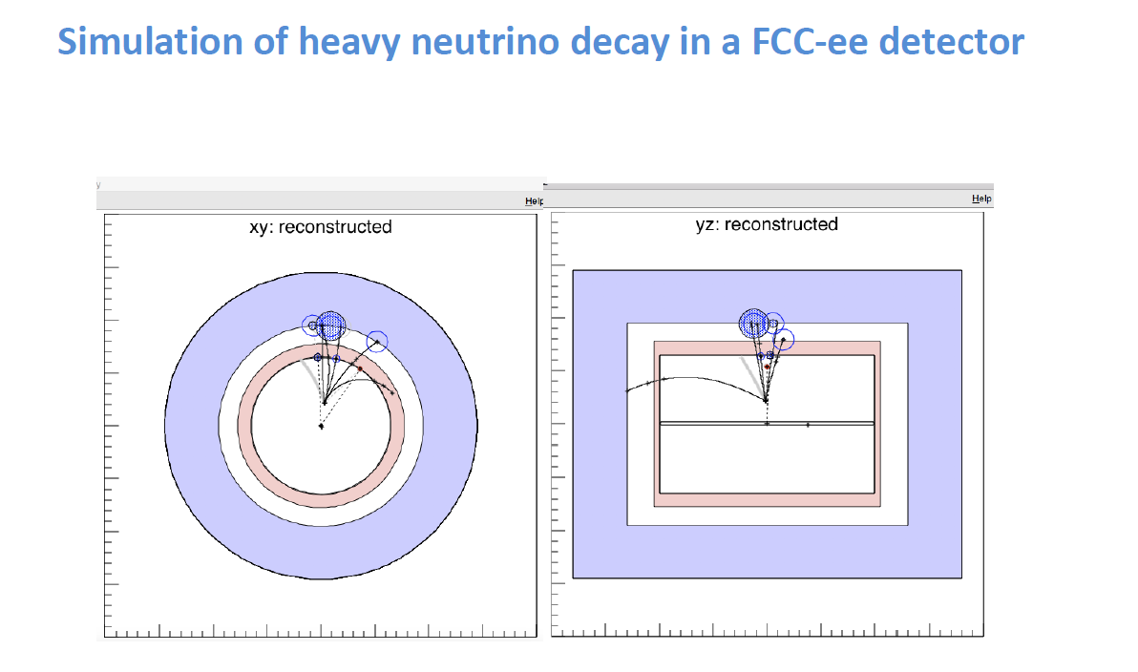

Slide 39
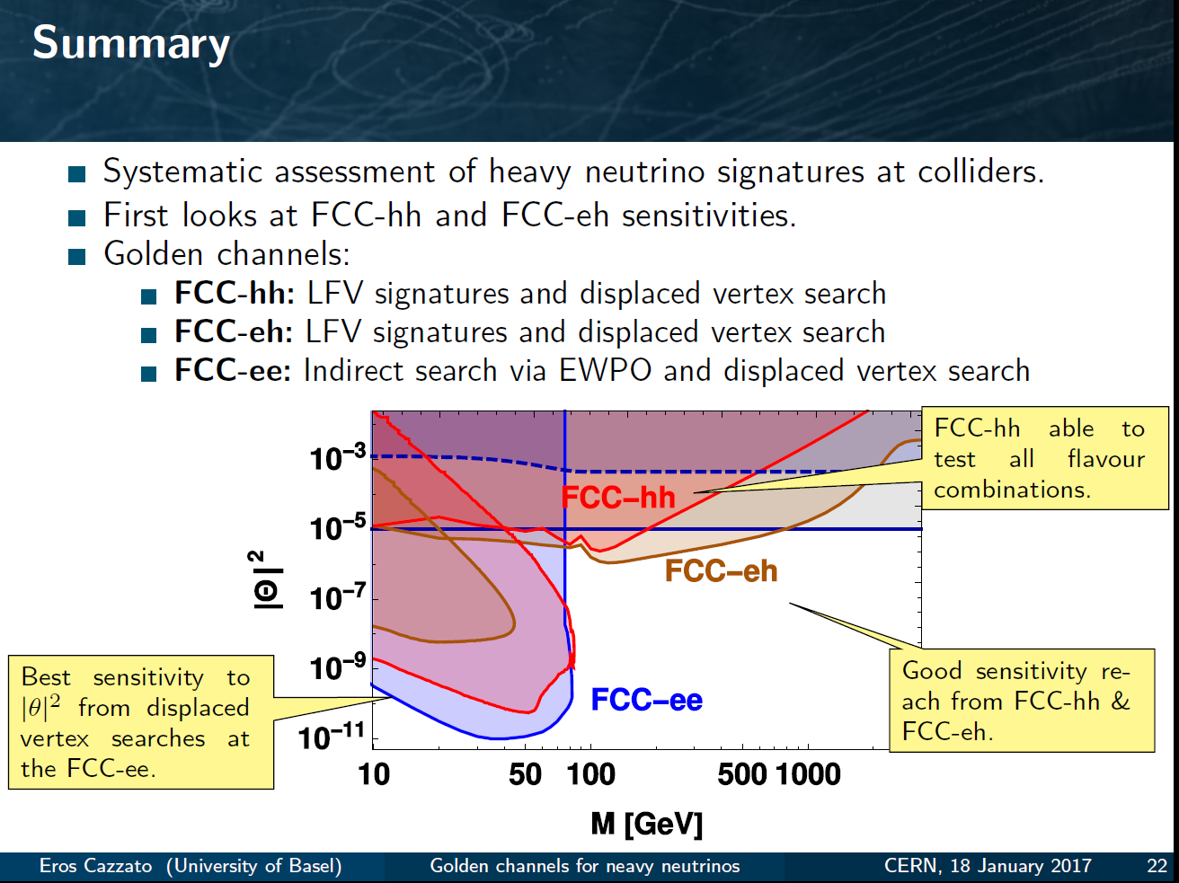
Another example of Synergy and complementarity
while ee covers a large part of space very cleanly ,
its either ‘white’ in lepton flavour or the result of EWPOs etc
Observation at FCC –hh or eh would test flavour mixing matrix!
EWPO
sensitivity
up to very high mass scales
detailed study required for all FCCs – especially FCC-hh to understand feasibility at all

Slide 40
CONCLUSIONS
CONCLUSIONS
-- The FCC design study is establishing the feasibility or the path to feasibility of an ambitious set of colliders after LEP/LHC, at the cutting edge of knowledge and technology. The CDR is on its way
-- Both FCC-ee and FCC-hh have outstanding physics cases
-- each in their own right
-- the sequential implementation of FCC-ee, FCC-hh, FCC-eh
maximises the physics reach
-- Attractive scenarios of staging and implementation (budget!) cover more than 60 years of exploratory physics, taking full advantage of the synergies and complementarities.
FCC (ee) could start seamlessly at the end of HL-LHC

Slide 41
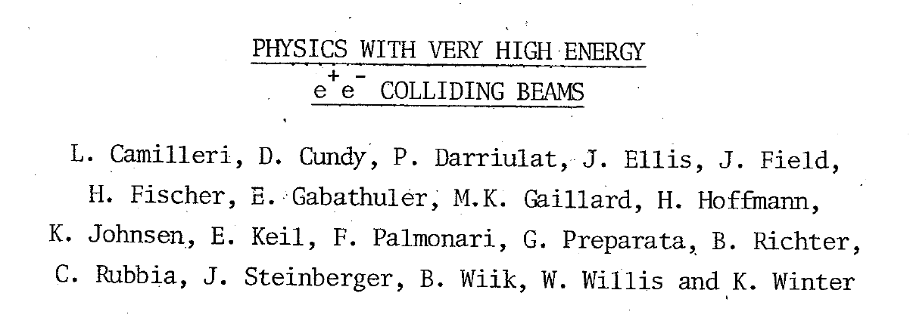
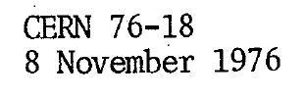
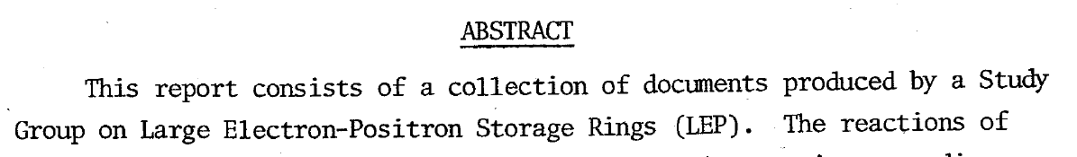
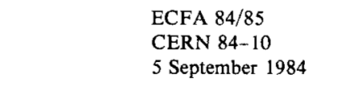
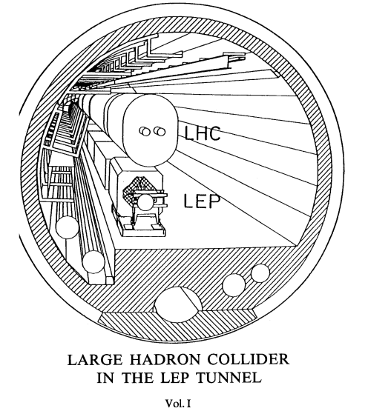
A successful model!
Did these people know that we would be running HL-LHC in that tunnel >60 years later?
e+e- 1989-2000
p p 2009-2039
Let’s not be SHY!

