Slide 1
PhD PROJECT DISCUSSION
Sofia Giappichini

Slide 2

TOPICS
ALPs
Higgs CP from $H→ττ$
(Tau reconstruction)

Slide 3
ALPs
Feebly-interacting particles
DM candidate
Solution to the strong CP and/or hierarchy problems
FCC-ee clean environment and large integrated luminosities will render it very sensitive to EW-coupled ALPs
Decay into $ℓ^{+}ℓ^{−},\overline{ q}q, γγ, gg, πππ,$ with at least dim-5 effective Lagrangian, from dim-6 to include H coupling

Slide 4
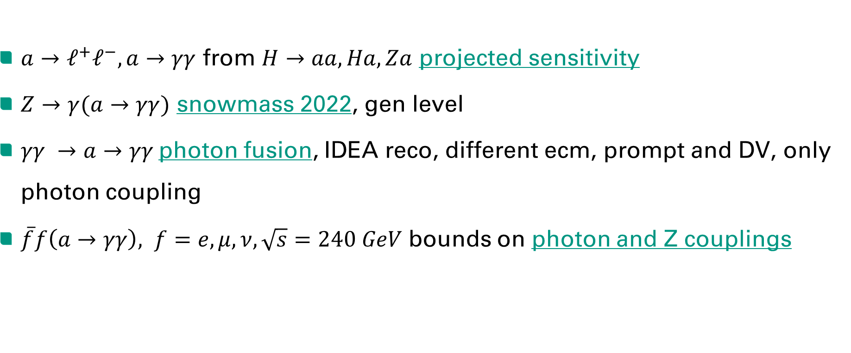
ALPs at FCC-ee
$a→ℓ^{+}ℓ^{−}, a→γγ$ from $H→aa, Ha,Za$ projected sensitivity
$Z→γ(a→γγ)$ snowmass 2022, gen level
$γγ →a→γγ$photon fusion, IDEA reco, different ecm, prompt and DV, only photon coupling
$\overline{f}f\left(a→γγ\right), f=e,μ,ν, \sqrt{s}=240 GeV$ bounds on photon and Z couplings
March 27, 2024 – Sofia Giappichini

Slide 5
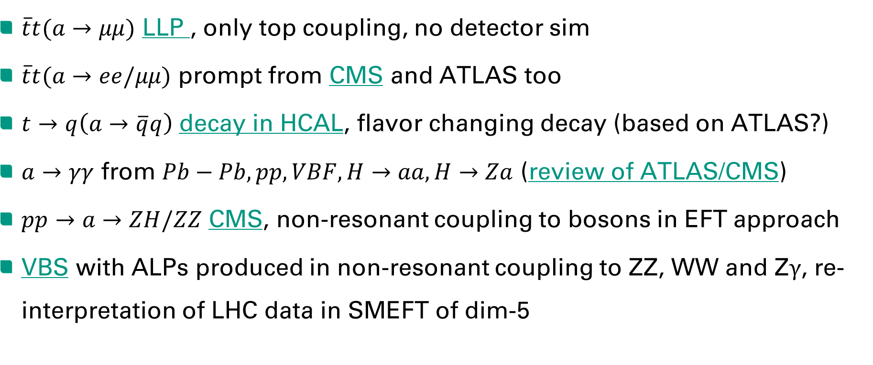
ALPs at LHC
$\overline{t}t(a→μμ)$ LLP , only top coupling, no detector sim
$\overline{t}t(a→ee/μμ)$ prompt from CMS and ATLAS too
$t→q\left(a→\overline{q}q\right)$ decay in HCAL, flavor changing decay (based on ATLAS?)
$a→γγ$ from $Pb−Pb, pp, VBF, H→aa, H→Za$ (review of ATLAS/CMS)
$pp→a→ZH/ZZ$ CMS, non-resonant coupling to bosons in EFT approach
VBS with ALPs produced in non-resonant coupling to ZZ, WW and Z$γ$, re-interpretation of LHC data in SMEFT of dim-5
March 27, 2024 – Sofia Giappichini

Slide 6
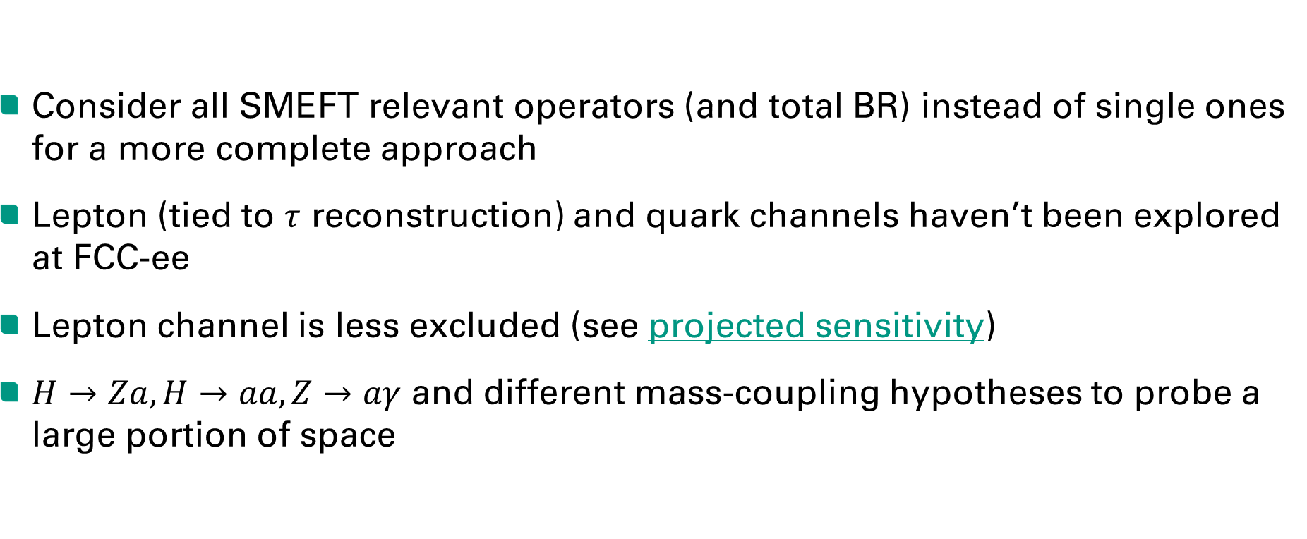
ALPs POSSIBILITIES
Consider all SMEFT relevant operators (and total BR) instead of single ones for a more complete approach
Lepton (tied to $τ$ reconstruction) and quark channels haven’t been explored at FCC-ee
Lepton channel is less excluded (see projected sensitivity)
$H→Za, H→aa, Z→aγ$ and different mass-coupling hypotheses to probe a large portion of space
March 27, 2024 – Sofia Giappichini

Slide 7
HIGGS CP
Higgs is CP-even in SM, CP-odd Higgs is excluded at $\sim 3σ$ (CMS+ATLAS)
Direct approach: CP-odd observables using angular distributions
Indirect approach: effect of CP-odd interactions on CP-even observables
CPV with massive vector boson can only be induced at loop level in a generic BSM theory and is expected to be small
CPV with fermions can occur unsuppressed making it especially interesting from a phenomenological point of view
CPV in the Higgs sector might have implications for weak scale baryogenesis in several BSM scenarios
March 27, 2024 – Sofia Giappichini

Slide 8
HIGGS CP at FCC-ee
CP HZZ$, Z\left(→ℓ^{+}ℓ^{−}\right)H(→b ̅b)$ studying angular observables from parameterised amplitudes, CP-even, CP-odd, CP-mixed (50%)
ILC $Z\left(→e^{+}e^{−},μ^{+}μ^{−},\overline{u}u,\overline{d}d,\overline{s}s\right)H(→τ^{+}τ^{−})$ with most decay modes of $τ$, CP-odd, CP-even, CP-mixed (50%)
CEPC $Z(→e^{+}e^{−},μ^{+}μ^{−})H(→gg /b ̅b /c ̅c$) with SMEFT, only CP-odd paramters
March 27, 2024 – Sofia Giappichini

Slide 9
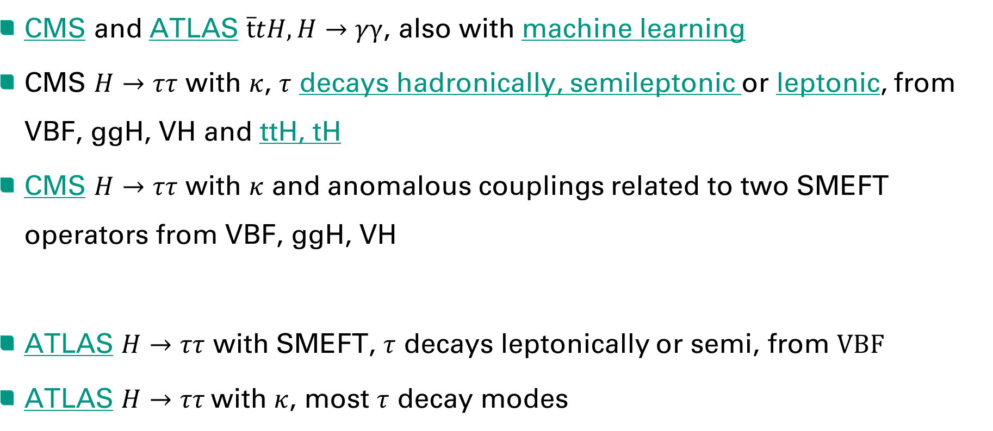
HIGGS CP at LHC
CMS and ATLAS $\overline{t}tH, H→γγ$, also with machine learning
CMS $H→ττ$ with $κ$, $τ$ decays hadronically, semileptonic or leptonic, from VBF, ggH, VH and ttH, tH
CMS $H→ττ$ with $κ$ and anomalous couplings related to two SMEFT operators from VBF, ggH, VH
ATLAS $H→ττ$ with SMEFT, $τ$ decays leptonically or semi, from $VBF$
ATLAS $H→ττ$with $κ$, most $τ$ decay modes
March 27, 2024 – Sofia Giappichini

Slide 10
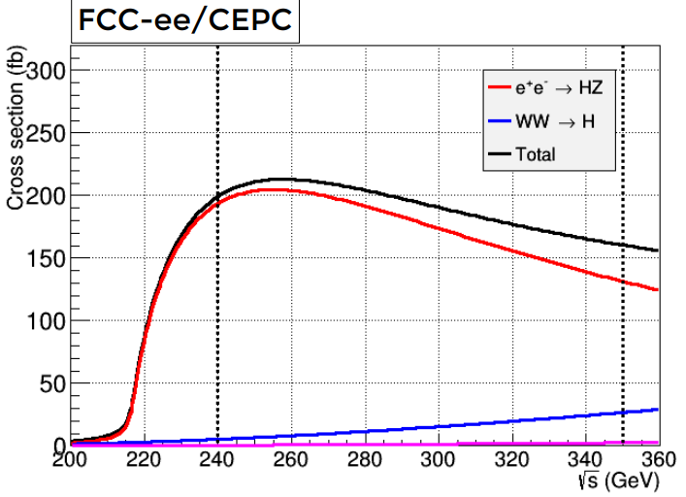
HIGGS CP POSSIBILITIES
For FCC-ee it seems like there is a lot of room for exploration
$H→ττ$ is seen as a very promising channel, there are a few options in terms of ecm and production channel (excl. tH, ttH) , $τ$ reconstruction
If studying it from an EFT (SMEFT, HEFT?) perspective with multiple operators then it would also be interesting in CMS
Different assumptions by selecting relevant operators: CP-even, CP-odd, CP-mix
March 27, 2024 – Sofia Giappichini

Slide 11
TAU RECONSTRUCTION
At FCC-ee DV from tau decays can be specifically searched for and used for tau reconstruction
Cleaner environment than LHC, especially for leptonic decays
Hadronic tau reconstruction from jet tagging algorithms (tested on CLIC)
Study on tau polarisation in $e^{+}e^{−}→τ^{+}τ^{−}$ (gen level)

