Slide 1

Testing the Standard Model with Most Accurate
Muon g-2 Measurement
René Reimann for the Muon g-2 collaboration
Oct 8th, 2024
BLV2024, Karlsruhe

Slide 2
Outline
Why is Muon g-2 a good test of the SM?
How to measure the Muon g-2?
Improvements in Run-2/3 results
Outlook & Conclusions

Slide 3
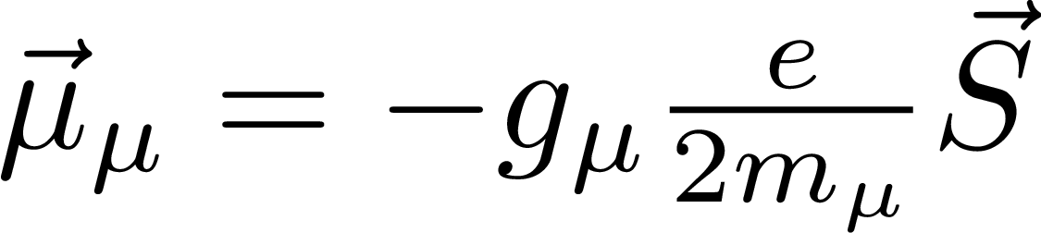

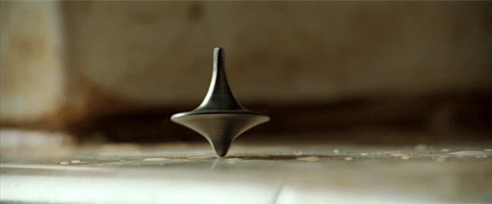
Muon magnetic moment
magnetic moment
proportionality
constant
spin
Potential energy
Torque → precession

Slide 4
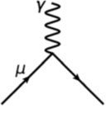
Muon magnetic moment
magnetic moment
proportionality
constant
spin
Dirac
(bare lepton)
g=2
1928
PRL 126, 141801 (2021)

Slide 5
Muon magnetic moment
magnetic moment
proportionality
constant
spin
Dirac
(bare lepton)
g=2
Schwinger
α/2π
1928
1947
PRL 126, 141801 (2021)

Slide 6
Muon magnetic moment
magnetic moment
proportionality
constant
spin
Dirac
(bare lepton)
g=2
anomalous magnetic moment
1928
today
PRL 126, 141801 (2021)

Slide 7
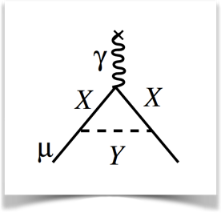
Muon magnetic moment
magnetic moment
proportionality
constant
spin
Dirac
(bare lepton)
g=2
anomalous magnetic moment
BSM physics
1928
today
PRL 126, 141801 (2021)

Slide 8
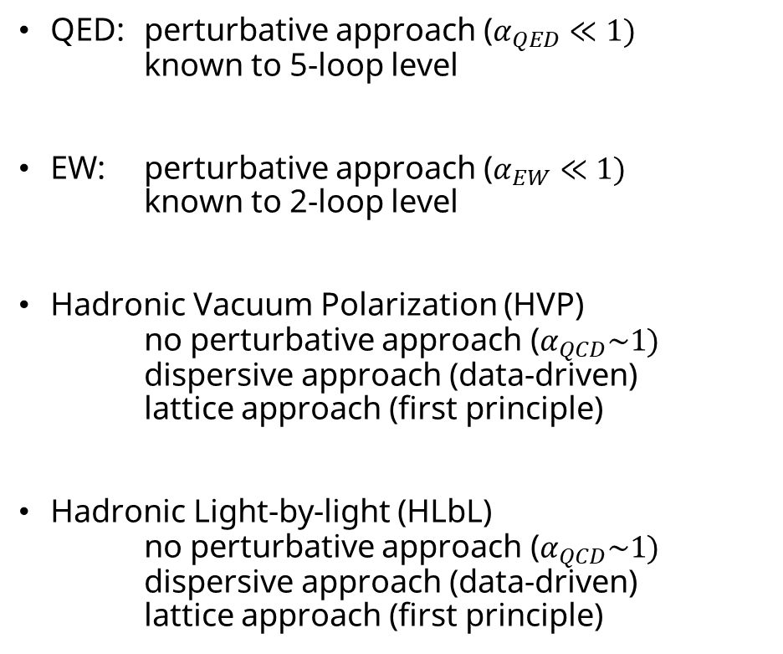
Standard Model Calculation
QED: perturbative approach ($α_{QED}≪1)$
known to 5-loop level
EW: perturbative approach ($α_{EW}≪1)$
known to 2-loop level
Hadronic Vacuum Polarization (HVP)
no perturbative approach ($α_{QCD}\sim 1)$
dispersive approach (data-driven)
lattice approach (first principle)
Hadronic Light-by-light (HLbL)
no perturbative approach ($α_{QCD}\sim 1)$
dispersive approach (data-driven)
lattice approach (first principle)

Slide 9
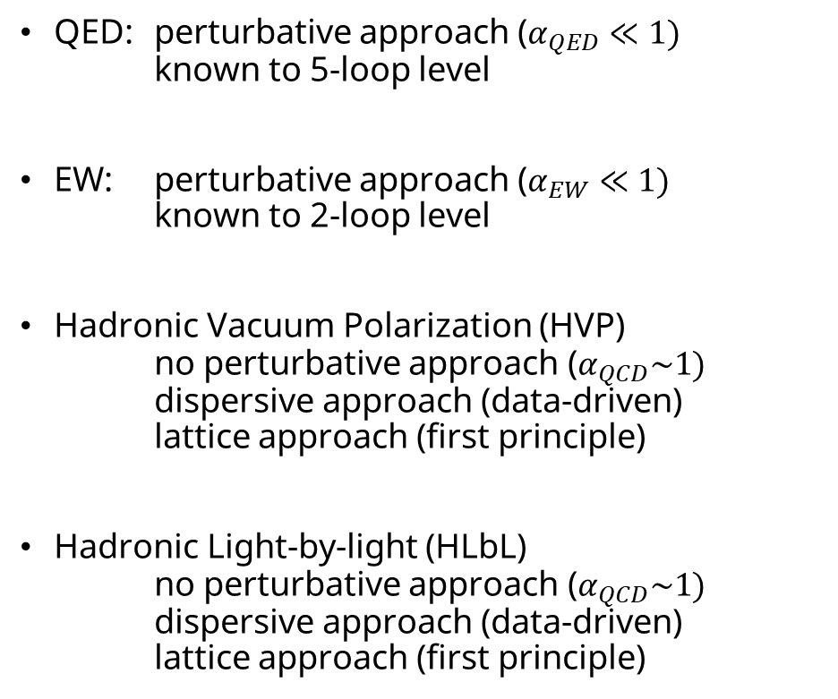
Standard Model Calculation
QED: perturbative approach ($α_{QED}≪1)$
known to 5-loop level
EW: perturbative approach ($α_{EW}≪1)$
known to 2-loop level
Hadronic Vacuum Polarization (HVP)
no perturbative approach ($α_{QCD}\sim 1)$
dispersive approach (data-driven)
lattice approach (first principle)
Hadronic Light-by-light (HLbL)
no perturbative approach ($α_{QCD}\sim 1)$
dispersive approach (data-driven)
lattice approach (first principle)
tension
agreement

Slide 10
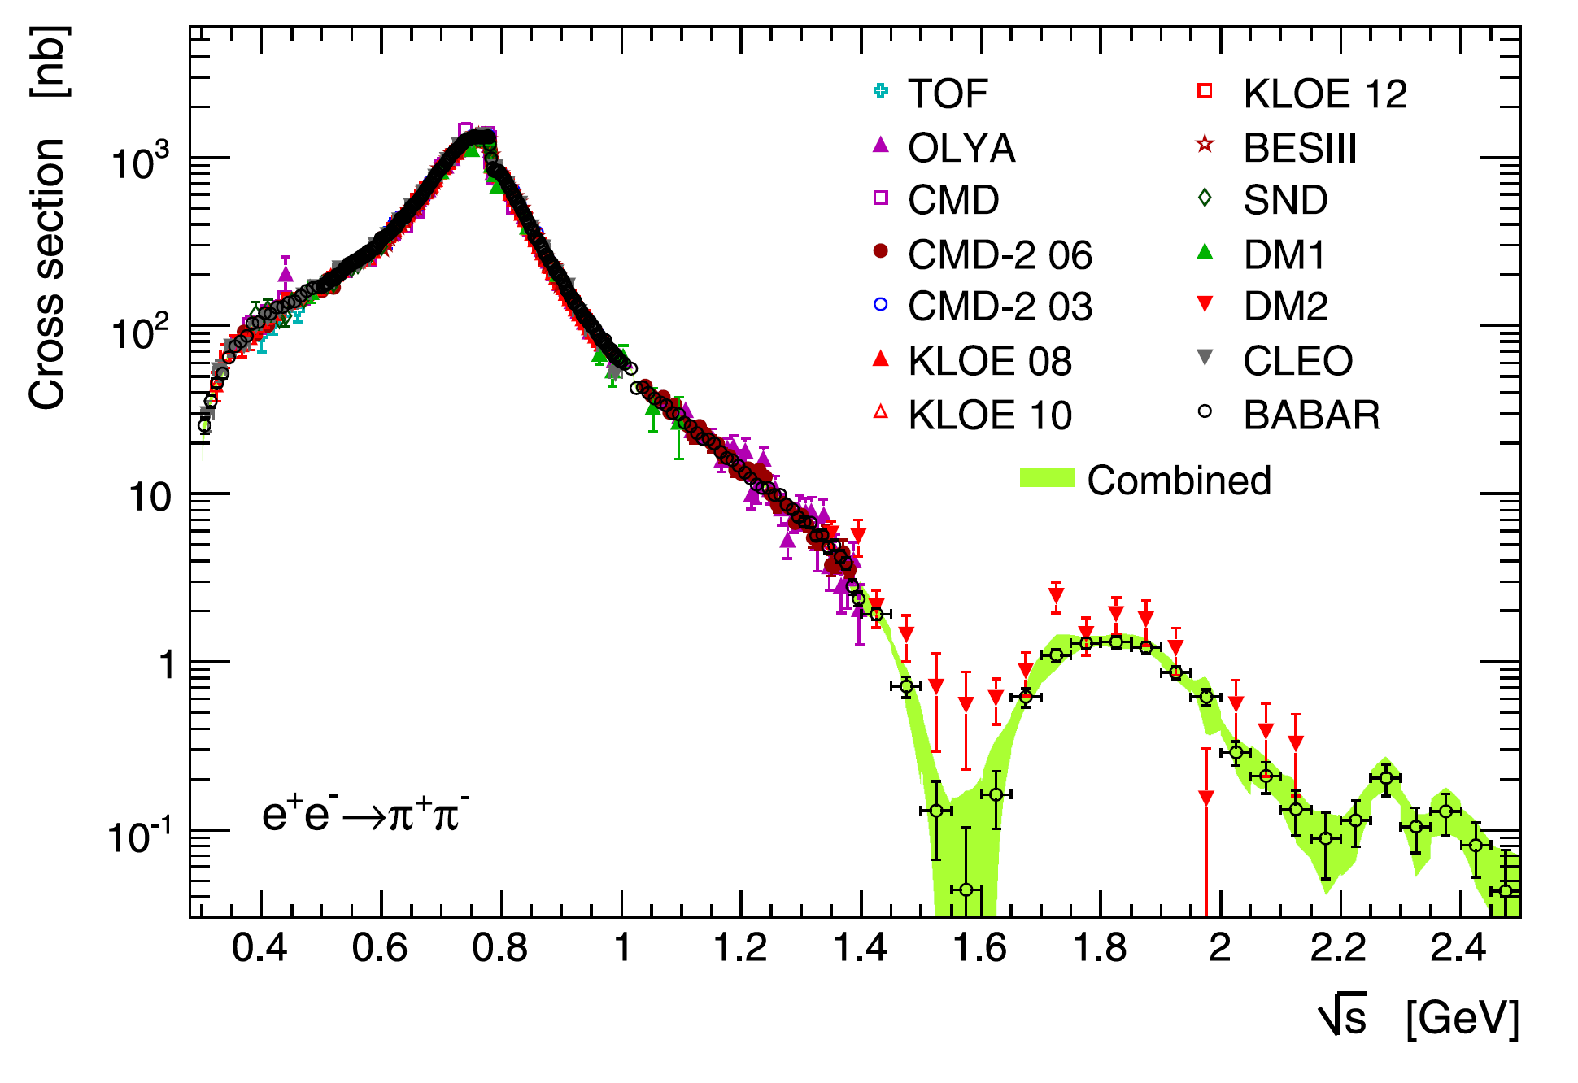
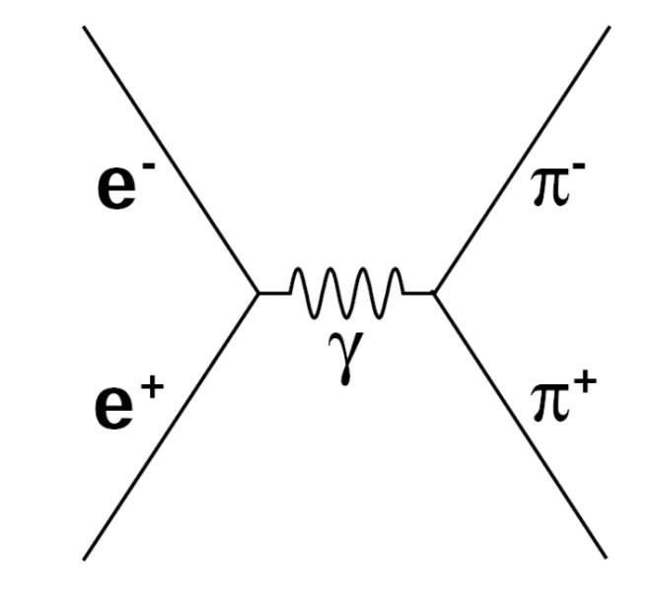
Dispersive Approach
Cross section data used in TI 2020 $a_{μ}^{HVP}$ prediction
Davier et. al, Eur. Phys. J. C. 80 (2020)
Dispersion Relation
follows from causality
Optical Theorem
follows from unitarity
of scattering matrix
calculated from total hadronic cross-section σ_{had}(s)
1/s weight → low energies most important
π⁺ π⁻ contribute 73% to LO
Credit: Thomas Teubner
Notes:
Combine with next three

Slide 11
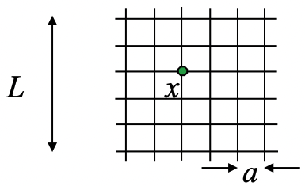
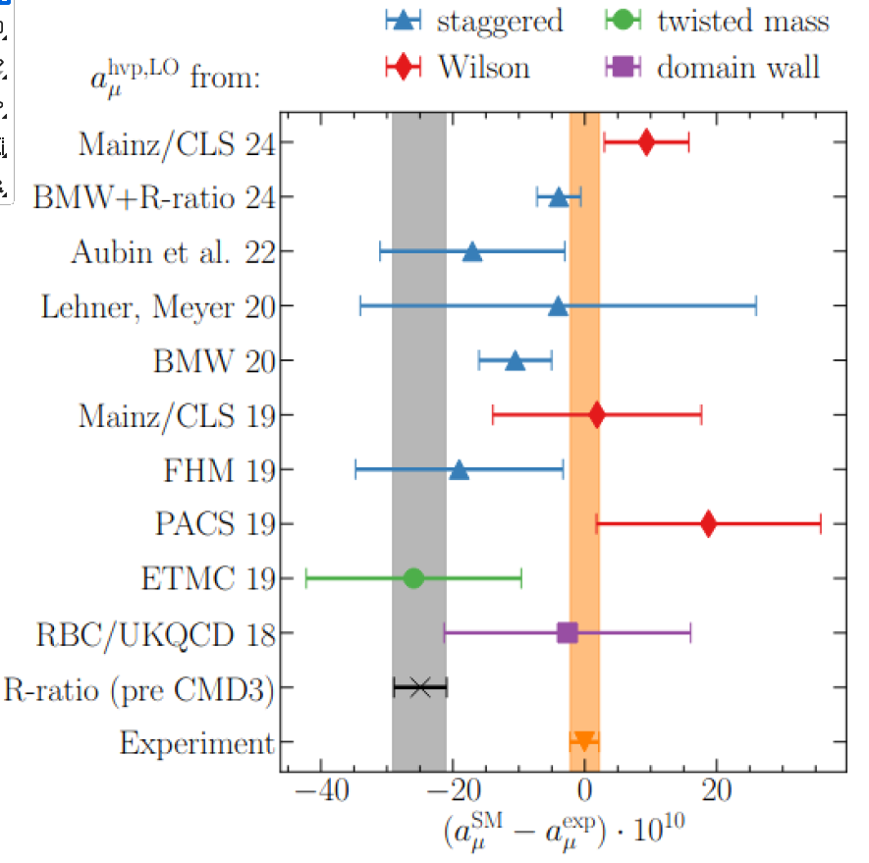
Lattice QCD Approach
First principle calculation to predict a_{µ}
Numerical integration on finite space-time lattice → very computing intensive
Preliminary: Consistency between different groups
M. Hoferichter, Workshop of TI, Sep 2024 @KEK
First prediction with <1% uncertainty by BMW
Lattice results not included in TI white paper due to low precision

Slide 12
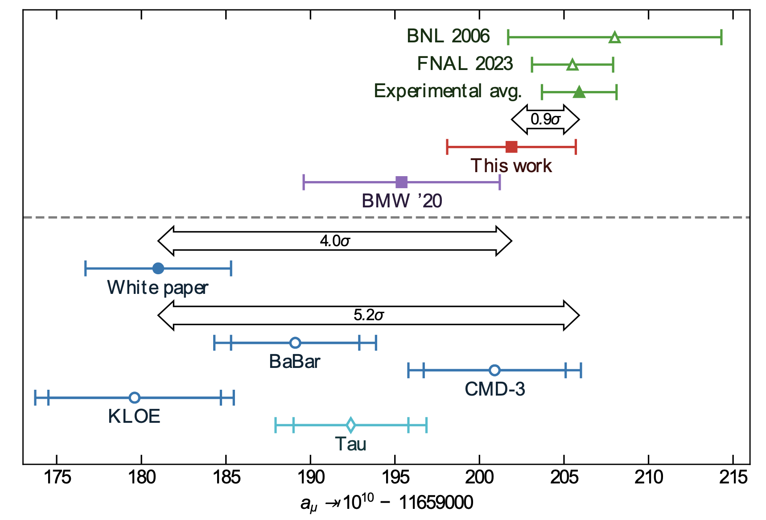
The Muon g-2 Puzzle
M. Hoferichter, Workshop of TI, Sep 2024 @KEK
Muon g-2 Puzzle
tension between theory (white paper) and experiment
New muon g-2 Puzzle
Inconsistency between
lattice and data-driven approach
different e⁺e⁻ experiments
Experiment
→ improve statistics & systematics
of measurement
BMW ‘24

Slide 13
Outline
Why is Muon g-2 a good test of the SM?
How to measure the Muon g-2?
Improvements in Run-2/3 results
Outlook & Conclusions

Slide 14
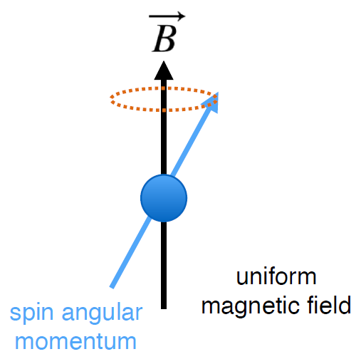
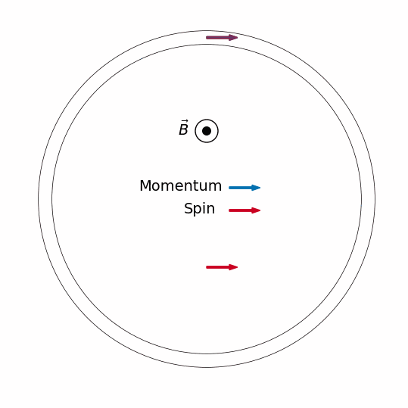
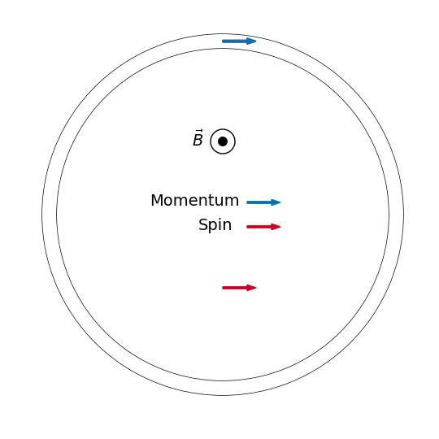
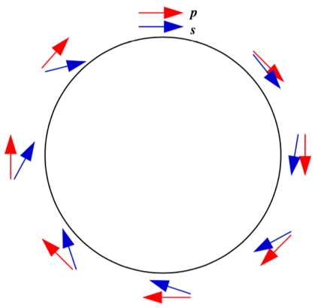
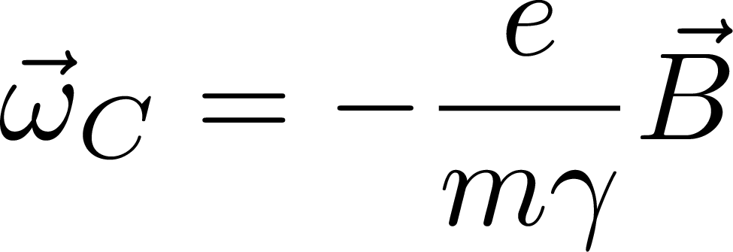
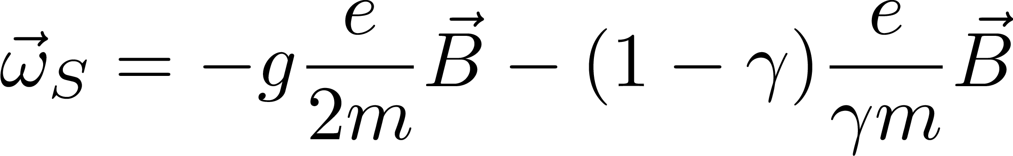
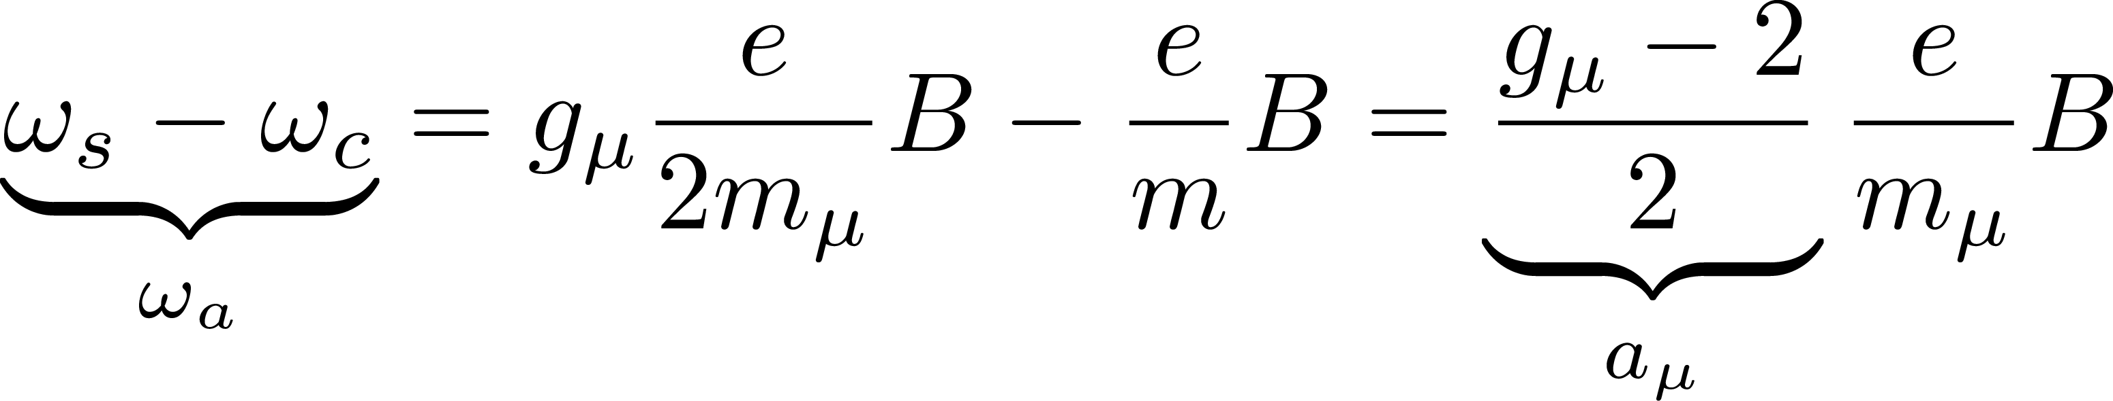
Muon in homogeneous magnetic field
Cyclotron Motion
Spin Precession
centrifugal force = Lorentz force
magnetic moment and field couple
g > 2
anomalous spin-precession frequency
anomalous magnetic
moment

Slide 15
The Muon g-2 experiment at FNAL
1.45 T vertical magnetic field

Slide 16

The Muon g-2 experiment at FNAL
µ⁺
1.45 T vertical magnetic field
highly polarized µ⁺ provided by FNAL muon campus at
$p_{μ}^{magic}=3.094\frac{GeV}{c}±0.5\%$

Slide 17
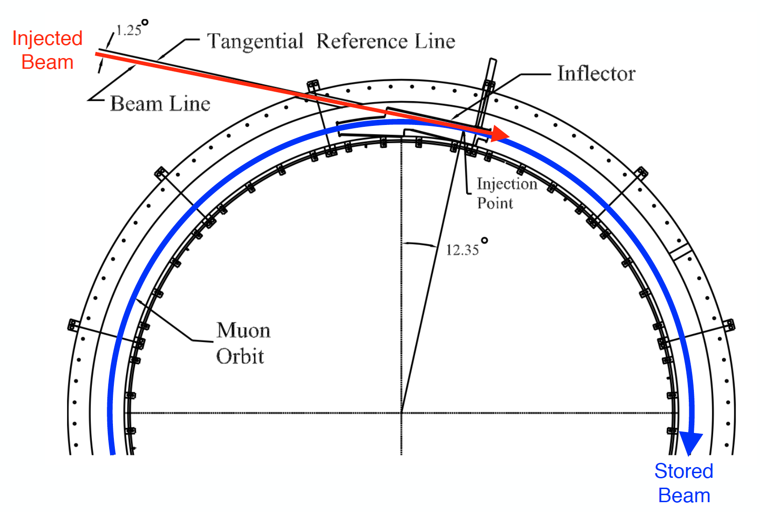

The Muon g-2 experiment at FNAL
1.45 T vertical magnetic field
highly polarized µ⁺ provided by FNAL muon campus at
$p_{μ}^{magic}=3.094\frac{GeV}{c}±0.5\%$
Superconducting inflector magnet in back of iron yoke

Slide 18
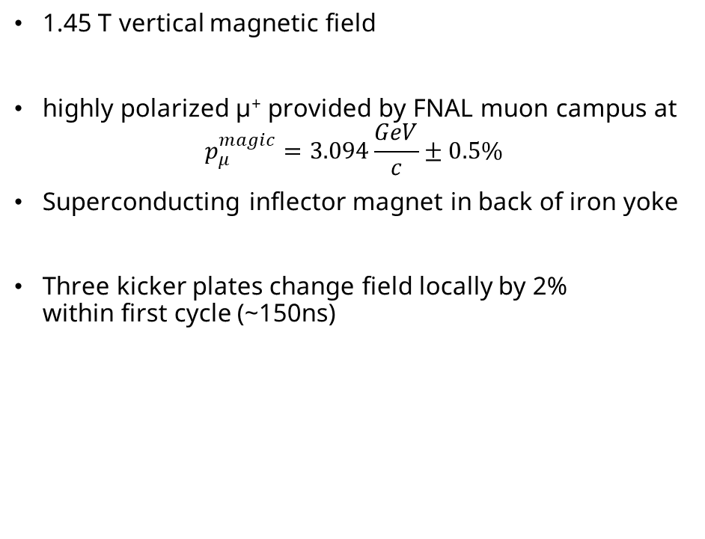
The Muon g-2 experiment at FNAL
1.45 T vertical magnetic field
highly polarized µ⁺ provided by FNAL muon campus at
$p_{μ}^{magic}=3.094\frac{GeV}{c}±0.5\%$
Superconducting inflector magnet in back of iron yoke
Three kicker plates change field locally by 2%
within first cycle (~150ns)

Slide 19
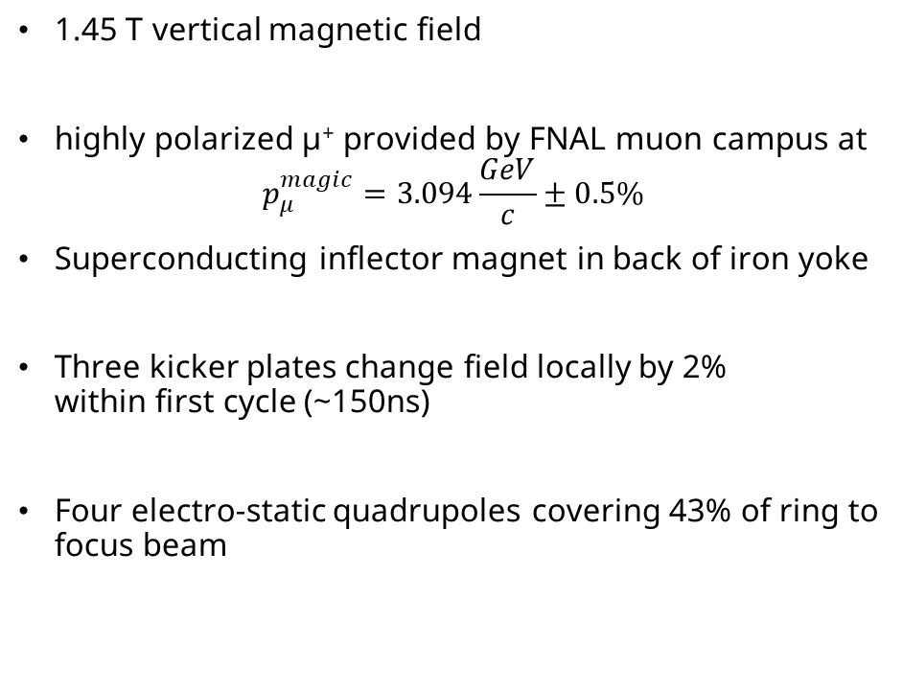
The Muon g-2 experiment at FNAL
1.45 T vertical magnetic field
highly polarized µ⁺ provided by FNAL muon campus at
$p_{μ}^{magic}=3.094\frac{GeV}{c}±0.5\%$
Superconducting inflector magnet in back of iron yoke
Three kicker plates change field locally by 2%
within first cycle (~150ns)
Four electro-static quadrupoles covering 43% of ring to focus beam

Slide 20
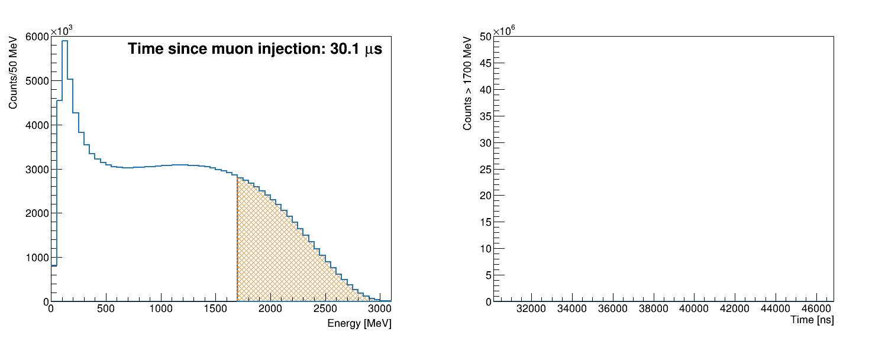
The Muon g-2 experiment at FNAL
24 PbF2 crystals calorimeters
Detect in spiraling positrons from muon decay
µ⁺
from Kim Siang Khaw
Run-3a

Slide 21
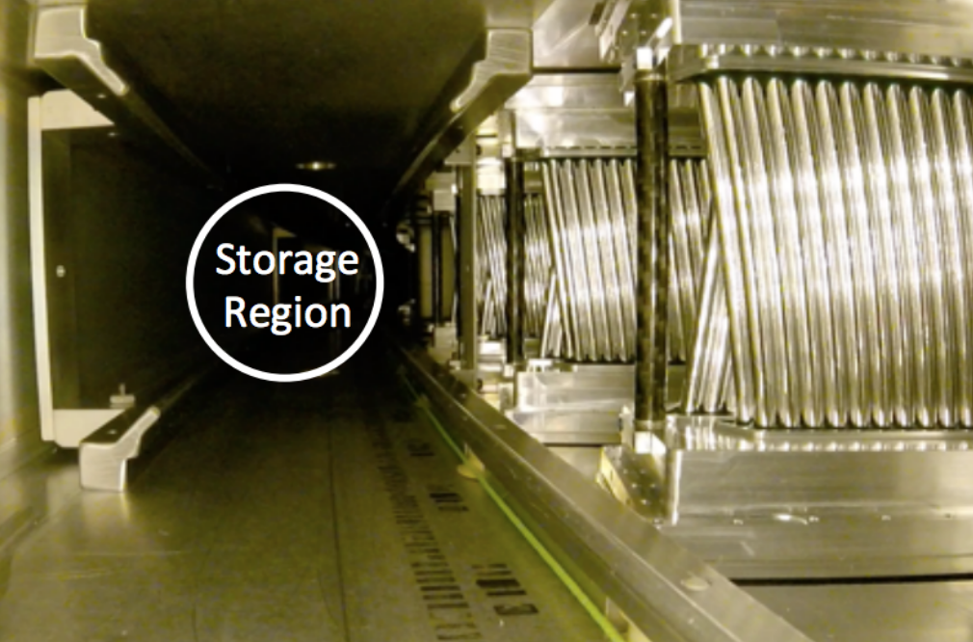
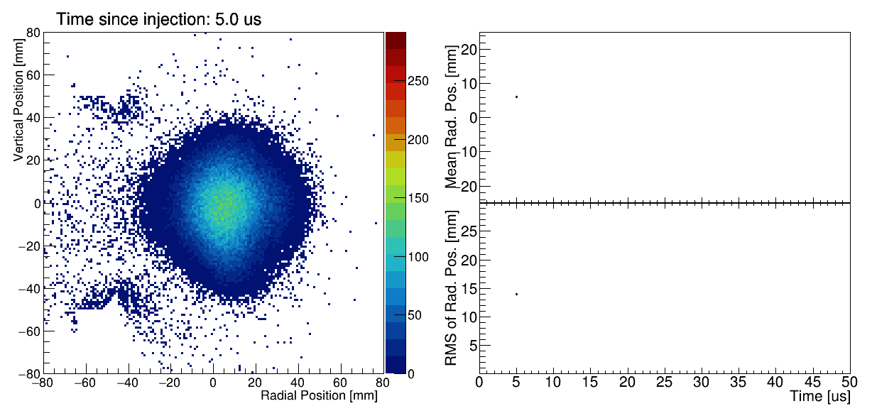
The Muon g-2 experiment at FNAL
Two tracking stations based on gas-filled straw tubes
Determine e+ trajectory to decay position and extrapolate to find muon beam distribution!
Run-3b

Slide 22
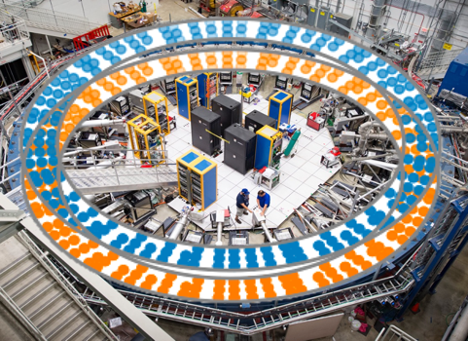
The Muon g-2 experiment at FNAL
378 NMR probes in vacuum chamber walls to track magnetic field drift 24/7
Movable device with 17 NMR probes measures spatial field distribution in muon storage region
Externally calibrated absolute water NMR probe
trolley

Slide 23
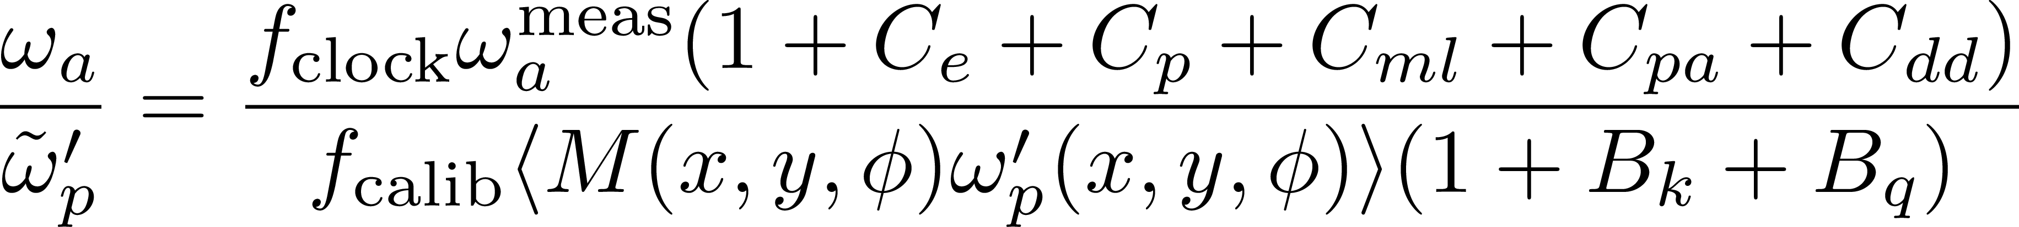
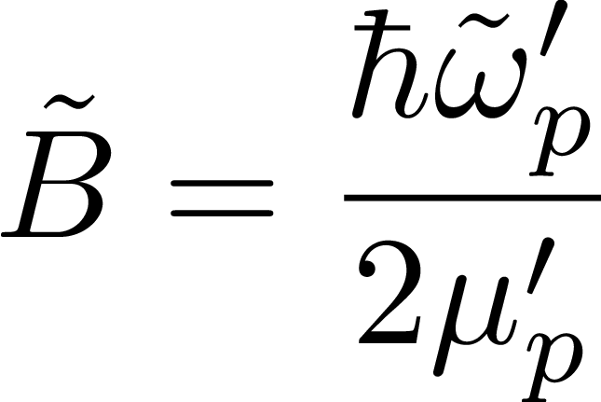
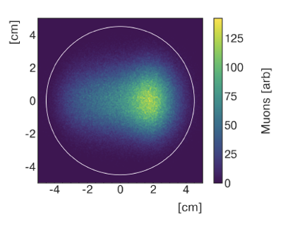
Extracting a_{µ}
Anomalous spin
precession frequency
Muon beam dynamics
corrections
Clock blinding
Spatial muon distribution
Magnetic field calibration
Spatial distribution of
magnetic field
Transient magnetic fields

Slide 24
Outline
Why is Muon g-2 a good test of the SM?
How to measure the Muon g-2?
Improvements in Run-2/3 results
Outlook & Conclusions

Slide 25
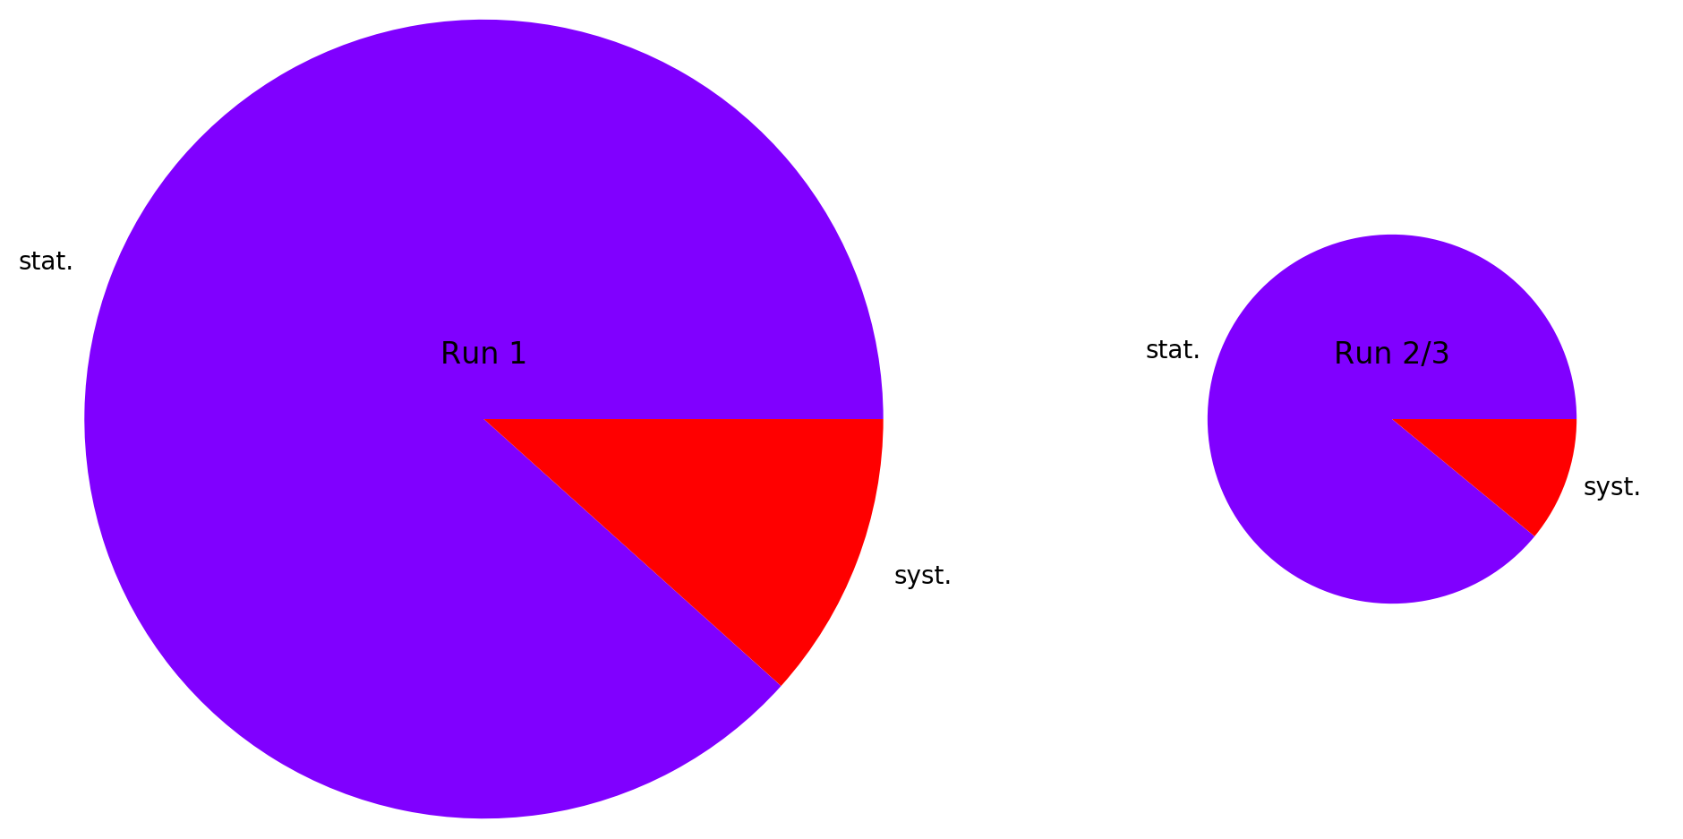
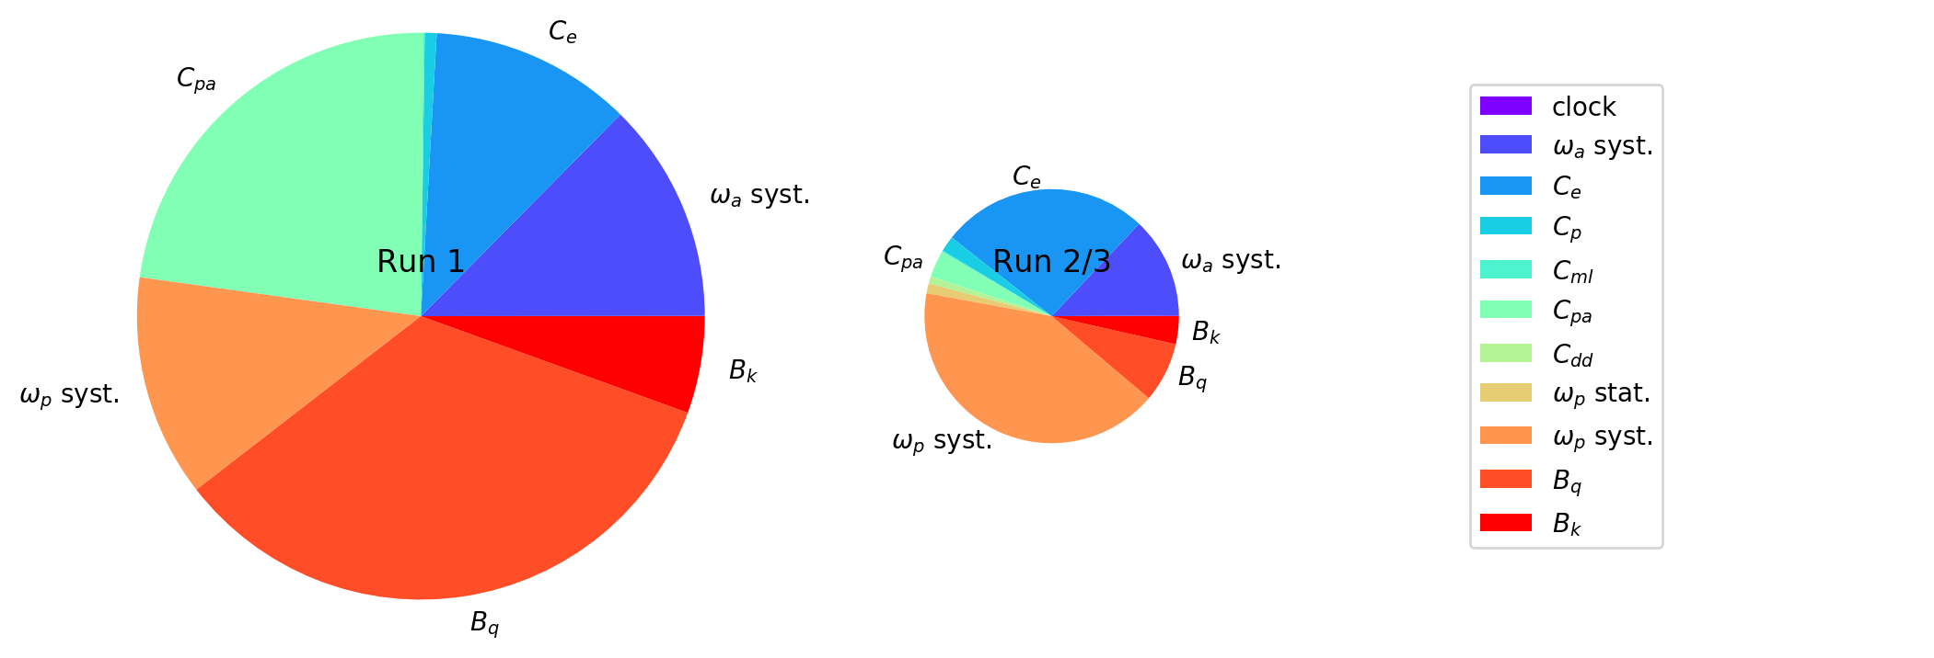
Uncertainties Run1 vs Run2
Total uncertainty: 462 ppb
Uncertainty reduced
by factore >2
Statistic and systematic uncertainty reduced by similar amount
Systematic uncertainty below TRD goal
Still statistics dominated
Run-1
434 ppb
157 ppb
Total uncertainty: 215 ppb
Run-2/3
201 ppb
70 ppb
Radius: uncertainty
Area: variance

Slide 26
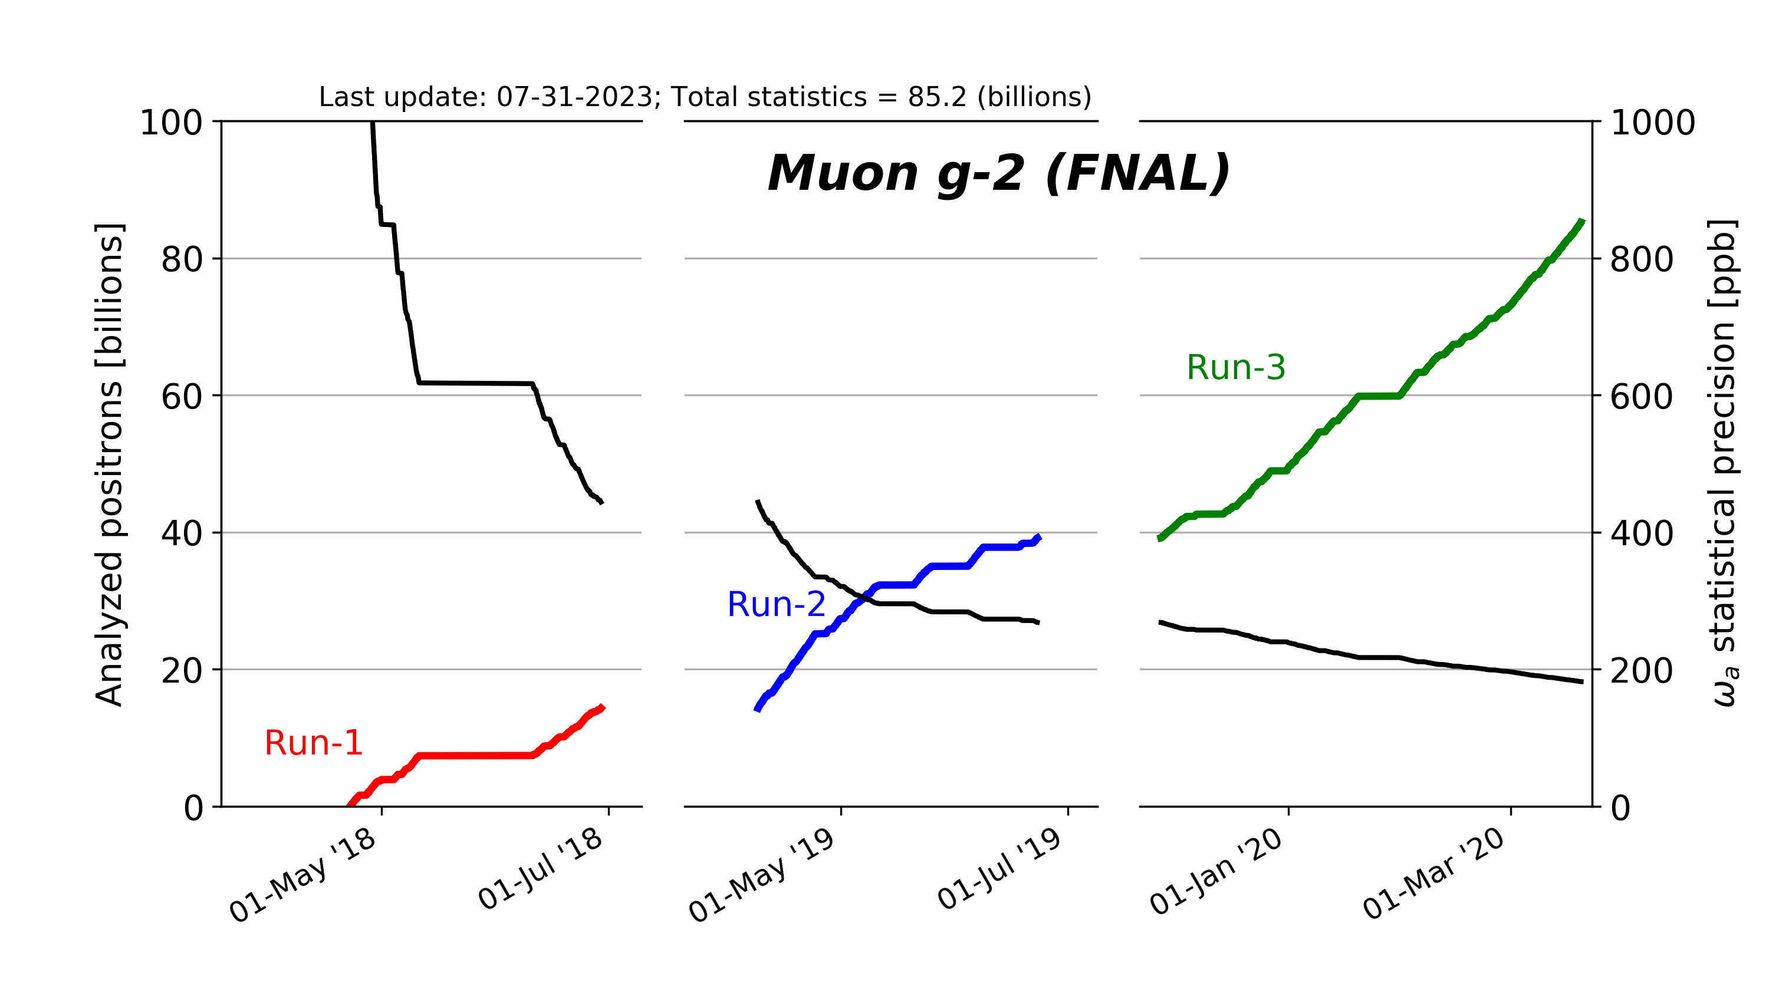
Improvements: Statistics
Weighted e⁺ in our final fit after quality control (E > 1 GeV, t > 30 us)
Run-1
434 ppb
Run-2/3
201 ppb
Radius: uncertainty
Area: variance

Slide 27
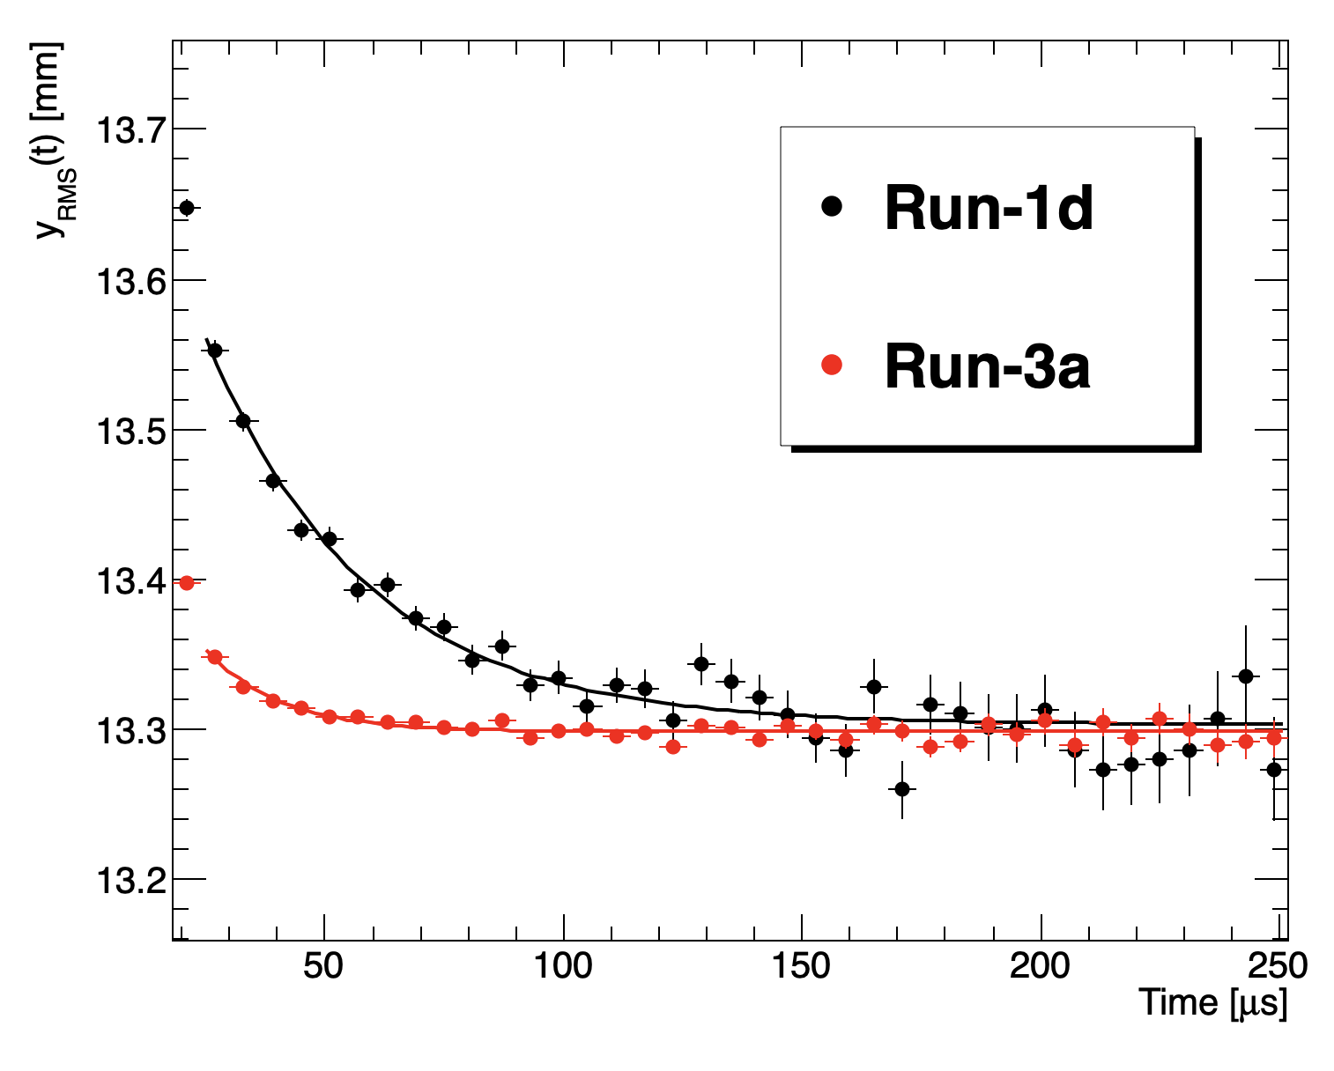
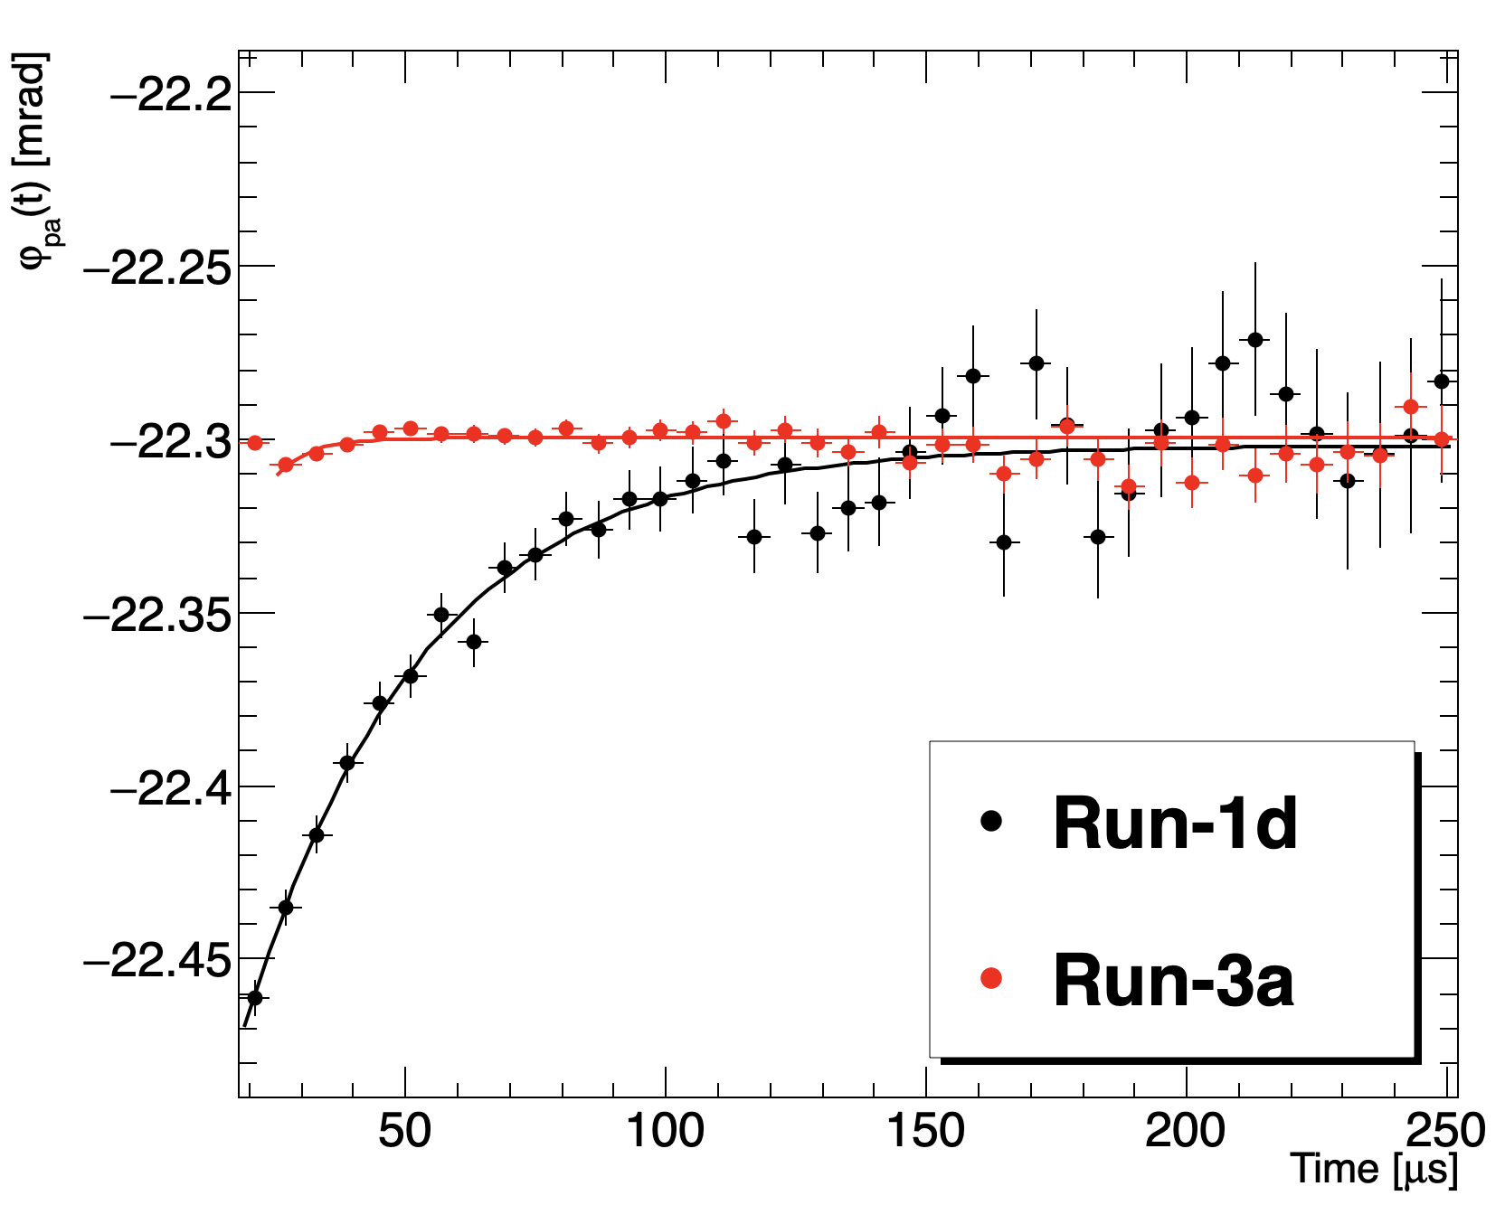
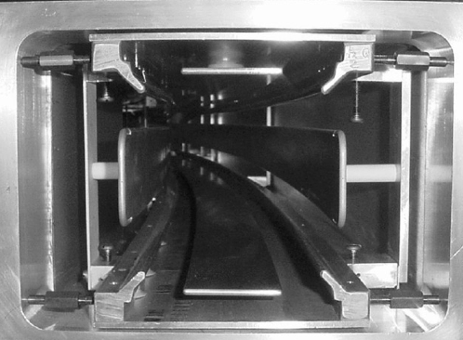
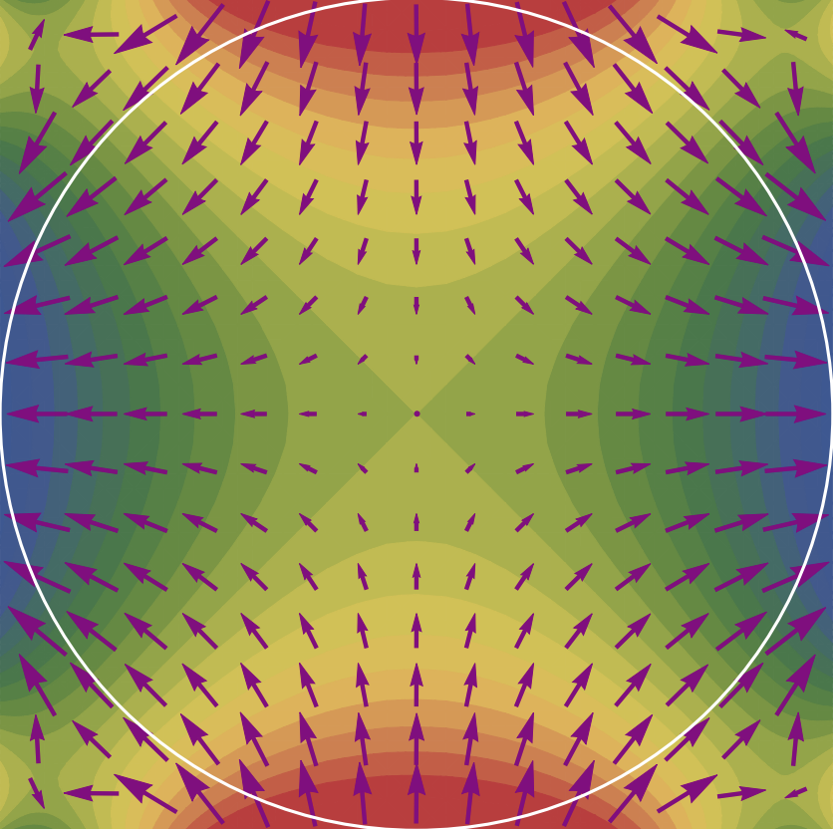
Improvements: Running Conditions
Electro-static quadrupoles keep muon beam stable
2 out of 32 resistors damaged in quad plates → unstable beam storage
Redesigned and replaced before Run-2
Reduces phase acceptance uncertainties 75 ppb → 13 ppb
Beam oscillation frequencies become also more stable
ω_{a} phase change
Vertical beam width change

Slide 28
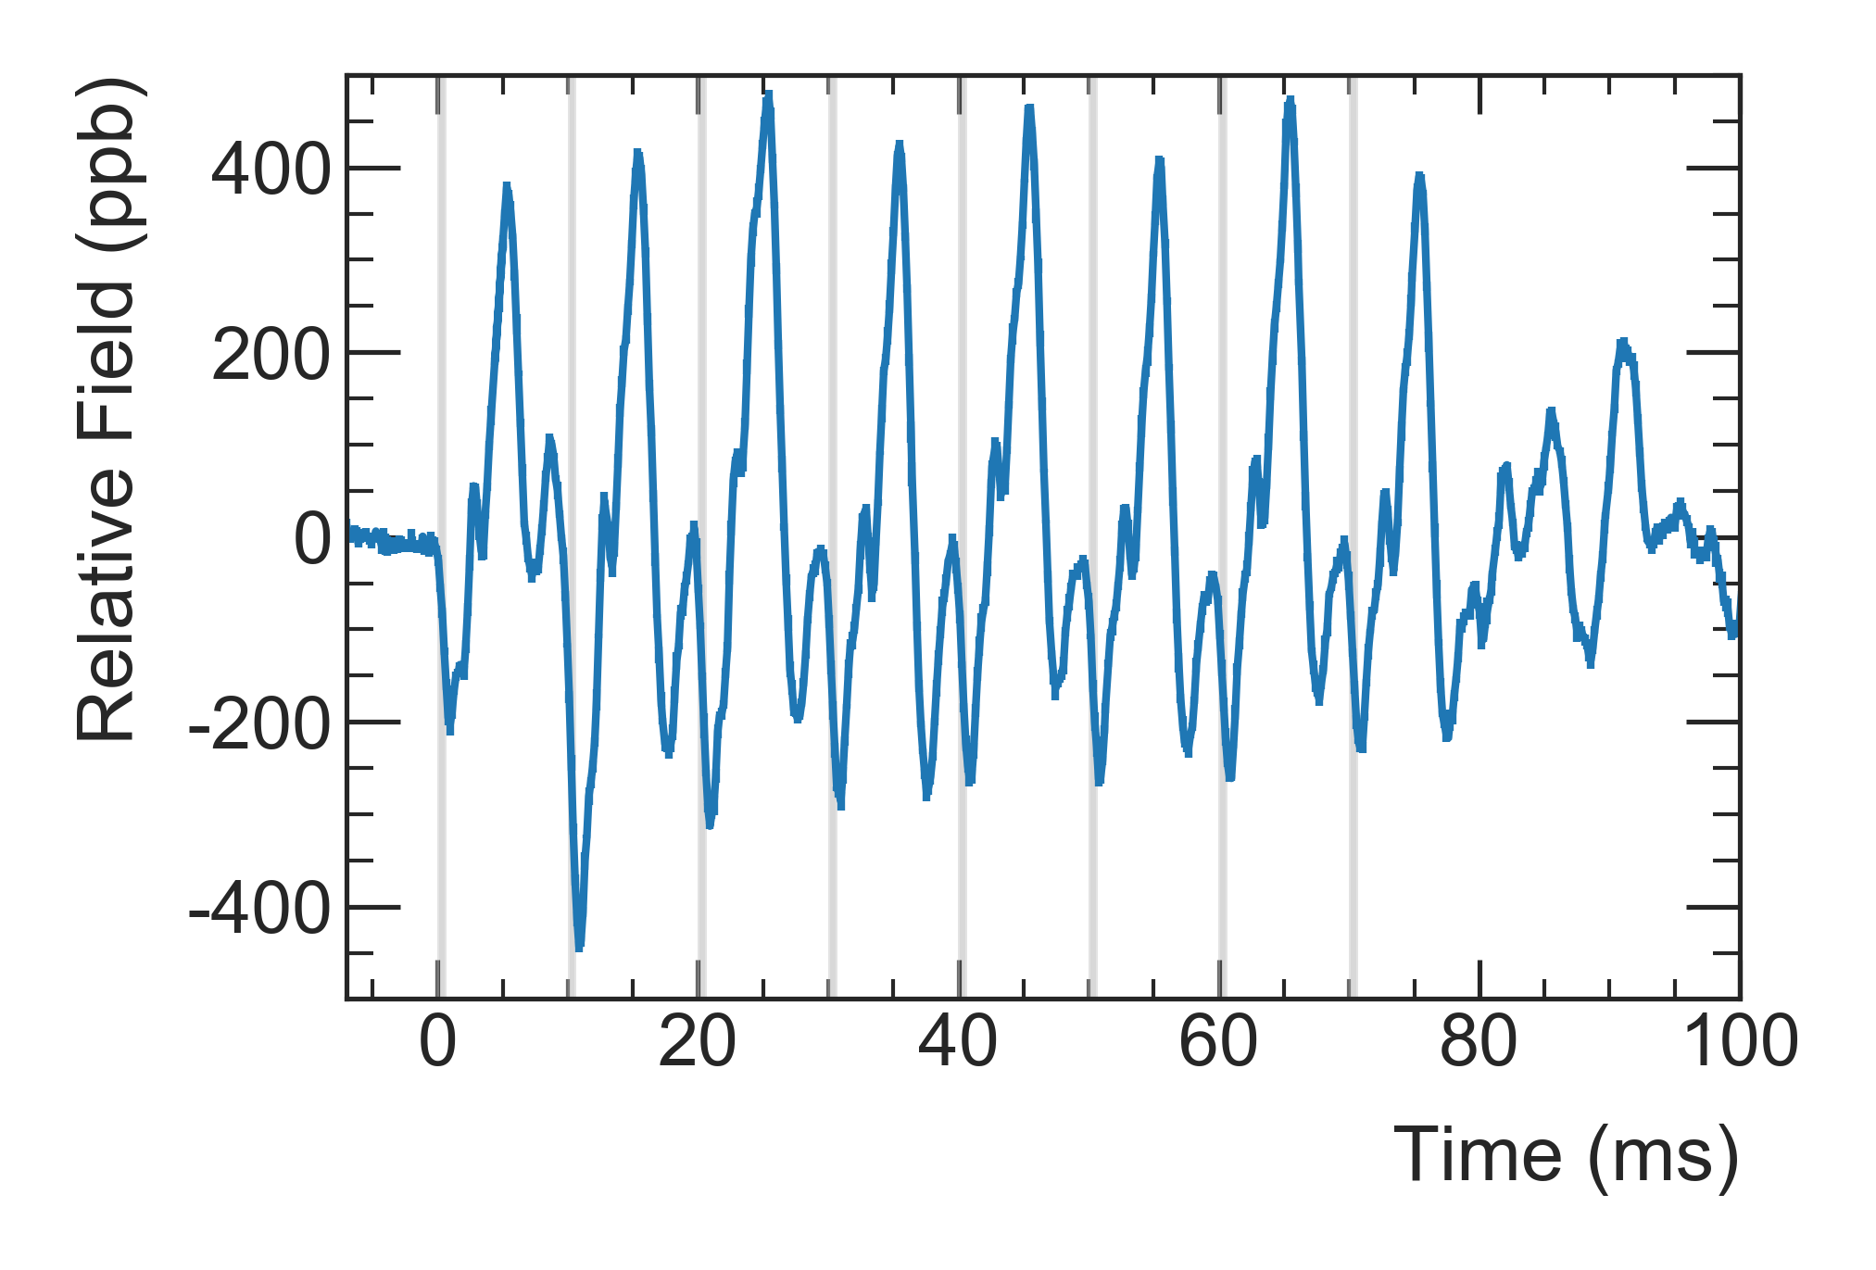
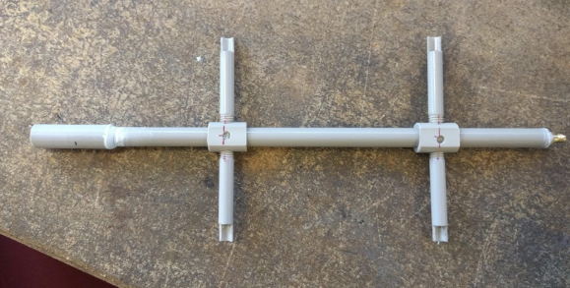
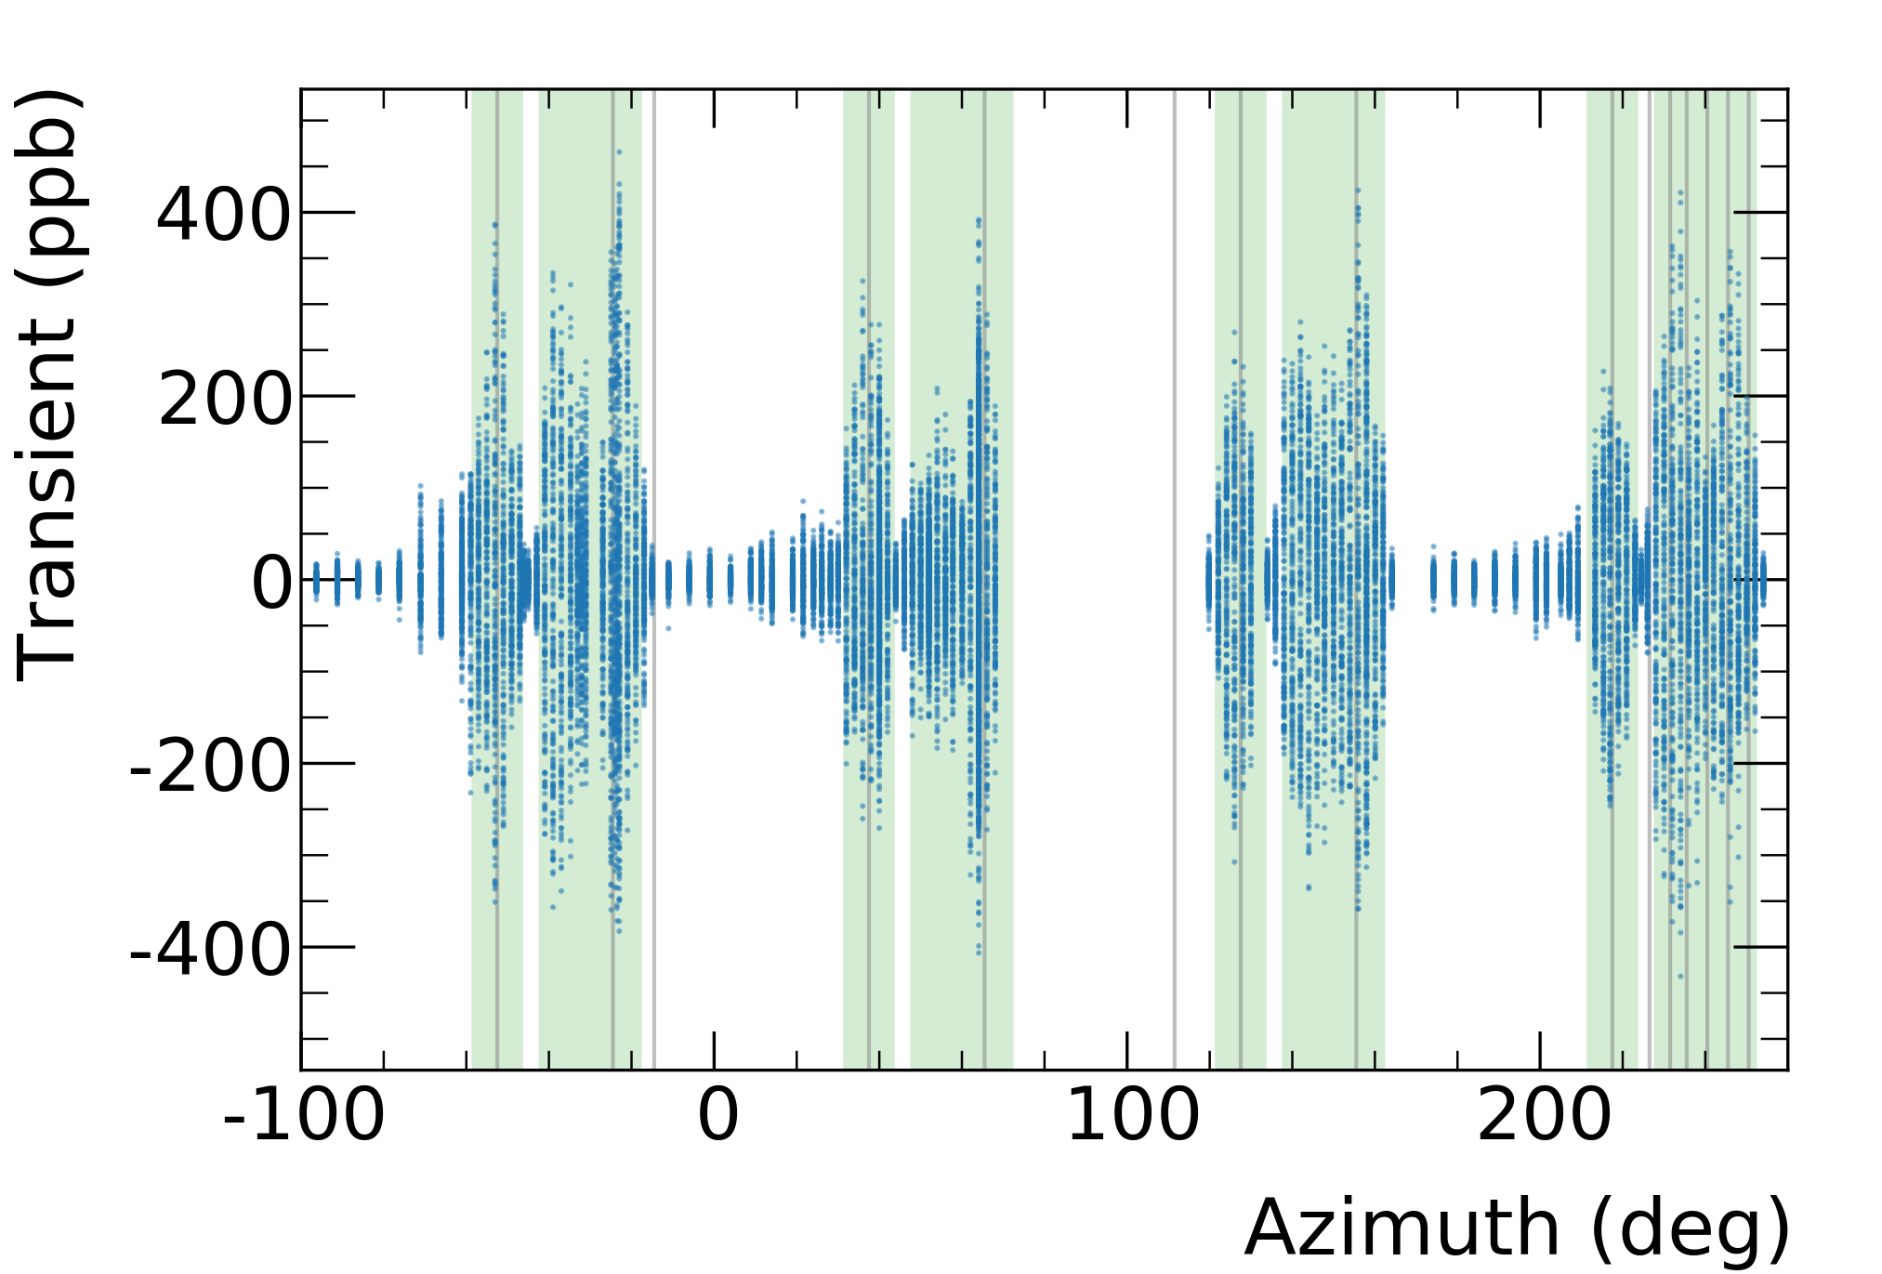
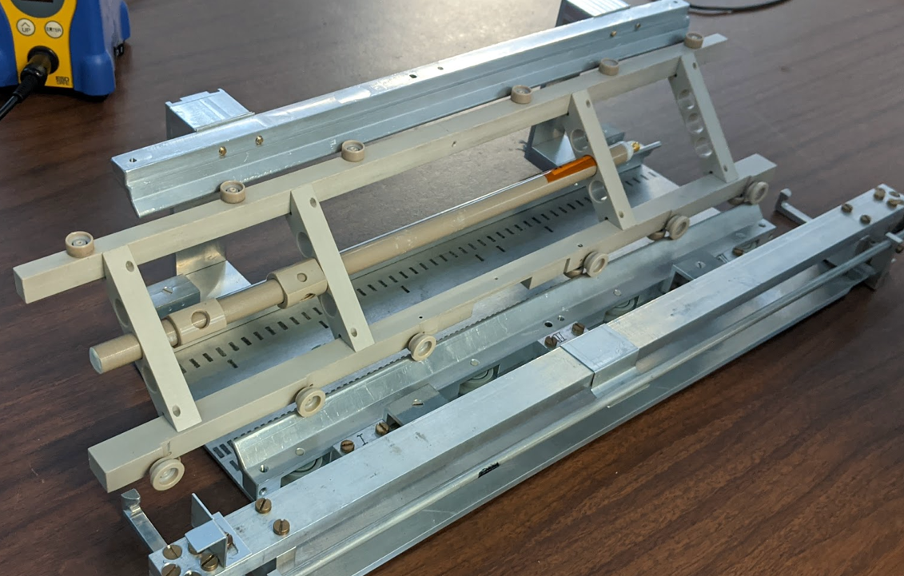
Improvements: Systematic Studies
Pulsing electrostatic quadrupoles for beam confinement
leads to magnetic field transient.
Run 1
Limited measurement points
Large uncertainty: 92 ppb
Muon fills
ESQ4
ESQ1
ESQ2
ESQ3
Run 2/3
Probe movable on trolley rails
Detailed measurement campaign over > 1 month
Uncertainty reduced to 20 ppb
Run-1 Measurement Locations

Slide 29
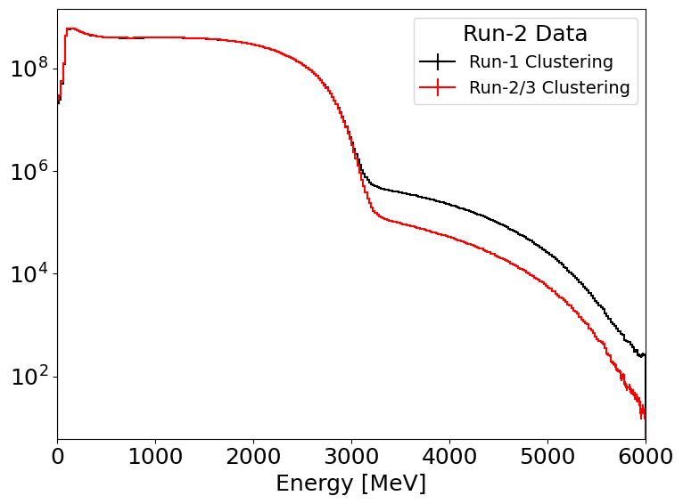
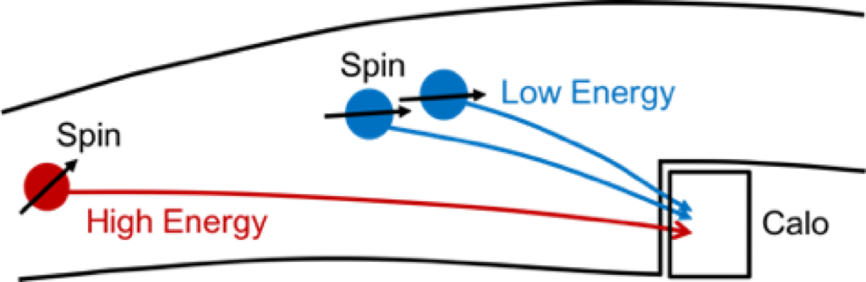
Improvements: Analysis
Pile-up correction
2 e⁺ arriving at same time can be mistaken for 1
Rate dependent → can bias ω_{a}
Reduced uncertainty by:
  Improved reconstruction
  Improved correction algorithm
Decay end point
Pile-up
Phase of high-energy muon
≠
Phase of two low-energy muons
Notes:
More details

Slide 30
Outline
Why is Muon g-2 a good test of the SM?
How to measure the Muon g-2?
Improvements in Run-2/3 results
Outlook & Conclusions

Slide 31
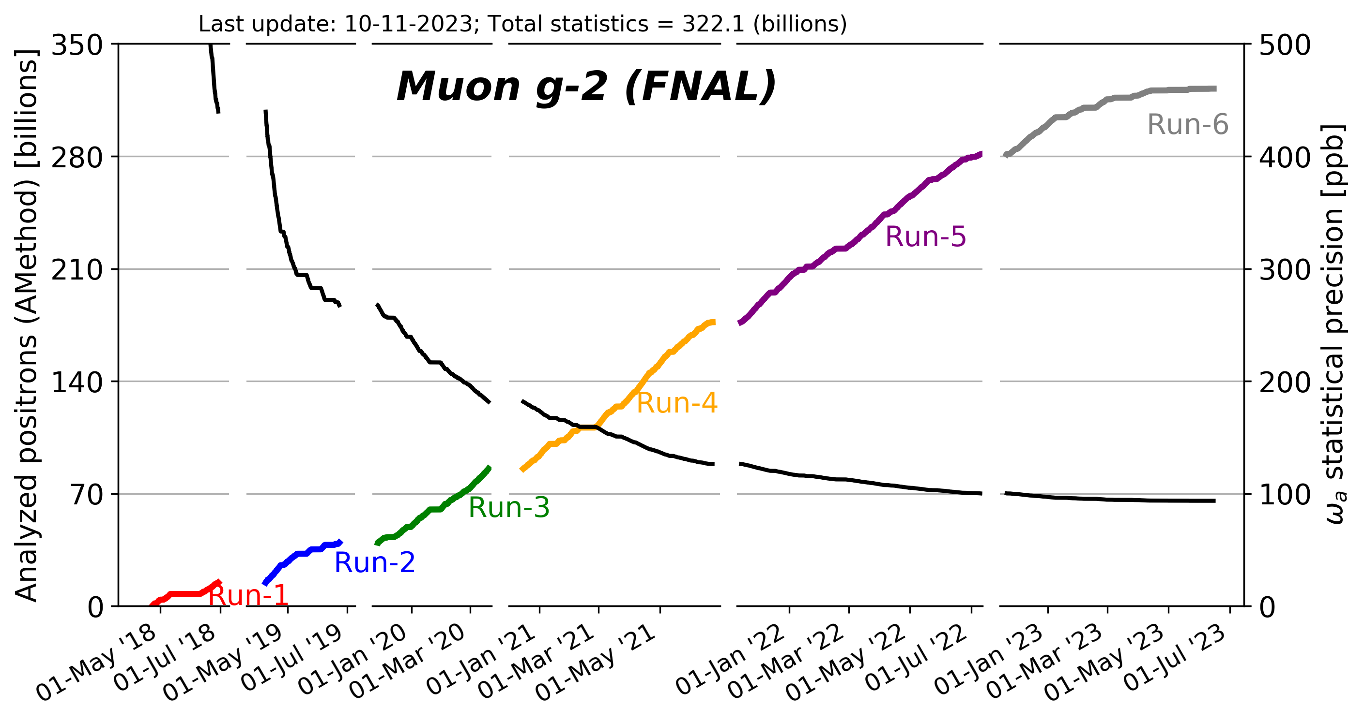
Outlook
Much more statistics
Another factor of about 2 in statistic uncertainty

Slide 32
Outlook
Exceeded TRD goal of 21 BNL statistcs
Last part of run 6 dedicated to systematic studies
Much more statistics
Another factor of about 2 in statistic uncertainty

Slide 33
Outlook
Exceeded TRD goal of 21 BNL statistcs
Last part of run 6 dedicated to systematic studies
Further systematic studies w/o beam concluded end Jan 2024
Much more statistics
Another factor of about 2 in statistic uncertainty

Slide 34
Conclusions
High precision measurements of Muon g-2
stringent test on SM theory
First time a three-way comparison of a_{µ} is possible
  Dispersive-approach lattice approach, experiment
  Very interesting
Run-2/3 data consistent with Run-1 and BNL
Improvement by factor >2 in statistical and systematic uncertainty
Surpassed TRD goals in statistics and systematics
Another reduction by factor of 2 in statistical uncertainty from Run-4/5/6
Experimental result will be long standing reference
for theory developments
published
expected in 2025

Slide 35
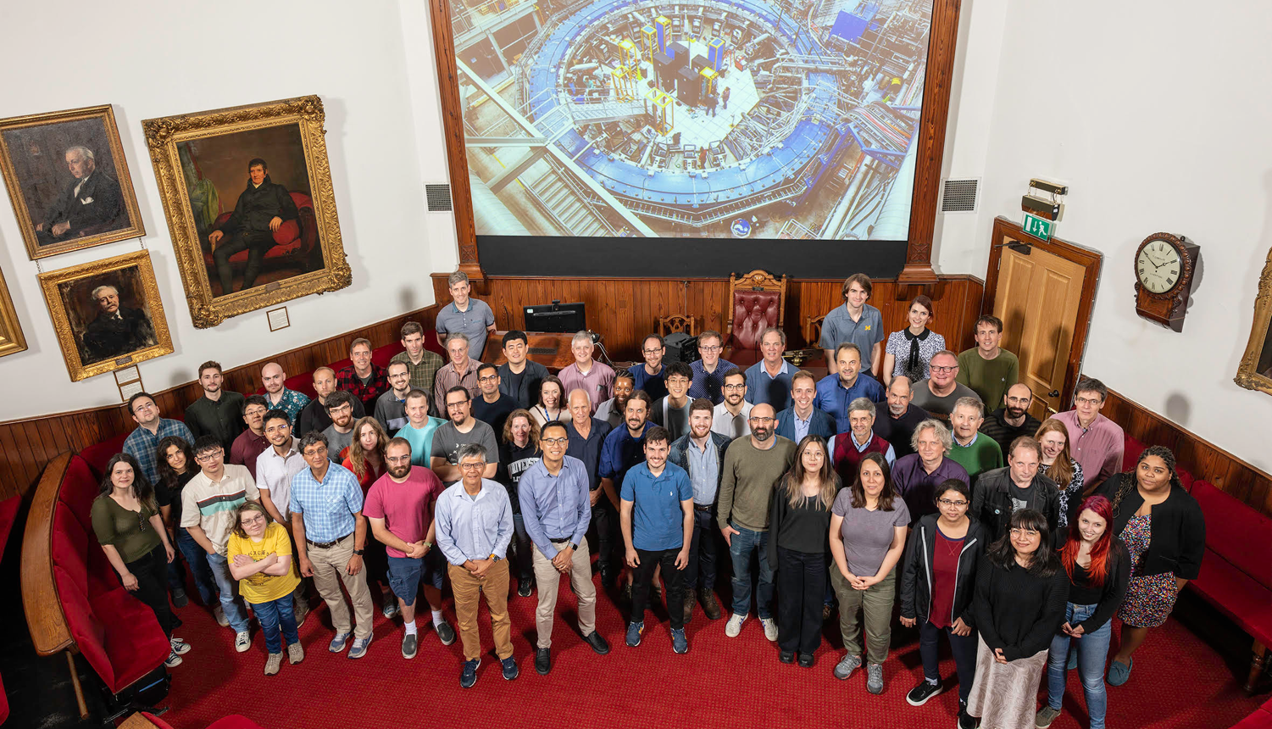
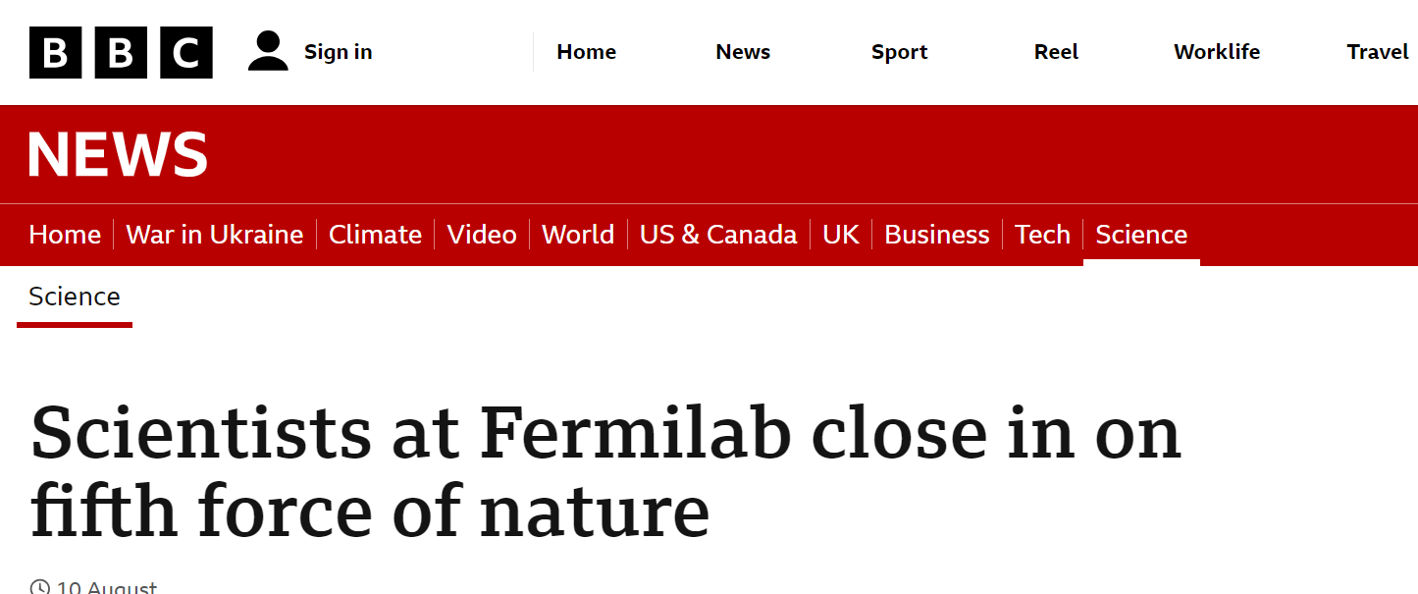
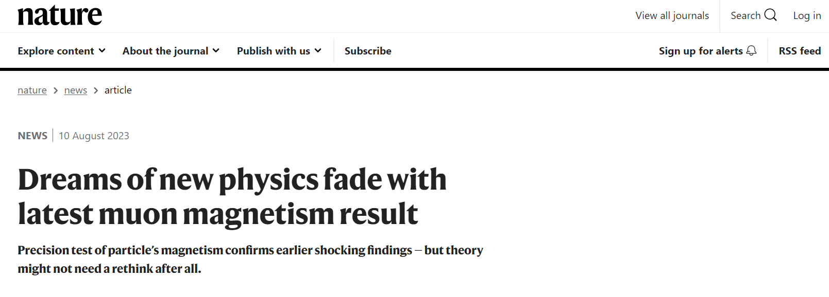
Thank you for your attention
Summer Collaboration meeting at University of Liverpool July 24-28, 2023

Slide 36
Backup

Slide 37
Beyond Standard Model Physics
Extra contribution to anomalous magnetic moment
Naïve scaling
Comparison with electron g-2
Muon g-2 is ~43000 more sensitive to new physics compared to electron g-2

Slide 38
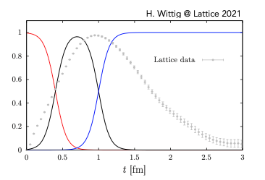
Lattice approach
First principal calculation by discretizing Euclidian space-time
BMW is presently the only sub 1% (HVP) lattice calculation in the full kinematic region
Cross-checks performed by other groups but only in limited (30%) (distance) region.
A. El-Khadra, P5 town hall, 21-24 Mar 2023
Notes:
Work in progress

Slide 39
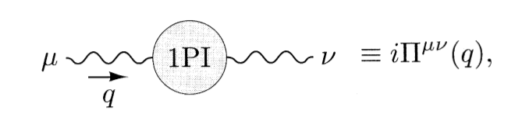
Lattice approach
BMW20: First sub% calculation of HVP contribution
on lattice
Calculation of “1 particle Irreducible diagrams”
Large systematics from continuum limit
upper right panel: limit and uncertainty estimation
lower right panel: limit for central window compared
to other lattice and data-driven results
BMW20 [Borsanyi et al, arXiv:2002.12347, 2021 Nature]

Slide 40
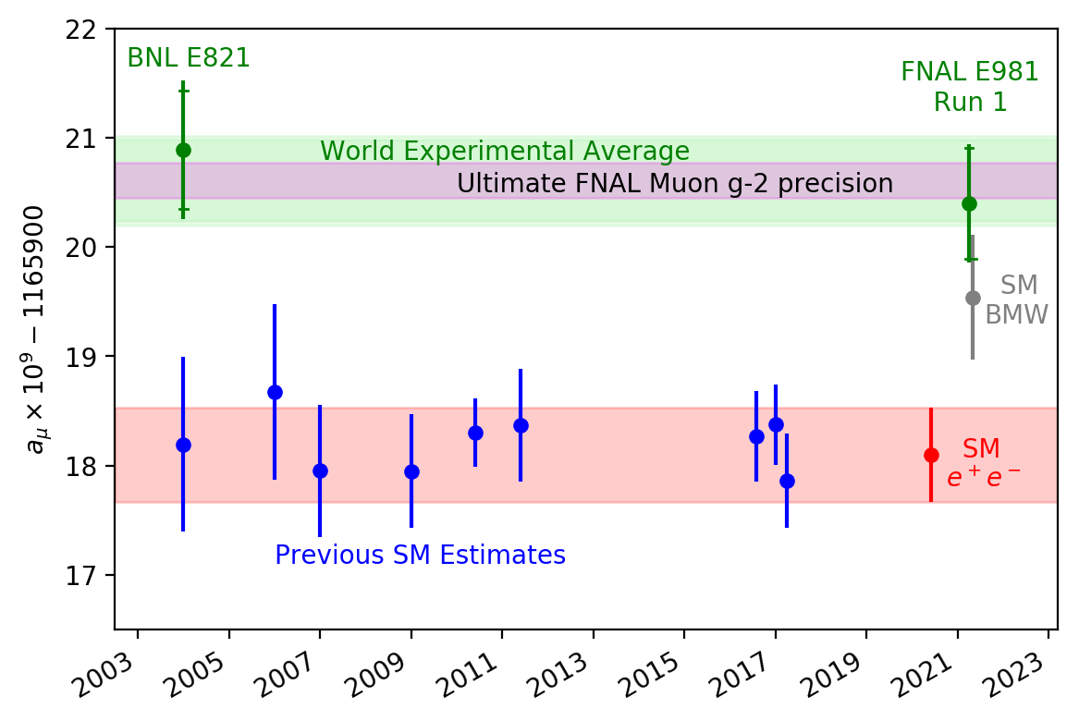
The Muon g-2 Puzzle
Long standing discrepancy
between theory calculation
and experimental result
Uncertainty in theory calculation dominated by calculation of hadronic vacuum polarization

Slide 41

Extracting a_{µ}
Anchor B, e and m_{µ} to other high-precision measurements and calculations
Measure magnetic field with NMR
→ proton spin-precession
10.5 ppb uncertainty Metrologia 13, 179 (1977)
exact Rev. Mod. Phys. 88, 035009 (2016)
22 ppb uncertainty Phys. Rev. Lett. 82, 11 (1999)
0.13 ppt uncertainty Phys. Rev. Lett. 130, 071801 (2023) / CODATA
25 ppb total external uncertainty

Slide 42
Why is Muon g-2 a good test of the SM?
From a theoretician’s point of view, the muon is a very clean system
in which highest precision predictions are achievable!
Highest precision
theoretical predictions
Highest precision
experiments
“They allow for high-precision tests!”

Slide 43





Fitting the “wiggle” plot
Simple Fit Function
Run 3a
Full Fit Function
Coherent betatron oscillation (“CBO”)
$χ^{2}$/ndf = 4086/4138
Any time dependent phase shift will bias the frequency
19 different analysis from 7 independent groups
Account for complex beam dynamics ~27 free parameters in fit

Slide 44


Magnetic field tracking
Spatial distribution described by multipole expansion
time interpolation using fixed probe data

Slide 45


Muon weighted magnetic field
We need the field seen by the muons
Tracking magnetic field multipole moments
Muon distribution given by tracker data and beam dynamics simulation
Run 3

Slide 46

Spin projection detection
S = 1/2
right-handed
S = 1/2
S = 1/2
right-handed
S = 1/2
left-handed
Muon decay described by weak force → parity violation
Maximum positron energy ≅ 52.8 MeV
Positron emitted preferably in direction of muon spin!
Figure credit: K.S. Khaw, PhD thesis, ETHZ, 2015

Slide 47

Relativistic muon in magnetic & electric fields
non-relativistic limit
electron motion
non-perpendicular
to magnetic field
cyclotron motion assumed motion perpendicular to magnetic field
pitch of electron
relativistically generated
motional magnetic field
proportional to electric field
$$a_{μ}^{SM}=116591810\left(43\right)×{10}^{−11}$$
disappears for γ≈ 29.3
magic momentum
p_{µ}=3.094 GeV/c

Slide 48


Muon decay in rest frame
Angular differential decay distribution is energy dependent
Figure credit: K.S. Khaw, PhD thesis, ETHZ, 2015
Figure: L. Roberts and W. Marciano, Lepton Dipole Moments

Slide 49

Magnetic field tracking
Trolley system
17 NMR probes
pulled through ring every ~3 days
measures spatial field dist. in storage region
Fixed probe system
72 azimuthal location (stations)
tracks field drift 24/7
measures field differences (drift)
aluminum

Slide 50

Muon Campus at Fermilab
MC1
Tevatron Ring
Accelerating protons to 8 GeV
Form 8 bunches
Pion production in fixed target
Pion decay to muons
(95% polarization)
Muons outrun protons
Muon g-2 experimental hall
M. Fertl
R. Reimann

Slide 51






Producing the muon beam
~2.5 km beamline consisting of magnetic lenses and steering elements
Protons lag muons, removed from beam
100 meters
Transport $μ^{+}$ to g-2
Inject pulsed $μ^{+}$ beam into g-2 storage ring
8 GeV protons strike target, produce pions
Pions decay to muons,
collect $\sim$3.1 GeV $μ^{+}$
→ polarized $μ^{+}$ beam
150 ns
16 fills / 1.4 s

Slide 52


The “wiggle” plot
Exponential decay from muon lifetime modulated with

Slide 53



Phase acceptance
Phase shift
Asymmetry
difference
Depends on energy and time
Beam profile must be well-understood during measurement period

Slide 54
Phase acceptance
Phase shift
Asymmetry
difference
Depends on energy and time
Beam profile must be well-understood during measurement period

Slide 55



Further improvements
Improved Running Conditions
Systematic Measurements & Studies
New detectors (scintillating fibers)
for direct beam measurements (Run-6)
Better understanding and modeling
of beam dynamics
Quadrupole RF system (Run-5/6) reduced horizontal beam oscillations

Slide 56







J-PARC muon g-2/EDM experiment
J-PARC MLF
Aiming for data taking
from 2028
graphite
target
Constructed in 2021
H-line experimental bldg.
Muon beam
Transmission muon microscope
μ+(4 MeV)
cooling
25 meV
4 MeV
acceleration
g-2/EDM
210 MeV
Construction from FY2022
storage
0.66 m
Shields, area control (2022)
RF Acc. Test at S2 area (May 2023)
Muon storage ring

Slide 57

J-PARC Experiment
Complementary technique
  μ beam accelerated from rest
  no E fields
  smaller magnet
Aiming for a result comparable to Run-1 result towards the end of the decade
Under construction aiming for data taking from 2028.
Succeeded to deliver a surface muon beam to H-line.
Constructed the experimental area for muon cooling and the first stage of the acceleration.
Currently taking data to demonstrate the muon cooling by using the laser ionization of muonium, followed by RF acceleration tests.
57
8/10/23
James Mott: New Results from Muon g-2

Slide 58



New method to measure $a_{μ}^{HVP, LO}$
S. Charity

Slide 59


181 collaboration members worldwide

