Slide 1
KAT strategy paper: Current version
Uli Katz
KAT community meeting, Karlsruhe
16 October 2024

Slide 2
Welcome!
Very happy to see so many of you!
Very happy to see many Early-Career Scientists. → It‘s about shaping the science landscape for your future!
Please contribute to discussions and exchanges. → It is the purpose of this meeting to collect your input! → We will have many & long discussion slots.
Note: Strategy for future must build on current status. → Thank you for your poster contributions! → They are a indispensible part of this meeting.

Slide 3
What we decided/discussed in July 2023
Decided at KAT meeting in March 2023
RDS produces new Denkschrift
KAT should come up with equivalent document at a similar (equal?) time line
Strongly motivated by need to incorporate DZA in strategy
A paper covering the field and its perspectives over a longer period (10 years?); English or German?
Involving a bottom-up approach to address full community
To be finalised mid-end 2025 (?)
Final product: Glossy brochure defining astroparticle physics in Gemany, not targeted at 3-year ErUM-Pro cycle
To be coordinated with astronomy/RDS but not combined with Denkschrift.
Also
10 years!
English and German!
end 2024
→ here we are

Slide 4
The Editorial Board (EB)
Endorsed at KAT meeting in July 2024
Christian Stegmann
Kathrin Valerius
Thomas Schwetz-Mangold
Uli Katz
The EB tasks
Produce version to be discussed and endorsed.
Organise editing, request input where required/appropriate.
Decide on formatting, structure, „rules“, …
Ensure consistency in contents and style.
…

Slide 5
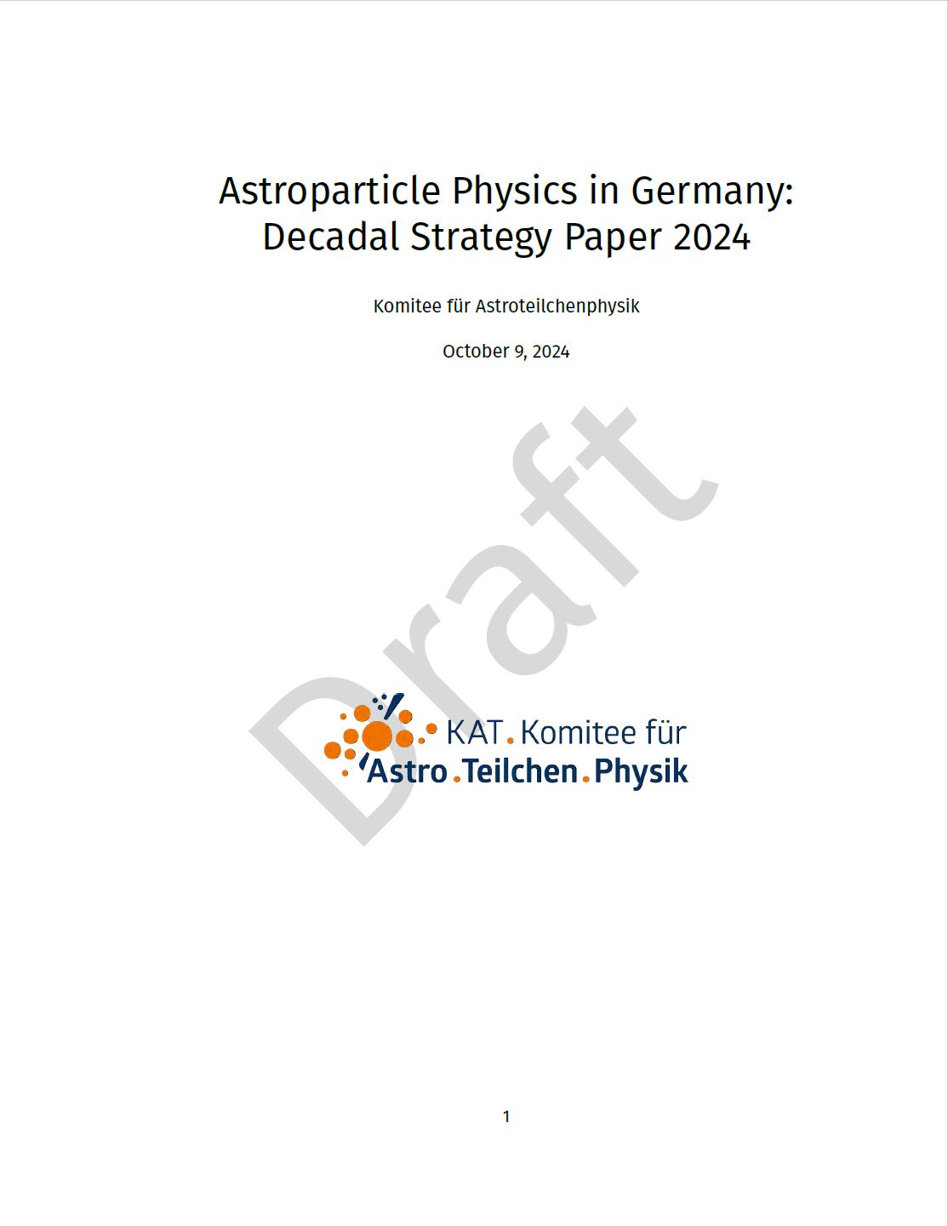
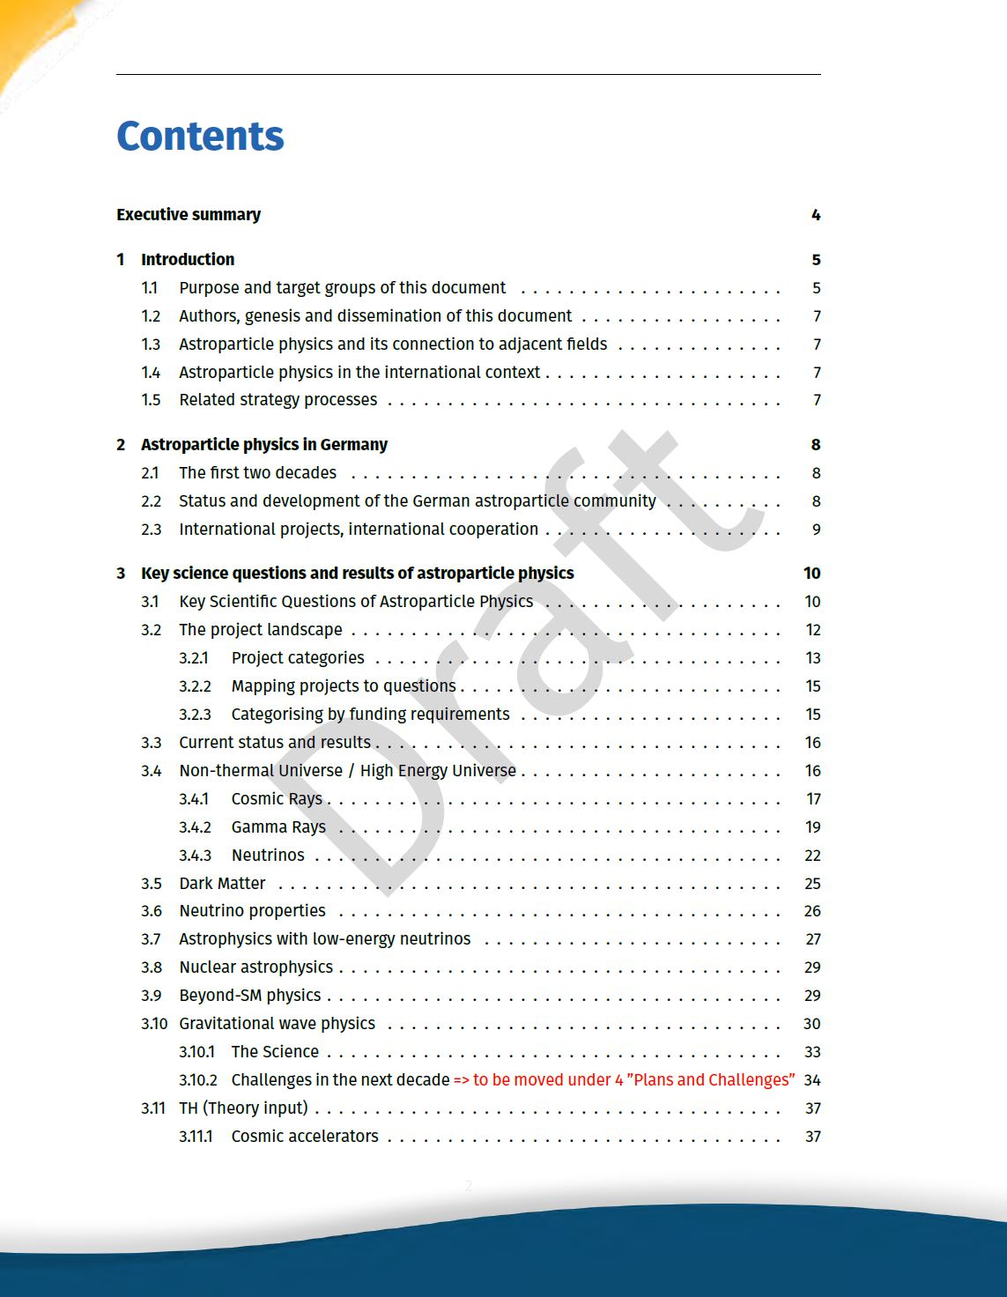
The KAT strategy paper today (1)

Slide 6
The KAT strategy paper today (2)
Input on status and challenges collected from KAT constituencies (many thanks!):
Dark Matter (DM)
Neutrino properties (NP)
Low-energy neutrino astrophysics (LN)
Cosmic rays (CR)
Gamma-ray astronomy (GA)
High-energy neutrino astrophysics (HN)
Gravitational waves (GW)
Nuclear astrophysics (NA)
Theory (TH)
Many parts still incomplete or even missing
Not yet consistent in style, detail, …
Some sections in (or before) genesis
In the follwing: Remarks along the table of contents

Slide 7
Table of Contents & general remarks
The ToC itself is probably not subject to major modifications:
Executive summary 1 Introduction 2 Astroparticle physics in Germany 3 Key science questions and results of astroparticle physics
4 Plans and challenges for the next decade 48
5 Astroparticle physics and society 6 Recommendations
Appendices
A few general remarks:
Science: Start with key science questions, describe where we are and derive the need for future projects.
Target audience: Stakeholders, decision makers, strategy bodies of science communities
They must like it, not we – it is not a science review (no equations, no references, no science result plots, …).
Still empty Partly drafted To be consolidated

Slide 8
1 Introduction
1.1 Purpose and target groups of this document 1.2 Authors, genesis and dissemination of this document
1.3 Astroparticle physics and its connection to adjacent fields
1.4 Astroparticle physics in the international context
1.5 Related strategy processes
Two alternative versions of 1.1
1.2: Should be rather „straight forward“.
1.3: Requires care in describing → We should not claim/abandon fields across current boundaries but also not ignore what happens there.
1.4: Important: Astroparticle physics needs intenational/global coordination, and German strategies need to be properly aligned.
1.5: Make use of synergies, avoid inconsistencies.

Slide 9
1.1 Purpose and target groups: Resource awareness
Note the following statement from 1.1:
Provide information on resources as far as available.
Do not gauge recommendations/prioritisations to assumed funding profile(s).
Nevertheless consider what the recommendations will mean/imply in the light of realistic funding scenarios.
“While the document emphasizes the scientific and technological advancements that have been made, it also aims to provide a clear, resource-aware strategy, considering the financial, infrastructural, and human resources needed to realise the ambitious goals of the field. The
document does not prioritize specific projects based on funding profiles but instead focuses on the broader strategic direction that should guide
future investments. It offers a vision for how Germany can continue to play a leading role in shaping the field of astroparticle physics while
ensuring that the projects undertaken are sustainable and deliver maximum scientific value.”

Slide 10
1.3 Connection to adjacent fields
Particle physics: Neutrino beams Axion searches Collider experiments Theory
Dark matter: Direct & indirect searches, axions, …
Neutrinos: Properties, oscillations, CP violation, …
Beyond Standard Model (e.g. sterile neutrinos)
Hadronic interaction (e.g. of cosmic rays)
...
High-energy astrophysics (e.g. AGNs)
Black holes, neutron stars
Supernovae and BNS mergers
Indirect dark matter searches
…
Nuclear astrophysics
DM and 0vbb experiments
…
Astronomy:
Elm. observations
Multi-messenger observations
Theory
Nuclear physics:
Experiments + Theory

Slide 11
1.5 Related strategy processes
Astroparticle physics: → APPEC – European Coordination Essential for European alignment New APPEC Roadmap in preparation (2027-2036) Please participate in survey, urge European partners as well → Theory: EuCAPT White Paper (2021) → Various relevant international roadmaps (e.g. P5 in the US)
Particle Physics → European Particle Physics Strategy Update (EPPSU) Target date: Summer 2025 (KAT strategy as input) A series of KET-organised workshops (next: 22-24 Nov., Bad Honnef, non-collider particle physics) EPPSU is of major importance for CERN Presentation by Heiko Lacker
Astronomy: → New Denkschrift – presentation by Jörn Wilms
Nuclear Physics: → NUPECC Long Range Plan 2024

Slide 12
2 Astroparticle physics in Germany
2.1 The first two decades
2.2 Status and development of the German astroparticle community 2.3 International projects, international cooperation
Still incomplete – please comment!
2.2 requires completion of the community census (see next slides)
2.3 is meant to describe the concrete international cooperations of the German astroparticle institutions, while 1.4 is more on international processes and cooperation instruments

Slide 13
2.2 German astroparticle community (1)
A census was started in spring 2024. We collect from all astroparticle groups (i.e. all group leaders):
Institution, Email, fractional AP commitment
Priorities (DM/NP/LN/CR/GA/HN/GW/NA/TH)
Group composition including PI (Permanent/Postdocs/PhD/Undergraduate/Technical)
Reference date: 1 Jan 2024
Currently ~55% complete → WE NEED THE MISSING DATA! What we do not need:
Summary data for whole institutions/universities
Future projections
Uncoordinated double-counting
A renewed request for input will be sent. Please reply!

Slide 14
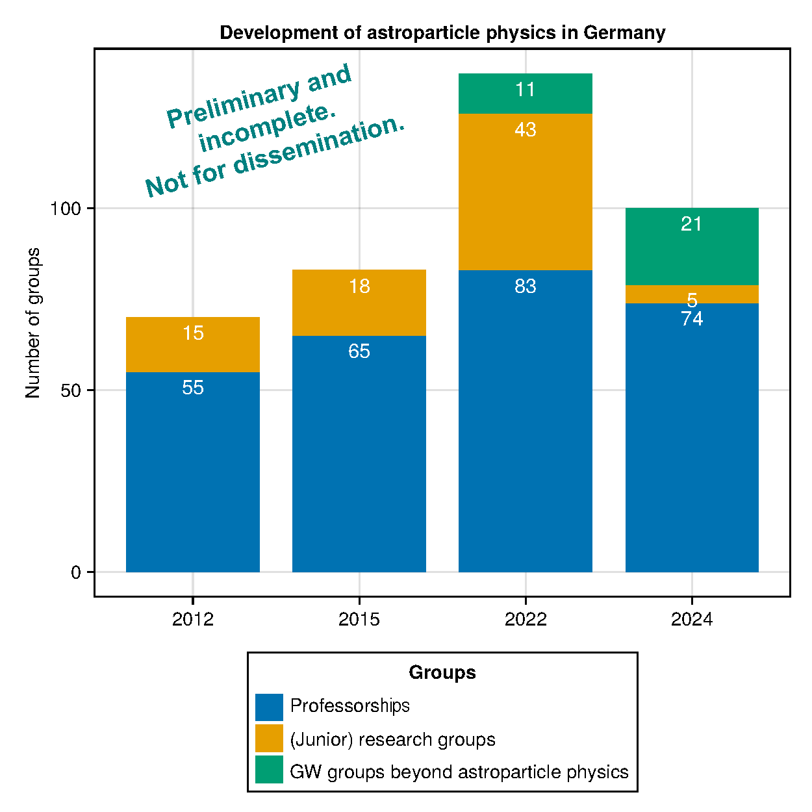
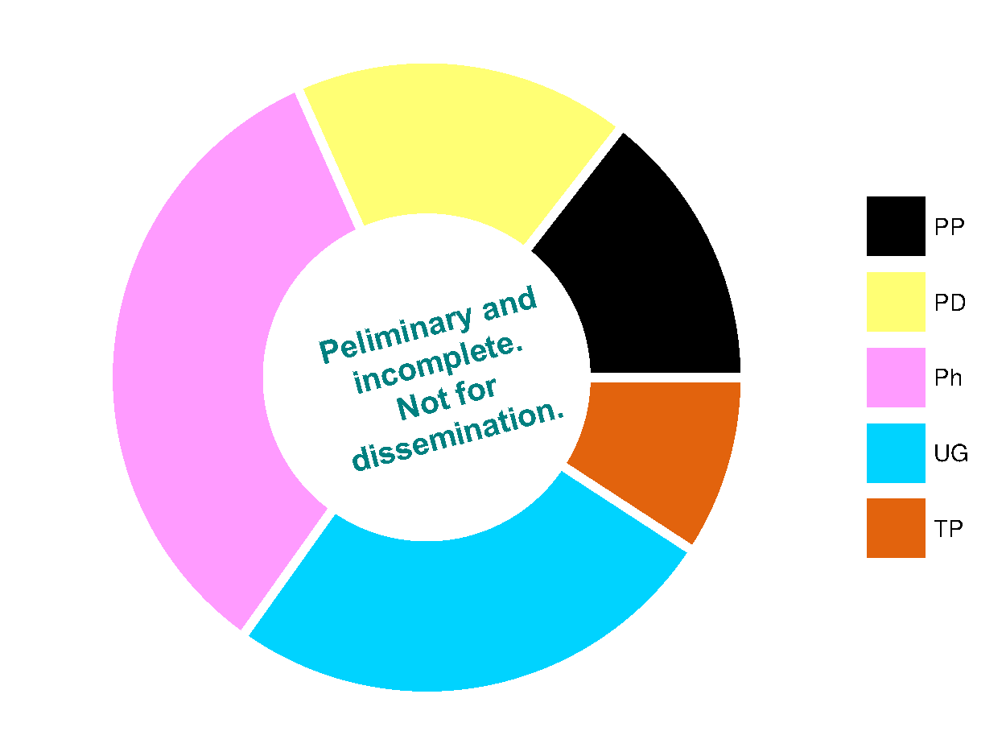
2.2 German astroparticle community (2)
A preview of what we can do with these data (thanks to Tom Gal):
Missing data → we are shrinking!

Slide 15
3 Key science questions and results of astroparticle physics
3.1 Key Scientific Questions of Astroparticle Physics 3.2 The project landscape 3.2.1 Project categories 3.2.2 Mapping projects to questions
3.2.3 Categorising by funding requirements
3.3 Current status and results
3.1 and 3.2 newly added to list key science questions and map them to the project landscape
3.1.1: Started and structured, by still incomplete – please help!
3.2.2: We hope the idea is clear but the matrix needs to be filled
3.2.3: We suggest to describe existing (and missing) decision processes for the following ranges of German invest volumes for projects: small (<10 M€); medium (10–50 M€); large (>50 M€).
3.3: To contain large parts of the KAT input (in sections 3.4-3.12, some section renumbering will be required).

Slide 16
4 Plans & challenges for the next decade
4.1 International research infrastructures
4.1.1 Gravitational waves
4.1.2 Gamma rays
4.1.3 Neutrinos
4.1.4 Underground labs
4.2 Dark Matter Direct Detection Experiments
4.3 Mid-and smaller-size experiments
4.4 Multi-messenger observations
4.5 Theoretical astroparticle physics
4.6 Computing
Will be restructured according to the project categories in 3.2.1.
Avoid research infrastructures used differently than in FIS process.
4.1.1, 4.2, 4.3 and 4.5: Already partially contained in 3.
4.1.4: Not clear where to address – perhaps „4.6 Infractructure“, also containing computing.
4.4: Thought to cover dedicated MM efforts, such as online reconstruction and alert networks. May be partially redistributed.
4.6: See afternoon session 14:00-16:00.

Slide 17
5 Astroparticle physics and society
5.1 An Environment for Educating Excellent Young Scientists
5.2 Knowledge and Technology Creation and Transfer
5.3 Cooperation with Technology Enterprises and Industry
5.4 International Dimension
5.5 Research Data as a Cultural Heritage
5.6 Sustainability
5.7 Gender, Diversity, Inclusion
5.8 Outreach
5.9 Strengthening Science in Remote Regions
All contain short “abstracts“ but still need to be worked out.
Some grouping may be possible:
Knowledge/technology transfer + cooperation with industry
International dimension + strengthening science in remote regions
Computing (4.6) + research data
See discussion today 14:00-16:00, also containig computing. Two presentations (Computing+data, Outreach) + structured discussion on all topics.

Slide 18
6 Recommendations
Still empty.
Must be consistent with (not equal to!) the recommendations for the 3-year ErUM-Pro cycles → strategy talks for next round ~May 2025
Should we aim at a number of general recommendations in addition to project prioritisations? Ideas could be
Conserve broad spectrum of astroparticle physics
Provide structured and competitive decision process for mid-size projects
Generate forum for continuous consultations with decision makers and adjacent fields ..
Explicitly address different funding agencies/institutions such as BMBF, DFG, HGF, MPG, EU, …?
How to phrase recommendation that are meaningful even in view of reduced/scarce financial resources?
Please consider these questions in the discussions!

