Slide 1
SLS2.0 Series Magnet Qualification
Challenges, results and lessons learned
Stéphane Sanfilippo for the PSI Magnet Section
SLS2.0 series Magnets : Context and the measurement challenge
The measurement strategy
Two Selected Results and lessons learned
Triplet measurements
Magnetic coupling electro & permanent magnets
I.FAST Workshop 2025 on Stability of Storage Ring Based Light Sources
Mar 17 – 21, 2025, KIT North Campus

Slide 2

Magnets for the Upgrade of the Swiss Light Source

Slide 3
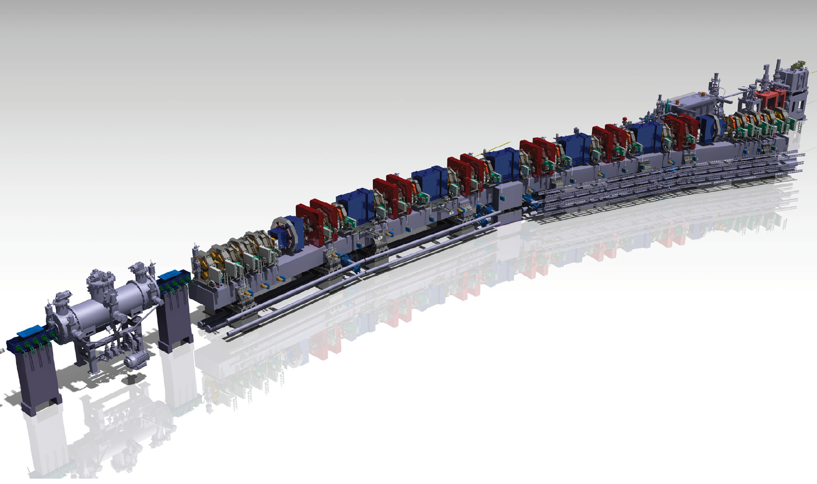
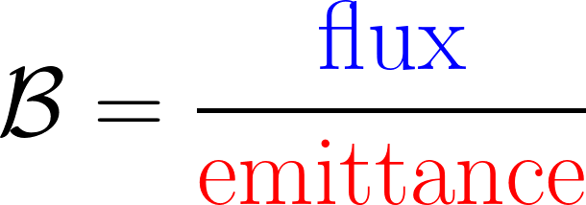
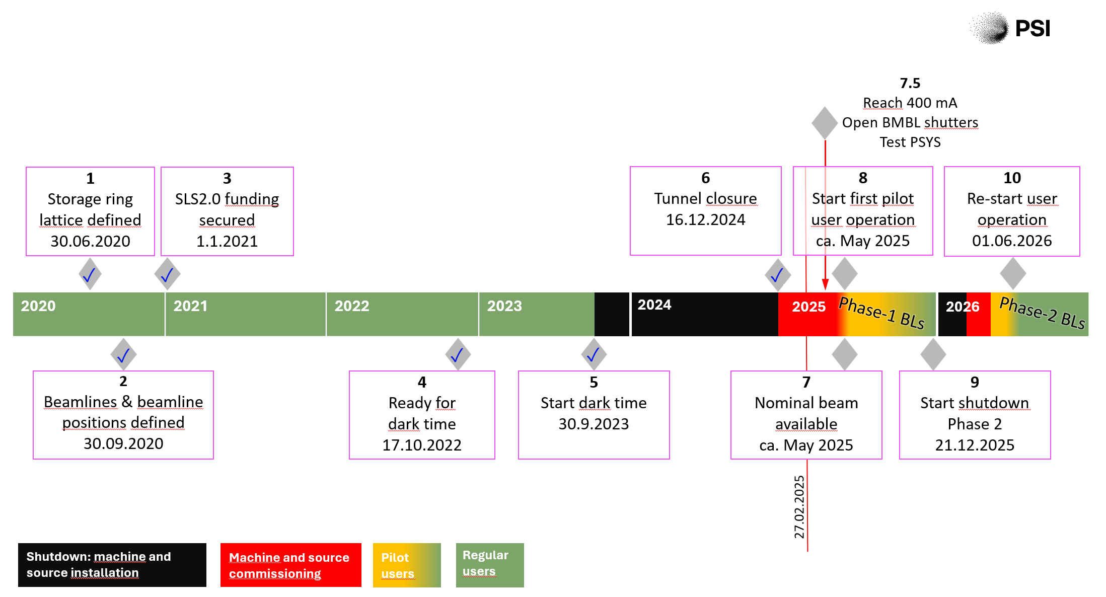
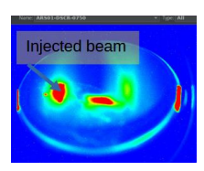
The upgrade of the Synchrotron Light Source - SLS2.0 https://www.psi.ch/fr/media/sls-20
E= 2.4→2.7 GeV
x 35
Brilliance
SLS 2.0: ε_{x} = 157 pm.rad
First light: 2025
Phase 1
Stored beam in January 2025!
Phase 2

Slide 4
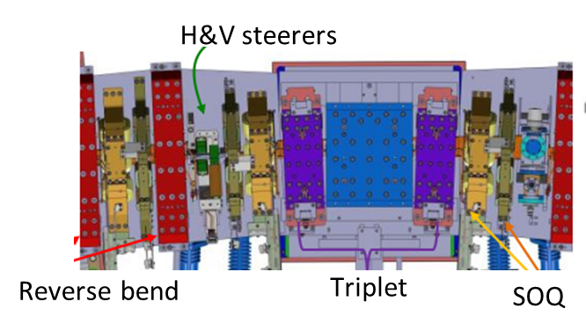
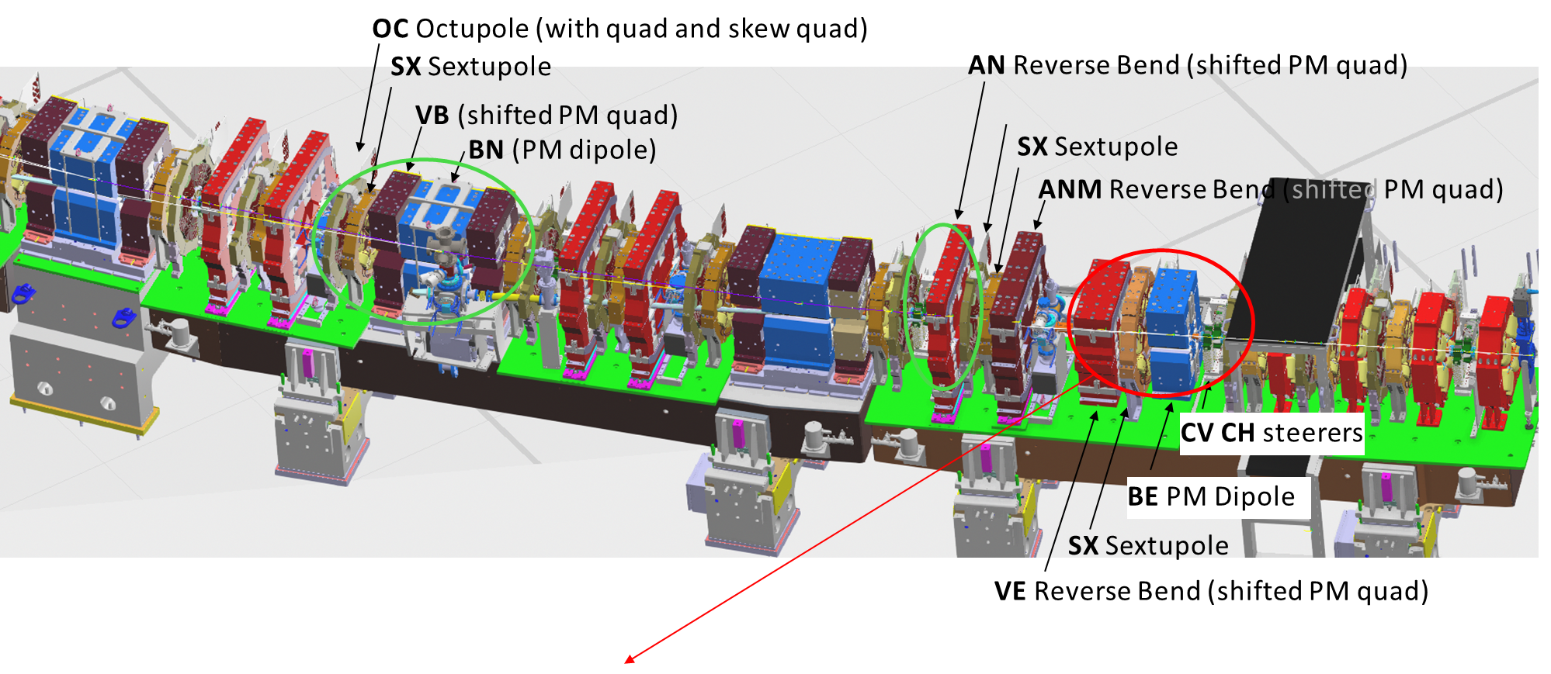
SLS2.0 magnets : the challenges
Fields above 1 T and increased field gradients
Combined function magnets
Tight tolerances (field quality 0.01….0.1 %; aligment below 30 micrometers)
Three types of magnets (electro/permanent/superconducting)
High number of magnets , 16 different types
Dense packing of magnets (Cross-talk effects).
Tight schedule for the design, production and measurements.
Lack of space !
Triplet

Slide 5
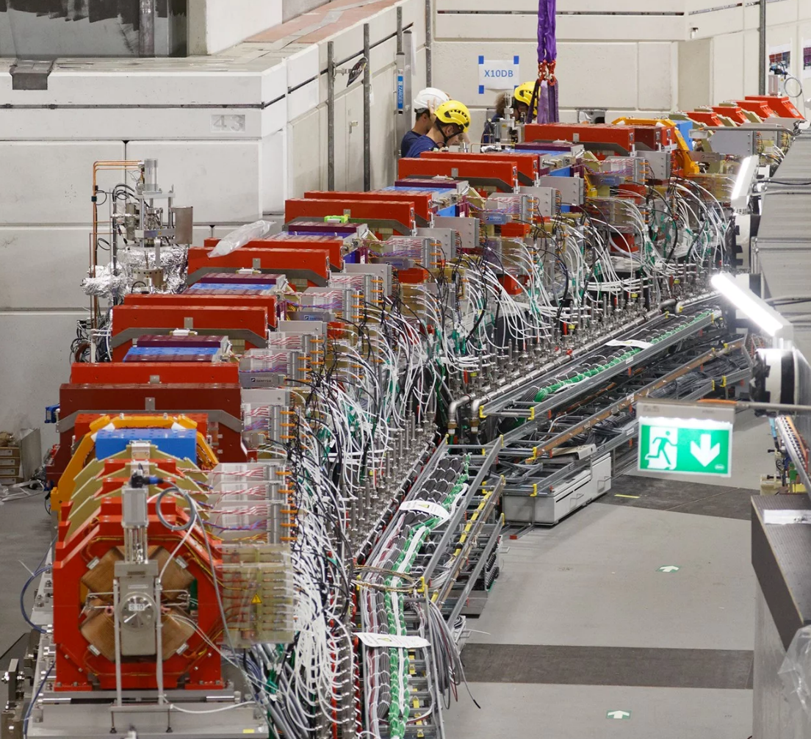
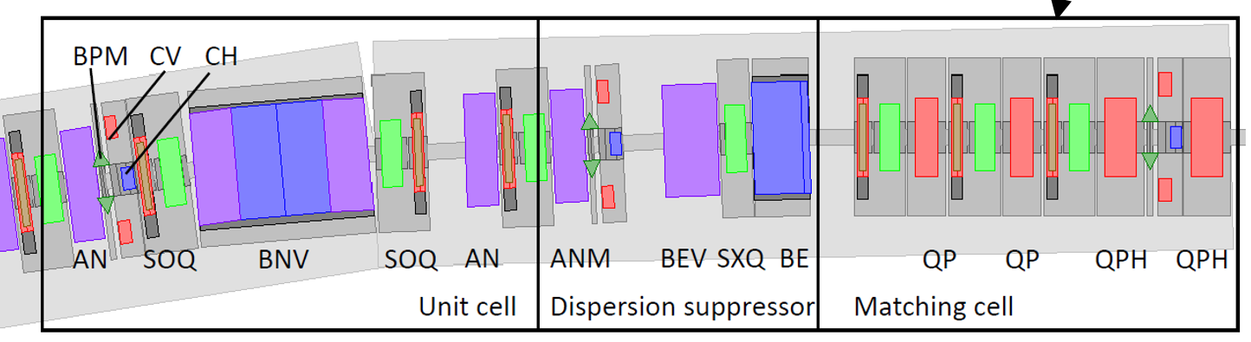
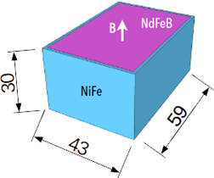
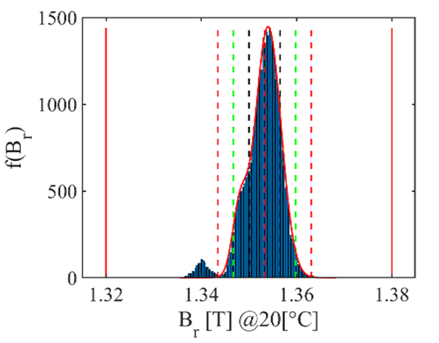
Magnets for the SLS upgrade
34 000 NdFeB blocks
16.6 tons
Permanent Magnets*
BN 56 Dipole
BS 4 Dipole
VB 96 Quad
VBX 24 Quad
Triplet 60
AN 120 Quad
ANM 24 Quad
BE 24 Dipole
VE 24 Quad
Total : 372
Electromagnets
QP 55 Quad
QPH 53 Quad
SXQ 24 6-Poles
SX 264 6-Poles
OC 264 8-poles
SOQ 264
CHV 112 Steering
Total: 780
* Reduction of the magnet power consumption ~60 %
1152 (phase 1)+ two 5 T superconducting superbends (phase 2)

Slide 6
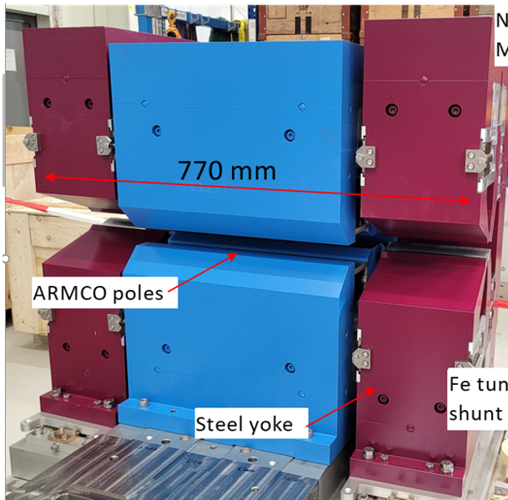
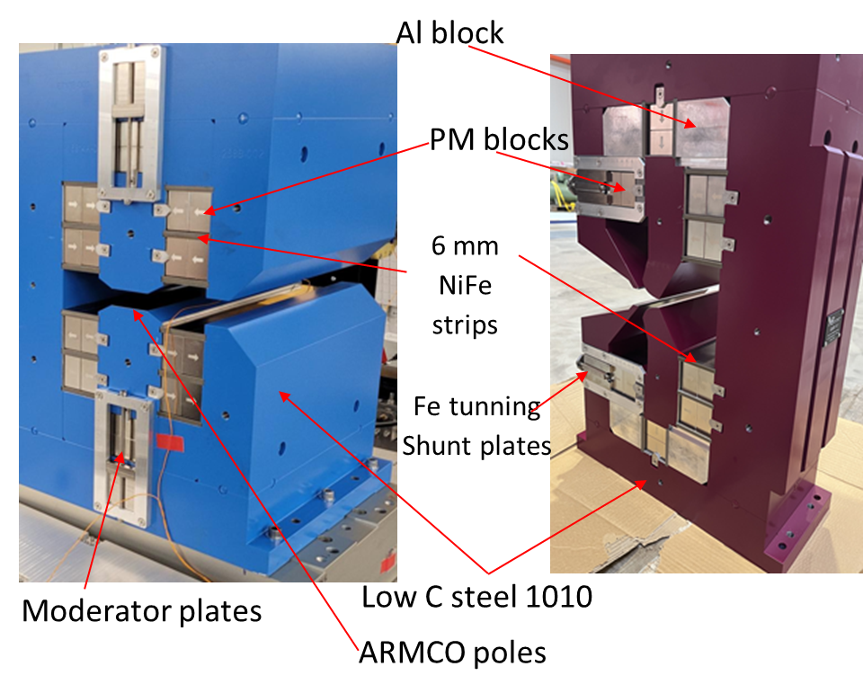
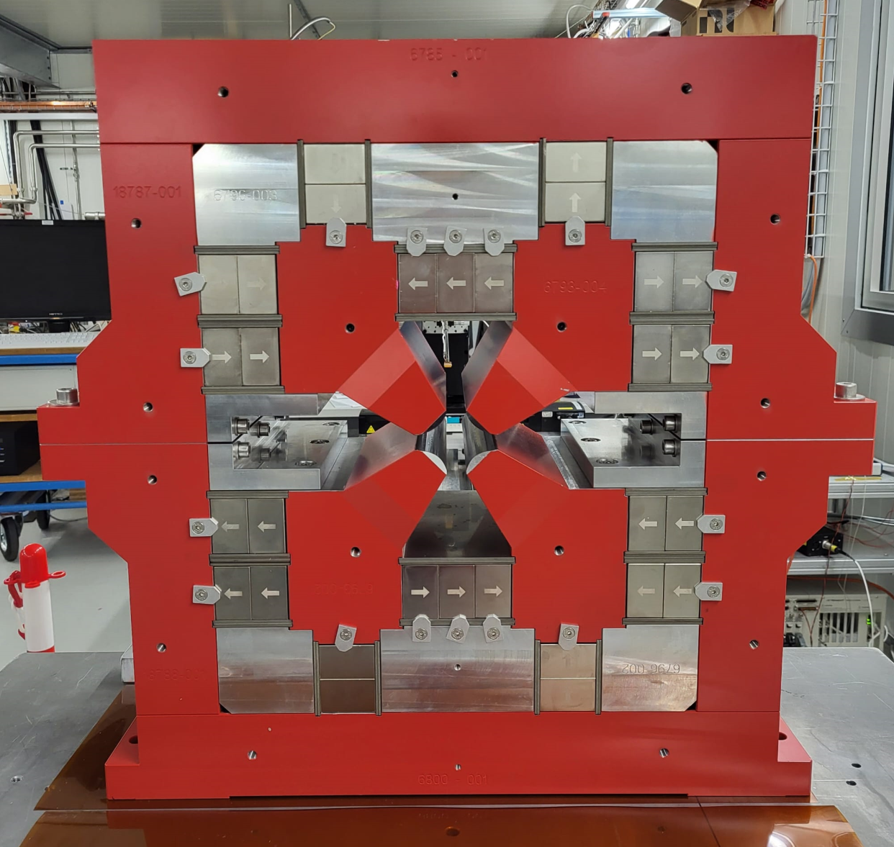
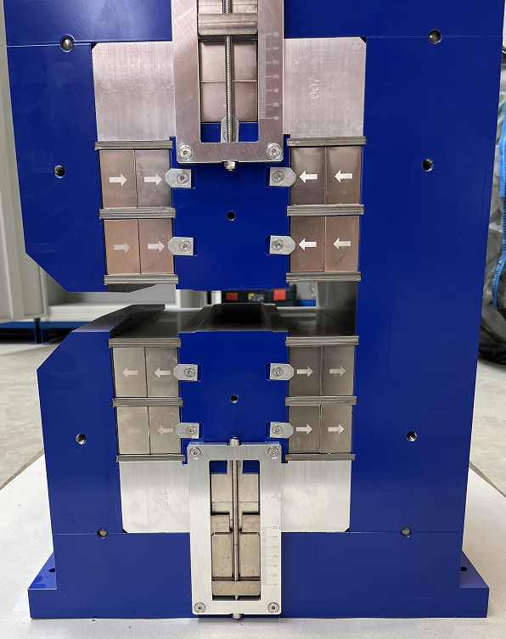
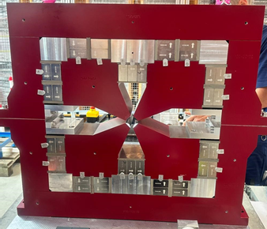
SLS2.0 permanent magnets
Dipole BN (56)
1.35 T; L=405 mm; G=22 mm
VB (120)
0.84 T
40.6 T/m
Triplet VB/BN/VB (60) , 0.861 Tm
Quadrupole AN(M) (148)
72.5-78 T/m ; Ø=22 mm
Quadrupole VE (24)
45.8 T/m; Ø=22 mm
2.1 T Superbend (4)
Gap =14 mm; L=405 mm

Slide 7
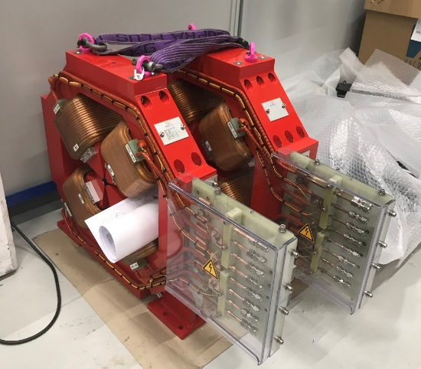
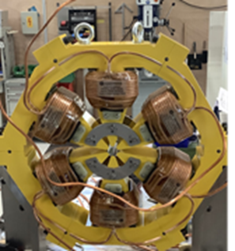
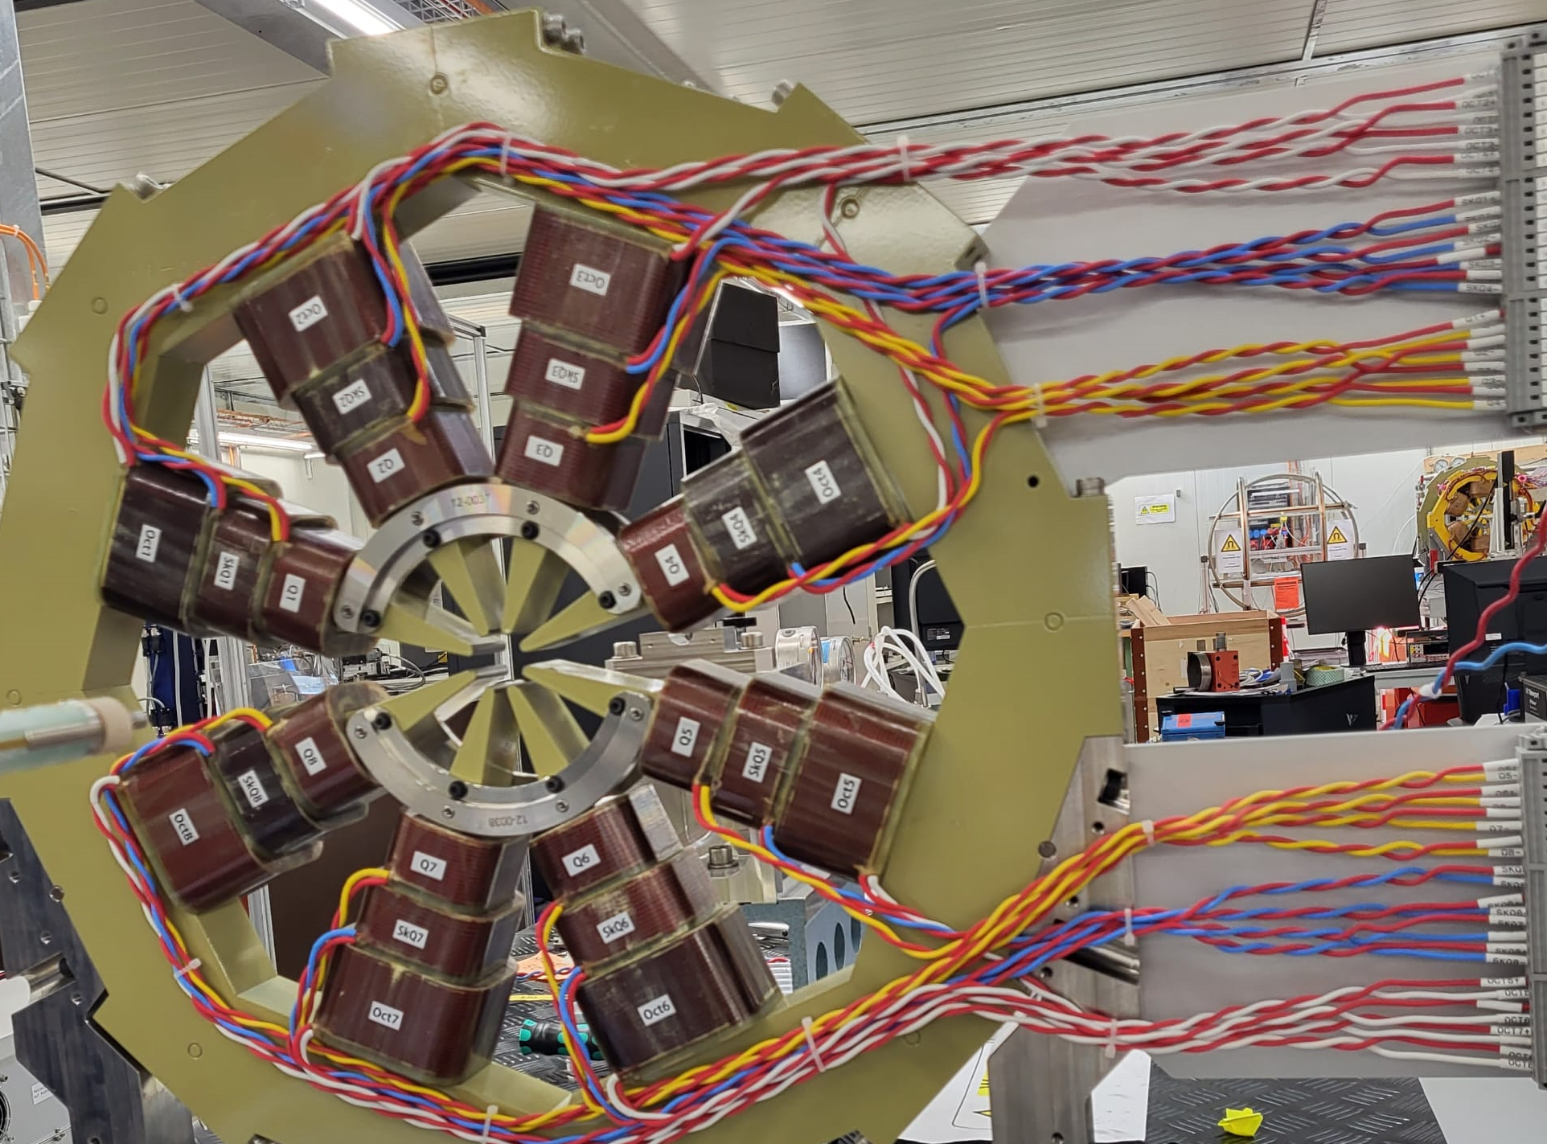
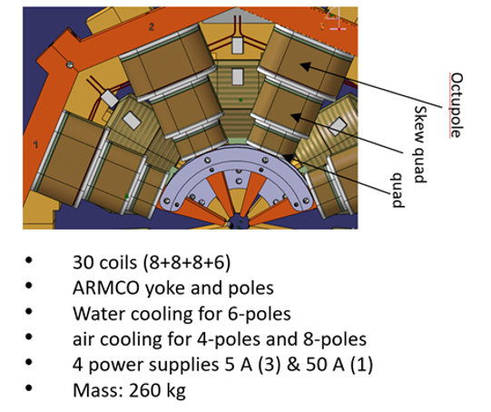
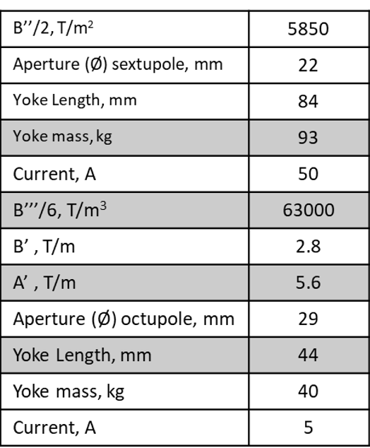
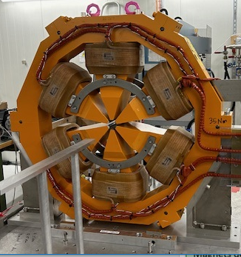
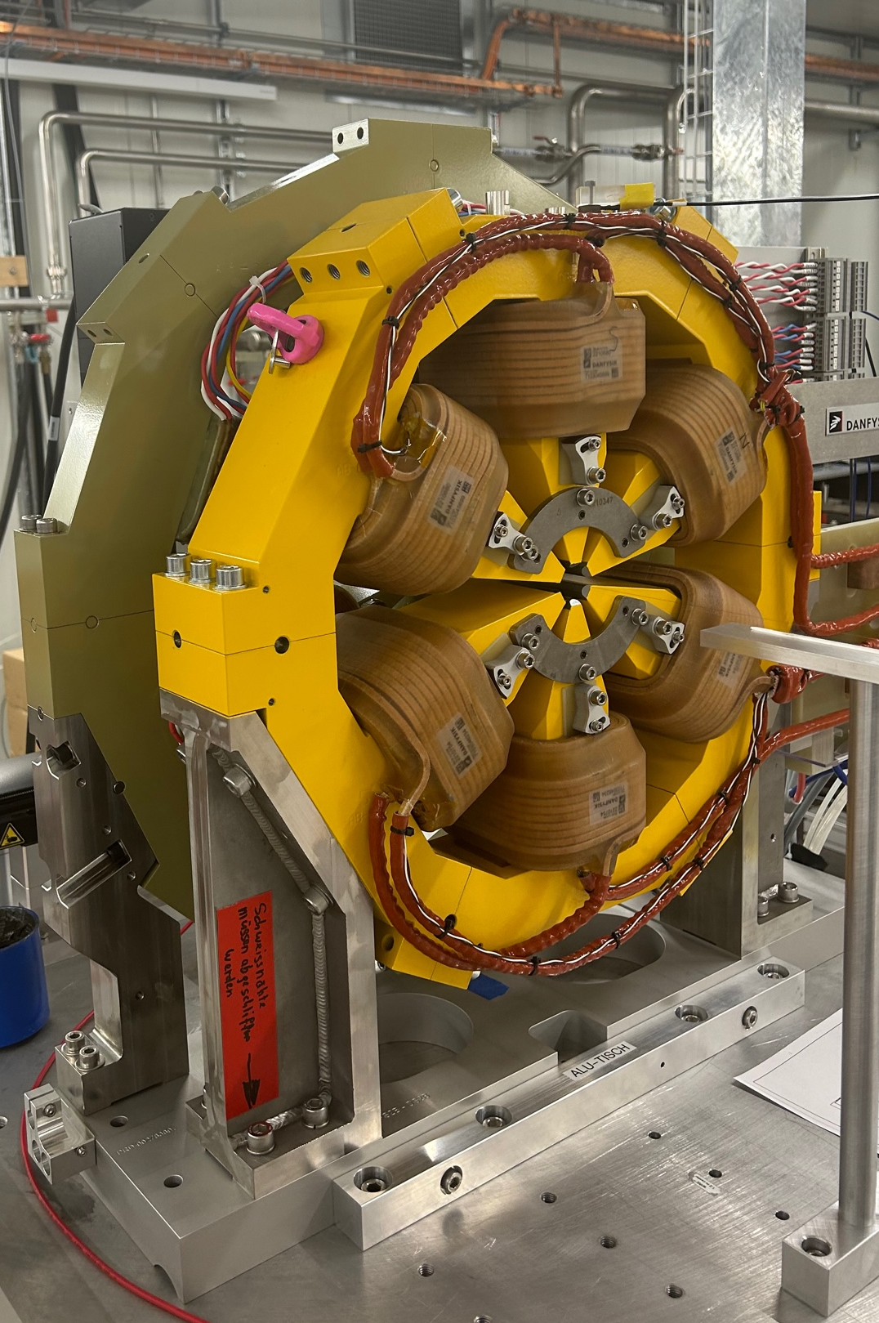
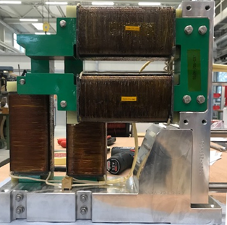
SLS2.0 electromagnets
Quadrupoles (110)
93T/m-98 T/m
Ø=21 mm
Sextupoles (288-6 types)
5093T/m²-5840 T/m²
Ø=22 mm
Combined functions
Octupoles (264-2 types)
Steerers CH/V
44 mT; 31.4 mT
Sextupoles SXQ (24)
SOQ (264)

Slide 8
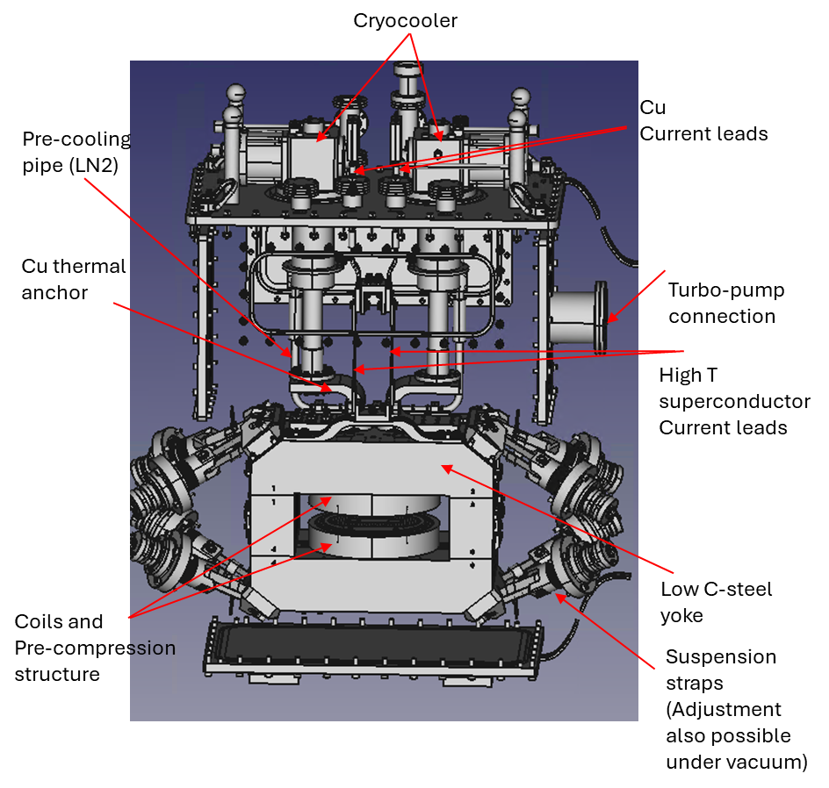
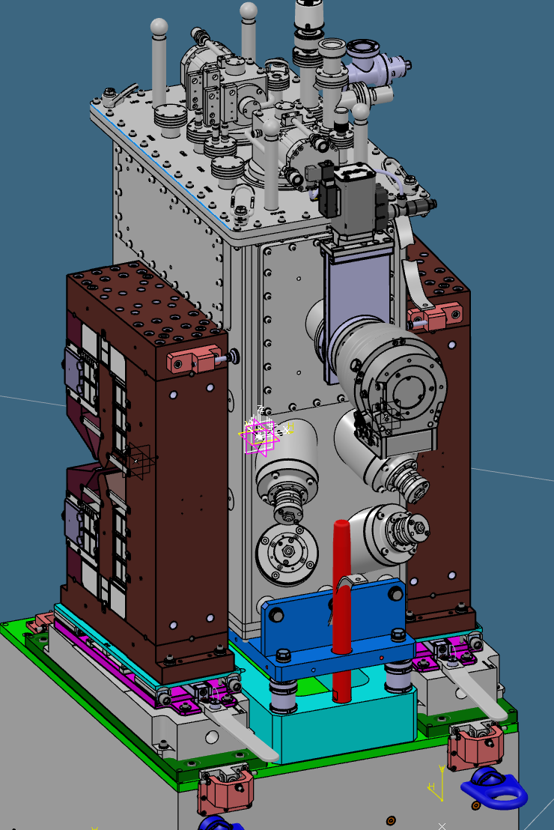
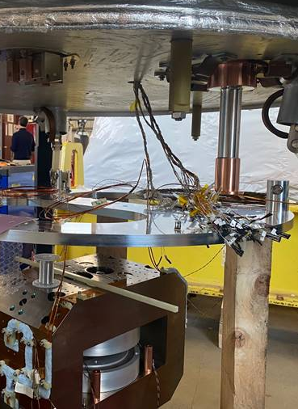
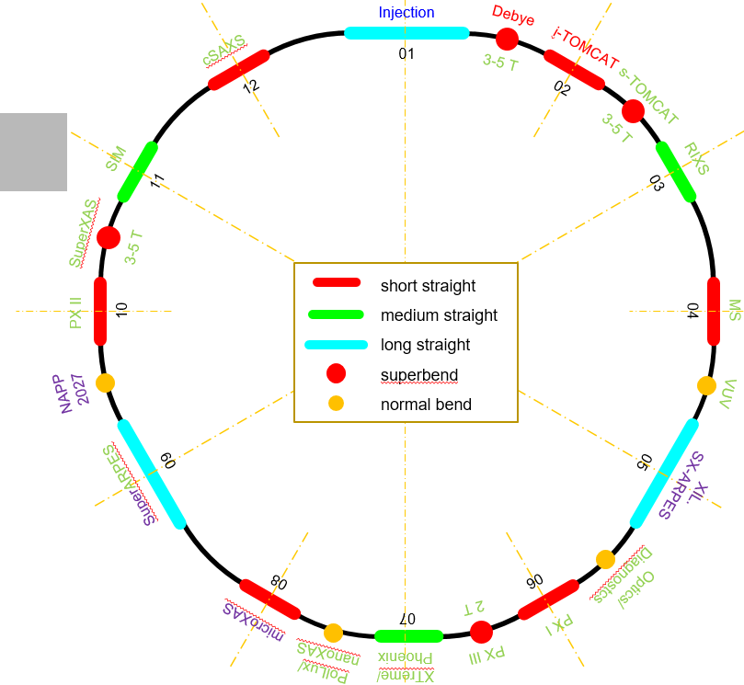
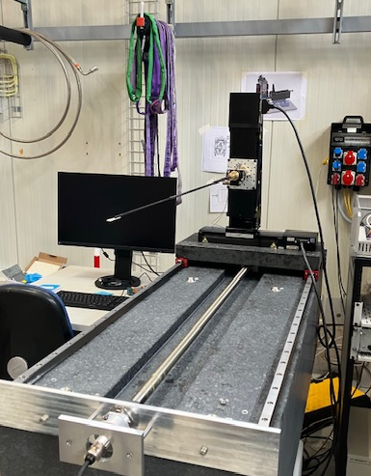
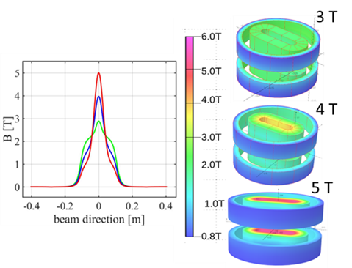
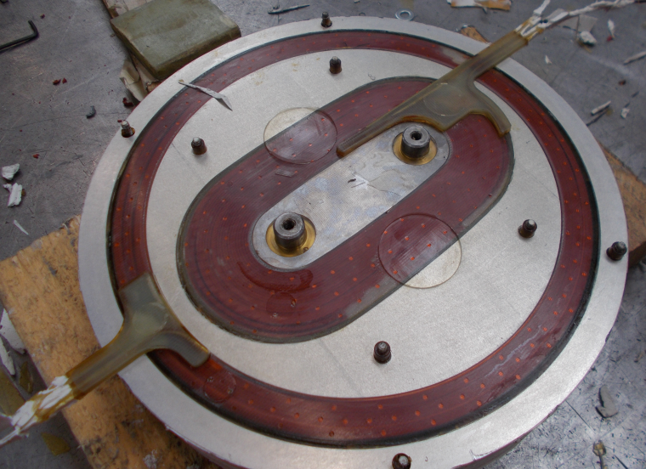
5T NbTi Superbend – phase 2
2 superconducting Superbend magnets will replace the PM-based ones.
2 operating scenarios: 3T and 5T peak field.
Superbend delivery planned between July and fall 2025
2 new VBS yokes are required (normal VBs are too weak);
Power tests and magnetic measurements with till end of 2025
Cold mass test at SIGMAPHI

Slide 9
Measurement strategy and implementation

Slide 10
SLS2.0 Magnet qualification
Challenge : 100 % of magnets are measured at PSI
7 measuring test benches operational since September 2023
Systems ( X benches) | Electro magnets | Permanent Magnets | 3-5T superbend
Rotating coils (2) | Field Strength Multipoles | Field Strength Multipoles Magnetic axis
Moving Wires (2) | Magnetic axis (reference magnet) | Triplet: Field Strength alignment
Vibrating Wires (2) | Magnetic Axis (SOQ)
3D Field Mapper | Field Strength & Maps (cross talk) | Field Strength & Maps ( BE & cross talk) | Field Strength Maps
Accuracy (wire) : 1-2 units
Reproduciblity : 1 unit
Axis : < 30 micrometers
Integrated Field Strength | Moving Wire | Rotating Coil | Compact Field Mapper
Uncertainty vs ref. (units) | Reference | <5 units | ~10 units
Reliable and accurate measurement systems

Slide 11
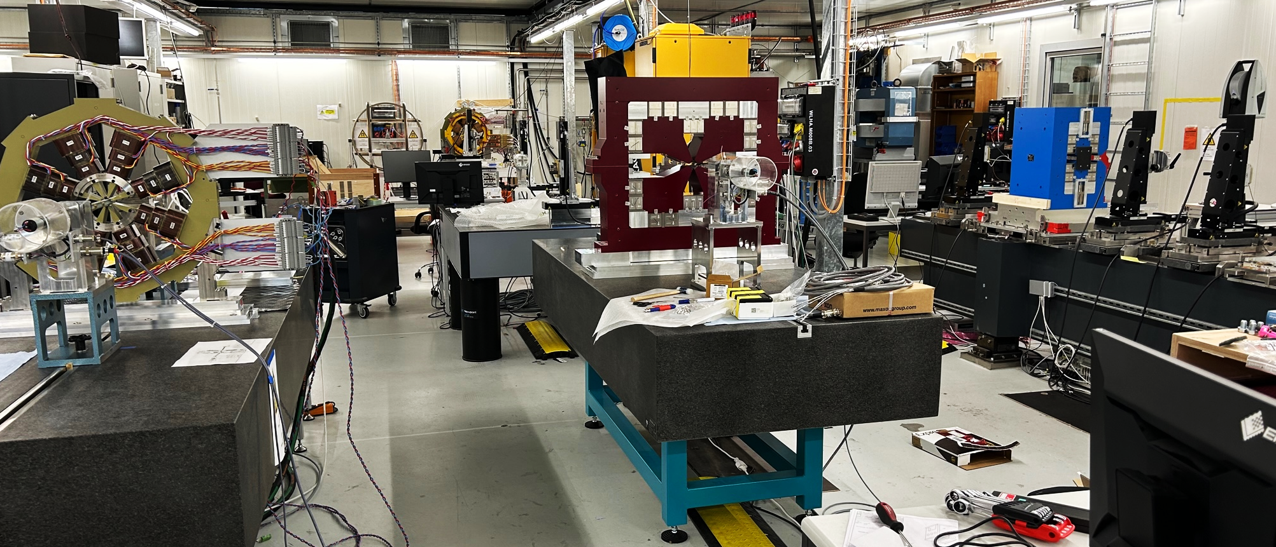







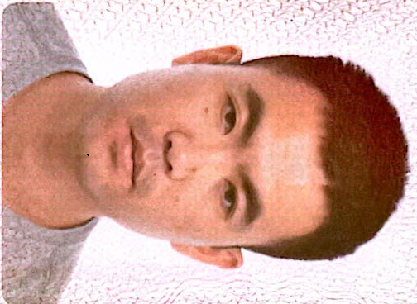









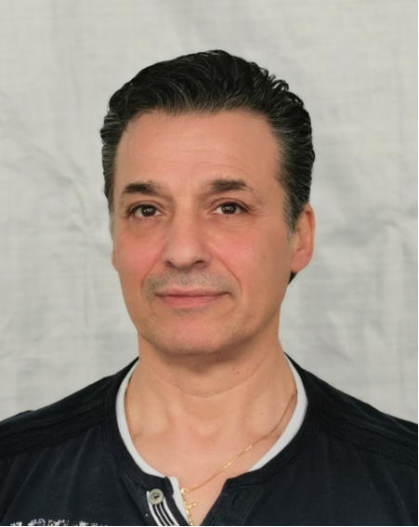



Infrastructure for SLS2.0 magnets:
Magnetic Measurement Lab
Field Mapper
Field Mapper
Vibrating Wires
Vibrating Wires
Moving Wires
Moving Wires
Rot. Coils
Seven magnetic measurement benches are operational
since september 2023
Assembly & Measurement
& Support teams for SLS2.0 in 2024 ~ 22 people

Slide 12
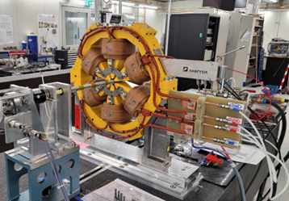
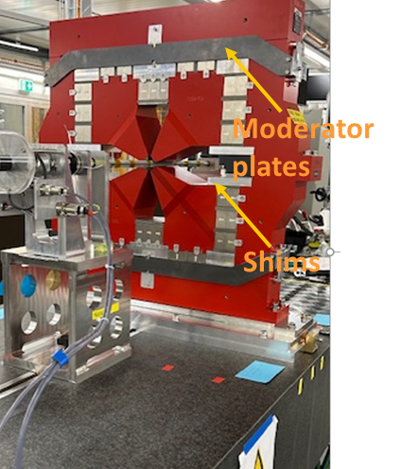
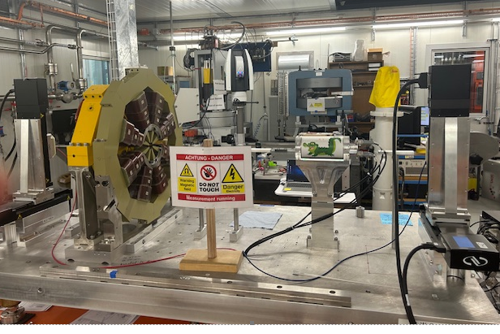
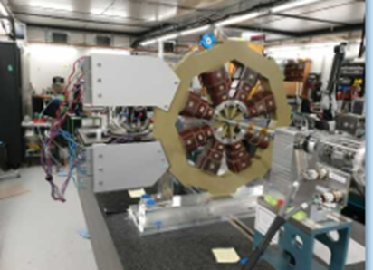

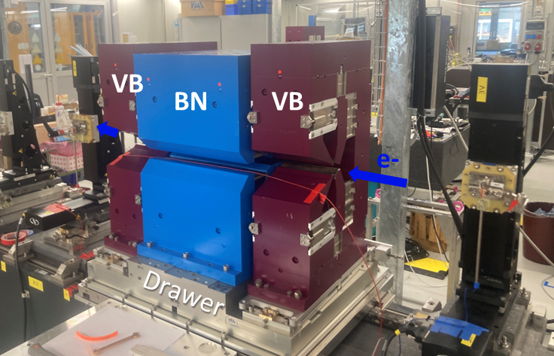
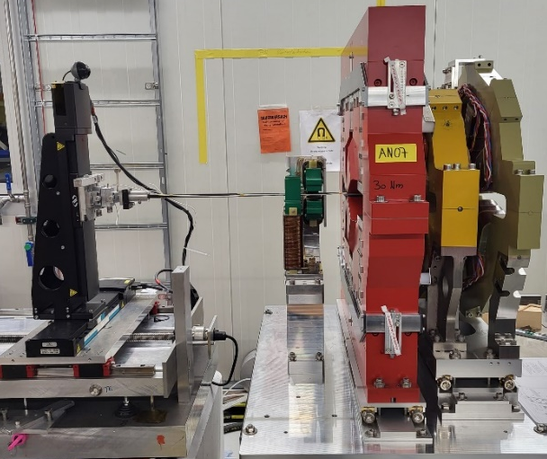


Magnetic measurements (phase 1)
Sextupoles &Octupoles axis measurement
with vibrating wires
Team of 4 persons
One team of 4 persons
Triplet measurements and alignment
with Moving Wires
Team of 4 persons
Magnetic coupling studies with Hall mapper
Team of 2 persons

Slide 13
Two challenging measurements results & lessons learned
- Triplets measurements
- Magnetic coupling

Slide 14
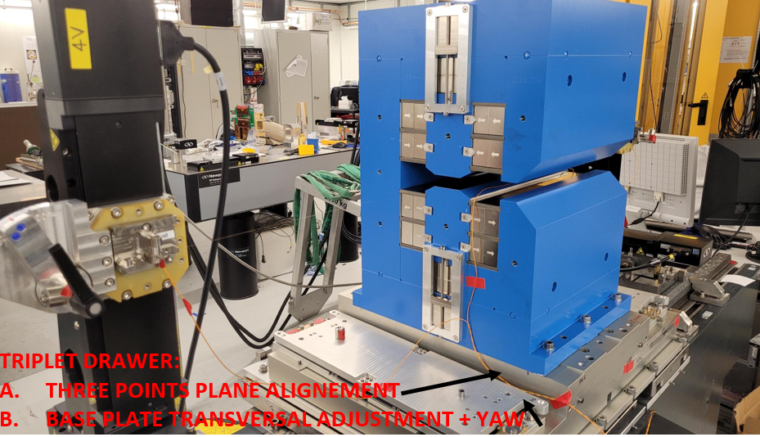
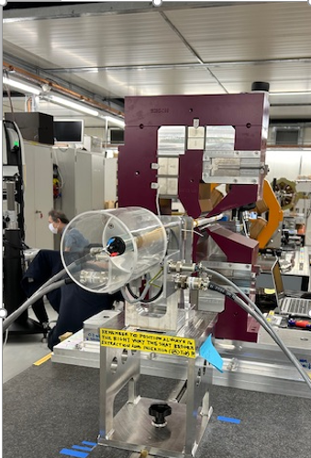
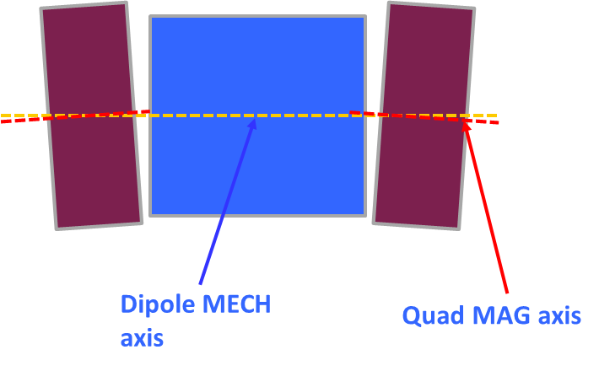
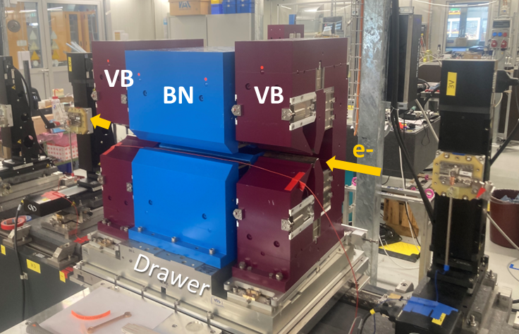
Alignment and tuning of the triplets : a multi step process
ciro.calzolaio@psi.ch, giuseppe.montenero@psi.ch
Simulation including cross-talk (once for all)
            Extract the nominal field integral of the stand alone dipole for magnet shimming
            Extract the horizontal & vertical field gradient components Ghor, Gver and the nominal integrated field gradient G for stand alone quads.
Single magnet measurement and optimization
            Dipole field integral (wire1) and shimming to ∫B₁dl=-0.5699 (Tm)
            Nominal integrated field gradient and shimming to ∫Gdl=7.0184 (T) and multipoles (Rotating coil)
            Magnetic axis position of each Quad (wire 1)
Triplet assembly and alignment
The dipole mechanical axis (MECH) define the nominal axes of triplet magnets
Quads are positioned on the drawer; a preliminary alignment is carried out on the two Quads vs. the nominal axes (wire 2)
Dipole is installed on the triplet; final tuning of the drawer and Quads (wire 2)- error less than 20 μm
The resulting integral of the assembled triplet is recorded as control parameter (wire 2)
Machine specifications: max 0.2 % relative uncertainty of the triplet field

Slide 15
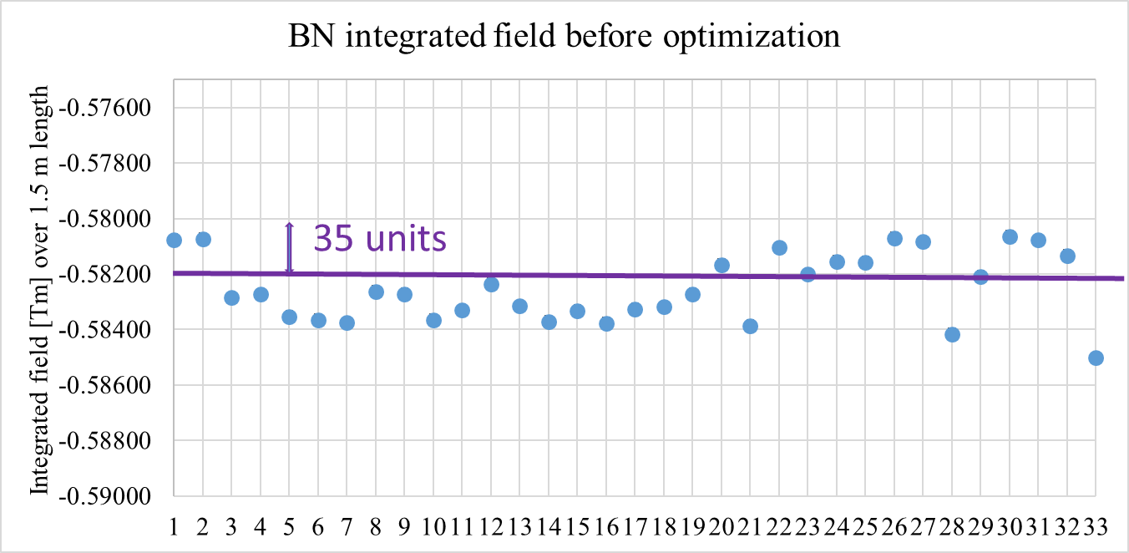
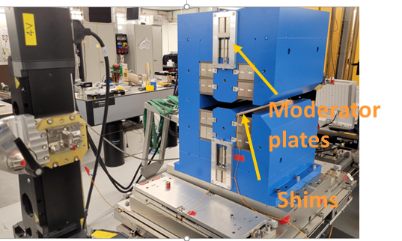

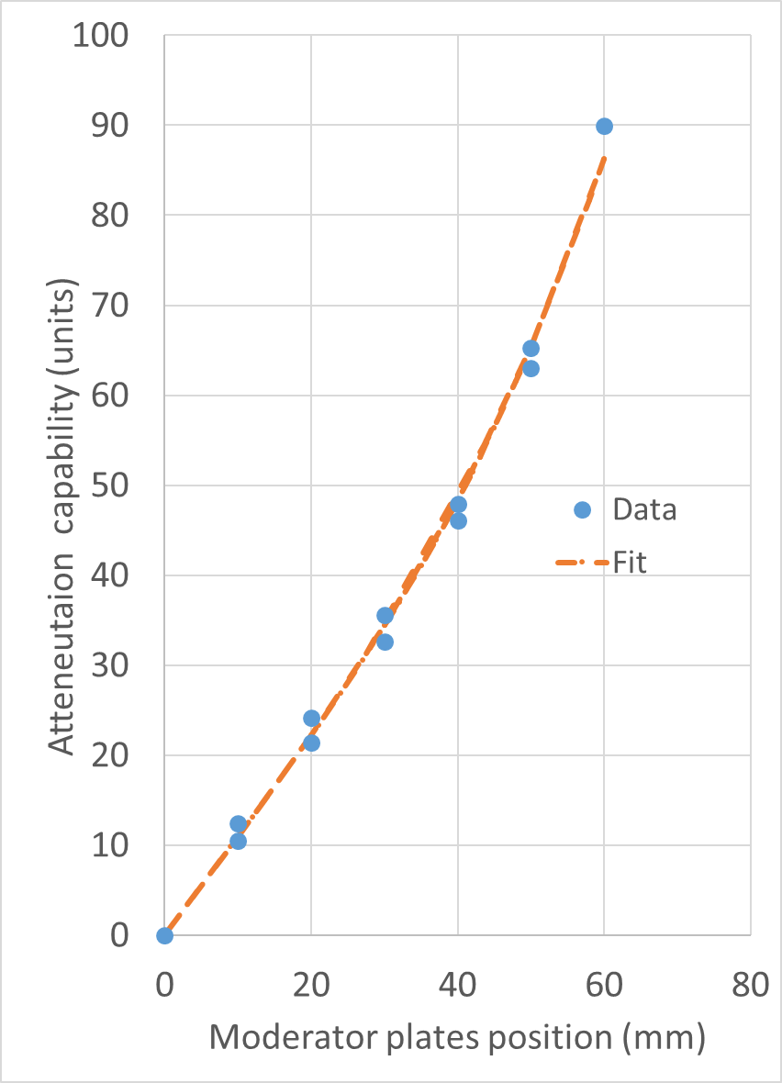
Individual measurements
Dipole optimization with moving wire
Single magnets measured/optimized with the moving wire (Field Strength)
Total tuned BN at target value: 33
Total BN tuned for VBXI/VBXO: 7
Field Integral | Not Optimized (BN for VB) | Optimized (BN for VB) | Attenuation
Average | -0.5823 Tm | -0.5724 Tm | 174 units
σ (unit) | 22 | 1.5
Integrated field strength before optimization : 1.74 % above the machine value in average and spread of 22 units- very good manufacturing quality and efficient PM blocks sorting!
Optimization with (0.75 -1 mm thick) shims +moderator plates successful – ~1 unit level

Slide 16
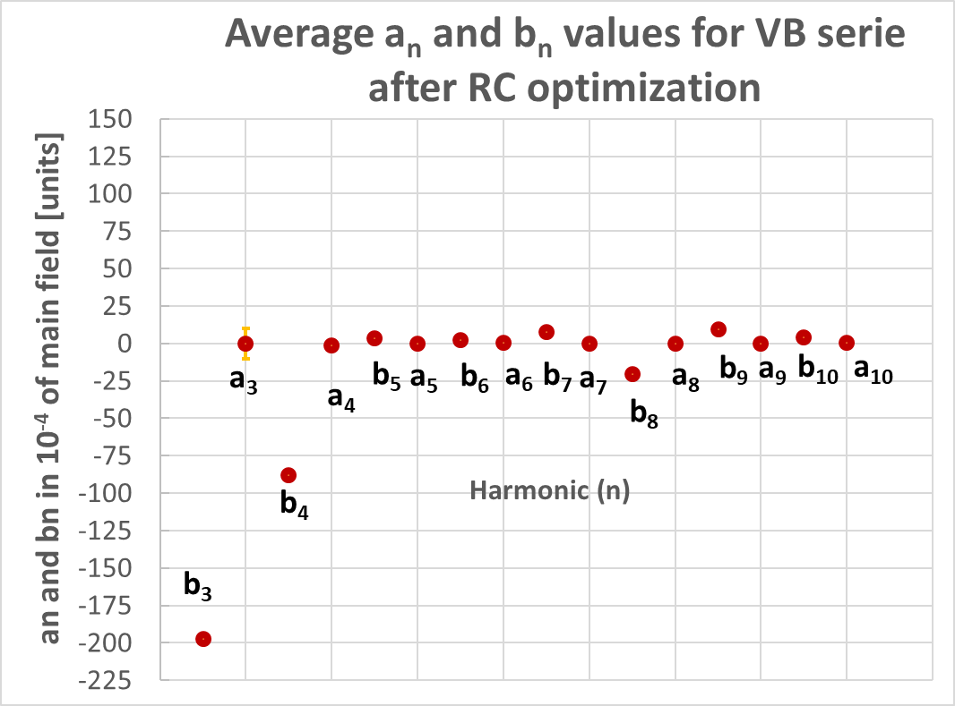
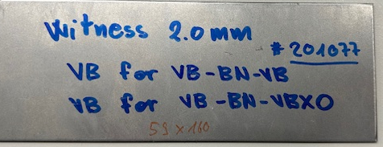
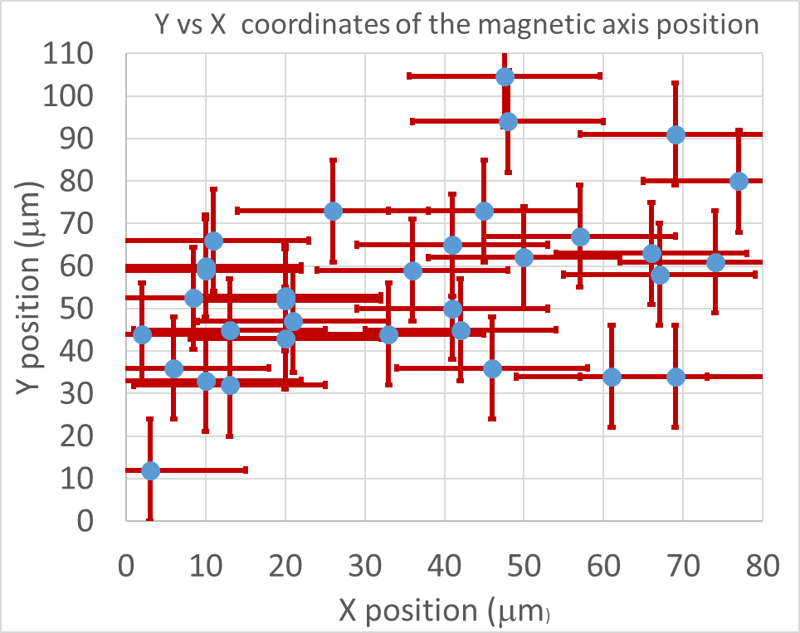
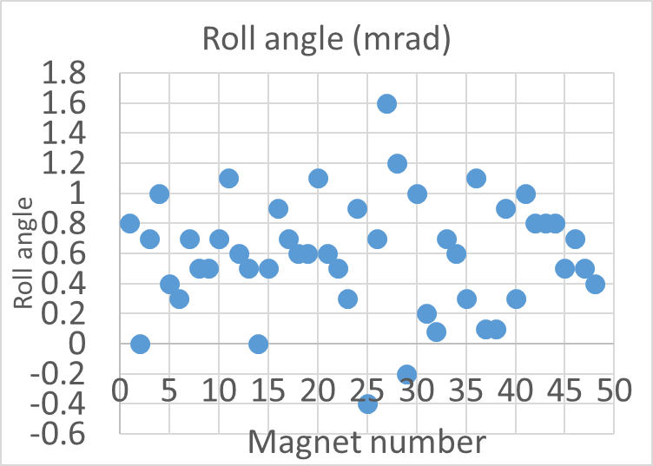
Individual measurements (2)
VB measurements with rotating coil (48 magnets)
Single magnets Field Strength
optimized with the rotating coils
2 mm low C steel shims
Field integral | Before optimization | After optimization
Δ (average) (meas. vs target) (unit) | + 769
σ (unit) | 26 | <2
Strength : 7.7 % above the target value but optimization works (shims, mod.plates)
Field Quality : b₃ and b₄ as high as expected, small skews, stable during production
Roll angles up to 1.6 mrad; large uncertainty of the mag. axis position with the Rot. Coils
Optimization of the axis position with the moving wire mandatory!

Slide 17








Triplet assembly, alignment and Field Integral tuning
Assembly, Alignment according individual meas.
Final tuning on the whole assembly
~7 triplets/month
VB
BS
VB
VB(X) Mag axis
Measurement (x2)
Assembly of the triplet
Mag. axis coordinates
Wire pos.3
Wire pos.2
Wire pos.1
Triplet alignment vs. the nominal axes (survey group)
+ final tuning
VBs quad strength stronger than computed
up to 60 units (coupling effect under-estimated)
Reduction of the triplet strength with the VBs moderator plates
Average measurement rate today : 3 Triplets every 2 weeks
Series measurements in Schedule : Last triplet delivered End of October 2024

Slide 18



Triplets field strength before and after tuning
(1)
(2)
: Single magnet measurements and assembly on the girder
: After fine tuning with moving wire measurements on the fiducialised triplets
Without triplet measurements : error of about 0.5 % in $\int{B1dl, \int{Gdl}}$
Measurements on assembled and aligned triplet is mandatory !

Slide 19
Triplet: major difficulties
Measuring various types of triplets reveal that each triplet is unique, making it imperative to follow each step of the process meticulously, especially the individual assessments of the Vertical Bends (VBs) in terms of field quality and axis alignment.
The primary bottleneck is due to the complexities involved with the VBs. The employment of Rotating Coils (RC) and Moving Wire techniques is essential for achieving the target strength value and for determining the magnetic axis (initially RC as starting point and subsequently, moving wire).
The quality of the positioning of the BN between the two VBs is crucial →survey group expertise for alignment
The computed magnetic coupling effect on the VBs strength was underestimated : a fine tuning process reduction up to 50 units for integrated field strengths
Achievable : uncertainty of 20 units in the field strength and 3 triplets every two weeks
Last Triplet was measured in schedule: End of October 2024

Slide 20




Computed magnetic coupling of PM dipoles and quadrupoles with next neighbors
Tuning values
for each
PM dipoles and Quads
Account for the crosstalk effect BUT
BH_{curve, simulations}
≠
BH_{curve, real magnets}
Mag. coupling needs to be corrected
Experimental program till December 2024:
differences between the computed values and the measurements
Fine tuning of the PM field integral if needed (discrepancies above 20 units)
Computed coupling effect :
Attenuation of Integrated Field Strength ranging between 2.5-3.9 %
+

Slide 21


Coupling measurements program
October 2023-December 24
AN-SOQ-CV
ANM-SOQ-CV
VE-SXQ
BE-SXQ
Experimental program during one year and before the closing of the tunnel based on selected critical magnet groups
Statistic is performed for selected configurations based on PM type

Slide 22

Coupling measurements – the example of CHV-AN-SOQ
AN=PM quad, SOQ=Sext+Oct,CHV=steerers
AN-Field integral | AN Alone | CHV+AN+SOQ on (28 A, 1.75 A) | Attenuation %
Computed (T) | -10.111 | -9.7881 | -3.2
Measured (T) | -10.115 | -9.7534 | -3.6
Δ [units] | -4 | 40
Saturated AN poles
B~2T
AN Quad alone : OK
AN measured with CHV+SOQ : 3.6 % of attenuation
Calculated effect : 3.2 %
Coupling under-estimated by 40 units (0.4 %)
Low saturated regions
B< 1T
OPERA simulation
Notes:
.

Slide 23


Coupling measurements – results overview
Retuning
Field Integral
All the field integral of permanent magnets retuned in the tunnel to guarantee an uncertainty below 0.1 % required by beam optics
Tuning amplitude ~ 0.5 %

Slide 24



Cumulative magnet measurements
No sleep till October 2024 but……We made it !
All magnets delivered
except last triplets
70 magnets / month
7 benches
From September 2023 : all the 7 magnetic measurement benches operational
Highest ramp rate : ~70 magnets per week
………Measurements completed end of October 2024
Notes:
To conclude the cumulative number of the measurements during three years., between 2022 and 2024. The number of qualified magnets increased when all the benches were operational. Recahing a rate 0f 70 magnets per week.
The schedule was respected with the last triplets delivered end of October 2024.

Slide 25
SLS2.0 series measurements:
(preliminary) lessons learned
Characterize all the material used for the fabrication : permeability, hysteresis, also at various temperatures→ minimize discrepancies calculated vs. measured values (specialized companies? Lab consortium?)
Include in the magnet design phase and the measurement time plan the magnetic coupling measurements of most sensitive sub-sets of machine magnets assemblies
Perform the commissioning of all the test benches with pre-series magnets and not during the series
Do not under-estimate the number of test benches: the magnetic measurement equipment and the delivery plan are coupled with the installation plan in the machine and the complexity of the measurements (upgrade from 5 → 7 benches)
Include the impact of neighboring magnetic components in the field integral tunning
Careful follow up of the logistics (assembly pieces, thermal shunts, moderator plates…) and the safety issues

Slide 26
Key elements for a successful mass production testing
Successful design and modeling phase of each magnet including the magnetic coupling and various operating scenarios.
Efficient tendering process to select competent and reliable manufacturers
Adaptative management strategy to prioritize the type of tested magnets
The financial support from the management line for a sufficient test benches number and the staff to operate them.
Competent team leaders to produce measurements protocols and train the measurement teams
Close collaboration between expert teams (power supply, beam optic…) to analyse and give a rapid feedback on the measurement results

Slide 27



Slide 28
Supplementary Slides

Slide 29


SOQ : magnetic axis alignment
with the vibrating wire
MEASUREMENT PROCEDURE:
➡ SOQ on the measurement bench positioning bar
➡ determine the sextupole magnetic axis
➡ determine the octupole magnetic axis (through auxiliary quad excitation)
➡ adjust the sextupole vertically (V) if magnetic axes misalignment >30 μm
repeat until <30 μm is achieved
➡ adjust the octupole horizontal (H) position to align to the sextupole magnetic axis
➡ fasten the sextupole-octupole fixing bracket
➡ verify the sextupole and octupole magnetic axes (with octupole quad and skew-quad functions)
➡ laser tracker fiducialisation
First results ∆ MECH-MAG successful on two SX: within 30 um (as expected)

Slide 30

SOQ axis
Position of the octupole with its paired sextupole
specifications
Repeteability : 2/5 μm in X/Y
The SOQ magnetic axis measurement process allows to align the octupole
with its paired sextupole inside the tolerances (+/- 015; +/-45 μm)
Meet the specifications

Slide 31





Magnetic measurements
Electroquadrupoles QP, QPH
08.22
115 electro-quadrupoles delivered
& measured with rotating coils
Field Integral
Transfer Function
Multipoles
Roll angle
Field integrals with comfortable margin
above the nominal values (3-4 %-designed for +3%)
spread 0.15 % - 0.2% (at 70 A)
Multipoles below the 20 units
Roll angles below 1 mrad- few outliners

Slide 32







Magnetic measurements
steerers
117 Steerer magnets measured
04.23
Field Integral
Transfer Function
Multipoles
Roll angle
Vertical steering & Horizontal steering strength : OK;
Multipoles : OK , sextupole between 200 and 250 units
Roll angles between +/-1 mrad- few outliners

